Slide 2
OPEN MEETING LAW
HB2144 - Dunn open meetings; capacity; posting; violation
All public bodies are required to provide for an amount of seating sufficient to accommodate the reasonably anticipated attendance of all persons desiring to attend the deliberations and proceedings, when feasible. A head of a public body that violates this requirement is liable for a civil penalty as provided in statute for open meeting law violations.
Passed House Gov Committee; waiting on House Rules Committee hearing.
SB1020 - Kavanagh open meetings; capacity; posting
All public bodies are required to provide for an amount of seating sufficient to accommodate the reasonably anticipated attendance of all persons desiring to attend the deliberations and proceedings, when feasible. The agenda for a public meeting is required to include notice of the time that the public will have physical access to the meeting place.
Introduced; Not assigned to any committees yet.
SB1270 - Kavanagh open meetings; capacity
Schools, school boards, executive boards, and municipalities are required to provide for an amount of seating sufficient to accommodate the reasonably anticipated attendance of all persons desiring to attend the deliberations and proceedings, when feasible. The agenda for a public meeting is required to include notice of the time that the public will have physical access to the meeting place.
Passed Senate Government Committee; waiting on Senate Rules Committee hearing.

Slide 3
CURRICULUM
HB2458 - Pingerelli race; ethnicity; prohibited instruction
Prohibits providing or allowing any person to provide instruction to students or employees that promotes or advocates for any of a list of concepts related to race and ethnicity.
Passed House Education Committee and House Rules Committee. Waiting on vote in COW.
SB1305 - Mesnard race; ethnicity; prohibited instruction
Prohibits providing or allowing any person to provide instruction to students or employees that promotes or advocates for any of a list of concepts related to race and ethnicity.
Passed the Senate. Transferred to the House 2/16.
SB1323 - Hoffman schools; sexually explicit materials; classification
An employee or independent contractor of a public school who violates the prohibition on referring students to or using any sexually explicit material in public school is guilty of a class 5 (second lowest) felony.
Passed Senate Judiciary 2/16. Waiting Senate Rules Committee.

Slide 4
TRANSPARENCY
HB2533 - Gilette classroom instruction; posting requirements
School districts and charter schools are required to post on their websites free of charge an electronic copy of each educational course of study offered by each school, a list of all learning materials, including the source of any supplemental educational materials, that are being used in each school, and each lesson plan that is being used or implemented in each school.
Passed House Education Committee 2/14. Waiting on House Rules Committee.
HB2699 - Chaplik districts; online database; educational materials
Beginning July 1, 2024, each school district is required to maintain an online database of all "educational materials" (defined) used by the school district and by each individual school operated by the school district. School districts are required to make the database accessible and electronically searchable by the public through the school district's website at no cost. Additional requirements for the database are specified.
Referred to committees; no action.
HB2537 - Pingerelli school transparency portal; reporting; requirements
Expands the information that must be included in the school financial transparency portal to include the number of full-time equivalent positions at each school, the average salary range for each type of position, each entry into the school district's or charter school's general ledger, the amount allocated for each current and prospective capital project or facility expense and funding sources for each project or expense, and the school district's or charter school's proposed, adopted, and revised budget.
HELD from House Education Committee - A for AZ working on this bill, and they want to transparency portal live before the bill is heard in committee.

Slide 5
PARENTAL CONSENT
HB2317 - Jones school counselors; parental consent
At the beginning of each school year, each public school that offers the services of a school counselor is required to provide the parent of each student enrolled in the public school with a school counseling consent form. Each parent is allowed to indicate on the form any topic that the school counselor is prohibited from discussing with the parent's child. A school counselor may not discuss any topic with a student that the student's parent has indicated on the school counselor consent form. A parent cannot prohibit a school counselor from discussing any matter that the school counselor would be required to report as a mandatory reporter of abuse or neglect, or from discussing student safety concerns.
Referred to committees; no action.
Referred to committees; no action.
HB2711 - Kolodin student information; parental notification; requirements
An employee or independent contractor of a school district who interacts with students is required to disclose to a student's parent any information that the employee or independent contractor learns about the student. For information relating to a student's gender, gender identity, gender pronouns, sexuality, sexual identity or similar topics, the employee or independent contractor is required to make the disclosure no later than 48 hours after learning the information. For any other information about the student, the employee or independent contractor is required to make the disclosure on request by the student's parent. School district governing boards are required to adopt policies to implement these requirements.
HB2786 - Heap teacher training; parental notification; requirements
Parental involvement policies adopted by school district governing boards are required to include procedures by which parents are notified of "training" (defined) for teachers or school administrators if the school district requires, endorses, recommends, encourages, funds, facilitates, or provides the training.
Passed House Education Committee 2/14; Waiting House Rules Committee hearing.

Slide 6
MISCELLANEOUS
HB2291 - Cook school districts; superintendents; contracts
A district governing board is authorized to rescind or terminate any employment contract between a superintendent and a school district if the board determines that the superintendent has violated a district policy prescribed by the board, or if one or more schools operated by the school district have been assigned a letter grade of D or F for at least three years…. the superintendent is not entitled to recover damages for the early termination of the contract or compensation for the remainder of the term of employment under the contract.
Passed House Education Committee and House Rules Committee; waiting on House COW.
HB2698 - Chaplik school districts; instructional time; requirements
Beginning July 1, 2024, notwithstanding any other law, a school district is required to use at least 80 percent of instructional time or instructional hours each school year to provide instruction in the areas of reading, writing, mathematics, science, and social studies.
Referred to committees.
HB2808 - Carbone public records; time frame
A custodian of public records is required to furnish copies, printouts, or photographs within five business days after receiving a request for the records. Allows an entity to extend the time for a response for specified reasons. A public body in violation of public records request laws is subject to a civil penalty of $500 for each day the request is unfulfilled, for up to a total of $5,000.
Passed House Government Committee 2/15; waiting on House Rules Committee.
SB1410 - Wadsack violations of state law; schools
At the request of a member of the Legislature, the Attorney General is required to investigate any official action taken by a school district or charter school governing board that the member alleges violates state law or the state Constitution. If the school district or charter school fails to resolve the violation within 30 days, the Attorney General is required to notify the Arizona Department of Education (ADE), and ADE must withhold 10 percent of the monthly Classroom Site Fund monies that the school district or charter school is eligible to receive, with some exceptions, for each month the violation continues.
Passed House Government Committee 2/15; waiting on House Rules Committee.

Slide 7
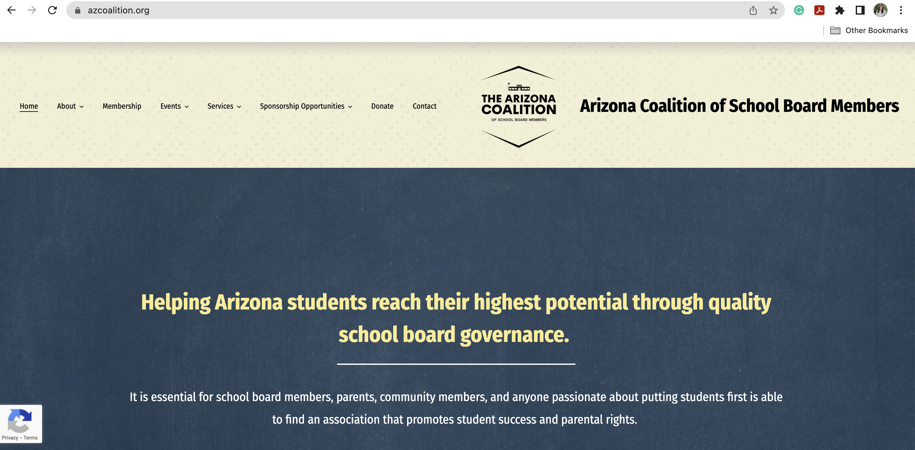
How to Use Member Portal

Slide 8
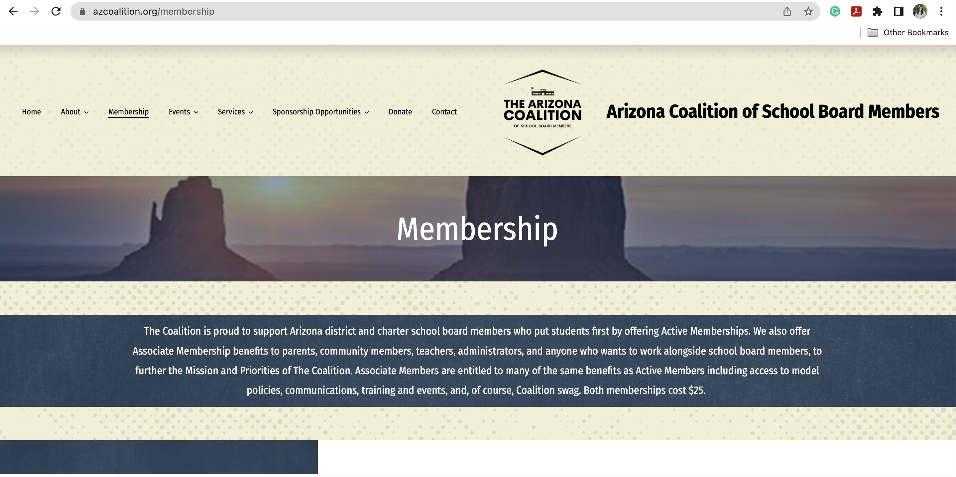
How to Use Member Portal

Slide 9
How to Use Member Portal

Slide 10
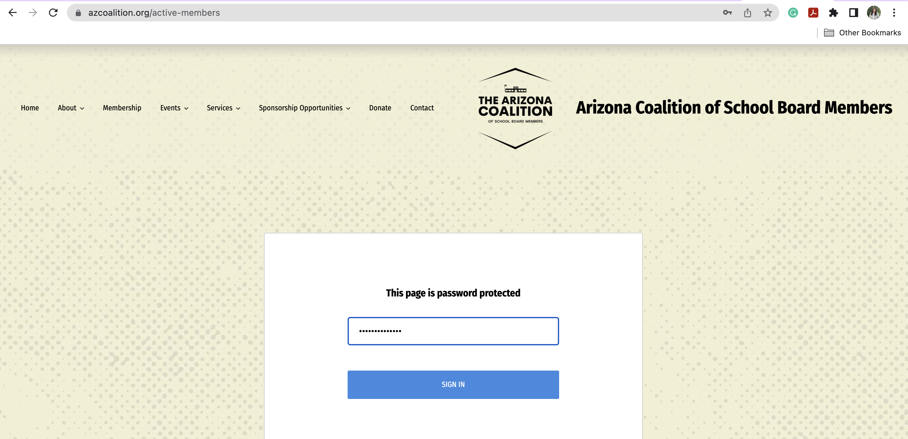
How to Use Member Portal

Slide 11
How to Use Member Portal

Slide 12
How to Use Member Portal

Slide 13
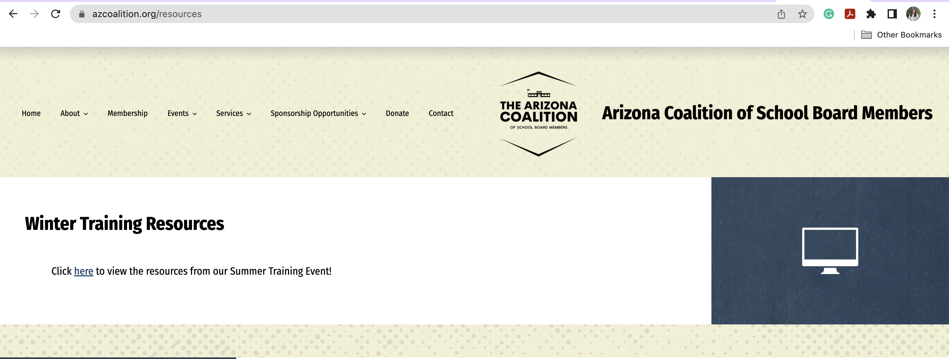
How to Use Member Portal

Slide 14
azcoalition.org
@TheAZCoalition

