Slide 2
ADE FINANCIAL RESOURCES
ADE | DISTRICT | EXTERNAL
School District Budgets
Comprehensive Annual Financial
Report (CAFR) - External Auditor
Annual Financial Report
(AFR) – District Self Reported
School District Employee Report
(SDER) – District Self Reported
USFR Compliance Questionnaire

Slide 3
BOARD MEMBER RESPONSIBILITY RE: AUDITS
15-914. Financial and compliance audits
Requires school district governing boards to publicly accept all audits and compliance questionnaires by a roll call vote.

Slide 4
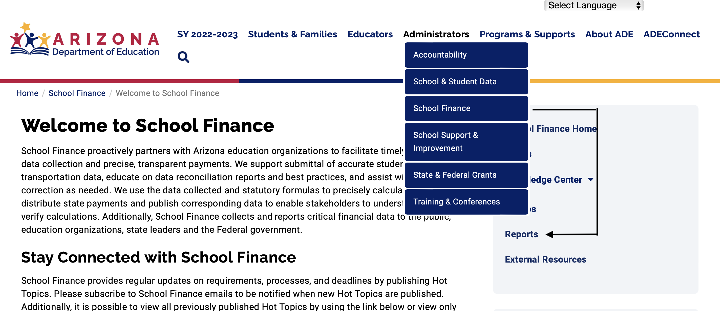
BUDGETS – ADE WEBSITE
www.azed.gov

Slide 5
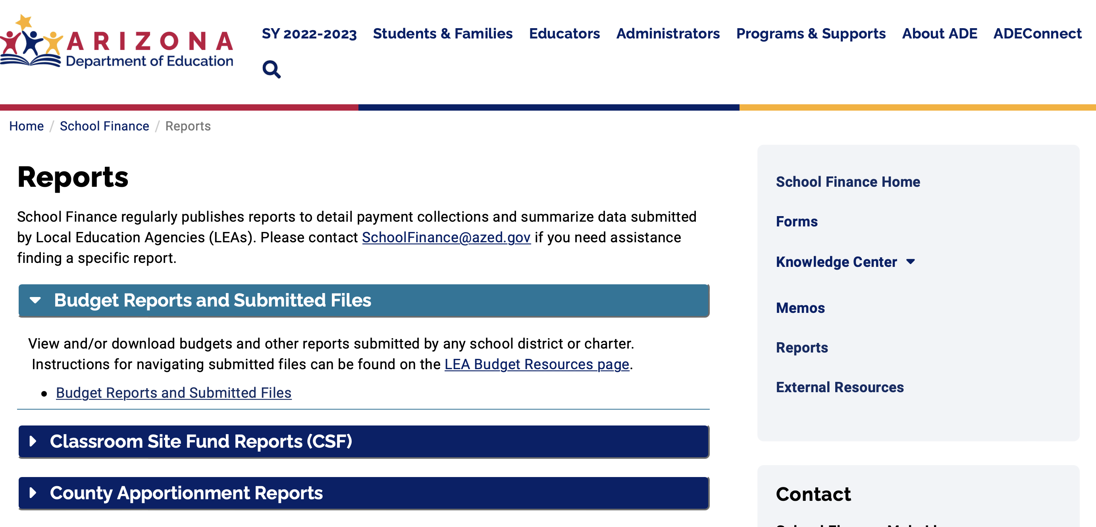
BUDGETS – ADE WEBSITE

Slide 6
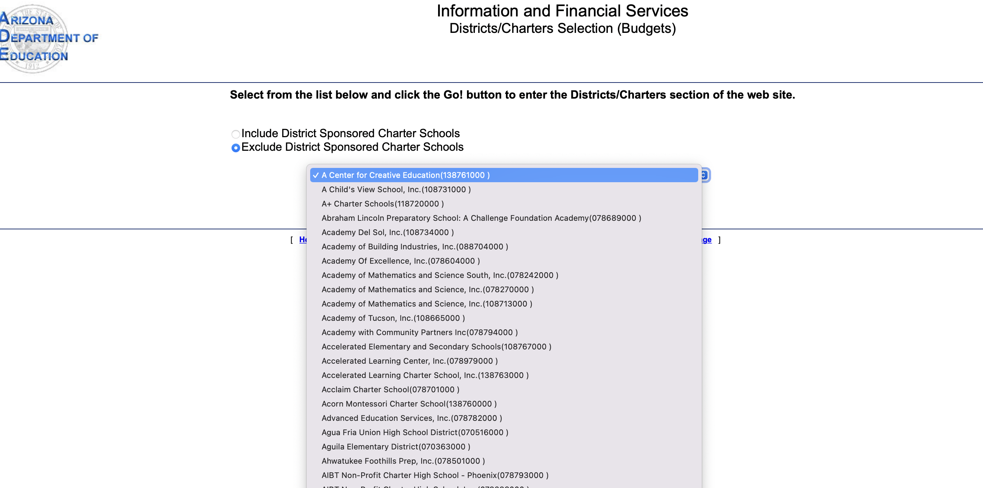
BUDGETS – ADE WEBSITE

Slide 7
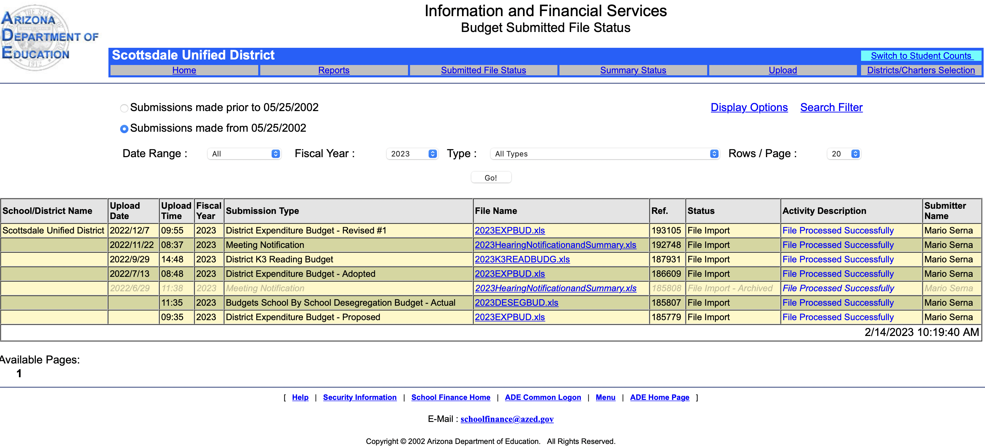
BUDGETS – ADE WEBSITE

Slide 8
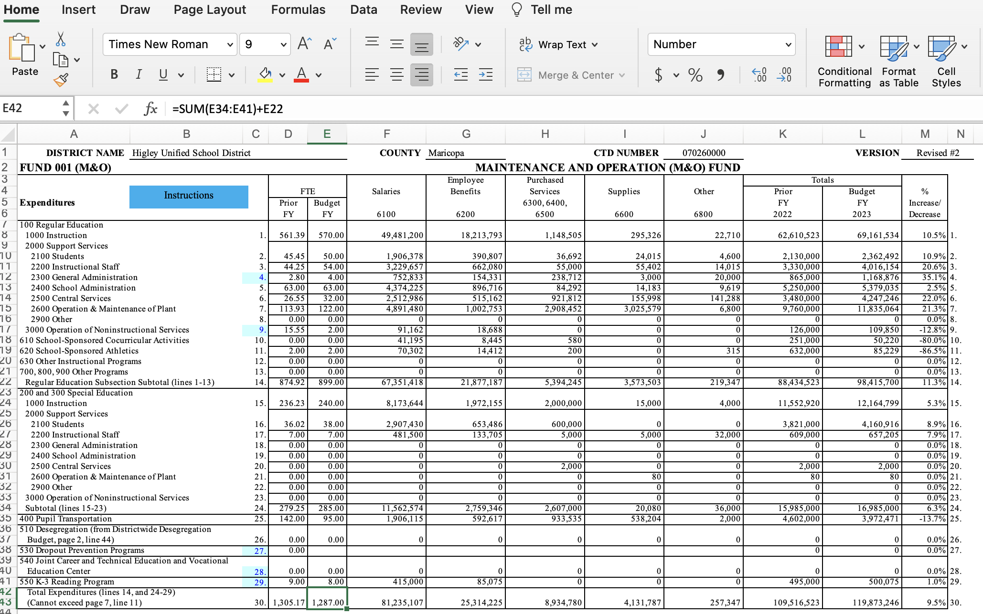
BUDGETS – ADE WEBSITE

Slide 9
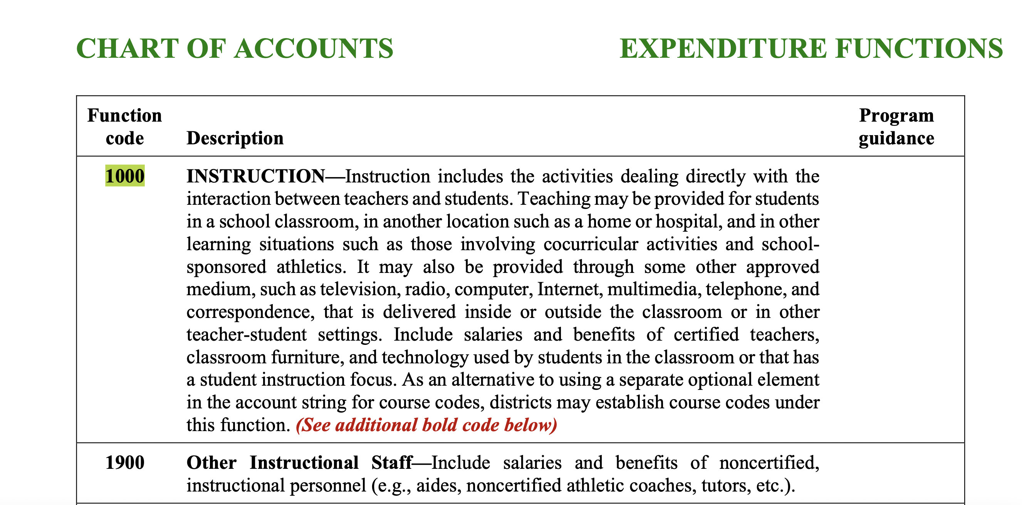
CHART OF ACCOUNTS

Slide 10
BUDGETING FOR PEOPLE
FTE vs Employee
Headcount x Rate
Assume PY Actuals = 1000 FTE x $50,000 = $50 million
Assume: Budget = $55 million
Salary increased by 10% ($5,000)
FTE increased by 10% (100 FTEs)
Combination of both

Slide 11
BUDGETING FOR PEOPLE
Budget = $55 million
Salary increased by 2% ($1,000) → $51,000
$55 million /$51,000 = 1,078
1,078/1000 = 7.8% FTE increase
Budgeting for FTEs should be a function of
ENROLLMENT

Slide 12
BUDGETS – ADE WEBSITE

Slide 13
AFR vs. BUDGETS
Regular Education Instruction ($ 000s)
 | 2018 AFR | 2019 AFR | 2020 AFR | 2021 AFR | 2022 AFR | 2023 | 2023 Budget vs. | % of 2022
 | Actuals | Actuals | Actuals | Actuals | Actuals | Budget | 2022 Actuals | Actuals
Dysart | 59,180 | 63,915 | 67,811 | 68,901 | 69,435 | 72,832 | 3,397 | 5%
Fountain Hills | 3,031 | 3,315 | 3,453 | 2,816 | 3,164 | 3,157 | (7) | 0%
Higley | 28,955 | 31,529 | 35,021 | 34,778 | 37,754 | 69,162 | 31,407 | 83%
JO Combs | 8,599 | 8,970 | 9,009 | 9,491 | 9,646 | 10,109 | 463 | 5%
Mesa | 159,060 | 172,860 | 176,678 | 165,523 | 182,518 | 217,549 | 35,030 | 19%
Peoria | 84,332 | 91,233 | 92,329 | 97,536 | 102,090 | 120,337 | 18,247 | 18%
Prescott | 8,527 | 9,140 | 9,214 | 8,620 | 9,733 | 12,384 | 2,651 | 27%
PVUSD | 78,687 | 79,634 | 81,285 | 72,365 | 95,842 | 95,720 | (122) | 0%
Scottsdale | 58,944 | 59,979 | 62,329 | 62,641 | 66,746 | 72,134 | 5,388 | 8%

Slide 14
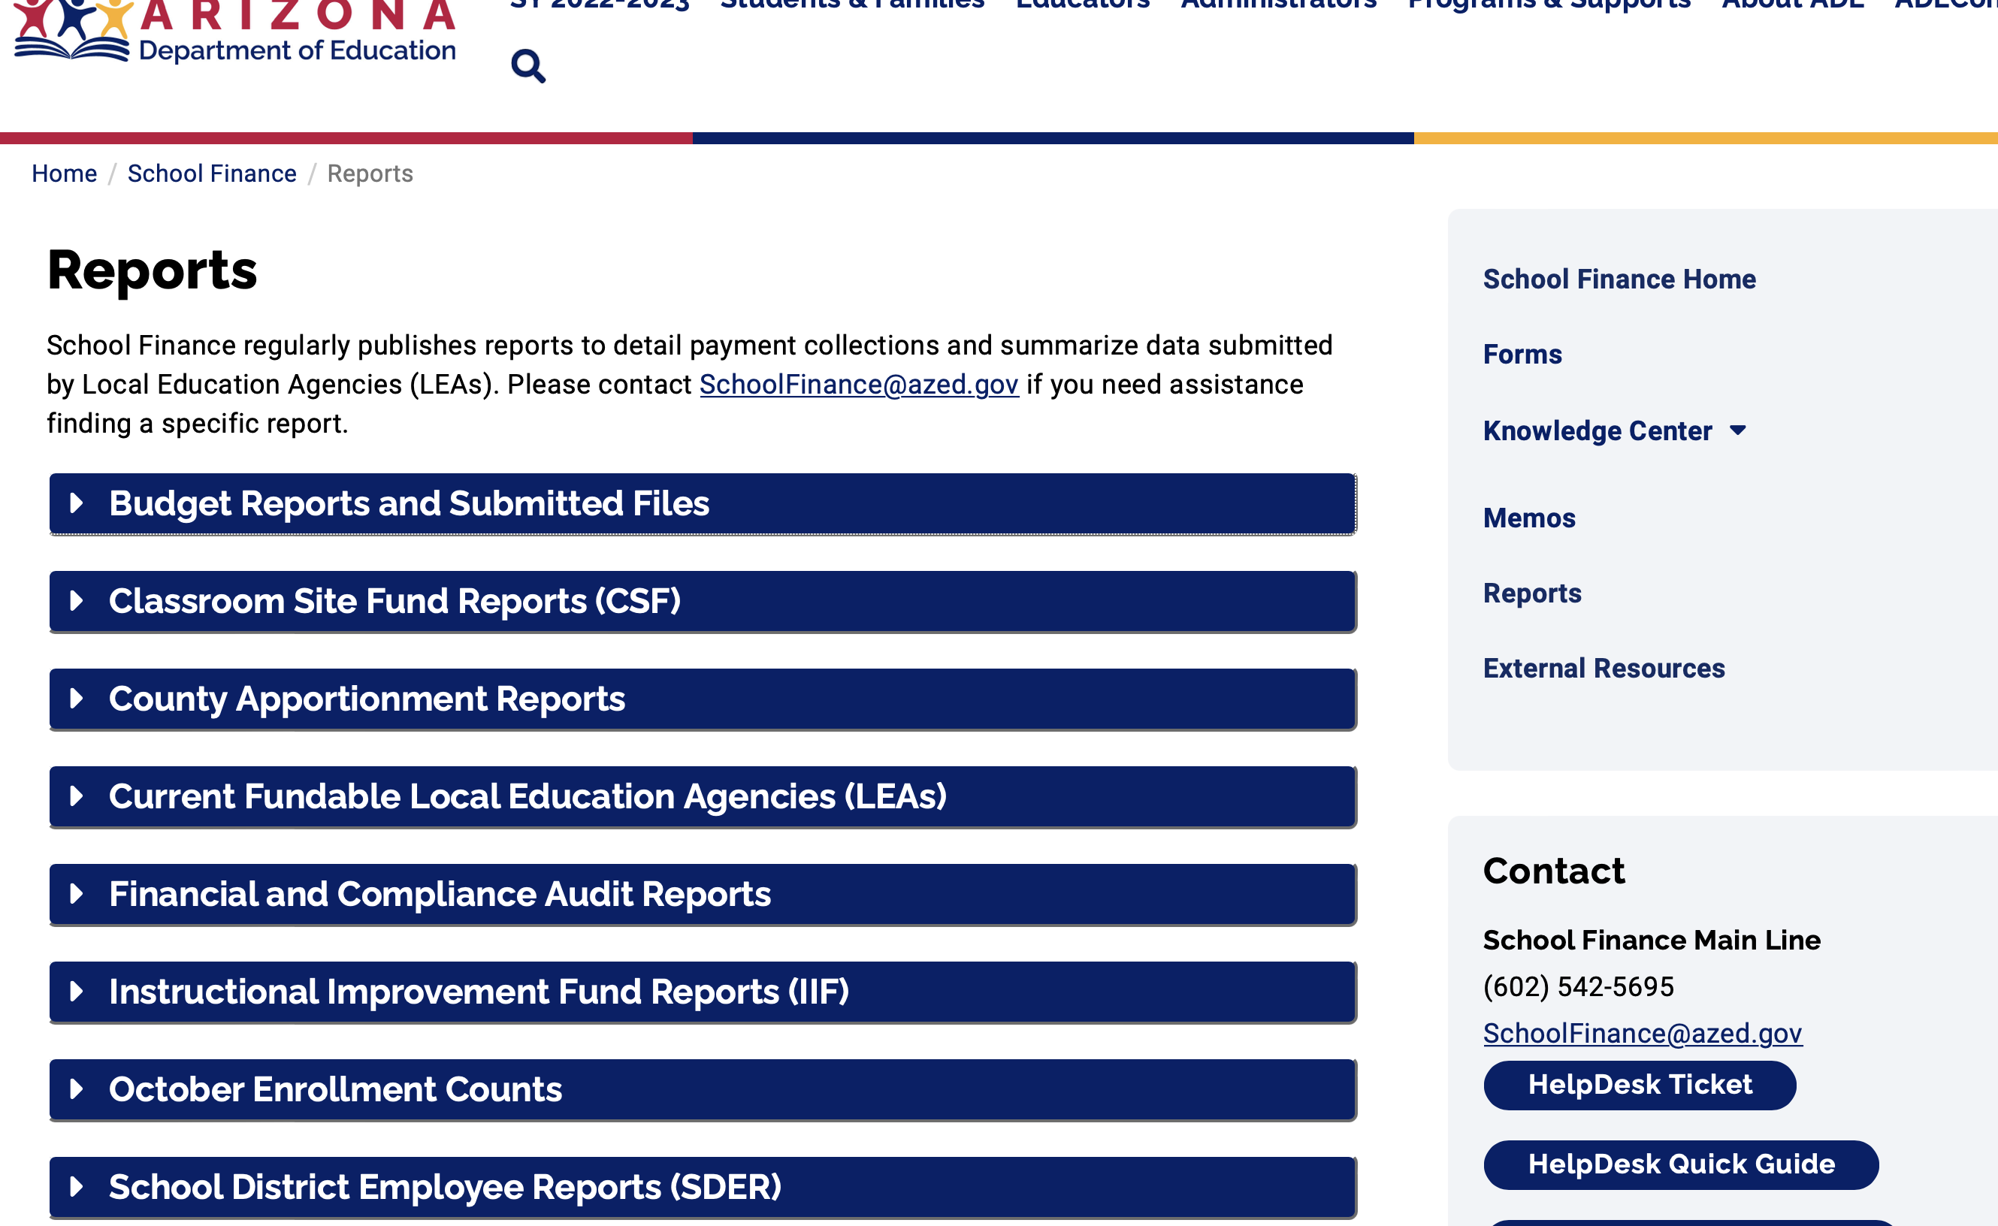
SDER – ADE

Slide 15
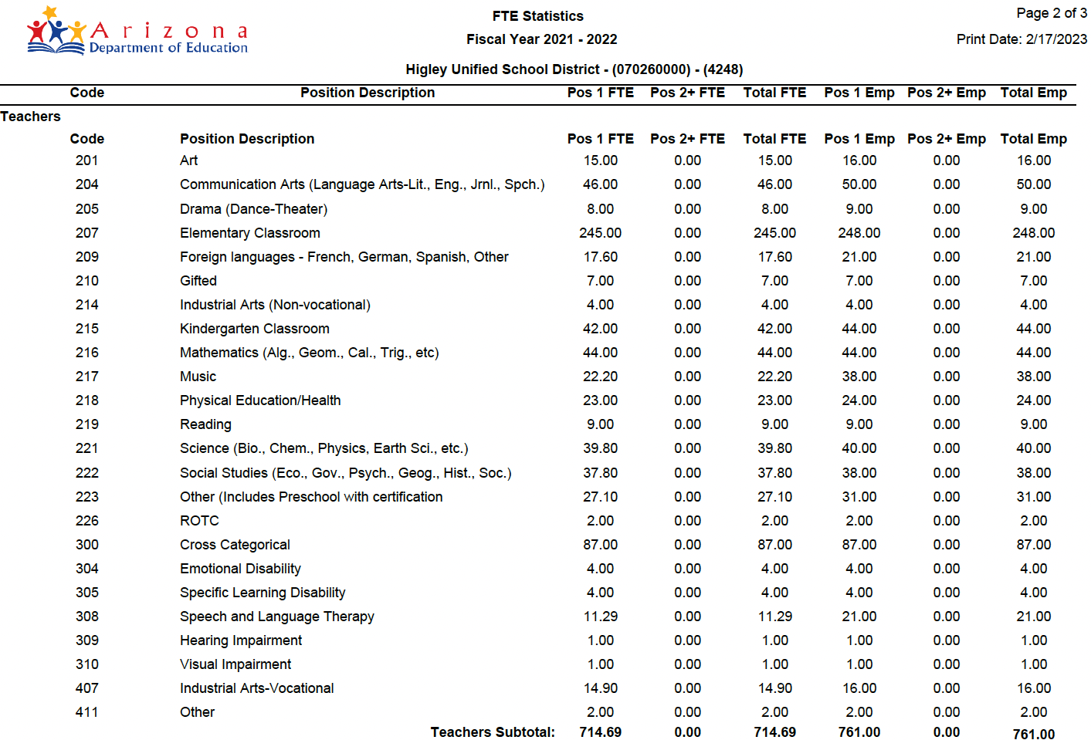
HIGLEY – FY 2022 SDER

Slide 16
ADE CONTACT INFORMATION
FINANCE
AZ Department of Education School Finance BUDGET Team
SFBudgetTeam@azed.gov
AZ Department of Education School Finance REPORTING Team
SchoolFinance@azed.gov

Slide 17
azcoalition.org
@TheAZCoalition

