Slide 1
Medical Assisted Treatment
The Family Solution Finder Learning Seminars

Slide 2
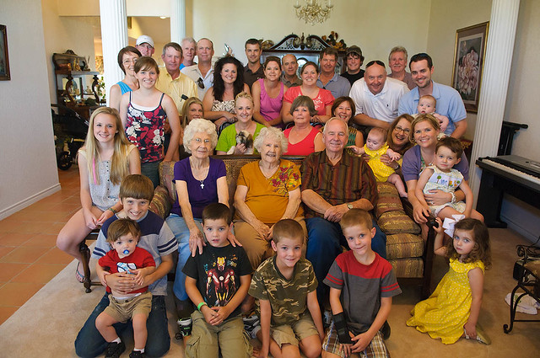
Medical Assisted Treatment
Combining cognitive behavioral therapy with Medical Assisted Therapy needs support of the family members. It is a treatment strategy using the best of both.
Notes:
The family Solution Finder has 32 1.5hr seminars coving all the issues a family will likely face in their journey. The family can view these in the monthly meeting or at home. Each issues require a family plan of action

Slide 4
What Is Medical Assisted Treatment
HOW does Medical Assisted Treatment
Work
What are the expectations of Medical Assisted Treatment
Practical Exercise
View video’s in workbooks

Slide 6
Conclusion
Ask if the treatment center provides Medical Assisted Treatment.
Family members need to support this service.
Family members need to have realistic expectations and open communications

Slide 7
CONTACT US:
Roy Poillon Executive Director/Founder
Office: 440.385.7605 Mobile: 814.722.8946
Familiesimpactedbyopioids@gmail.com
www.Familiesimpactedbyopioids.com
LinkedIn Roy Poillon
Facebook: Familiesimpactedbyopioids public group
Instagram: Families Impacted by Opioids
ALWAYS SEEK THE ADVICE OF A PROFESSIONAL THERAPIEST BEFORE ACTING ON ANY PART OF THE INFORAMTION PROVIDED IN THESE PROGRAMS.

