Slide 1
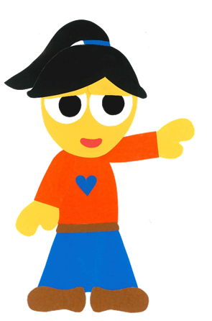
WE
CAN
READ
Donald Joyce

Slide 2
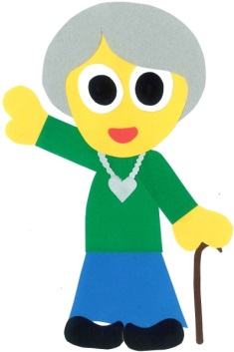
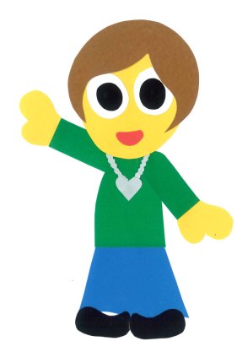
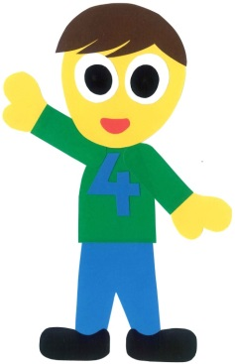
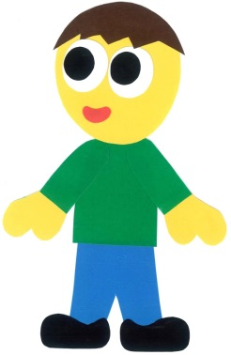
Who Is That?
By:
Donald Joyce
WE CAN READ

Slide 3
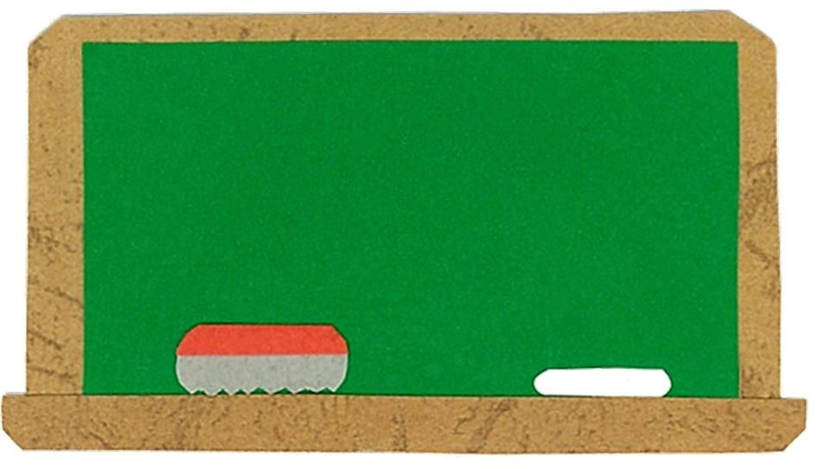
Let’s
Talk!

Slide 4
How many people are
in your family?
There are __ people in my family.

Slide 5
Let’s
Learn!

Slide 6
grandfather
grandmother
mother
father
brother
sister

Slide 7
Let’s
Read!

Slide 8
Who Is That?
By:
Donald Joyce
WE CAN READ

Slide 9
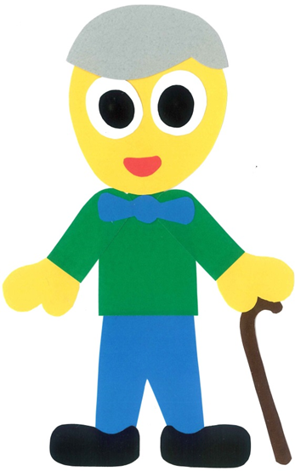
Who is that?

Slide 10
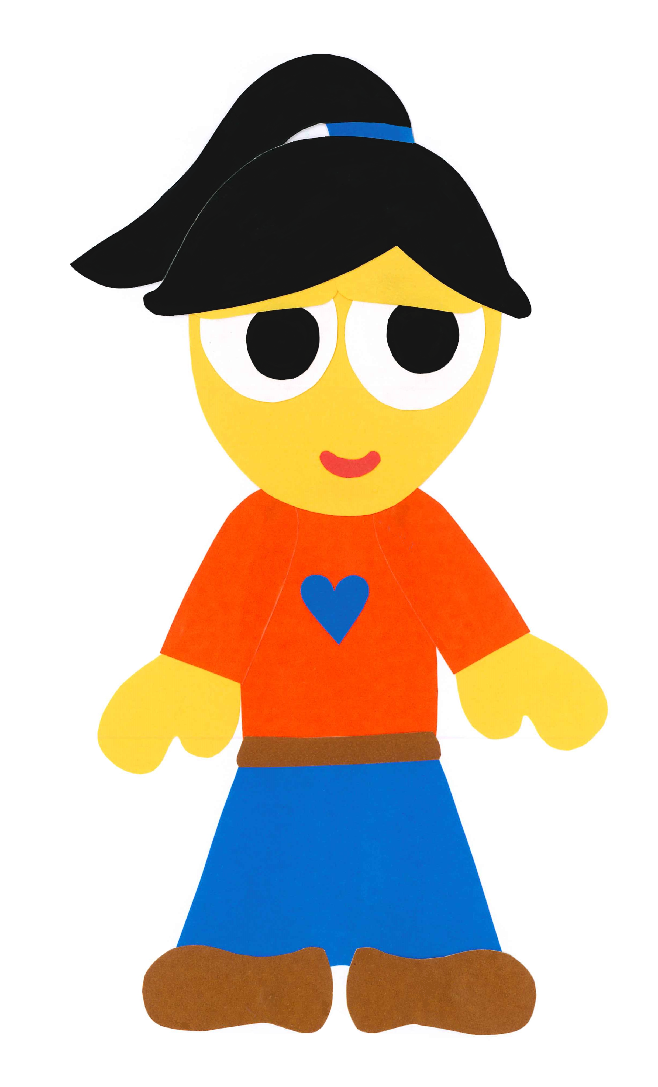
That is my grandfather.

Slide 11
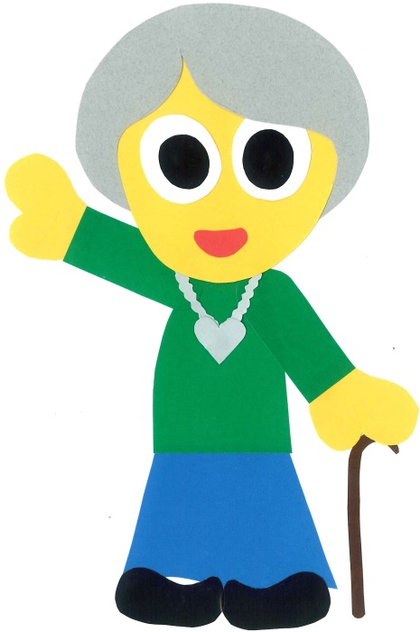
Who is that?

Slide 12
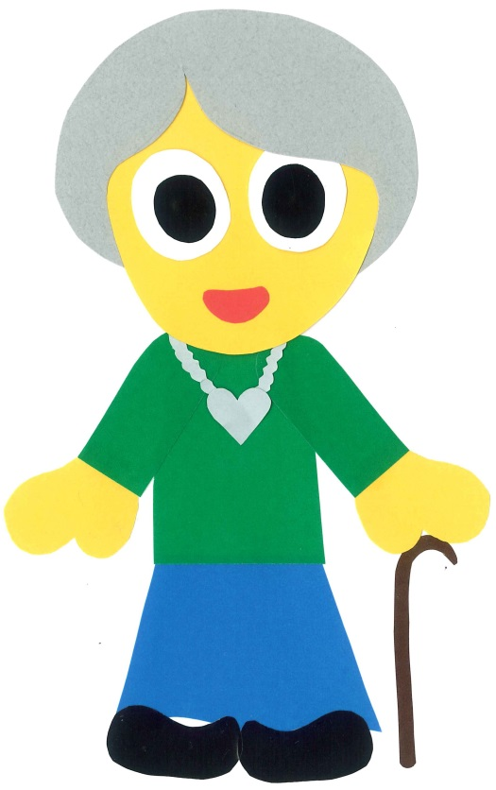
That is my grandmother.

Slide 13
Who is that?

Slide 14
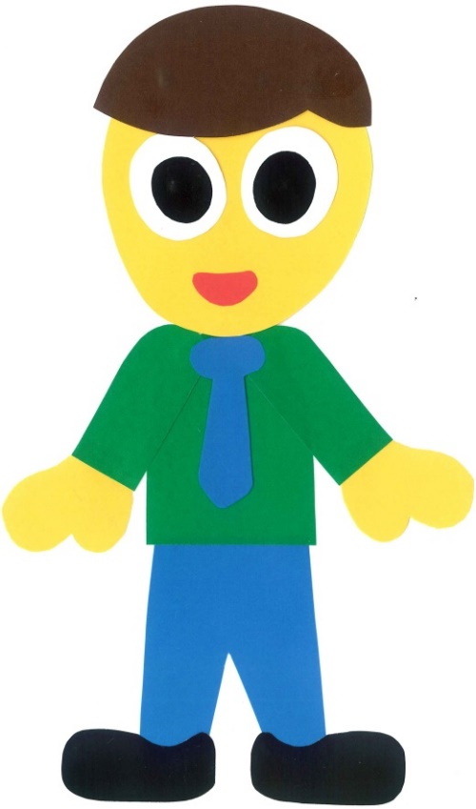
That is my father.

Slide 15
Who is that?

Slide 16
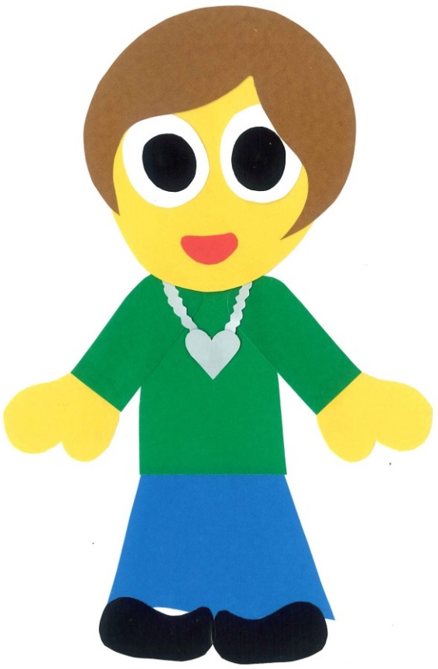
That is my mother.

Slide 17
Who is that?

Slide 18
That is my sister.

Slide 19
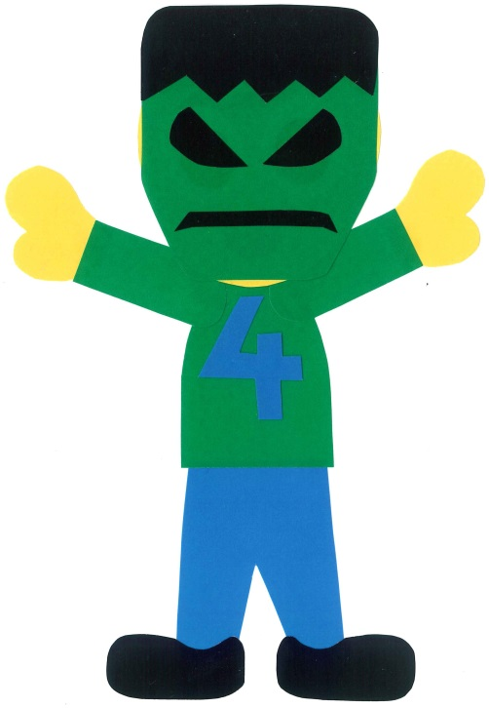
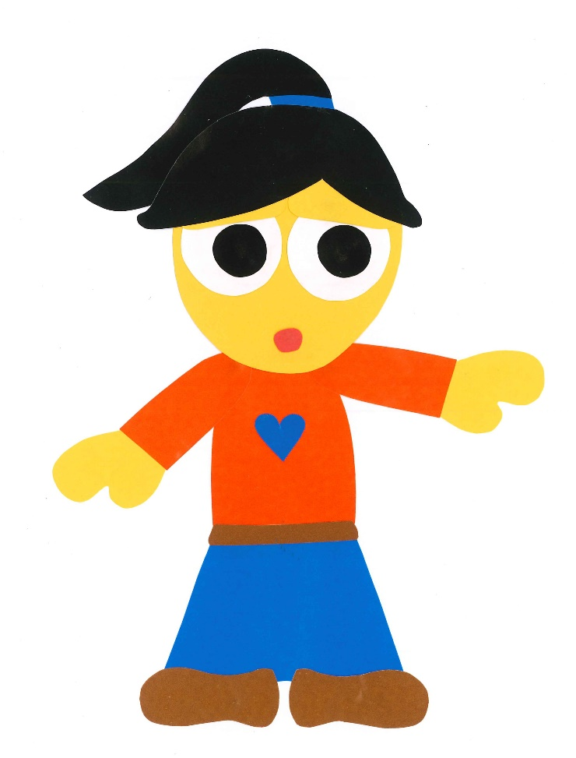
Who is that?

Slide 20
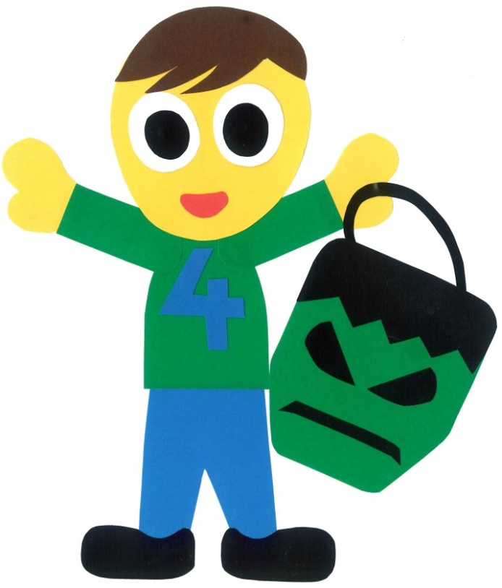
That is my brother.

Slide 21
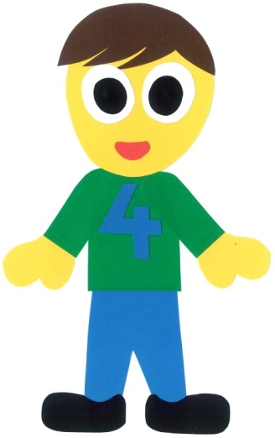
This is my family.

Slide 22
Who Is That?
By:
Donald Joyce
WE CAN READ

Slide 23
Let’s
Review!

Slide 24
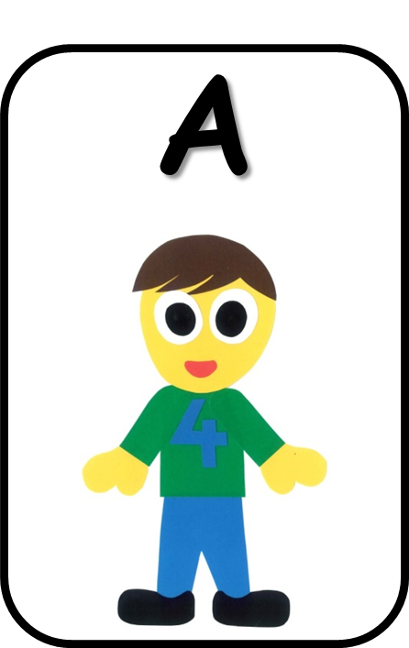
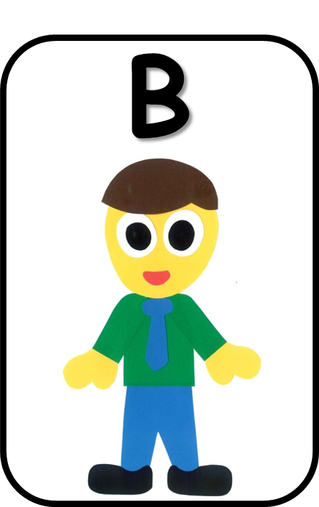
That is my father.

Slide 25
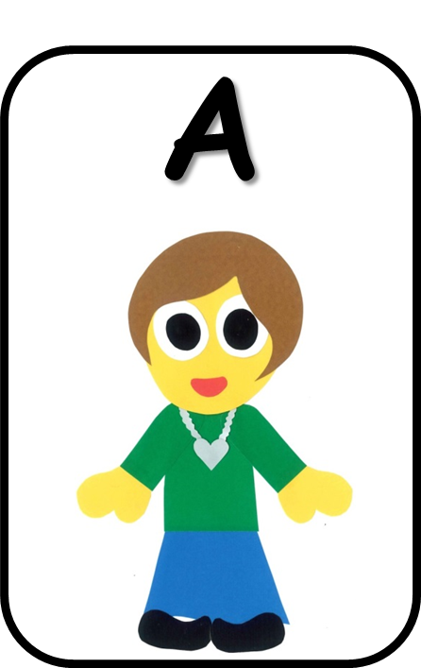
That is my mother.

Slide 26
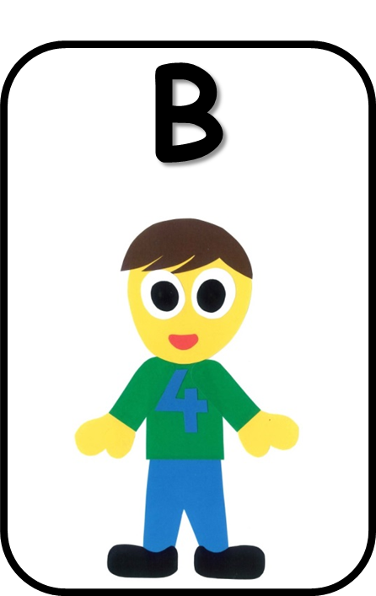
That is my brother.

Slide 27
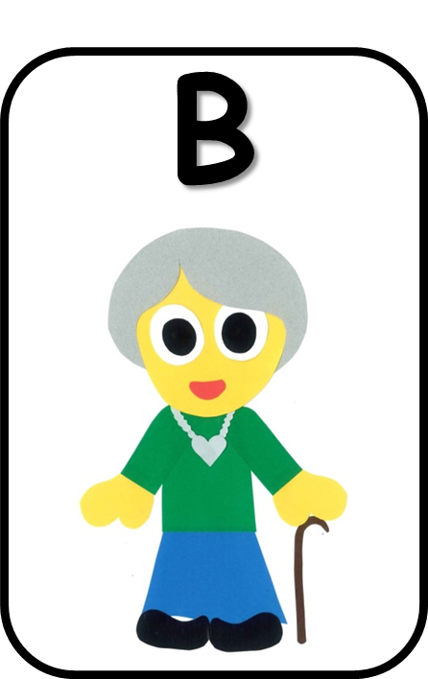
That is my grandmother.

Slide 28
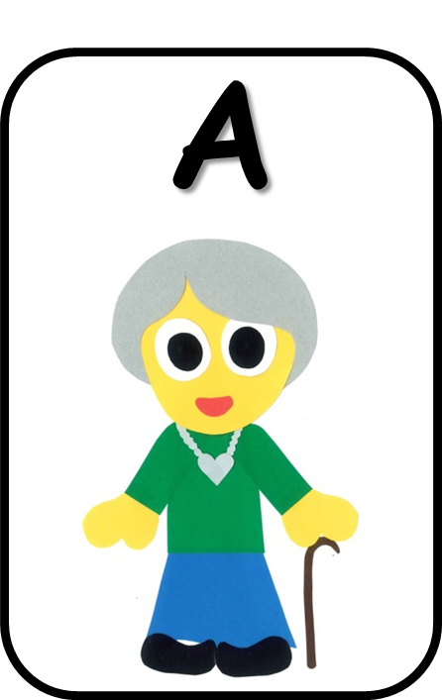
That is my sister.

Slide 29
That is my grandfather.

Slide 30
Let’s
Connect!

Slide 31
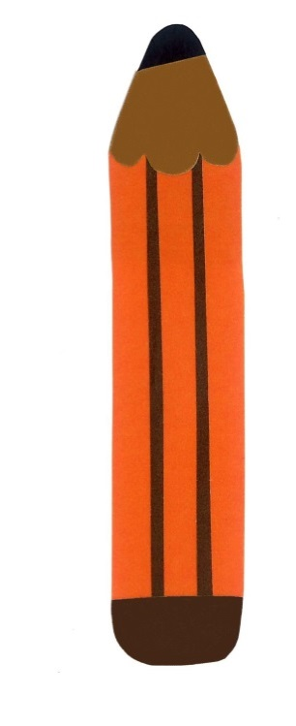
Get a pencil and paper!

Slide 32
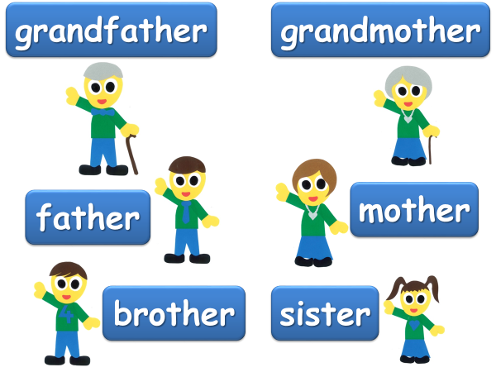
Draw someone in your family.
My mother

Slide 33
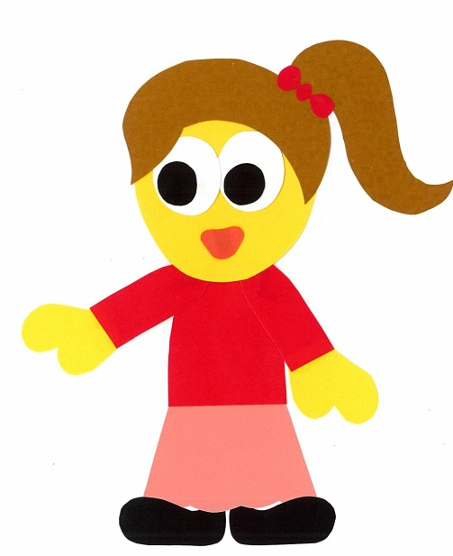
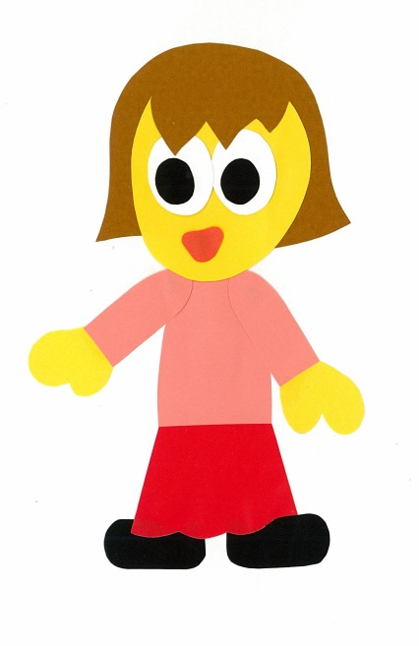
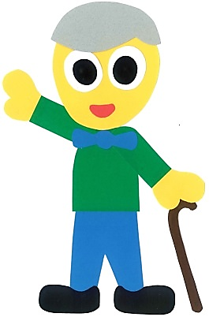
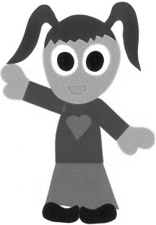
Find a friend. Play a guessing game.
Is that your father?
No, it isn’t.

Slide 34
Is that your ____?
Yes, it is.
No, it isn’t.

Slide 35
WE
CAN
READ
Donald Joyce
www.teacherdonald.com

