Slide 2
TRUMP!!!
Your Father belongs in Hospice!
There is no God
The Pope killed Kennedy
Cut Trubisky!

Slide 3
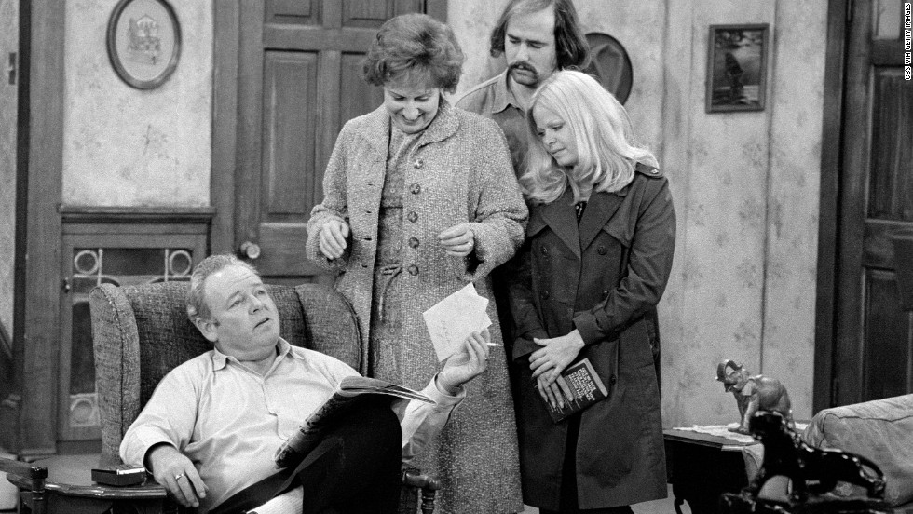

Slide 5
Someday this all will be on your cellphones Dweebs!
1982
What’s a cellphone?

Slide 6
Congress established the Medicare hospice benefit as both a cost-containment mechanism to limit the program’s high costs for beneficiaries in their last year of life and a quality improvement tool to improve care for the dying. Medicare pays hospices a capitated per diem in exchange for delivering almost all services needed in a day to treat the patient’s terminal illness. Excluded from this payment are room and board costs for a beneficiary who lives in a nursing facility and any costs for attending physicians who are not hospice staff. Hospices coordinate the care of the terminally ill acting as a gatekeeper to manage treatment of the terminal condition. They specialize in pain and symptom management and provide greater levels of aide services than otherwise available under Medicare. In addition, Medicare’s hospice benefit also covers counseling and bereavement services for beneficiaries’ family members.

Slide 7
March, 1990
HOSPICES
95% Non-Profit
2014
37% Non-Profit

Slide 8
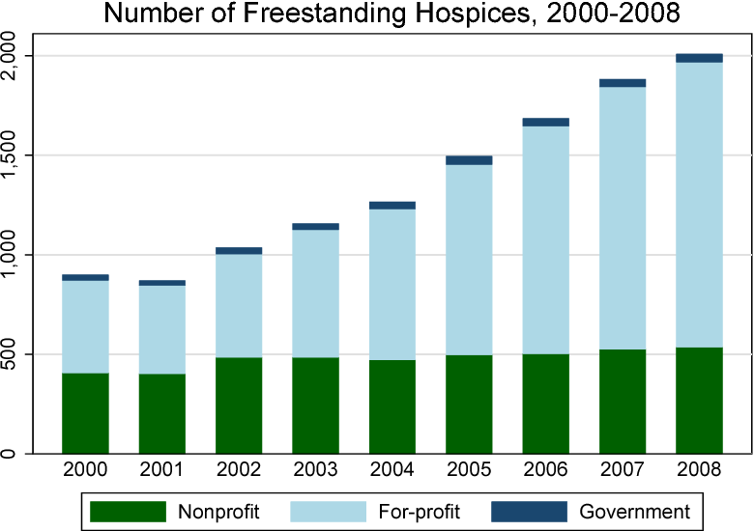
Dalton & Bradford; Journal of Health Economics, 2018

Slide 9
Boomers began turning 65 in 2011
…Over 20% of the US population will be +65
By 2029 when all the Boomers will be 65 or older…
The Grey Tsunami
Cracker Barrell

Slide 10
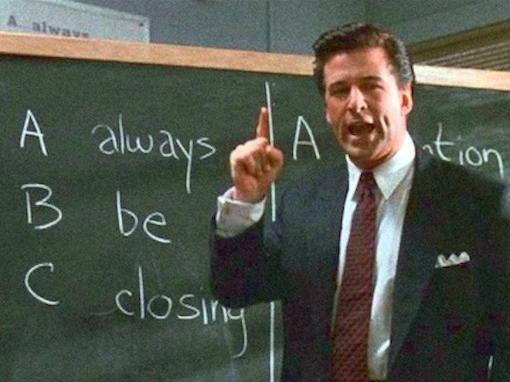
Many Non-Profits aren’t built to compete:
Sales
Marketing
Analytics
Capital
R&D
Donors

Slide 11
Run the Picket Fence at ‘em!
We have to learn to compete:
Marketing
Relationships
Quality
Data
Community Buy-In
Margin/Mission
Partners

Slide 12
Our $1.2M Contribution
Charity Care
Uncompensated Care
Bad Debt Write-Off

Slide 13
The Angel Standard
Define It
Characteristics
Behaviors
Measurable
Repetitive
Trainable

Slide 14
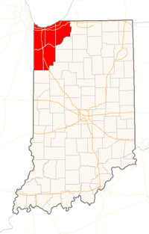
1,477 People
80 Staff
Hospice
Palliative
MOW
LifeLine
Phoenix Center

Slide 15
The Future of the VNA
Stigma
Pre-Aging Svcs
Support Svcs
Day Programs
???
IntegratedPalliative Care
Strategic Plan
Competition
Growth of Hospice
Community Education

Slide 16
-ISH

Slide 17
Thank You!
Bob Franko
rfranko@vnanwi.org
(219) 531-8053

