Slide 2
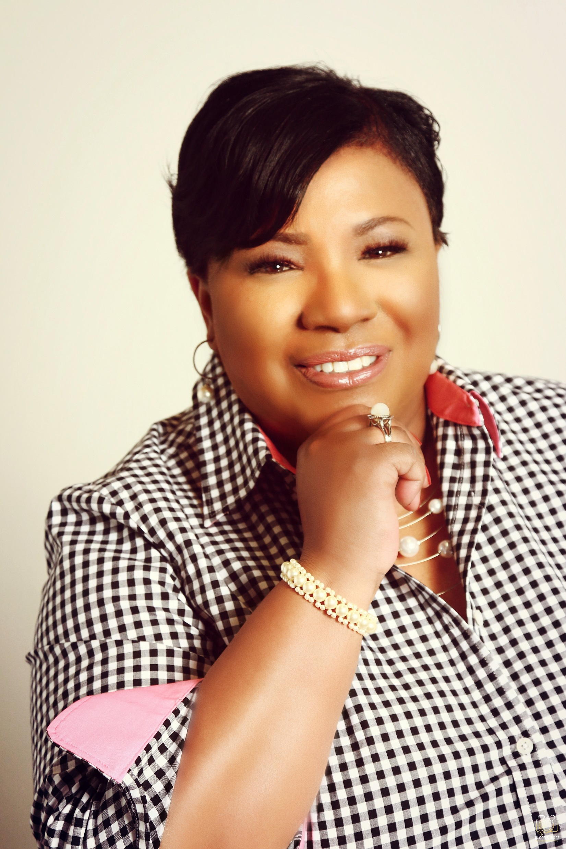
Lisa D. Jacobs
President, Sisters Who Care NC

Slide 3
Leadership Team
Christine Harper
Renee Patterson
Leadership Development Coordinator
Regional Director, Raleigh

Slide 4
Leadership Team
Lisa M. Duncan
LaTanya Brown
Marie Howard Griffin
Regional Director, Union County
Regional Director, Bruinswick County
Regional Director, New Hanover County

Slide 5
Leadership Team
Veronica Weathers
Kenyette Brown
Deidra Munford
Regional Director, Mecklenburg County
Regional Director, Cumberland Couny
Regional Director, Triad NC

Slide 6
Leadership Training (4th Sunday at 6:30pm – 8:00pm)

Slide 7
Thursday Night Prayer & Bible Study

Slide 8
4th of July FunRaiser for Christian Life Home

Slide 9
Domestic Violence Workshop with Called to Peace Ministries

Slide 10
Diaper Campaign for the Dorothy Mae Hall Foundation

Slide 11
Decking the Halls at Christian Life Home

Slide 12
Fresh Anointing PodCast Reverend Dr. Jae Richardson,

Slide 13
Lunch & Love Campaign for Atrium Health Cabarrus ICU Unit

Slide 14
Cycle Forward Campaign Sustaining the dignity of women and girls

Slide 15
Road to Shalom Workshops

Slide 16
Red Rubies Foundation Book Drive

Slide 17
Project Help Workshop & Virtual Tour

Slide 18
On the Horizon
Mission Trip
Retreat
Info Meetings
Red Springs Mission Camp
Date: July 8-10, 2021
POC: Lisa M. Duncan
Camp Mundo Vista, Sophia NC
Date: October 22-23, 2021
POC: Lisa D. Jacobs
Regional information meetings will be hosted throughout the year.

