Slide 1
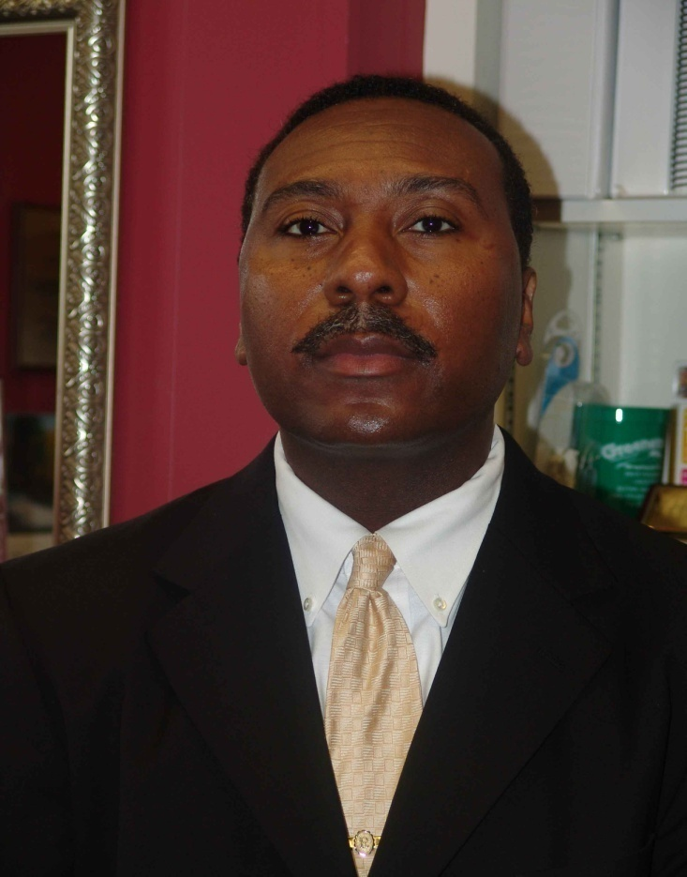
Superintendent Major Accomplishments and Goals For Midfield City Schools
By
Dr. Douglas L. Ragland Superintendent 2007-2010

Slide 2

Accomplishments and Goals
Attained Excellent Financial Stability in the district despite the recession and 18% Proration for 2008-09 and 2009-10.

Slide 3

Successfully prepared, maintained, and supervised a 25,000,000.00 million dollar budget throughout my tenure.

Slide 4
The Midfield City School System attained and maintained 2.5 months of operational reserves, thus surpassing the legal requirement of 1 month that school systems throughout the state must have.

Slide 5

Attained Excellent Financial Audit Reports with a rating of Unqualified, which is the highest rating, for 3 consecutive years.

Slide 6
Successful Adoption and Support of Alabama State Department Education Ruler:
Safe and Disciplined Schools
Highly Qualified Personnel
Challenging Curricular
Emerging Leaders
These standards have been successfully applied in the district and as a result educational excellence has been manifested.

Slide 7
Development and implementation of a first-ever organizational chart and Board approved job descriptions to match for accountability purposes.

Slide 8
The following policies were modified, created and implemented to ensure financial enhancement and legal protection for the district:
Professional Education Personnel Evaluation
Educate Alabama Evaluation System
Certified Personnel Reduction In Force
Support Personnel Reduction in Force
Certified Personnel Vacation
Support Personnel Vacation
Accumulated Overtime Hours for 12 month Employees
Complaints and Grievances
Field Trips and Excursions
Code of Conduct
Meetings
District Reorganization Chart
Purchasing
General Organization
Job Description approval for all positions in the district
Salary Schedule Modifications
Student Transfer /Withdrawal.

Slide 9
The Midfield City School System was selected for the 2009-2010 school year to be a site for the Virtual Alabama School Safety Program in partnership with Alabama Homeland Security, Alabama State Department of Education, Alabama Criminal Justice Information Center and Auburn University Montgomery Center for Government.

Slide 10

Protocol establishment was established as follows:
School Level-Teachers and Administration
Central Office Level- Central Office Administrators and Superintendent
Board Level-School Board Members.

Slide 11
All teachers in Midfield City Schools were Highly Qualified and Certified in 2010.

Slide 12
Development of first-ever Midfield City Schools College Recruitment Incentive Program for the purposes of recruiting the best and brightest teachers to Midfield City Schools and developing promising relationships with higher education institutions.

Slide 13
Midfield Elementary, Rutledge Middle and Midfield High Schools successfully renewed their 5 year accreditation status through SACS-CASI for the period 2008-2013.

Slide 14
The Midfield City School System has the distinction of never failing to make Adequate Yearly Progress (AYP) during my tenure.

Slide 15
Successful Special Education System-wide Audit conducted by the Alabama State Department of Education in October 2009.

Slide 16

Scholarship monies totaling 2.8 million for Midfield High School Seniors in 2009 and 2010.

Slide 17

Midfield High School had 35% of its students attending four year universities and colleges from 2007-2010.

Slide 18

Midfield High School had 45% of its students attending two year colleges from 2007-2010.

Slide 19
The Midfield High School Career Technical Program had 100% of its programs Business Industry Certified in 2010.

Slide 20

A Midfield High School Student was one of 44 students selected out of 211 students from 28 high schools in Jefferson County to be a member of the Youth Leadership Forum Class of 2009-2010.

Slide 21

Midfield High School Lady Patriots are 4-time state 4A Basketball Champions which is a remarkable and an unprecedented feat.

Slide 22
The Midfield High School Boys Basketball Team was the Area and Sub-District Champions and Regional Runner-ups in 2008.

Slide 23
The Midfield High School Football Program was the recipient of 2 consecutive regional Championships and consecutive 9-1 seasons in 2008 and 2009.

Slide 24
Rave reviews were received from parents, stakeholders and the media on Play Productions such as Annie Charlie and the Chocolate Factory and Thoroughly Modern Millie.

Slide 25
Thoroughly Modern Millie has the distinction of being the 21st play production for Midfield City Schools.

Slide 26
Midfield Elementary has the distinction of having youngest spelling bee champion at the age of 8 to finish 3rd place in the Jefferson County Spelling Bee Competition .

Slide 27
The Midfield City School System had Capital Improvement monies totaling 13.8 million dollars in 2010.

Slide 28

A total of 5.5 million dollars was allocated to be spent on Rutledge Middle School for building renovations for the 2010 school year.

Slide 29
A total of 3.4 million dollars was allocated to be spent on renovations for Midfield High School for the 2010 school year .

Slide 30

Additional parking for Midfield Elementary School as well as furniture and technology needs for all schools were designated and approved as capital projects to be completed.

Slide 31
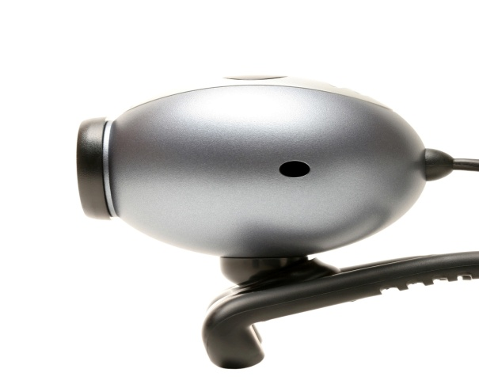
State of the Art Surveillance Systems were installed in Midfield Elementary, Midfield High, and the Central Office and and Rutledge Middle was scheduled to receive its surveillance system after the completion of the renovation of the school.

Slide 32
A total of 4.4 million dollars in capital monies was projected to be in the budget after completion of renovations in all schools.

Slide 33
All Midfield City Schools and the Midfield City Schools Alternative Program were nominated for The Council for Leaders in Alabama Schools (CLAS) Banner School Award.

Slide 34
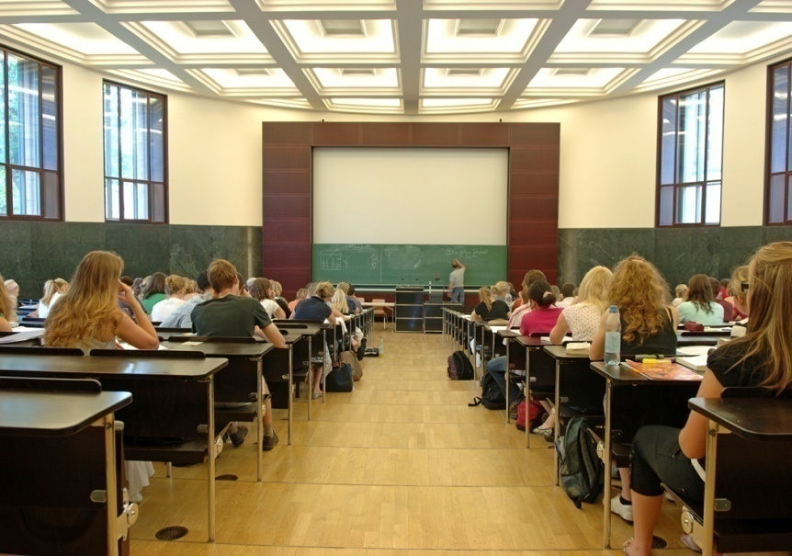
Midfield Elementary and Rutledge Middle Schools were selected as Alabama Math and Science Technology Initiative (AMSTI) selected schools and teachers and administrators were trained in these methods.

Slide 35

Midfield Elementary School was selected as an Alabama Reading Initiative School and a designated Alabama Reading Initiative Demonstration Site.

Slide 36

Rutledge Middle was selected as an Alabama Reading Initiative School.

Slide 37

Successful attainment and implementation of the 21st Century Grant Program in the amount of $600,000.

Slide 38

Successful attainment of Technology Grant and Discretionary Funds in the amount of $90,000 in 2008.

Slide 39
Successful attainment for Technology Centers that Work Grant in the amount of $25,000.00, in 2008.

Slide 40

Successful Attainment of High Schools That Work Grant for Midfield High School in the amount of $20,000 in 2008.

Slide 41
Administration and Personnel participated in the High Schools That Work Grant Professional Development Training in an effort to enhance academic excellence at Midfield High School.

Slide 42

Successful attainment of Alabama Connecting Classrooms Educators Students Statewide (ACCESS) Grant of $85,000 for Midfield High School for Distance Learning Laboratory in 2009.

Slide 43
Successful Attainment of an Advanced Placement Grant for Midfield High School in the amount of $14,300.00, in 2008, and $8,320.00, in 2009.

Slide 44
Midfield High School began offering Advanced Placement Courses in English, Math, Social Studies, and Science for 11th and 12th graders in 2009.
Advanced Placement World History for 10th graders commenced in 2009.
Implementation of Pre-Advanced Placement Courses in major core subject areas for 9th and 10th graders was designated as the next goal.

Slide 45
Personnel participated in Advanced Placement Professional Development Training to enhance excellence in Advanced Placement Courses taught at Midfield High School.

Slide 46
Successful Attainment of Child Nutrition Equipment Grant in the amount of $50,000 for Midfield High School in 2010.

Slide 47
Successful attainment of Child Nutrition Fruits and Vegetables Grant in the amount of $25,000 for Midfield Elementary School in 2010.

Slide 48
Partnerships
Midfield City Schools developed partnerships with the following postsecondary institutions and organizations:
Jefferson State Community College
Lawson State Community College
Miles College
University of Alabama at Birmingham
University of Montevallo
Samford University
Greater Alabama Council Boy Scouts of America Youth Leadership Development Program
Jefferson County Committee for Economic Opportunity (JCCEO)-Preschool /Head Start/Child Nutrition
Midfield City Hall.

Slide 49

Superintendent Goals:
All schools will have students at 100% reading and math proficiency by 2014.

Slide 50
All schools will have nationally board certified teachers in every grade level by 2014.

Slide 51

A significant number of Midfield High School Graduates will achieve National Merit Scholarships annually.

Slide 52
All schools will be recognized as Blue Ribbon Schools which is a national honor for academic excellence.

Slide 53
All schools will exceed national testing requirements by scoring in the 7, 8, and 9 stanines.

Slide 54

Creation of Midfield Education Foundation to fund schools in enhancing academics.

Slide 55

Development of Dual Enrollment Partnership with Jefferson State Community College in an effort to provide opportunities for Midfield High School Students to receive both high school and college credit.

Slide 56

Partnership between Midfield High School and Jefferson State Community College will provide an opportunity for students to enroll in Jefferson State Community College and receive both a high school diploma and an associate’s degree upon completion of the program.

Slide 57

Partnership with Greater Alabama Council Boy Scouts of America Youth Leadership Development Program will allow Midfield High School Students to receive thousands of dollars in scholarship monies.

Slide 58

Culinary Arts Program formed at Midfield High School will provide opportunities to partner with the Culinary Arts Program at Jefferson State Community College.

Slide 59

Automotive Computer Assisted Drawing, African American History, and Culinary Arts will be available for Midfield High School students to take at Jefferson State Community College as a result of our partnership.

Slide 60

Creation of a “Learn and Serve’’ Program in the district where our students can learn from and serve the businesses and community stakeholders that are so vital to the success of our school system.

Slide 61
Development of a strategic plan with emphasis on communication, academics, finance, community involvement, parental involvement, facility planning, and student services.

Slide 62
Perpetual implementation of the Education Ruler in reference to safety, discipline, qualified personnel, challenging curricular and leadership development.

Slide 63

Advanced technology for all schools and the central office in our efforts to enhance learning and professional development for teachers and students and provide you with knowledge of every entity of our school system. (Finances, Board Policies, Academics, Capital Plans, Board Meetings , Strategic Plan, etc).

Slide 64

State, Regional, and National Math champions by 2014.

Slide 65
State, Regional, and National Debate , Oratorical, and Forensics Champions by 2014.

Slide 66
County, State and National Spelling Bee Champion by 2014.

Slide 67
Enhancement of the Fine Arts Curriculum in all schools to meet the needs of the gifted and talented in those areas by 2014.

Slide 68

All students graduating with Advanced Diplomas and being fluent in at least one foreign language.

Slide 69
Gifted, Enrichment and Advanced Academic Programs and Course Offerings in all schools by 2014.

Slide 70
Area, Regional, and State Championships in all athletic sports by 2014.

Slide 71
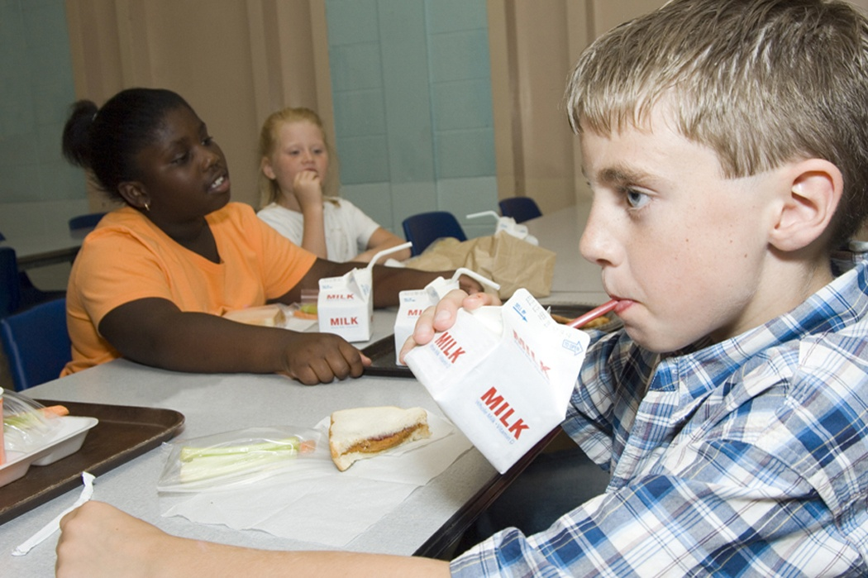
Meeting the needs of the whole child-academically, socially, physically, emotionally, and through extra-curricular activities.

Slide 72

Beliefs
Together Everyone Accomplishes More (Team)
High Expectations in maximizing every child’s potential resulting in optimal success.
Every child can learn.
Every child can behave.

Slide 73
Leaders Ensuring Success at all Levels
Bus Drivers Safety
Maintenance Staff Dependable
Custodians Cleanliness
CNP Workers Sanitary /Nutritious /Delicious
Secretaries Customer Service/Efficient
Bookkeepers Financial Stability
Paraprofessionals Assisting in all Aspects
Teachers Backbone for Success
Administrators Captains of the Ships
Board Members Policy Makers and Supporters
Superintendent Responsible Steward/Humble Servant
Elected Officials Key Stakeholders

Slide 74

Mission Statement
In Midfield City Schools we plan to have a world class school system by educating every child fully, serving every stakeholder immensely, and consequently ensuring the optimal success of our children, parents, and community at large. We will be known as Midfield City Schools: Tradition of Excellence and Pathway to Success, thus leaving no child, no parent, and no community behind!!! Remember, Together Everyone Accomplishes More (TEAM).

Slide 75
PROFESSIONAL DEVELOPMENT FOR
DR. DOUGLAS L. RAGLAND
100% attendance in all School Superintendent in Alabama (SSA) Meetings
Met all professional development requirements for professional certificate renewal until 2012
Superintendent Evaluation score of 50 out of 52 which is excellent on the scoring matrix
Served as presenter for University of Alabama Superintendents’ Academy on 3 separate occasions on the following topics: (1) “Anticipating the First Year’s Experiences: Insights and Implementing Your Vision”, (2) “Communication and the School Board Policy”, and (3) “Researching the Position”
Certified as SACS-CASI Chairperson for statewide and regional accreditation visits
Certified in the areas of Finance and Curriculum which is a state law requirement for Superintendents to be certified in these areas
Attended all Alabama Association of School Boards state and local meetings with the exception of the one scheduled on the same day as our SSA Meeting in September 2009
Successful host for Alabama Association of School Boards District Statewide Meeting
Successful Special Education System-wide Audit conducted by the Alabama State Department of Education in October 2009
Served as Superintendent Liason for Youth Leadership Program sponsored by the Boy Scouts of America
Organized and coordinated Spelling Bee Programs for the Midfield City School System
Serves as Jefferson County Spelling Bee Judge
Serves as Alabama State Spelling Bee Judge
Served as Keynote Speaker at Miles College Student Internship Cloaking Ceremony
Served as Keynote Speaker at first- ever Birmingham Lincoln Education Conference
Served as Keynote Speaker for Midfield Elementary 4th Grade Recognition Program
Served as Keynote for the Midfield Elementary Veterans Awards Day Program
Served as Keynote Speaker and Reader for the Summer Community Program in the City of Midfield 2008
Served as speaker at Midfield City Schools Back to School Rallies for 2007, 2008, and 2009
Serves on the Midfield Chamber of Commerce Board of Directors
Serves as liason for Midfield City Schools for Lawson State and Jefferson State Community Colleges for educational opportunities for Midfield City Schools
Served as Speaker and Reader for the Summer Community Program in the City of Midfield 2008
Served as speaker at Midfield City Schools Back to School Rallies for 2007 and 2008
All other accomplishments are listed in detail on my resume and biographical sketch.

