Slide 1
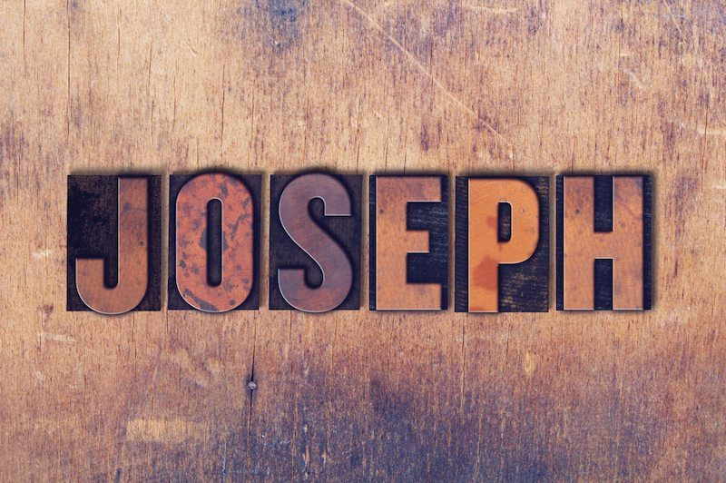
Welcome in the Name of
The Triune God
September 25, 2022
Joseph In Prison
Prelude by Roxanne Groff
Office of the Acolyte
Ringing of the Bell
Scripture Focus:
Genesis 39:1-23
Notes:
Image: Preparing yeast dough. Copyright © tomasworks/iStock/Thinkstock. Used by permission.

Slide 2
CONFESSION AND FORGIVENESS
All may make the sign of the cross, the sign marked at baptism…
P: We confess our sins before God and one another.
Pause for silence and reflection.
P: God of promise,
Notes:
Image: Five Loaves by Caroline Coolidge Brown. Copyright © Caroline Coolidge Brown. All rights reserved. Used by permission of the artist.

Slide 3
CONFESSION AND FORGIVENESS
C: You have given us all we are and all we have, and still we have not trusted you fully. We have tried to be god in our own lives, hurting ourselves and those around us in our attempts to control. Wash us clean in the waters of your salvation, and bring us back into right relationship with you.
Notes:
Image: Five Loaves by Caroline Coolidge Brown. Copyright © Caroline Coolidge Brown. All rights reserved. Used by permission of the artist.

Slide 4
CONFESSION AND FORGIVENESS
L: God welcomes you home with open arms, and forgives you all your sin, for the sake of Jesus Christ. By the power of the Holy Spirit, live in the promise of God’s love, freely given.
C: Amen.
☩
Notes:
Image: Five Loaves by Caroline Coolidge Brown. Copyright © Caroline Coolidge Brown. All rights reserved. Used by permission of the artist.

Slide 5
Hymn of Praise
Arise, Your Light Has Come! ELW 314
1 Arise, your light has come!
The Spirit's call obey;
show forth the glory of your God
which shines on you today.
2 Arise, your light has come!
Fling wide the prison door;
proclaim the captive's liberty,
good tidings to the poor.
Notes:
Image: Five Loaves by Caroline Coolidge Brown. Copyright © Caroline Coolidge Brown. All rights reserved. Used by permission of the artist.

Slide 6
Hymn of Praise
Arise, Your Light Has Come! ELW 314
3 Arise, your light has come!
All you in sorrow born,
bind up the brokenhearted ones
and comfort those who mourn.
4 Arise, your light has come!
The mountains burst in song!
Rise up like eagles on the wing,
God's pow'r will make us strong.
Notes:
Image: Five Loaves by Caroline Coolidge Brown. Copyright © Caroline Coolidge Brown. All rights reserved. Used by permission of the artist.

Slide 7
APOSTOLIC GREETING
P: The grace of our Lord Jesus Christ, the love of God, and the communion of the Holy Spirit be with you all.
C: And also with you.
Notes:
Image: Five Loaves by Caroline Coolidge Brown. Copyright © Caroline Coolidge Brown. All rights reserved. Used by permission of the artist.

Slide 8
PRAYER OF THE DAY
P: Let us pray… Faithful God, you prospered the work of Joseph’s hands, in good times and bad. Give us Joseph’s unfailing love for you, that by the power of your Holy Spirit, we might overcome whatever life throws at us.
C: Amen.
Notes:
Image: Five Loaves by Caroline Coolidge Brown. Copyright © Caroline Coolidge Brown. All rights reserved. Used by permission of the artist.

Slide 9
Notes:
Image: Preparing yeast dough. Copyright © tomasworks/iStock/Thinkstock. Used by permission.

Slide 10
Scripture Reading
R: The Scripture includes readings from the book of Genesis, Chapter 39.
C: Glory to you O’ Lord! (Spoken)
Notes:
Image: Five Loaves by Caroline Coolidge Brown. Copyright © Caroline Coolidge Brown. All rights reserved. Used by permission of the artist.

Slide 11
Genesis 39:1-23
Now Joseph was taken down to Egypt, and Potiphar, an officer of Pharaoh, the captain of the guard, an Egyptian, bought him from the Ishmaelites who had brought him down there. ²The Lord was with Joseph, and he became a successful man; he was in the house of his Egyptian master. ³His master saw that the Lord was with him, and that the Lord caused all that he did to
Notes:
Image: Five Loaves by Caroline Coolidge Brown. Copyright © Caroline Coolidge Brown. All rights reserved. Used by permission of the artist.

Slide 12
Genesis 39:1-23
prosper in his hands. ⁴So Joseph found favor in his sight and attended him; he made him overseer of his house and put him in charge of all that he had. ⁵From the time that he made him overseer in his house and over all that he had, the Lord blessed the Egyptian’s house for Joseph’s sake; the blessing of the Lord was on all that he had, in house and field. ⁶So he left
Notes:
Image: Five Loaves by Caroline Coolidge Brown. Copyright © Caroline Coolidge Brown. All rights reserved. Used by permission of the artist.

Slide 13
Genesis 39:1-23
all that he had in Joseph’s charge; and, with him there, he had no concern for anything but the food that he ate. Now Joseph was handsome and good-looking.
⁷And after a time his master’s wife cast her eyes on Joseph and said, “Lie with me.” ⁸But he refused and said to his master’s wife, “Look, with me here, my master has no concern about anything
Notes:
Image: Five Loaves by Caroline Coolidge Brown. Copyright © Caroline Coolidge Brown. All rights reserved. Used by permission of the artist.

Slide 14
Genesis 39:1-23
in the house, and he has put everything that he has in my hand. ⁹He is not greater in this house than I am, nor has he kept back anything from me except yourself, because you are his wife. How then could I do this great wickedness, and sin against God?” ¹⁰And although she spoke to Joseph day after day, he would not consent to lie beside her or to be with her. ¹¹One
Notes:
Image: Five Loaves by Caroline Coolidge Brown. Copyright © Caroline Coolidge Brown. All rights reserved. Used by permission of the artist.

Slide 15
Genesis 39:1-23
day, however, when he went into the house to do his work, and while no one else was in the house, ¹²she caught hold of his garment, saying, “Lie with me!” But he left his garment in her hand, and fled and ran outside.
¹³When she saw that he had left his garment in her hand and had fled outside, ¹⁴she called out to the members of her household and said to
Notes:
Image: Five Loaves by Caroline Coolidge Brown. Copyright © Caroline Coolidge Brown. All rights reserved. Used by permission of the artist.

Slide 16
Genesis 39:1-23
them, “See, my husband has brought among us a Hebrew to insult us! He came in to me to lie with me, and I cried out with a loud voice; ¹⁵and when he heard me raise my voice and cry out, he left his garment beside me, and fled outside.” ¹⁶Then she kept his garment by her until his master came home, ¹⁷and she told him the same story, saying, “The Hebrew servant,
Notes:
Image: Five Loaves by Caroline Coolidge Brown. Copyright © Caroline Coolidge Brown. All rights reserved. Used by permission of the artist.

Slide 17
Genesis 39:1-23
whom you have brought among us, came in to me to insult me; ¹⁸but as soon as I raised my voice and cried out, he left his garment beside me, and fled outside.”
¹⁹When his master heard the words that his wife spoke to him, saying, “This is the way your servant treated me,” he became enraged. ²⁰And Joseph’s master took him and put him into the
Notes:
Image: Five Loaves by Caroline Coolidge Brown. Copyright © Caroline Coolidge Brown. All rights reserved. Used by permission of the artist.

Slide 18
Genesis 39:1-23
prison, the place where the king’s prisoners were confined; he remained there in prison. ²¹But the Lord was with Joseph and showed him steadfast love; he gave him favor in the sight of the chief jailer. ²²The chief jailer committed to Joseph’s care all the prisoners who were in the prison, and whatever was done there, he was the one who did it.
Notes:
Image: Five Loaves by Caroline Coolidge Brown. Copyright © Caroline Coolidge Brown. All rights reserved. Used by permission of the artist.

Slide 19
Genesis 39:1-23
²³The chief jailer paid no heed to anything that was in Joseph’s care, because the Lord was with him; and whatever he did, the Lord made it prosper.”
Notes:
Image: Five Loaves by Caroline Coolidge Brown. Copyright © Caroline Coolidge Brown. All rights reserved. Used by permission of the artist.

Slide 20
Genesis 39:1-23
P: This is the Word of the Lord.
C: Praise to You, O Christ (Spoken)
Notes:
Image: Five Loaves by Caroline Coolidge Brown. Copyright © Caroline Coolidge Brown. All rights reserved. Used by permission of the artist.

Slide 21
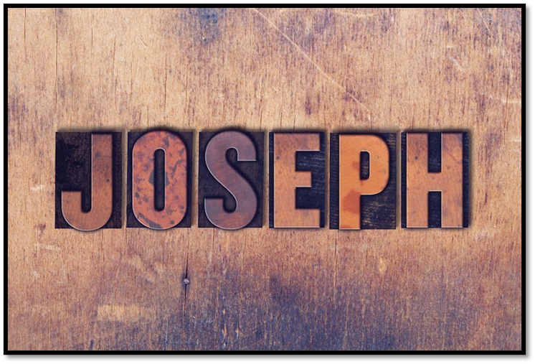
Sermon
Notes:
Image: Five Loaves by Caroline Coolidge Brown. Copyright © Caroline Coolidge Brown. All rights reserved. Used by permission of the artist.

Slide 22
APOSTLE’S CREED
C: I believe in God, the Father almighty, creator of heaven and earth.

Slide 23
APOSTLE’S CREED
C: I believe in Jesus Christ, his only Son, our Lord. He was conceived by the power of the Holy Spirit and born of the virgin Mary. He suffered under Pontius Pilate, was crucified, died, and was buried.

Slide 24
APOSTLE’S CREED
C: He descended into hell. On the third day he rose again. He ascended into heaven, and is seated at the right hand of the Father. He will come again to judge the living and the dead.

Slide 25
APOSTLE’S CREED
C: I believe in the Holy Spirit, the holy catholic Church, the communion of saints, the forgiveness of sins, the resurrection of the body, and the life everlasting. Amen.

Slide 26
NICENE CREED
C: We believe in one God, the Father, the Almighty, maker of heaven and earth, of all that is, seen and unseen.

Slide 27
NICENE CREED
C: We believe in one Lord, Jesus Christ, the only Son of God, eternally begotten of the Father, God from God, Light from Light, true God from true God, begotten, not made, of one Being with the Father.

Slide 28
NICENE CREED
C: Through him all things were made. For us and for our salvation he came down from heaven; by the power of the Holy Spirit he became incarnate from the virgin Mary, and was made man. For our sake he was crucified under Pontius Pilate;

Slide 29
NICENE CREED
C: he suffered death and was buried. On the third day he rose again in accordance with the Scriptures; he ascended into heaven and is seated at the right hand of the Father. He will come again in glory to judge the living and the dead, and his kingdom will have no end.

Slide 30
NICENE CREED
C: We believe in the Holy Spirit, the Lord, the giver of life, who proceeds from the Father and the Son. With the Father and the Son he is worshiped and glorified. He has spoken through the prophets. We believe in one holy catholic and apostolic Church.

Slide 31
NICENE CREED
C: We acknowledge one Baptism for the forgiveness of sins. We look for the resurrection of the dead, and the life of the world to come. Amen.

Slide 32
BLESSING OF QUILTS AND KITS
P: God, our neighbors around the world are in need of hope. Your Spirit is a mighty force, your whispers of hope bring light into the world. Open our hearts and hands to see your presence in our neighborhoods and across the world.
C: Jesus, help us speak words of hope to our neighbors.

Slide 33
BLESSING OF QUILTS AND KITS
P: God, we give you thanks for the pieces of fabric, thread, sewing machines, and the items collected for the kits. May their presence be a sign of hope, may these quilts wrap our neighbors in unending love, and may these kits offer dignity and healing.
C: Jesus, help us reach out in hope to our neighbors.

Slide 34
BLESSING OF QUILTS AND KITS
P: God, we give thanks for all the hands that fashioned hope into a quilt, for the hands that collected and sorted, for the hands that continually open wider so that no one feels left out.
C: Jesus, help us see hope in our neighbors.

Slide 35
BLESSING OF QUILTS AND KITS
P: God, we ask you to guide the staff and partners at LWR. May their voices and hands be a beacon of hope. Keep them safe. Keep them filled with your strength and perseverance.
C: Jesus, help us share a taste of hope with our neighbors.

Slide 36
BLESSING OF QUILTS AND KITS
P: God, be with our neighbors who will receive these gifts. May they be wrapped in love, may they taste your goodness, may they touch signs of your hope. Whether or not we know their names or where they live, they are our neighbors, our brothers and sisters in Christ.
C: Jesus, help us share a taste of hope with our neighbors.

Slide 37
BLESSING OF QUILTS AND KITS
P: Recognizing God’s abundant hope, we send these quilts and kits to be a sign of hope to our neighbors near and far as signs of God’s justice, and a feast of God’s goodness. In the name of the Father, + the Son, and the Holy Spirit.
C: Amen.

Slide 38
PRAYERS OF INTERCESSION
Each petition will end with the words,
A: God of promise,
The congregation will respond with:
C: You hear our prayer.

Slide 39
PRAYERS OF INTERCESSION
The prayer concludes…
P: Trusting in your grace and mercy, we lift these prayers to you, in the name of Jesus Christ.
C: Amen.

Slide 40
SHARING OF THE Peace
The Sharing of the Peace that began when the congregation arrived is now shared with the Pastor at this time...
P: The peace of the Lord be with you always.
C: And also with you.

Slide 41
Offering Prayer
Notes:
Image: Five Loaves by Caroline Coolidge Brown. Copyright © Caroline Coolidge Brown. All rights reserved. Used by permission of the artist.

Slide 42
THE LORD’S PRAYER
P: Jesus is the “tie that Binds us together”, let us pray as Jesus taught…
C: Our Father, who art in heaven, hallowed be thy name, thy kingdom come, thy will be done, on earth as it is in heaven. Give us this day our daily bread; and forgive us our trespasses,

Slide 43
THE LORD’S PRAYER
C: as we forgive those who trespass against us; and lead us not into temptation, but deliver us from evil. For thine is the kingdom, and the power, and the glory, forever and ever. Amen.

Slide 44
Announcements
Notes:
Image: Five Loaves by Caroline Coolidge Brown. Copyright © Caroline Coolidge Brown. All rights reserved. Used by permission of the artist.

Slide 45
SENDING BLESSING
P: God, who gives life to all things and frees us from despair, bless you with truth and peace. And may the holy Trinity, ☩ one God, guide you always in faith, hope, and love.
C: Amen.
☩

Slide 46
Sending Song
“Praise to the Lord, the Almighty” ELW 858
Notes:
Image: Five Loaves by Caroline Coolidge Brown. Copyright © Caroline Coolidge Brown. All rights reserved. Used by permission of the artist.

Slide 47
Praise to the Lord, the Almighty--ELW 858
1 Praise to the Lord, the Almighty, the King of creation!
O my soul, praise him, for he is your health and salvation!
Let all who hear now to his temple draw near,
joining in glad adoration!
Notes:
Image: Five Loaves by Caroline Coolidge Brown. Copyright © Caroline Coolidge Brown. All rights reserved. Used by permission of the artist.

Slide 48
Praise to the Lord, the Almighty--ELW 858
2 Praise to the Lord, who o'er all things is wondrously reigning
and, as on wings of an eagle, uplifting, sustaining.
Have you not seen all that is needful has been
sent by his gracious ordaining?
Notes:
Image: Five Loaves by Caroline Coolidge Brown. Copyright © Caroline Coolidge Brown. All rights reserved. Used by permission of the artist.

Slide 49
Praise to the Lord, the Almighty--ELW 858
3 Praise to the Lord, who will prosper your work and defend you;
surely his goodness and mercy shall daily attend you.
Ponder anew what the Almighty can do
if with his love he befriend you.
Notes:
Image: Five Loaves by Caroline Coolidge Brown. Copyright © Caroline Coolidge Brown. All rights reserved. Used by permission of the artist.

Slide 50
Praise to the Lord, the Almighty--ELW 858
4 Praise to the Lord! Oh, let all that is in me adore him!
All that has life and breath, come now with praises before him!
Let the amen sound from his people again.
Gladly forever adore him!
Notes:
Image: Five Loaves by Caroline Coolidge Brown. Copyright © Caroline Coolidge Brown. All rights reserved. Used by permission of the artist.

Slide 51
DISMISSAL
P: Until we gather again as God’s people to offer our worship and praise, depart in Christ’s Love,
C: Seeking, welcoming, and serving all. Amen!
Postlude by Roxanne Groff
Copyright © 2022 Augsburg Fortress. All rights reserved. Reprinted by permission under Augsburg Fortress Liturgies Annual License #SAS023830. New Revised Standard Version Bible, Copyright © 1989, Division of Christian Education of the National Council of the Churches of Christ in the United States of America. Used by permission. All rights reserved. Revised Common Lectionary, Copyright © 1992 Consultation on Common Texts, admin Augsburg Fortress. Used by permission.

