Slide 1
FECAL WELL D-ONE®

Slide 2
INTESTINAL INFECTIONS
DEFINITION
Intestinal infections are common diseases of the digestive tract that have diarrhea as characteristic symptom.
It’s the result of bacterial or viral infections and represents a major health and social problem in developing countries.

Slide 3
The intestine is an important organ for the defense of the organism.
The physiological bacterial flora is the first line of defense capable to counteract the invasion of pathogenic microorganisms.

Slide 4
There are many microorganisms (Salmonella, Shigellas, Campylobacter, Yersinia enterocolitica etc…) that can attack intestines, leading typically consequences as nausea, vomiting and, more frequently, diarrhea.
The symptomatology strongly debilitates the body, due to the massive loss of fluids and minerals.
Toxins released by these bacteria reduce the intestinal capacity to absorb water.
The result is an uncontrolled expulsion of liquid fecal mass with increased diarrhea and decreased digestive efficiency.

Slide 5
At the base of infectious colitis there are distinct damaging mechanisms due to:
Invasive Microorganisms, which penetrate and affecting the epithelial lining of the intestine;
Enterotoxins, which exert a direct toxic action on the intestinal lumen.

Slide 6
In diarrhea from invasive microorganisms:
infectious agents penetrate cells by endocytosis and release toxins and other substances that block cell function and cause its death.
Unlike toxigenic microorganisms, the invasive have as main target colon and distal ileum, causing ulceration and inflammatory reactions.

Slide 7
Many microorganisms produces Enterotoxins thst can cause different actions:
Cytotonic, without causing epithelium damage
or
Cytotoxic, with cell damage.
An example of diarrhea caused by enterotoxin is the one from Vibrio Cholerae and enterotoxigenic Escherichia Coli, that produce cytotonic toxins type causing a massive liquid losses and dehydration.

Slide 8
Coproculture is the diagnostic test that allows the etiological agent identification especially in cases where there are clinical signs such as high fever and protracted bloody diarrhea.
Presence of mucus and pus characterizes inflammatory diarrhea caused by invasive agents.
Bacterial culture is indicated in patients who live in particular endemic areas with special or eat suspect foods.

Slide 9
It should be mentioned that the growth of bacteria depends on the used culture medium and it is often necessary to use a selective culture medium, enrichment broths, isolations, biochemical and serological tests.

Slide 10
Investigations
Microscopic examination - fecal leukocytes.
In presence of persistent or recurrent diarrhea microscopic examination may be useful for diagnosis of inflammatory state.
Culture.
Sample direct seeding;
Seeding with enrichment;
Seeding on membrane filter.

Slide 11
Investigations - Culture.
Salmonella-Shigella Isolation
Use of enrichment media: liquid media useful to inhibiting the growth of normal microorganisms in the early hours of incubation, increasing the chances of detecting pathogens in low bacterial (Selenite Selenite cystine, Rappaport, Tetrathionate, Kauffmann Muller Tetrathionate broth).
Selenite broth, due to the presence of sodium selenite, exhibits a high toxicity to E. coli but not for the majority microorganisms of Salmonella.
Some strains of Shigella are inhibited to the same extent of E.coli: for Shigella isolation is therefore recommended to use a less selective enrichment broth (GN broth).

Slide 12
Campylobacter Isolation
Campylobacter Isolation depends on the antimicrobial agents present in the growing media (C.upsaliensis, H.fennelliae are sensitive to cephalothin), by incubation in a microaerophilic (5% of O2,10% CO2 and 85% N2) at a temperature of 42 °C, which inhibits the growth of the normal microbiota.
Can be used different selective media: Skirrow, Karmali, Blaser Wang, Butzler, Preston, Bolton, CCDA (free blood agar).
May also be employed procedures of enrichment by liquid substrates (Campy-THIO): these procedures are recommended for clinical samples when is suspected the possibility of low viable microbial loads (carriers, post-symptomatic patients or treated with antibiotics) or food samples.
Can be used alternative methods of isolation: through filters membrane can achieve isolation of Campylobacter species unable to grow at 42 °C or on selective media.

Slide 13
Vibrio spp. Isolation
Vibrio grows well on normal differential media, even if use of selective media (TCBS selective agar) can facilitate the isolation.
If is not possible to immediate sowing, it is recommended the use of transport media (Cary-Blair) or peptone water (pH 8).
Yersinia spp. Isolation
Yersinia grows well on ordinary differential media, although the use of selective media (CIN: cefsulodin-Irgasan-Novobiocin Agar) that can facilitate the isolation.
Low temperature incubation for primary isolation is only suggested in cases of clinical suspicion.

Slide 14
E.coli O157:H7 Isolation
Differential media (McConkey + Sorbitol, chromogenic media for E. coli O 157) for the isolation of E. coli O157: H7, responsible for hemorrhagic colitis associated with production of cytotoxic toxin.
According to the well documented serotypes plurality , it is preferable to use other to demonstrate the production of shiga like cytotoxins, by immunoassays or directly from feces.

Slide 15
Investigation - Identification.
Based on used media, suspect colonies are subjected to biochemistry identification (Salmonella, Shigella, Campylobacter, Aeromonas, Plesiomonas, Vibrio, Yersinia) and serological confirmation by somatic antigens.
Equipped laboratories will complete the strains characterization by means of a serotyping with flagellar antigens. In case of Salmonella spp., for example, the colonies biochemically identified and serologically confirmed (polyvalent antiserum) are subjected to serological typing according to the updated scheme of Kauffmann-Withe that provides the characterization of a somatic phase (groups AE) and a flagellar phase (phases 1 and 2).

Slide 16
E.coli
Are commercially available immunoassays for O157 and H7 antigens detection to be prepared directly from feces or by enrichment broths cultivation.
These tests are not recommended as first-line test due a failure detection of STEC non-O157 E. coli O157 not producing Shiga toxins. In the market there are also immunochromatographic and immunoassays methods for determination of strains of E.coli tossinogenici.shiga-toxin (STEC O157 and non-O157) and for the detection of heat labile toxins / thermostable (LT / ST) of ETEC.
Campylobacter.
Available immunoassays or immunochromatographic tests for determination of cell-wall antigens in feces with species-variable sensitivity.
V. cholerae.
There are immunoassays systems and reverse passive latex agglutination systems (RPLA) for the determination of enterotoxin.

Slide 17
Faecal WELL D-ONE® allows presumptive identification of gastrointestinal pathogens such as:
Escherichia coli O157
Salmonella spp.
Pseudomonsas spp.
Shigella spp.
Yersinia enterocolitica
Vibrio spp
Proteus/Providencia spp.
KES Group
Enterobacter sakazakii
ESBL
KPC
Campylobacter spp.
Candida spp

Slide 18
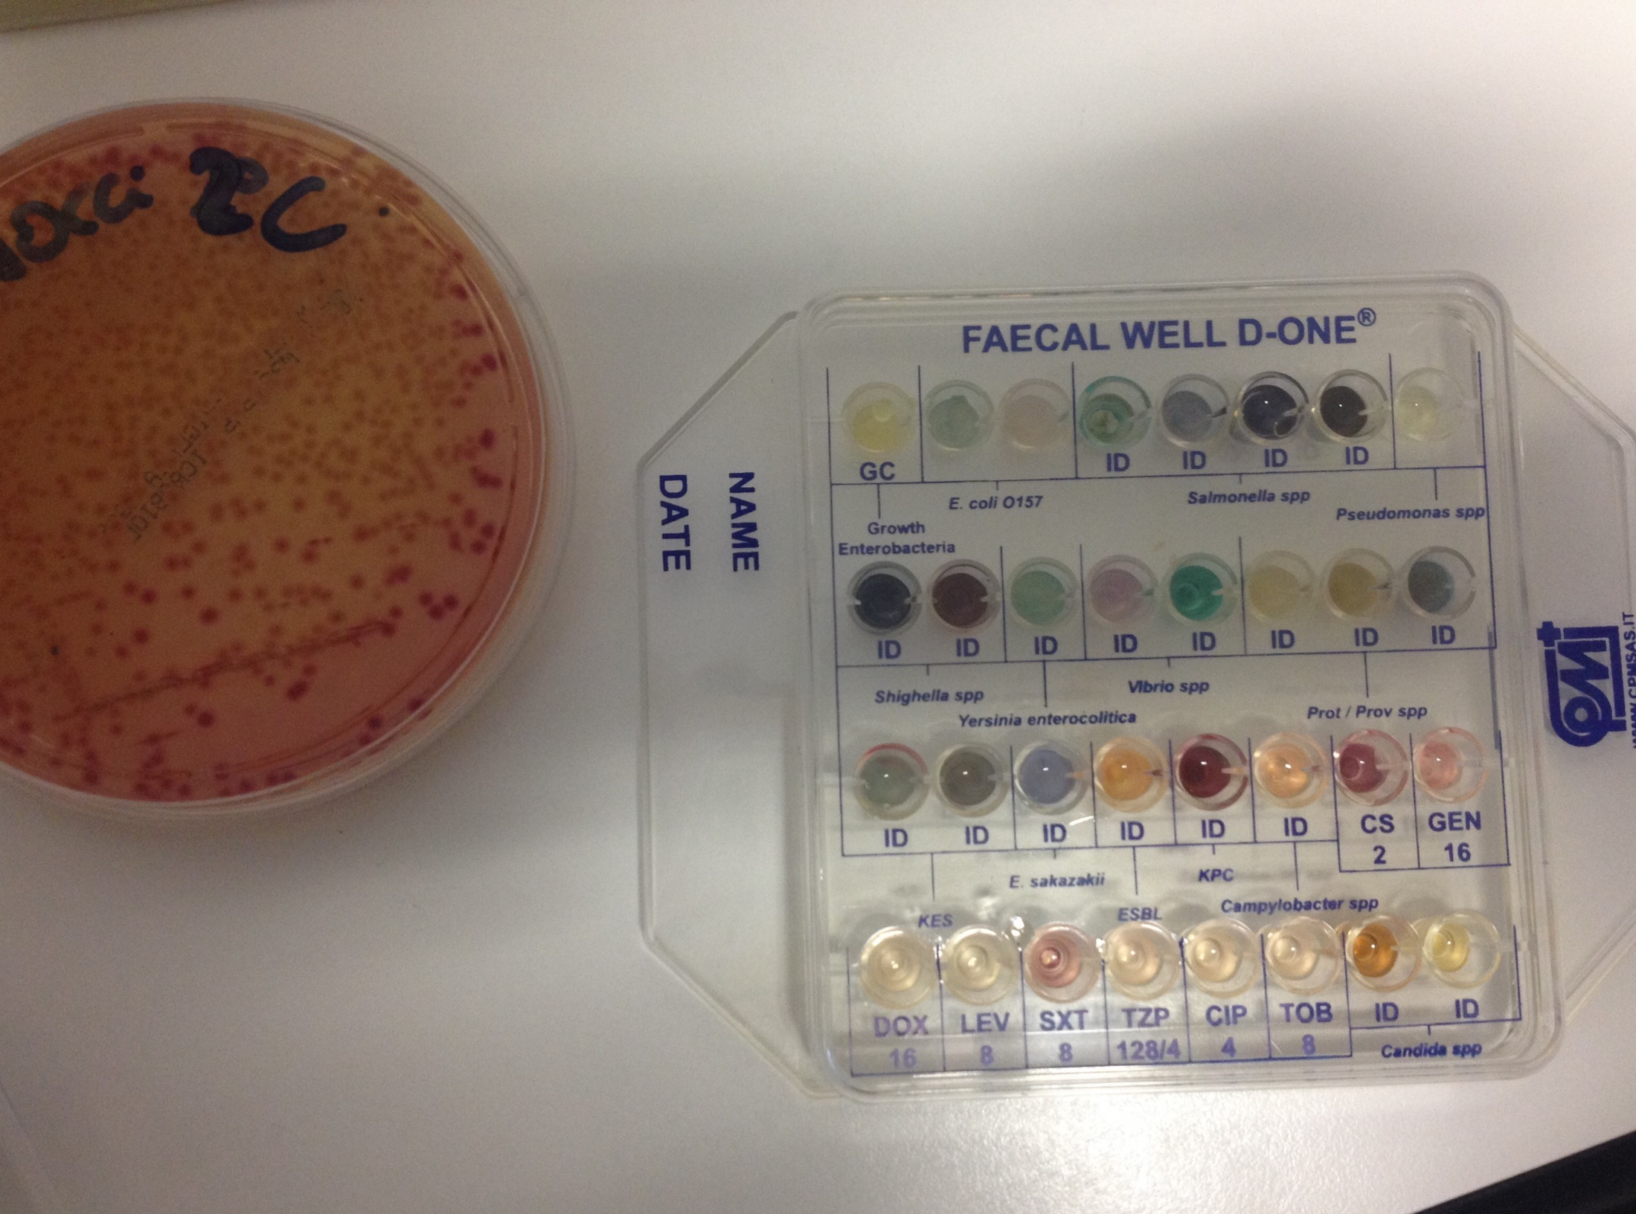

Slide 19
FAECAL WELL D-ONE® also allows to test the susceptibility to antibiotics.
FAECAL WELL D-ONE® is a system composed by a polypropylene plate, containing 32 conical wells for better visualization of color reactions that occur as a result of microorganisms growth in selective specific media.

Slide 20
SAMPLE COLLECTION AND PREPARATION - Feces, rectal swab
Sample must be taken in accordance with the established procedure in each laboratory.
Feces:
- Take Approximately an handle of sample and dilute it into saline solution vial supplied in the kit;
Homogenize the solution with a Pasteur pipette or an automatic pipette. Aliquot 150 μL (3 drops) of the obtained suspension in each of the 32 wells of the kit;
Incubate at 37 °C for 24 hours.

Slide 21
Rectal swab
- Dip the swab into saline solution vial contained in the kit;
- Carefully press the swab against the wall of the vial so that the material is properly homogenized;
Mix the solution with a Pasteur pipette or an automatic pipette;
Aliquot 150 μL (3 drops) of the obtained suspension in each of the 32 wells of the kit;
Incubate at 37 °C for 24 hours.

Slide 22
The sampling should be performed as soon as possible after the onset of symptoms and still in an acute phase of infection.
Feces should be received in the laboratory within 1-2 hours from the issue, otherwise would be stored at 4-6 °C for ≤ 24 hours (buffered saline, transportation medium Carey-Blair / Stuart / Amies).
Beyond this limit the samples should be maintained at -70 °C.
The sample must be accompanied by a claim form that includes, besides the personal data, the collection of all data and clinical medical history to help the diagnostic process.

Slide 23
WELL 1
WELL N° 1 is specific for growth control of enterobacteria and then as a further confirmation of Gram-negative bacteria presence.

Slide 24
WELLS 2 AND 3
Allows the presumptive identification of Escherichia coli O157, known serotype entero-haemorrhagic Escherichia coli bacterium that it’s contracts usually through the consumption of contaminated food.
The infection can cause bloody diarrhea and, in severe cases where are exposed to particular risk, renal failure, anemia and dehydration, spontaneous bleeding, organ failure and altered mental status in elderly.
Some of these patients develop permanent disabilities.

Slide 25
Escherichia coli O157: H7 Infection
Syndrome with acute bloody diarrhea that can cause acute hemolytic-uremic syndrome.
The E. coli O157: H7 and similar strains of E. coli (called enterohemorrhagic E. coli) produce high levels of toxins that are indistinguishable from the mighty cytotoxin produced by Shigella dysenteriae type 1.
These Shiga toxins are produced in the large intestine after ingestion of E. coli enterohaemorrhagic.
Have a toxic effect on endothelial cells of the bowel vessel wall and, if absorbed, exert toxic effects on vascular endothelium.

Slide 26
WELLS4,5,6,7
The wells No. 4-5-6-7 allow presumptive identification of Salmonella spp., microorganism most commonly sought after diarrheal events as a cause of food poisoning.
Infections caused by Salmonella spp. differ in forms with typhoid Salmoenlla typhi and Salmonella paratyphi, generally responsible for typhoid fever, enteric fever and, forms non-typhoid caused by Salmonella typhimurium and Salmonella enteritidis, responsible for clinical forms predominantly gastrointestinal manifestation.

Slide 27
TYPHOID FEVER
Systemic disease caused by Salmonella typhi and characterized by fever, prostration, abdominal pain and rosy skin rash.
Typhoid bacilli are shed in the feces of asymptomatic carriers and in urine and feces of patients with active disease.
Inadequate hygiene after defecation may spread S. typhi
to food or water.
In endemic areas, where health measures are generally inadequate, S. typhi is transmitted most often through water than through food. In developed countries instead, transmission occurs mainly through contaminated food by healthy carriers during preparation. The organism enters in the body through the GI tract and opens the way to the bloodstream via the lymphatic vessels. In ileum and in the colon we can find inflammation in the lamina propria and monocyte Peyer's patches, where it is common to tissue necrosis. In serious cases you may have severe ulceration, bleeding and perforation bowel.

Slide 28
NON-TYPHOID SALMONELLA INFECTIONS
The epidemiology of other salmonellosis is similar to typhoid fever, but more complex, because the disease can manifest in humans also for direct or indirect contact with many species of infected animals, with the food derivatives from them or with their excrements.
Common sources of Salmonella are animals from infected meat, poultry, fresh milk, eggs and products made with eggs.
Enteric fever is a systemic syndrome characterized by fever, prostration, and septicemia. A similar syndrome, but often less severe, is caused by S. paratyphi A, B and C.

Slide 29
WELL 8
WELL n°8 allows instead to presumptively identify Pseudomonas spp. frequent guest of the body (skin and digestive tract)

Slide 30
WELLS 9-10
The wells No. 9 and 10 identify Shigella spp. that, as Salmonella spp., is a species of Enterobacter frequently isolated as a cause of enteritis and enterocolitis.
Shigella sonnei with Shigella flexneri represent two of the most frequent species isolated as a cause of toxic food infection whose symptoms may be mild compared to Shigella dysenteriae certainly more virulent and dangerous and characterized by a more severe clinical picture that may result in severe dysentery (from hence its name of bacillary dysentery), nausea and sometimes vomiting, cramps and fever.
The virulence factor of this pathogen is given by its ability to produce the Shiga toxin (A and B) which acts as a cytotoxin capable of causing necrosis and ulceration.

Slide 31
WELL 11
Well n°11 identifies Yersinia enterocolitica, enterobacter responsible of Yersiniosis that can cause a variety of symptoms depending on the age of the infected person.
The most common symptoms are fever, abdominal pain and diarrhea, often bloody.
In older children and adults, abdominal pain and fever may be the predominant symptoms. In a small percentage of cases, there may be complications such as skin rashes, joint pain or the spread of bacteria in the bloodstream.

Slide 32
WELLS 12-13
The wells No. 12 and No. 13, allowing identification of Vibrio spp. whose species are often pathogenic. Most of the strains that cause important diseases are associated with gastroenteritis.
Pathogenic species normally known to be particularly virulent and dangerous include Vibrio cholerae (the causative agent of cholera), V. parahaemolyticus and V. vulnificus. V. cholerae is generally transmitted by contaminated water as well as from certain foods such as uncooked seafood.
Outbreaks of V. vulnificus occur quite frequently in hot or humid areas.
V. parahaemolyticus is manifested by symptoms similar to V. cholerae but can regress spontaneously within 2-3 days.

Slide 33
CHOLERA
Acute infection caused by Vibrio cholerae that affects the entire
small intestine, characterized by profuse watery diarrhea, vomiting,
muscle cramps, dehydration, oliguria and collapse.
The causative organism is the Vibrio cholerae serogroups 01 and 0139, an aerobic bacillus short, curved and mobile. Both the classical biotypes of V. cholerae and El Tor biotypes can cause serious illness;
However, with the El Tor biotypes are much more frequent forms of
mild or asymptomatic infection.
Cholera is spread by ingestion of water, fish, crustaceans and other
types of contaminated food by the feces of symptomatic infected subjects or asymptomatic.
Cholera is endemic in some regions of Asia, Middle East, Africa, Central and Southern America.
Uncomplicated Cholera has a limited course : it heals in 3-6 days.
The mortality rate in severe cases can not be treated can be > 50% due to dehydration but it is <1% with an electrolyte liquid therapy timely and appropriate.
In most of patients the V. cholerae disappears within 2 weeks, but some
individuals become chronic carriers of the biliary tract.

Slide 34
INFECTIONS FROM NOT CHOLERICS VIBRIOS
These vibrios are different from Vibrio cholerae from a biochemical point and serological view, depending on the species, causing wound infections, enteric sepsis or diarrhea.
The vibrios different from cholera are : V. parahemolyticus, V. mimicus,V. alginolyticus, V. vulnificus
The V. parahemolyticus is an halophilic germ incriminated in outbreaks of diarrhea from food (in sea foods not thoroughly cooked, usually shrimp) in Japan and in the coastal areas of the USA.

Slide 35
WELLS 14-15-16
The wells No. 14 -15-16 allow to identify Proteus / Providencia spp.
Proteus is a Enterobacter that normally is present in the gastrointestinal tract in man but it can cause damage if it spreads to other locations such as the urinary tract where it can cause infections.

Slide 36
WELLS 17-18
Wells No. 17-18 are for identification of KES group (Klebsiella, Enterobacter, Serratia), microorganisms that can reside in the fecal flora but that can be both responsible for serious infections in other locations.

Slide 37
WELL 19
The well No. 19 identifies Enterobacter sakazakii, opportunistic pathogen responsible for neonatal infections (especially meningitis and necrotizing enterocolitis) in many cases fatal.
Recent studies have shown its widespread mainly because isolated in food samples, in home, hospital and insects, and not least in powdered milk for infants, probably contaminated during production processes.
In this regard, the presence of even a modest charge of the microorganism in this type of food is enough to determine the risk of infection in children in the first months of life, especially if under weight born or immunocompromised.

Slide 38
WELL 20
The well No. 20 allows the identification of Enterobacteriaceae ESBL (extended-spectrum beta-lactamase) more in deep Enterobacteriaceae producing extended spectrum Beta Lactamase. These are able to inactivate penicillins, narrow spectrum cephalosporins, many broad spectrum cephalosporins (cefotaxime and ceftazidime) and monobactamici (aztreonam).
The ESBL pathogens are:
Klebsiella pneumoniae, Escherichia coli, Enterobacter cloacae.

Slide 39
Well 21
Well No. 21 allows identification of KPC, or Klebsiella pneumoniae carbapenemase.
Gram-negative bacteria are highly resistant to the drugs that cause significant infections.
KPC represents important resistance mechanisms for an increasingly broad range of Gram-negative bacteria and no longer limited to only K. pneumoniae.

Slide 40
WELL 22
Some Campylobacter species
(C. jejuni, C. coli and C. lari) are frequently identified as causative agents of acute infectious diarrhea in developed countries.
These are infections caused by consumption or from improper handling of raw or undercooked meat, especially poultry, and contaminated fresh milk.
Generally the infection resolves within a few days, and only rarely or in "in risk "categories, such as children, the elderly and immunocompromised individuals, may occur post infectious complications such as arthritis and neurological disorders.

Slide 41
Wells from No. 23 to No. 30 allow antibiotic susceptibility test with:
CS – COLISTIN SULFATE 2 µg/mL
GEN – GENTAMICIN 16 µg/mL
DOX – DOXYCYCLINE 16 µg/mL
LEV- LEVOFLOXACIN 8 µg/mL
SXT –SULFAMETHOXAZOLE 8 µg/mL
TZP – PIPERACILLIN – TAZOBACTAM 128/4 µg/mL
CIP – CIPROFLOXACIN 4 µg/mL
TOB – TOBRAMYCIN 8 µg/mL

Slide 42
WELLS 31-32
Allow the presumptive identification of Candida spp., a species of yeast that generally form part of the normal microbial flora of skin, mouth, gastrointestinal tract and vagina.
The best known is Candida albicans, which is responsible for many cases of vaginal disorders and more.

Slide 43
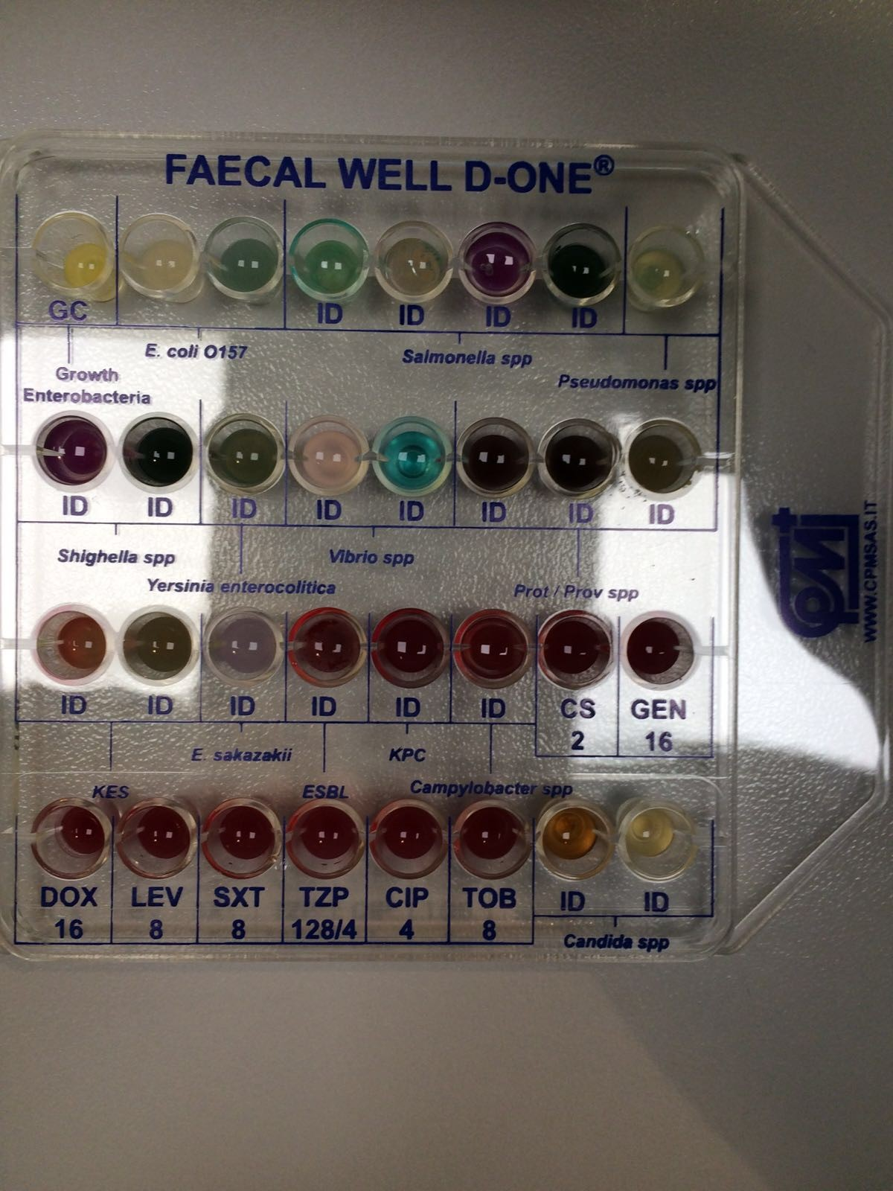
Well 17 for presumptive identification of the KES is red and turbid as the well 18 green.
Positive well for presumptive identification of ESBL and 21 for presumptive identification of KPC .
Well 22 for presumptive identification of Campylobacter red transparent with no turbidity.
Positive for ESBL and KPC with drug resistance.
Members of Proteus spp and Klebsiella spp are usually multiresistant and present ESBL and KPC .
They are also able to grow in Campylobacter well for the same reason .

Slide 44
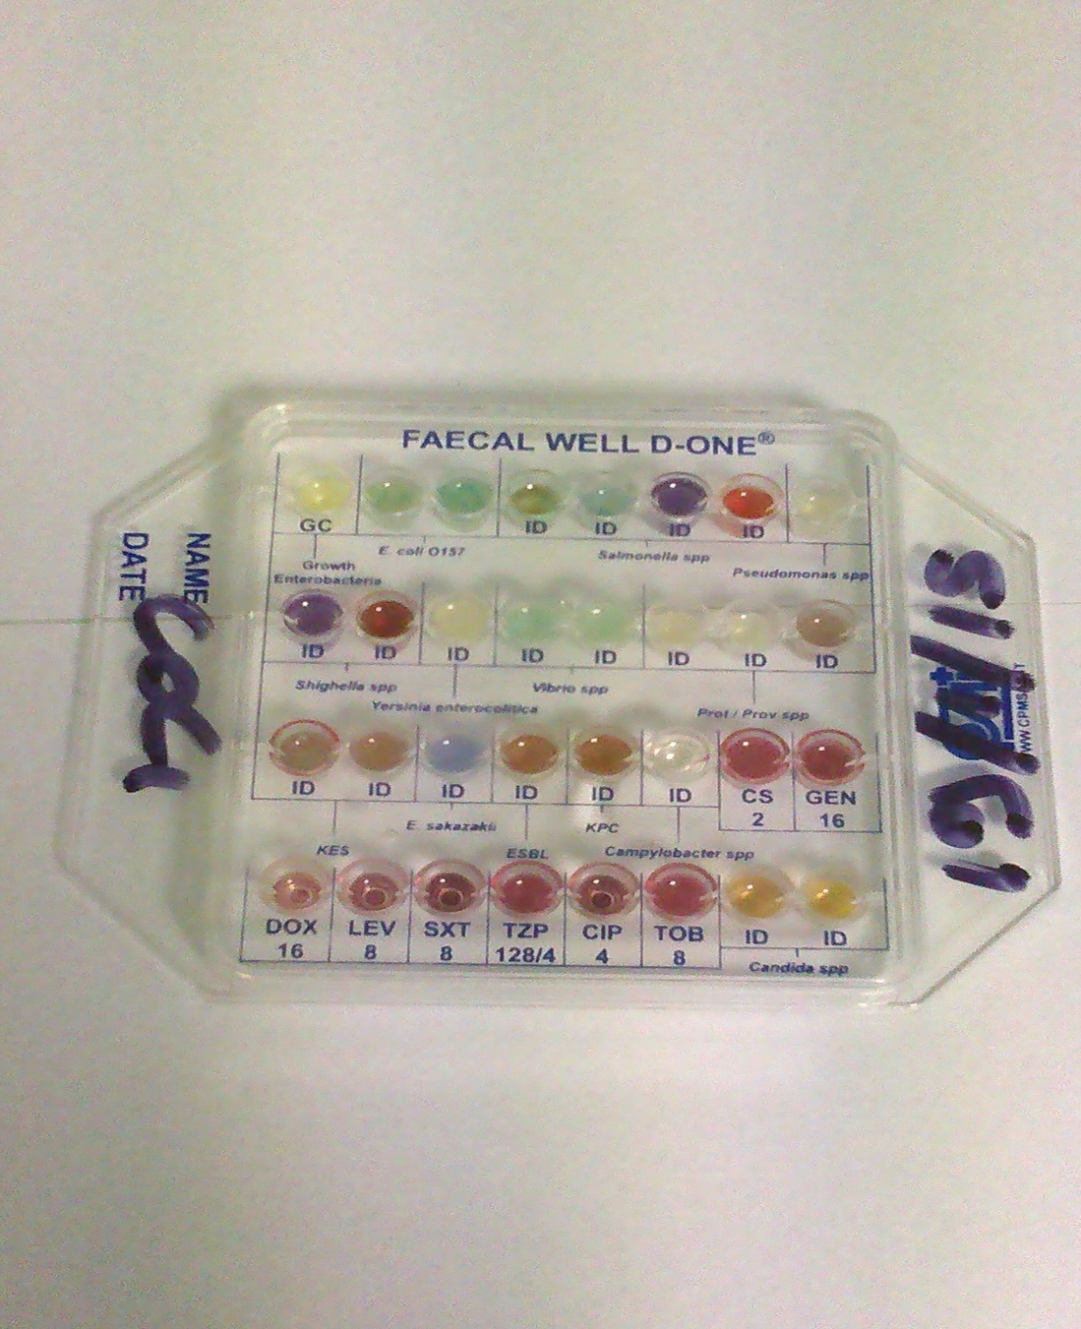
E.Coli

Slide 45
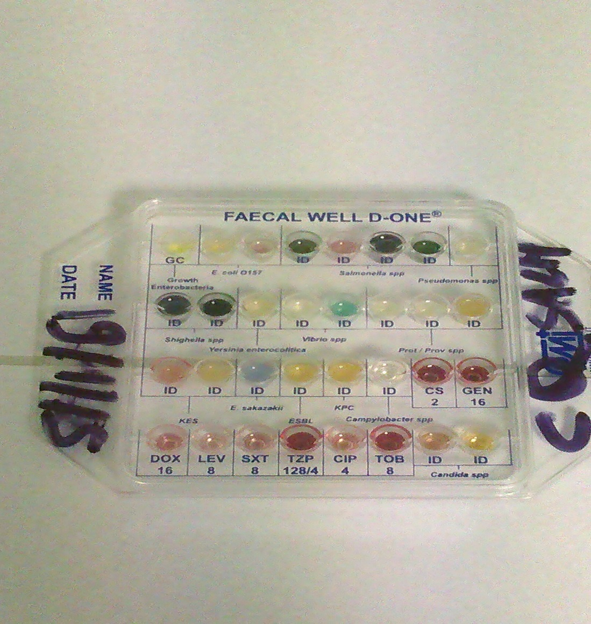
Salmonella spp.

Slide 46
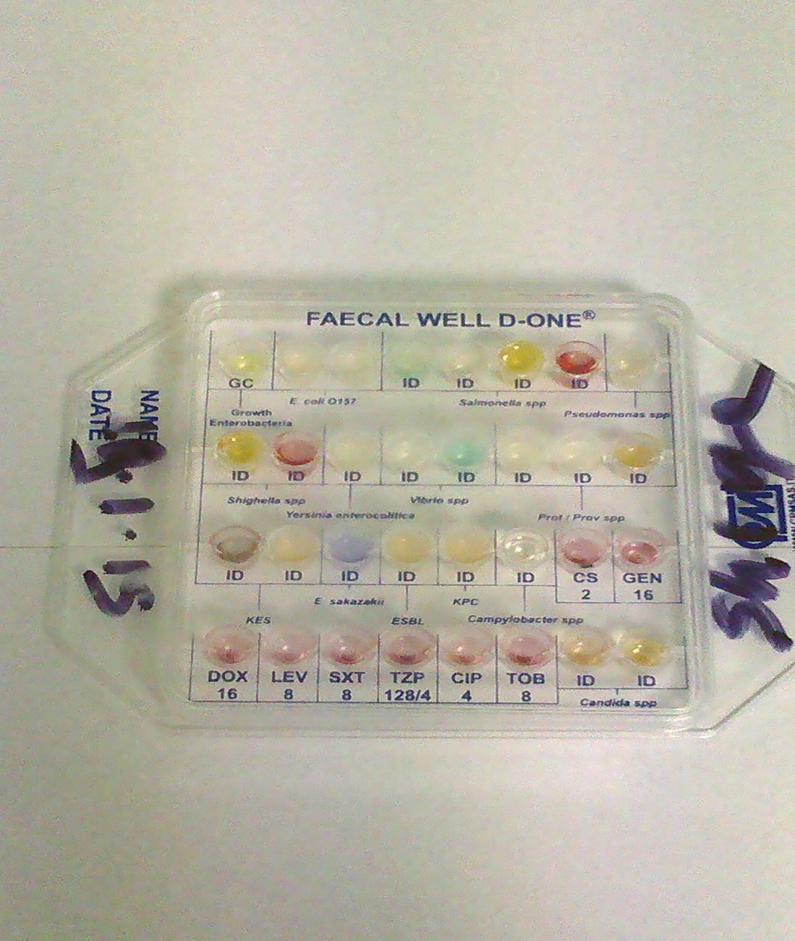
Shigella spp.

Slide 47
CONCLUSION
“The greater danger for most of us lies not in setting our aim too high and falling short; but in setting our aim too low, and achieving our mark.” (Michelangelo)
THANKS!
Prof. Isis Tamargo Martinez, PhD
Dr.ssa Sabina Ripani
Dr. Francesco Pacella
La seguente presentazione ed il suo contenuto è di proprietà della CPM SAS ed è da ritenersi strettamente confidenziale e riservata
esclusivamente ai destinatari. Se ne vieta la divulgazione senza il consenso della CPM SAS

