Slide 1
Technology and the Classroom
A Wave of Change

Slide 2
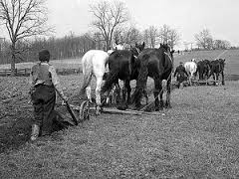
Agrarian Age

Slide 3
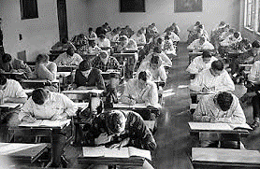
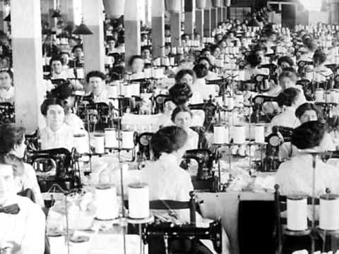
Industrial Age

Slide 4
Information Age

Slide 5
Intelligence Age

Slide 6
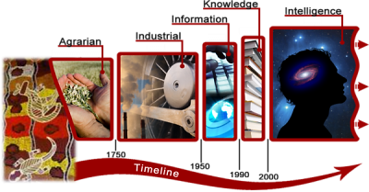

Slide 7
Are we preparing the LEARNER for tomorrow?

Slide 8
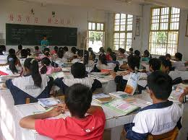
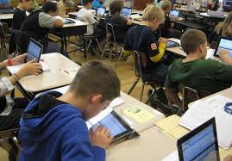

Slide 9
Ipad in Education

Slide 10
http://youtu.be/3mfsypizJxw

Slide 11
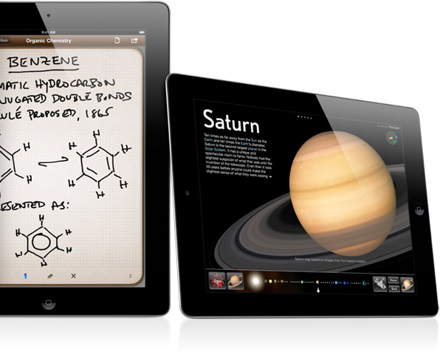
IPad Implementation
Educator
Educator and Learner
Virtual Teaching

Slide 12
Systems of Education
Conventional + Creativity
App Driven
Flip the Classroom
School in the Cloud

