Slide 1
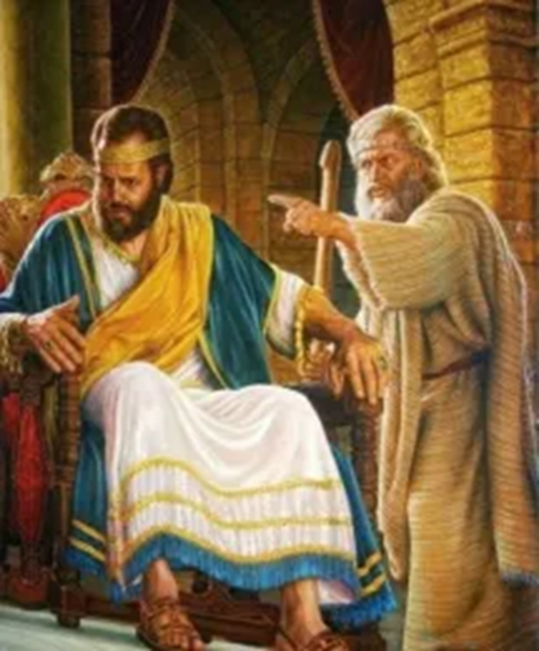
Welcome in the Name of
The Triune God
October 23, 2022
David and Bathsheba
Prelude by Roxanne Groff
Office of the Acolyte
Ringing of the Bell
Scripture Focus:
2 Samuel 11:1-5, 26-27; 12:1-9;
Psalm 51:1-9
Notes:
Image: Preparing yeast dough. Copyright © tomasworks/iStock/Thinkstock. Used by permission.

Slide 2
CONFESSION AND FORGIVENESS
All may make the sign of the cross, the sign marked at baptism…
P: We confess our sins before God and one another.
Pause for silence and reflection.
P: Gracious God,
Notes:
Image: Five Loaves by Caroline Coolidge Brown. Copyright © Caroline Coolidge Brown. All rights reserved. Used by permission of the artist.

Slide 3
CONFESSION AND FORGIVENESS
C: We have sinned against you and our neighbors. We have taken what is not ours, and justified our actions. We have turned away from your wisdom. We have not done justice, loved kindness, nor walked humbly with you. Forgive us for the harms we have caused through word and action, and restore us to the joy of following your will for us.
Notes:
Image: Five Loaves by Caroline Coolidge Brown. Copyright © Caroline Coolidge Brown. All rights reserved. Used by permission of the artist.

Slide 4
CONFESSION AND FORGIVENESS
L: God knows our every weakness and yet loves us without ceasing. Rejoice and be glad, for the God of grace and mercy forgives you all your sins, for the sake of our savior Jesus Christ.
C: Amen.
☩
Notes:
Image: Five Loaves by Caroline Coolidge Brown. Copyright © Caroline Coolidge Brown. All rights reserved. Used by permission of the artist.

Slide 5
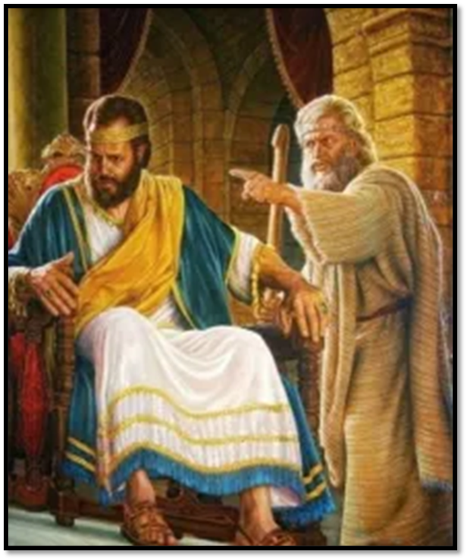
Hymn of Praise
“Change My Heart, O God” ELW 801
Notes:
Image: Five Loaves by Caroline Coolidge Brown. Copyright © Caroline Coolidge Brown. All rights reserved. Used by permission of the artist.

Slide 6
“Change My Heart, O God” ELW 801
Change my heart, O God;
make it ever true.
Change my heart, O God;
may I be like you.
Notes:
Image: Five Loaves by Caroline Coolidge Brown. Copyright © Caroline Coolidge Brown. All rights reserved. Used by permission of the artist.

Slide 7
“Change My Heart, O God” ELW 801
You are the potter;
I am the clay.
Mold me and make me;
this is what I pray.
Change my heart, O God;
make it ever true.
Change my heart, O God;
may I be like you.
Notes:
Image: Five Loaves by Caroline Coolidge Brown. Copyright © Caroline Coolidge Brown. All rights reserved. Used by permission of the artist.

Slide 8
“Change My Heart, O God” ELW 801
Change my heart, O God;
make it ever true.
Change my heart, O God;
may I be like you.
Notes:
Image: Five Loaves by Caroline Coolidge Brown. Copyright © Caroline Coolidge Brown. All rights reserved. Used by permission of the artist.

Slide 9
APOSTOLIC GREETING
P: The grace of our Lord Jesus Christ, the love of God, and the communion of the Holy Spirit be with you all.
C: And also with you.
Notes:
Image: Five Loaves by Caroline Coolidge Brown. Copyright © Caroline Coolidge Brown. All rights reserved. Used by permission of the artist.

Slide 10
PRAYER OF THE DAY
P: Let us pray… God of forgiveness, David betrayed your commandments and committed terrible crimes. Yet even his horrific sins were not too much for you to forgive. Remind us that there is nothing we can do that will turn you away from us.
C: Amen.
Notes:
Image: Five Loaves by Caroline Coolidge Brown. Copyright © Caroline Coolidge Brown. All rights reserved. Used by permission of the artist.

Slide 11
Notes:
Image: Preparing yeast dough. Copyright © tomasworks/iStock/Thinkstock. Used by permission.

Slide 12
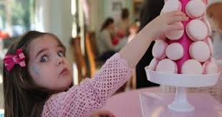
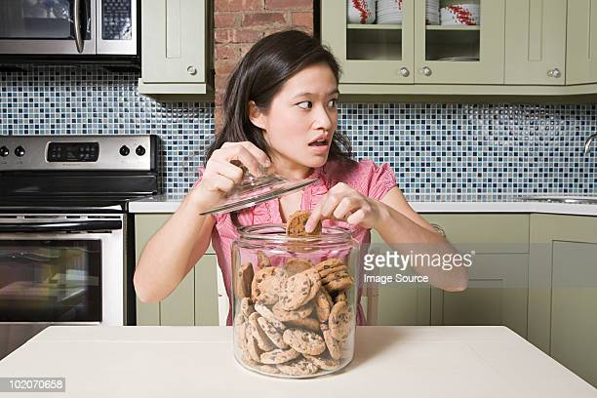
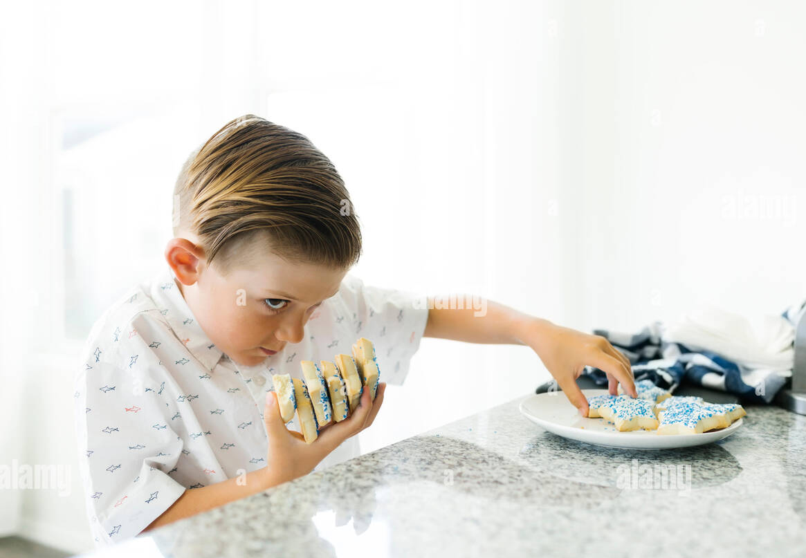
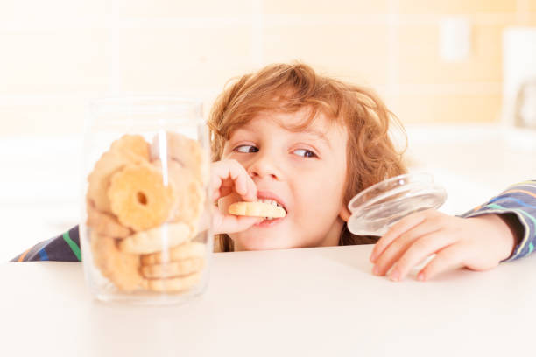
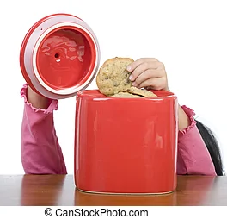
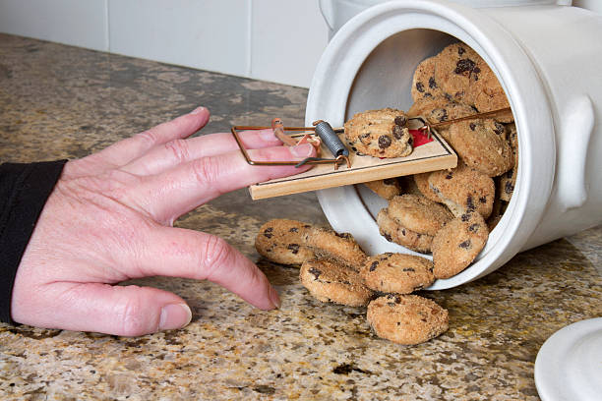
Notes:
Image: Preparing yeast dough. Copyright © tomasworks/iStock/Thinkstock. Used by permission.

Slide 13
Scripture Reading
R: The Scripture includes readings from the book of 2nd Samuel, Chapters 11 and 12 and Psalm 51
C: Glory to you O’ Lord! (Spoken)
Notes:
Image: Five Loaves by Caroline Coolidge Brown. Copyright © Caroline Coolidge Brown. All rights reserved. Used by permission of the artist.

Slide 14
2 Samuel 11:1-5; 26-27; 12:1-9;
Psalm 51:1-9
2nd SAMUEL
In the spring of the year, the time when kings go out to battle, David sent Joab with his officers and all Israel with him; they ravaged the Ammonites, and besieged Rabbah. But David remained at Jerusalem. ²It happened, late one afternoon, when David rose from his couch and was walking about on the
Notes:
Image: Five Loaves by Caroline Coolidge Brown. Copyright © Caroline Coolidge Brown. All rights reserved. Used by permission of the artist.

Slide 15
2 Samuel 11:1-5; 26-27; 12:1-9;
Psalm 51:1-9
roof of the king’s house, that he saw from the roof a woman bathing; the woman was very beautiful. ³David sent someone to inquire about the woman. It was reported, “This is Bathsheba daughter of Eliam, the wife of Uriah the Hittite.” ⁴So David sent messengers to get her, and she came to him, and he lay with her. (Now she
Notes:
Image: Five Loaves by Caroline Coolidge Brown. Copyright © Caroline Coolidge Brown. All rights reserved. Used by permission of the artist.

Slide 16
2 Samuel 11:1-5; 26-27; 12:1-9;
Psalm 51:1-9
was purifying herself after her period.) Then she returned to her house. ⁵The woman conceived; and she sent and told David, “I am pregnant.”
²⁶When the wife of Uriah heard that her husband was dead, she made lamentation for him. ²⁷When the mourning was over, David sent and brought her to his house, and she
Notes:
Image: Five Loaves by Caroline Coolidge Brown. Copyright © Caroline Coolidge Brown. All rights reserved. Used by permission of the artist.

Slide 17
2 Samuel 11:1-5; 26-27; 12:1-9;
Psalm 51:1-9
became his wife, and bore him a son. But the thing that David had done displeased the Lord.
And the Lord sent Nathan to David. He came to him, and said to him, “There were two men in a certain city, the one rich and the other poor. ²The rich man had very many flocks and herds; ³but the poor man had nothing but one little
Notes:
Image: Five Loaves by Caroline Coolidge Brown. Copyright © Caroline Coolidge Brown. All rights reserved. Used by permission of the artist.

Slide 18
2 Samuel 11:1-5; 26-27; 12:1-9;
Psalm 51:1-9
ewe lamb, which he had bought. He brought it up, and it grew up with him and with his children; it used to eat of his meager fare, and drink from his cup, and lie in his bosom, and it was like a daughter to him. ⁴Now there came a traveler to the rich man, and he was loath to take one of his own flock or herd to prepare for the wayfarer
Notes:
Image: Five Loaves by Caroline Coolidge Brown. Copyright © Caroline Coolidge Brown. All rights reserved. Used by permission of the artist.

Slide 19
2 Samuel 11:1-5; 26-27; 12:1-9;
Psalm 51:1-9
who had come to him, but he took the poor man’s lamb, and prepared that for the guest who had come to him.”
⁵Then David’s anger was greatly kindled against the man. He said to Nathan, “As the Lord lives, the man who has done this deserves to die; ⁶he shall restore the lamb fourfold, because he did this thing, and because
Notes:
Image: Five Loaves by Caroline Coolidge Brown. Copyright © Caroline Coolidge Brown. All rights reserved. Used by permission of the artist.

Slide 20
2 Samuel 11:1-5; 26-27; 12:1-9;
Psalm 51:1-9
he had no pity.” ⁷Nathan said to David, “You are the man! Thus says the Lord, the God of Israel: I anointed you king over Israel, and I rescued you from the hand of Saul; ⁸I gave you your master’s house, and your master’s wives into your bosom, and gave you the house of Israel and of Judah; and if that had been too little, I would have added as
Notes:
Image: Five Loaves by Caroline Coolidge Brown. Copyright © Caroline Coolidge Brown. All rights reserved. Used by permission of the artist.

Slide 21
2 Samuel 11:1-5; 26-27; 12:1-9;
Psalm 51:1-9
much more. ⁹Why have you despised the word of the Lord, to do what is evil in his sight? You have struck down Uriah the Hittite with the sword, and have taken his wife to be your wife, and have killed him with the sword of the Ammonites.”
Notes:
Image: Five Loaves by Caroline Coolidge Brown. Copyright © Caroline Coolidge Brown. All rights reserved. Used by permission of the artist.

Slide 22
2 Samuel 11:1-5; 26-27; 12:1-9;
Psalm 51:1-9
PSALM 51
Have mercy on me, O God, according to your steadfast love; according to your abundant mercy blot out my transgressions. ² Wash me thoroughly from my iniquity, and cleanse me from my sin. ³ For I know my transgressions, and my sin is ever before me. ⁴ Against you, you alone, have I sinned, and
Notes:
Image: Five Loaves by Caroline Coolidge Brown. Copyright © Caroline Coolidge Brown. All rights reserved. Used by permission of the artist.

Slide 23
2 Samuel 11:1-5; 26-27; 12:1-9;
Psalm 51:1-9
done what is evil in your sight, so that you are justified in your sentence and blameless when you pass judgement. ⁵ Indeed, I was born guilty, a sinner when my mother conceived me.
⁶ You desire truth in the inward being; therefore teach me wisdom in my secret heart. ⁷ Purge me with hyssop, and I shall be clean; wash me, and I
Notes:
Image: Five Loaves by Caroline Coolidge Brown. Copyright © Caroline Coolidge Brown. All rights reserved. Used by permission of the artist.

Slide 24
2 Samuel 11:1-5; 26-27; 12:1-9;
Psalm 51:1-9
shall be whiter than snow. ⁸ Let me hear joy and gladness; let the bones that you have crushed rejoice. ⁹ Hide your face from my sins, and blot out all my iniquities.
Notes:
Image: Five Loaves by Caroline Coolidge Brown. Copyright © Caroline Coolidge Brown. All rights reserved. Used by permission of the artist.

Slide 25
2 Samuel 11:1-5; 26-27; 12:1-9;
Psalm 51:1-9
P: This is the Word of the Lord.
C: Praise to You, O Christ (Spoken)
Notes:
Image: Five Loaves by Caroline Coolidge Brown. Copyright © Caroline Coolidge Brown. All rights reserved. Used by permission of the artist.

Slide 26
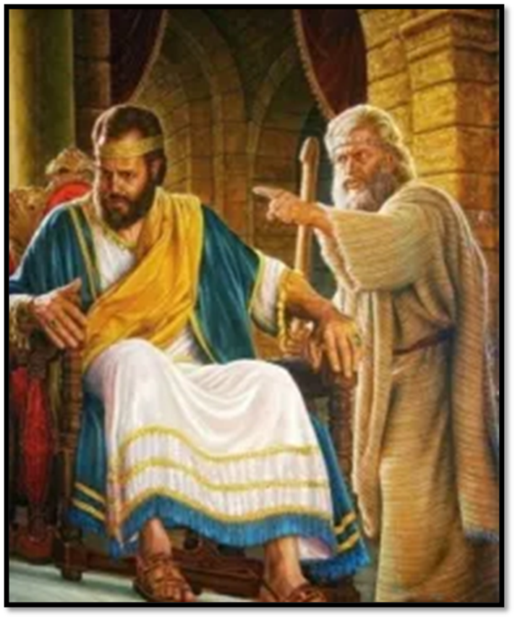
Sermon
Notes:
Image: Five Loaves by Caroline Coolidge Brown. Copyright © Caroline Coolidge Brown. All rights reserved. Used by permission of the artist.

Slide 27
APOSTLE’S CREED
C: I believe in God, the Father almighty, creator of heaven and earth.

Slide 28
APOSTLE’S CREED
C: I believe in Jesus Christ, his only Son, our Lord. He was conceived by the power of the Holy Spirit and born of the virgin Mary. He suffered under Pontius Pilate, was crucified, died, and was buried.

Slide 29
APOSTLE’S CREED
C: He descended into hell. On the third day he rose again. He ascended into heaven, and is seated at the right hand of the Father. He will come again to judge the living and the dead.

Slide 30
APOSTLE’S CREED
C: I believe in the Holy Spirit, the holy catholic Church, the communion of saints, the forgiveness of sins, the resurrection of the body, and the life everlasting. Amen.

Slide 31
NICENE CREED
C: We believe in one God, the Father, the Almighty, maker of heaven and earth, of all that is, seen and unseen.

Slide 32
NICENE CREED
C: We believe in one Lord, Jesus Christ, the only Son of God, eternally begotten of the Father, God from God, Light from Light, true God from true God, begotten, not made, of one Being with the Father.

Slide 33
NICENE CREED
C: Through him all things were made. For us and for our salvation he came down from heaven; by the power of the Holy Spirit he became incarnate from the virgin Mary, and was made man. For our sake he was crucified under Pontius Pilate;

Slide 34
NICENE CREED
C: he suffered death and was buried. On the third day he rose again in accordance with the Scriptures; he ascended into heaven and is seated at the right hand of the Father. He will come again in glory to judge the living and the dead, and his kingdom will have no end.

Slide 35
NICENE CREED
C: We believe in the Holy Spirit, the Lord, the giver of life, who proceeds from the Father and the Son. With the Father and the Son he is worshiped and glorified. He has spoken through the prophets. We believe in one holy catholic and apostolic Church.

Slide 36
NICENE CREED
C: We acknowledge one Baptism for the forgiveness of sins. We look for the resurrection of the dead, and the life of the world to come. Amen.

Slide 37
PRAYERS OF INTERCESSION
Each petition will end with the words,
A: Merciful God,
The congregation will respond with:
C: You hear our prayer.

Slide 38
PRAYERS OF INTERCESSION
The prayer concludes…
P: We lift all for whom we pray into your loving arms, O God, in the name of Jesus, our savior.
C: Amen.

Slide 39
SHARING OF THE Peace
The Sharing of the Peace that began when the congregation arrived is now shared with the Pastor at this time...
P: The peace of the Lord be with you always.
C: And also with you.

Slide 40
Offering Prayer
Notes:
Image: Five Loaves by Caroline Coolidge Brown. Copyright © Caroline Coolidge Brown. All rights reserved. Used by permission of the artist.

Slide 41
THE LORD’S PRAYER
P: Jesus is the “tie that Binds us together”, let us pray as Jesus taught…
C: Our Father, who art in heaven, hallowed be thy name, thy kingdom come, thy will be done, on earth as it is in heaven. Give us this day our daily bread; and forgive us our trespasses,

Slide 42
THE LORD’S PRAYER
C: as we forgive those who trespass against us; and lead us not into temptation, but deliver us from evil. For thine is the kingdom, and the power, and the glory, forever and ever. Amen.

Slide 43
Announcements
Notes:
Image: Five Loaves by Caroline Coolidge Brown. Copyright © Caroline Coolidge Brown. All rights reserved. Used by permission of the artist.

Slide 44
SENDING BLESSING
P: God, who gives life to all things and frees us from despair, bless you with truth and peace. And may the holy Trinity, ☩ one God, guide you always in faith, hope, and love.
C: Amen.
☩

Slide 45
Sending Song
“Just As I Am, Without One Plea” LBW 296
Notes:
Image: Five Loaves by Caroline Coolidge Brown. Copyright © Caroline Coolidge Brown. All rights reserved. Used by permission of the artist.

Slide 46
Just As I Am, Without One Plea LBW 296
1 Just as I am, without one plea,
but that thy blood was shed for me,
and that thou bidd’st me come to thee,
O Lamb of God, I come, I come.
2 Just as I am, and waiting not
to rid my soul of one dark blot,
to thee, whose blood can cleanse each spot,
O Lamb of God, I come, I come.
Notes:
Image: Five Loaves by Caroline Coolidge Brown. Copyright © Caroline Coolidge Brown. All rights reserved. Used by permission of the artist.

Slide 47
Just As I Am, Without One Plea LBW 296
3 Just as I am, though tossed about
with many a conflict, many a doubt,
fightings and fears within, without,
O Lamb of God, I come, I come.
4 Just as I am, poor, wretched, blind;
sight, riches, healing of the mind,
yea, all I need in thee to find,
O Lamb of God, I come, I come.
Notes:
Image: Five Loaves by Caroline Coolidge Brown. Copyright © Caroline Coolidge Brown. All rights reserved. Used by permission of the artist.

Slide 48
Just As I Am, Without One Plea LBW 296
5 Just as I am, thou wilt receive,
wilt welcome, pardon, cleanse, relieve;
because thy promise I believe,
O Lamb of God, I come, I come,
6 Just as I am; thy love unknown
has broken ev’ry barrier down;
now to be thine, yea, thine alone,
O Lamb of God, I come, I come.
Notes:
Image: Five Loaves by Caroline Coolidge Brown. Copyright © Caroline Coolidge Brown. All rights reserved. Used by permission of the artist.

Slide 49
DISMISSAL
P: Until we gather again as God’s people to offer our worship and praise, depart in Christ’s Love,
C: Seeking, welcoming, and serving all. Amen!
Postlude by Roxanne Groff
Copyright © 2022 Augsburg Fortress. All rights reserved. Reprinted by permission under Augsburg Fortress Liturgies Annual License #SAS023830. New Revised Standard Version Bible, Copyright © 1989, Division of Christian Education of the National Council of the Churches of Christ in the United States of America. Used by permission. All rights reserved. Revised Common Lectionary, Copyright © 1992 Consultation on Common Texts, admin Augsburg Fortress. Used by permission.

