Slide 1
Welcome to the Berean Bible Fellowship
Church
Sermon Today: “There Is Power in the Blood of Jesus”
1 Peter 1:18-21 Dr. George Chocolate
The Berean Virtual Lifeguard – (210) 381-4600

Slide 2
The Berean Challenge Fellowship Hour Online Etiquette Mute your Audio**** Use the Chat Box to respond Call the Lifeguard w/problems Text Gwen w/Important Message Join the After-Service Fellowship
The Berean Virtual Lifeguard – (210) 381-4600

Slide 3
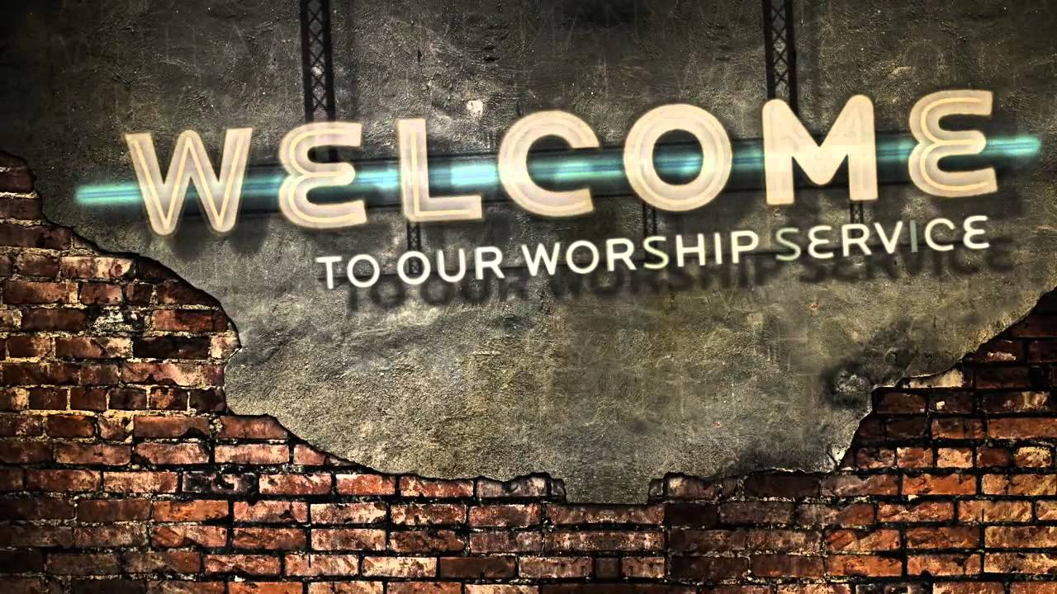
The Berean Challenge Fellowship Hour Order of Service Scripture Reading Announcements Worship and Praise Giving Community Prayer Special Music The Preached Word Invitation Song of Celebration Benediction
The Berean Virtual Lifeguard – (210) 381-4600

Slide 4
The Berean Challenge Fellowship Hour Scripture Reading
The Berean Virtual Lifeguard – (210) 381-4600

Slide 5
The Berean Challenge Fellowship Hour
The Issues We Are Facing
Community Spread
Social Distancing
Daily Fellowship/Prayer Check-In Hour 12:15
Long Run Approach
Zoom Orientation
We Are Working On
The Berean Challenge Fellowship Hour – Sundays 11:00
The Berean Challenge Disciple Hour – Sundays 9:30
The Berean Challenge Teaching Hour – Wednesdays 6:00
The Berean YEA Challenge Hour – Wednesdays 6:00
Online Giving
Givelify
Cash App
Square
Mailing Envelopes
Direct Deposit
Technology Setup Assistance
Let's Reach Out to all Bereans
Send Link to Family and Friends
www.Bereansa.com
Live Stream on Facebook
The Berean Virtual Lifeguard – (210) 381-4600

Slide 6
The Berean Challenge Fellowship Hour Song of Praise Brother John Kearney
The Berean Virtual Lifeguard – (210) 381-4600

Slide 7
The Berean Challenge Fellowship Hour
Mike and Charlotte
Chad and Jessica
Tony
Use the Chat Box
To record your praise!
The Berean Virtual Lifeguard – (210) 381-4600

Slide 8
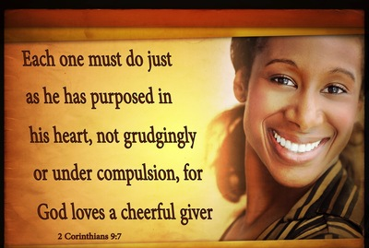
The Berean Challenge Fellowship Hour Giving Time Dr. Smith Givelify Cash App Direct Deposit Envelope Request Dr. Willie Jenkins
The Berean Virtual Lifeguard – (210) 381-4600

Slide 9
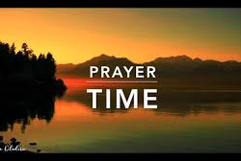
The Berean Challenge Fellowship Hour Community Prayer Time Use the Chat Box to Request Prayer Dr. Randolph Smith
The Berean Virtual Lifeguard – (210) 381-4600

Slide 10
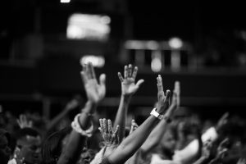
The Berean Challenge Fellowship Hour Preparation for the Word
The Berean Virtual Lifeguard – (210) 381-4600

Slide 11
The Berean Challenge Fellowship Hour Song of Preparation Deacon Edmund Tyrance
The Berean Virtual Lifeguard – (210) 381-4600

Slide 12
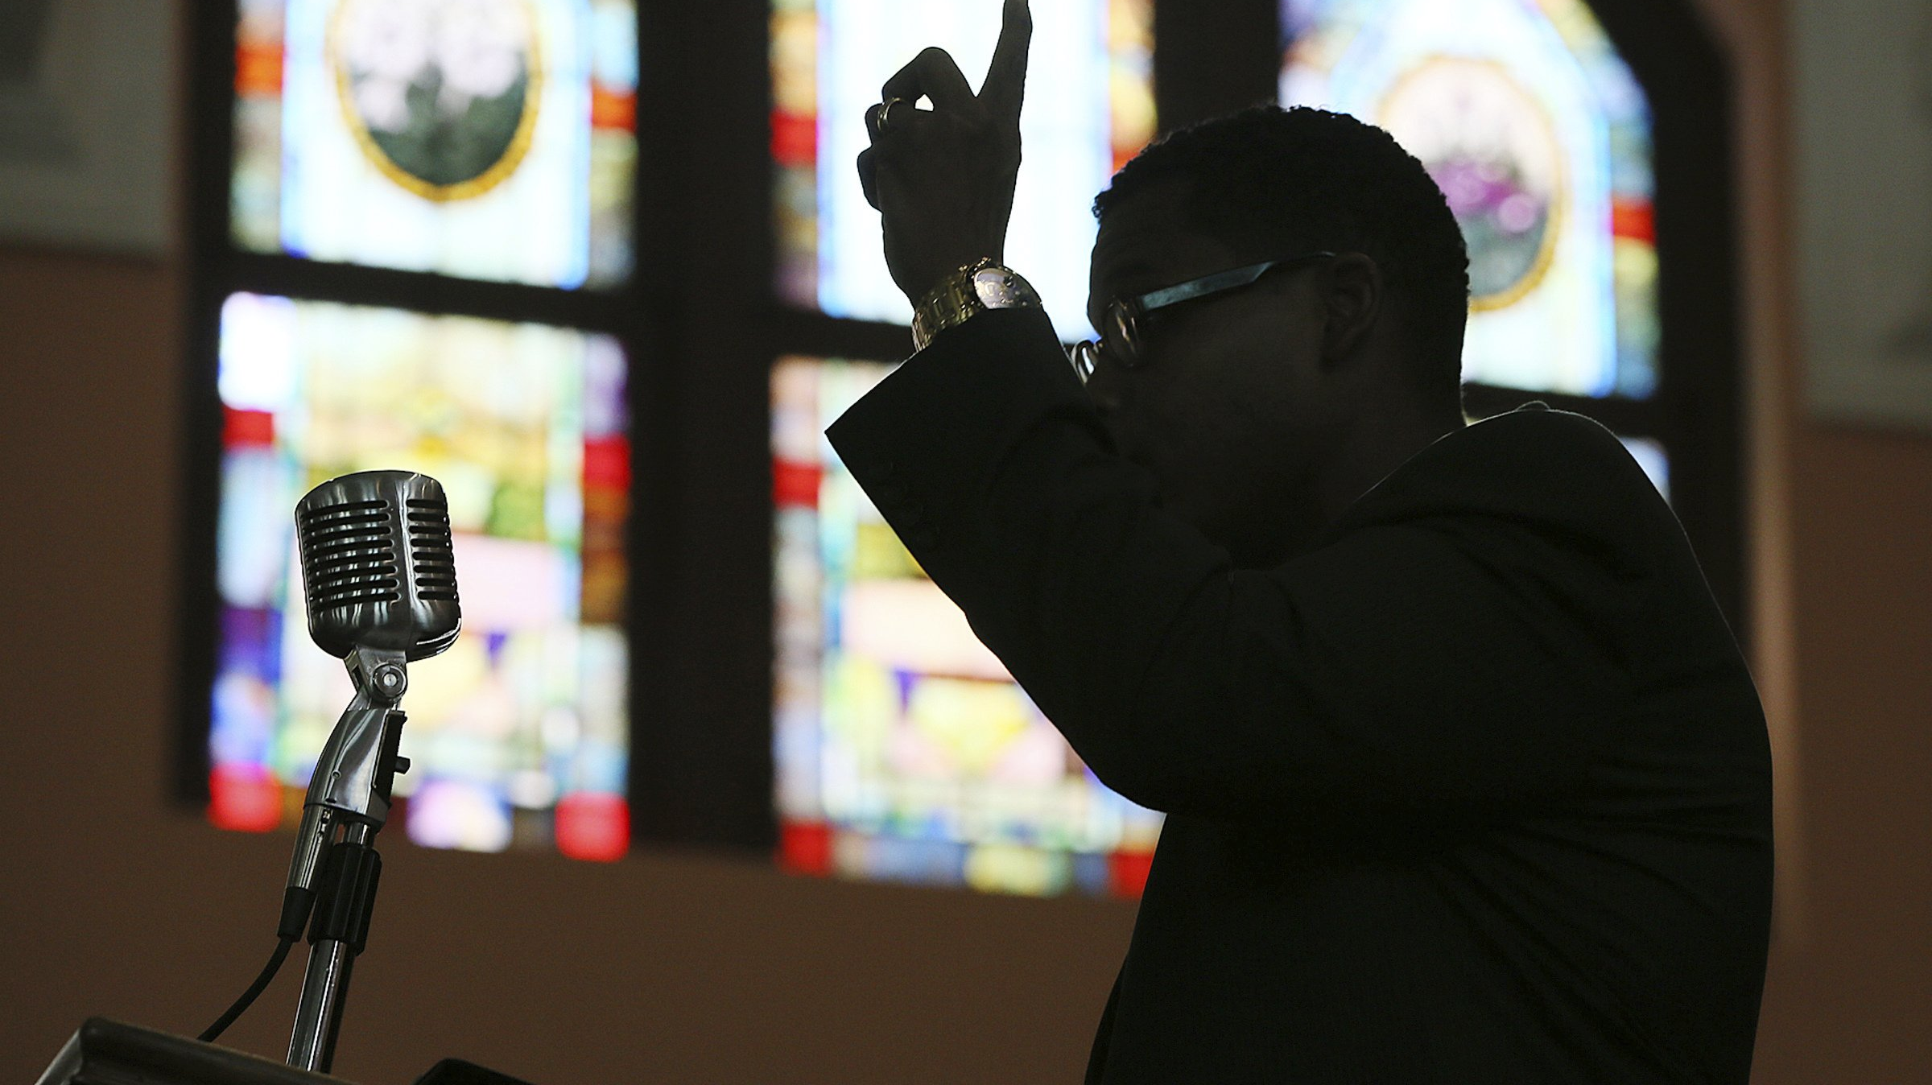
The Berean Challenge Fellowship Hour The Berean Challenge Message
Dr. George Chocolate
The Berean Virtual Lifeguard – (210) 381-4600

Slide 13
Welcome
to the
Berean Challenge Hour …
Sermon Today:
“There Is Power in the Blood of Jesus”
1 Peter 1:18-21
Dr. George Chocolate
The Berean Virtual Lifeguard – (210) 381-4600

Slide 14
The Berean Challenge Fellowship Hour “What Really Happens When We Die?” Dr. G. C. Patterson
Go to www.bereansa.com
Starting Next Sunday 11:00
The Death Experience…
The Journey of the Resurrected Body…
The “Thy Kingdom Come” Reality…
The Eternal State in Glory/Heaven…
The Mercy & Grace of God Throughout…
The Series
The Berean Virtual Lifeguard – (210) 381-4600

Slide 15
The Berean Challenge Fellowship Hour Service Benediction
The Berean Virtual Lifeguard – (210) 381-4600

Slide 16
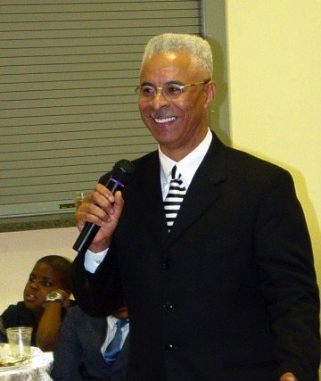
The Berean Challenge Fellowship Hour The Berean Challenge Message

