Slide 1
Skimmer Strategy
Efforts in Protection and Prevention
Rick Kimsey
Assistant Director, Division of Consumer Services

Slide 2
Skimming
Illegal interception of personal data, often credit card information, that is intended to be used for illegal purposes (e.g., purchases on your behalf without your knowledge).
Skimming can take place anytime and anywhere a credit or debit card is used, including at ATMs, hotels, retail establishments, restaurants, gas pumps, etc.

Slide 3
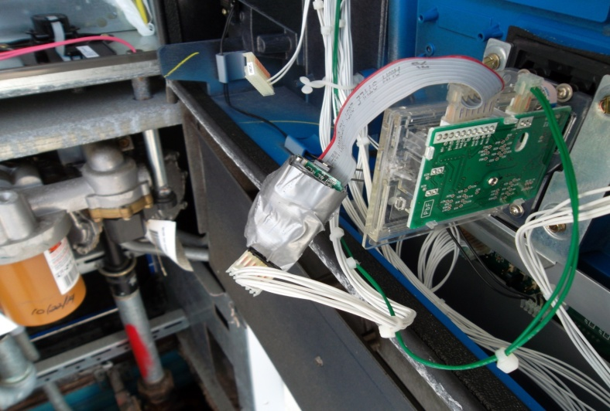
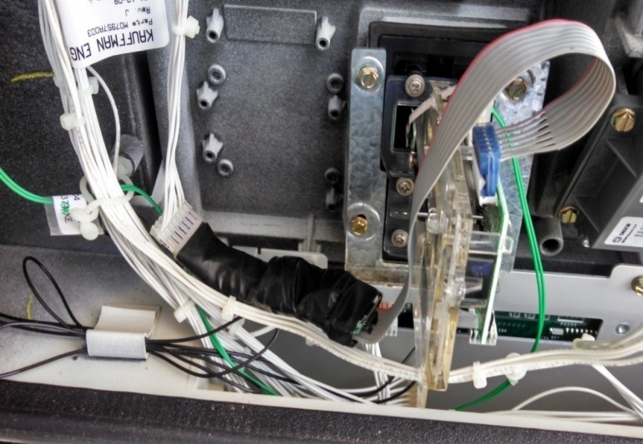
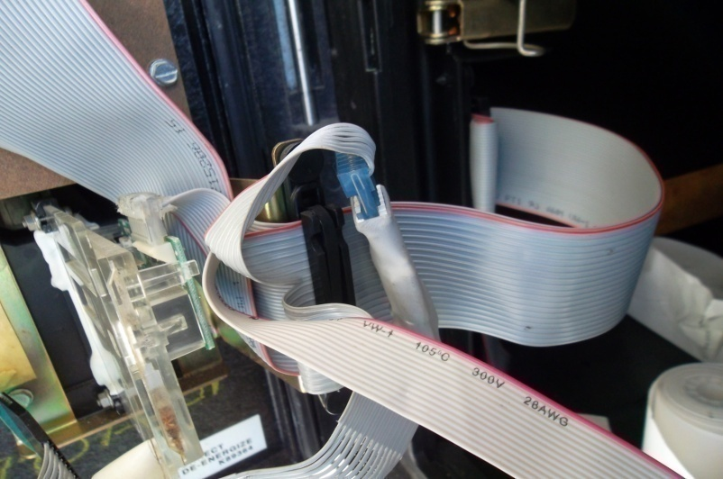
Skimmer Examples

Slide 4
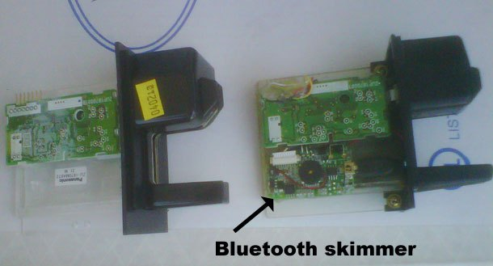
Card Reader Skimmers

Slide 5
Florida
Florida is the third largest fuel consumer in the country, behind only Texas and California.
Florida consumes over 10 Billion gallons of motor fuel annually.
Motor fuel is sold at more than 8,000 gas stations across the state.
There are roughly between 60,000 and 65,000 credit card readers in gas pumps statewide.

Slide 6
FDACS
The Bureau of Standards has regulatory authority over the operation of petroleum dispensers.
Approximately 68 field inspectors about 50 dedicated to petroleum.
That equates to approximately 1,300 credit card readers per inspector.

Slide 7
Current Situation
During calendar year 2015 division inspectors began locating credit card skimming devices throughout the state.
The number began to quickly increase.
In-line, card reader and GSM based skimmers are being located.

Slide 8
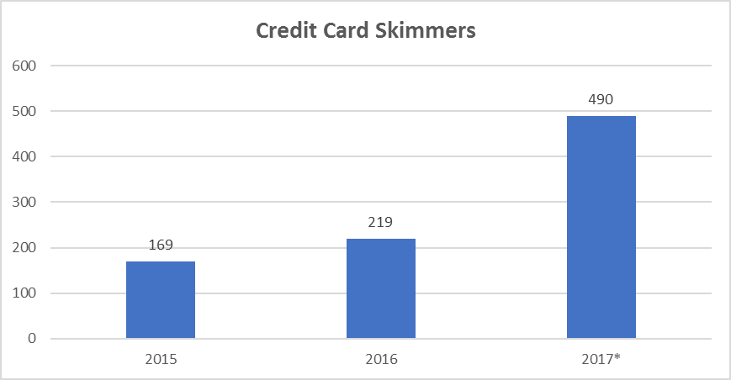
Current Situation

Slide 9
Current Situation
According to the National Crime Victimization Survey (NCVS) it is estimated that each victim of account takeover fraud experiences approximately $1,103 in direct and indirect losses.
Industry estimates suggest that there are roughly 100 card numbers on each skimmer found, but this number can vary widely depending on the time and consumer activity at the given location.
Therefore, a rough estimate of the direct and indirect economic loss to the public is $110,300 per skimmer.

Slide 10
Current Situation
25% increase in 2015
120% increase in 2016 (to date)
Potential Impact to Consumers
$54,000,000 in 2017

Slide 11
Current Situation
Commissioner Putnam championed legislation this past year to help combat illegal skimming activities at gas pumps.
User Requirements effective October 2016, Section 525.07(10), F.S.
Increased Penalties effective July 2016, Section 817.625, F.S.:

Slide 12
User Requirements
Pressure-sensitive security tape placed over the panel opening that leads to the scanning device for the retail petroleum fuel measuring device in a manner that will restrict or give evidence to the unauthorized opening of the panel.
Electronic prevention in the form of a device or system that will render the retail petroleum fuel measuring device or the scanning device in the measuring device inoperable if there is an unauthorized opening of the panel.
Encryption in the form of a device or system that encrypts the customer payment card information in the scanning device so it cannot be skimmed or filtered.
Other security measures are permissible so long as they are approved by the department.

Slide 13
Increased Penalties
Changes requirements to include “possession” of counterfeit cards; not just trafficking them.
Reduce the threshold for minimum number of counterfeit cards involved.
Increase the subsequent penalty from a third degree to second degree felony.

Slide 14
Impact
120% Increase in skimmers located
More than 85% of skimmers located since October have been behind compliant security measures!

Slide 15
Threats
Lack of Information and Coordination
Consumers
Law Enforcement
Prosecutors
Chip and Pin
Businesses
Weakest link in the chain.
Unwanted effects after devices are located.
No financial interest.

Slide 16
Next Moves
A change in the approach from detection to prevention is needed.
Increased Focus
Increased Enforcement
Partnership
Legislation

Slide 17
Increased Focus
Skimmer inspections have become an integral part of our program.
Reduced other functions to free up time to focus on skimmer inspections.
Intensive training for inspectors to systematically check devices.
Partner with local law enforcement in periodic skimmer sweeps.
Use skimmer location data to schedule predictive sweeps.
Statutory changes 2018

Slide 18
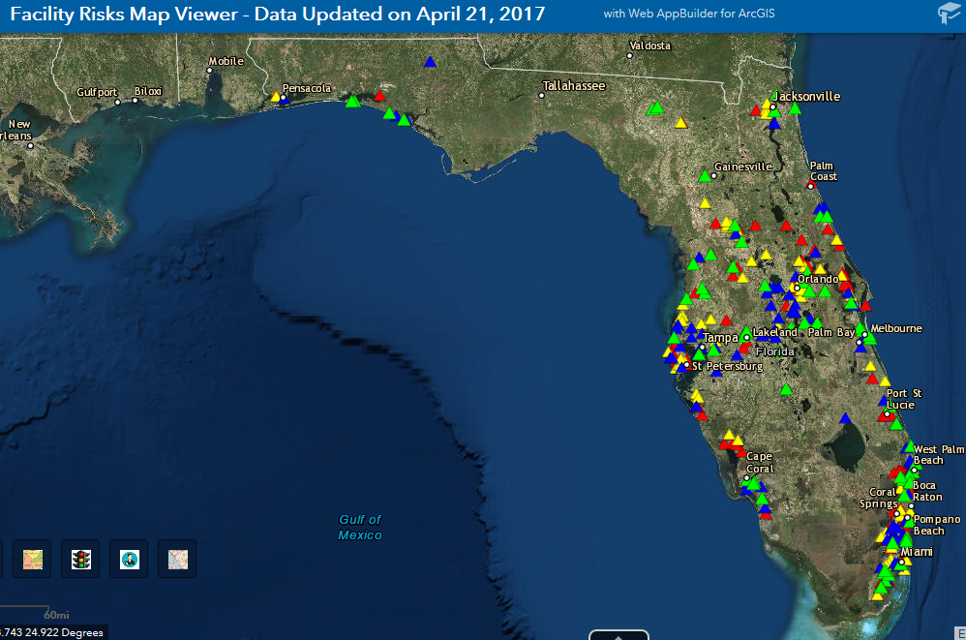
Data Use

Slide 19
Increased Enforcement
Increased awareness and investigative training for local agencies.
Coordination of state-wide cases between agencies.
Intelligence sharing.
New tools and procedures.
Proper preparation for prosecution.

Slide 20
Partnerships
NCWM
Adopt new security requirements
Greater state interest
Consumers
Central POC
Education
Credit Card Companies
Real-time lead information
Coordinated Focus

Slide 21
Partnerships
Business
Detection training
Reporting
Best Practices
Industry certification
Prosecution
Training
Dedicated unit
Benefits

Slide 22
Questions
Rick Kimsey
850-921-1556
richard.kimsey@freshfromflorida.com

