Slide 1
Chemistry Coursework title 2017 Investigate quantitatively, at room temperature, the effect of dilution on the pH of (i) vinegar, (ii) a solution containing 5 g washing soda per litre of water, (iii) a solution containing 5 g sucrose per litre of water.

Slide 2
Part 1 (Introduction)
(i) Statement or problem to be investigated What
you are going to do in your own words
(ii) Background research undertaken You
will have to look up a few websites and books to
find information for your investigation. You may even have to ask your teacher or someone at
home for information. This is your background research you will need to give at least 2 pieces .Refer to questions sheet
Internet
(Give full link!)
Books
(Author and Publisher
Page and Details)

Slide 3
The pH scale (General) The pH scale indicates the acidity or alkalinity of solutions. Acids have a pH of less than 7. Alkalis have a pH of more than 7. Pure water and neutral solutions have a pH equal to 7

Slide 4
The ions present in acid and alkali solutions (General/Credit)
(General)
An acid solution is one which contains hydrogen ions H⁺(aq).
An alkaline solution is one which contains hydroxide ions OH⁻(aq).
The concentration of ions in pure water is small.
(Credit)
In water and in neutral solutions the concentration of H⁺(aq) and OH⁻(aq) is the same. This is why water is neutral.
An acidic solution contains more H⁺(aq) ions than does pure water.
An alkaline solution contains more OH⁻(aq) ions than does pure water

Slide 5
What happens when an acid and an alkali are diluted
Diluting an acid by adding more water increases the pH of the solution towards 7 making it less acidic. (decreases the concentration of H ⁺(aq) ions)
Diluting an alkali by adding more water decreases the pH of the solution towards 7 making it less alkaline.(decreases the concentration of OH ⁻(aq) ions)
Vinegar (CH₃COOH). is also known as Ethanoic acid or acetic acid Vinegar is made from the fermentation of ethanol (grain alcohol) by bacteria .
The chemical name for washing soda is sodium carbonate (Na₂CO₃) has a pH of 11.6. It is used to soften water.
The molecule is a disaccharide combination of the monosaccharides glucose and fructose with the formulaC₁₂H₂₂O₁₁.
Sucrose does not ionise in water so would not be expected to affect the concentration of h+ ions or OH- ions in water.

Slide 6
Part 2 (Preparation and Planning) (5 needed)
(i) Variables1. The Independent Variable (what I will change - 1 thing)*
The concentration of the solutions Ie making the solution more dilute/more concentrated
2. The Dependent Variable (what I will measure - 1 thing)*
PH of Chemicals/reagents/solutions
3. The controlled Variable (what i will keep the same - as many as you can!)
Eg : Use Same ph meter/ph probe each time
Same room temperature
Same dilutions for all reagents tested
Same bottle od deionized water to make up solutions

Slide 7
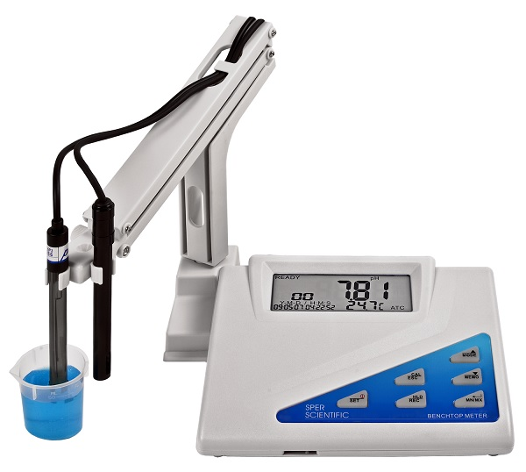
Equipment: Be sure to list every piece of equipment you use, leave nothing out!

Slide 8
Tasks:
This is the list of jobs that need to be done in order. (Like a to-do list)
Use bullet points 4 points needed
Eg :
Make solutions of washing soda, sucrose, vinegar
Record and analyse results
etc

Slide 9
Part 3 (Procedures, apparatus etc.)
(i) Safety - don't just say I wore safety glasses, say why!
For example…
I wore safety glasses (You need at least two safety precautions)
Handle pH probe carefully and store in buffer solution when not in use.
Take care when handling glassware not to drop and break it.
Clean any spillages immediately to prevent any accidents.

Slide 10
(ii + iii) Procedure with diagram
The best advice I can give is to write it like a recipe. if a person cannot copy the experiment using what you have written it’s no good and you need to do it again .
Number your steps.
Label all parts in your diagram

Slide 11
Sample procedure:
1. Gather all apparatus and chemicals.
2.Label graduated cylinders and vials 1-5
3.Attach the pH probe to the data logger and turn on.
4.Find the pH of deionized water.
5.Find the pH of the vinegar.
6.Add 1 ml of vinegar to 100ml graduated cylinder and add deionized water to 100mls. This is graduated cylinder 1.
7.Take 1 ml of solution from cylinder 1 and add to cylinder 2 and bring up to 100mls with deionized water.
8.Repeat serial dilutions until all cylinders contain the correct dilutions.

Slide 12
Sample procedure continued:
9: Measure the pH of each solution of vinegar with pH probe/universal indicator paper rinsing probe after each measurement.
10:Repeat steps 5-9 with sucrose and washing soda consecutively, ensuring all containers and equipment have been thoroughly rinsed.
11: Record room temperature
12: Record results in a table and draw graphs.
13:Analyse results.

Slide 13
(iv) Data and observations
Decide what results you are going to take and when you are going to take them before the experiment. Make up a data table before you start your experiment so you can record your measurements as soon as you observe them. This will ensure that you are consistent in the way that you record your results and it will also make it easier to analyse.
Measurements should be clearly laid out in graph and/or table form.
If your experiment involves any colour changes this is where you mention it.
Was there anything else you noticed when doing the experiment whatever it is, no matter how small, include it.
Other observations to note include · Did you encounter any problems with the experimental method? · Did you notice any interesting patterns happening?

Slide 14
(i) Calculations and Data Analysis –
Make sure you outline any calculations or formulae that you used.
Eg : formula for calculating resistance
How did you find average values?
Did you round off any numbers ?
Some useful sentence starters in this section are: · I can see from my results that ………………………….. · When I changed ………………….., ………………….. changed by………………….. · From the graph I can see that …………………………………………….

Slide 15
Sample Table of results.pH of substances at different concentrations
Substance | pH value T3 (Include concentration here) | pH value T2 | pH value T4 | pH value T 5
vinegar
sucrose
Washing soda

Slide 16
calculations
You could include a table that shows the overall change in pH value for each substance and draw a graph of this (bar chart ,line plot etc.)
You could calculate the pH change as % increase or decrease in pH.

Slide 17
Sample curve

Slide 18
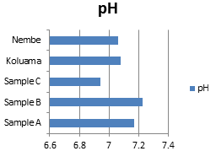
Sample bar chart

Slide 19
(ii) Conclusion and Evaluation of results. Answer some of the following questions in your written report.
Do your results answer the question you were asking at the start?
When you changed the concentration of solutions did it affect the PH of substances?
Were the results what you were expecting?
Is there a trend in your results? did anything unusual happen?
Can you explain it if so ?
If you drew a graph did you get a straight line or a curve – what does this show?

Slide 20
In general as the vinegar became more dilute the ph increased
In general as the washing soda became more dilute the ph decreased
In general as the sucrose became more dilute the ph remained more or less the same
Can you explain WHY ?
(LOOK BACK TO BACKGROUND RESEARCH)
DID YOU USE UNIVERSAL INDICATOR PAPER ? WERE THE RESULTS AS ACCURATE?
ANY SURPRISING RESULTS FOR EXAMPLE SUCROSE DIDN’T HAVE A PH OF 7 ( BECAUSE THE PH OF DEIONISED WATER WAS NOT 7)

Slide 21
Part 5 (comments) (i) Refinements, extensions and sources of error
Were you surprised by these results?
Was there anything that might have affected your results? Eg: PH METER READINGS FLUCTUATED, GRADUATED CYLINDERS WERE ONLY DRY FOR FIRST SOLURTIONS,DATA LOGGER BATTERIES RAN LOW,UNIVERSAL INDICATOR PAPER –NO SIGNIFICANT COLOUR CHANGES ETC.
Are there any changes you would make if you could do the experiment again? Is there any way of making it more accurate?
Does your investigation have any real life applications?
Could you develop your experiment further, how?

