Slide 1
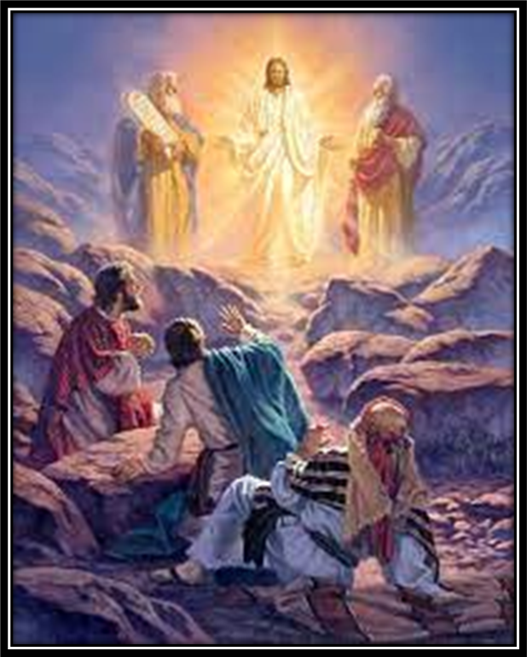
Trinity Evangelical Lutheran Church
Announcements
February 19, 2023
The Transfiguration of Jesus
Matthew 16:24-17:9

Slide 2

Body, Mind, Spirit
Mind: Play solitary card game
Body: Complete your Health Care Power of Attorney
Spirit: Volunteer at Church

Slide 3


Our Office Secretary Is Sharon Fourman
Church Office Schedule
This week only…
Mon, Wed, & Thurs
  8:00 am – 12:00 noon
Church Office: 937 692-5670
Email: secretary@pitsburgtlc.org

Slide 4


The Trinity Trumpet
A Monthly Newsletter
Published by Trinity Lutheran Church,
Pitsburg, OH
We’re looking for stories and pictures of Trinity people in action!
Submit to Secretary, Sharon Fourman at secretary@pitsburgtlc.org
Articles and Info due on or about the 15th of each month

Slide 5

We’re Online!
www.pitsburgtlc.org
Sermons and announcements are posted weekly
Trinity Trumpet is Posted here too!
The ‘Official’ Trinity Calendar is available for you to see!
Pictures, Videos and more!
Also, like us on FaceBook at
facebook.com/pitsburgtrinitylutheran.church

Slide 6
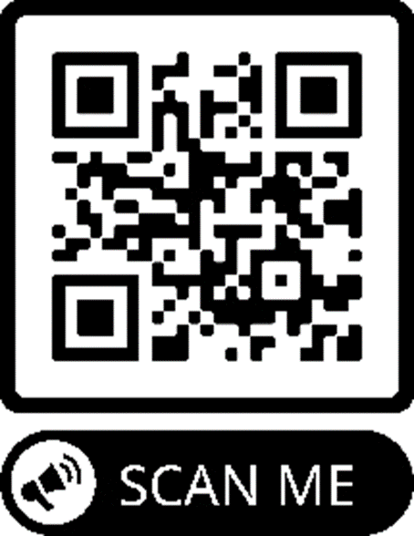
We’re Online!
www.pitsburgtlc.org
We now have our own QR Code!
Scan this code with your Smartphone and you will connect to all our Online media (Facebook, YouTube, and our own Church Website)

Slide 7
Online Giving
www.pitsburgtlc.org
Click the “Give to Trinity” Button
Stay current in your giving even when you can’t make it to Worship!
Separate Giving Categories for:
    General Treasury
    Benevolence/Mission Support
    Building Fund
    Annual Christmas Auction
    Donald K. Lucas Memorial Fund
    Thrive Capital Campaign

Slide 8


Church
Council
Trinity Church Council
Next Meeting:
March 15, 2023
@ 7:00 pm

Slide 9


Trinity’s Team Meetings
Next Meeting
TBD
@ 6:00 pm
On the Agenda – Preparing the proposed 2023 budget

Slide 10
Please Pass the Pew Pads
(We now track Communion on the Pads)

Slide 11

Worship Team
Next Meeting:
  TBD

Slide 12

Mutual Ministry Team
  Julie Kossler
  VACANT
  Peggy Didier
  Please see one of them with your comments and suggestions
  Next Meeting - TBD

Slide 13
To: All Kids
If you see any of the following:
Another student struggling to make friends
Another student being bullied
A student who is shy or not with the “in” crowd
A student who eats lunch by themselves
Please be a leader!
Say Hi. Smile at them.
Ask if you can sit with them at their lunch table.
              Include them in ANY activity.
              You never know what that person might be facing inside or outside of school.
              Your kindness will make a HUGE difference in someone’s life!
Trinity4Kindness

Slide 14


Christian Education
Sunday School Teachers and Helpers Needed!!!
New, easy to use curriculum
Can you give one Sunday per month for our Children?

Slide 15

Trinity Trumpet
    Your Trinity Trumpet Newsletter for February is available!
    Please take your copy before you leave today!

Slide 16
Trinity Trumpet
    Newsletter Deadline is Tuesday, February 21st
    Please turn in all your newsworthy items to Sharon Fourman at:
    secretary@pitsburgtlc.org

Slide 17


Choice FISH Pantry
Please join us every Friday @ 3:30 pm
400 Markwith Dr, Greenville OH
Most Needed Items
Kidney Beans
Canned Peas
Hamburger Helper
Pork & Beans
Canned Mixed Veggies
Large Cans of Soups
Applesauce
Boxed Meals
(i.e. Rice a Roni)

Slide 18

Next Meeting:
March 1, 2023
@ 11:30 am
Please note the time!!!

Slide 19
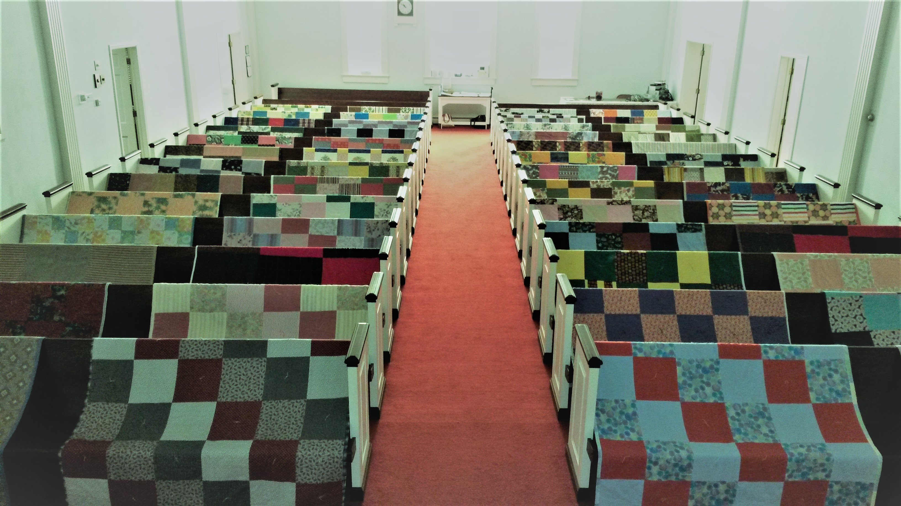
Prayers and Squares
Quilting Ministry
February 28 @ 10:00 am
March 9 @ 10:00 am

Slide 20


Ladies and Gents Luncheon
Date: March 16, 2023
Where: TBD???
For Reservations:
        See Linda Baker or call her at (937) 547-0975

Slide 21

Confirmation Program
    All 7th and 8th Grade Students
    Confirmands are to attend Ash Wednesday Worship on February 22, at 7:00 pm
    Next Class: February 8, 2023

Slide 22
Confirmation Program
    Weekly Worship attendance is required (In person or via FaceBook)
    Worship Notes may be emailed to pastor@pitsburgtlc.org or placed in Pr Mel’s mailbox outside the Church Office
    Confirmands are encouraged to take turns as Acolyte

Slide 23

    Who can be an Acolyte? YOU CAN!!!
    Please sign up for Acolyte Duty on the chart by the Church Office!
    Confirmation Students are Highly Encouraged to perform Acolyte duty…
    Please sign up today!

Slide 24
New Member Class
We are forming a “New Member” Class for anyone who wants to learn more about Being Lutheran and what Being a member of Trinity entails
    Classes will begin January 8th
    Classes start at 12:00 Noon or as soon after Worship as possible
    Please see Pastor Mel if Interested in attending

Slide 25

    Commemorate special days like Anniversaries, Birthdays, Baptisms and more…
    Please sign up for Altar Flowers on the chart by the Church Office or see PJ Musser

Slide 26
Trinity’s Team Meetings
Christian Education Team
Next Meeting
September 14th @ 6:00 pm
Purpose -- plan for Fall Festival
Please come if you can!

Slide 27

Blood Pressure Screening
BP Screening
2nd & 4th Sundays
After Worship In The Nursery
Notes:
Cover: Sermon on the Mount by Laura James. Copyright © Laura James. All rights reserved. Used by permission of the artist.

Slide 28


Holy Communion – Today!
Communion Today is “By Station”
Safe for all humans (Especially sinners)
Holy Communion Schedule
    First and Third Sundays each month
    All White and Red Sundays of the Church Year

Slide 29

Calling all Adults!
Join Us For “Christian Conversations”
Not Your Ordinary Adult Sunday School
Sharing – Discussion - Prayer
Free Donuts, Juice, and Coffee
Every Sunday @
9:30 am
Notes:
Cover: Sermon on the Mount by Laura James. Copyright © Laura James. All rights reserved. Used by permission of the artist.

Slide 30

The Lutheran Course
Intended for “New Members”
Also for Those who want a “Refresher Course”
Light-hearted
Learn what it means to be a “Lutheran”
Continues Today!
After Worship!
Notes:
Cover: Sermon on the Mount by Laura James. Copyright © Laura James. All rights reserved. Used by permission of the artist.

Slide 31
Lenten Season Begins With Ash Wednesday
February 22, 2023
At 7:00 pm

Slide 32
Greater Greenville Lenten Worship Services
Every Wednesday during Lent @ 12:00 noon
St John Lutheran Church Greenville OH
Lunch Served after Worship

