Slide 1
Making changes; a Care Plan
www.davidstuart.org/care-plan-fi

Slide 2
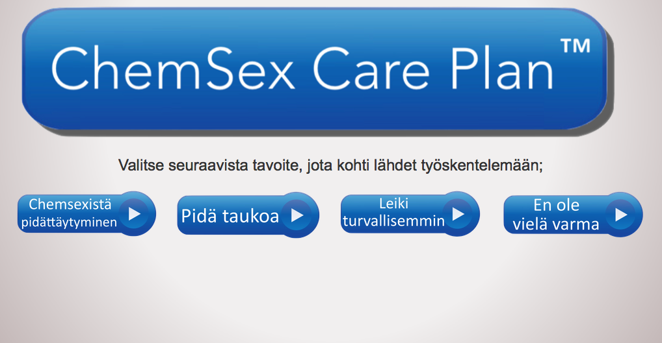
Choose a goal

Slide 3
Support with abstinence
Staying stopped
Anticipating triggers
1 day at a time
Support networks
Managing cravings
Relapse prevention
Smart Recovery
Twelve Step programmes

Slide 4
Choose a goal

Slide 5
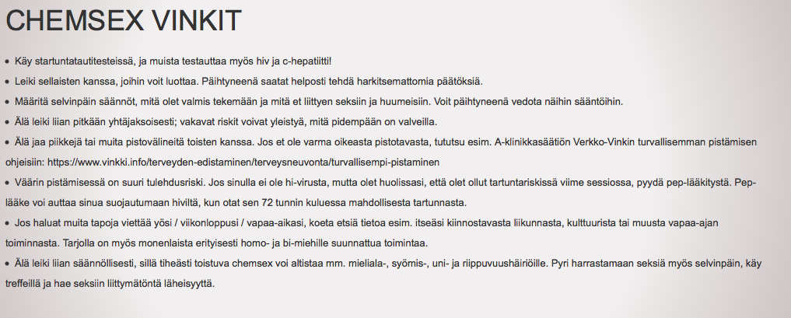
Play more safely
Crystal meth
Safer injecting
Safer ChemSex
Mephedrone
Safer sex
GHB/GBL
Safer App use
Sexual wellbeing
The law

Slide 6
Choose a goal

Slide 7
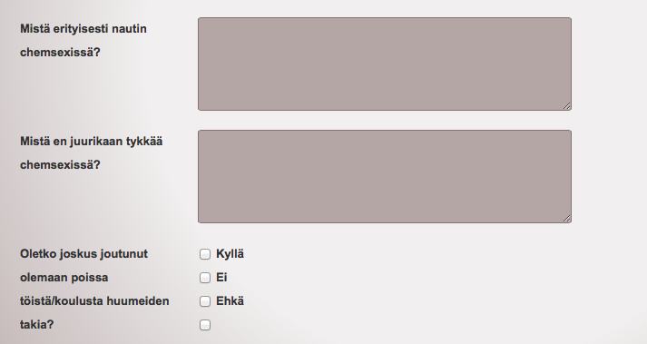
Reflecting on drug use/behaviour

Slide 8
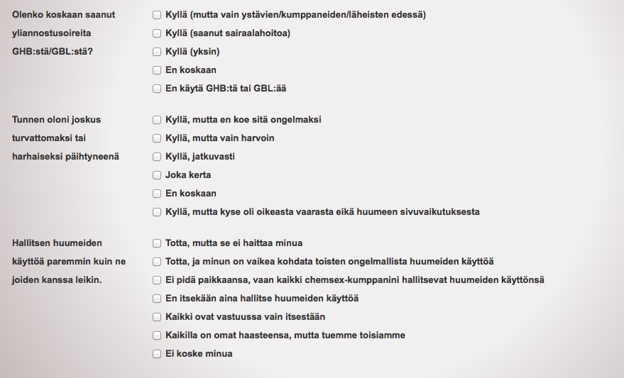
Reflecting on drug use/behaviour

Slide 9
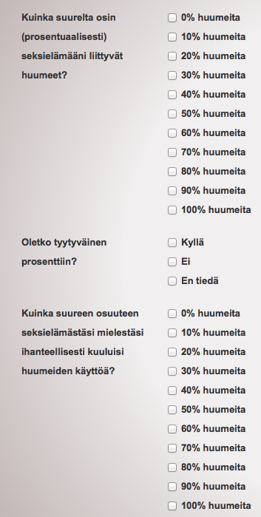
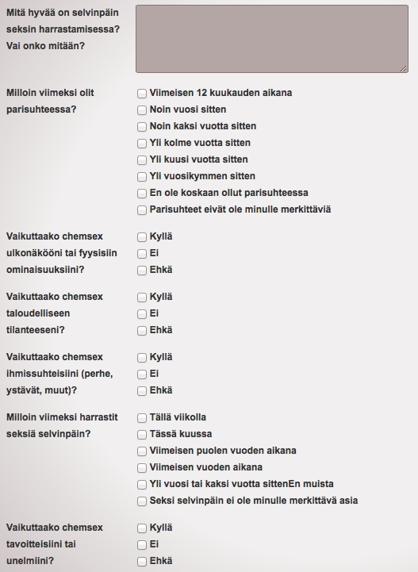

Slide 10
Reflecting on drug use/behaviour

Slide 11
Choose a goal

Slide 12
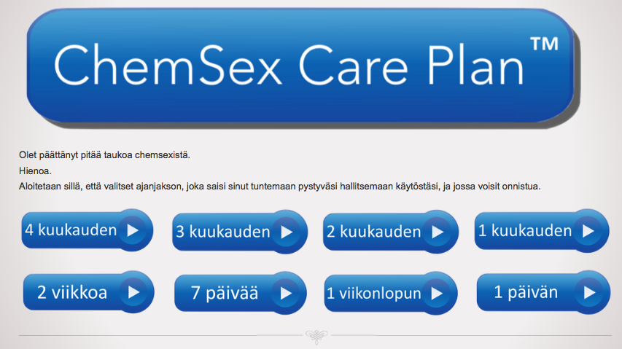
Take a break/identify a goal

Slide 13
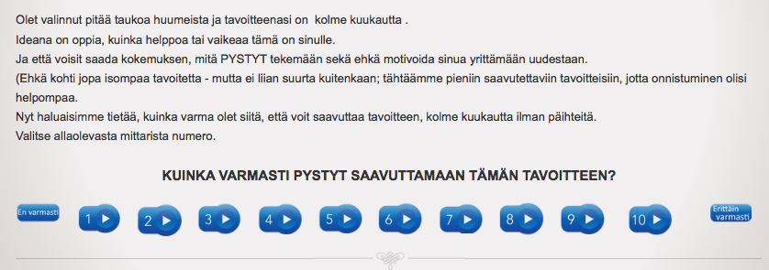
Rate your own confidence
-decisional balance

Slide 14
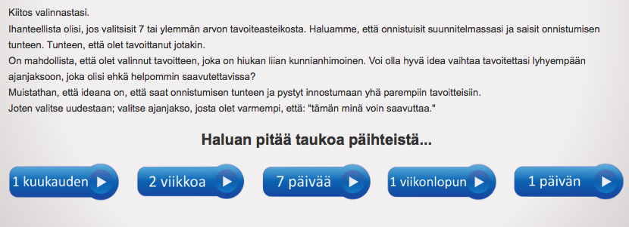
Not very confident?
Choose a more achievable goal

Slide 15
Now rate confidence level again

Slide 16
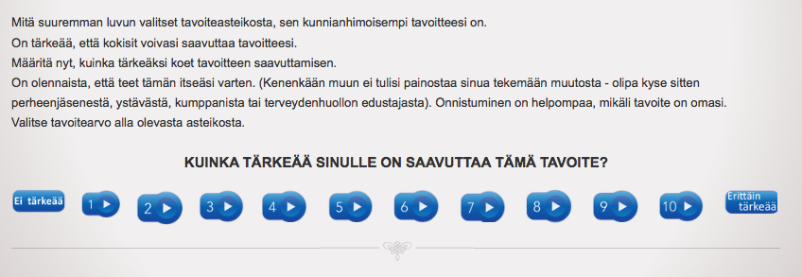
How important is it to you?

Slide 17
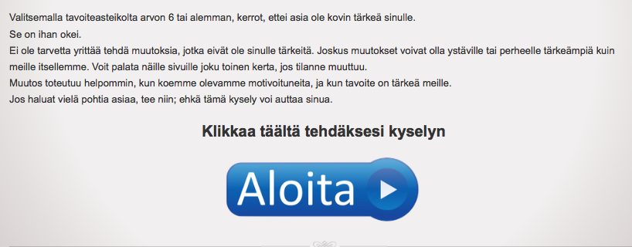
Not very important?
Come back another time

Slide 18
Rate how important it is to you
(-decisional balance)
But perhaps it IS important......

Slide 19
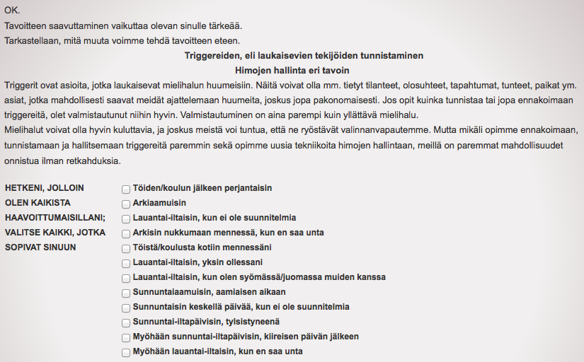
Identify your most vulnerable times

Slide 20
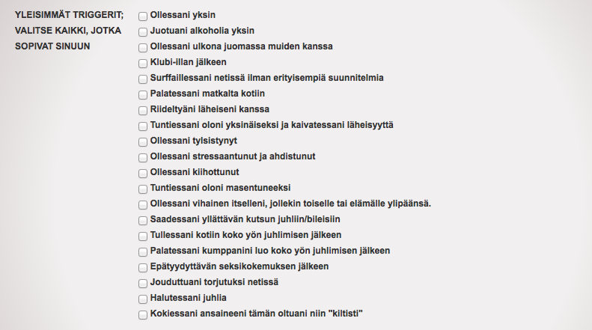
Identifying triggers

Slide 21
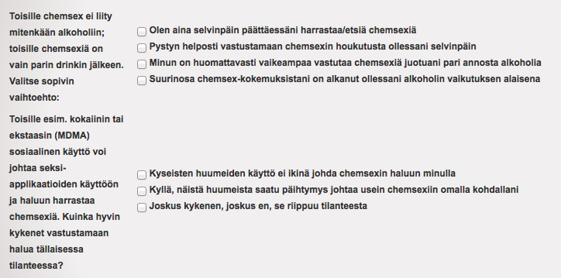
OTHER TRIGGERS;
ALCOHOL? NON-CHEMSEX DRUGS?

Slide 22
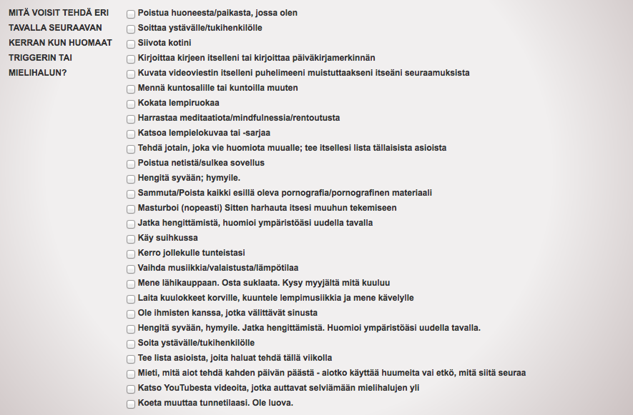
Managing cravings differently

Slide 23
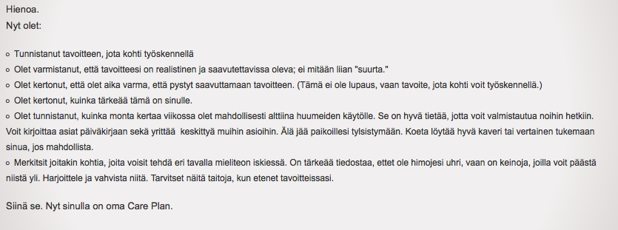
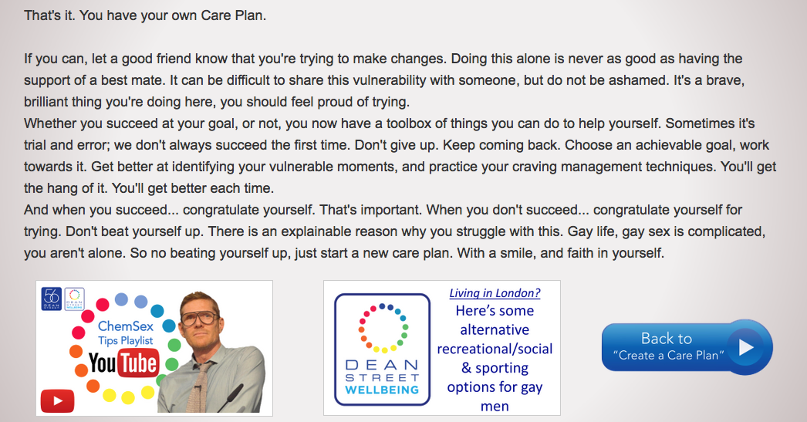
DONE! Online Care Plan created

Slide 24
FOR CHEM USERS
www.DavidStuart.org/care-plan-fi
@davidastuart
DS17

Slide 25
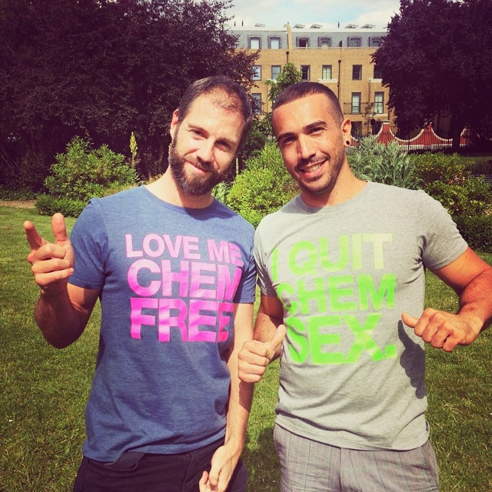
FOR PROFESSIONALS
www.davidstuart.org/professionals
@davidastuart
DS16

