Slide 1
Faith, Science, and the Genesis Creation

Slide 2
Christians and Natural Theology as a discipline:
Originated in 16th century Europe/17th century England (Puritans were notables in movement)
Gained prominence at the turn of the 19th century
Concerns knowing God through contemplation of the natural world
Companion to revealed theology, which concerns knowing God through scripture.
Book of scripture and the book of nature – the two books
Notes:
Christians lead the charge in the study of nature, though using highly allegorical interpretations through much of Europe’s history. However, through abandoning Aristotelian philosophy during the scientific revolution (16th century), Christians began looking at nature empirically, which mirrored the emerging exegetical method that was to define the protestant reformation. So, in reality science today owes its origins directly to Christians dating back 4 centuries.
Arguably the most profound concept to come out of 19th century Christianity’s interaction with science was the ‘Two Books’ view of nature and the Bible →

Slide 3
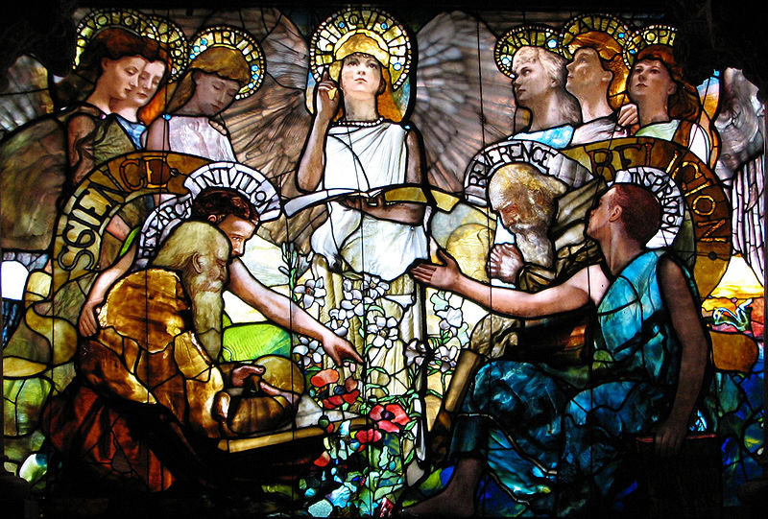
19th Century Christian Commentary on the ‘Two Books’
The center third of “Education” (1890) by Louis Tiffany located in Linsly-Chittenden Hall at Yale.
Notes:
This decorative window pane depicts Science (personified by Devotion, Labor, Truth, Research and Intuition) and Religion (personified by Purity, Faith, Hope, Reverence and Inspiration) in harmony, presided over by the central personification of "Light·Love·Life".
Reference
Education (Chittenden Memorial Window). (2011, March 1). In Wikipedia, The Free Encyclopedia. Retrieved 23:33, March 17, 2011, from http://en.wikipedia.org/w/index.php?title=Education_(Chittenden_Memorial_Window)&oldid=416570116.

Slide 4
The Two Books
Definition
The study of the Bible and nature with the presupposition that both – since by God’s direct work – harmonize, and any disharmony is the result of man’s misinterpretation of either, or both.
Notes:
It is important that we start with this presupposition. If we firmly believe the Bible and that all of nature is by God’s direct handiwork, then science (which is the study of nature on an empirical level) stops being the boogie man. Remember the quote I started this series of classes with?
“Let science dig, and dredge, and work her laboratories. She is searching for God’s truth. If her teachers are atheistic, accept still the truth that is well established; but to the atheism give no quarter, for it is to Man the annihilation of hope and of all the higher joys of his being.”
As well see as we progress through this class, the consensus of 19th century theologians, Christian scientists, those within our early community, and historians of science today is that it is the misinterpretation of either (or both) of God’s Two Books that leads to problems.

Slide 5
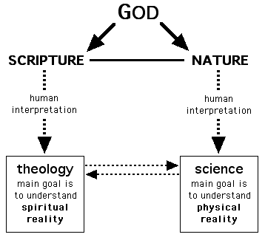
Courtesy of The American Scientific Affiliation
Notes:
Note the origin is God… again, this is something that needs to be soundly established in our minds. Secondly, as just stated, each of God’s works (the Bible and nature) are subject to the fallibility of human interpretation. Finally, the “goals” of each of God’s works is limited in scope: Scripture gives us the spiritual reality and science the physical. I’ll also throw in that Scripture teaches us of God’s purpose and nature (science) shows us His power (ref. Psalm 19).

Slide 6
The expression ‘book of nature’ used as early as the 5th century by Augustine in his argument against the Manichaean’s dualistic view of Creation:
“But had you begun with looking on the book of nature as the production of the Creator of all … you would not have been led into these impious follies and blasphemous fancies with which, in your ignorance of what evil really is, you heap all evils upon God.”
Contra Faustum Manichaeum, Book XXXIII, XX
Notes:
While the appeal by Christians to the natural world as evidence of God goes back to Christ himself, it was Augustine who first used the phrase “book of nature” and linked it to God’s direct work. It was often shortened to simply “book” whose author was God →
Reference
The Gnostic Archives (n.d.). The Gnostic Society Library. In Augustin: Reply to Faustus the Manichaean. (Book XXXIII, XX). Retrieved March 17, 2011, from http://www.gnosis.org/library/contf3.htm.

Slide 7
Hugh of St. Victor (12th Century):
“For the whole sensible world is like a kind of book written by the finger of God—that is, created by divine power—and each particular creature is somewhat like a figure, not invented by human decision, but instituted by the divine will to manifest the invisible things of God’s wisdom.”
De tribus diebus
Notes:
This book was “written by the finger of God”… obviously meant as a Biblical reference to God’s direct hand in creating, perhaps to be juxtaposed with the giving of the Law on Mt. Sinai (Ex 31:18). This would certainly fit the Two Books concept nicely.
Whatever Hugh’s reason, we see again the truth of nature: it is “created by divine power” and exists “to manifest the invisible things of God’s wisdom.” We, as Christians, need then not fear science since we believe it reveals God’s magnificent creation. That said, it is perfectly acceptable to answer with “I don’t know” when asked about scientific findings that we aren’t sure what to do with yet. We can, as Christadelphians, chalk it up to “uncertain details”.

Slide 8
Francis Bacon (17th Century):
"God has, in fact, written two books, not just one. Of course, we are all familiar with the first book he wrote, namely Scripture. But he has written a second book called creation.”
The following quote by Bacon can be found in early editions of Darwin’s Origin of Species:
"Let no man... maintain that a man can search too far, or be too well studied in the book of God's word, or the book of God's works.”
Notes:
Author of what became known as the Baconian method of empirical study, Francis Bacon is regarded as the first to formally challenge Aristole’s Organon with his own philosophy. Bacon’s philosophical method of study was the ancestor of today’s scientific method. He was respected enough by Darwin to be included in the early edition’s of Origin of Species, even though Bacon was a staunch advocate of divine intervention in the natural world.

Slide 9
Frances Bacon (17th Century):
“…our Saviour saith, YOU ERR, NOT KNOWING THE SCRIPTURES, NOR THE POWER OF GOD; laying before us two books or volumes to study, if we will be secured
from error; first, the Scriptures, revealing the Will of God; and then the creatures [natural creation] expressing His Power; whereof the latter is a key unto the former…opening our belief, in drawing us into a due meditation of the omnipotency of God, which is chiefly signed and engraven upon His works.”
The Advancement Of Learning, 1605
Notes:
More from Bacon.

Slide 10
Johannes Kepler (16th -17th Centuries):
“Since we astronomers are priests of the highest God in regard to the book of nature, it benefits us to be
thoughtful, not of the glory of our minds, but rather,
above all else, of the glory of God.”
Notes:
An astronomer and mathematician, Kepler is well-regarded as helping to establishing astronomy as a scientific discipline, and whose works influenced Issac Newton. Kepler was also a Christian.

Slide 11
‘Now if God did indeed write Books of both Words and
Works, it follows that they cannot conflict with each
other.
The problem for us is that they are written in different
languages and mixing the languages of ‘philosophy’
(science) and divinity is an excellent recipe for
confusion.
The Two Books notion can be regarded as an early
understanding of complementarity; it can also be
regarded as an expression of the unity of true
knowledge.’
RJ Berry, God's Book of Works: The Nature and Theology of Nature’, page 33 (2003)
Notes:
Complementarity - The concept that the underlying properties of entities (especially subatomic particles) may manifest themselves in contradictory forms at different times, depending on the conditions of observation; thus, any physical model of an entity exclusively in terms of one form or the other will be necessarily incomplete.
Reference
complementarity. (n.d.) The American Heritage® Science Dictionary. (2005). Retrieved April 2 2011 from http://www.thefreedictionary.com/complementarity

Slide 12
Psalm 19:
1 The heavens declare God's glory; the sky displays his handiwork.
2 Day after day it speaks out; night after night it reveals his greatness.
3 There is no actual speech or word, nor is its voice literally heard.
4 Yet its voice echoes throughout the earth; its words
carry to the distant horizon. In the sky he has pitched a tent for the sun.
Like a bridegroom it emerges from its chamber; like a strong man it enjoys running its course.
It emerges from the distant horizon, and goes from one end of the sky to the other; nothing can escape its heat.
Notes:
I mentioned Psalms 19 a few slides back. This Psalm is a good Biblical reference for the Two Books concept, showing in the first 6 verses how God’s creation (nature) “speaks” to us in the “Book of His Works”, revealing to us His majesty and power… →

Slide 13
Psalm 19 cont’d…
7 The law of the Lord is perfect and preserves one’s life. The rules set down by the Lord are reliable
and impart wisdom to the inexperienced.
8 The Lord’s precepts are fair and make one joyful.
The Lord’s commands are pure and give insight for life.
9 The commands to fear the Lord are right and endure forever.
The judgments given by the Lord are trustworthy
and absolutely just.
They are of greater value than gold, than even a great amount of pure gold; they bring greater delight than honey, than even the sweetest honey from a honeycomb.
Yes, your servant finds moral guidance there; those who obey them receive a rich reward.
Notes:
…and going on to tell us of the “Book of His Word” which reveals to us His purpose.

Slide 14
Psalm 8:
1 O Lord, our Lord, ‍how magnificent ‍is your reputation ‍throughout the earth! You reveal your majesty in the heavens above!
‍3 When I look up at the heavens, which your fingers made, and see the moon and the stars, which you set in place, ‍
4 Of what importance is the human race, ‍that you should notice ‍them? Of what importance is mankind, ‍that you should pay attention to them, ‍
Notes:
Few things visible to our eyes can match the glorious beauty of the sky. From the “Book of His Word” we learn that it is by His hand all of the heavenly bodies are placed and keep their course. But, we don’t believe God actually hung all the heavenly bodies in their respective places similarly to hanging ornaments on a Christmas tree. Science gives us insight into the “how”, but we look to the Bible to see the “why”.

Slide 15
Romans 1:
18 For the wrath of God is revealed from heaven
against all ungodliness and unrighteousness of
people who suppress the truth by their
unrighteousness,
19 because what can be known about God is
plain to them, because God has made it plain to
them.
20 For since the creation of the world his invisible
attributes – his eternal power and divine nature –
have been clearly seen, because they are
understood through what has been made. So
people are without excuse.
Notes:
A well-known and well-quoted passage from Paul’s letter to the Roman saints. Paul states here that nature itself bears witness of God’s existence. And, it is sufficient enough to persuade all to seek Him out.

Slide 16
Acts 14:
26 In past generations he allowed all the nations to go their own ways,
27 yet he did not leave himself without a witness by doing good, by giving you rain from heaven and fruitful seasons, satisfying you with food and your hearts with joy."
Notes:
Paul here appeals to nature as evidence of God’s goodness to all His creation. It is a “witness”, according to Paul.

Slide 17
Acts 17:
22 So Paul stood before the Areopagus and said, "Men of Athens, I see that you are very religious in all respects.
23 For as I went around and observed closely your objects of worship, I even found an altar with this inscription: 'To an unknown god.' Therefore what you worship without Knowing it, this I proclaim to you.
Notes:
When in Athens, Paul ,likewise preached to the Greeks using the ‘book of works’. First he pointed out their ignorance of the true God →

Slide 18
Acts 17:
24 The God who made the world and everything in it, who is Lord of heaven and earth, does not live in temples made by human hands,
25 nor is he served by human hands, as if he needed anything, because he himself gives life and breath and everything to everyone.
Notes:
Then he told them that the true God was very different to the other gods they worshipped →

Slide 19
Acts 17:
26 From one man he made every nation of the human race to inhabit the entire earth, determining their set times and the fixed limits of the places where they would live,
27 so that they would search for God and perhaps grope around for him and find him, though he is not far from each one of us.
Notes:
Next he pointed out that there was enough evidence in the ‘book of works’ for the one true God for them to know He existed →

Slide 20
Acts 17:
28 For in him we live and move about and exist, as even some of your own poets have said, ‘For we too are his offspring.’
Here Paul quotes the Greek philosopher Epimendes and the Greek astronomer Aratus.
Notes:
Paul proved to the Greeks that their own philosophers and scientists had been able to discover important information about the true
God just from observing the creation, the ‘book of works’→

Slide 21
‘But thou art not dead: thou livest and abidest forever, for in thee we live and move and have our being.’
Epimenides of Knossos, 'Cretica', 6th century BC
‘Everywhere everyone is indebted to Zeus. For we are indeed his offspring...’
Aratus of Sicyon, 'Phaenomena', lines 4-5, 4th-2nd century BC
Notes:
Paul quotes Greek ‘scientists’ to prove that truths about God’s existence and character are observable from the ‘book of works’ →

Slide 22
Acts 17:
29 So since we are God’s offspring, we should not think the deity is like gold or silver or stone, an image made by human skill and imagination.
Paul is saying that our observation of creation, and of our Creator, tells us something about who He is and how He should be worshipped.
Notes:
Even with only this information, Paul says, it is clear that the worship of other gods is wrong, and the worship of images and idols
is also wrong →

Slide 23
Acts 17:
30 Therefore, although God has overlooked such times of ignorance, he now commands all people everywhere to repent,
31 because he has set a day on which he is going to judge the world in righteousness, by a man whom he designated, having provided proof to everyone by raising him from the dead.”
Notes:
Paul then segues from the evidence in the ‘book of works’ to God’s purpose in His creation as revealed in the ‘book of His Word’.
And so the pattern is established – appeal to nature as evidence of a Creator then appeal to the Scriptures to see the Creator’s purpose. →

Slide 24
How Paul used the Two Books concept:
Points out where the Greeks were right – they believed in a creator, but believed wrongly
Tells them that God has made the creation in a way which provides evidence that He exists
Tells them that God has made the creation in a way which provides information about His character
Quotes their own philosophers and scientists to prove that they had understood this information
Corrects their understanding of God by revealing what they do not know (the ‘book of works’ is not enough)
Notes:
Paul’s knowledge of Greek philosophy, astronomy, and religion were invaluable here. He was able to use his education in Greek
humanities to preach the Gospel of Christ. I always think of Paul’s speech here when I hear in our community that the humanities
are worthless, or that science is to be avoided. Paul is certainly the antithesis of such thinking.

Slide 25
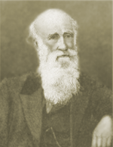
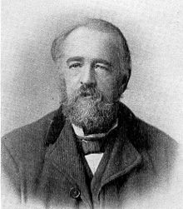
19th Century Christadelphian Commentary on the ‘Two Books’
Notes:
The Two Books concept in our earliest beginnings…

Slide 26
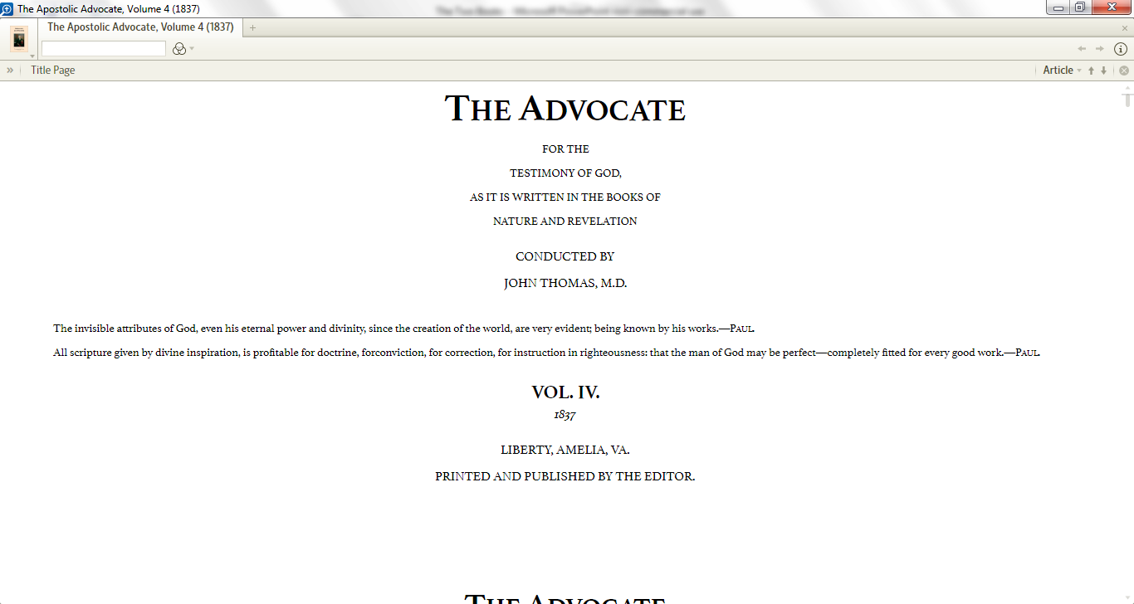
Notes:
The Two Books concept has been an integral part of our community since the beginning. This is the title page for Dr. Thomas’ magazine The Advocate. Worth noting is that Dr. Thomas changed the subtitle of his magazine between volumes 3 and 4 in order to establish the direction he wished to take it.
Also notice the two scriptures he uses…also a change from volume 3. Here is his explanation for the change →

Slide 27
“‘The Advocate’ is its present name, and will continue so to be. The rest of its title is expletive of the subject-matter for which it pleads, viz. THE TESTIMONY OF GOD.
The grand divisions of this testimony are twofold—first the evidence he has given of his Eternal Power, and Divinity in what is termed Nature; and, secondly, that which is contained in the Historical Books and the Law of Moses, the Prophets, the Psalms, and the Apostolic Writings.”
Continued…
Notes:
There is no mistaking it… Dr. Thomas wished to give the study of the ‘book of His works’ its proper and esteemed place alongside the ‘book of His Word’. His reason is simple and straightforward →

Slide 28
“Our design in doing this, is, that the works of God may be brought to bear illustratively on his word…
THE ADVOCATE will, therefore, exercise himself to the best of his ability and judgment, in setting forth the manifold wisdom of God as inscribed on the brilliant pages of those two interesting volumes.”
The Apostolic Advocate (2:260), 1835-6
Notes:
The ‘book of His works’ compliments the ‘book of His Word’ and vice-versa. This stands in stark contrast to the thinking of many in our community today who have a strong distrust of science, but Dr. Thomas wished to pursue the study of both with diligence. Enough so that he actually changed the subtitle of his magazine to reflect this!

Slide 29
"Nature makes no false impressions, and just so the Bible...The inconsistency spoken of between nature and scripture, arises not from antagonism, but from the misinterpretations of both. It is man’s interpretation of the one set against man’s interpretations of the other. It is not nature versus scripture, but false science against true theology, or false theology against scientific fact."
WDJ (1884). ‘The Bible as a Law of Life and Immortality’. The Christadelphian, (1:93).
Notes:
I have never found out who “W.D.J.” is (the initials of this quote’s author), but his(?) series titled “The Bible as a Law of Life and Immortality” is a refreshing one. The real issue is that there is no inconsistency between nature and the Bible, but between interpretations of either, or both.

Slide 30
“Between the revelation of nature and those of scripture, there is no opposition; but though this is the case, neither reveal the other’s facts.
Hence, to search in nature for that of scripture is like to searching in scripture for that of nature which no thinking man does, yet it is done in the former case, and true theology is in consequence snuffed out.”
WDJ (1884). ‘The Bible as a Law of Life and Immortality’. The Christadelphian, (1:93).
Notes:
The point? The ‘two books’ of God reveal different aspects of God. We don’t look at nature (or science) to learn the gospel; we don’t look at the Bible to learn the intricacies of science.

Slide 31
“THE harmony between the Bible (rightly interpreted) and Nature is perfect.”
“It is only where there is misinterpretation of either of these works of God that discord is introduced.”
‘The Word of God’ (1921). The Christadelphian (58:241).
Notes:
Discord comes from misinterpreting either the Bible or nature, or both.

Slide 32
“That the earth had a history anterior to the six days’ work, is certain, from both scripture and nature. Geology proves the existence of forms of life long before the Mosaic creation; and the Bible tacitly affirms a pre-Adamite order of things, in the words addressed to Adam and Eve ‘replenish’.”
Brother Roberts, The Christadelphian (5:172), 1868
Notes:
In the context of this comment, we segue into the next area of early Christadelphian views on science and the Bible… namely, the age of the earth.

Slide 33
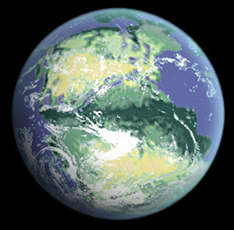
19th Century Christian Commentary on the age of the earth

Slide 34
“[E]vangelicals in science {in the 19th century} had remarkably little difficulty in adjusting their theology to the idea of a lengthy earth history, and numerous harmonizing schemes were confidently, if not always consistently, advanced.”
Livingstone, Darwin’s Forgotten Defenders, 1984
Notes:
The first major scientific challenge to Biblical interpretation during this period was geology’s discovery of an ancient earth, determined through the study of strata and widely accepted by scientists of the day… including Christian scientists. Christian theologians had little problem reinterpreting their views on the Genesis creation with this new scientific evidence.

Slide 35
Edward Hitchcock, noted Geologist/Congregationalist Minister (1793-1864):
"It appears that every successive general change that has taken place on the earth's surface has been an improvement on its condition. Animals and plants of a higher organization have been multiplied with every change, until at last the earth was prepared for the existing races.“
Livingstone quoting Hitchcock in Elementary Geology @ pp. 156-57
Notes:
While there are many, many examples to draw upon, we’ll content ourselves with this quote by Edward Hitchcock. It is an interesting quote and shows how Hitchcock, like his contemporaries in both science and theology, had no issue with the earth “developing” (a common word used in place of “evolving” during this period) from a lesser inhabitable state to one suitable for life, culminating in the existence of man. What is fascinating about this quote is that it is mirrored by brother Roberts →

Slide 36
“It is well for us to contemplate the mighty works of God. Geology teaches us much; it speaks of a time and creation on this earth when animal life, if not totally, was nearly unknown, and only the lower order of vegetable life covering its face, and this must have existed many thousands of years; and during the whole of that long period, the earth was undergoing wonderful and necessary changes to fit it for a creation of a higher order, and evidently with the creature man in view.”
Brother Roberts, The Christadelphian (21:177-178), 1884
Notes:
Appealing to geological advances of the day, brother Roberts gladly concedes of a earth developing from a more primitive state to one capable of sustaining a higher order of life.
For added benefit of this shared view between leading Christian scientists of the day and leaders in our own community, let’s juxtapose the two quotes →

Slide 37
Edward Hitchcock, Elementary Geology:
"It appears that every successive general change that has taken place on the earth's surface has been an improvement on its condition. Animals and plants of a higher organization have been multiplied with every change, until at last the earth was prepared for the existing races."
Robert Roberts, The Christadelphian:
“Geology…speaks of a time and creation on this earth when animal life, if not totally, was nearly unknown, and only the lower order of vegetable life covering its face… the earth was undergoing wonderful and necessary changes to fit it for a creation of a higher order, and evidently with the creature man in view.”
Notes:
While not word-for-word, the commonality of the two quotes is unmistakable. From this we can rightly conclude that brother Roberts was perfectly content accepting what the science of the day was telling him, and he had no issue interpreting the Bible in light of this discovery →

Slide 38
Early Christadelphian Commentary on the age of the earth

Slide 39
“That Moses does not teach the creation of the earth in the ordinary sense six thousand years ago is proved by his recognition of a pre-’creation’ existence. Before the six days’ work began, he speaks of the earth as being ‘without form and void,’ and ‘darkness on the face of the deep.’—(Gen. 1:2.) How long it had been in this state is not hinted; but the narrative leaves room for the measureless ages said to be required by geology.”
Brother Roberts, The Christadelphian (10:163), 1873
Notes:
This appears to me to be the Ruin-Reconstruction Creationism view (Gap Theory). That brother Roberts is willing to regulate a pre-Adamic earth to the “measureless ages…required by geology” again shows the respect he gave to science.

Slide 40
Clip from the Shepton Mallet Journal, of March 19th, containing lecture on geology, containing a good deal of natural truth well-stated, but having no bearing on Bible claims, though the lecturer evidently thought otherwise. The Bible does not interfere with the pre-Adamic age of the world.
The Christadelphian (25:764), 1888
Notes:
This shows that our community did not attempt to make the Bible a scientific textbook. The ‘book of His works’ has its purpose and it does not “interfere” with the Bible as the Bible does not “interfere” with science.

Slide 41
'Interested Stranger.—No doubt the earth has gone through changes.
Christadelphian. — Have not these changes been in the nature of progress—an advance from a crude to a more perfect state?
Interested Stranger.—It has doubtless been so.
Christadelphian.—From what sort of a state did this process make its start?
Interested Stranger.—That, I think, we cannot ascertain.
Christadelphian. — Not in an exact sense perhaps; but are we not justified in saying that if we go far enough back in the record of the earth’s physical history, as written in the rocks, we come to a time when the earth was a molten mass, incapable of sustaining life, either vegetable or animal?’
Notes:
The next three slides are an excerpt from a fictional conversation brother Roberts wrote and published in The Christadelphian. Among other topics covered, an appeal to nature as evidence of God is included.
Let's read this carefully. A Christadelphian, in 1885, saying that if we go far enough back in the record of the earth's physical history (as written in the rocks), we come to a time when the earth was a molten mass, incapable of sustaining life, either vegetable or animal? You can read that in any standard science textbook today, but that was pioneering science and theology in the late 19th century. In fact it is rejected by many in our own community, in this day and age. And did you note that the earth has 'gone through changes', which have been 'in the nature of progress—an advance from a crude to a more perfect state?’ Let's read on →

Slide 42
'Christadelphian.—And you may be aware that by means of the spectroscope, it has been discovered that the heavenly bodies are composed of the same chemical substances that go to make up the earth?
Interested Stranger.—Yes.
Christadelphian.—You may perceive then that the one is capable of throwing light upon the other. We cannot ascertain the physical history of the earth further back than the fire period from the earth itself: but the starry heavens show us (through the telescope) bodies in various stages of development, and therefore stages through which it is probable the earth has come. The nebulous matter in the milky way is very instructive on this point.'
Notes:
Again, read this carefully in order to understand the force of it. Here's a Christadelphian using science to determine the history of the earth. Previously our Christadelphian traced the history of the earth back to a 'molten mass' by reading the geological evidence. He is now going back before the time that the earth was a molten mass. How? By observing the stars and other planets, and understanding that they are made of the same stuff the earth is made of. This is groundbreaking enough in the 19th century, but this Christadelphian actually says that through these observations we can discern how the earth was created. He says that since we can see other heavenly bodies 'in various stages of development', it is very probable that the earth has gone through the same processes of development. As if that wasn't enough, we get to this stunning point a little later →

Slide 43
'Christadelphian.—Here is the point: if the universe has been a progressive development, there must have been a time—inconceivably remote truly—but still a time when it began to travel from its invisible state of abstract power to its present state of concrete form and glory.‘
Brother Roberts, The Christadelphian (22:405), 1885
Notes:
The universe is in a state of progressive development, and this started from a time when it 'began to travel from its invisible state of abstract power to its present state of concrete form and glory'. That's as close to the Big Bang as you'll see this side of the 20th century. Stunning stuff. And from a Christadelphian. And published in The Christadelphian Magazine by brother Roberts. (Many thanks to brother J. Burke for his comments on the previous 3 slides)

Slide 44
“Revelation {the Bible} does not enter into the mysteries of molecular physics, or the development of the life-germ, or the way in which it operates on material organisms. All these it relegates to science, whose function it is to investigate them.
Brother Roberts, The Christadelphian (13:158), 1876
Notes:
Here brother Roberts clearly distinguishes between what the Bible can and can’t tell us, and where we can go to understand the natural world’s workings. Science is not the enemy.

Slide 45
Christians and Science:
The view that Christian doctrine opposed scientific studies in (and before) mid-19th century Victorian England is erroneous.
Christianity has a well-documented history both defending science and reconciling it with the Scriptures.
The early Christadelphian community shared in this history and defense.
Notes:
So, in conclusion, we can be confident that our community has a solid history of engaging science with the firm belief that there is NO DISHARMONY between it and our faith. While there is scant evidence that our early brothers and sisters accepted Darwinian ideals, there is enough quality evidence to determine they accepted certain aspects of the development (evolution) of our universe, planet, and life.

