Slide 1
12.10.2015. Monday 8.00-12.55 | Lecture: The function and structure of the skin. Diagnosis of skin disorders. Medical and physical forms of treatment | Prof. Neira P. Ivić, Ph.D
13.10.2015. Tuesday 8.00-12.05 12.10-12.55 | Lecture: Infections and infestations Seminar: Skin and psyche | Prof. Neira P. Ivić, Ph.D A.Čarija, M.D.
14.10.2015. Wednesday 8.00-9.35 9.40-11.15 | Seminar: Psoriasis and other papulosquamous disorders Lecture: Disorders of keratinization | O. Kosor, M.D. Prof N.P.Ivić, Ph.D.
15.10.2015. Thursday 8.00-9.35 9.40-11.15 | Seminars: Eczema and dermatitis Drug eruptions | R. Ivanišević, M.D. O. Kosor, M.D.
16.10.2015. Friday 8.00-9.35 9.40-11.15 11.20-12.55 | Seminar: Reactive erythemas and vasculitis Lecture: Disorders of blood vessels and lymphatics Practicals in Clinic and Outpatient Department | R. Ivanišević, M.D. Prof. Neira P. Ivić, Ph.D.
19.10.2015. Monday 8.00-9.35 9.40-11.15 11.20-12.55 | Seminars: Bullous diseases Sebaceoud and sweat gland disorders, Cosmetology Practicals in Outpatient Department | D. Anđelinović, Ph.D. A.Čarija, M.D.
20.10.2015. Tuesday 8.00-9.35 9.40-11.15 11.20-12.55 | Seminars: Connective tissue disorders Disorders of pigmentation Regional dermatology (hair and nails) Practicals in Outpatient Department | D. Anđelinović, Ph.D. A.Čarija, M.D.

Slide 2
21.10.2015. Wednesday 8.00-10.25 10.30-11.15 11.20-12.55 | Lecture: Skin tumours Seminar: Skin reactions to light Practicals in Outpatient Department | Prof. Neiraa P. Ivić, Ph.D O.Kosor , M.D.
22.10.2015. Thursday 8.00-8.45 8.50-9.35 9.40-12.55 | Seminars: Other genetic disorders The skin in systemic diseases Practicals in Outpatient Department | R. Ivanišević, M.D. D. Anđelinović, Ph.D.
23.10.2015. Friday 8.00-9.35 9.40-12.55 | Lectures: Sexually transmitted infections Lyme disease Practicals in Outpatient Department | Prof. Neira P. Ivić, Ph.D.
26.10.2015. Monday 8.00-12.55 | Practicals in Outpatient Department
27.10.2015. Tuesday 8.00-12.55 | Practicals in Outpatient Department
28.10.2015. Wednesday 8.00-12.55 | Practicals in Outpatient Department
29.10.2015. Thursday 8.00-12.55 | Practicals in Outpatient Department
30.10.2015. Friday | Written examination

Slide 3
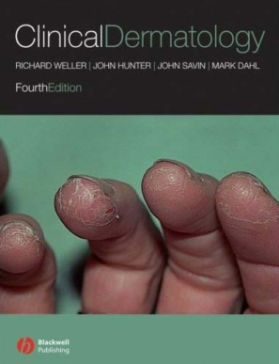
Literature:
Obligatory readings:
Weller R, Hunter J, Savin J, Dahl M. Clinical Dermatology, 4th edition,
Blackwell Publishing 2008.
Supplement readings:
Bolognia JL, Jorizzo JL, Schaffer JV. Dermatology, 3rd edition,
Elsevier Saunders 2012.

Slide 4
The function and
structure of the skin
Neira Puizina-Ivić, Ph.D. Prof.
Clinic of dermatovenereology
School of Medicine
University Split

Slide 5
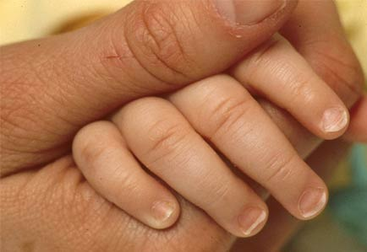
the skin – the interface between humans and environment
Notes:
Koža je granica i barijera našeg tijela prema okolini. Ona nije samo pukih nekoliko slojeva kertinocita i bazalna membrana, nego je opremljena brojnim mehanizmima koji nam omogućavaju preživljavanje.
Koža mora biti opskrbljena učinkovitim komunikacijskim i kontrolnim sustavom kako bi štitila od stalnih promjena koja se događaju u okolišu.

Slide 6
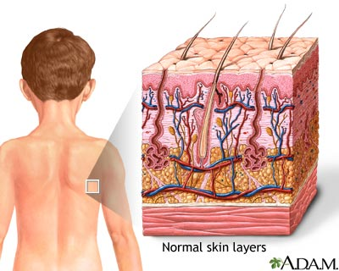
4 kg
2m²
Notes:
Skin is inteface between humans and environemnt. It is the lagrest organ of the body, and its weight is average 4 kg. It covers area of 2 m2 (its surface is 2 m2). It protects skin and body of harsh external conditons (alkali and acids), and prevent loss of important body constituents, especially water.

Slide 7
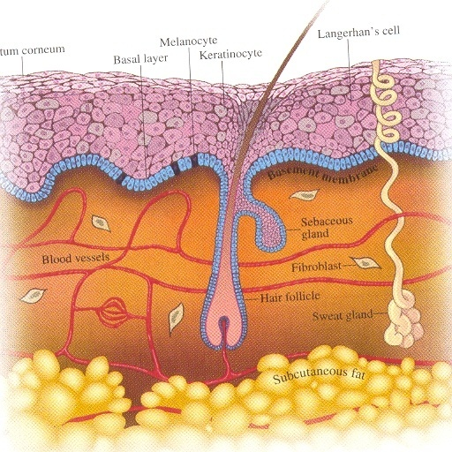
Skin has three layers:
1. Epidermis
2. Dermis
3. Subcutaneous tissue

Slide 8
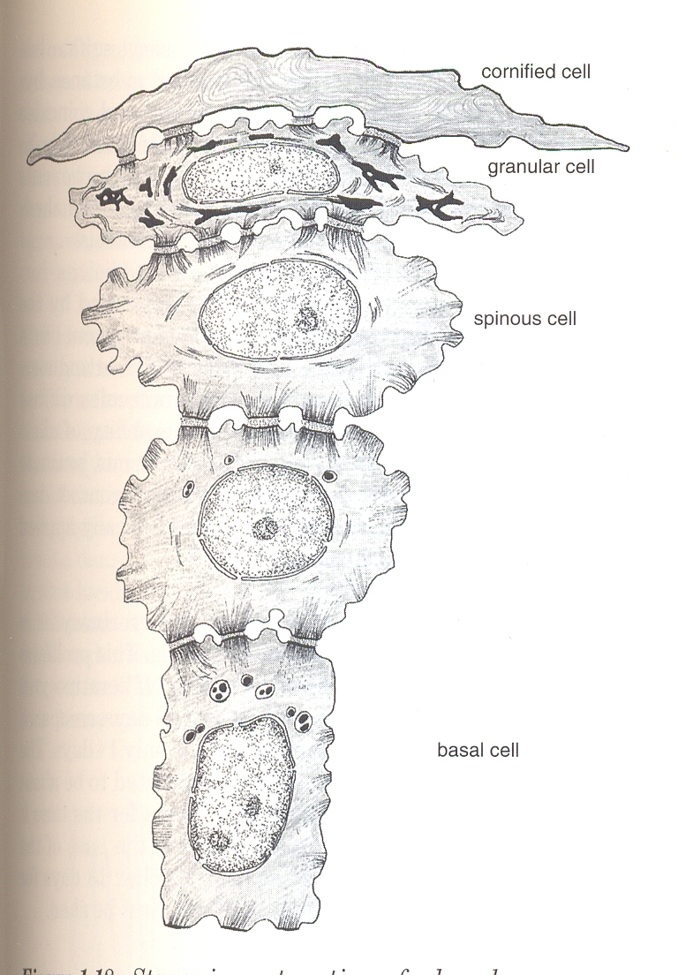
Epidermis
horny layer /stratum corneum/
granular layer /stratum granulosum/
spinous layer /stratum spinosum/
basal layer /stratum basale/
Notes:
Cells are streched like sails

Slide 9
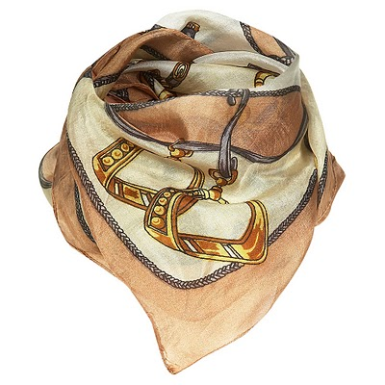
Epidermis
turn over or transit time
28 days
0,1 -1,5 mm
Notes:
Thickness of epidermis varies from 0,1 mm on eyelids to 1-1,5 mm on the palms and soles. A generated cell moves or is pushed by underlying mitotic activity to the surface, passing through the prickle and granular cell layers, before dying in the horny layer.
The journey and maturatuon of cell from basal layer through epidermis up to horny layer last 21 day, but time need for complete sheding is necessary 28 days. That is reason why we order patients 3 to 4 weeks after some destructive procedure such as peeling and cryotherapy as well. Skin thickness is sometime compared with thickness of scarf.

Slide 10
Epidermis
0,1 -1,5 mm
30% are preparing for division
(growth fraction)
- columnar cells
- rest on a basement membrane
- hemidesmosomes anchoring them to lamina densa of
the basal lamina
Notes:
Thichness of epidermis varies from 0,1 mm on eyelids to 1-1,5 mm on the palms and soles. A generated cell moves or is pushed by underlying mitotic activity to the surface, passing through the prickle and granular cell layers, before dying in the horny layer.
The journey and maturatuon of cell from basal layer through epidermis up to horny layer last 21 day, but time need for complete sheding is necessary 28 days. That is reason why we order patients 3 to 4 weeks after some destructive procedure such as peeling and cryotherapy as well. Skin thickness is sometime compared with thickness of scarf.

Slide 11
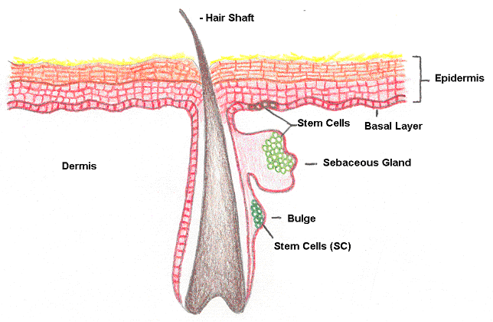
Skin stem cells
Notes:
Stem cells reside amongst these interfollicular basal cells and also amongst the cells of the external root sheet at the bulge in the hair follicle at the lever of attachment of the arrector pili muscle. They can not be identified by histologic sections, but only by their ability to incorporate radioactive thymidine into their DNA for long period of the time. They divide infrequently, but can generate new proliferative cells in the epidermis and hair follicle in response to damage.

Slide 12
Skin stem cells
Notes:
Stem cells reside amongst these interfollicular basal cells and also amongst the cells of the external root sheet at the bulge in the hair follicle at the lever of attachment of the arrector pili muscle. They can not be identified by histologic sections, but only by their ability to incorporate radioactive thymidine into their DNA for long period of the time. They divide infrequently, but can generate new proliferative cells in the epidermis and hair follicle in response to damage.

Slide 13
Epidermis
0,1 -1,5 mm
-larger than basal cells
-firmly attached to each other (desmosomes,
cadherins, cytoplasmatic processes)
Notes:
Following the mitosis (taht can lasts for 50-200 hours – it is controversial), cells pass through the several different phases of mitosis, and cells are pushed by underlying mitotic activity. It starts to differentiate, and in the same time cell lost their capacity to divide, and synthesizes keratins.

Slide 14
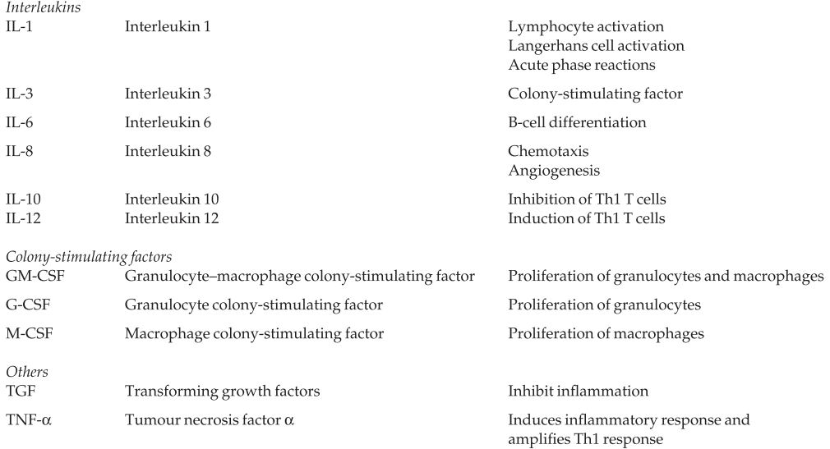
Some cytokines produced by keratinocytes

Slide 15
Cell attachment:
Steroid sulphatase activates in horny layer and allows scaling and
Glycoproteins – intecellular “mortar”
Desmosomes and tonofibrilles
Lipids and sterol sulphate – very firm attachment

Slide 16
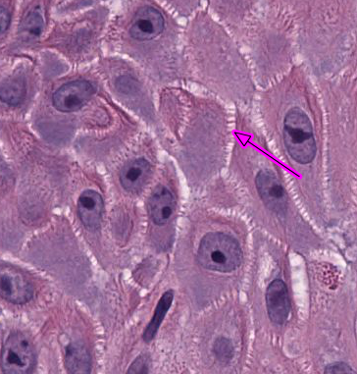
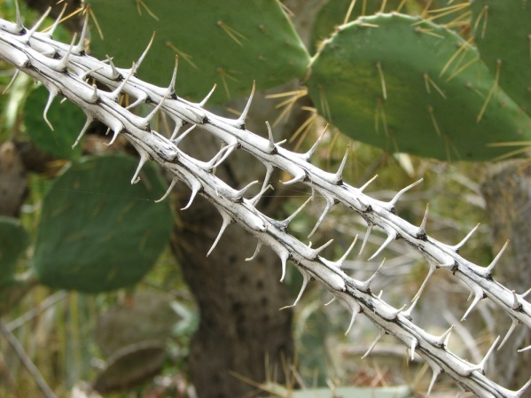
desmosomes in the
light microscope
like prickles

Slide 17
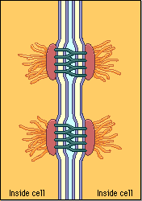
Desmosomes
thickened patches that contain
keratin
desmoplakin
desmin
increase the rigidity
of tissue
Notes:
Desmosomes appear as thickened patches in the cell membrane region between two cells. Desmosomes contain specialized proteins–such as keratin (the same protein found in fingernails and hair), desmoplakin, and desmin filaments–that increase the rigidity of tissues. The most common type of desmosome–spot desmosomes–are found in epithelium, smooth muscle, and many other animal tissues. These are buttonlike junctions that bind cells together and also function as anchors for fibers in the cytoskeleton.

Slide 18
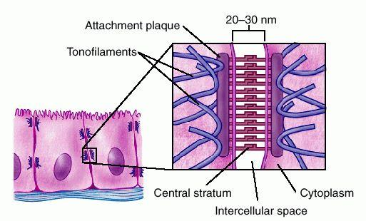

Slide 19
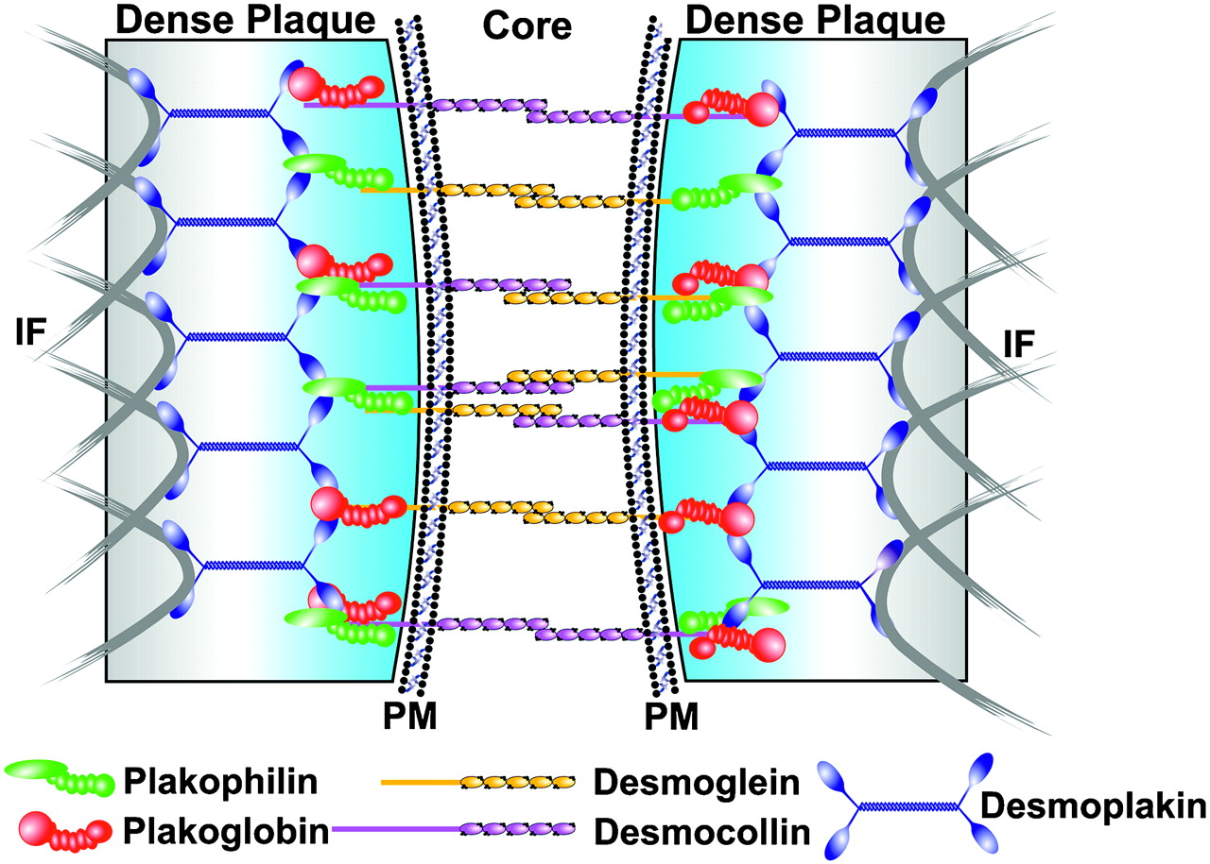
desmoplakin
desmoglein
desmocollin
Notes:
Under the light microscope, the desmosomes look like “prickles”. They are specialized attachment plaques that have been charachterized biochemically. They contain desmoplakins, desmogleins and desmocollins. Autoantibodies to these proteins are found in pemphigus when they are responsible for the detachment of keratinocytes from one another and so for intaepidermal blister formation.

Slide 20
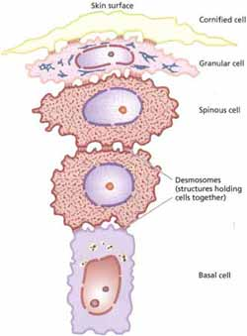
Keratinocytes
spinous or
prickle layer
Notes:
Spinous or prickle cell layer is composed of keratinocytes that are larger than basal cells. They synthetize keratins. They are firlmy attached to each other by small interlocking cytoplasmic processes, by abundant desmosomes and by other cadherins and separated by intercellular layer of glycoproteins and lipoproteins. Under the lihgt microscope, the desmosomes look like “prickles”

Slide 21
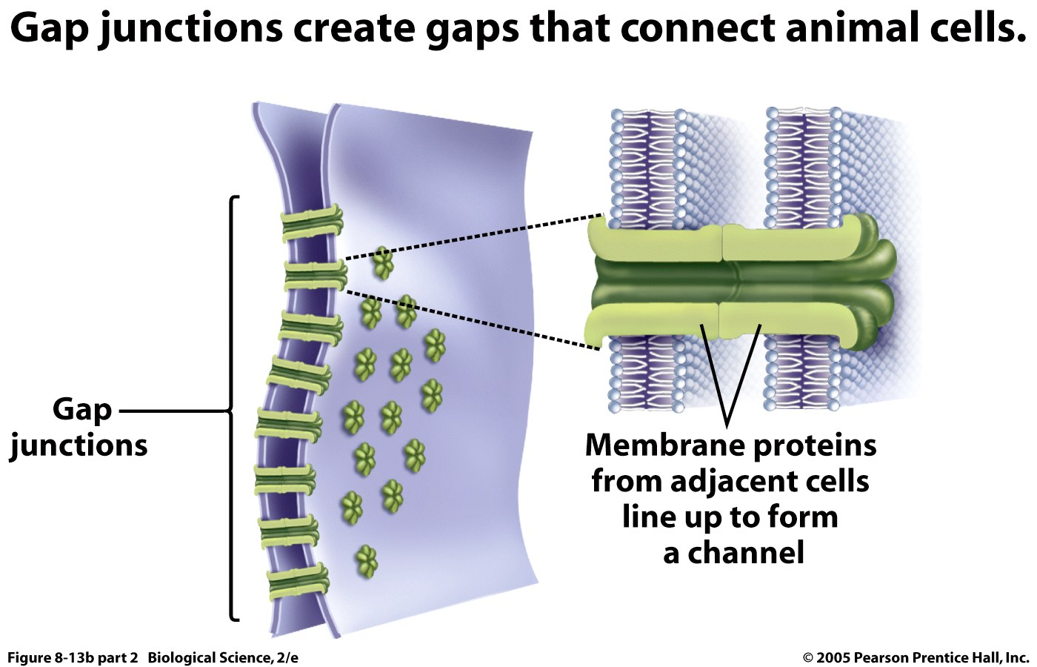
cytoplasmatic continuity between keratinocytes occurs at gap junctions

Slide 22
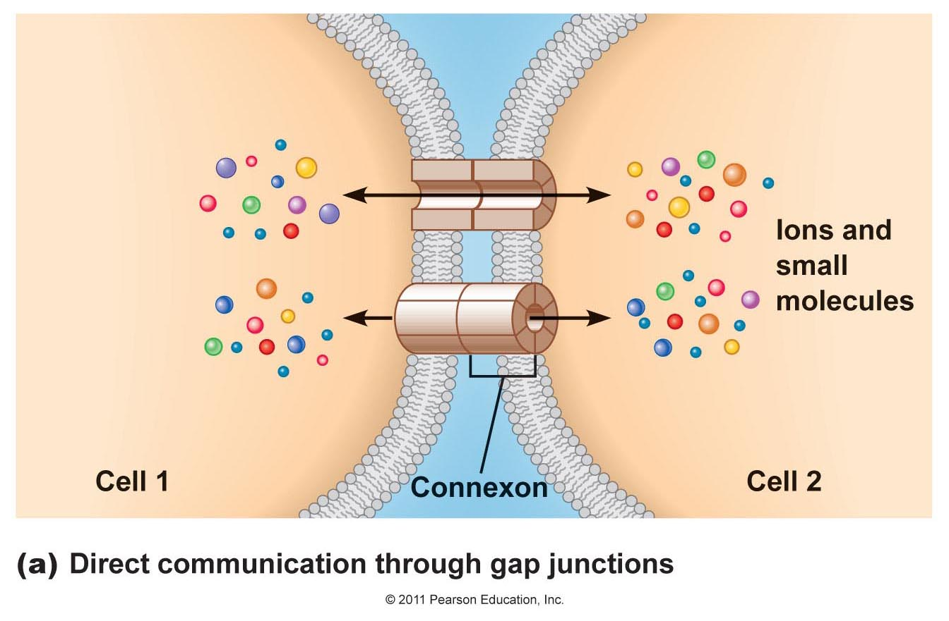

Slide 23
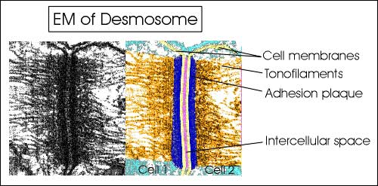
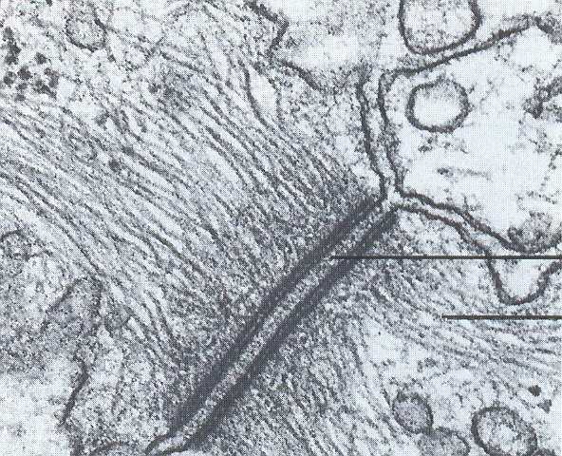
Tonofilaments
small fibers running from
cytoplasm to the desmosome
more numerous in spinous layer
Notes:
Tonofilaments are small fibers running from the cytoplasm to the desmosomes. They are more numerous in cells of spinous layer than of the basal layer , and are packed into bundles called tonofibrils.

Slide 24
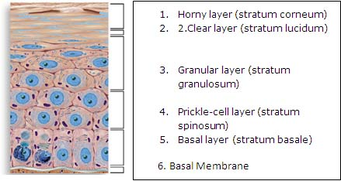

Slide 25
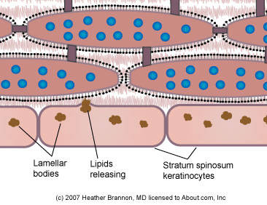
Odland bodies
lamellar granules
Notes:
The epidermal lipids are produced in the Golgi apparatus of the keratinocytes in the upper layers of the prickle cell layer. Odland bodies; Golgi apparatus ...

Slide 26
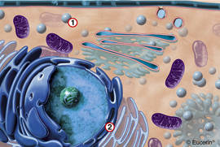

Slide 27
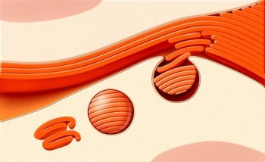
content is discharged into the
intercellular space of granular layer and arrange
- precursors of the lipids
intercellular space of the horny layer -
lipids
polysaccharides
enzymes
Notes:
Epidermal lamellar bodies, also called Odland body, lamellar bodies, lamellar granules, or keratinosomes. Epidermal lamellar bodies are vesicles present in keratinocytes of the prikly layer stratum spinosum and, in larger numbers, in the keratinocytes of the granuluar layer stratum granulosum of the epidermis. They contain lipids and enzymes. After exocytosis in the intercellular space, the lipids are metabolized by the enzymes to g

Slide 28
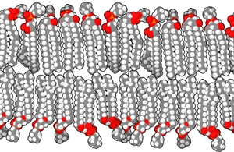
Notes:
Natural bilayers are usually composed of phospholipids, which have a hydrophilic head and two hydrophobic tails each. When phospholipids are exposed to water, they arrange themselves into a two-layered sheet (a bilayer) with all of their tails pointing toward the center of the sheet. The center of this bilayer contains almost no water and excludes molecules like sugars or salts that dissolve in water but not in oil. This assembly process is similar to the coalescing of oil droplets in water and is driven by the same force, called the hydrophobic effect. Because lipid bilayers are quite fragile and are so thin that they are invisible in a traditional microscope, bilayers are very challenging to study. Experiments on bilayers often require advanced techniques like electron microscopy and atomic force microscopy.
The stratum corneum lipids consist of a heterogeneous mixture of saturated, long-chain ceramides (CERs), free fatty acids (FFAs), and cholesterol (CHOL) in a roughly 1:1:1 molar ratio*. Normally, lipids arrange themselves into a two-layered sheet, or bilayer, with all of their hydrophobic (water-repelling) tails pointing inwards and their hydrophilic (water-attracting) heads outwards. However, the lipid molecules in the stratum corneum are fully extended, so that the two tails of each molecule point in opposite directions (Figure 1). Furthermore, the molecules are stacked on top of each other in an alternating fashion, forming a structure which is much more impermeable than a normal lipid bilayer.
Figure 1 Schematic drawing of the skin: Left part: schematic cellular-scale drawing of epidermis. Mid part: molecular-scale drawing of the lamellar lipid structure occupying the space between the cells of the stratum corneum. Right part: atomic model of the lipid structure's repeating unit, composed of two mirrored subunits, each composed of one fully extended ceramides- (CERs), one cholesterol- (CHOL) and one free fatty acid (FFA) molecule.
The researchers developed a novel experimental approach for this particular project, combining cryo-electron microscopy defocus series with molecular modelling and electron microscopy simulation. They froze healthy, living, human skin to below -140 °C, thereby preserving every molecule in its native location. They then sliced the tissue into layers 25 to 50 nanometers thick and examined the layers using an electron microscope. The results obtained show that the lipids are organized in an arrangement -- something which has never been described in a biological system --stacked bilayers of fully extended ceramides (CERs) with cholesterol molecules associated with the CER sphingoid moiety.
A visualization of the molecular organization in the skin, showing the arrangement of lipid molecules in the stratum corneum, is represented in Figure 2.
Figure 2 Visualization of molecular organization of the skin: Arrangement of lipid molecules in the stratum corneum. The long chains of green balls represent hydrocarbon chains in ceramides, cholesterol and free fatty acids. Notes This article entitled “The human skin barrier is organized as stacked bilayers of fully extended ceramides with cholesterol molecules associated with the ceramide sphingoid moiety“ was originally published by Iwai I, Han H, den Hollander L, Svensson S, Ofverstedt LG, Anwar J, Brewer J, Bloksgaard M, Laloeuf A, Nosek D, Masich S, Bagatolli LA, Skoglund U, Norlén L in J Invest Dermatol. 2012 Sep;132 (9) :2215-25. doi: 10.1038/jid.2012.43. Epub 2012 Apr 26, see http://www.ncbi.nlm.nih.gov/pubmed/22534876#
Please also refer to Lars Norlén’s website at http://ki.se/ki/jsp/polopoly.jsp?d=27086&a=63500&cid=27089&l=en
References
* P. Wertz, L. Norlén, “Confidence Intervals’’ for the ‘‘true’’ lipid compositions of the human skin barrier?. In: B. Forslind, M. Lindberg (eds) Skin, Hair, and Nails Structure and Function. Marcel Dekker, New York (2003) pp 85–106.
Author Lars Norlén
Co-Authors HongMei Han, Lianne den Hollander, Jamshed Anwar, Stina Svensson, Lars-Göran Öfverstedt, Ulf Skoglund, Luis A. Bagatolli, Sergej Masich, Daniel Nosek, Aurelie Laloeuf, Maria Bloksgaard, Jonathan Brewer, Ichiro Iwai
Lars Norlén
Read more
Lars Norlén
Assoc. Professor Lars Norlén is a specialist in Clinical Dermatology and Venereology at the Karolinska Institutet in Stockholm, Sweden, and is heading a research group addressing the molecular function of normal and diseased skin.
Contact:
lars.norlen@ki.se
Mar. 2013
The human skin barrier is organized as stacked bilayers of fully extended ceramides with cholesterol molecules associated with the ceramide sphingoid moiety

Slide 29
Epidermis
granular layer
flatter cells
more tonofibrils
large irregular granules
(proteins including involucrin,
loricrin and profilaggrin)
0,1 -1,5 mm
Notes:
Cellular differentiation continues in the granular layer, which consist of two or three layers that are flatter than those in the spinous layer and have more tonofibrils. As the name of the layer implies, these cells contain large basopilic granules of keratohyalin which merge with tonofilaments. They contain proteins, including involucrin, loricrin and profillagrin, which cleaved into filaggrinby specific phosphatases as the granular cells move into the horny layer.

Slide 30
Skin barrier
profilaggrin
cleaved
filaggrin
Notes:
Profillagrin is cleaved by specific phosphatases into filaggrin as the granular cells move into horny layer

Slide 31
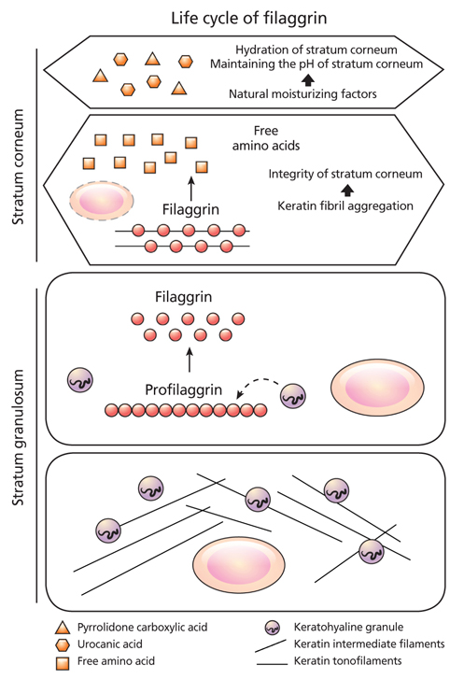

Slide 32
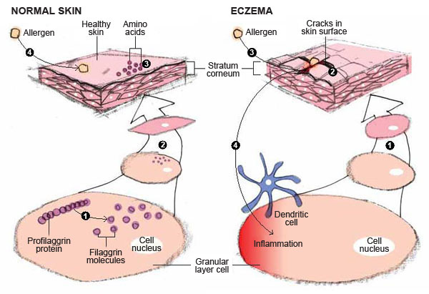

Slide 33
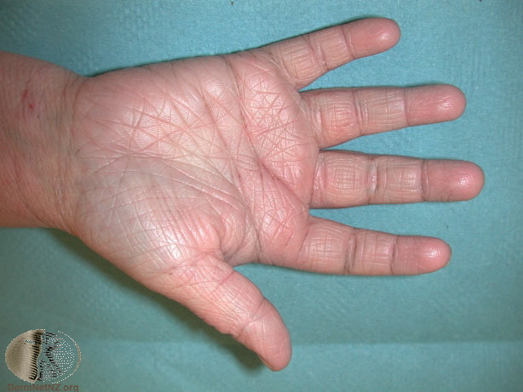
causes ichthyosis vulgaris
risk for atopic dermatitis
pronounced palm lines
loss or mutation
filaggrin gene
in 10% european
population
risk of asthma and AD
more severe forms
of atopic asthma

Slide 34
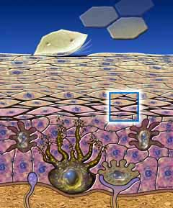
horny layer
- flattened dead cells
- like bricks separated
by lipids (mortar)
effective barrier to:
water loss
invasion of infections
toxic chemicals

Slide 35
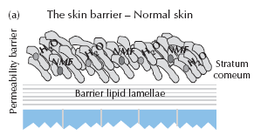
10% H₂O
70% H₂O

Slide 36
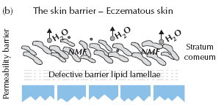
dry skin
cracks
itching

Slide 37
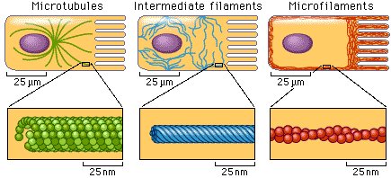
Keratinization
keratin
internal cytoskeleton
Notes:
All cells have internal skeleton made up of microfilamets (7 nm diameter, actin), microtubules (20-35 nm, tubulin, and intermediate filaments (10 nm diameter). Keratins are the main intermediate filaments in epithelial cells, and are comparable to vimentin in mesenchymal cells, neurofilaments in neurones amd desmin in muscle cells. Gene mutation of keratin causes a number of skin diseases including epidermolysis bullosa and bullous ichthyosiform erythroderma.

Slide 38
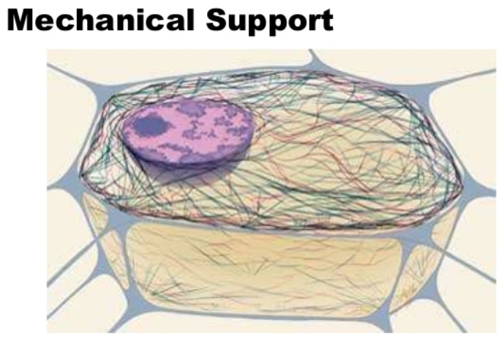

Slide 39
Epidermal simbionts
Melanocytes
Langerhans cells
Merkel cell

Slide 40
Epidermal simbionts
Melanocytes
Langerhans cells
Merkel cell

Slide 41
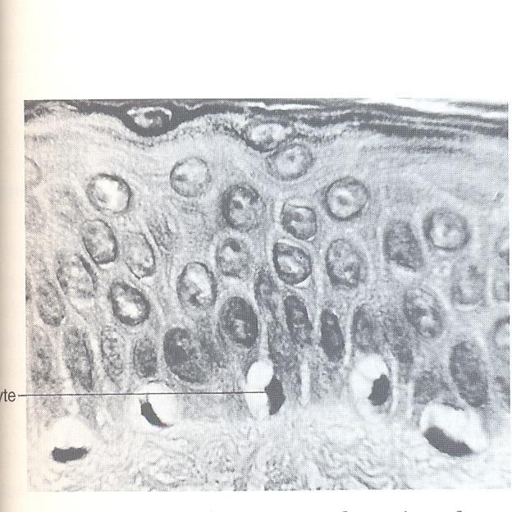
melanocytes
Notes:
Melanocytes are the only cells that can synthetize melanin

Slide 42
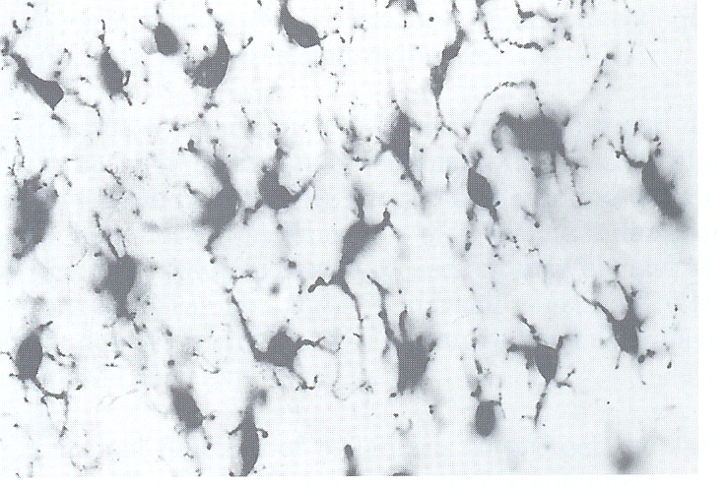
Melanocytes
split-skin technique

Slide 43
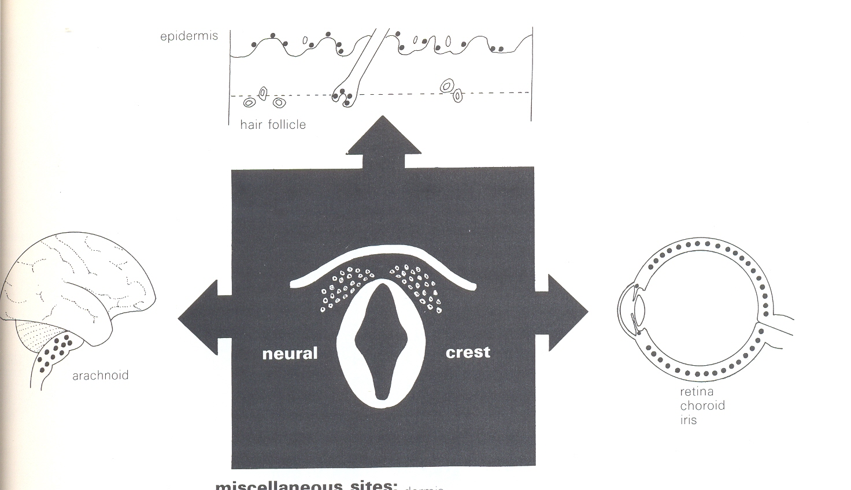
Melanocytes migration during embrional life
other locations: dermis
mucosa
inner ear
orbita
mesenterium
Notes:
They migrate from neural crest into the basal layer of the ectoderm where in human embryos they are seen in early as 8 weeks gestation. They are also seen in hair bulbs, the retina and pia arachnoid.

Slide 44
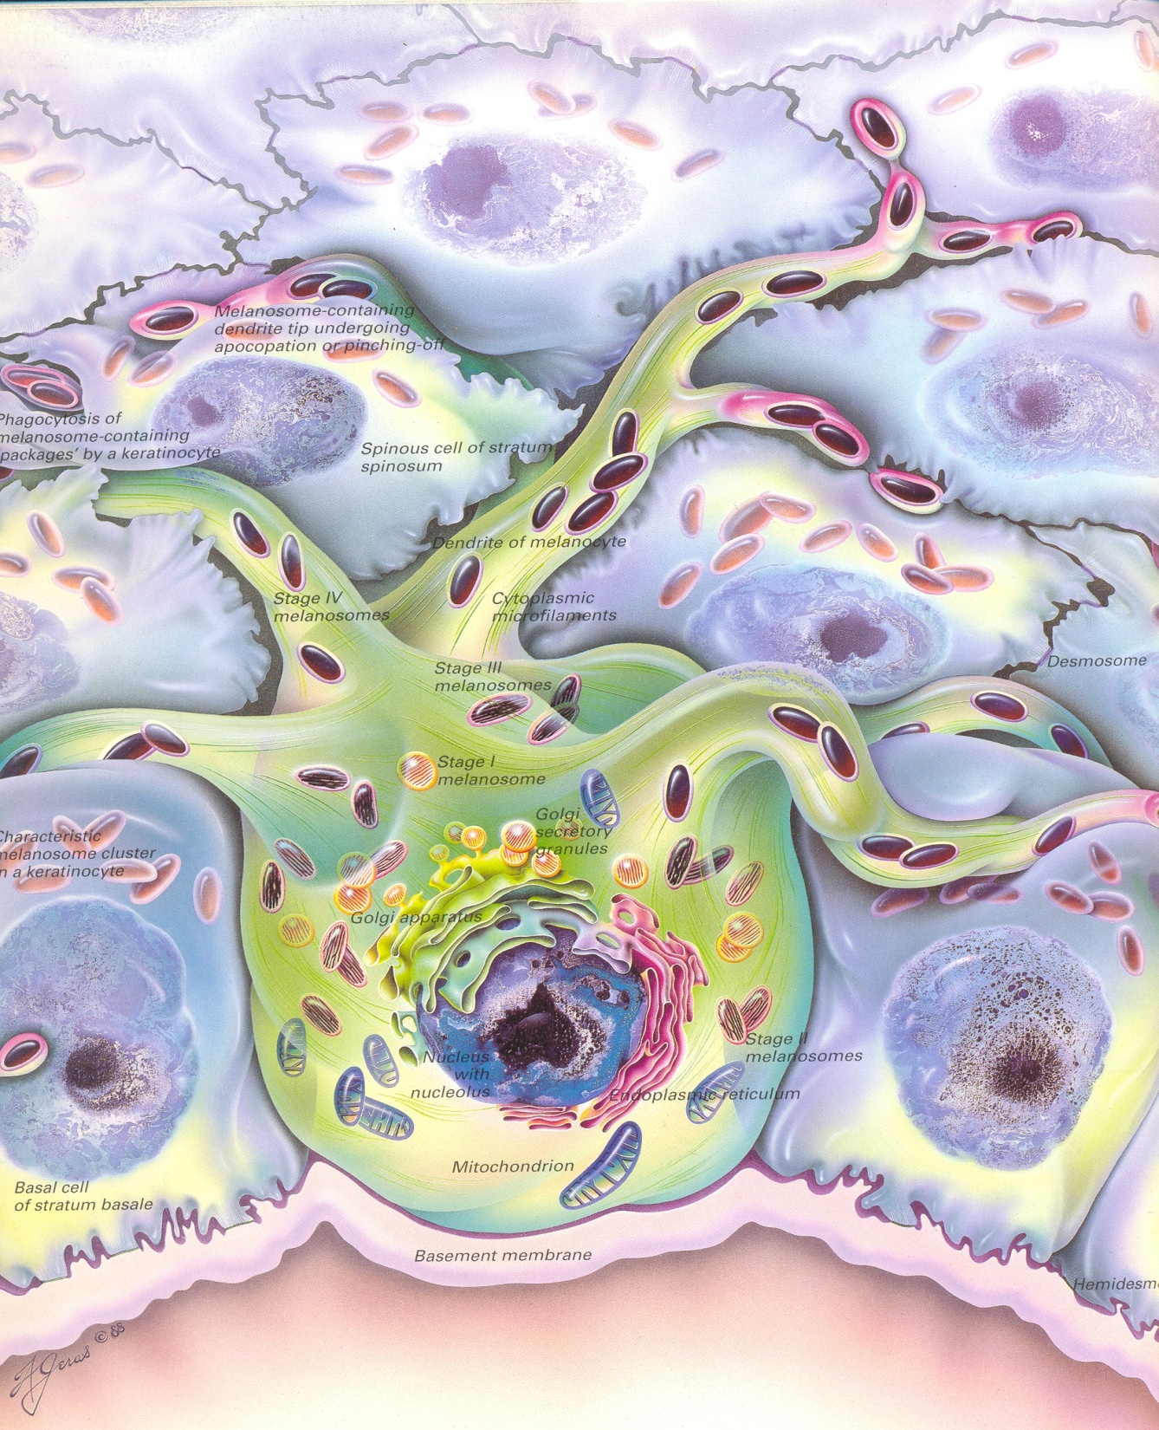
epidermal-melanin unit
face 1/5 keratinocytes
trunk 1/36 keratinocytes
Notes:
Each dendritic melanocyte associates wih a number of keratinocytes forming epidermal melanin unit. The dendritic proceses of melanocytes wind between teh epidemal cells and end as discs in contact with them.

Slide 45
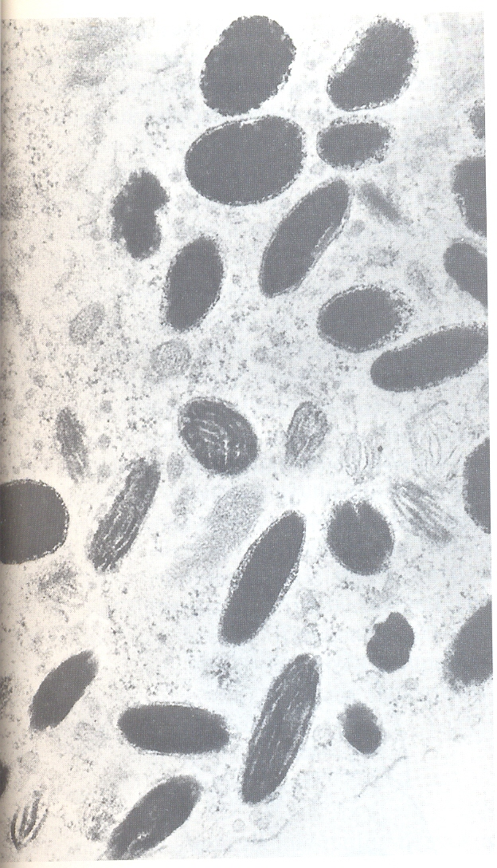
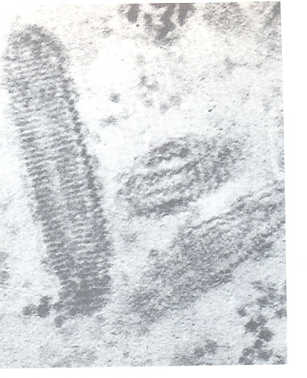
Melanosomes
Notes:
Their cytoplasm contains discretes organelles – the melanosomes containing varying amount of the pigment melanin. This is injected in to surrounding keratinocytes to provide them with pigmentation to help protect skin against damaging ultraviolet radiation.

Slide 46
epidermal-melanin unit
face 1/5 keratinocytes
trunk 1/36 keratinocytes

Slide 47
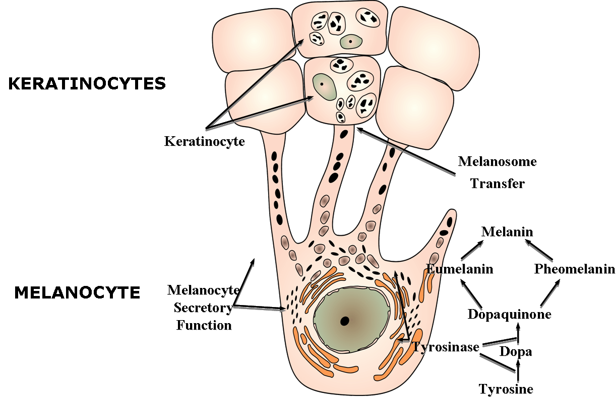

Slide 49
Epidermal simbionts
Melanocytes
Langerhans cells
Merkel cell

Slide 50
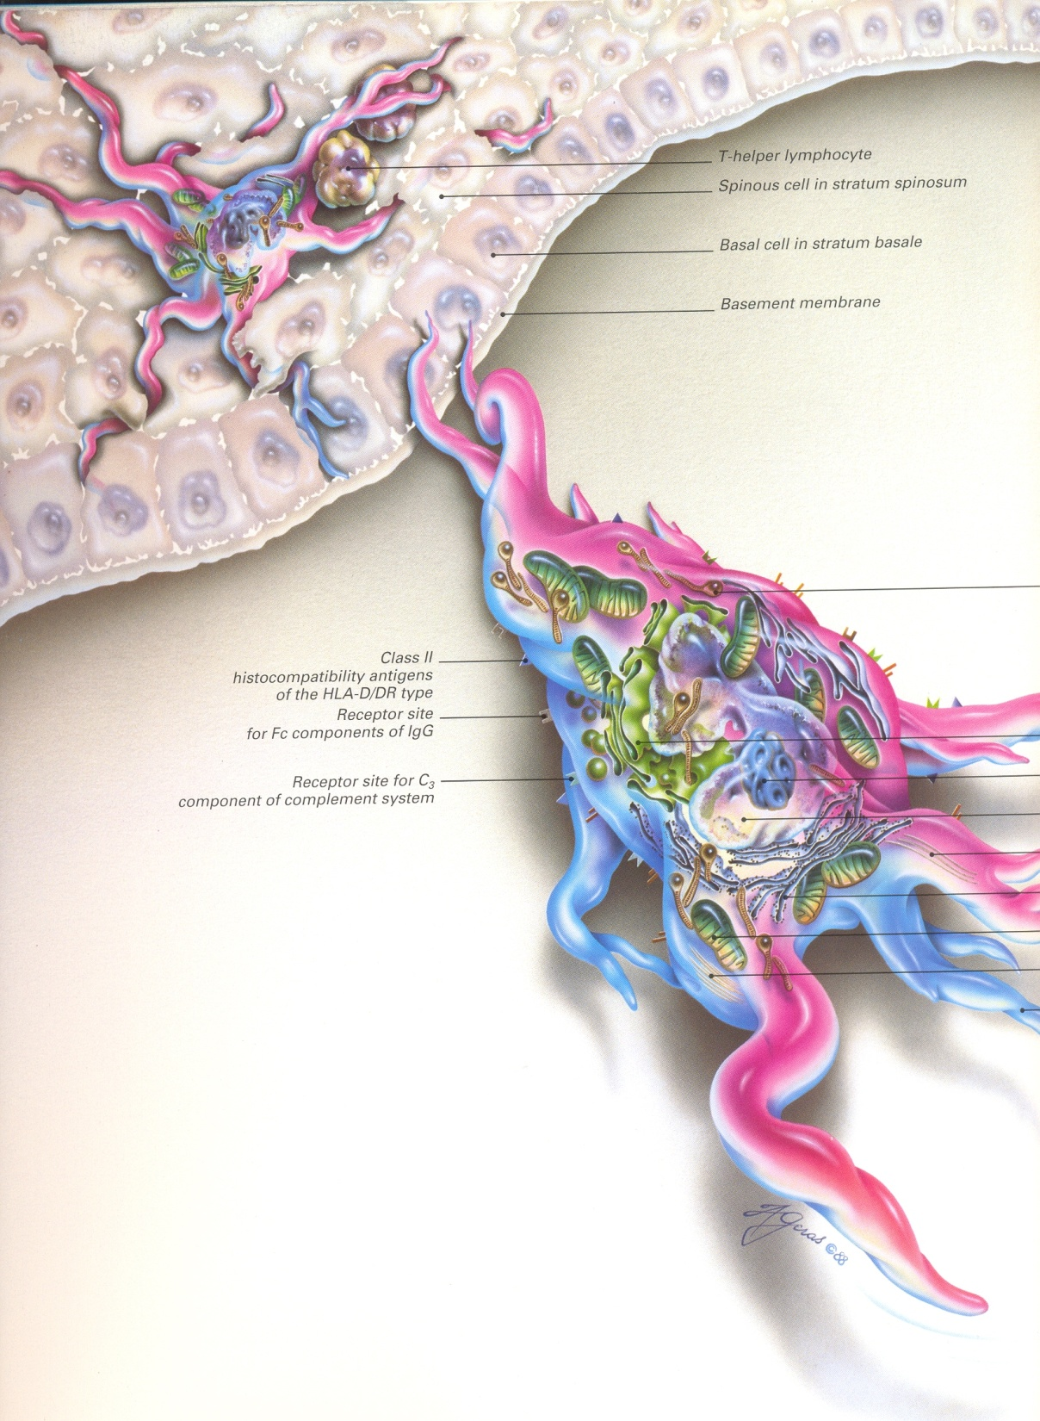
800 LCs/mm²
in spinous layer
no desmosomes
4% of epidermal cells
MHC class II
HLA-D/DR type
receptor for Fc segment IgG and IgE
receptor for C3b
Langerhans cell
(1860.)
Notes:
LC is dendritic cell like melanocytes. It also lack desmosomes. LCs are alone among epidermal cells in possesing surface receptors for C3b and Fc portion og IgG immunoglobulin and IgE, and bearing major histocompatibility complex class II antigens

Slide 51
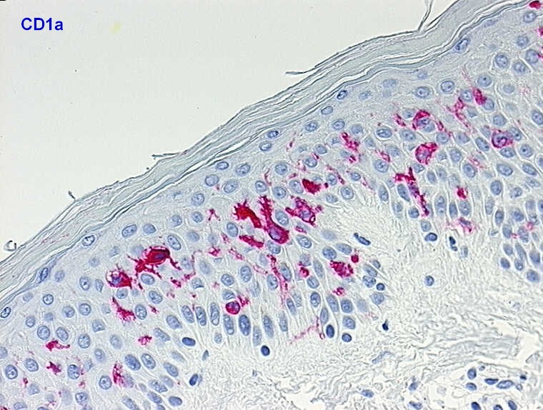

Slide 52
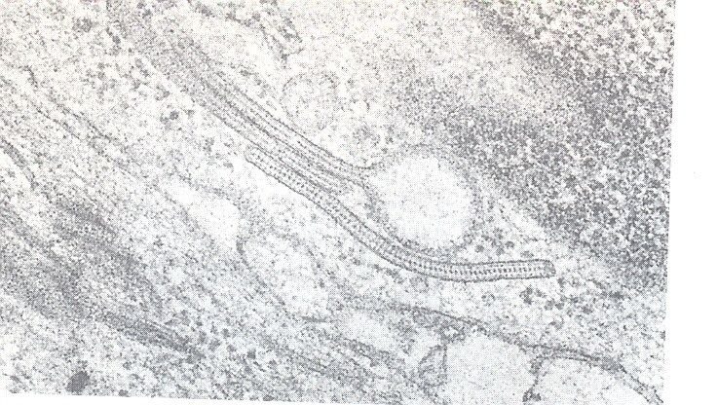
Birbeck granules
Notes:
Spcific granules within the cell looks like tennis racket when seen in electron microscopy. They are plate-like, with round bleb protruding from the surface. LCs come from a mobile pool of precursor originating in the bone marrow.

Slide 53
Langerhans cell
key role in immune rections
(IV type)
presentaion of antigens to T lymphocytes
immunosurveillance for viral and tumour antigens
after UV exposure decreases number
(damaged cells are not recognized by immune system)
Notes:
Topical or systemic corticosteroids also reduce the density of epidermal LCs.

Slide 54
Epidermal simbionts
Melanocytes
Langerhans cells
Merkel cell

Slide 55
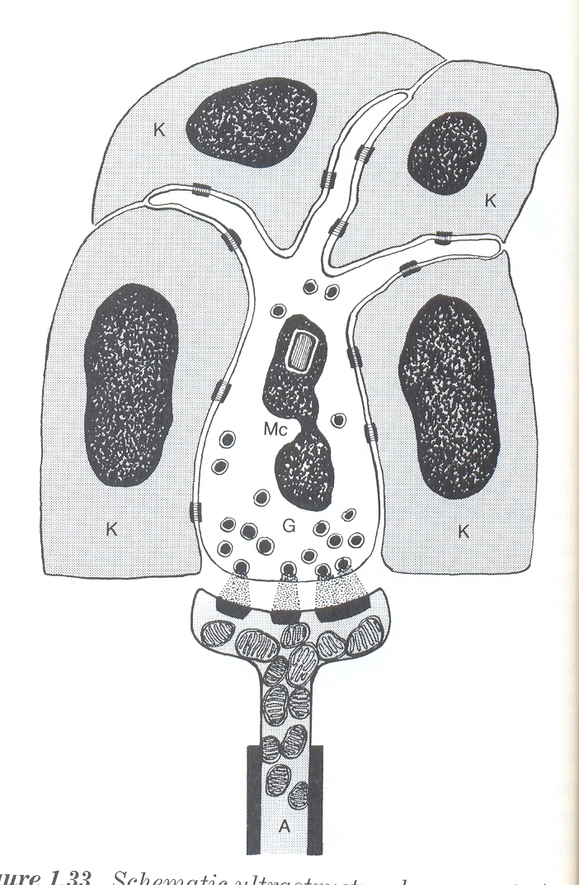
Merkel cell
lying in or near basal layer
act as transducer for fine touch
only in particular regions
-near follicles
-usna šupljina
-okolina dlake
Notes:
They are concentrated in localized thickenings of the epidermis near hair follicles

Slide 56
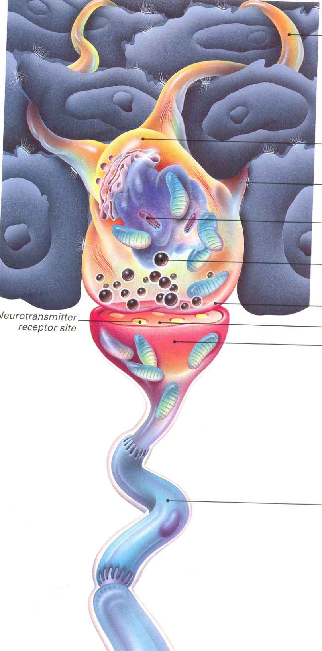
serves as mechanoreceptors
sparse desmosomes
contain membrane bound
spherical granules
fine unmyelinated nerve endings
Notes:
Sparse desmosomes connect these cells to neighbouring keratinocytes. Fine unmyelinated nerve endings are often associated with Merkel cells which express immunoreactivity for various neuropetides.

Slide 57
Dermo-epidermal
junction

Slide 58
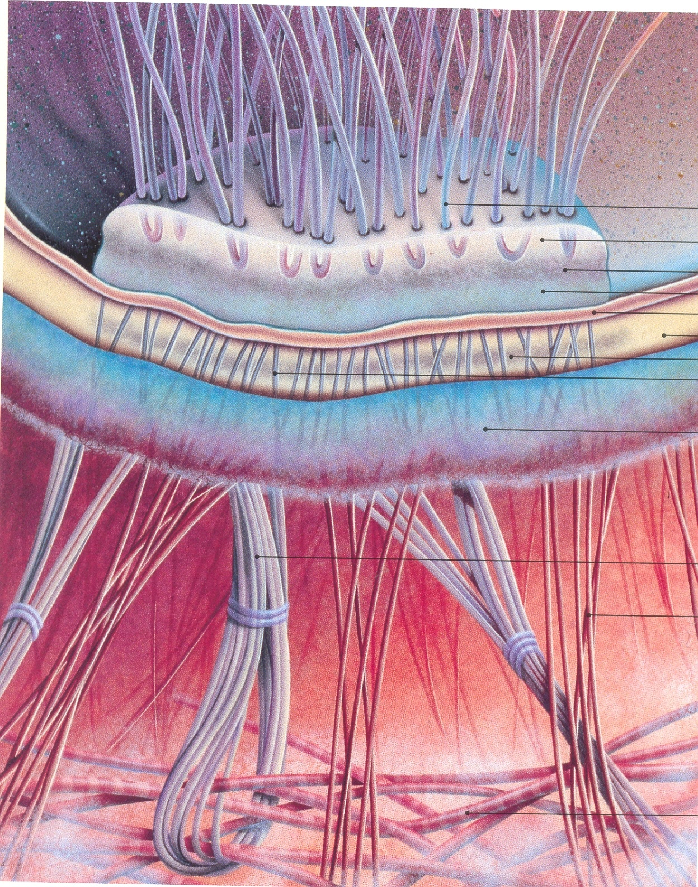
Dermo-
epidermal
junction
collagen IV and VII
elastic filaments
anchoring filaments
cross lamina lucida and connect
lamina densa to the basal cell
elastic fibrils
Notes:
The basement membrane lies at the interface between epidermis and dermis.With light microscope it can be highlited using periodic acid – Schiff (PAS) stain, because of its abundance of neutral mucopolysaccharides. Electron microscopy shows several zones: lamina densa rich in collagen type IV, and lamina lucida that separates from electron – lucent area – lamina lucida that contains antigen of bullous pemphigoid. Lamina lucida contains adhesive molecules, laminin-1, laminin-5 and entactin. BP antigens (230 i 180 kDa) are synthesized by basal cells and are found in close association with hemidesmosomes and laminin. All these structures provide mechanical support, encouraging the adhesion, growth, differentiatiation as well as migration of the overlying basal cells. It acts as semipermeable filter that regulates the transfer of nutrients and cells from dermis to epidermis.
The plasma membrane of the basal cells has hemidesmosomes.

Slide 59
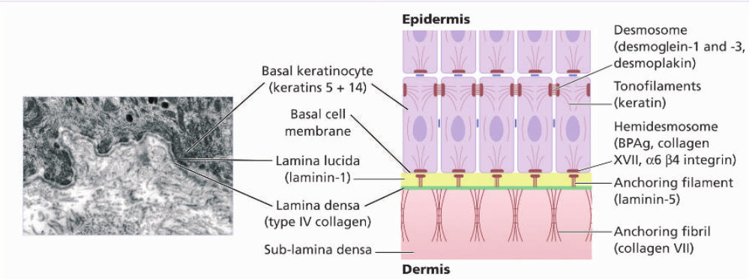
Notes:
The basement membrane lies at the interface between the epidermis and dermis. With light microscope it can be highlited using periodic acid-Schiff (PAS ) stain, because of abundance of neutral mucopolysaccharides. Elecron microscopy shows that lamina densa (rich in collagen type IV) is separated from basal cells by electron - lucent area – lamina lucida. Fine anchoring filaments of laminin-5 cross the lamina lucida and connect the lamina densa to the plasma membrane of the basal cells. Anchoring fibrils made of collagen type VII and small collagen fibers (type I and III) extend from the papillary dermis to the deep part of lamina densa.

Slide 60
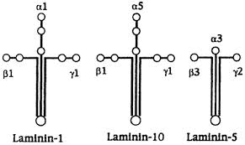
Laminis are large non-collagen glycoproteins produced by keratinocytes. They act as a glue – helping to hold the epidermis onto the dermis.
Notes:
Laminis are large non-collagen glycoproteins produced by keratinocytes aided by entactin promote adhesion between the basal cells above the lamina lucida and type IV collagen the main constituent of the lamina densa, below it. Entactin also known as nidogen-1 (NID-1) is a protein that in humans is encoded by the NID1 gene.^{[1][2]} Entactin is a component of the basement membrane alongside other components such as collagen type IV, proteoglycans (heparan sulfate and glycosaminoglycans), laminin^{[3]} and fibronectin.^{[4]}

Slide 61
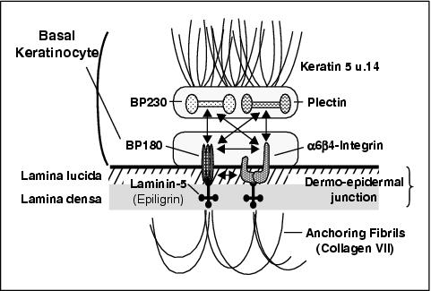
Bullous pemphigoid antigens
Notes:
BP antigens of molecular weights 230 and 180 kDa are synthetized by basal cells and are found in close association with the hemidesmosoms and laminins. Their function is unknown, but antibodies to them are found in pemphigoid.

Slide 62
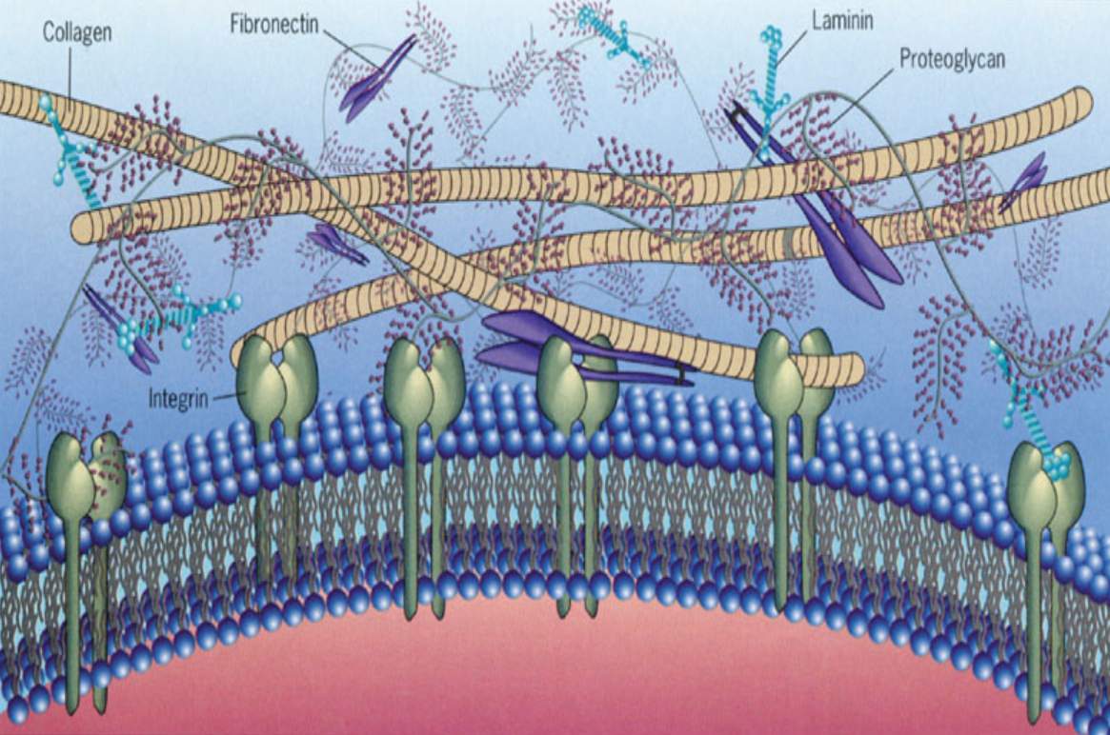
An overview of the macromolecular organization
of extracellular matrix

Slide 63
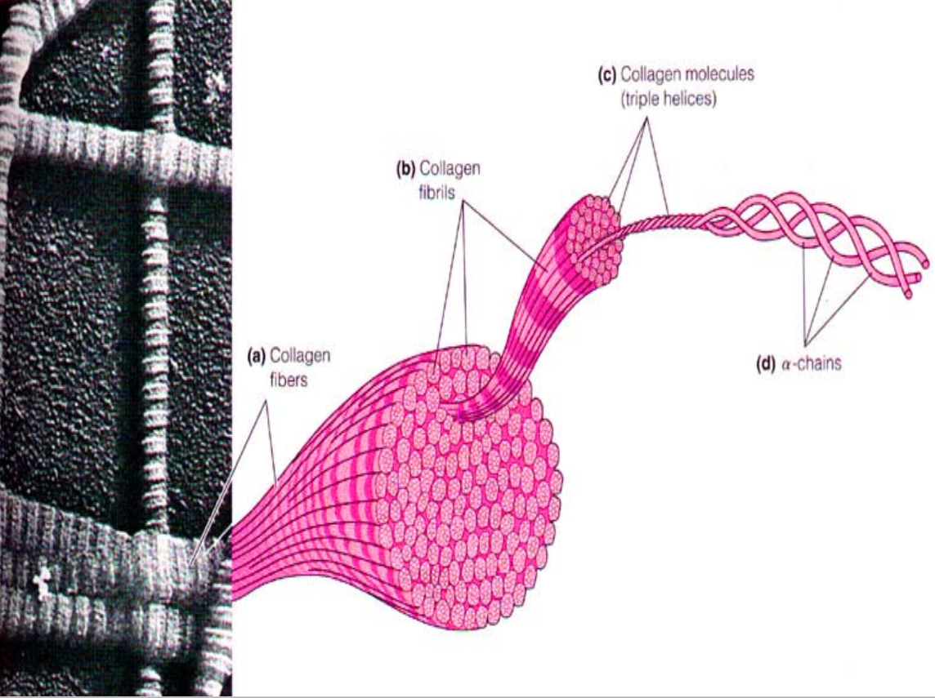
The structure of collagen

Slide 64
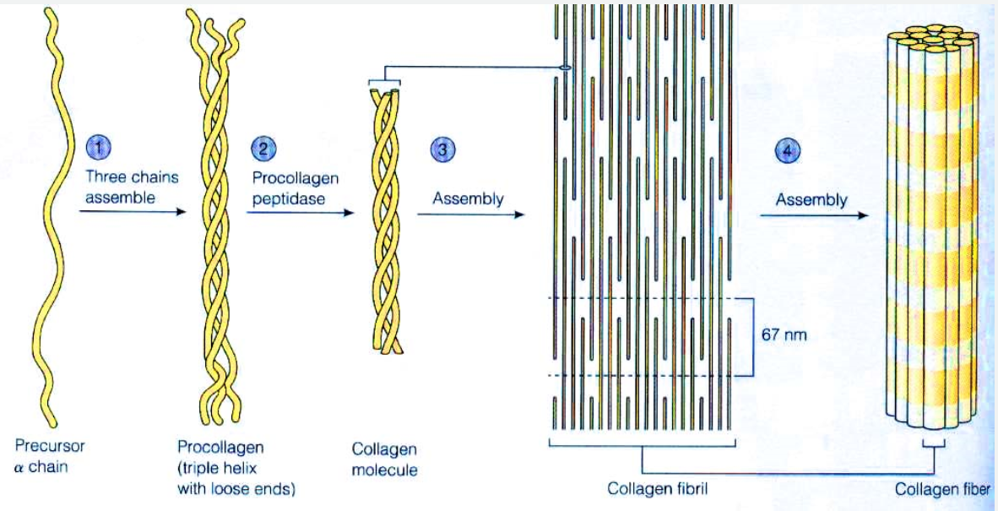
Assembly of collagen fibers begins in the endoplasmatic reticulum
and is completed outside the cell

Slide 66
Dermis

Slide 67
Skin has three layers:
1. Epidermis
2. Dermis
3. Subcutaneous tissue
Notes:
Dermis lies between epidermis and the subcutaneous fat. It supports epidermis nutritionally and structurally. Its thickness varies, being greatest in the palms and soles, and least in the eyelids. In old age the dermis thins and loses elasticity.

Slide 68
rete pegs/epidermal ridges
dermal papillae
Notes:
The dermis interdigitates with epidermis, so upward projections of the dermis – dermal papillae interlock with with down ridges of the epidermis – the rete pegs. This interdigitation is responsible for ridges seen most readly on the fingertps as fingerprints. It is important in the adhesion between epidermis and dermis as it incerases the area of contact between them.

Slide 69
papillary
dermis
collagen fibers
elastic fibers
ground substance
inflammatory cells
fibroblasts
mast cells

Slide 71
UV
collagen synthesis
matrix metalloproteinases
destroy collagen fibers
fibroblast

Slide 72
reticular
dermis
collagen and
elastic fibrs

Slide 73
Fibers of the dermis
collagen fibers 70-80% dry weight
stabilized by
covalent cross
links involving
lysine and
hydroxilysine
proline
hydroxyproline
glycine as every third aminoacids
Notes:
The dermis is largely made of interwoven fibers principally collagen paked in the bundles. Those in papillary dermis are finer than those in the deeper reticular dermis. Collagen makes up 70-80% of the dry weight of the dermis. These molecules consist of three polypetide chains forming a triple helix with non helicaly segments on the both ends. Collagen is unusual protein as it contains a high proprtion of proline and hydroxyproline and many glycine residues. The spacing of glycine as every third amino acid is prerequisite for the formation of a triple helix. Defects in the enzymes needed for collagen synthesis are responsible for some skin disorders including the Ehlers-Danlos syndrome, lastyrism (fragility of skin and other connective tissues) and osteogenesis imperfecta.

Slide 74
Distribution of some types of collagen
Notes:
There are many genetically distinct collagen proteins all with triple helical molecules, and all rich in hydroxyprolinen and hydroxylisine

Slide 75
Abnormalities in the collagen tissue
Ehlers-Danlos syndrome
osteogenesis
imperfectas

Slide 76
Fibers of the dermis
elastic fibers about 2% of the dry weight
von Gieson elastin stain
shows elastic fibers
Notes:
Elastic fibers intermingled with the collagen return skin in to unstreched state. They account for about 2% of dry weight.

Slide 77
Abnormalities in the elastic tissue
pseudoxanthoma
elasticum
cutis laxa

Slide 78
Ground substance of the dermis
Notes:
The amorphous ground substance of the dermis consists of of two glycosaminogycans (hyaluronic acid and dermatan sulphate) with smaller amounts of heparan sulphate and chondroitine sulphate. The ground substance has several important functions; 1. it binds water, allowing nutrients, hormones and waste products to pass through the dermis; 2. it acts as lubricant between collagen and elasric fibre network; 3. it provides bulk, allowing the dermis to act as a shock absorber.

Slide 79
Blood
vessels
capillary
loops
superficial plexus
deep plexus
(just above subcutaneous fat)
Notes:
Deep plexus lies just above subcutaneous fat, and its arterioles supply the sweat glands and hair papillae.
The supeficial plexus is in the papilary dermis and arterioles from it become capillary loops in the dermal papillae. An arteriole arising in the deep dermis supplies an inverted cone of tissue vith base at the epidermis.
The blood vessels in the skin are important in thermoregulation. Under sympathetic nervous control artheriovenous anastomoses at the level of the deep plexus can shunt blood to the venous plexus at the expense of the papillary loops, thereby reducing surface heat loss by convection.

Slide 80
Cutaneous
lymphatics
afferent lymphatics begin
as blind-ended capillaries
Notes:
Afferent lymphatics begin as blind-ended capillaries in the dermal papila and pass to a superficial lymphatics plexus in the papillary dermis. There are teo deeper horizontal plexuses, and collecting lymphatics from the deeper one run with the veins in the superficial fascia.

Slide 81
Nerves
autonomic
nerves
Notes:
The skin is liberally supplied with an estimated 1 000 000 nerve fibers. Most are found in the face and extremities. Their cell bodies lie in the dorsal root ganglia. Both myelinated and non-myelinated fibres exist. Non-myelinated are in increasing proportion peripherally.

Slide 82
Sensory receptors:
touch
temperature
pain
itch
Notes:
Živci završavaju u koži u obliku tjelešaca koja imaju određenu funkciju, a to su receptori za dodir, toplinu, bol i svrbež.

Slide 83
Skin has three layers:
1. Epidermis
2. Dermis
3. Subcutaneous tissue
Notes:
Dermis lies between epidermis and the subcutaneous fat. It supports epidermis nutritionally and structurally. Its thickness varies, being greatest in the palms and soles, and least in the eyelids. In old age the dermis thins and loses elasticity.

Slide 84
organisation of
subcutaneous tissue
septum
lobule

Slide 85
Skin is immunological
battleground of body
Notes:
The skin acts as barrier to prevent injury of underlying tissue and to prevent infections from entering the body. Simply it keeps the inside in and the outside out

Slide 86
neither CD4
nor CD8
helper
cytotoxic
can kill virally
infected cells or
tumour cells
(not previously sensitized
with antibody)
without activation of
specific lymphocytes
Notes:
CD4 (induce immunologic response and inflammation) and CD8 (induce lyse of infected, grafted and cancerous cells. Most inflammatory responses are polyclonal, while malignat is composed of unique clone.
NK cells are neither CD4 nor CD8. They kill virally infected cells or tumour cells without previously sensitation. They develop in bone marrow.

Slide 87
Immune system
Non specific immunity
/innate/
Specific immunity
/adaptive/
memory of previous contact
specific for antigene
long lasting
four main types of responses
without pevious contact
fast non-specific response
a.b
t1/2
2-3 days
10x> u ac. inflammation
IL
Notes:
Prodoor kroz anatomsku barijeru može potaknuti dva tipa imunološkog odgovora i to prirođeni koji je nespecifićan i ne zahtijeva prethodni kontakt s alergenom, dakle ne treba imunološko pamćenje. Komponente ovoga sustava su neutofili, makrofazi i dendritske stanice. One predočavaju dijelove fagocitiranih alergena i predočavaju ih T limfocitima koji čine dio specifične imunosti te se na taj način isprepliću ova dva imunološka odgovora.
Stečeni ili prilagodbeni (adaptivni) pamti prethodno izlaganje alergenu i specifično je za alergen. Brojne molekularne komponente sudjeluju u obe vrste imuniteta pa se ispreprliću. Primjer je IgE p.t. koje može vezivanjem za mastocite inducirati imunološki odgovor.
Uspješna imunološka obrana podrazumijeva aktivaciju, regulaciju i uspješnu rezoluciju (iščezavanje) imunološkog odgovora.
Koštana srž proizvodi 100 milijardi PMN da dan, a 10x više u fazi akutne upale.
Svaki od ovih dvaju imunoloških odgovora ima staničnu i humoralnu komponentu. Obe su ove faze isprepletene i teško ih je odvojiti.

Slide 88
Antibodies
IgG is responisble for long lasting humoral immunity, cross the placenta, activates complemnet
IgM is the largest, it is the first after immunisation, do not cross placenta
IgA acts as protective paint in g.i.t and respiratory tract
Notes:
IgG is responisble for long lasting humoral immunity. It can cross the placenta and binds complement to activate the classic complement pathway. IgG can coat neutrophils and macrophages and act as an opsonin.

Slide 89
defensins
complement
TLRs (macrophages, Treg, LC)
APC
Notes:
Defensins in epidermis inhibit bacterial replication there. Complement can be activated by many infection agents, and TLRs react with various causative agents and different chemicals..

Slide 90
Notes:
U koži nalazimo sva 4 imunološka tipa rekacija po Coombsu.

Slide 91
I type
(anaphylaxis)
II type
(cytotoxic)
III type
(immune complex)
IV type
(delayed
hypersenitivity)
Notes:
The Gell and Coombs system defines four basic immunologic mechanisms for drug reactions.25 Type I reactions (anaphylaxis) result from IgE antibodies binding to drug antigen and cross-linkage of adjacent IgE molecules, leading to mediator release. Type II (cytotoxic) reactions occur when IgG or IgM antibodies recognize drug antigen associated with cell membranes, causing complement activation. Type III (immune complex) reactions involve the formation of antigen-antibody complexes. Type IV (delayed hypersensitivity) reactions are mediated by sensitized lymphocytes.

Slide 92
crosslinking
IgE
IgE
mast cell
Notes:
IgE binds to Fc receptors on mast cells and basophils, where it sensitizes them to release inflammatory mediators in type I immediate hypersensitivity reactions.

Slide 93
Mast cells are important effector cells for anaphylaxis
IL-1, IL-2,
IL-3, IL-4,
IL-5, IL-6,
IL-8, IL-10,
IL-13, TNFα,
MIPs, IFN-γ,
GM-CSF,
TGF-β, bFGF,
VPF/VEGF,
PGD₂, LTB₄,
LTC₄, PAF,
histamine,
serotonine,
heparine,
chondroitin-
sulfate,
chymase,
tryptase,
carboxy- peptidase
aactivation
extravasation
MC
vasodilatation
cells
recruitment
Prof. M. Maurer
Notes:
There are two distinct populations of mast cells; connective tissue and mucosal. They differ in their staining properties, content of inflammatory mediators and proteolytic enzymes. Skin mast cells play a central part in the pathogenesis of urticaria.

Slide 94
I type
(anaphylaxis)
II type
(cytotoxic)
III type
(immune complex)
IV type
(delayed
hypersenitivity)
Notes:
The Gell and Coombs system defines four basic immunologic mechanisms for drug reactions.25 Type I reactions (anaphylaxis) result from IgE antibodies binding to drug antigen and cross-linkage of adjacent IgE molecules, leading to mediator release. Type II (cytotoxic) reactions occur when IgG or IgM antibodies recognize drug antigen associated with cell membranes, causing complement activation. Type III (immune complex) reactions involve the formation of antigen-antibody complexes. Type IV (delayed hypersensitivity) reactions are mediated by sensitized lymphocytes.

Slide 95
Ni, Co, Cr
fragrance, preservative,rubber,neomycin
24h
48h
Notes:
Dendritic cells come from the bone marrow and move into the epidermis where they remain. Their dendrites intercalate between keratinocytes

Slide 96
Hair

Slide 98
has 100 000 hairs
hair grows for about 1000 days
sheds about
100 hairs/day

Slide 99
testosteron
independent hairs

Slide 100
The hair cycle:
Anagen phase /active/ 3-5 years
Catagen phase /conversion/ few weeks
Telogen phase /resting/ 3-4 months

Slide 102
telogen
anagen

Slide 103
hair papilla
hair matrix
hair bulb

Slide 104
Three main types of hair:
lanugo hairs – fine long hairs covering the foetus
shed about 1 month before birth
2. vellus hair – fine short unmedullated hair covering
much of the body surface. They replace lanugo just
before birth
3. terminal hairs – long coarse medullated hairs seen
in the scalp or pubic region. Growth is influenced by
circulating androgen levels.

Slide 105
sebaceous gland
always with hair follicle

Slide 106
apocrine glands
connected with the follicle

Slide 107
eccrine glands /sweat gland/
independent of follicle

Slide 108
Nails
free margin
lateral margin
nail plate
lunula
eponihium
proximal margin

