Slide 1
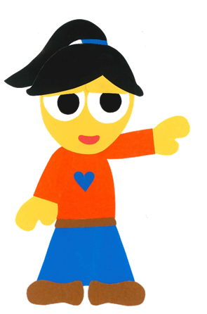
WE
CAN
READ
Donald Joyce

Slide 2
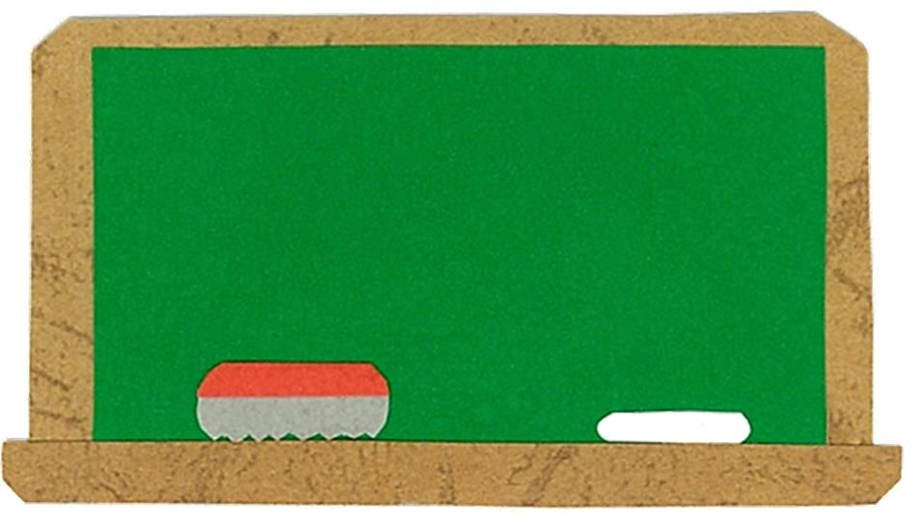
Let’s
Talk!

Slide 3
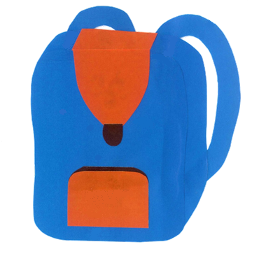
What is in your schoolbag?
I have ___.

Slide 4
What is in your schoolbag?
I have ___.
Me too!

Slide 5
Let’s
Learn!

Slide 6
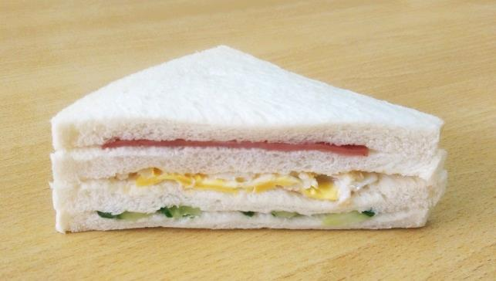
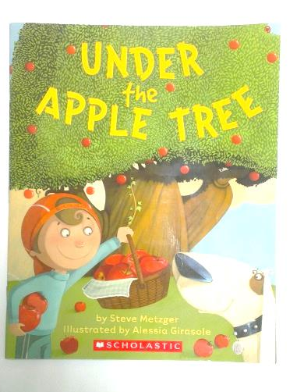
schoolbag
scissors
sandwich
pencil
book
ruler
eraser

Slide 7
Let’s
Read!

Slide 8
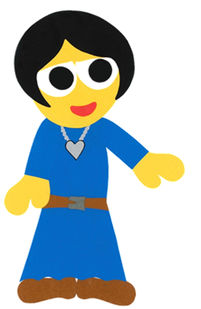
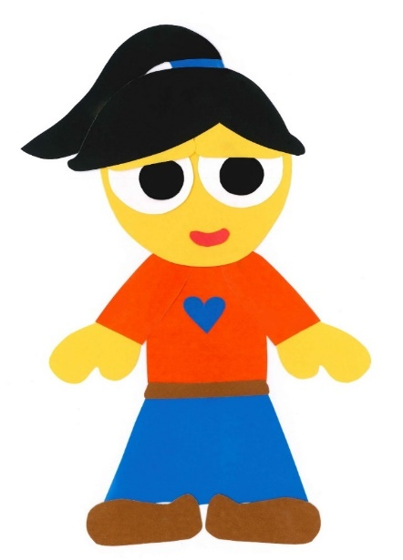
What Is In Your Schoolbag?
WE CAN READ
By: Donald Joyce

Slide 9
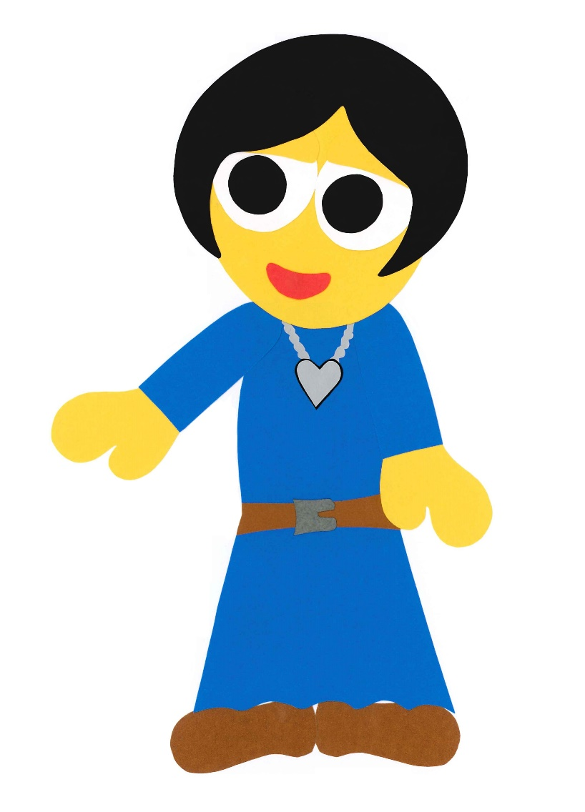
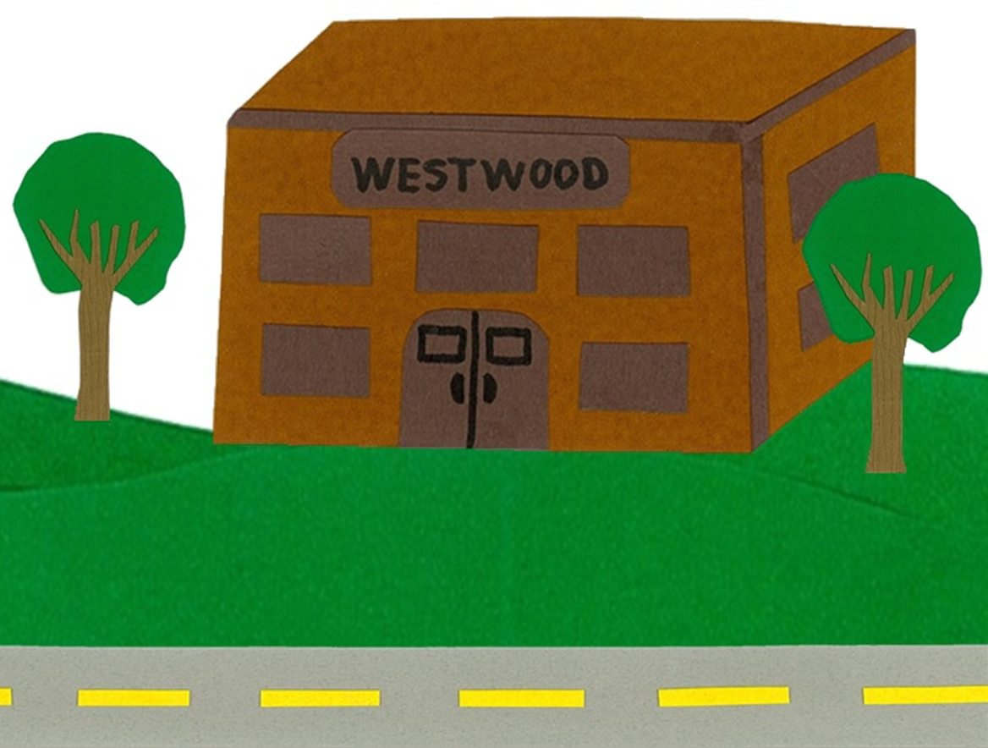
Are you ready for school?

Slide 10
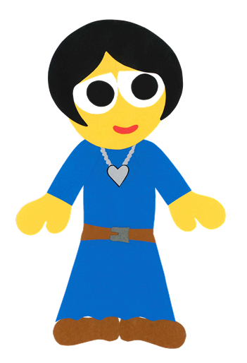
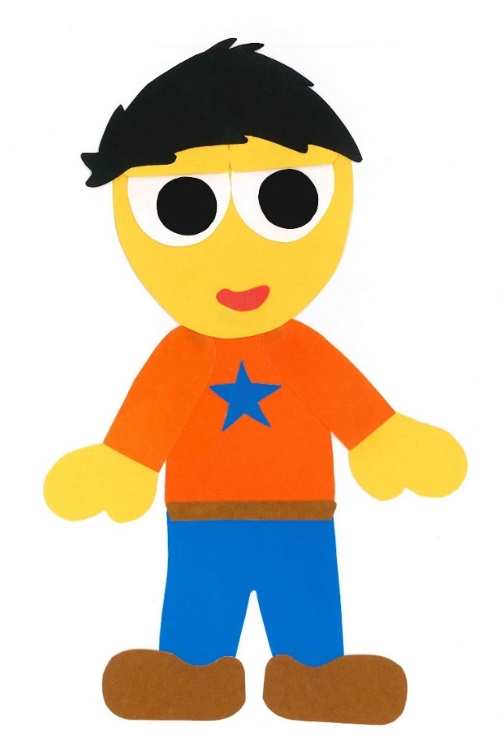
Yes, we are.
Yes, we are.

Slide 11
What is in your schoolbag, Kelly?

Slide 12
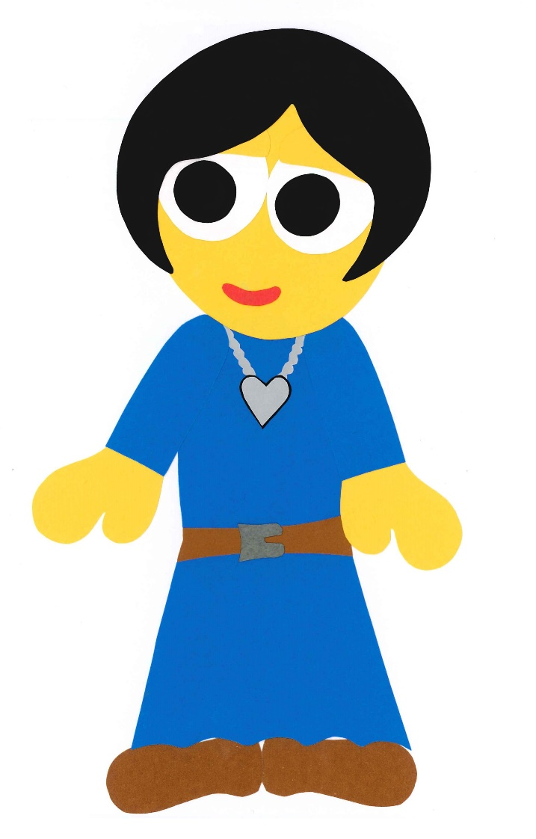
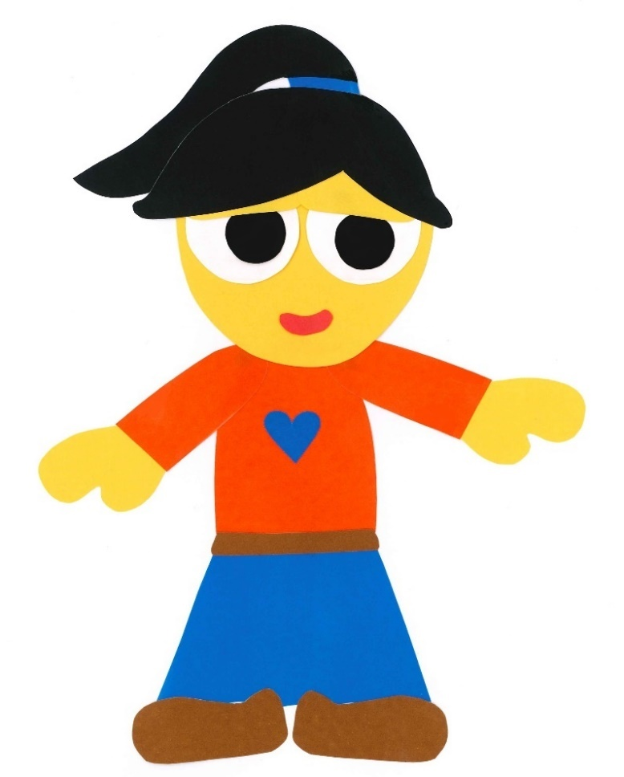
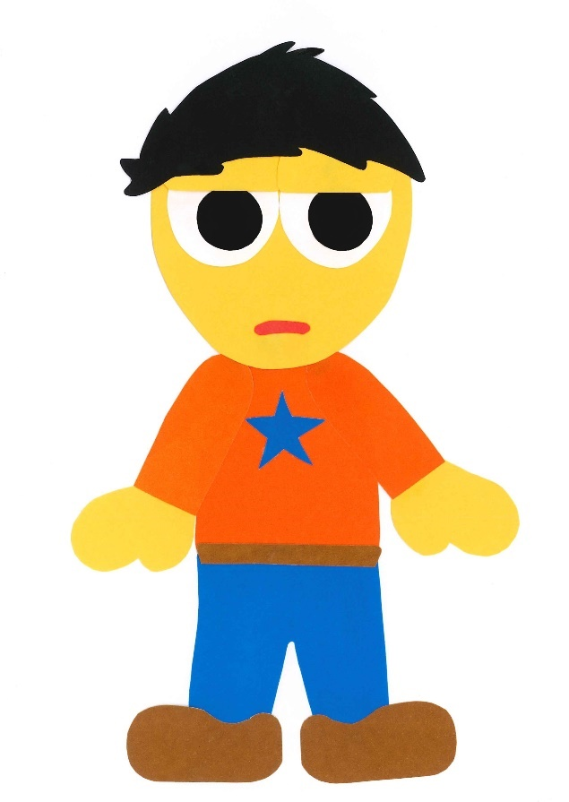
I have a pencil.

Slide 13
I have an eraser.

Slide 14
I have a ruler.

Slide 15
I have scissors.

Slide 16
I have a book.

Slide 17
What is in your schoolbag, Kevin?

Slide 18
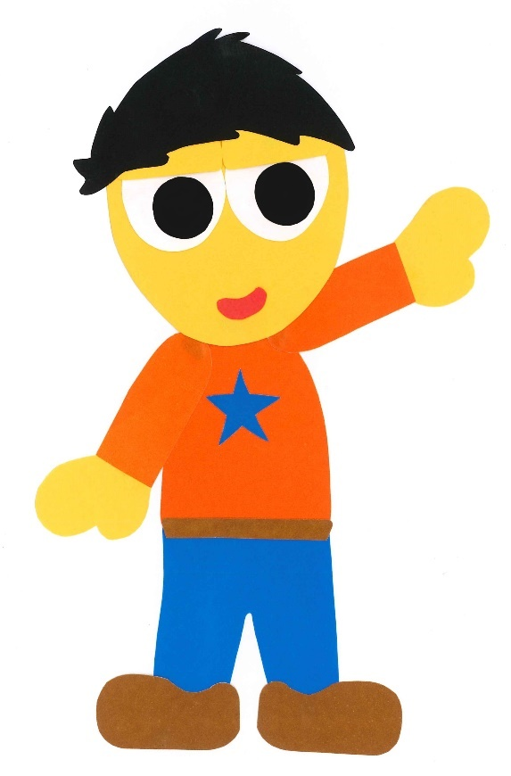
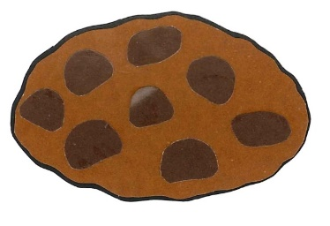
I have a cookie.

Slide 19
I have a sandwich.

Slide 20
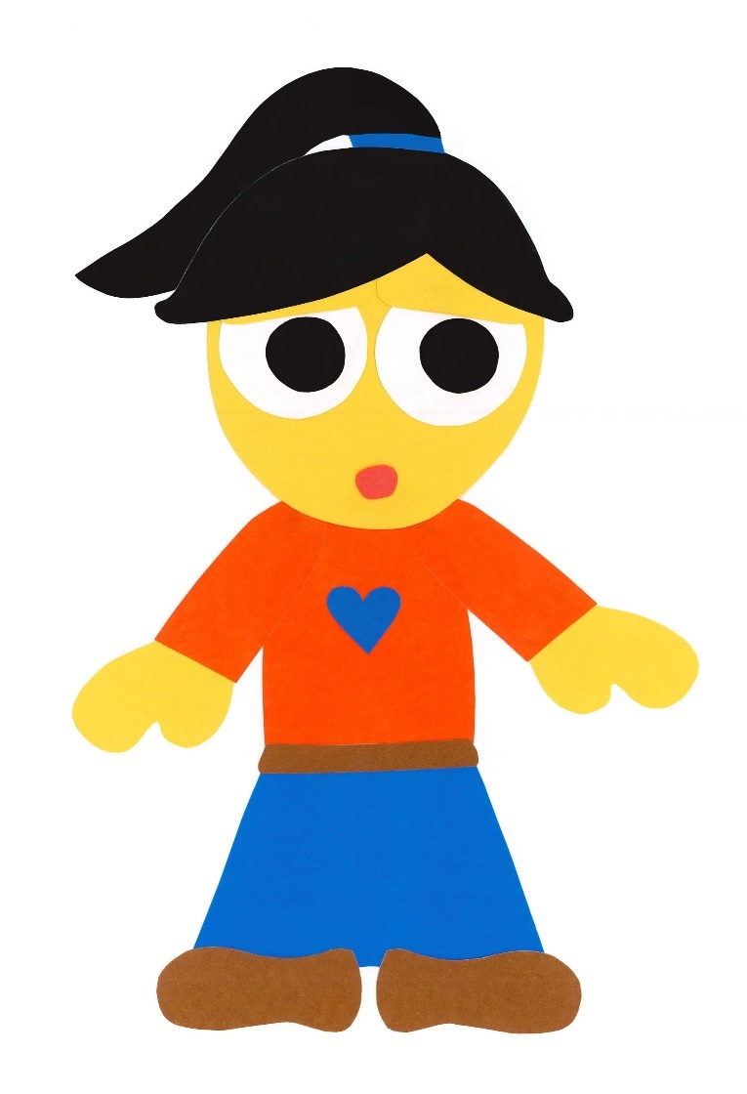
I have a pizza.

Slide 21
What Is In Your Schoolbag?
WE CAN READ
By: Donald Joyce

Slide 22
Let’s
Review!

Slide 23
Sam has _____.

Slide 24
Sam has a pencil.

Slide 25
Sam has _____.

Slide 26
Sam has an eraser.

Slide 27
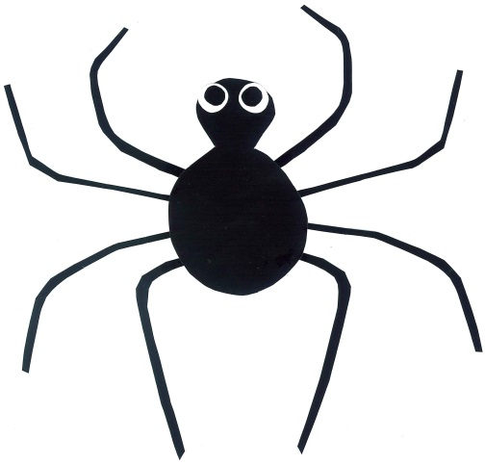
Sam has _____.

Slide 28
Sam has scissors.

Slide 29
Sam has _____.

Slide 30
Sam has a ruler.

Slide 31
Sam has _____.

Slide 32
Sam has a book.

Slide 33
Let’s
Connect!

Slide 34
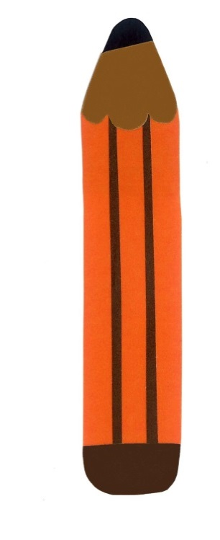
Get a pencil and paper!

Slide 35
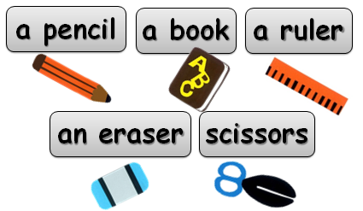
What is in your schoolbag?
I have ___.

Slide 36
WE
CAN
READ
www.teacherdonald.com

