Slide 1


The Family Is A System
The Family Solution Finder Learning Seminars

Slide 2
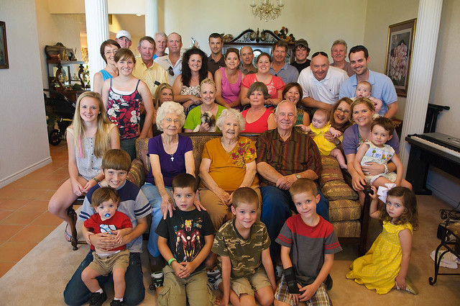
The Family Seeks Balance
Being in Balance means Everyone contributes to support the family’s ability to function.
Being Out of Balance Means One family member dose for the other what they should do for themselves.
What can correct balance? Family Therapy.
How do families get unbalanced? Substance use disorder in a family can Creates unbalance.
Notes:
The family Solution Finder has 32 1.5hr seminars coving all the issues a family will likely face in their journey. The family can view these in the monthly meeting or at home. Each issues require a family plan of action

Slide 3


Slide 4

Program Overview
Homeostasis
Functionality
Potentiality
Denial, Enable, co-dependency
Practical Exercises

Slide 5
Each Family Member has a level of Functionality.
Use Practical Exercise # One to determine your Individual family members functionality and potentiality
1. Functionality, as a family member we all have our own individual issues, How well equipped we are to deal with our own issues as we seek to participate in the family system becomes our degree of functionality. How well does each fulfill their role in the family?
3. Being Function means we are in balance with ourselves so we can contribute to the family dynamic in a positive and productive manner.
2. Functionality is measured by how well we can participate with the family issues while at the same time dealing with our own individual issues. Use the practical exercise to evaluate your family members functionality.
Notes:
The SP~ARK’s Program is a self-administered faith development program that has three steps.
Self evaluation
Scoring and identify faith practices strengths and weaknesses.
Plan of Action for self directed learning.

Slide 6
CAN THEY DO IT? Potentiality
Functionality and Potentiality is a matter of can they bring forward their ability as a function into the family dynamic to participate in collectively on a family issue. What is their potential to do this?
What happens if potentiality is low? Hopefully, acceptance, understanding and help. There is no advantage towards eliminating a family member because they have a low potentiality to participate in a specific family issue. Some members will be stronger than others, and this is in part what makes us unique.
This difference also helps us to need each other as one complements the other. This intra-dependence is healthy when in balance.
Notes:
We will first look at the structure of the entire workbook.
The go into the purposeful driven ministry, then all three programs.

Slide 7
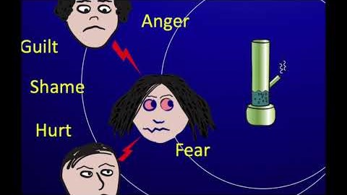

Slide 8
Obstacles in seeking balance: Family Members Denial, Enabling and codependency
Denial: Tends to feel the problem is not true.
Enabling: Tends to provide one or more of the 10 types of enabling that allows or supports wrong choices and behavior.
Codependency: Tends to get a type of reward from the person misuse of substances.
Notes:
For each of the following use the sample sheet provided in your handouts, then complete the exercise.

Slide 9
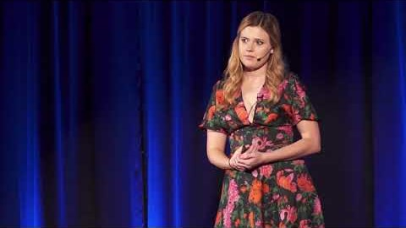

Slide 10

Apply what you Learn
The Family Solution Finder, Workbook Module II
The Family Solution Finder, 3-D’s Coping Skills Workbook Learning module III
The Family Solution Finder, Local Resource Connections Workbook Learning Module IV

Slide 11
Conclusion
Homeostasis: Balancing the family system
Functionality: skills and gifts of each individual family member
Potentiality: Likelihood of the family member to contribute
Obstacles: Family members Denial, Enable and Codependency
Complete a “Family’s Best Practices Model and Plan of Action” for this issue

Slide 12
CONTACT US:
Roy Poillon Executive Director/Founder
  Office: 440.385.7605 Mobile: 814.722.8946
  Familiesimpactedbyopioids@gmail.com
  www.Familiesimpactedbyopioids.com
  LinkedIn Roy Poillon
  Facebook: Familiesimpactedbyopioids public group
  Instagram: Families Impacted by Opioids
  ALWAYS SEEK THE ADVICE OF A PROFESSIONAL THERAPIEST BEFORE ACTING ON ANY PART OF THE INFORAMTION PROVIDED IN THESE PROGRAMS.

