Slide 1
Stopping Politics in K-12 with Academic Transparency
Van Sittert Center for Constitutional Advocacy

Slide 2
“Fake Outrage”
“There are a lot of critical issues facing public schools right now, but one of them that’s actually not critical is whether or not they are teaching Critical Race Theory…
Critical Race Theory is not a public school curriculum. It is not being taught in public schools...
I think it’s something that should be left to legal scholars to debate and not for us to try and debate in a local school board meeting, when it’s not something that local schools are doing.”
--Chip Slaven, National School Boards Association Executive Director
https://www.wvpublic.org/section/education/2021-08-12/new-head-of-national-school-boards-association-talks-masks-critical-race-theory-and-ways-forward-post-pandemic

Slide 3
“Fake Outrage”
School board member: “When was the last anti-CRT conference you had? I’ll answer for you, you’ve never had one.”
Response: “That’s correct, sir, because education equity is one of our priorities.
--ASBA Associate Executive Director Tracey Benson
https://goldwaterinstitute.org/localcontrol/

Slide 4
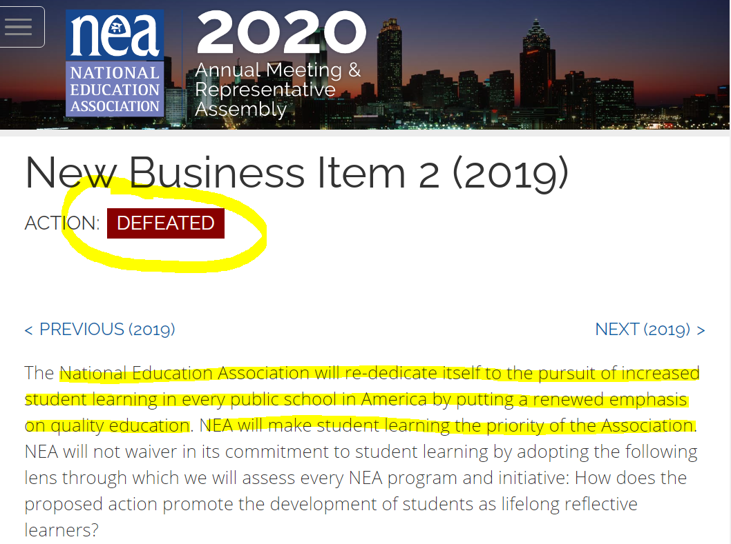
See https://indefenseofliberty.blog/2019/07/16/has-red-for-ed-turned-its-back-on-its-supporters/

Slide 5
New Business Item 11 (2019)
See https://indefenseofliberty.blog/2019/07/16/has-red-for-ed-turned-its-back-on-its-supporters/

Slide 6
New Business Item 25 (2019)
See https://indefenseofliberty.blog/2019/07/16/has-red-for-ed-turned-its-back-on-its-supporters/

Slide 7
New Business Item 56 (2019)
See https://indefenseofliberty.blog/2019/07/16/has-red-for-ed-turned-its-back-on-its-supporters/

Slide 8
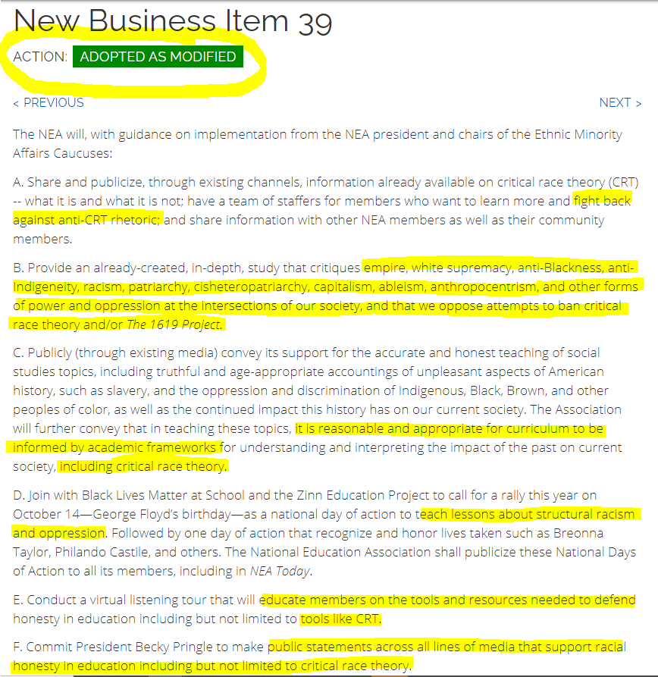
https://web.archive.org/web/20210705090534/https://ra.nea.org/business-item/2021-nbi-039/

Slide 9
Published in the “Education Newspaper of Record” Education Week (Fall 2020):
“Keeping Politics Out of the Classroom Is Like Keeping the Water Out of Rain
We must take up controversial issues like racism, sexism, homophobia, or xenophobia, or inherently political topics such as gun control or climate change…”
http://blogs.edweek.org/teachers/classroom_qa_with_larry_ferlazzo/2020/10/keeping_politics_out_of_the_classroom_is_like_keeping_the_water_out_of_rain.html?cmp=eml-enl-eu-news2&M=59724826&U=&UUID=85ec34aa2ce3d4f15d60e72e6f86cde1

Slide 10
Published in the “Education Newspaper of Record” Education Week (Fall 2020):
“Principals Need Help Building Anti-Racist Schools
…make social justice, equity, and anti-racism more prominent in the curriculum. The key…is hiring the right people and having the backing from the top…
…developing new syllabi and experiences for aspiring school leaders…”
https://www.edweek.org/leadership/principals-need-help-building-anti-racist-schools/2020/09?r=1480413213&cmp=eml-enl-eu-news2&M=59710439&U=&UUID=85ec34aa2ce3d4f15d60e72e6f86cde1

Slide 11
Published in the “Education Newspaper of Record” Education Week (Spring 2021):
“Same old Civics Ed. Won’t Save Us
We do not need this restoration of American civic education. We need a total reconstruction…
1. Facts and patriotism are not the answer.
2. It’s long past time to confront white supremacy.
3. Every teacher is a civics teacher.
Teachers of all subjects can and must connect their subject areas to real-world issues if schools hope to sustain democracy. ”
https://www.edweek.org/teaching-learning/opinion-same-old-civics-ed-wont-save-us/2021/01

Slide 12
New York Times 1619 Project Rewriting American History for the Next Generation
https://www.nytimes.com/2020/06/18/insider/nikole-hannah-jones-1619.html

Slide 13
New York Times 1619 Project Rewriting American History for the Next Generation
https://www.nytimes.com/2020/06/18/insider/nikole-hannah-jones-1619.html

Slide 14
The 1619 Project in the Classroom
“Shana Hairston, a high school history teacher ... will be teaching a personal finance class this semester and said she could teach students about how capitalism works by using the 1619 Project essay linking capitalism to slavery.”
https://www.realclearinvestigations.com/articles/2020/01/31/disputed_ny_times_1619_project_is_already_shaping_kids_minds_on_race_bias_122192.html

Slide 15
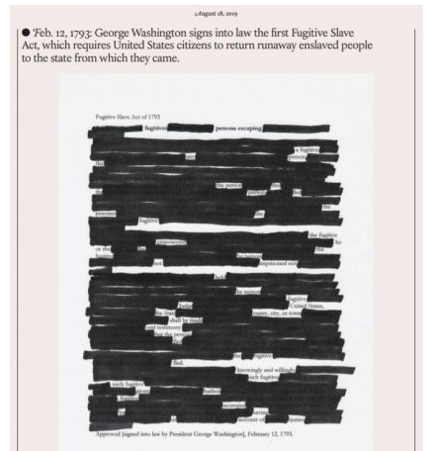
Sample 1619 Project Curriculum Material
“Erasure Poetry: Highlighting Inequities, Envisioning Liberation”
“…lay bare the real purpose of the document or transform it into something wholly new”
Among suggested documents: Declaration of Independence
“Create an erasure of your chosen document.”
https://pulitzercenter.org/builder/lesson/activities-extend-student-engagement-26505

Slide 16
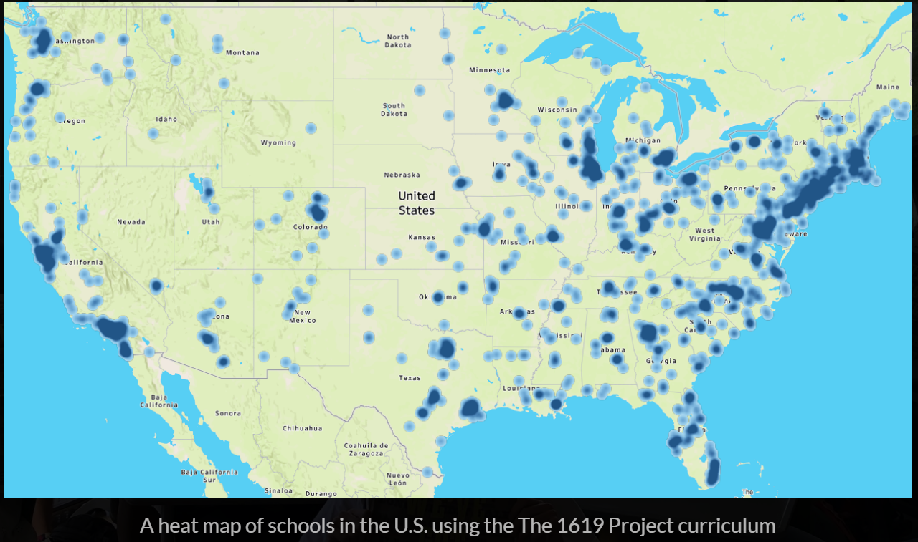
Do You Know Where the 1619 Project is Being Taught in AZ? Do Parents?
“Since its publication in August [2019], the 1619 Project has been adopted in more than 3,500 classrooms in all 50 states. It is mostly being used as supplemental, optional classroom teaching material. By and large, school systems are adopting the project by administrative fiat, not through a public textbook review process.”
https://www.realclearinvestigations.com/articles/2020/01/31/disputed_ny_times_1619_project_is_already_shaping_kids_minds_on_race_bias_122192.html ; https://pulitzercenter.shorthandstories.com/2019-annual-report/index.html

Slide 17
Publishers Pushing Radical Content, as Parents Left in the Dark
From Penguin Random House Publishers, email to Arizona School District staff:
“I wanted to specifically highlight some books that have been at the crux of current conversations on race and social justice in which many educators in AZ have been expressing interest. These books can be included in your curriculum, be the basis for an all school read, or added to your classroom library…”
How to Be an Anti-Racist, by Ibram Kendi, states: “The most threatening racist movement is … the regular American’s drive for a race-neutral” state…“The only remedy to racist discrimination is antiracist discrimination. The only remedy to past discrimination is present discrimination.”
White Fragility, by Robin DiAngelo, states “I strive to be ‘less white.’ To be less white is to be less racially oppressive”

Slide 18
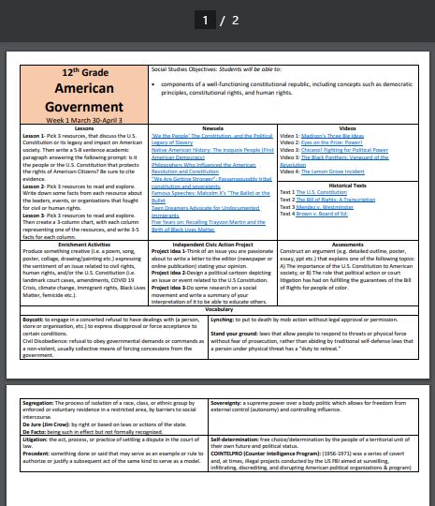
“Curriculum” Less Important than What’s Underneath. Example: Tucson Unified School District, AZ
Social Studies Objective:
“Students will be able to: [identify] components of a well-functioning constitutional republic, including concepts such as democratic principles, constitutional rights, and human rights.”
Resources:
“The Black Panthers: Vanguard of the Revolution”, “Chicano! Fighting for Political Power”, “The Constitution and the Political Legacy of Slavery”, Malcom X’s “The Ballot or the Bullet”
Vocabulary
“boycott,” “civil disobedience,” “Jim Crow,” “stand your ground”, “lynching,” “segregation” “COINTELPRO (Counter Intelligence Program): a series of covert and, at times, illegal projects conducted by the US FBI aimed at surveilling, infiltrating, discrediting, and disrupting American political organizations & program[s].”
http://www.tusd1.org/Portals/TUSD1/District/docs/LearnFromHome/WeekOne/Week1Gr12AmericanGovernment.pdf

Slide 19
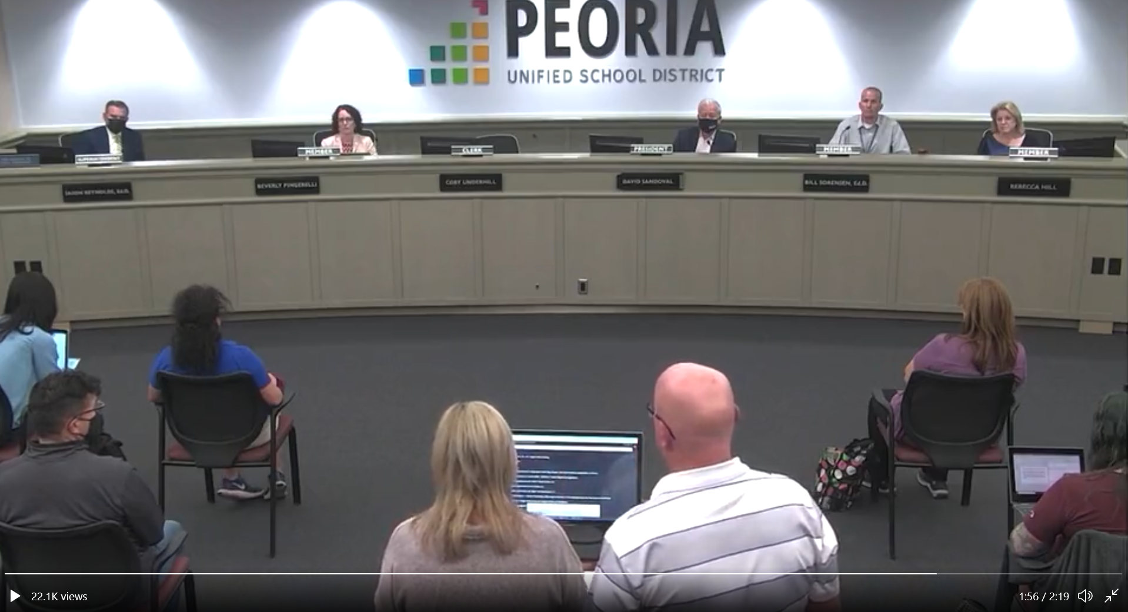
“Critical race theory wasn't the only reason we pulled our daughter from her school”
Amy and Shawn Souza
November 15, 2021
https://www.azcentral.com/story/opinion/op-ed/2021/11/15/critical-race-theory-one-reason-pulled-daughter-peoria-school/8592329002/

Slide 20
How Can States, School Boards Respond?

Slide 21
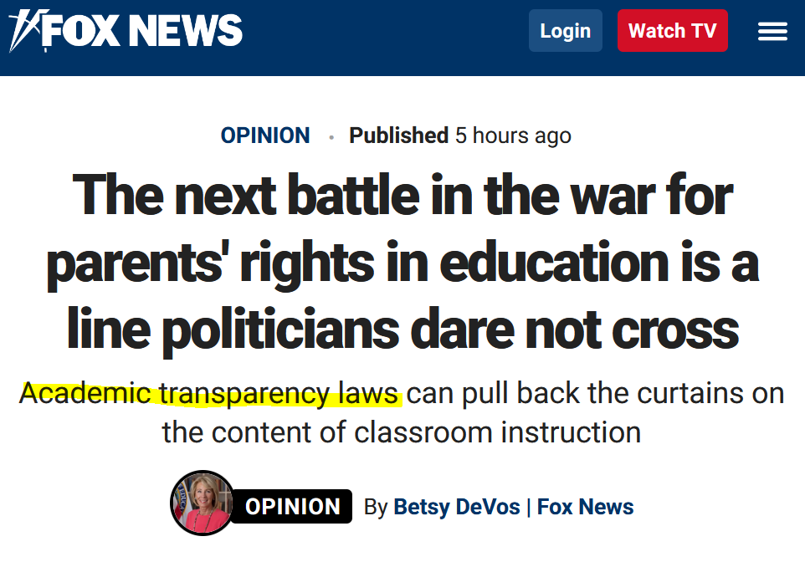
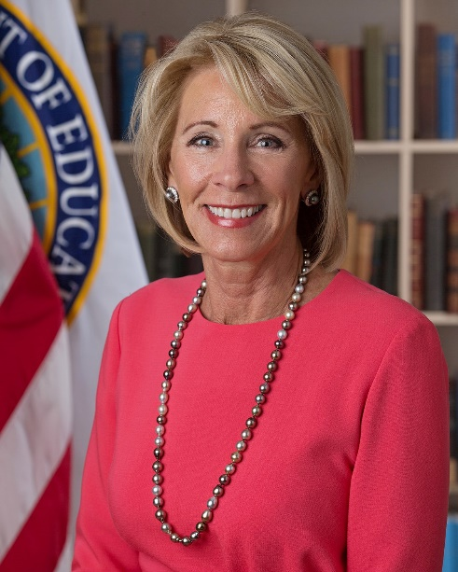
“Wisconsin lawmakers recently passed overwhelmingly the nation’s first, most powerful academic transparency law...”
“The bill requires schools to post online a list of the specific instructional materials being presented—so that current and prospective parents can see for themselves whether the content awaiting their kids is academically rigorous, or ideologically extreme.”
https://www.foxnews.com/opinion/betsy-devos-parents-rights-education-politicians

Slide 22
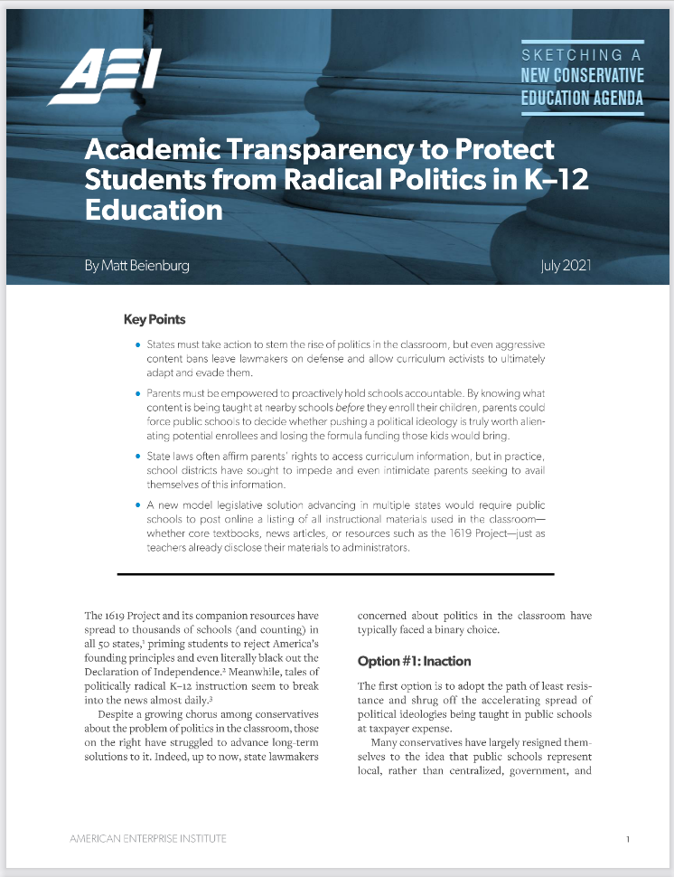
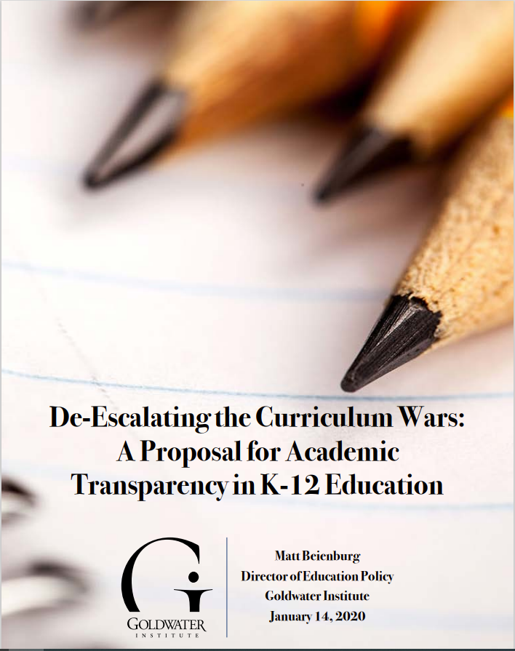
Academic Transparency: Sunlight is the Best Disinfectant
Parents should be able to know what content awaits at nearby schools before they have to enroll their children
Schools respond to incentives: If parents know which schools insist on pushing radical content, those schools will risk the further loss of students and their associated funding
Schools should not be hiding content from prospective parents: Reporting broad ‘curriculum’ frameworks, basic textbooks, etc. is no longer enough
It should not be harder for a parent to look up what schools are teaching than to locate complicated budget documents, financial data, etc. that schools are required to post online

Slide 23
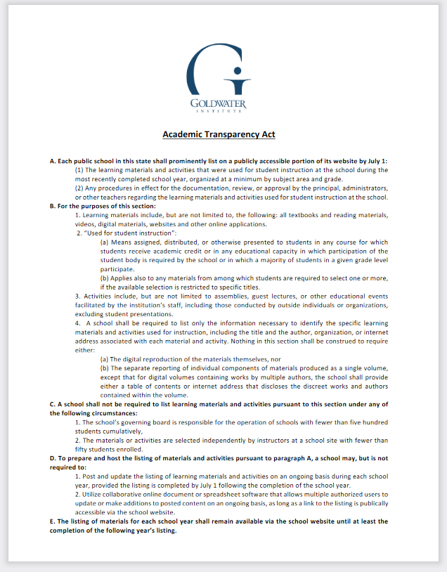
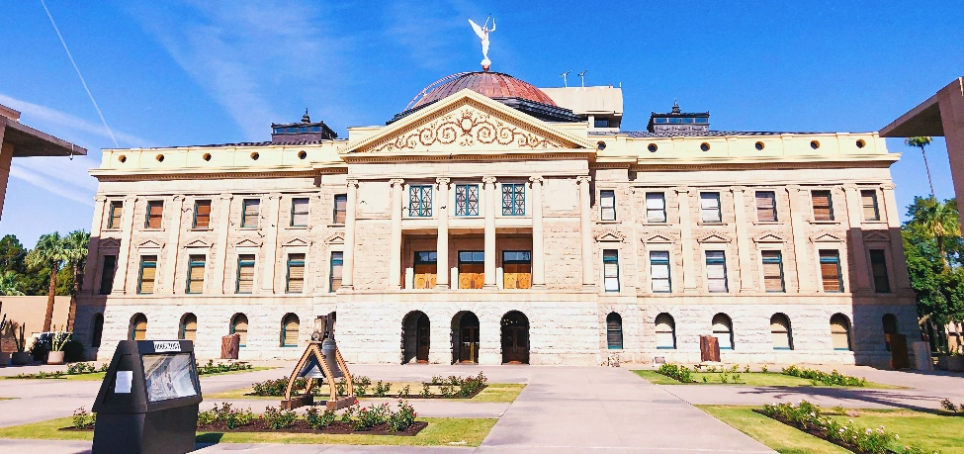
Goldwater Institute Academic Transparency Act Legislative Proposal
“Each public school shall prominently list on a publicly accessible portion of its website:
The learning materials and activities that were used for student instruction at the school… organized at a minimum by subject area and grade….”
https://azlibrary.gov/azcm/about

Slide 24
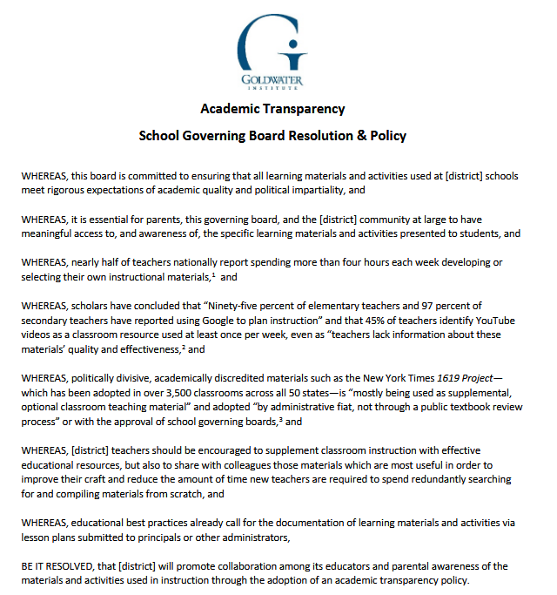
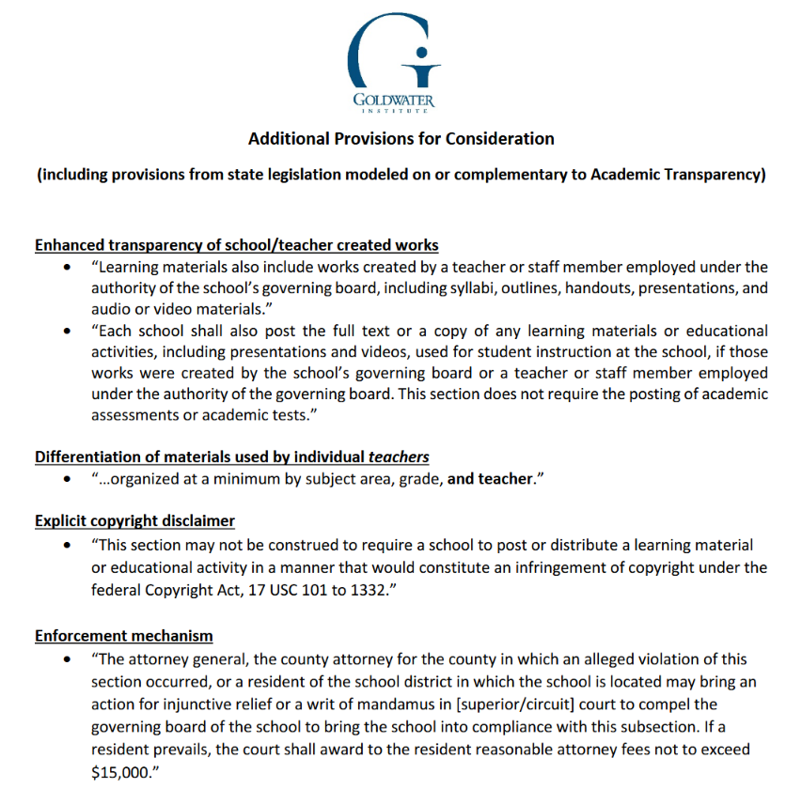
https://goldwaterinstitute.org/wp-content/uploads/2021/08/District-Version-Academic-Transparency-2021-8.pdf

Slide 25
Academic Transparency Act Key Features
Brings course content into the light in a practical, accessible way for parents
Ensures that board members and the public, not just teachers and career bureaucrats, know what is being taught
Provides comprehensive transparency
Doesn’t interfere with teachers’ ability to update lesson plans at any time during the year:
Minimizes the additional workload required to provide transparency
K-12 schools & universities have proven they can share course syllabi & other info online

Slide 26
How it Works
“A school shall be required to list only the information necessary to identify the specific learning materials and activities used for instruction, including the title and the author, organization or internet address…”
1 single entry
“Social Justice for Kids, https://nomadpress.net/the-learning-center/social-justice-for-kids/”
Multiple
authors
1 single entry
128 pages of separate readings/worksheets
“Grade 1 Basic Math Success Workbook, Sylvan Learning”

Slide 27
Options Already Exist

Slide 28
Perspectives from Teachers:
“This is a great collaborative effort for teachers and educators to find other resources that are effectively being used across the state and posting those and making them available for their colleagues.
As a former Wake County teacher, 20 years ago I provided all of this information. I turned in my lesson plans to my principal. Doing it electronically now would be so much simpler than what I was expected to do as a Wake County teacher. So all of this is stuff that I had to do as a teacher that now as a parent I would greatly appreciate.”
--Kelly M., North Carolina
“What the critical race theory debate misses: We really don’t know what’s happening in our classrooms… states, districts, and school boards have less control over what gets in front of students than do Google, Pinterest, and the lesson sharing website Teachers Pay Teachers — the top three places teachers go when looking for materials”
…the fact that so much of the curriculum in American classrooms is not codified in any meaningful way is an overlooked facet of the ongoing debate over critical race theory in schools.”
--Robert Pondiscio, Former Teacher, Senior Fellow, American Enterprise Institute
https://www.wral.com/gop-lawmakers-want-school-materials-listed-online/19660358/ ; https://www.aei.org/education/what-the-critical-race-theory-debate-misses-we-really-dont-know-whats-happening-in-our-classrooms/

Slide 29
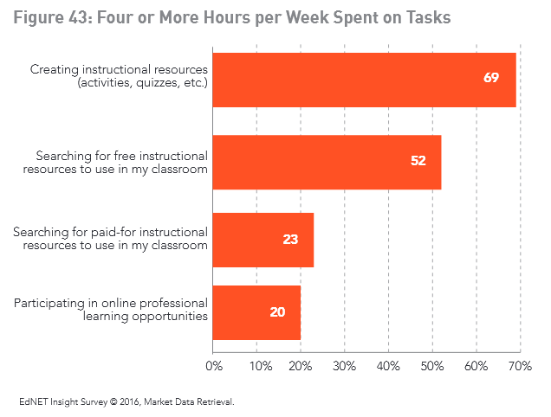
The Status Quo Wastes Teachers’ Time
“In total, teachers spent more than 12 hours each week creating or searching for materials, either free or for a fee. If there are four weeks in a month, teachers spent 50 hours each month on these tasks, taking away significant time from analyzing data, communicating with parents, and diagnosing specific student needs”
https://mdreducation.com/wp-content/uploads/2020/12/StateofK12Market2016_ClassroomTrends.pdf

Slide 30
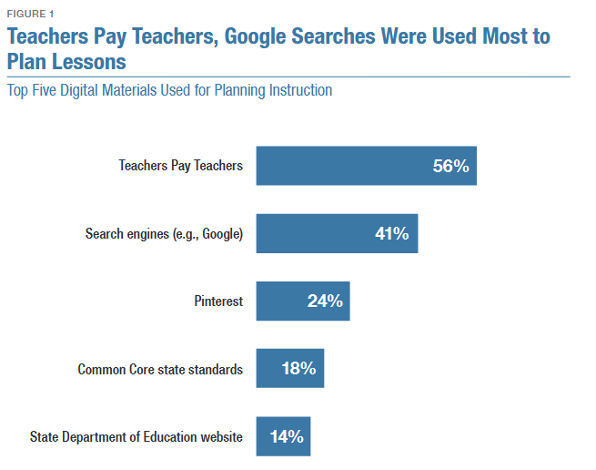
The Status Quo: Wasted Time, Lost Opportunity
“Ninety-five percent of elementary teachers and 97 percent of secondary teachers have reported using Google to plan instruction…However, teachers lack information about these materials’ quality and effectiveness.”
https://www.rand.org/content/dam/rand/pubs/research_reports/RR2500/RR2575z17/RAND_RR2575z17.pdf

Slide 31
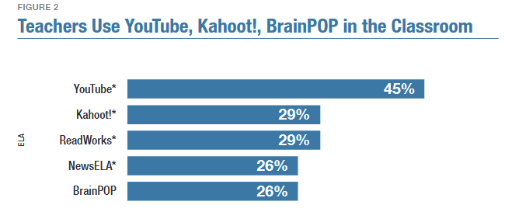
The Status Quo: Wasted Time, Lost Opportunity
This figure shows the top five digital materials that “my students use this once a week or more on their own during classroom instructional time” or that teachers report “I use this once a week or more during whole-class instructional time or to plan my instruction.”
https://www.rand.org/content/dam/rand/pubs/research_reports/RR2500/RR2575z17/RAND_RR2575z17.pdf

Slide 32
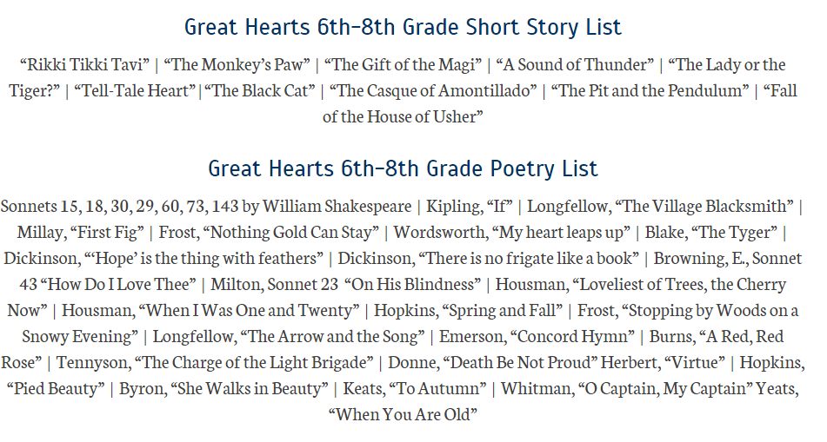
Academic Transparency Examples
https://www.greatheartsamerica.org/great-hearts-life/great-hearts-curriculum/curriculum-overview/

Slide 33
https://cptl.asu.edu/civic-literacy-curriculum

Slide 34
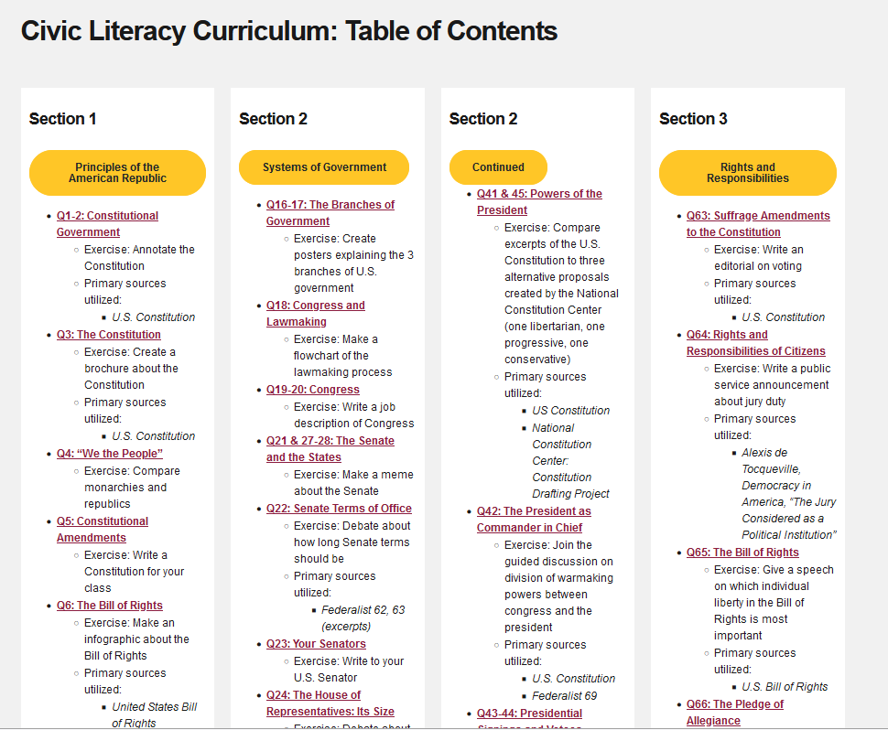
Q73: English Colonists
Exercise: Make an advertisement convincing a British citizen to move to America
Primary sources utilized:
Mayflower Compact
Virginia Declaration of Rights (1776)
Christopher Columbus’s Journal
Letters to Walter Raleigh

Slide 35
Q108: The Soviet Union
Exercise: Annotate Revelations from the Soviet Archives
Primary sources utilized:
Library of Congress Collection: Revelations from the Soviet Archives

Slide 36
Revelations from the Soviet Archives: Internal Workings of the Soviet Union (Library of Congress)
It is difficult for a human being even to imagine such terror, tyranny, violence, and lawlessness. When we went there, we could not conceive of such a horror, and now we, crippled ourselves, together with several thousands who are still there, appeal to the ruling center of the Soviet state to curb the terror that reigns there….
…indeed there are some guilty people, but the majority suffer innocently,
I saw all this with my own eyes and am not exaggerating. People are starving, living on food substitutes…
…on the table there were gnawed bones from a sickly horse…
…very small children as pale as wax with swollen cheeks sat at the filthy table like marmots, and with spoons ate, from a common cup, hot water into which had been added from a bottle a white liquid of questionable taste and sour smell…
Filipp Borodin…cries like a babe, asks death for his children. ....

Slide 37
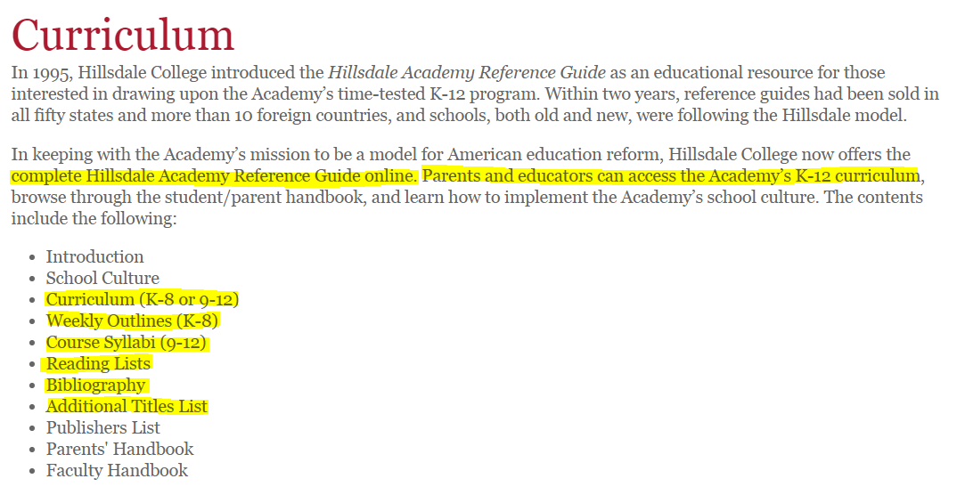
Academic Transparency Examples
https://academy.hillsdale.edu/academics/curriculum

Slide 38
Academic Transparency Example

Slide 39
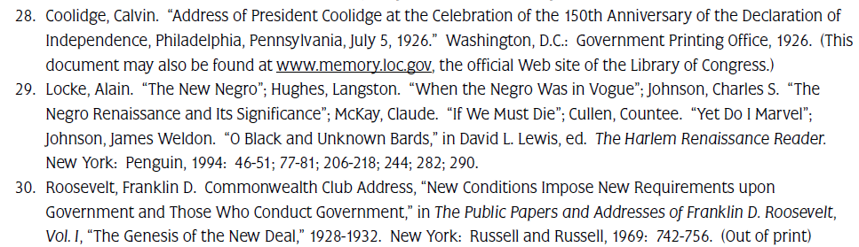
Academic Transparency Example

Slide 40
Academic Transparency Example
https://webapp4.asu.edu/bookstore/viewsyllabus/2197/93080

Slide 41
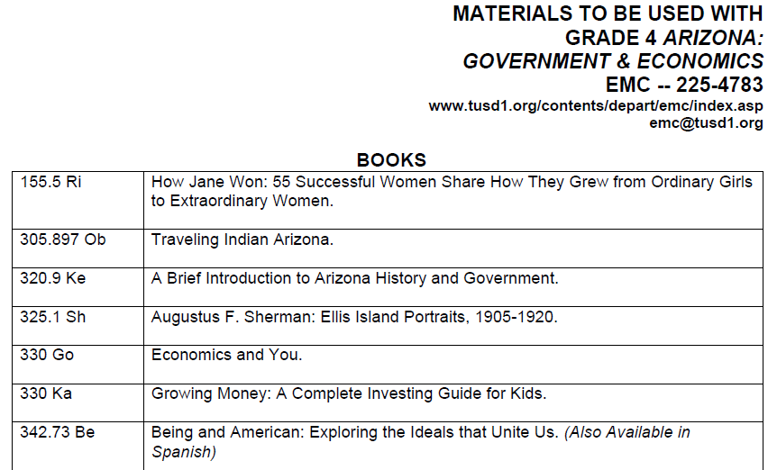
Example District Tucson Unified, AZ
...
...

