Slide 1
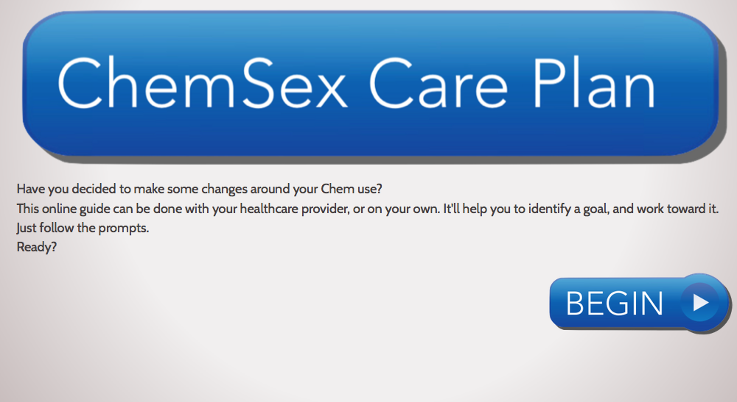
Making changes; a Care Plan
www.davidstuart.org/care-plan

Slide 2
Choose a goal

Slide 3
Support with abstinence
Adapting to this “change-of-life”
Identifying & better-managing the cravings and triggers we will experience
Negotiating sober sex and horny-ness
Creating new friendships/networks.
Communicating with older friends/networks
Re-Learning our relationship to sex, what we want from it, how to pursue it
Re-negotiating the role sex-apps play in our lives (& other social media)
learning to manage our raw emotions without the support of
the "confidence-giving" chems.
Staying stopped
Anticipating triggers
1 day at a time
Support networks
Managing cravings
Relapse prevention
Smart Recovery
Twelve Step programmes

Slide 4
Choose a goal

Slide 5
Play more safely
Safer ChemSex
Crystal meth
GHB/GBL
Mephedrone
Sexual wellbeing
Safer injecting
Safer sex
Safer App use
The law

Slide 6
Choose a goal

Slide 7
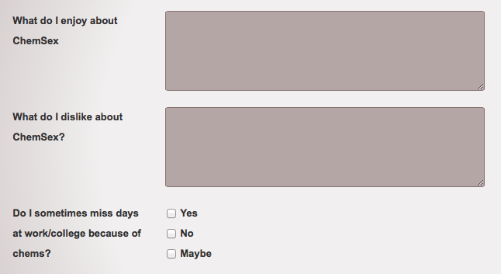
Reflecting on drug use/behaviour

Slide 8
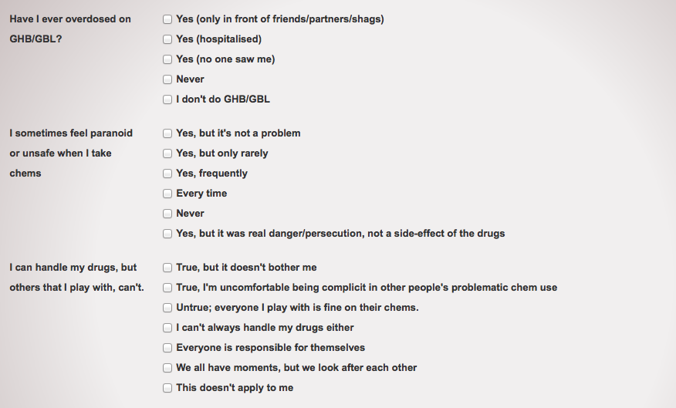
Reflecting on drug use/behaviour

Slide 9
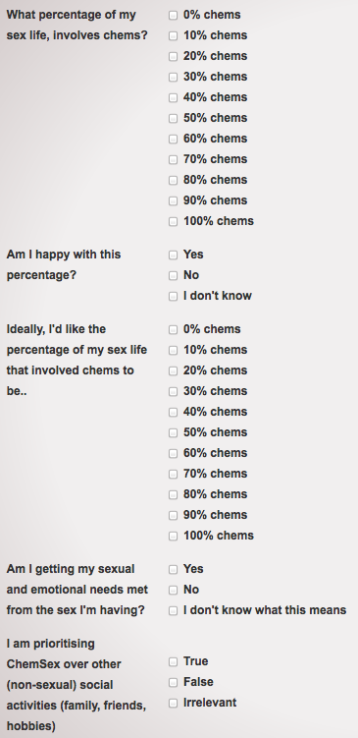
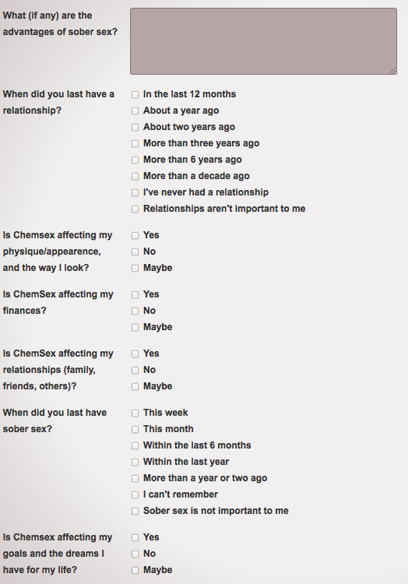

Slide 10
Reflecting on drug use/behaviour

Slide 11
Choose a goal

Slide 12
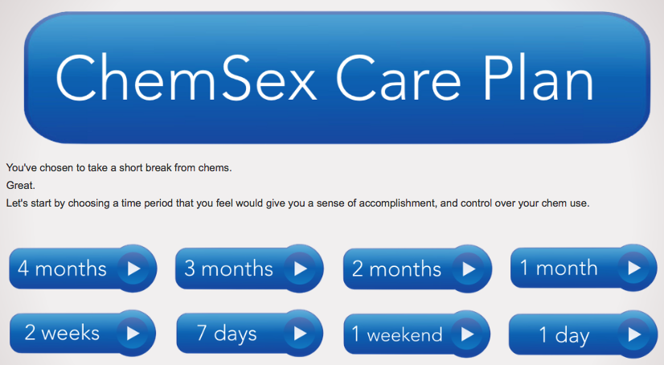
Take a break/identify a goal

Slide 13
Rate your own confidence
-decisional balance

Slide 14
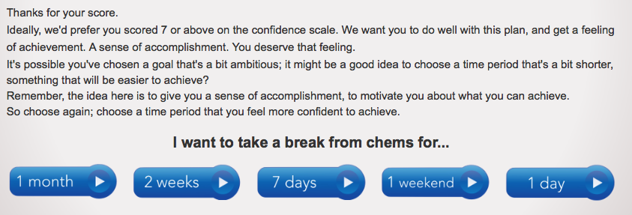
Not very confident?
Choose a more achievable goal

Slide 15
Now rate confidence level again

Slide 16
How important is it to you?

Slide 17
Not very important?
Come back another time

Slide 18
Rate how important it is to you
(-decisional balance)
But perhaps it IS important......

Slide 19
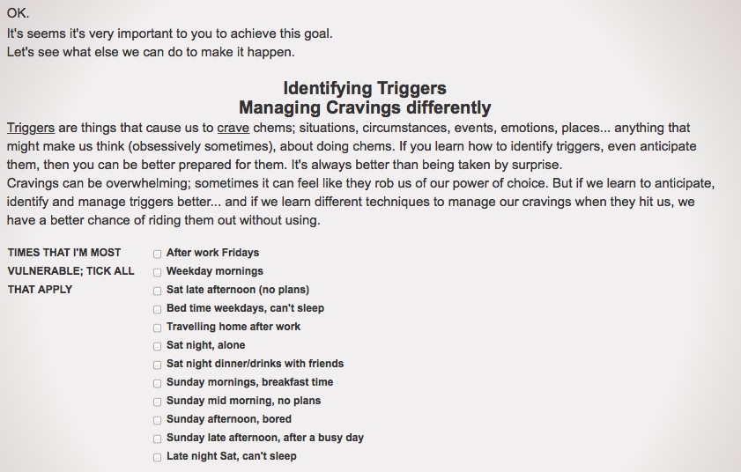
Identify your most vulnerable times

Slide 20
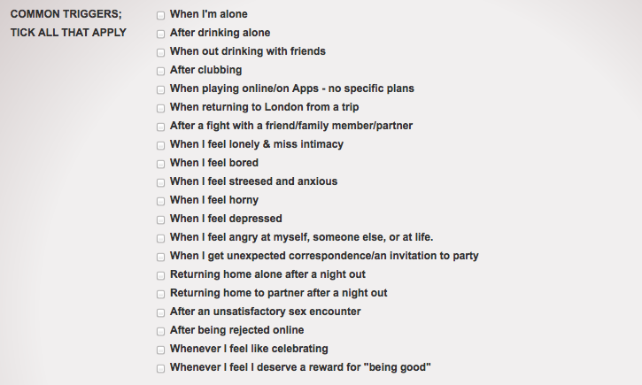
Identifying triggers

Slide 21
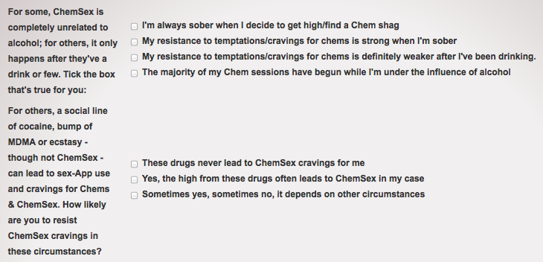
OTHER TRIGGERS;
ALCOHOL? NON-CHEMSEX DRUGS?

Slide 22
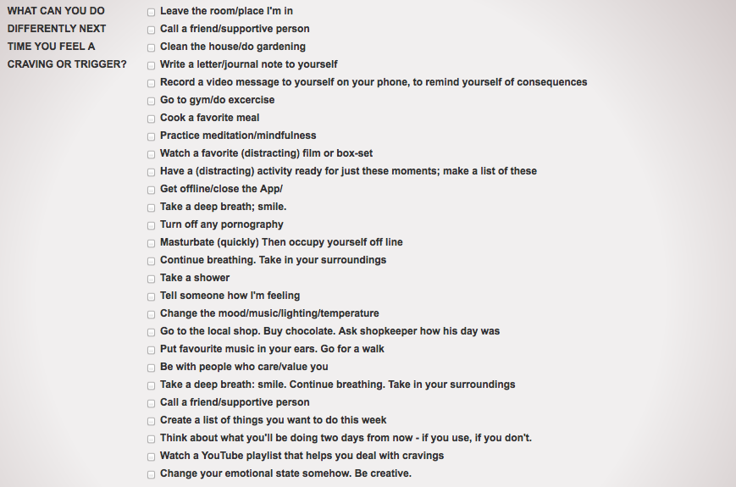
Managing cravings differently

Slide 23
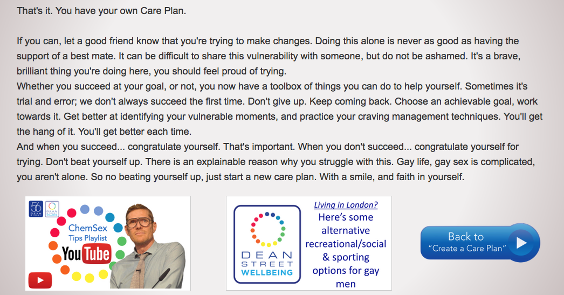
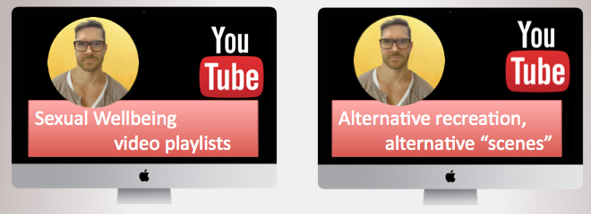
DONE! Online Care Plan created

Slide 24
FOR CHEM USERS
www.DavidStuart.org/care-plan
@davidastuart
DS17

Slide 25
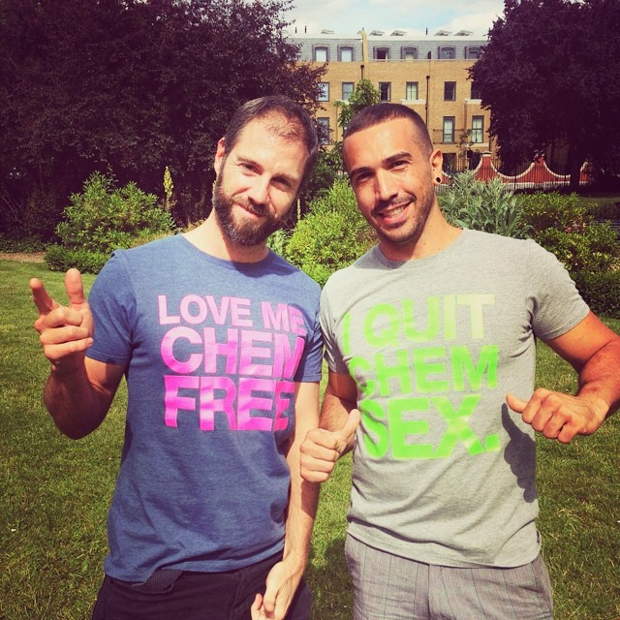
FOR PROFESSIONALS
www.davidstuart.org/professionals
@davidastuart
DS16

