Slide 1
Regulation of Respiration
Prof. dr. Zoran Valić
Department of Physiology
University of Split School of Medicine

Slide 2
nervous system normally adjusts the rate of alveolar ventilation almost exactly to the demands of the body
oxygen pressure (Po₂) and carbon dioxide pressure (Pco₂) in the arterial blood are hardly altered
heavy exercise!

Slide 3
Respiratory Center
several groups of neurons in the medulla oblongata and pons of the brain stem
dorsal respiratory group (inspiration)
ventral respiratory group (mainly expiration)
pneumotaxic center (dorsally in the pons, controls rate and depth of breathing)

Slide 4
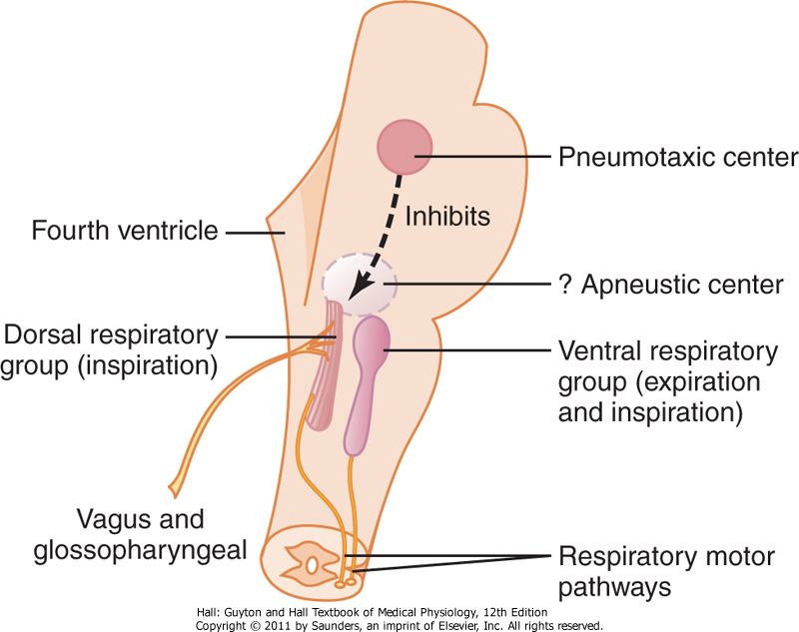

Slide 5
Dorsal Respiratory Group
control of inspiration & respiratory rhythm
nucleus of the tractus solitarius and reticular substance (vagus and glossopharyngeus)
peripheral chemoreceptors
baroreceptors
receptors in the lungs

Slide 6
Rhythmical Inspiratory Discharges
transection experiment (⇨ repetitive bursts of inspiratory neuronal action potentials)
cause is unknown – prof. Đogaš!
neural networks, neurons from adjacent areas of the medulla

Slide 7
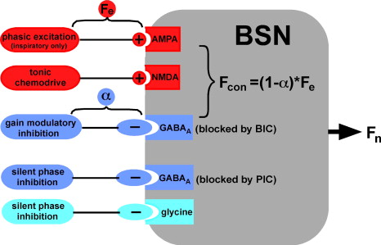

Slide 8
Inspiratory "Ramp" Signal
transmitted to the inspiratory muscles (diaphragm)
it begins weakly and increases steadily in a ramp manner for about 2 s, ceases abruptly for approximately the next 3 s
“ramp signal” – causes a steady increase in the volume of the lungs during inspiration, rather than inspiratory gasps

Slide 10
control of the rate of increase of the ramp signal
control of the limiting point at which the ramp suddenly ceases – shortening of inspiration (shortening of expiration – increasing frequency of respiration)

Slide 11
Pneumotaxic Center
located dorsally in the nucleus parabrachialis of the upper pons
control the "switch-off" point of the inspiratory ramp (0,5-5 s)
limit inspiration, increasing the rate of breathing (from 3-5 to 30-40 breaths per minute)

Slide 12
Ventral Respiratory Group
RVLM; nucleus ambiguus & retroambiguus
inactive during normal quiet respiration
do not appear to participate in the basic rhythmical oscillation
increased respiratory drive
both inspiration and expiration (abdominal muscles)

Slide 13
The Hering-Breuer Inflation Reflex
sensory nerve signals from the lungs
stretch receptors (muscular portions of the walls of the bronchi and bronchioles – vagus)
"switches off" the inspiratory ramp – increases the rate of respiration

Slide 14
in humans not activated until the tidal volume increases to more than three times normal (V_{T} > 1.5 L per breath)
protective mechanism for preventing excess lung inflation

Slide 15
Chemical Control of Respiration
ultimate goal of respiration is to maintain proper concentrations of O₂, CO₂ & H⁺ in the tissues
⇧ CO₂ or H⁺ act directly on the respiratory center
O₂ does not have a significant direct effect – acts almost entirely on peripheral chemoreceptors (carotid and aortic bodies)

Slide 16
Direct Chemical Control
additional neuronal area – chemosensitive area
located bilaterally, lying only 0.2 millimeter beneath the ventral surface of the medulla
highly sensitive to changes in either blood PCO₂ or H⁺ concentration

Slide 17
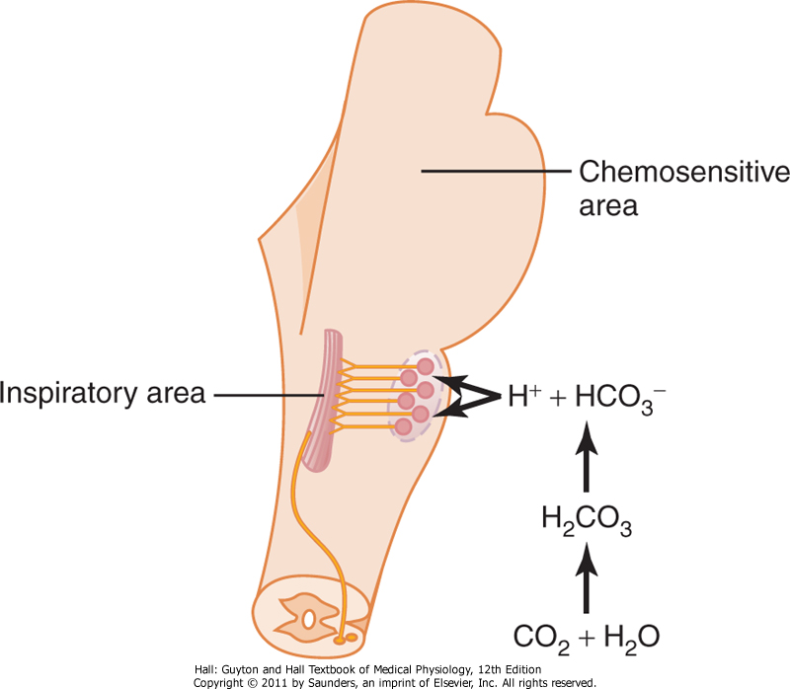

Slide 18
Influence of H⁺
may be the only important direct stimulus for chemosensitive neurons
however, H⁺ do not easily cross the blood-brain barrier – less effect than PCO₂

Slide 19
Influence of PCO₂
little direct effect in stimulating the neurons in the chemosensitive area
potent indirect effect – action through H⁺ ions
blood-brain barrier almost do not exist for CO₂

Slide 21
Decreased Stimulatory Effect of CO₂
CO₂ excites respiratory center greatly the first few hours after the PCO₂ first increases, but then it gradually declines over the next 1 to 2 days to 1/5 the initial effect
action of the kidneys (increased levels of HCO₃⁻) – in blood, cerebrospinal fluid and intercellular fluid

Slide 22
Quantitative Effects of PCO₂ and H⁺ on Alveolar Ventilation
normal range of PCO₂ in blood is between 35 and 75 mm Hg (4.5 – 10.0 kPa)
normal range of pH: 7.3 – 7.5

Slide 23
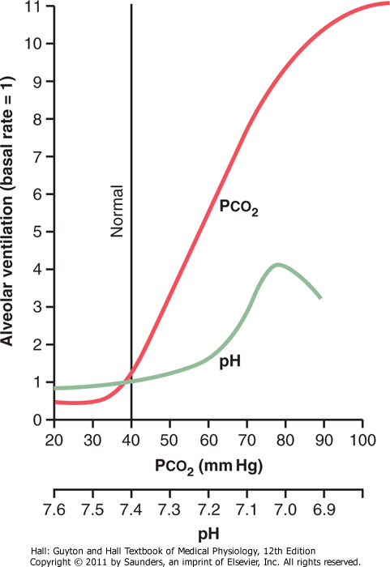

Slide 24
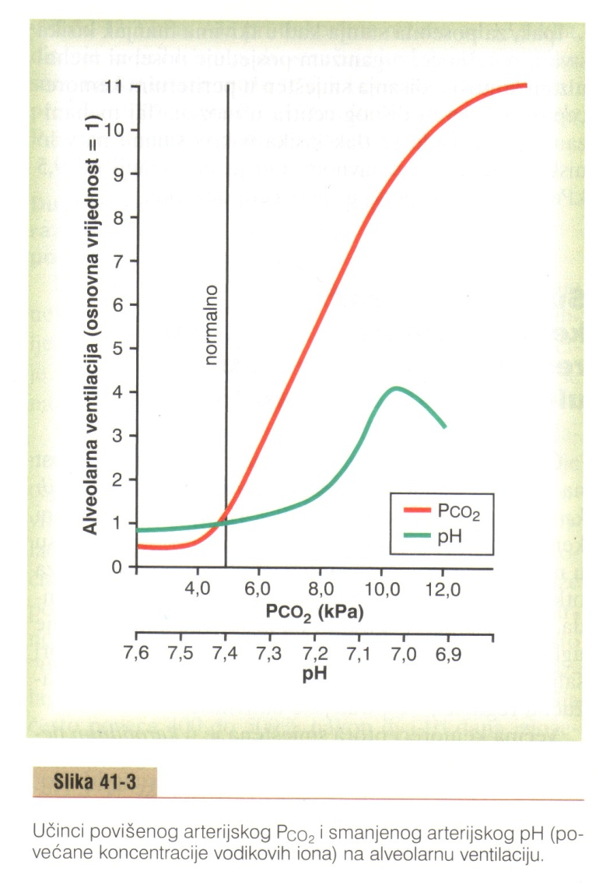

Slide 25
Direct Effect of O₂
virtually no direct effect on the respiratory center
very effective hemoglobin-oxygen buffer system (from 60 to 1000 mmHg)
in special conditions with lack of oxygen – peripheral chemoreceptors (PO₂ below 70 mmHg)

Slide 26
Peripheral Chemoreceptor System – Role of Oxygen
special nervous chemical receptors – chemoreceptors
several areas outside the brain
changes in O₂, CO₂ and H⁺
transmit nervous signals to the respiratory center

Slide 27
carotid bodies (Hering's nerves, glossopharyngeal nerves) & aortic bodies (vagus) – dorsal medullary respiratory area
minute artery, blood flow 20 times the weight of the bodies themselves (percentage of O₂ removed from the flowing blood is virtually zero)

Slide 28
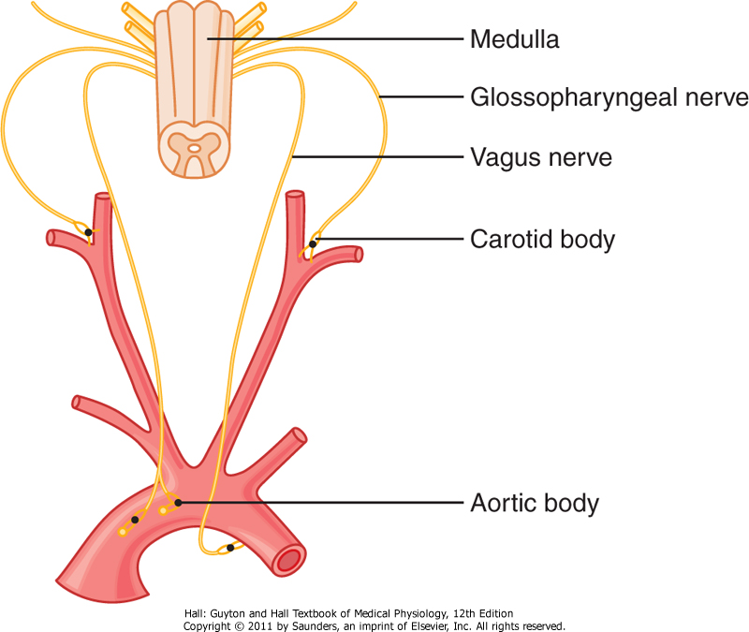

Slide 29
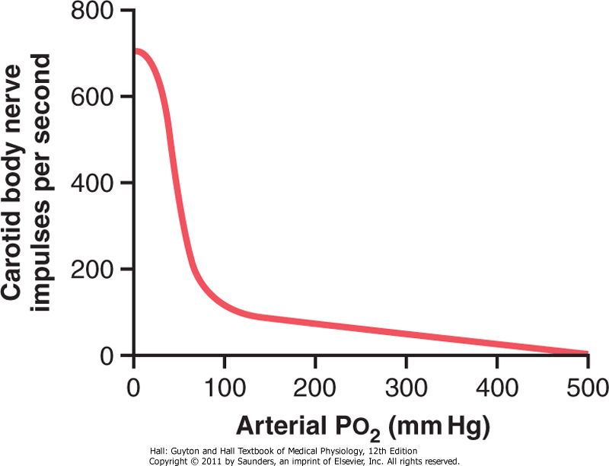

Slide 31
Influence of CO₂ & H⁺ on Chemoreceptors
also excite the chemoreceptors
direct effects of both these factors in the respiratory center itself are much more powerful (7x)
5x as rapidly as central stimulation – onset of exercise!

Slide 32
Basic Mechanism of Stimulation of the Chemoreceptors by Oxygen
the exact means are still unknown!
glomus cells (glandular-like cells) – synapse directly or indirectly with the nerve endings
opposing opinions (nerve endings might function as the chemoreceptors)

Slide 33
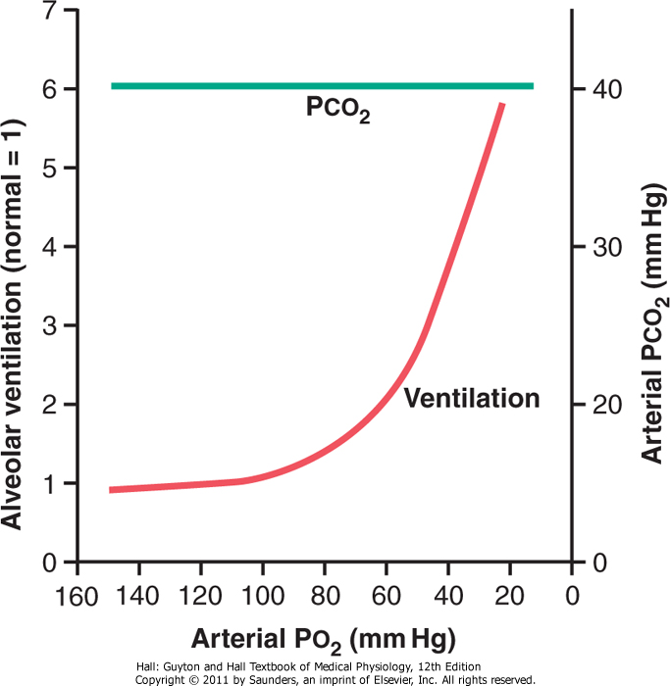

Slide 35
Phenomenon of Acclimatization
within 2 to 3 days, the respiratory center loses about 4/5 of its sensitivity to changes in PCO₂ and H⁺
instead of 70 percent increase (acute), alveolar ventilation increases 400 to 500 percent after 2 to 3 days of low oxygen

Slide 36
Composite Effects of PCO₂, pH & PO₂ on Alveolar Ventilation

Slide 37
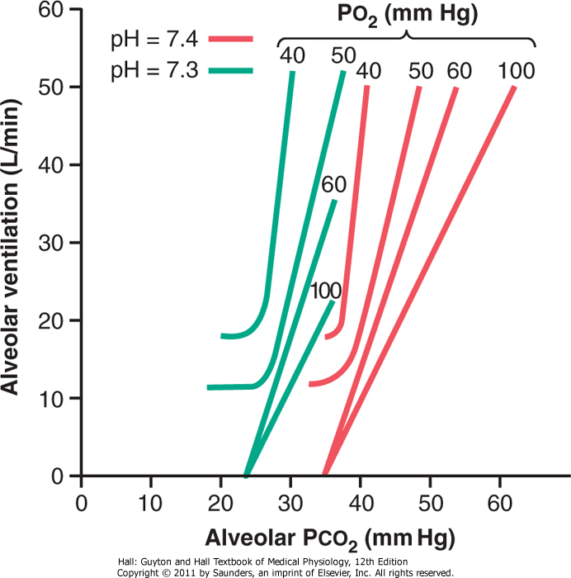

Slide 39
Regulation of Respiration During Exercise
O₂ consumption and CO₂ formation can increase as much as 20-fold
alveolar ventilation ordinarily increases almost exactly in step with the increased level of oxygen metabolism
arterial PO₂, PCO₂, and pH remain almost exactly normal

Slide 40
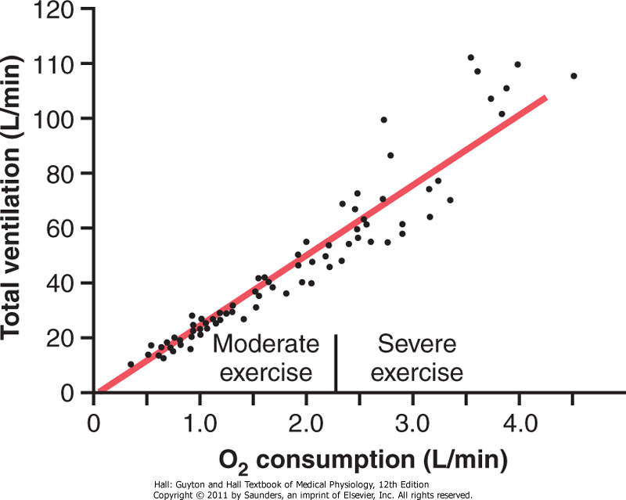

Slide 41
What causes the increased ventilation during exercise?
chemical changes – NO
collateral impulses into the brain stem to excite the respiratory center (analogous to the increase in arterial pressure)
excitation of proprioreceptors in joints and muscle – excitation of respiratory center (passive movements & severed nerves)
hypoxic muscles, variations in PO₂, PCO₂

Slide 42
Interrelation Between Chemical and Nervous Factors
occasionally the nervous respiratory control signals are either too strong or too weak
chemical factors play a significant role in the final adjustment of respiration
increase in alveolar ventilation – decreases arterial Pco₂ below normal at the onset of exercise

Slide 43
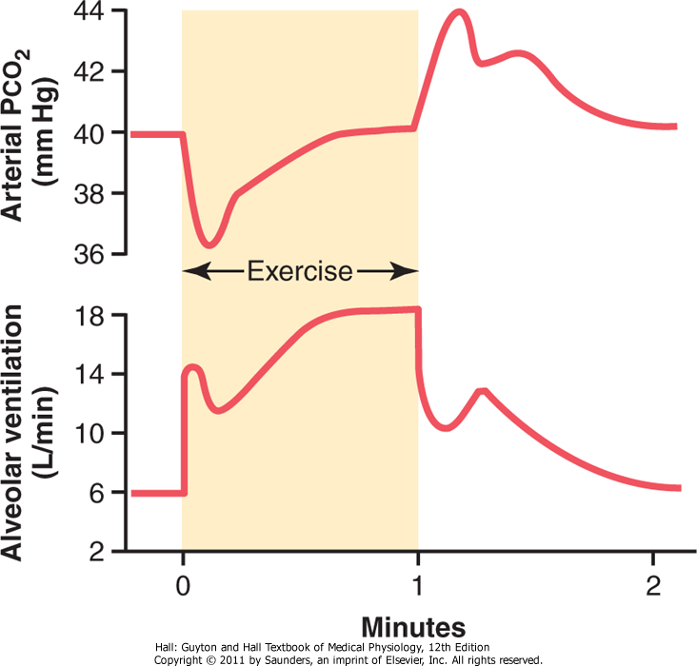

Slide 45
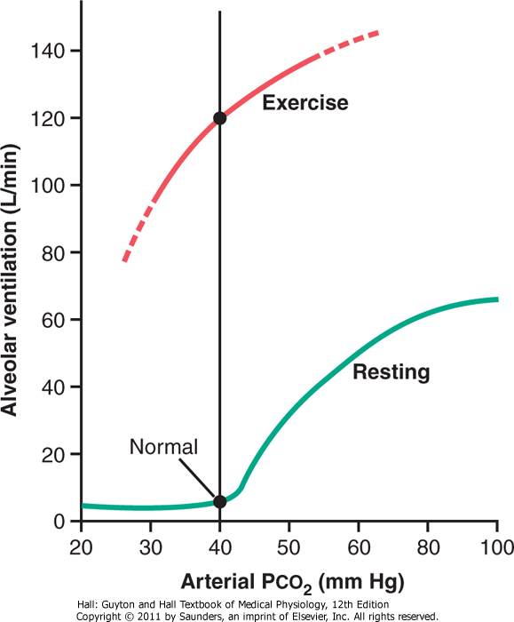

Slide 46
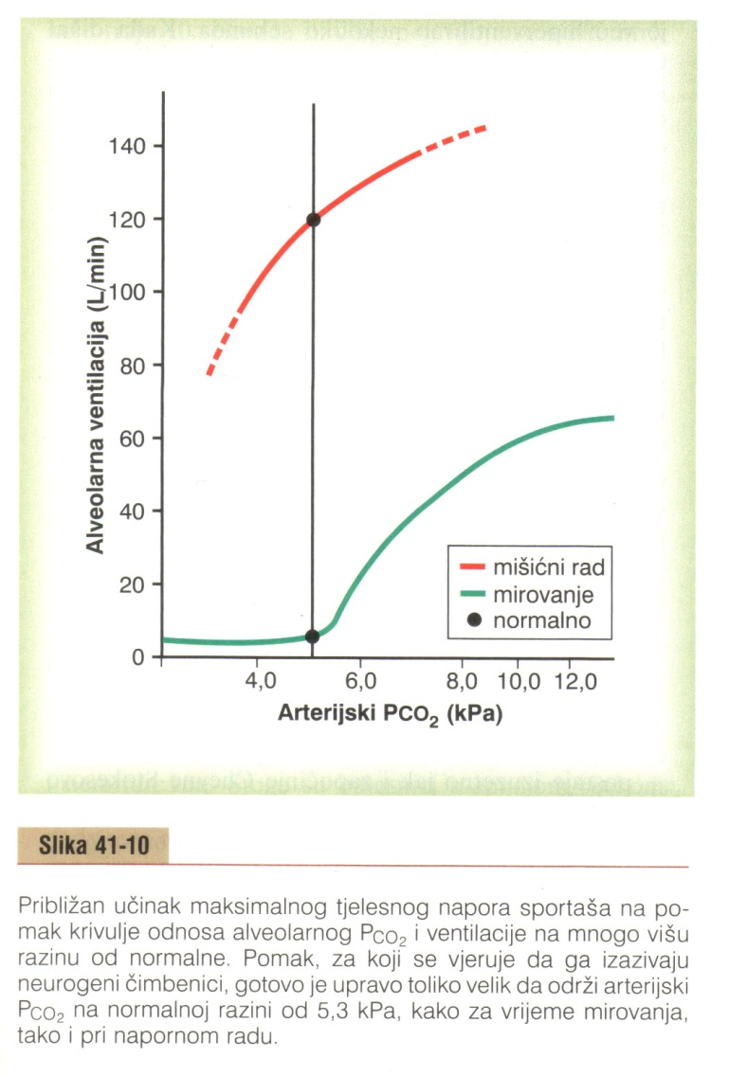
- neurogeni pomak ventilacijske
krivulje
- zadržavanje oblika krivulje (funkcije)

Slide 47
brain's ability to shift the ventilatory response curve during exercise is at least partly a learned response
with repeated periods of exercise, the brain becomes progressively more able to provide the proper signals

Slide 48
even the cerebral cortex is involved in this learning because experiments that block only the cortex (anesthesia) also block the learned response

Slide 49
Voluntary Control of Respiration
one can hyperventilate or hypoventilate to such an extent that serious derangements in Pco₂, pH, and Po₂ can occur in the blood
directly from the cortex or other higher centers

Slide 50
Effect of Irritant Receptors in the Airways
epithelium of the trachea, bronchi, and bronchioles is supplied with sensory nerve endings called pulmonary irritant receptors
cause coughing and sneezing

Slide 51
Function of Lung "J Receptors"
few sensory nerve endings in the alveolar walls in juxtaposition to the pulmonary capillaries
stimulated when the pulmonary capillaries become engorged with blood or when pulmonary edema occurs (heart failure)
their excitation may give the person a feeling of dyspnea

Slide 52
Effect of Brain Edema
depressed or even inactivated respiratory center by acute brain edema
resulting from brain concussion
therapy: intravenous injection of hypertonic solutions such as highly concentrated mannitol solution

Slide 53
Anesthesia
overdosage with anesthetics or narcotics – respiratory arrest
sodium pentobarbital, halothane & morphine

Slide 54
Periodic Breathing
occurs in a number of disease conditions
person breathes deeply for a short interval and then breathes slightly or not at all for an additional interval
most common – Cheyne-Stokes breathing (slowly waxing and waning respiration occurring about every 40 to 60 seconds)

Slide 55
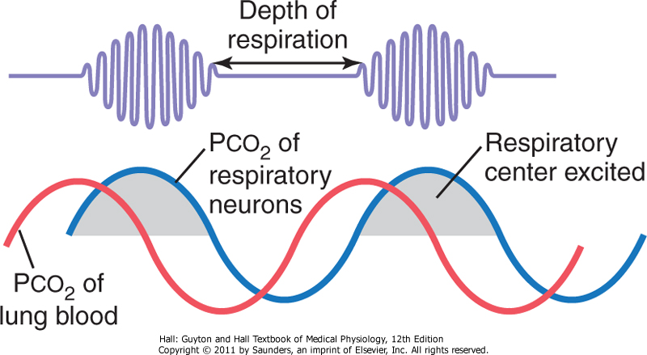

Slide 56
Basic Mechanism of Cheyne-Stokes Breathing
it takes few seconds before the pulmonary blood can be transported to the brain
under normal conditions, this mechanism is highly "damped"
long delay occurs for transport of blood from the lungs to the brain (severe cardiac failure)
increased negative feedback gain (brain damage – a prelude to death)

Slide 57
Sleep Apnea
apnea – absence of spontaneous breathing
occasional apneas occur during normal sleep
in persons with sleep apnea – frequency and duration are greatly increased
occurring 300 to 500 times each night, lasting for 10 seconds or longer
obstruction of the upper airways or impaired CNS respiratory drive

Slide 58
Obstructive Sleep Apnea
caused by blockage of the upper airway
muscles of the pharynx normally keep passage open
during sleep, these muscles usually relax
the airway passage remains open enough to permit adequate airflow

Slide 59
some individuals have an especially narrow passage, and relaxation of these muscles during sleep causes the pharynx to completely close so that air cannot flow into the lungs
loud snoring and labored breathing occur ⇨ apnea ⇨  PO₂,  PCO₂ ⇨ great stimulation of respiration ⇨ fragmented, restless sleep ⇨ excessive daytime drowsiness & increased sympathetic activity

Slide 60
in older, obese persons
nasal obstruction, a very large tongue, enlarged tonsils, or shapes of the palate
therapy:
surgical removal of excess fat tissue at the back of the throat (uvulopalatopharyngoplasty), enlarged tonsils or adenoids, or creation of opening in the trachea (tracheostomy) to bypass the obstructed airway during sleep
nasal ventilation with continuous positive airway pressure (CPAP)

Slide 61
"Central" Sleep Apnea
central nervous system drive to the ventilatory muscles transiently ceases
causes:
damage to the central respiratory centers
abnormalities of the respiratory neuromuscular apparatus
may have decreased ventilation when they are awake, although they are fully capable of normal voluntary breathing
caused by stroke

