Slide 1
An Analysis of
Lead-times for Northeast
Tornado Warnings
2010-2016
Ethan C. Burwell
Earth and Atmospheric Sciences
Cornell University, Ithaca, NY

Slide 2
May 31, 2017
Wappingers, NY Tornado
Photo By Breanna Winter via USAToday
Notes:
New York’s first tornado of the year touched down on May 31, 2017. The storm moved through the town of Wappingers in Dutchess County as an EF1 with 100 mph winds. While no deaths or injuries were attributed to this storm, the tornado is notable for its unrealized potential-impacts.

Slide 3
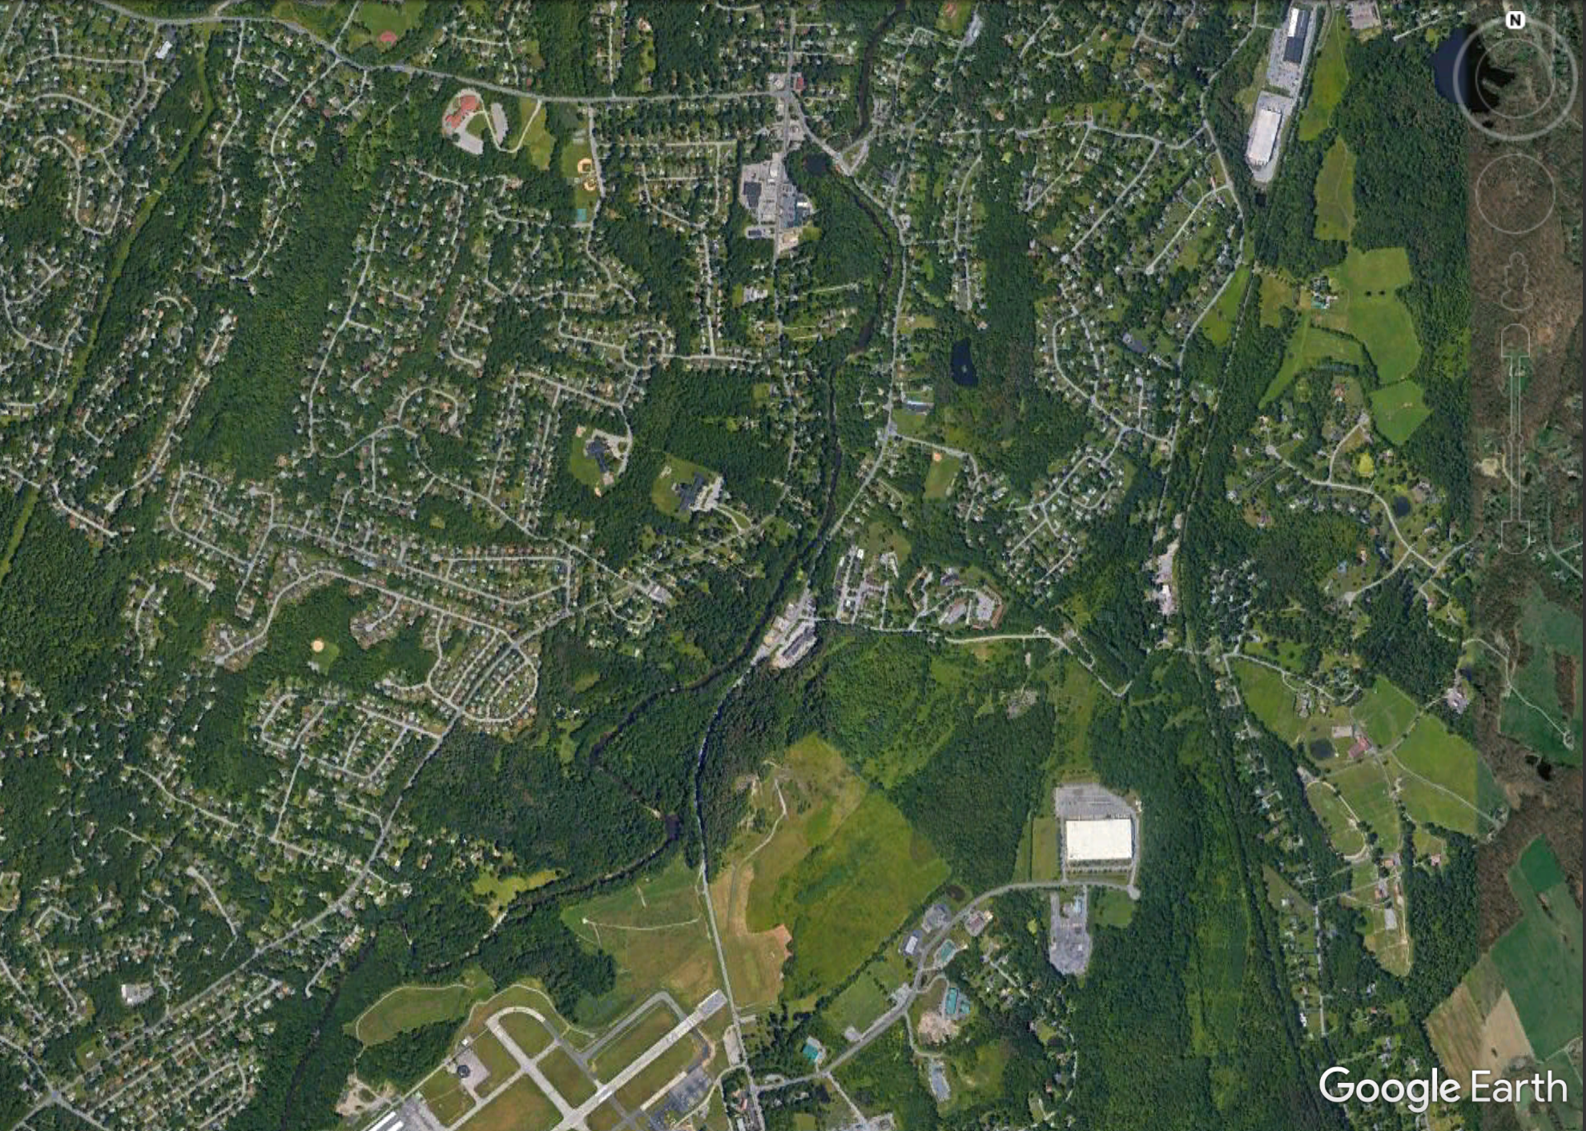
City of Poughkeepsie
(Four miles NW)
Touchdown
Dutchess Co. Airport
Notes:
Forming on a school day, the tornado touched down one-quarter mile from Vassar Road Elementary School, and less than half a mile from Kinry Road Elementary School. The two schools serve approximately 700 kindergarten through fifth grade students in the Wappingers School district. With the tornado forming at 6:58PM, it is likely that both elementary schools were largely empty, however, that was not the case three miles down the road at Roy C. Ketcham High School where their annual spring chorus concert began at 7:00PM. The initial tornado warning was issued at 7:14PM

Slide 4
One–mile radius
City of Poughkeepsie
(Four miles NW)
Touchdown
Dutchess Co. Airport
Notes:
Forming on a school day, the tornado touched down one-quarter mile from Vassar Road Elementary School, and less than half a mile from Kinry Road Elementary School. The two schools serve approximately 700 kindergarten through fifth grade students in the Wappingers School district. With the tornado forming at 6:58PM, it is likely that both elementary schools were largely empty, however, that was not the case three miles down the road at Roy C. Ketcham High School where their annual spring chorus concert began at 7:00PM. The initial tornado warning was issued at 7:14PM

Slide 5
One–mile radius
City of Poughkeepsie
(Four miles NW)
Kinry Elementary
Touchdown
Dutchess Co. Airport
Notes:
Forming on a school day, the tornado touched down one-quarter mile from Vassar Road Elementary School, and less than half a mile from Kinry Road Elementary School. The two schools serve approximately 700 kindergarten through fifth grade students in the Wappingers School district. With the tornado forming at 6:58PM, it is likely that both elementary schools were largely empty, however, that was not the case three miles down the road at Roy C. Ketcham High School where their annual spring chorus concert began at 7:00PM. The initial tornado warning was issued at 7:14PM

Slide 6
One–mile radius
City of Poughkeepsie
(Four miles NW)
Kinry Elementary
Vassar Elementary
Touchdown
Dutchess Co. Airport
Notes:
Forming on a school day, the tornado touched down one-quarter mile from Vassar Road Elementary School, and less than half a mile from Kinry Road Elementary School. The two schools serve approximately 700 kindergarten through fifth grade students in the Wappingers School district. With the tornado forming at 6:58PM, it is likely that both elementary schools were largely empty, however, that was not the case three miles down the road at Roy C. Ketcham High School where their annual spring chorus concert began at 7:00PM. The initial tornado warning was issued at 7:14PM

Slide 7
How prevalent are negative lead times?

Slide 8
How prevalent are negative lead times?
“NWS Tornado Warnings with Zero or Negative Lead Times”
Brotzge and Erickson (2008)

Slide 9
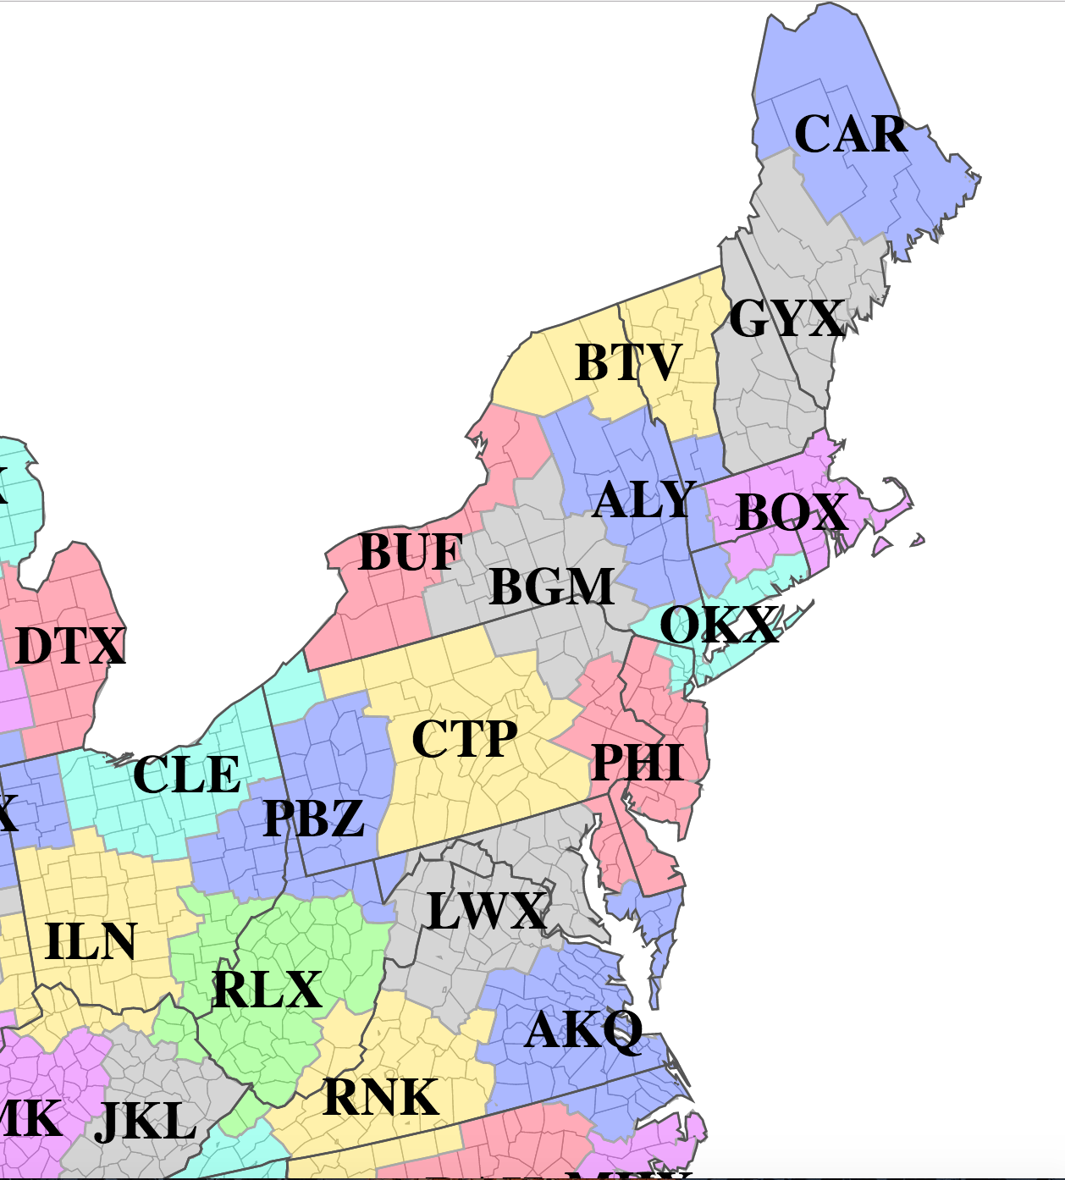
States north and east of the Potomac River

Slide 10
CAR
GYX
BTV
BUF
ALY
BOX
BGM
OKX
CTP
PHI
CLE
PBZ
LWX
AKQ
States north and east of the Potomac River

Slide 11
CAR
GYX
BTV
BUF
ALY
BOX
BGM
OKX
CTP
PHI
CLE
PBZ
LWX
AKQ
States north and east of the Potomac River

Slide 12
How prevalent are negative lead times?
Warnings for Confirmed Northeast Tornados
January 2010 through December 2016
CAR
Total | Negative Lead | Positive Lead | No Warning
100% (253) | 17% (44) | 46% (116) | 37% (93)
GYX
BTV
BUF
ALY
BOX
BGM
OKX
CTP
PHI
CLE
PBZ
LWX
AKQ

Slide 13
How prevalent are negative lead times?
Warnings for Confirmed Northeast Tornados
January 2010 through December 2016
CAR
Total | Negative Lead | Positive Lead | No Warning
100% (253) | 17% (44) | 46% (116) | 37% (93)
GYX
BTV
BUF
ALY
Excluding LWX
BOX
BGM
OKX
CTP
PHI
CLE
PBZ
LWX
AKQ

Slide 14
How prevalent are negative lead times?
Warnings for Confirmed Northeast Tornados
January 2010 through December 2016
CAR
Total | Negative Lead | Positive Lead | No Warning
100% (253) | 17% (44) | 46% (116) | 37% (93)
GYX
BTV
BUF
ALY
Excluding LWX
BOX
BGM
OKX
CTP
PHI
CLE
PBZ
LWX
AKQ

Slide 15
How prevalent are negative lead times?
Warnings for Confirmed Northeast Tornados
January 2010 through December 2016
CAR
Total | Negative Lead | Positive Lead | No Warning
100% (253) | 17% (44) | 46% (116) | 37% (93)
GYX
BTV
BUF
ALY
Excluding LWX
BOX
BGM
OKX
CTP
PHI
CLE
PBZ
LWX
AKQ

Slide 16
How prevalent are negative lead times?
Warnings for Confirmed Northeast Tornados
January 2010 through December 2016
CAR
Total | Negative Lead | Positive Lead | No Warning
100% (253) | 17% (44) | 46% (116) | 37% (93)
GYX
BTV
BUF
ALY
Excluding LWX
BOX
BGM
OKX
CTP
PHI
CLE
PBZ
LWX
AKQ

Slide 17
How prevalent are negative lead times?
Warnings for Confirmed Northeast Tornados
January 2010 through December 2016
CAR
Total | Negative Lead | Positive Lead | No Warning
100% (322) | 17% (54) | 51% (164) | 32% (104)
GYX
BTV
BUF
ALY
Including LWX
BOX
BGM
OKX
CTP
PHI
CLE
PBZ
LWX
AKQ
Notes:
Significance: Only half of all tornadoes have advanced warning. One-third of all tornadoes have no warning.

Slide 18
Positive Leads 51%
Average:
9 minutes
No Warning 32%
Negative
Leads
17%

Slide 19
What factors characterize tornados with
positive leads, negative leads, and no warnings?

Slide 20
What factors characterize tornados with
positive leads, negative leads, and no warnings?
Brotzge and Erickson (2008)
Intensity Region / WFO Office Time of Day Month of Year Radar Morphology | Distance from Radar County Population Density Daily Warning Number Hourly Warning Number

Slide 21
What factors characterize tornados with
positive leads, negative leads, and no warnings?
Brotzge and Erickson (2008)
Intensity Region / WFO Office Time of Day Month of Year Radar Morphology | Distance from Radar County Population Density Daily Storm Order Hourly Warning Number

Slide 22
Intensity

Slide 23
Stacked Intensity Distribution

Slide 24
Morphology

Slide 25
Morphology
“Spring and Summer Severe Weather Reports over the Midwest as a Function of Convective Mode:
A Preliminary Study”
Gallus et al. (2008)

Slide 26
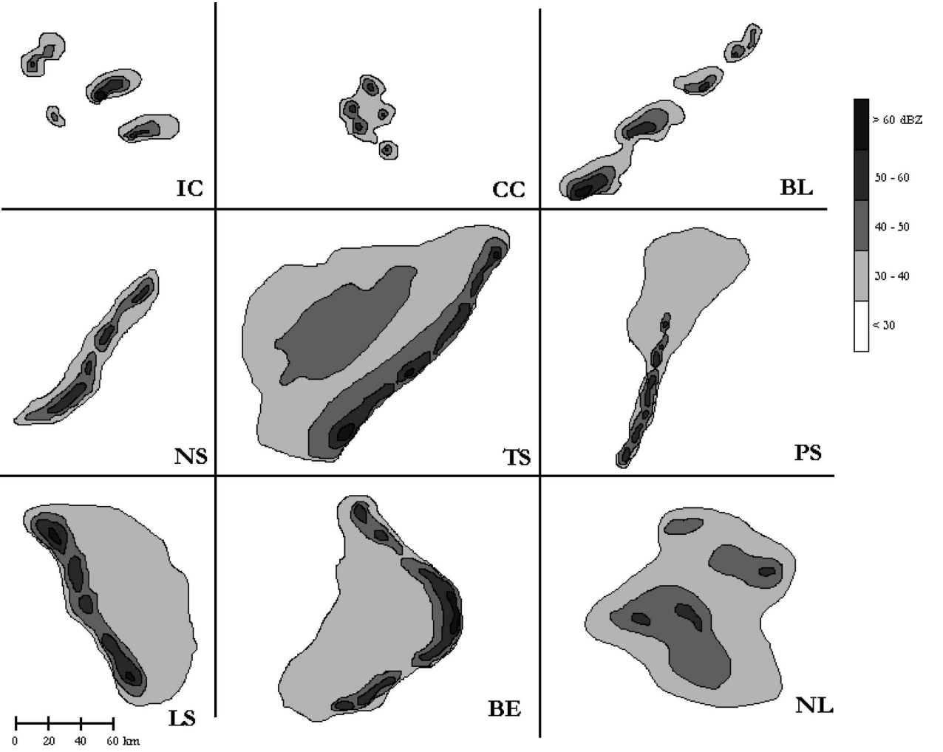
Morphology
“Spring and Summer Severe Weather Reports over the Midwest as a Function of Convective Mode:
A Preliminary Study”
Gallus et al. (2008)

Slide 27
Morphology
“Spring and Summer Severe Weather Reports over the Midwest as a Function of Convective Mode:
A Preliminary Study”
Gallus et al. (2008)

Slide 28
Morphology
“Spring and Summer Severe Weather Reports over the Midwest as a Function of Convective Mode:
A Preliminary Study”
Gallus et al. (2008)

Slide 29
Morphology
“Spring and Summer Severe Weather Reports over the Midwest as a Function of Convective Mode:
A Preliminary Study”
Gallus et al. (2008)

Slide 30
Morphology
“Spring and Summer Severe Weather Reports over the Midwest as a Function of Convective Mode:
A Preliminary Study”
Gallus et al. (2008)

Slide 31
Morphology
“Spring and Summer Severe Weather Reports over the Midwest as a Function of Convective Mode:
A Preliminary Study”
Gallus et al. (2008)

Slide 32
Morphology
“Spring and Summer Severe Weather Reports over the Midwest as a Function of Convective Mode:
A Preliminary Study”
Gallus et al. (2008)

Slide 33
Morphology
“Spring and Summer Severe Weather Reports over the Midwest as a Function of Convective Mode:
A Preliminary Study”
Gallus et al. (2008)

Slide 34
Morphology
“Spring and Summer Severe Weather Reports over the Midwest as a Function of Convective Mode:
A Preliminary Study”
Gallus et al. (2008)

Slide 35
Morphology
“Spring and Summer Severe Weather Reports over
the Midwest as a Function of Convective Mode:
A Preliminary Study”
Gallus et al. (2008)

Slide 40
“Discrete”
Convective Cluster
51%

Slide 41
“Discrete”
Convective Cluster
51%
“Embedded”
Convective Cluster
49%

Slide 42
“Discrete”
Convective Cluster
51%
“Stratiform”
Convective Cluster
49%

Slide 45
Storm Order

Slide 47
Lead Distribution of First Daily Tornado

Slide 48
Take-Aways

Slide 49
Take-Aways
Intensity
Storms that become more intense are more likely to be warned
Duration
The relationship between duration and lead time is null
Morphology
Convective Clusters and Trailing Stratiform produce the most positive leads and non - warned storms
Convective Clusters and Broken Lines have the highest percentage of non - warned storms
Convective Clusters can be classified as “discrete” and “stratiform”; over 50% of the “stratiform” go unwarned
Storm Order
The first storm of any day has a 40% chance of a positive lead and 40% chance of going unwarned
Days with multiple storms are less likely (31% vs 45%) for the first storm to go unwarned than days with a single storm

Slide 50
Take-Aways
Intensity
Storms that become more intense are more likely to be warned
Duration
The relationship between duration and lead time is null
Morphology
Convective Clusters and Trailing Stratiform produce the most positive leads and non - warned storms
Convective Clusters and Broken Lines have the highest percentage of non - warned storms
Convective Clusters can be classified as “discrete” and “stratiform”; over 50% of the “stratiform” go unwarned
Storm Order
The first storm of any day has a 40% chance of a positive lead and 40% chance of going unwarned
Days with multiple storms are less likely (31% vs 45%) for the first storm to go unwarned than days with a single storm

Slide 51
Take-Aways
Intensity
Storms that become more intense are more likely to be warned
Duration
The relationship between duration and lead time is null
Morphology
Convective Clusters and Trailing Stratiform produce the most positive - lead tornados and non - warned tornados
Convective Clusters and Broken Lines have the highest percentage of non - warned storms
Convective Clusters can be classified as “discrete” and “stratiform”; over 50% of the “stratiform” go unwarned
Storm Order
The first storm of any day has a 40% chance of a positive lead and 40% chance of going unwarned
Days with multiple storms are less likely (31% vs 45%) for the first storm to go unwarned than days with a single storm

Slide 52
Take-Aways
Intensity
Storms that become more intense are more likely to be warned
Duration
The relationship between duration and lead time is null
Morphology
Convective Clusters and Trailing Stratiform produce the most positive - lead tornados and non - warned tornados
Convective Clusters and Broken Lines have the highest percentage of non - warned tornados
Convective Clusters can be classified as “discrete” and “stratiform”; over 50% of the “stratiform” go unwarned
Storm Order
The first storm of any day has a 40% chance of a positive lead and 40% chance of going unwarned
Days with multiple storms are less likely (31% vs 45%) for the first storm to go unwarned than days with a single storm

Slide 53
Take-Aways
Intensity
Storms that become more intense are more likely to be warned
Duration
The relationship between duration and lead time is null
Morphology
Convective Clusters and Trailing Stratiform produce the most positive - lead tornados and non - warned tornados
Convective Clusters and Broken Lines have the highest percentage of non - warned tornados
Convective Clusters can be classified as “discrete” or “embedded”; over 50% of the “embedded” go unwarned
Storm Order
The first storm of any day has a 40% chance of a positive lead and 40% chance of going unwarned
Days with multiple storms are less likely (31% vs 45%) for the first storm to go unwarned than days with a single storm

Slide 54
Take-Aways
Intensity
Storms that become more intense are more likely to be warned
Duration
The relationship between duration and lead time is null
Morphology
Convective Clusters and Trailing Stratiform produce the most positive - lead tornados and non - warned tornados
Convective Clusters and Broken Lines have the highest percentage of non - warned tornados
Convective Clusters can be classified as “discrete” or “embedded”; over 50% of the “embedded” go unwarned
Storm Order
The first storm of any day has a 40% chance of a positive lead and 40% chance of going unwarned
Days with multiple storms are less likely (31% vs 45%) for the first storm to go unwarned than days with a single storm

Slide 55
Take-Aways
Intensity
Storms that become more intense are more likely to be warned
Duration
The relationship between duration and lead time is null
Morphology
Convective Clusters and Trailing Stratiform produce the most positive - lead tornados and non - warned tornados
Convective Clusters and Broken Lines have the highest percentage of non - warned tornados
Convective Clusters can be classified as “discrete” or “embedded”; over 50% of the “embedded” go unwarned
Storm Order
The first storm of any day has a 40% chance of a positive lead and 40% chance of going unwarned
Days with multiple storms are less likely (31% vs 45%) for the first storm to go unwarned than days with a single storm

Slide 56
Photo By Breanna Winter via USAToday

Slide 57
References & Data
Brotzge, J., and S. Erickson, NWS Tornado Warnings with Zero or Negative Lead Times. Wea. Forecasting, 24, 140-154.
Gallus, W. A., Jr., N. Snook, and E. V. Johnson, 2008: Spring and summer severe weather reports over the Midwest as a function of convective mode: A preliminary study. Wea. Forecasting, 23, 101-113.
Tornado Data Source:
National Centers for Environmental Information,
https://www.ncdc.noaa.gov/stormevents/
Radar & Warning Data Source:
Iowa State University,
http://mesonet.agron.iastate.edu/GIS/apps/rview/warnings.phtml
Wappingers Tornado Photo by Breanna Winter via USAToday
https://www.usatoday.com/story/news/2017/06/01/its-official-tornado-hit-wappinger-wednesday/362162001/
Cover Photo taken by Ethan Burwell

