Slide 1
Georgia Association of Veteran Certifying Officials (GAVCO) Annual Conference
March 8 - 10, 2017
COMPLIANCE 101
Jerome I. Marshall
Chief, Education Liaison Officer (CELO)
Education Service | South Region | Atlanta, GA
MyVA Veterans Experience Office Staff Training

Slide 2
Overview
Why compliance surveys are conducted
When compliance surveys are conducted
How compliance surveys are conducted
How to best prepare for a compliance survey
Questions

Slide 3
LAW
38 USC 3684. Reports by veterans, eligible persons, and institutions; reporting fee
(a)(1) …the educational institution offering a course in which such veteran or eligible person is enrolled under chapter 31, 32, 33, 34, 35, or 36 of this title shall, without delay, report to the Secretary, in the form prescribed by the Secretary, such enrollment and any interruption or termination of the education of each such veteran or eligible person. The date of such interruption or termination will be the last date of pursuit, or, in the case of correspondence training, the last date a lesson was serviced by a school.
(b) The Secretary, prior to making payment of a reporting fee to an educational institution, as provided for in subsection (c) of this section, shall require such institution to certify that it has exercised reasonable diligence in determining whether such institution or any course offered by such institution approved for the enrollment of veterans or eligible persons meets all of the applicable requirements of chapters 31, 34, 35, and 36 of this title and that it will, without delay, report any failure to meet any such requirement to the Secretary.

Slide 4
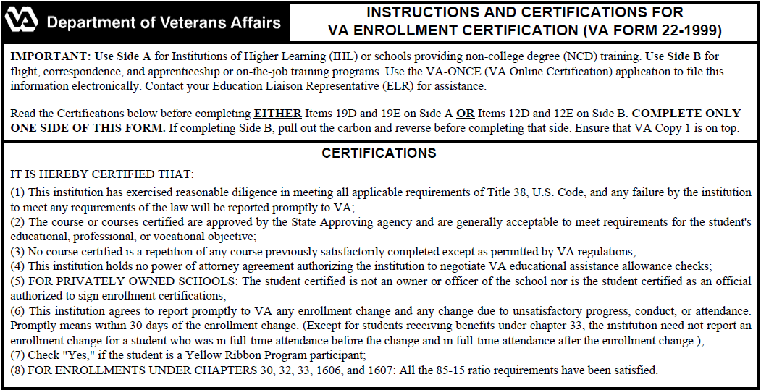
ENROLLMENT CERTIFICATION

Slide 5
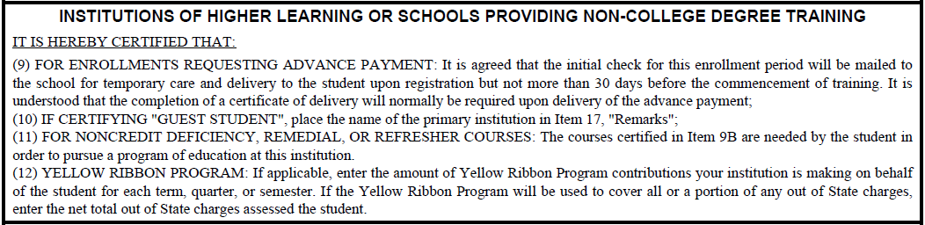
ENROLLMENT CERTIFICATION

Slide 6
VA-ONCE MOU
III. OBLIGATIONS AND AGREEMENTS OF INSTITUTION
The institution, by executing this agreement and in consideration of the agreement of VA to accept the alternative VA-ONCE generated written or electronic documents submitted by the institution, agrees to comply with all applicable laws, regulations, and VA requirements pertaining to certifications of enrollments and notices of change in student status, even though the provisions of those laws, regulations, or requirements do not appear on the certifications created by the VA-ONCE program.
The institution acknowledges that by using the VA-ONCE program it is subject to all the duties and liabilities pertaining to educational institutions found in 38 U.S.C. sections 3684 and 3685; 38 CFR sections 21.4203, 21.4209, 21.7156, 21.7307, 21.7656, 21.7807, and 21.5200; all certifications applicable to the institution certifying on comparably prescribed VA forms otherwise in use at the time of the certifications; and any other provisions of law or regulations that apply.

Slide 7
LAW
38 USC 3693. Compliance surveys
(a)(1) Except as provided in subsection (b), the Secretary shall conduct an annual compliance survey of educational institutions and training establishments offering one or more courses approved for the enrollment of eligible veterans or persons if at least 20 such veterans or persons are enrolled in any such course. The Secretary shall-
(A) design the compliance surveys to ensure that such institutions or establishments, as the case may be, and approved courses are in compliance with all applicable provisions of chapters 30 through 36 of this title;
(B) survey each such educational institution and training establishment not less than once during every 2-year period
(C) assign not fewer than 1 education compliance specialist to work on compliance surveys in any year for each 40 compliance surveys required to be made under this section for such year.
(b) The Secretary may waive the requirement in subsection (a)(1) for a compliance survey with respect to an educational institution or training establishment if the Secretary determines, based on the record of compliance of such institution or establishment with all the applicable provisions of chapters 30 through 36 of this title, that the waiver would be appropriate and in the best interest of the United States Government.

Slide 8
ADDITIONAL OBJECTIVES
To verify the propriety of payments of educational benefits to eligible individuals under the provisions of the laws administered by VA.
To confirm continued compliance with all approval criteria.
To assist school or training officials better understand their statutory responsibilities and the procedural requirements of VA.
To determine, on the basis of facts disclosed from document reviews and personal visits, whether there are deviations from the responsibilities and requirements by eligible individuals, schools, or training establishments; and
To assure that proper action is promptly taken through appropriate channels for the correction of existing discrepancies, or for the discontinuance of benefits in the event correction is not accomplished.
Protect integrity of GI Bill Education for future generations!

Slide 9
Elements of Compliance Survey
Preparation – Selection of schools and training establishments to be surveyed and individual beneficiaries to be reviewed.
Review of records maintained by VA, schools and State Approving Agencies (SAA).
Post-survey Actions & Follow-up – Reports and correspondence with school and training establishment officials, the appropriate SAA, and other VA elements.

Slide 10
SCHEDULE OF COMPLIANCE SURVEYS
New Law (recap):
Annual survey of schools and job training establishments with 20 or more students/trainees.
Survey each such school or job training establishment at least on every two years.
VA may waive the above requirement based on a school or training establishment’s demonstrated record of compliance.
Procedural guidance pending.

Slide 11
CASES TO BE REVIEWED
Compliance surveys are based on a review of records of a sample of cases.
Cases selected randomly.
Number to be reviewed proportionate to VA student population of the school.
Currently:

Slide 12
CASES TO BE REVIEWED
Sample may be expanded based on findings.
Expanded sample equal in size to original.
May be further expanded to 100% if warranted by findings.

Slide 13
RECORDS TO BE REVIEWED
38 USC 3690. Overcharges by educational institutions; discontinuance of allowances; examination of records; false or misleading statements
(c) Examination of Records.—Notwithstanding any other provision of law, the records and accounts of educational institutions pertaining to eligible veterans or eligible persons who received educational assistance under this chapter or chapter 31, 32, 34, or 35 of this title, as well as the records of other students which the Secretary determines necessary to ascertain institutional compliance with the requirements of such chapters, shall be available for examination by duly authorized representatives of the Government.

Slide 14
RECORDS TO BE REVIEWED
20 U.S.C. § 1232(g). FERPA – (also known as the Buckley Amendment)
Subpart D – Disclosure of Personally Identifiable Information From Education Records by an Educational Agency or Institution
§ 99.31 Under what conditions is prior consent not required to disclose information?
• The exceptions which relate to LEAs are:
• To school officials with legitimate educational interests (defined in annual notification)
• To schools in which a student seeks or intends to enroll
• To Federal, State, and local educational authorities conducting an audit, evaluation, or enforcement of education programs
• In connection with financial aid, such as a college loan
• To organizations conducting studies on behalf of schools
• To parents of a dependent student
• To comply with a judicial order or subpoena (reasonable effort to notify)
• In a health or safety emergency
• Directory information
• To State and local officials in connection with serving the student under the juvenile justice system.

Slide 15
RECORDS TO BE REVIEWED
Records and accounts which are evidence of tuition and fees charged to and received from or on behalf of all veterans, reservists, and eligible persons and from other students similarly circumstanced
Records of previous education or training of veterans, reservists, and eligible persons at the time of admission as students and records of advance credit, if any, granted by the educational institution at the time of admission
Records of the veteran’s, reservists, or eligible person’s grades and progress
Records of all advertising, sales or enrollment materials as required by §21.4252(h) and section 3696(b), title 38, United States Code
Records and computations showing compliance with the requirements of §21.4201 regarding the 85-15 percent ratio of students for each course
Records necessary to demonstrate compliance with the requirements of §21.4252(e) pertaining to the time necessary to complete a correspondence course.

Slide 16
RECORDS TO BE REVIEWED
Additional records for NCD school:
  records of leave,
  absences,
  class cuts,
  makeup work, and
  Tardiness
Additional records for non-accredited courses:
  Records of interruptions for unsatisfactory conduct or attendance,
  Records of refunds of tuition, fees and other charges made to a veteran or eligible person who fails to enter the course or withdraws or is discontinued prior to completion of the course.

Slide 17
AREAS OF REVIEW - GENERAL
Were the records and accounts of VA beneficiaries and other students provided for examination (38 CFR 21.4209, 21.7307, 21.9770)
Did VA beneficiaries commence the course on the date certified (38 CFR 21.4131, 21.4203, 21.5810, 21.5831, 21.7131, 21.7152, 21.7631, 21.7652, 21.9720)
Are VA beneficiaries enrolled in and pursuing the approved program as certified (38 CFR 21.3030, 21.5131, 21.7130, 21.7630, 21.9710)
Does the school maintain a record of previous education and training of VA beneficiaries, has granted appropriate credit and has reported the grant to the beneficiaries (38 CFR 21.4253, 21.4254, 21.4263)
Are accurate, current and complete records of enrollment or correspondence lessons serviced maintained (38 CFR 21.4253, 21.4254)

Slide 18
AREAS OF REVIEW - GENERAL
Was enrollment, tuition and fees and, if applicable, correspondence lessons serviced accurately and promptly reported (38 CFR 21.4203(e)(f)(g), 21.4204, 21.7156, 21.9735)
Was VA promptly notified when beneficiaries terminated or interrupted training (38 CFR 21.4203, 21.7156, 21.9735)
Are accurate, current and complete records of progress or grades maintained for VA beneficiaries (38 CFR 21.4253, 21.4254, 21.4262, 21.4263)
Was VA promptly notified when beneficiaries did not progress satisfactorily according to approved standards and practices of the facility (38 CFR 21.4203(d), 21.4277)
Are charges to VA beneficiaries for tuition and fees the same or less than the charges to other similarly circumstanced students (38 CFR 21.4210(d), 21.9600, 38 U.S.C. 3690(a))

Slide 19
AREAS OF REVIEW - GENERAL
Certification of the 85 percent enrollment limitation was verified (38 CFR 21.4201)
Was VA promptly notified when beneficiaries terminated or interrupted training (38 CFR 21.4203, 21.7156, 21.9735)
The facility promptly notified VA of any changes in credit or clock hours, or tuition & fees, that would affect the amount of payment to beneficiaries (38 CFR 21.4203, 21.7156(b), 21.9735)

Slide 20
ADDITIONAL AREAS OF REVIEW - NONACCREDITED COURSES
Were students furnished a copy of the course outline, schedule of tuition and fees and other charges, and regulations pertaining to attendance, grading policy, conduct and rules of operation (38 CFR 21.4254(c))?
Were enrollments within the limitation established by the State Approving Agency (38 CFR 21.4254(c))?
Does the school's refund policy meet Pro-rata Refund requirements of VA regulations (38 CFR 21.4254(c), 21.4255, 21.4256)?
Above review items may also be applicable for an accredited course, if part of the approval criteria?

Slide 21
ADDITIONAL AREAS OF REVIEW
Has the school corrected and not repeated any discrepancy found on the prior survey, other than an occasional clerical error (38 CFR 21.4210(d))
Have the school and VA beneficiaries met and are complying with all other applicable provisions of the law including those concerning:
  Advertising, sales or enrollment practices of any type (38 CFR 21.4252(b)(h), 21.4254(c))
  Power of attorney and non-assignability of benefits (38 CFR 21.4146, 21.9680)
  Independent study (38 CFR 21.4267)
  Practical training (38 CFR 21.4265)
  Two-year period of operation for branches (38 CFR 21.4251)
  Tutorial assistance (38 CFR 21.4236, 21.9685)
  Owner/officer restriction and conflicting interests certification (38 CFR 21.4005, 21.4202(c), 21.5001, 21.7305, 21.7805, 21.9770)

Slide 22
ADDITIONAL AREAS OF REVIEW
Have the school and VA beneficiaries met and are complying with all other applicable provisions of the law including those concerning (continued):
  Contractual arrangements (38 CFR 21.4233(e))
  Advance pay (38 CFR 21.4203, 21.9715)
  Non-duplication of benefits (38 CFR 21.4020, 21.4022, 21.5022, 21.5023, 21.7143, 21.7642, 21.9690)
  Yellow ribbon agreement (38 CFR 21.9700)
  Work-Study (38 USC 3485)

Slide 23
ADDITIONAL AREAS OF REVIEW – PRINCIPLES OF EXCELLENCE
Did the school provide a "Financial Aid Shopping Sheet"?
Did the school inform, and does it have policies to alert students to the availability of Federal financial aid prior to arranging other financing?
Does the school use fraudulent and unduly aggressive recruiting?
Has the school obtained the approval of its accrediting agency for new course offerings prior to enrolling students in such courses or programs where appropriate?
Are service members and reservists readmitted to programs if they are temporarily unable to attend class or have to suspend their studies due to service requirements and accommodations made for short absences resulting from service obligations?

Slide 24
ADDITIONAL AREAS OF REVIEW – PRINCIPLES OF EXCELLENCE
Does the school provide detailed educational plans outlining graduation requirements?
Does the school have a point of contact for academic and financial advising to assist service member and veteran students and their families?

Slide 25
PREPARATION
VA/SAA
Surveyor contacts SCO by phone or email to schedule survey visit.
Surveyor provides list of students and type records to be reviewed.
Notice may include request for SCO to notify students that VA/SAA staff will be available for individual interviews on voluntary basis.
SCO/School
Assembles requested records.
May make arrangements to provide surveyor with access to school’s electronic records system, if feasible.
Secures an out-of-the-way working area for the survey and student interviews, if applicable.
Notifies appropriate hierarchy of visit.

Slide 26
ONSITE REVIEW
Entrance Briefing conducted upon arrival
  Surveyor meets with appropriate school staff to discuss the purpose of the visit
  School staff may be asked to provide an overview of records and certification system/process.
Surveyor conducts independent review.
Exit Briefing conducted at conclusion of review
  Surveyor meets with appropriate school officials to inform of any findings from the review.
  Surveyor and school officials try to reach agreement on appropriate corrective action on any discrepancies and deficiencies not involving approval criteria.
  SCO may be asked to submit adjustments or amendments, as necessary, to correct routine reporting discrepancies.
  Surveyor may otherwise refer more complex reporting discrepancies for corrective award processing.

Slide 27
POST-SURVEY ACTIONS
  Survey findings letter to school confirming discrepancies and any corrective agreements regarding certification discrepancies.
  Discrepancies involving approval criteria will be referred to SAA for appropriate corrective action.
  Approval-related issues include:
  Failure to maintain adequate records of prior education or training or to give appropriate credit.
  Failure to maintain adequate records showing progress.
  Evidence that the school is not financially sound or that it is using false or misleading advertising.
  Indication that the quality of instruction is not adequate or up to standards of other similar schools.

Slide 28
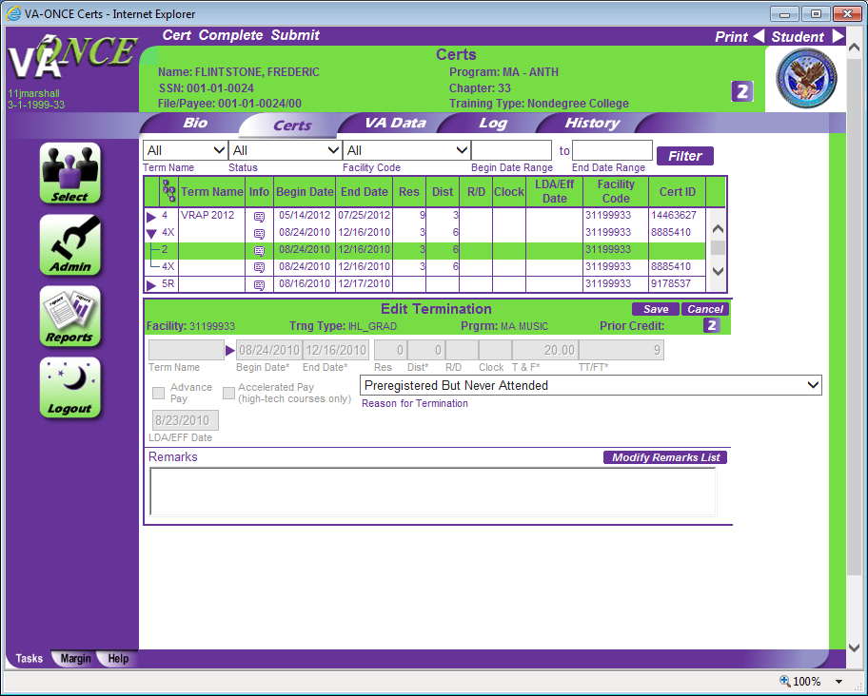

Slide 29
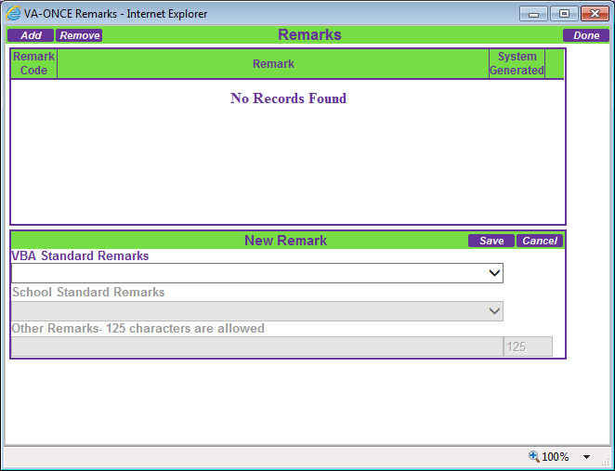

Slide 30
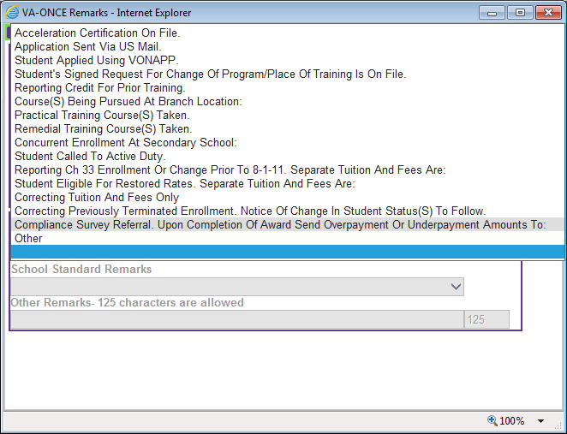

Slide 31
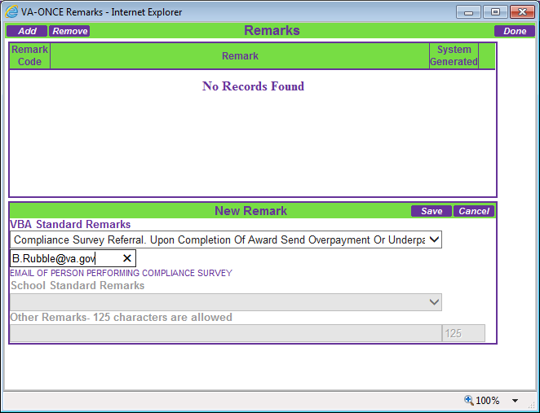

Slide 32


Slide 33
POST-SURVEY ACTIONS
  Approval-related issues (continued):
  Failure to enforce the approved policy relating to attendance, conduct, or progress.
  Failure to follow the approved school calendar or approved attendance schedules.
  Failure to make required refunds of tuition and fees, or charging tuition and fees in excess of those approved.
  Failure to furnish a copy of the course outline, school policies, and similar material.
  Failure to give certificates indicating satisfactory completion of a course.
  Failure to adhere to enrollment limitations.

Slide 34
POST-SURVEY ACTIONS
Common reporting-related discrepancies include:
  Student not enrolled in the same course certified by school.
  Student not pursuing the number of hours certified.
  Student did not commence the course on the date certified.
  Dates of interruption or termination not reported or reported incorrectly.
  Changes in training time not reported or reported incorrectly.

Slide 35
Serious Reporting Errors
Substantial Pattern of Overpayments
  May lead to referral for suspension and/or discontinuance
Potential School Liability
  May be indicated when overpayments created due to negligent or willful failure to report or negligent or willful false certification.
  Potential fraud referred to VA Office of the Investigator General.

Slide 36
PREVENTING DISCREPANCIES
Make sure institution has a system in place in order to communicate with Business Office on scholarships, discounts, and other funds that must be deducted from amount reported to VA.
Emplace and a system or program at your school that alerts you when VA students have changed their enrollment.
Review your latest WEAMS report and ensure all school officials and programs are current and updated in the VA approval system.
Understand your school’s prior credit evaluation process and ensure each VA student has documentation in the file to show prior credit has been evaluated.
Ensure you are only certifying courses required to meet program objective.
Read and understand your school’s policy on satisfactory attendance and progress and ensure student is meeting these requirements before certifying.

Slide 37

QUESTIONS?

Slide 38


Contact Us
WEBSITE: www.benefits.va.gov/gibill
FACEBOOK: www.facebook.com/gibillEducation
TELEPHONE: 1-888-GIBILL-1 (1-888-442-4551)

