Slide 1
Lymphocytic Hematologic Malignancies: What does BTK have to do with it?
mary.coleman@UND.edu
MS,MS,MLS(ASCP)^{CM}, CG(ASCP)^{CM}, SH(ASCP)^{CM}
University of North Dakota
Department of Medical Laboratory Science
Notes:
Department of Medical Laboratory Science School of Medicine and Health Sciences Room E381
1301 North Columbia Road Stop 9037
Grand Forks, ND 58202-9037

Slide 2
Objectives
The participant will be able to:
discover the complexity of the chronic lymphocytic leukemia malignancy
recognize chronic lymphocytic leukemia mutations
correlate various mutations with specific hematologic treatment

Slide 3
Introduction: Chronic Lymphocytic Leukemia (CLL) / Small lymphocytic Lymphoma
Most Common type of leukemia
20,000 people in USA are diagnosed every year, 4410 deaths in 2022
CLL is most common leukemia in older adults; male to female ratio: 2:1
CLL by definition is always a disease of neoplastic B cells, whereas T-CLL is now called T-cell prolymphocytic leukemia
Traditional medicine practice: treat CLL only if there are symptoms
CLL is not a curable disease despite the number of novel targeted agents for the treatment of CLL including next generation BTK inhibitors, but the relative risk of death has decreased since 2012
Notes:
Annual Clinical Updates Hematologic Malignancies, Oct 2021: CLL is one of the most frequent types of leukemia. It typically occurs in elderly pts and has a highly variable clinical course. Leukemic transformation is initiated by specific genomic alterations that interfere with the regulation of proliferation and of apoptosis in clonal B-cells.

Slide 4
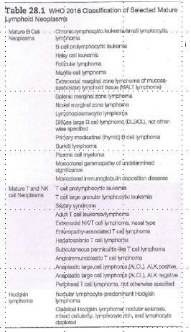
Lymphoma versus Leukemia
Lymphoma – disease involving the lymph nodes, tonsils, spleen, thymus, and lymphoid tissues of the GI tract. Most lymphomas involve mature cells/mature lymphoid neoplasms, but some can have blasts and be lymphoblastic malignancies
Leukemia – disease involving the bone marrow and usually peripheral blood
The distinction is not always clear cut
WHO classifies them together
Table 28.1, p. 626, 4th ed McKenzie
Notes:
Small lymphocytic lymphoma (SLL) considered the same disease, but called SLL if just seen in the splenic, nodal, or other extramedullary area. McKenzie 2020 ed: Ch 28 focuses on the mature lymphoid neoplasms, and discusses their etiology and pathophysiology, how a dx is established, the classification scheme, and unique features of selected subtypes. Mature lymphoid neoplasms represent a heterogeneous group of disorders that can be divided into two broad categories based on the distribution of the disease: lymphoma and leukemia. Lymphomas are malignant neoplasms that present as tumor masses primarily involving the lymphoid organs, including lymphoid nodes, tonsils, spleen, thymus and lymphoid tissues of other organs. Although most lymphomas are composed of mature lymphoid cells, blastic malignancies do occur. . Leukemia is a malignant neoplasm that primarily involves the bone marrow and peripheral blood The CLL malignancies are composed of mature looking lymphs and usually have an insidious onset and indolent ( lazy) course . Lymphoblastic leukemia also called ALL is a proliferation of blasts belonging to the lymphoid lineage. … Mckenzie 2015 ed, p 536: Lymphoid neoplasms can be divided into mature and precursor neoplasms, based on the stage of maturation of the neoplastic cells… Mckenzie, 2010 ed. P. 546 – Lymphoid malignancies represent a heterogeneous group of disorders composed of cells that resemble one or more stages of normal lymphocyte development. This broad group can be divided into 4 categories based on the maturity of the neoplastic cells and the distribution of disease: ALL, CLL, malignant lymphoma, plasma cell neoplasms. The distinction between leukemia and lymphoma is not always clear cut. Leukemia primarily involves the bone marrow and peripheral blood, but tissue involvement can occur. Lymphoma primarily involves tissue, but bone marrow and peripheral blood involvement can occur. Lymphoblastic lymphoma and ALL probably represent different clinical manifestations of a single disease entity. Therefore the WHO classification groups them.

Slide 5
Epidemiology
Increased the risk:
A family history is a strong predictive factor: having a family history of a first-degree relative with hematologic malignancy including a lymphoma, leukemia or myeloma
Having a history of working or living on a farm
Being a hair stylist
Having a history of hepatitis C infection
Exposure to Agent Orange in Vietnam
Decreased the risk:
A history of allergies
Having had blood transfusion
Having exaggerated sun exposure
Being a smoker
Notes:
Williams 10th ed, p. 1617. CLL is the only type of common adult leukemia to not be affected by radiation. But Schwartz and Klug from UND SMHS say CLL has not been associated with ionizing radiation in several highly exposed populations, thus CLL is generally considered to be nonradiogenic, but reports of increased risk of CLL among uranium miners and among some workers at nuclear plants have challenged that view. Epidemiology deals with the incidence, distribution, and possible control of diseases and other factor relating to health

Slide 6
Epidemiology: CLL Risk Factors
Breaking News - 3/27/2019 - Jury Awards $80M Verdict in Roundup Case
"SAN FRANCISCO (CN) – Agrochemical giant Monsanto failed to warn a California man that its Roundup weed killer causes cancer even though it knew the widely used herbicide is unsafe and must pay over $80 million in damages, a unanimous jury found Wednesday.
Concluding Monsanto acted with “malice or oppression” by not putting a cancer warning on Roundup’s product label despite multiple studies conducted over four decades showing the herbicide is carcinogenic, the six-person jury awarded plaintiff Ed Hardeman $75 million in punitive damages as punishment for the company’s deceitful conduct and to deter similar conduct in the future."
If you or a loved one has been diagnosed with non-Hodgkin's Lymphoma, contact us now for a free evaluation at https://roundup.claim-review.com
Round-Up
Radon
Radon is a natural radioactive gas that is a product of the decay of the radioactive elements uranium or thorium that are widely distributed in rocks and soils.
The majority of the exposure of most individuals to ionizing radiation comes from exposure to radon at home.
Radon is the second largest cause of deaths from lung cancer, accounting for 10-`15% of deaths of lung cancer in the USA per year. Radon gas enters homes via a gradient of negative pressure that pulls soil gases into the lower level of the dwelling.
The authors Schwartz and Klug speculate radon increases CLL risk and that the mechanisms may be similar to those by which radon causes lung cancer: Radon is known to damage lymphocyte DNA and its inhalation is a biologically plausible cause of CLL.

Slide 7
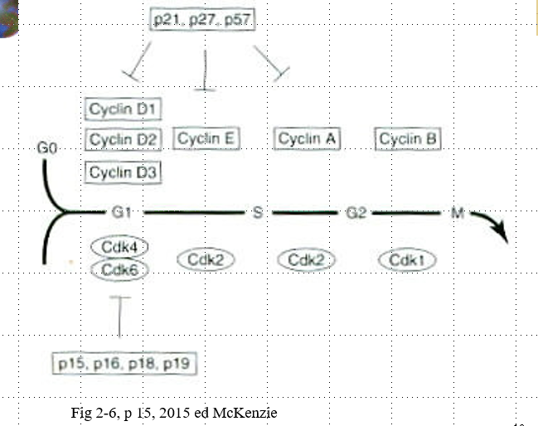
Genetics and Epigenetics in CLL
A genetic mutation occurs:
del 13q14 most common abnormality: 50% of patients
Trisomy 12: 15-20% of patients
del 11q22.3: 10-15% of patients
Others: 6q21, del 17 p13.1
In general loss and gain of chromosomes is common whereas balanced translocations are not common
RNA expression of noncoding micro RNAs ( miRNAs or miRs) serve as a model for disease pathogenesis. For example, loss of 13q14 results in a loss of a tumor-suppressor gene and results in short noncoding miRNA. This modulates the expression of various pro and antiapoptopic proteins of relevance to CLL.
del 17p13.1 leads to the deletion of the famous tumor protein p53 (TP53)
G₁ – checks for DNA damage
Rb (retinoblastoma susceptibility gene)
p53 – molecular policeman, tumor suppressor gene; most commonly mutated gene in human tumors
G₂-M checkpoint monitors the accuracy of DNA replication during S-phase
Metaphase checkpoint ( mitotic – spindle checkpoint) – fxns to ensure that all chromosomes are properly aligned on the spindle apparatus prior to initiating chromosomal separation and segregation at anaphase
Notes:
McKenzie, 2015, p. 15 – Cell- cycle checkpoints: cell proliferation and differentiation depends on the accurate duplication and transfer of genetic information, which requires the precise ordering of cell-cycle events. Cells achieve this coordination by using cell-cycle checkpoints to monitor events at critical points in the cycle and, if necessary, halt cycle’s progression. The main functions of checkpoints are to detect malfunctions within the system and to assess whether certain events are properly completed before the cell is allowed to proceed through the next phase of the cycle. When problems are detected checkpoint mechanisms interrupt cell cycling to allow correction of the problem or elimination of the defective cell. Four major cell-cycle checkpoints have been described. The G₁ checkpoint checks for DNA damage and prevents progression into S phase if the genomic DNA is damaged. The S-phase checkpoint monitors the accuracy of DNA replication during S phase and checks for damaged or unreplicated DNA; it can block mitosis if any ( damaged or unreplicated DNA) is found. Williams? Pathogenesis involves a hematopoietic stem cell predisposition to CLL, epigenetic programing that becomes locked at the stage of differentiation in which B-cell transformation occurs, loss of specific noncoding RNA entities and specific coding, and noncoding DNA mutations. In addition, epigenetic dysregulation and/or programming of super enhancer and transcription factors contributes to disease progression to the Richter transformation, progression of CLL into an aggressive high-grade, large B cell non-Hodgkin lymphoma. Williams, 2021, Ch. 91, p. 1618: Other deletions, such as the del 17p13.1, are present in less than 10% of pts with CLL and frequently involve the deletion of the tumor protein p53 (TP53) gene that encodes the p53 protein that is critical for cellular apoptosis or repair, especially in response to cytotoxic stimuli. Most patients with deletion of TP53 also have an inactivating mutation on the other allele. These patients do not respond to cytotoxic therapy and have a higher risk of Richter transformation to more aggressive lymphomas over the course of their disease; they also have a high frequency of genomic instability with complex karyotypes. Next-generation sequencing of both the whole genome and whole exon has further extended our understanding of CLL pathogenesis. ~ 100 recurrent mutations have been observed to occur in CLL, although validation of many is required. This is particularly true when using error- corrected, highly sensitive sequencing that will also ID clonal hematopoiesis aberrations that are acquired with age. A large sequencing effort in CLL ID 44 recurrently mutated genes, 23 putative genes, and 11 recurrent somatic copy numbers, with less than 10% having at least one driver. The mutational load is also low in CLL compared with solid tumors. Mutational aberrations generally are associated with the origin of the B-cell transformation (IGHV-mutated vs unmutated) IGHV-mutated CLL is associated with mutations in MYD88 and KLHL6, whereas IGHV unmutated CLL is associated with many mutations, including SF3B1 ( splicing factor 3B subunit 1, NOTCH1 ( Notch homologue 1), translocated-associated) TM, TP53, XPo1 ( gene encoding exportin-1, FBXW7, RPS15, POT1, KRAS, and ERK1 ( extracellular signal regulated kinase 1) . A number of genes have been shown to have noncoding mutations, including the promoter of PAX5 and NOTCH1, which also contribute to pathogenesis. Acquisition of additional mutations and expansion of aggressive subclones as disease progresses or in the context of chemotherapy has been documented and generally is associated with both disease progression and transformation. Epigenetic changes of the genome may drive both silencing and over expression of genes important to the pathogenesis of CLL. Silencing can involve chronic gene suppression through methylation, and transient silencing through repressor complexes driven by histone acetylation changes or other chromatin modifications. Similarly, disease-specific super-enhancer activation leads to overexpression of numerous genes related to the pathogenesis of CLL including TCL1, SYK, BCL2, MCL1, and many others. Integrating chromatin immunoprecipitation with bromodomain-containing protein ( BRD) 2/4 inhibitors (BRD-profiling) have confirmed multiple genes involved in CLL pathogenesis driven by super-enhancers. Similar studies integrating chromatin immunoprecipitation with histone deacetyl inhibitor rx have demonstrated pathogenic miRs involved in CLL pathogenesis. The repertoire of genetic aberrations driving CLL pathogenesis are complex, whereas converging biology around critical features such as BCR signaling make CLL vulnerable to therapeutic targeting.

Slide 8
CLL Biology
CLL is characterized by gradual accumulation of leukemic cells primarily from defective apoptosis that is partly contributed to by microenvironment interaction and constitutive active B-cell receptor (BCR) signaling.
Overexpression of multiple antiapoptotic proteins:
B-cell lymphoma-2 (BCL-2), myeloid cell leukemia-1 (MCL-1), Bcl-2 homologous antagonist/killer (BAK) , X-linked inhibitor or apoptosis protein (XIAP)
Overexpression with transcription factors:
Nuclear factor kappa B ( NF-kB), Nuclear factor of activated T cells, Signal transducer and activator of transcription 3 (STAT), NOTCH and WNT signaling pathways
A combination of these factors provide the CLL cells with a survival and proliferative advantage.
The surface immunoglobulin heterodimer that forms an integral part of the BCR is critical for both antigen-dependent and antigen-independent signaling through the BCR. The signal is transduced through a variety of kinases including Lck/Yes novel, phosphatidylinositol – 4,5-biphosphate 3-kinase (P13K), spleen tyrosine (SYK) and Bruton tyrosine kinase (BTK). Their activation results in phosphorylation of phospholipase C-gamma-2 (PLCy2) and induction of downstream second messengers that further modulated cell-survival regulators
Notes:
Williams 2021, Ch. 91 p. 1619: CLL is characterized by gradual accumulation of leukemic cells primarily from defective apoptosis that is partly contributed to by microenvironment interaction and constitutive active B-cell receptor (BCR) signaling. Overexpression of multiple antiapoptotic proteins like B-cell lymphoma-2 (BCL-2), myeloid cell leukemia-1 (MCL-1), Bcl-2 homologous antagonist/killer (BAK) and X-linked inhibitor or apoptosis protein (XIAP) along with transcription factors – e.g. nuclear factor kappa B ( NF-kB), nuclear factor of activated T cells, and signal transducer and activator of transcription 3 (STAT) and NOTCH and WNT signaling pathways have been demonstrated in CLL. Additional survival signals are provided by the microenvironment and include cellular factors like nurselike cells, mesenchymal stromal cells and various chemokines like stromal cell-derived factor-1. In addition, integrin mediated adhesion via CD49d/CD29 complex ( very late antigen 4) to its ligand fibronectin or vascular cell-adhesion molecule 1 promotes marrow and/or lymph node adhesion that results in enhanced survival. A combination of these factors provide the CLL cells with a survival and proliferative advantage. CLL B cells exhibit differential proliferation and signaling in the various disease compartments, including the blood, spleen and marrow. CLL B cells isolated from the blood of patients lack proliferative potential in vitro and are restricted to the resting phase of the cell cycle. These cells also undergo spontaneous apoptosis in routine culture conditions. Their survival can be extended when these cells are cultured on stromal cells or nurselike cells that are generally found in the secondary lymphoid organs. These secondary lymphoid organs are generally diffusely infiltrated by the B cells and are potentially the site of cell division and proliferation. Another contributing feature to CLL biology is progressive immune dysregulation in the cellular, humoral and innate immune compartments. Progression of CLL is associated with an early increase in the absolute number of circulating T cells and specifically an increase in the immunosuppressive T-regulatory cells and myeloid derived suppressor cells. The leukemic B cells are responsible for initiating and propagating the immune dysfunction observed in the ds by producing immunosuppressive cytokines like transforming growth factor-beta, downregulating critical surface molecules required for development of a functional immune system and release of exosomes. As CLL ds progresses, immune suppression becomes worse. However, even at the precursor monoclonal B cell lymphocytosis stage, immune suppression exists as suggested by an increased infectious risk. In addition to the direct effect of immune suppression predisposing to infection, aberrant functioning immune cells also contribute to the pathogenesis of CLL through release of cytokines, chemokines and small extracellular vesicles that promote CLL growth and survival. The BCR plays an integral part in the development, fitness, and maturation of B cells. Constitutive activation of the BCR is one of the most important survival signals for the propagation of CLL B cells. The surface immunoglobulin heterodimer that forms an integral part of the BCR is critical for both Ag-dependent and Ag independent signaling through the BCR. The signal is transduced through a variety of kinases including Lck/Yes novel, phosphatidylinositol – 4,5-biphosphate 3-kinase (P13K), spleen tyrosine (SYK) and Bruton tyrosine kinase (BTK). Their activation results in phosphorylation of phospholipase C-gamma-2 (PLCy2) and induction of downstream second messengers that further modulated cell-survival regulators. Targeting the various kinases involved in the BCR pathway has resulted in significant improvement in the therapy for this disease. BTK, P13K and SYK inhibitors have each shown excellent efficacy and tolerability, and these agents are currently being used in various combinations to improve disease outcomes. BTK was initially characterized as a deficient kinase in pts with X-lined agammaglobulinemia, a disease characterized by a severe immunodeficient state. Specific mutations in BTK results in severe impairments in B-cell development and humoral immunity. Activating mutations of BTK have not been ID in CLL or other cancers, but CLL B cells tend to have higher levels of BTK, which can be induced through the BCR signaling pathway. Similar to BTK, both SKY and P13K can be induced by both the autonomous and Ag-dependent BCR activation and result in providing the critical signals that result in leukemic cell survival and proliferation. Similar to the BTK inhibitor ibrutinib, the P13K isoform delta inhibitors, idealisib and duvelisib, antagonize internal and external survival signals to the CLL cells and result in significant clinical response.

Slide 9
CLL Biology
Bruton tyrosine kinase (BTK) mediated intracellular signaling of the B-cell receptor(BCR) is critical for B Cell development, expansion, and survival.
BTK is an enzyme that exists in most kinds of blood cells. In CLL, BTK enzyme is overactive, causing the B lymphocytes to become defective and grow out of control.
BTK, a member of the tyrosine kinase expressed in carcinoma (TEC) kinase family, is a nonreceptor tyrosine kinase and an essential component of the BCR signalosome.
During BCR signaling BTK phosphorylation leads signal transduction via multiple pathways, culminating in the nuclear translocation of transcription factors, including NF-kappaB.
Activated BCR signaling contributes to the initiation and maintenance of B cell malignancies
Aberrant BCR signaling has been strongly linked to lymphomagenesis and plays a crucial role in the pathobiology of CLL, mantle cell lymphoma and other hematologic malignancies.
BTK is an essential component of BCR signaling, as demonstrated by the observed effects of mutations interfering with its functions both in animals and humans.
BTK was clinically validated as a target in B-cell malignancies by the first-in-class inhibitor ibrutinub which currently has 6 US FDA approved indications including CLL, MCL, Waldenstrom macroglobulinemia, and marginal zone lymphoma
Notes:
Signalosome: large supramolecular protein complexes. Lymphomagenesis: lymphoma growth and development (Munoz J, et al) Bruton tyrosine kinase (BTK) mediated intracellular signaling of the B-cell receptor(BCR) is critical for B Cell development, expansion, and survival. BTK, a member of the tyrosine kinase expressed in carcinoma (TEC) kinase family, is a nonreceptor tyrosine kinase and an essential component of the BCR signalosome. During BCR signaling BTK phosphorylation leads signal transduction via multiple pathways, culminating in the nuclear translocation of transcription factors, including NF-kappaB. Activated BCR signaling contributes to the initiation and maintenance of B cell malignancies. Aberrant BCR signaling has been strongly linked to lymphomagenesis and plays a crucial role in the pathobiology of CLL, mantle cell lymphoma and other hematologic malignancies. BTK is an essential component of BCR signaling, as demonstrated by the observed effects of mutations interfering with its functions both in animals and humans. BTK was clinically validated as a target in B-cell malignancies by the first-in-class inhibitor ibrutinub which currently has 6 US FDA approved indications including CLL, MCL, Waldenstrom macroglobulinemia, and marginal zone lymphoma.

Slide 10
Evaluation of the patient with CLL
Symptoms and Clinical Features of CLL
Persistent fevers, night sweats, abdominal fullness, bothersome lymph node or spleen enlargement, weight loss
As the disease progresses, patients may be more prone to infections and bleeding due to more bone marrow involvement, aka, decreased platelets and white cells
Impaired immune function
Lab testing
Lymphocytosis, large prolymphocytes with prominent nucleoli should be <55% of the differential, cracked chromatin lymphocytes, many smudge cells
May or may not have anemia and thrombocytopenia. If anemia: normocytic normochromic anemia,
If macrocytic anemia, patient should have a DAT test, haptoglobin, retic count to rule out autoimmune hemolytic anemia. Also rule out a GI bleed and Vit B12 deficiency and malabsorption.
If anemic and thrombocytopenic do a bone marrow
CpG stimulated karyotype and FISH studies should be done at time of diagnosis and every time the disease character changes.
Notes:
Williams 2021, Ch. 91 p. 1620:For an improved evaluation of the cellular morphology on the blood film, an albumin preparation is sometimes required. Patients can also have large prolymphs with prominent nucleoli in the blood, but these lymphs must be less than 55% of the total lymph population to still be considered CLL. A marrow aspirate and biopsy are not required to establish a dx for the vast majority of pts with CLL at initial presentation. The anemia is typically normocytic and normochromic and plt morphology is typically preserved. Pt with a macrocytic anemia or an isolated anemia should have a direct antiglobulin ( Coombs) test, haptoglobin test, and reticulocyte count performed to rule out autoimmune hemolytic anemia (AIHA). These patients should also be evaluated for Vit B12 and folic acid deficiencies and malabsorption or GI bleed from CLL involvement should be ruled out. A marrow aspirate and biopsy are recommended in pts with anemia and thrombocytopenia to evaluate the presence of autoimmune HA and/or immune thrombocytopenia. Marrow biopsy typically shows diffuse marrow involvement with a monotypic population of small lymphocytes. The red cell precursors and megakaryocytes usually display unremarkable morphology but are diminished in numbers with progressive disease. Conventional stimulated karyotype analysis and interphase FISH studies, to evaluate the presence of the abnormalities commonly seen in patients with CLL, should be performed on all pts at the time of dx and every time the ds changes character to determine the extent of any clonal evolution. Pts with atypical presentations, especially those with absent or low CD23 expression should have a negative FISH study for t ( 11:14) to exclude mantle cell lymphoma. Lymph node biopsy is not typically required for further establishment of the dx of CLL. Lymph nodes typically show architectural effacement by diffuse infiltration by cells of a similar morphology as observed in the blood. Patients with CLL will frequently have hypogammaglobulinemia with a decrease in the serum conc of immunoglobulin ( Ig G, IgA, and IgM. The degree of hypogammaglobulinemia correlates with progressive ds and predisposes pts to recurrent sinopulmonary infections with encapsulated organisms. T-cell defects, which increase the risks of viral infections, also have been described; however this is not routinely assessed at the time of initial presentation. A small % of patients also have monoclonal gammopathy with IgM or IgG or light-chain monoclonal paraproteinemia which can be detected on serum protein electrophoresis and immunofixation. Excessively high heavy-chain paraproteinemia can result in symptoms related to hyperviscosity as seen in patients with Waldenstrom macroglobulinemia and should be managed as such.

Slide 11
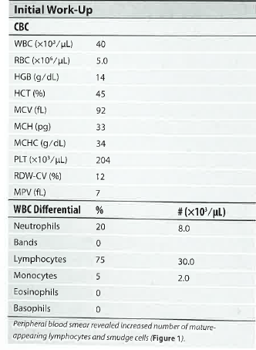
Case Study: 70 yr old male visits physician for annual check up. 2019 case.
Rai KR, Hsu P: CLL/SLL. In: Gulati G, Flicko-O’Hara, Kraus JR (eds): Case Studies in Hematology and Coagulation. 2nd ed. Chicago;: ASCP Press. 2019. pp. 207-210
Notes:
Palpable, enlarged multiple nodes bilaterally, in the neck, axilla, and inguinal regions.

Slide 12
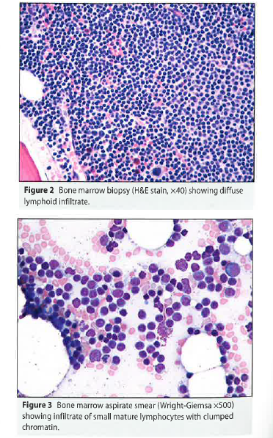
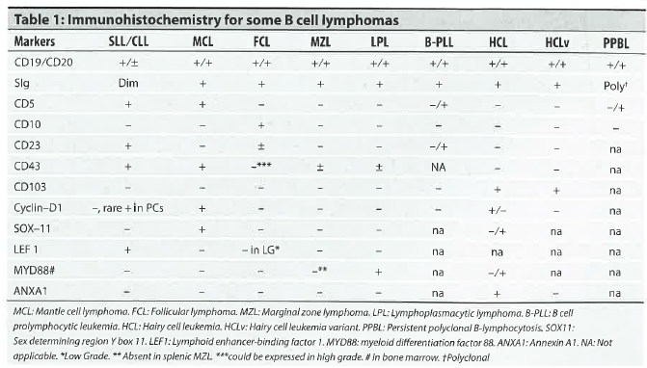
Case Study: 70 yr Old male
The patient had a monoclonal population B lymphocytes, CD19+, CD20+( dim) ,
CD5+, CD23+, kappa sIgM ( dim), CD10 neg, FMC-7, CD103, and CD25 neg
Additional work up
Notes:
Monoclonal population B lymphocytes, CD19+, CD20+, CD5+, CD23+, with kappa sIgM ( dim) restriction, CD10 neg, FMC-7, CD103, and CD25 neg. Trilineage hematopoiesis with maturation was present but markedly reduced.

Slide 13
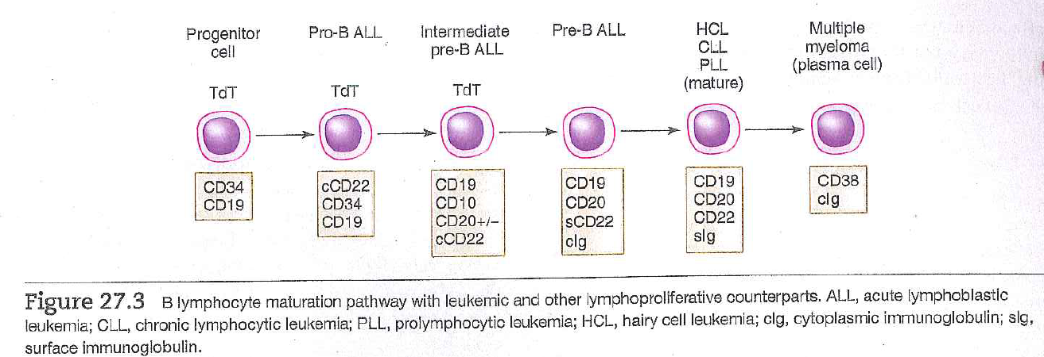
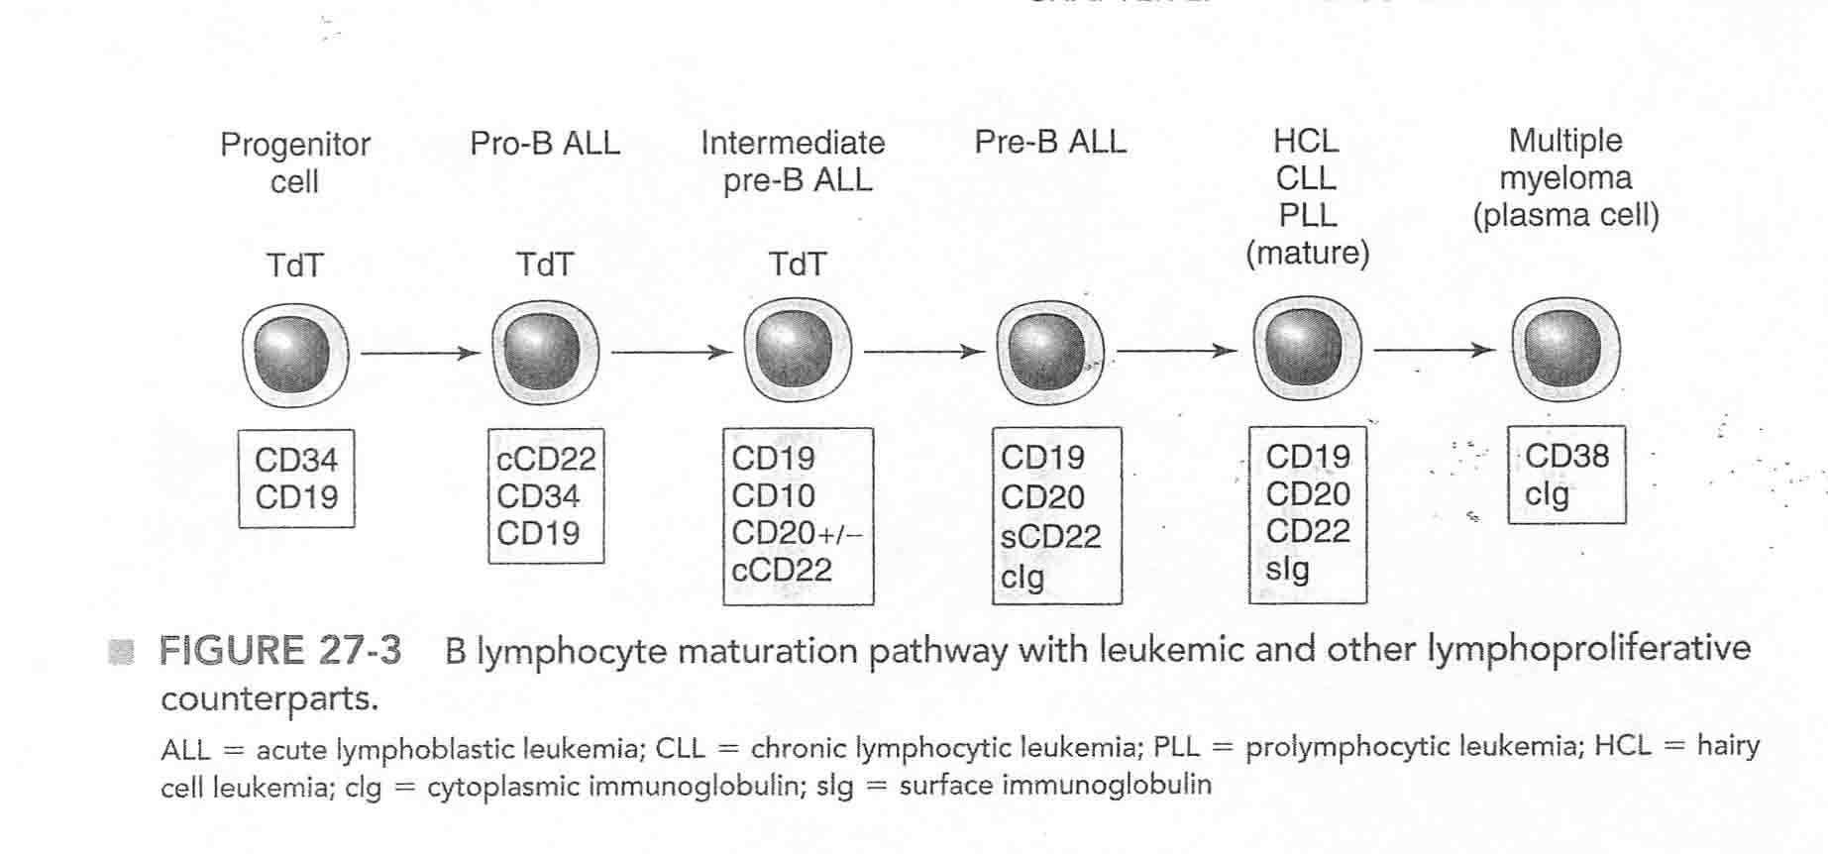
Chronic Lymphoid Disorders - Immunophenotype
Fig. 27.3, p. 612, 2020 ed. Mckenzie
Immunophenoytpe of malignant lymphoid cell population
CD19 positive
CD10 negative
Weak sIg
CD5 positive, may be CD 23 +
CD38, ZAP70 – If many positive cells, poor prognosis
IGVH – Immunoglobulin heavy chain region mutation testing: mutated IGHV genes better prognosis
CLL -Weak expression CD 20, and monoclonal immunoglobulin. Expression CD5 and CD 23
Notes:
FMC-7, epitope of CD20 95% are B cell origin with these findings: , Weak Surface immunoglobulin, B cell antigens 19,20,22, plus T lymph antigen CD5, CD 23, Considered intermediate B cells Mckenzie, 2004, p 576, Fig 30-4. 6. Explain the significance of the results of terminal deoxynucleotidyl transferase (TdT), CD10, CD19, HLA-DR (Ia) antigen, the presence cytoplasmic : chains, surface immunoglobulin CD 2, CD5, CD7 in identifying the immunophenotype of the acute lymphocytic leukemias. 9. Differentiate 4 immunologic types of acute lymphocytic leukemias based on the immunophenotype. 10. Relate the immunophenotype to FAB morphology of the lymphoblasts in acute lymphocytic leukemias.

Slide 14
Case Study 70 yr Old Male: 2019 Case
Treatment: The patient was placed on observation only, with the plan to start with chemo-immunotherapy ( FCR= fludarabine _+ cyclophosphamide+ rituximab ) if the disease showed rapid progression or if the patient developed disease related symptoms such as weight loss, night sweats, or fatigue.
Follow-up monitoring would include IGVH mutation status,ZAP-70, CD38 and beta-2 macroglobulin. If IGVH mutated, CD38 is negative, ZAP-70 is negative and beta-2 macroglobulin is low, the prognosis is excellent in early state patients.
Notes:
ASCP Press: Some patients run a benign course and may live for many years without any complications or need for therapy, while others may have an aggressive course and rapidly progress despite chemotherapy. Decisions to initiate therapy are made based on the rapidity of progression of disease, the presence of bulky and/or symptomatic adenopathy, the development of cytopenias, progression to large cell lymphoma, and patient preference. Chemotherapy including purine analogs ( fludarabine, pentostatin) , alkalating agents ( cyclophosphamide) , corticosteroids, and monoclonal antibodies ( rituximab, ofatumumab, obinotumab) have been standards, alone or in combination , for years. More recently targeted therapies including ibtrutinib and idealalasib have shown efficacy with minimal side effects and are being used more commonly. In younger patients, allogeneic hematopoietic progenitor cell transplantation is potentially curative therapy. Stem cell transplant is generally avoided in older patients.

Slide 15
Knowledge Check
1. What are some chromosome abnormalities associated with CLL?
A. Trisomy 12, del 13q14, del 11q22.3
B. Translocation(t) ( 9;22) ( q34;q11.2)
C. Translocation (t) (11;14 ) (q13;q32)
2. What happens when a CLL mutation occurs?
A. Antiapoptosis
B. <Anti transcription factor production B lymphs
C. < anti transcription factor production T lymphs
3. The blood picture in CLL is:
A. > 5000 lymphs/mcL
B. < 55 % prolymphs/mcL
C. Smudge cells
D. All of the above
4. What CD markers are seen in CLL?
A. CD 5, 19, 20, 23
B. CD 2,5,7
C. CD 10

Slide 16
CaSe Study 2022
All patients should undergo a comprehensive prognostic evaluation at the time of initial presentation. This evaluation allows the clinician to explain the specific disease characteristics to the patient and also helps the patient with the emotional adjustment process that they have to go through when initially diagnosed with CLL and discussions on the need for treatment.
Notes:
Williams, 10th ed p. 1620: All patients should undergo a comprehensive prognostic evaluation at the time of initial presentation. This evaluation allows the clinician to explain the specific disease characteristics to the patient and also helps the patient with the emotional adjustment process that they have to go through when initially diagnosed with CLL and discussions on the need for treatment.

Slide 17
Case Study 2022: Molecular Testing
National Comprehensive Cancer Network (NCCN) recommends molecular analysis at diagnosis before initiation treatment for patients with CLL to assess prognosis and help inform treatment decisions.
Tests should include:
FISH to detect deletion11q23, deletion 13q14, trisomy 12, and deletion 17p. 13.1. Williams recommends: FISH for t (11;14) to rule out mantle cell lymphoma
TP53 sequencing
CpG-stimulated metaphase karyotype ( CpG-Oligodeoxynucleotide)
IGHV mutation status
Emerging technologies: single nucleotide polymorphism(SNP), microarray for karyotype analysis, targeted next generation sequencing, targeted next generation sequencing, (NGS), analysis of IGHV as well as genes recurrently mutated in CLL ( e.g. TP53) and measurable residual disease
A failure to perform recommended molecular testing has consequences for patients, as it can result in an inaccurate estimation of prognosis and inappropriate treatment selection.
Clinical evidence demonstrated that TP53 mutations, IGHV unmutated status, del (17p) and del(11q)as well as the presence of 3 or more unrelated clonal chromosomal abnormalities in a sample are associated with poor prognosis.
Unmutated IGHV is present in ~ 40% of untreated cases. The unmutated status not only informs a bad prognosis but also predicts a worse response to the chemoimmunotherapy regimen fludarabine-cyclophosmamide-rituximab.
Notes:
CpG stimulated metaphase karyotype, CME: CLL is a clonally complex disease with a high degree of intratumoral and interpatient heterogeneity. The genetic variability results in a wide range of clinical outcomes and highlights the need for accurate prognostic tests in CLL. Real world data indicate that molecular testing is underutilizes in patients with CLL. Between 2015and 2018 FISH was only performed in 31% of patients. Rates of testing for TP53and IGHV mutation were even lower at 11% each. A failure to perform recommended molecular testing has consequences for patients, as it can result in an inaccurate estimation of prognosis and inappropriate treatment selection. Clinical evidence demonstrated that TP53 mutations, IGHV unmutated status, del (17p) and del(11q)as well as the presence of 3 or more unrelated clonal chromosomal abnormalities in a sample are associated with poor prognosis. Unmutated IGHV is present in ~ 40% of untreated cases. The unmutated status not only informs a bad prognosis but also predicts a worse response to the chemoimmunotherapy regimen fludarabine-cyclophosmamide-rituximab. Unlike many other biomarkers, the IGHV status in in a given patient, either mutated or nonmutated or unmutated, is not affected by disease evolution and stays the same throughout the disease and treatment course. Recently, there has been increased interest in using MRD monitoring in CLL to predict patient outcomes and optimize therapeutic selection. MRD quantification in CLL has proven to be an independent prognostic marker of progression free survival (PFS)and overall survival(OS) after chemotherapy and allogeneic transplantation. It is now a surrogate marker for evaluating efficacy in several clinical trials before clinical endpoints can be assessed. The goal of achieving MRD negative CLL to maximize the length of PFS is a way to pursue the eradication of the disease; however the clinical validity of MRD measurement is still an area of uncertainty. With further research, MRD may be applied in future clinical practice for determining when to discontinue treatment, inferring second line therapeutic selection and screening for emerging mutations conferring resistance to newer agents to anticipate clinical relapse.

Slide 18
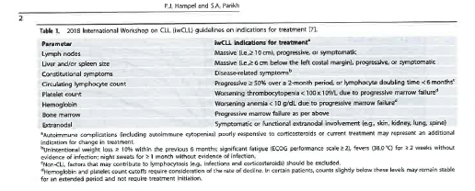
Guidelines for Treatment-iwCLL
Table 1, Hampel PJ, Parikh SA, 2022
Notes:
Blood cancer journal 2022: the 2022 lymphoid neoplasm classification updates from the WHO and the international consensus classification clinical advisory committee agree in defining CLL as a low-grade lymphoproliferative neoplasm with ≥ 5000 lymphs/ mcL clonal B-cells in the peripheral circulation that express CD5, CD19, CD 20 ( dim- level of expression) and CD23. All cases of CLL are preceded by monoclonal B-cell lymphocytosis (MBL), a pre-malignant condition defined as < 5000/mcL clonal B cells in the absence of lymphadenopathy., organomegaly, and cytopenias. MBL has been detected in ~ 10-15% of healthy individuals > 40 yrs of age, making it one of the most common premalignant conditions in humans. Aside from the risk of progression from MBL to CLL requiring therapy ( estimated at ~ 1-2% per year for individuals with high-count count MBL, patients with High or low count MBL have an increased risk for infections and lymphoid malignancies. However, individuals with MBL and early stage asymptomatic CLL who do not meet the 2018 international workshop on CLL ( IwCLL) criteria to initiate therapy should be offered close follow up. … The vast majority of CLL patients have early stage asymptomatic disease at dx. Only those patients who meet the 2018 iwCLL criteria for initiation of therapy should be offered treatment. Another reference: Diagnosis based on morphology, flow cytometry/ immunophenotyping, molecular diagnostics and cytogenetics. For most cases of leukemia, morphologic evaluation is performed on peripheral blood and bone marrow aspirates and core biopsies. For lymphoma diagnosis, a tissue biopsy or a fine-needle aspirate of the mass. Proving monoclonality generally is synonymous with malignancy Immunoglobulin light chains, abnormal phenotype, T cell receptor genes, or cytogenetics and molecular studies The presence of an abnormal T cell phenotype, such as CD5 negative, can support the diagnosis of a T cell lymphoma

Slide 19
Newly Diagnosed CLL Patient Not Meeting 2018 iwCLL Criteria to Initiate Therapy
Fig. 1, Table 1, Hampel PJ, Parikh SA, 2022

Slide 20
Zeta chain associated protein kinase of 70 kDa (ZAP-70), its methylation status and other surrogates of IGHV mutation status
Zeta chain associated protein kinase of 70 kDa ( ZAP-70) is an intracellular tyrosine kinase that is typically associated with T-cell development and T cell receptor signaling and represents the most commonly referred to surrogate. Expression of ZAP-70 in CLL B cells provides a survival advantage through intrinsic and extrinsic signals mediated through the BCR. Cytoplasmic assessment of ZAP-70 in CLL B cells by flow cytometry correlates strongly with IGHV mutational status and clinical outcomes, with an expression of 20% or more predictive of poor outcomes.
IGHV mutation or the methylation status does not change over time and likely represents the place in B-cell differentiation where CLL clones transform.
Another prognostic factor is the expression of CD38, a 45-kDa transmembrane glycoprotein that can be detected on the surface of CLL B cells by flow cytometry; a level of expression < 30% correlates strongly with progression-free survival ( PFS)
LDH an enzyme whose expression is driven by MYC expression is associated with more aggressive ds and Richter transformation.
Notes:
Williams 2021, Ch. 91 p. 1620: The assessment of IGHV somatic mutation by a polymerase chain reaction-based assay has been shown to be an extremely reliable and important prognostic tool for patients with CLL. Patients with less than 2% homology in their nucleotide sequence compared with consensus germline sequence are considered to have unmutated IGHV. Patients with a mutated IGHV, which is present in ~ 60% of patients with CLL have a significantly prolonged treatment-free interval, longer remission durations and Overall survival. These patients also have a very low incidence of clonal evolution or transformation to an aggressive histology. The IFHV mutation status does not vey over time and serves as a reliable marker for predicting long-term disease outcomes. The only currently known exception to the mutation rule is the presence of IGHV 3-21 somatic mutations, which may confer an aggressive phenotype similar to leukemic cells from patients with unmutated IGHV, at least in a subset of patients. p. 1622:There have been many different surrogates or even different biologic readout tests examined for a replacement of IGHV mutation status. IGHV mutation or the methylation status does not change over time and likely represents the place in B-cell differentiation where CLL clones transform. Zeta chain associated protein kinase of 70 kDa ( ZAP-70) is an intracellular tyrosine kinase that is typically associated with T-cell development and T cell receptor signaling and represents the most commonly referred to surrogate. Expression of ZAP-70 in CLL B cells provides a survival advantage through intrinsic and extrinsic signals mediated through the BCR. Cytoplasmic assessment of ZAP-70 in CLL B cells by flow cytometry correlates strongly with IGHV mutational status and clinical outcomes, with an expression of 20% or more predictive of poor outcomes. The assessment of ZAP-70 by flow cytometric testing has been plagued with several issues, including lack of reproducibility and reliability of the reagents used. Consequently, the NCCN guidelines do not recommend the routine use of ZAP-70 as a prognostic marker outside of clinical trials. Given the stability of DNA and epigenetic modification by methylation, investigators have also sought to assess ZAP-70 expression by the absence of promoter methylation, which has similar prognostic significance and can be performed reproducibly in different labs. Another prognostic factor is the expression of CD38, a 45-kDa transmembrane glycoprotein that can be detected on the surface of CLL B cells by flow cytometry; a level of expression (Typo said > 30%)> 30% correlates strongly with progression-free survival ( PFS). CD38 is involved in cellular metabolism by synthesizing cyclic diphosphate-ribose from nicotinic acid adenine, and its activity and expression correlate with lymphocytic proliferation, as demonstrated by their high Ki-67 proliferation index, with progressive ds CD 38 expression also changes with ds progression, but the assessment of the extent of expression of CD 38 is based on nonstandardized, subjective parameters. In virtually all comparative studies in which prognostic factors are entered into a multivariate analysis CD38 is found to be strongly associated with other unfavorable prognostic factors but is not an independent prognostic factor. Multiple other surrogate parkers exist, but the significance of only a few are reproducible in multiple studies. D49d is a surface subunit of the integrin heterodimer that is involved in promoting survival of the CLL cells through growth signals derived from the microenvironment. Patients whose CLL cells express CD49d by flow cytometry are considered to be positive and constitute a group of patients with an aggressive disease course and inferior survival. The beta 2 microglobulin has been shown to be a prognostic marker for remission duration, PFS ( progression free survival) , and OS ( overall survival). Similarly LDH an enzyme whose expression is driven by MYC expression is associated with more aggressive ds and Richter transformation. Lymphocyte doubling time could also be used as a tool to determine the prognosis of CLL. Pts with lymphocyte doubling time of 12 months or less have shorter OS and a Rx free survival, but with most new prognostic scores this finding is less important and should not be used as the sole indicator for Rx. The iwCLL states that less than 6 months doubling time is an indicator for Rx, but this particular indicator is controversial among CLL experts. Most important for this criterion of Rx is factoring in the entire pt condition ( age, comorbidities, etc) Over the years, multiple other prognostic proteins or cytokines have been found to be associated with various measures of ds outcomes. However none of these is routinely used for clinical decision making.

Slide 21
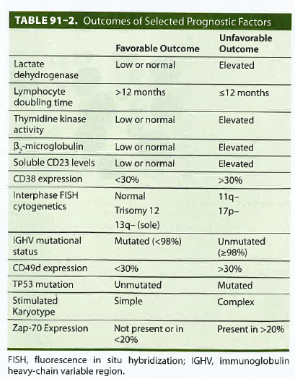
Prognostic Factors
Table 91-1, p. 1622. 10th ed. Williams
Table 91-2, p. 1622. 10th ed. Williams

Slide 22
Staging for CLL
Notes:
Williams 2021, Ch. 91 p. 1623: The Rai and Binet staging systems have been used for patients with CLL. These easy to use staging systems are based on assessment of ds burden as determined by lymphadenopathy and splenomegaly demonstrated on physical exam and the presence of cytopenias. Further modifications of the Binet system established low-risk ( stage 0: lymphocytosis only), intermediate risk ( stages 1-2; lymphocytosis with lymphadenopathy and hepatosplenomegaly) and high-risk groups of patients with CLL ( stages 3-4): lymphocytosis with anemia and thrombocytopenia). These classification systems provide an estimate of median overall survival ( OS) of 150, 90 and 19 months, respectively, and helped classify patients for subsequent therapeutic intervention. The staging systems still remain relevant and complementary to molecular testing. With the introduction of new molecular markers, a collaborative CLL international prognostic index was established to both predict therapy-free outcomes of patients at initial dx, prognosis with chemoimmunotherapy and OS. This index identified 5 independent prognostic factors related to TP53 status ( no abnormalities vs del 17p or TP53 mutations or both, IGHV mutational status ( mutated vs unmutated) serum beta 2 macroglobulin conc ( , or = to 3.5 mg/L vs > 3.5 mg/L) clinical stage ( Binet A or Rai 0 vs Binet B-C or Rai I-IV ) and age ( < or = to 65 yrs versus > 65 yrs. Assigning relative scores for evaluation based on contributing risk, four groups were id, with OS at 5 yrs being different in the low-risk, 93.2%, intermediate risk (79.3%) high risk ( 63.3%), and very high risk ( 23.3%) groups. The CLL international prognostic index is now being commonly applied to CLL trials to enable prediction of outcomes across clinical trials, observational studies, and in clinical care. Computated tomography (CT) scans are generally not required for the routine initial evaluation of pts with CLL because conventional stating systems rely on physical exam findings. Similarly, routine CT scans for the serial evaluation of ds extent have no role in pts with CLL. CT scans may be performed in pts with symptomatic ds and before starting therapy and to assess node response if physical exam demonstrates a complete remission in all palpable nodes. In some cases magnetic resonance imaging can be substituted for CT scans if there is a concern over radiation exposure. Similarly, a positron emission tomography (PET) scan has no role in the routine mgt of pts with CLL outside of trying to exclude an alternative dx. CLL lymph nodes are fluorodeoxy-glucose non-avid; however, flurodeoxyglucose-PET scanning can be used for the ID of pts with Richter transformation or alternatively, to direct the most appropriate lymph node are to biopsy for suspected dx of this ( ? Richter transformation). Both receipt and withdrawal of targeted BCR inhibitor agents can result in more or less avid lymph nodes on PET scan and can diminish the value of such testing.

Slide 23
Staging for CLL
Notes:
Williams, 10th ed, p. 1623. With the introduction of new molecular markers, a collaborative CLL international prognostic index was established to both predict therapy-free outcomes of patients at initial dx, prognosis with chemoimmunotherapy and OS. This index identified 5 independent prognostic factors related to TP53 status ( no abnormalities vs del 17p or TP53 mutations or both, IGHV mutational status ( mutated vs unmutated) serum beta 2 macroglobulin conc ( , or = to 3.5 mg/L vs > 3.5 mg/L) clinical stage ( Binet A or Rai 0 vs Binet B-C or Rai I-IV ) and age ( < or = to 65 yrs versus > 65 yrs. Assigning relative scores for evaluation based on contributing risk, four groups were id, with OS at 5 yrs being different in the low-risk, 93.2%, intermediate risk (79.3%) high risk ( 63.3%), and very high risk ( 23.3%) groups

Slide 24
Treatment of CLL
Treatment (Rx) of patients with CLL is initiated at the time of symptomatic progressive disease
The specific criteria for initiating therapy have been detailed in the iwCLL 2018 guidelines and NCCN guidelines. This recommendation is primarily based on studies with chemotherapy and chemoimmunotherapy that failed to demonstrate a survival advantage in patients treated early in the course of the disease (ds)
Trials are currently underway with kinase inhibitors to determine whether early intervention can alter the natural hx of the ds, but currently , initiation of treatment (rx) is only recommended when pts fulfill the iwCLL 2018 criteria for rx regardless of the prognostic factor analysis.
Pts with autoimmune complications of CLL can be managed accordingly with glucocorticoids and immunosuppressive therapies before proceeding with definitive therapy for the underlying disease (ds).
Pts with CLL rarely exhibit evidence of leukostasis resulting from profound leukocytosis, therefore an elevated WBC count should virtually never be used as the sole criterium for initiating treatment (rx).
Similarly, hypogammaglobulinemia should not be used as a reason to rx the disease. Periodic IV Ig infusions can be used in pts with hypogammaglobulinemia and recurrent life-threatening infections. The iwCLL -2018 criteria should also be used when determining the timing of therapy for pts with relapsed ds.
One of the most important factors to consider before initiating rx is the functional state of the pt. … Clinical trials now focus on developing rx with targeted inhibitors specifically for the older population. CLL therapy has been transformed with the addition of new targeted therapeutics making the application of chemotherapy or chemoimmunotherapy only applicable in a small population of CLL pts.
Notes:
Williams 2021, Ch. 91 p. 1623: Rx of patients with CLL is initiated at the time of symptomatic progressive ds. The specific criteria for initiating therapy have been detailed in the iwCLL 2018 guidelines and NCCN guidelines. This recommendation is primarily based on studies with chemotherapy and chemoimmunotherapy that failed to demonstrate a survival advantage in pts treated early in the course of the ds. Trials are currently underway with kinase inhibitors to determine whether early intervention can alter the natural hx of the ds, but currently , initiation of rx is only recommended when pts fulfill the iwCLL 2018 criteria for rx regardless of the prognostic factor analysis. Pts with autoimmune complications of CLL can be managed accordingly with glucocorticoids and immunosuppressive therapies before proceeding with definitive therapy for the underlying ds. Pts with CLL rarely exhibit evidence of leukostasis resulting from profound leukocytosis, therefore an elevated WBC count should virtually never be used as the sole criterium for initiating rx. Similarly, hypogammaglobulinemia should not be used as a reason to rx the disease. Periodic IV Ig infusions can be used in pts with hypogammaglobulinemia and recurrent life-threatening infections. The iwCLL -2018 criteria should also be used when determining the timing of therapy for pts with relapsed ds. One of the most important factors to consider before initiating rx is the functional state of the pt. … Clinical trials now focus on developing rx with targeted inhibitors specifically for the older population. CLL therapy has been transformed with the addition of new targeted therapeutics making the application of chemotherapy or chemoimmunotherapy only applicable in a small population of CLL pts.

Slide 25
Chemotherapy for the RX of CLL
Alkylating agents: Chlorambucil was used as the prominent alkylating agent for the rx of CLL until 2000. … Bendamustine was approved for the rx of pts with CLL in 2008. … Nucleoside analogs also have been used for the rx of CLL since 1991. Fludarabine has been the most commonly used agent from this class of drugs. Fludarabine is associated with significant hematologic and immunologic toxicities.
CLL therapy has been transformed with the addition of new targeted therapeutics making the application of chemotherapy or chemoimmunotherapy only applicable in a small population of CLL pts.
Notes:
Williams 2021, Ch. 91 p. 1624: Alkylating agents: Chlorambucil was used as the prominent alkylating agent for the rx of CLL until 2000. … Bendamustine was approved for the rx of pts with CLL in 2008. … Nucleoside analogs also have been used for the rx of CLL since 1991. Fludarabine has been the most commonly used agent from this class of drugs. Fludarabine is associated with significant hematologic and immunologic toxicities.

Slide 26
Antibody Therapy
The advent of antibodies for the Rx of pts with CLL has been a major advance in the mgt of the disease (ds), with the first consistent evidence of improving survival. Numerous antibody (ab) targeting different receptors have been developed and are at various stages of development.
Four antibodies are currently approved for routine management (mgt).
One of these ( alemtuzumab) is no longer actively marked for this indication. Alemtuzumab: is a CD52-targeting, humanized, monoclonal ab that mediates its efficacy through direct cytotoxicity, complement dependent cytotoxicity (CDC) and ab-dependent cell-mediated cytotoxicity (ADCC). At this time alemtuzumab is only rarely used in pts with CLL who have nonbulky nodal relapsed ds.
CD20 targeting ab: Rituximab is a chimeric murine CD 20 targeting monoclonal ab that has been used extensively for the rx of pts with CD20+ lymphoid malignancies. CD 20 is a calcium channel that interacts with the BCR complex and is ubiquitously expressed on B-cell non-Hodgkin lymphomas and is weakly expressed on CLL cells.
Ofatumumab- CD20 targeting antibody
Obinutuzumab, Cd20 targeting antibody
Notes:
Williams 2021, Ch. 91 p. 1624-25: The advent of antibodies for the Rx of pts with CLL has been a major advance in the mgt of the ds, with the first consistent evidence of improving survival. Numerous ab targeting different receptors have been developed and are at various stages of development. Four antibodies are currently approved for routine mgt. One of these ( alemtuzumab) is no longer actively marked for this indication. Alemtuzumab: is a CD52-targeting, humanized, monoclonal ab that mediates its efficacy through direct cytotoxicity, complement dependent cytotoxicity (CDC) and ab-dependent cell-mediated cytotoxicity (ADCC). CD52 is ubiquitously expressed on lymphocytes (including B and T cells) and monocytes and this explains the efficacy and toxicity of the ab. Alemtuzumab is extremely effective in clearing the blood and marrow of ds and is also active in pts with del 17p disease. However alemtuzumab has limited efficacy in pats with bulky lymphadenopathy especially in patients with lymph nodes that are greater than 5 cm in diameter. Alemtuzumab was initially approved in 2001 by the FDA for the Rx of patients in whom prior therapy with nucleosides have failed. Responses occurred in 30-40% of pts but CRs occurred in less than 5% of pts, with a median response of only 9 months. Major toxicities observed with alemtuzumab include profound immunosuppression that results in opportunistic organisms such as CMV, pneumocystis or varicella zoster. Consequently antiviral and antimicrobial prophylaxis therapy should be initiated in all patients receiving alemtuzumab and should be continued for at least 6 months after completing therapy. Alemtuzumab was shown to be efficacious in multiple sclerosis at lower doses than administered in CLL, prompting the company to withdraw it from marketing for CLL in 2015. … at this time alemtuzumab is only rarely used in pts with CLL who have nonbulky nodal relapsed ds. CD20 targeting ab: Rituximab is a chimeric murine CD 20 targeting monoclonal ab that has been used extensively for the rx of pts with CD20+ lymphoid malignancies. CD 20 is a calcium channel that interacts with the BCR complex and is ubiquitously expressed on B-cell non-Hodgkin lymphomas and is weakly expressed on CLL cells.
CD52 is ubiquitously expressed on lymphocytes (including B and T cells) and monocytes and this explains the efficacy and toxicity of the ab. Alemtuzumab is extremely effective in clearing the blood and marrow of ds and is also active in pts with del 17p disease. However, alemtuzumab has limited efficacy in pats with bulky lymphadenopathy especially in patients with lymph nodes that are greater than 5 cm in diameter. Alemtuzumab was initially approved in 2001 by the FDA for the Rx of patients in whom prior therapy with nucleosides have failed. Responses occurred in 30-40% of pts but CRs occurred in less than 5% of pts, with a median response of only 9 months. Major toxicities observed with alemtuzumab include profound immunosuppression that results in opportunistic organisms such as CMV, pneumocystis or varicella zoster. Consequently, antiviral and antimicrobial prophylaxis therapy should be initiated in all patients receiving alemtuzumab and should be continued for at least 6 months after completing therapy. Alemtuzumab was shown to be efficacious in multiple sclerosis at lower doses than administered in CLL, prompting the company to withdraw it from marketing for CLL in 2015.

Slide 27
Chemoimmunotherapy
Fludarabine, cyclophosphamide, and rituximab (FCR) : chemoimmunotherapy has been studied extensively in patients with previously treated and untreated CLL.
In the initial single-institution, phase 2 experience of 300 untreated patients with CLL, this combination resulted in an exciting ORR ( Objective response Rate) of 95%, with a CR (complete remission) rate of 72 % with median time to progression of 80 months in patients with untreated CLL
FCR resulted in significant and sustained myelosuppression with 35% of patients experiencing cytopenias three months after completing therapy. Notably, therapy-related myeloid neoplasms/ myelodysplastic syndromes occurred in 5.1% of patients with Richter transformation in 9 %.
Notes:
Williams 2021, Ch. 91 p. 1625: Combining chemotherapy with targeted ab was a major advance in the mgt of pts with CLL but now has been largely surpassed by the intro of targeted therapies. The relevant chemoimmunotherapies and population to which they are appropriate to consider is summarized here: . Fludarabine, cyclophosphamide, and rituximab (FCR) : chemotherapy has been studied extensively in patients with previously treated and untreated CLL. Fludarabine was administered at 25 mg/m^2 IV, Cyclophosphamide at 250 mg/m^2 IV on days 2 to 4 of cycle 1, and on days 1 to 3 of cycles 2 to 6, and rituximab at 375 mg/M^2 IV on day 1 of cycle 1 and 500 mg/m^2 on day 1 of cycles 2 to 6. In the initial single-institution, phase 2 experience of 300 untreated patients with CLL, this combination resulted in an exciting ORR ( Objective response Rate) of 95%, with a CR ( complete remission) rate of 72 % with median time to progression of 80 months in patients with untreated CLL. FCR resulted in significant and sustained myelosuppression with 35% of patients experiencing cytopenias three months after completing therapy. Notably, therapy-related myeloid neoplasms/ myelodysplastic syndromes occurred in 5.1% of patients with Richter transformation in 9 %.

Slide 28
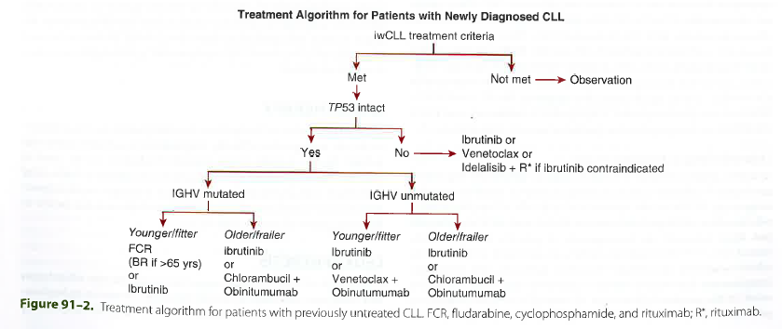
Targeted therapies for CLL
The introduction of BCR kinase inhibitors has significantly improved the mgt options for pts with CLL and represents a group of agents that have altered the natural history of the disease
Ibrutinib is a first in class, irreversible inhibitor of BTK and covalently binds to Cys-481 near the ATP binding domain of the BTK molecular and abrogates enzyme activity and BCR-mediated survival signals. Ibrutinib also have the ability to irreversible target IL-2 inducible T-cell kinase in T cells and other Tec family kinases
Venetoclax targets BCL-2. BCL-2 is an antiapoptotic protein overexpressed in most patients with CLL and causes disruption of apoptosis in CLL tumor cells.
Fig. 91-2, p. 1630, 10th ed. Williams
Notes:
Williams, 10th ed, p. 1628: Venetoclax: Is an oral Mgt = management. Williams 2021, Ch. 91 p. 1626: Williams 2021, Ch. 91 p. 1626: The introduction of BCR kinase inhibitors has significantly improved the mgt options for pts with CLL and represents a group of agents that have altered the natural hx of the disease. Mature results have emerged, with ibrutinib, showing acceptable safety and durable remission in most pts with CLL, particularly those who have not received prior tx or who lack high-risk genomic features. The introduction of BCR kinase inhibitors has significantly improved the mgt options for pts with CLL and represents a group of agents that have altered the natural hx of the disease. Other BCR signaling agents targeting P13K delta have had less impact in CLL, in part because of a more severe toxicity profile that has hindered the ability to move these agents into previously untreated pts with CLL without untoward autoimmune hepatitis and other toxicities. Venetolcax is a small molecule that inhibits the interaction of BCL2 with its BH3-linked partner proteins. Ibrutinib is a first in class, irreversible inhibitor of BTK and covalently binds to Cys-481 near the ATP binding domain of the BTK molecular and abrogates enzyme activity and BCR-mediated survival signals. Ibrutinib also have the ability to irreversible target IL-2 inducible T-cell kinase in T cells and other Tec family kinases. The phase 1 study of ibrutinib demonstrated significant broad clinical activity across a variety of B-cell malignancies. This prompted a large phase 2 study that examined a 420 mg and 840 mg and 840 mg daily dose in previously untreated pts with CLL aged 65 yrs and older. The clinical response was similar at both doses of the drug, with a high degree of BTK occupancy prompting use of the lower dose in all of the subsequent CLL trials.

Slide 29
CLL – Progression of Disease; Differential Diagnosis
Progression of the disease
May live ~2-20 years with the disease
May transform to more aggressive diseases
Prolymphocytic leukemia
Richter transformation – to a large B-cell lymphoma: 2-8% , some say 9 % of CLL patients
Assess CD38 and ZAP70 markers- if present, more aggressive course of disease
Differential diagnosis
Reactive lymphocytosis – viral infections
Lymphoma
Notes:
McKenzie, 2015, p 540: If there is no clinical evidence of an overt lymphoid neoplasm, the significance of < 5 X 10^9/L lymphs , but a small population of cells with CLL CD phenotype, it is referred to as monoclonal B lymphocytosis. Less than 10% of pt with CLL/SLL develop transformation to a B-cell lymphoid neoplasm with a worse prognosis. Over time, the # of prolymphs can increase, often in assn with acquired genetic abnormalities, although progression to prolympcytic leukemia is unusual. Richter’s transformation is the transition to an aggressive large B-cell lymphoma, which occurs in ~ 2-8% of pts with CLL/SLL. The Rai and Binet prognostic staging systems, which are based on physical examination and blood counts, can be used to assess the need for therapy and the specific type of therapy. Typically, pts with early stage CLL do not receive therapy but are monitored for ds progression. Std therapy for those who are symptomatic or have advanced ds is chemotherapy with rituximab ( anti-CD20). And fludarabine, cyclophosphamide, … P 538: Many prognostic markers have been used to ID cases of CLL that will have a more aggressive course than expected, including expression of the proteins CD38 and Zap-70, presence of cytogenetic abnormalities, and degree of mutation of the ig heavy chain variable region. Pre 2015: Prolymphocytic leukaemia and Richter's syndrome,In about 10 out of every 100 people (10%) the CLL changes over time into another type of leukaemia called prolymphocytic leukaemia. Doctors call this transformation. Sometimes prolymphocytic leukaemia is diagnosed in people who have not had CLL.
Advanced CLL can sometimes develop into a cancer of the lymphatic system (a lymphoma). This is called Richter's syndrome. About 5 out of every 100 people with CLL (5%) will develop Richter's syndrome. . Mckenzie, 2010 ed. P. 550 - prognostic factors – CLL with a more aggressive behavior is associated with higher levels of CD38 and ZAP70 expressed and an unmutated IgVH gene. 13q14-q23.1 is associated with a relatively good prognosis. Othere chromosomal abnormalities are associated with a worse prognosis. LouAnn Peterson, 2006, P. 610 Pract Dx of Hematologic disorders – Staging – most common system is the RAI ( reye) system. Stage 0 ( low risk, survival 10 yrs) - lymphocytosis in blood and bone marrow only. Stage 1 ( intermediate risk, survival 6 yrs)- lymphocytosis plus enlarged lymph nodes. Stage 2 ( intermediate risk, survival 6 yrs) – lymphocytosis plus enlarged liver and/or spleen; lymphadenopathy may be present. Stage 3 ( high risk, survival 2 yrs) - lymphocytosis plus anemia ( hgb < 11 g/dL) lymph nodes, spleen, or liver may be enlarged. Stage IV ( high risk, survival 2 yrs) – lymphocytosis and thrombocytopenia ( plt count < 100 x 10^3/mm^3); anemia and organomegaly may be present.
CLL is usually an indolent disease. The extent of disease is the most important indicator of prognosis for patients with CLL. Advanced disease is indicated by involvement of many lymph node groups, splenomegaly, hepatomegaly, and/or extensive bone marrow involvement leading to cytopenias. A worse prognosis has also been associated with a karyotype demonstrating multiple cytogenetic abnormalities or the presence of trisomy 12 and a diffuse rather than nodular pattern of bone marrow infiltration. Currently no curative therapy is available. Treatment is reserved for the control of symptoms. Less than 10% of patients with CLL develop transformation of their disease into one with a worse prognosis. Richter's transformation is the development of large cell lymphoma in a patient with CLL. Prolymphocytoid transformation of CLL is associated with an increase number of prolymphocytes. P. 617/ A minority of pts with CLL, experiences a morphologic transformation to a more aggressive malignant neoplasm. Prolymphocytoid transformation of CLL is the most common transformation, occurring in about 15% of pts. Prolymphoctyoid transformation occurs after a chronic phase of CLL and is associated with increasing # of circulating prolymphs, progressive anemia, thrombocytopenia, lymphadenopathy, splenomegaly, and resistance to therapy. The blood contains

Slide 30
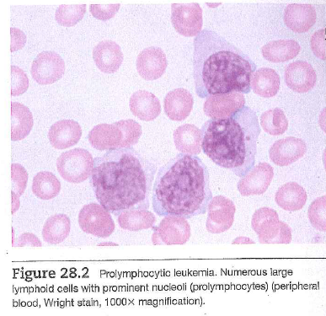
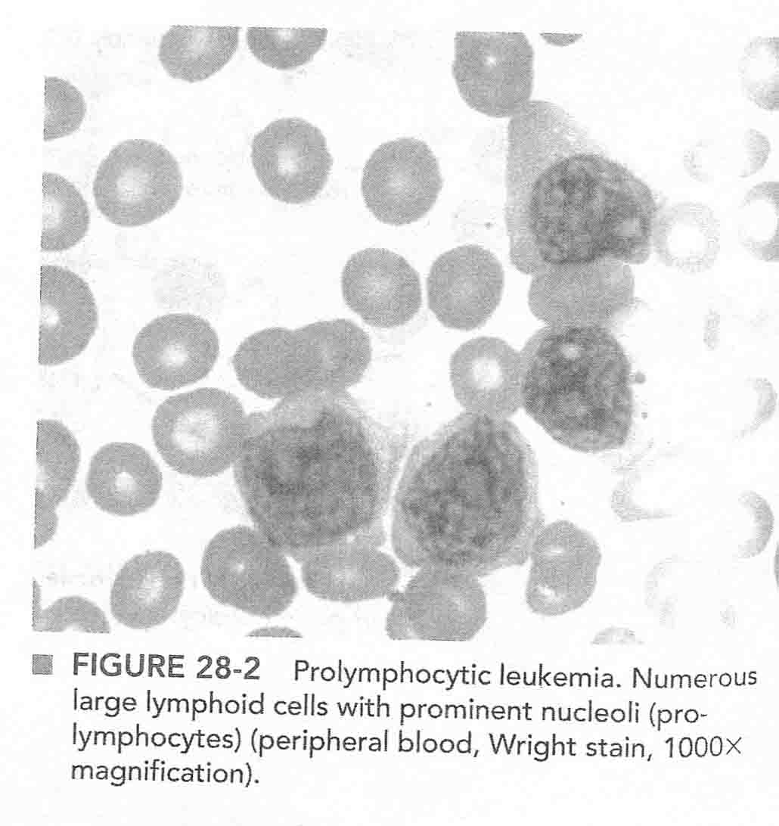
B Cell Prolymphocytic Leukemia (PLL)
Lab Dx
CBC: Extreme lymphocytosis –>300 x 10^9/L, anemia, and thrombocytopenia
Prolymphocyte -Larger cell with one nucleolus, moderately condensed chromatin, pale basophilic cytoplasm - > 55% of lymphocytes
May start out like PLL ( denovo) or rarely progress into prolymphocytic from CLL
CD markers: Strong sIg, CD20+, FMC-7 +, CD23 neg, CD5 variable
Chromosomes: del 17p, which results in inactivation p53 gene.
More aggressive disease than CLL, poor prognosis. Bone marrow: prolymphocytes predominate
Fig. 28.2, p. 628, 2020 ed. McKenzie
Notes:
McKenzie 2015 p 540: B-cell prolymphocytic leukemia ( B-PLL) is an aggressive, rare, leukemic disorder that does not respond to Rx. Usually denovo, but rarely can develop from CLL. Unlike CLL, pts with B-PLL usually have prominent splenomegaly but minimal lymphadenopathy. Pre 2015: For prolymphocytic leukemia 5.1 Describe the morphology of the peripheral blood on Wright's stain 5.2 Explain the immunophenotype Prolymphocytic leukemia (PLL) is an aggressive leukemic disorder of mature B or T lymphoid cells. Approximately 70% of cases are of a B cell lineage. B Cell PLL B cell PLL is a disease of adult patients with a male predominance. Although most cases arise de novo, PLL may represent the terminal phase of prolymphocytoid transformation of CLL. The clinical history of CLL is often the only way of identifying the preceding chronic disease. Unlike CLL, patients with PLL usually have marked splenomegaly but minimal lymphadenopathy. The CBC in patients with PLL reveals marked absolute lymphocytosis, often >300 x 109/L, anemia, and thrombocytopenia. The neoplastic cells have a characteristic appearance: large cells with moderate amounts of pale basophilic cytoplasm mature condensed chromatin, and a single prominent nucleolus. Prolymphocytes represent less than 10% of the lymphocytes seen in CLL and greater than 55% of the lymphocytes present in PLL. Cases with 11-55% prolymphocytes are classified as CLL/PL or CLL mixed cell type. The cell marker phenotype of prolymphocytes often differs from the cells of CLL in demonstrating strong surface immunoglobulin expression, strong CD22, lack of CD11c, expression of FMC-7, and lack of CD5. B cell PLL is an aggressive disease that usually does not respond to treatment. In contrast, CLL/PL has a variable clinical course. T Cell PLL T cell PLL is a rare disorder of adults that also has marked lymphocytosis and splenomegaly. However, patients with T cell PLL have more frequent lymphadenopathy, hepatomegaly, and skin lesions than patients with B cell PLL. The morphologic appearance of T cell PLL is also more variable than that of B cell PLL. The cells of T cell PLL usually have a prominent nucleolus but are medium in size and may have convoluted nuclear outlines. T cell PLL has a mature phenotype with expression of CD3, CD2, and CD5. most cases are CD4 positive. Although a few cases express both CD4 and CD8, they are negative for TdT. The majority of cases of T cell PLL have cytogenetic abnormalities, most frequently inv(14)q11q32 and trisomy 8q. t cell PLL is an aggressive disorder with a median survival time of only 7.5 months.

Slide 31
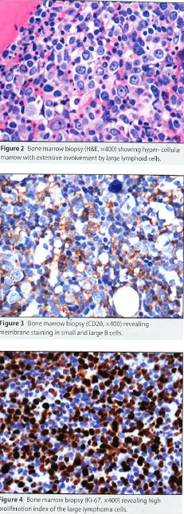
Richter Transformation
Immunohistochemical stains performed on bone marrow section demonstrated small B lymphocyte were positive for CD20 and CD5. Large atypical lymphocytes were positive for CD 20 and negative for CD 5, CD 15, and CD 30. Cytogenetic studies showed a trisomy 12.

Slide 32
Knowledge check
1. Which of these examples are chronic lymphocytic leukemia mutations?
A. Trisomy 12, del 13q, del 11q, del 17p
B. Translocation 8;21
C Inversion 16q
2. Which of the following mutations correlates with specific hematologic treatments
A. If iwCLL treatment criteria met and TP53 not intact treat with ibrutinib, venetoclax
B. If iwCLL treatment criteria met, TP53 intact, IGHV mutated treat with FCR or ibrutinib
C. A and B are correct

Slide 33
References
1. Byrd JC, Kittal AS, Awan FT. Chronic lymphocytic leukemia. In: Kaushansky K, Lichtman MA,Prchal JT, Levi MM, Burns LJ, Burns DC, ( eds) Williams Hematology, 10th ed. New York: McGraw-Hill, 2021; pp. 1617-1635.
2. Hallek M, Al-Sawaf O. Chronic lymphocytic leukemia: 2022 update on diagnostic and therapeutic procedures. Am J Hematol. 2021;96:1679-1705.
3.Hampel PJ, Parikh SA. Chronic lymphocytic leukemia treatment algorithm 2022. Blood Cancer Journal. 2022;12:161- 170.
4. Keleman K, Craig FE. Mature lymphoid neoplasms. In: McKenzie SB, Landis-Piwowar K,Williams JL. , (eds): Clinical Laboratory Hematology. 4th ed. Boston: Pearson Education. 2020; pp. 622-644
5. Munoz J, Wang Y, JainP, Wang M. Zanubrutinib in lymphoproliferative disorders: a comprehensive review. Ther Adv Hematol. 2022; 13:1-21.
6. Rai KR, Hsu P: CLL/SLL. In: Gulati G, Flicko-O’Hara, Kraus JR, (eds): Case Studies in Hematology and Coagulation. 2nd ed. Chicago;: ASCP Press. 2019; pp. 207-210
7. Schwartz GG, Klug MG. Incidence rates of chronic lymphocytic leukemia in US states are associated with residual radon levels. Future Oncol. 2016;12(2):165-174.

