Slide 1
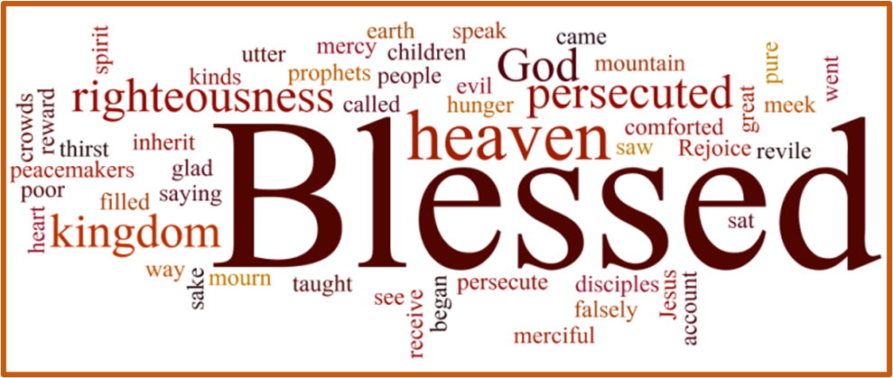
Trinity Evangelical Lutheran Church January 22, 2023
WELCOME!
The Beatitudes
Matthew 5:1-20
Notes:
Image: Five Loaves by Caroline Coolidge Brown. Copyright © Caroline Coolidge Brown. All rights reserved. Used by permission of the artist.

Slide 2
= Please stand if able
= Please be seated
Prelude – Roxanne Groff
Office of the Acolyte
Ringing of the Bell
Welcome
Notes:
Image: Five Loaves by Caroline Coolidge Brown. Copyright © Caroline Coolidge Brown. All rights reserved. Used by permission of the artist.

Slide 3
CONFESSION AND FORGIVENESS
All may make the sign of the cross, the sign marked at baptism…
L: We confess our sins before God and one another.
Pause for silence and reflection.
L: Merciful God…
Notes:
Image: Five Loaves by Caroline Coolidge Brown. Copyright © Caroline Coolidge Brown. All rights reserved. Used by permission of the artist.

Slide 4
CONFESSION AND FORGIVENESS
C: Christ came into the world and showed us how to live, but we have failed to live by what he taught. We have not loved you with all our heart, soul, mind and strength, we have not done to others as we would have done to ourselves. Shine a light on our hearts, that we might turn from the shadows of our sin and walk in your ways.
Notes:
Image: Five Loaves by Caroline Coolidge Brown. Copyright © Caroline Coolidge Brown. All rights reserved. Used by permission of the artist.

Slide 5
CONFESSION AND FORGIVENESS
L: Jesus came not to condemn the world, but that the world might be saved through him. By his abundant love, all your sins are forgiven, that you might walk in the light of Christ.
C: Amen.
Notes:
Image: Five Loaves by Caroline Coolidge Brown. Copyright © Caroline Coolidge Brown. All rights reserved. Used by permission of the artist.

Slide 6
Hymn of Praise
“Come, Thou Fount of Every Blessing”
LBW 499
Notes:
Image: Five Loaves by Caroline Coolidge Brown. Copyright © Caroline Coolidge Brown. All rights reserved. Used by permission of the artist.

Slide 7
Come, Thou Fount of Every Blessing LBW 499
1 Come, thou Fount of ev'ry blessing,
tune my heart to sing thy grace;
streams of mercy, never ceasing,
call for songs of loudest praise.
While the hope of endless glory
fills my heart with joy and love,
teach me ever to adore thee;
may I still thy goodness prove.
Notes:
Image: Preparing yeast dough. Copyright © tomasworks/iStock/Thinkstock. Used by permission.

Slide 8
Come, Thou Fount of Every Blessing LBW 499
2 Here I raise my Ebenezer:
"Hither by thy help I've come";
and I hope, by thy good pleasure,
safely to arrive at home.
Jesus sought me when a stranger,
wand'ring from the fold of God;
he, to rescue me from danger,
interposed his precious blood.
Notes:
Image: Preparing yeast dough. Copyright © tomasworks/iStock/Thinkstock. Used by permission.

Slide 9
Come, Thou Fount of Every Blessing LBW 499
3 Oh, to grace how great a debtor
daily I'm constrained to be;
let that grace now like a fetter
bind my wand'ring heart to thee.
Prone to wander, Lord, I feel it;
prone to leave the God I love.
Here's my heart, oh, take and seal it;
seal it for thy courts above.
Notes:
Image: Preparing yeast dough. Copyright © tomasworks/iStock/Thinkstock. Used by permission.

Slide 10
APOSTOLIC GREETING
P: The grace of our Lord Jesus Christ, the love of God, and the communion of the Holy Spirit be with you all.
C: And also with you.
Notes:
Image: Five Loaves by Caroline Coolidge Brown. Copyright © Caroline Coolidge Brown. All rights reserved. Used by permission of the artist.

Slide 11
PRAYER OF THE DAY
P: Let us pray… Loving God, in Jesus you proclaim a blessing for those in deprivation, a promise of your transforming love. Make us instruments of your justice, that all might have life abundantly.
C: Amen.
Notes:
Image: Five Loaves by Caroline Coolidge Brown. Copyright © Caroline Coolidge Brown. All rights reserved. Used by permission of the artist.

Slide 12
Notes:
Image: Preparing yeast dough. Copyright © tomasworks/iStock/Thinkstock. Used by permission.

Slide 13
Scripture Reading
R: Our scripture reading for this day is from the Gospel according to Matthew, the 5th chapter.
C: Glory to you O’ Lord! (Spoken)
Notes:
Image: Five Loaves by Caroline Coolidge Brown. Copyright © Caroline Coolidge Brown. All rights reserved. Used by permission of the artist.

Slide 14
Matthew 5:1-20
When Jesus saw the crowds, he went up the mountain; and after he sat down, his disciples came to him. ²Then he began to speak, and taught them, saying:
³“Blessed are the poor in spirit, for theirs is the kingdom of heaven.⁴“Blessed are those who mourn, for they will be comforted. ⁵“Blessed are the meek, for they will
Notes:
Image: Five Loaves by Caroline Coolidge Brown. Copyright © Caroline Coolidge Brown. All rights reserved. Used by permission of the artist.

Slide 15
Matthew 5:1-20
inherit the earth. ⁶“Blessed are those who hunger and thirst for righteousness, for they will be filled. ⁷“Blessed are the merciful, for they will receive mercy. ⁸“Blessed are the pure in heart, for they will see God. ⁹“Blessed are the peacemakers, for they will be called children of God. ¹⁰“Blessed are those who are persecuted for righteousness’ sake, for
Notes:
Image: Five Loaves by Caroline Coolidge Brown. Copyright © Caroline Coolidge Brown. All rights reserved. Used by permission of the artist.

Slide 16
Matthew 5:1-20
theirs is the kingdom of heaven. ¹¹“Blessed are you when people revile you and persecute you and utter all kinds of evil against you falsely on my account. ¹²Rejoice and be glad, for your reward is great in heaven, for in the same way they persecuted the prophets who were before you.
¹³“You are the salt of the earth; but if salt has lost its taste, how can its
Notes:
Image: Five Loaves by Caroline Coolidge Brown. Copyright © Caroline Coolidge Brown. All rights reserved. Used by permission of the artist.

Slide 17
Matthew 5:1-20
saltiness be restored? It is no longer good for anything, but is thrown out and trampled underfoot. ¹⁴“You are the light of the world. A city built on a hill cannot be hid. ¹⁵No one after lighting a lamp puts it under the bushel basket, but on the lampstand, and it gives light to all in the house. ¹⁶In the same way, let your light shine before others, so that they may see your good works and
Notes:
Image: Five Loaves by Caroline Coolidge Brown. Copyright © Caroline Coolidge Brown. All rights reserved. Used by permission of the artist.

Slide 18
Matthew 5:1-20
give glory to your Father in heaven. ¹⁷“Do not think that I have come to abolish the law or the prophets; I have come not to abolish but to fulfill. ¹⁸For truly I tell you, until heaven and earth pass away, not one letter, not one stroke of a letter, will pass from the law until all is accomplished. ¹⁹Therefore, whoever breaks one of the least of these commandments, and teaches
Notes:
Image: Five Loaves by Caroline Coolidge Brown. Copyright © Caroline Coolidge Brown. All rights reserved. Used by permission of the artist.

Slide 19
Matthew 5:1-20
others to do the same, will be called least in the kingdom of heaven; but whoever does them and teaches them will be called great in the kingdom of heaven. ²⁰For I tell you, unless your righteousness exceeds that of the scribes and Pharisees, you will never enter the kingdom of heaven.”
Notes:
Image: Five Loaves by Caroline Coolidge Brown. Copyright © Caroline Coolidge Brown. All rights reserved. Used by permission of the artist.

Slide 20
Matthew 5:1-20
R: This is the Word of the Lord.
C: Praise to You, O Christ (Spoken)
Notes:
Image: Five Loaves by Caroline Coolidge Brown. Copyright © Caroline Coolidge Brown. All rights reserved. Used by permission of the artist.

Slide 21
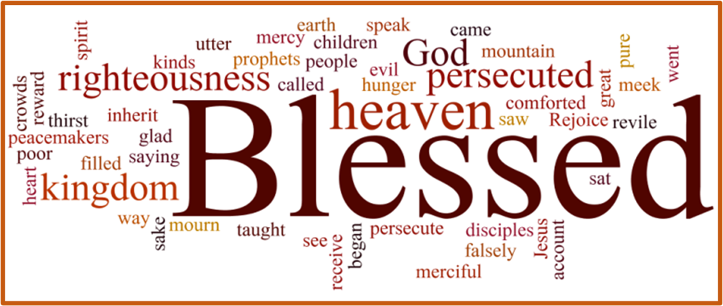
Sermon
Notes:
Image: Five Loaves by Caroline Coolidge Brown. Copyright © Caroline Coolidge Brown. All rights reserved. Used by permission of the artist.

Slide 22
APOSTLE’S CREED
C: I believe in God, the Father almighty, creator of heaven and earth.

Slide 23
APOSTLE’S CREED
C: I believe in Jesus Christ, his only Son, our Lord. He was conceived by the power of the Holy Spirit and born of the virgin Mary. He suffered under Pontius Pilate, was crucified, died, and was buried.

Slide 24
APOSTLE’S CREED
C: He descended into hell. On the third day he rose again. He ascended into heaven, and is seated at the right hand of the Father. He will come again to judge the living and the dead.

Slide 25
APOSTLE’S CREED
C: I believe in the Holy Spirit, the holy catholic Church, the communion of saints, the forgiveness of sins, the resurrection of the body, and the life everlasting. Amen.

Slide 26
NICENE CREED
C: We believe in one God, the Father, the Almighty, maker of heaven and earth, of all that is, seen and unseen.

Slide 27
NICENE CREED
C: We believe in one Lord, Jesus Christ, the only Son of God, eternally begotten of the Father, God from God, Light from Light, true God from true God, begotten, not made, of one Being with the Father.

Slide 28
NICENE CREED
C: Through him all things were made. For us and for our salvation he came down from heaven; by the power of the Holy Spirit he became incarnate from the virgin Mary, and was made man. For our sake he was crucified under Pontius Pilate;

Slide 29
NICENE CREED
C: he suffered death and was buried. On the third day he rose again in accordance with the Scriptures; he ascended into heaven and is seated at the right hand of the Father. He will come again in glory to judge the living and the dead, and his kingdom will have no end.

Slide 30
NICENE CREED
C: We believe in the Holy Spirit, the Lord, the giver of life, who proceeds from the Father and the Son. With the Father and the Son he is worshiped and glorified. He has spoken through the prophets. We believe in one holy catholic and apostolic Church.

Slide 31
NICENE CREED
C: We acknowledge one Baptism for the forgiveness of sins. We look for the resurrection of the dead, and the life of the world to come. Amen.

Slide 32
PRAYERS OF INTERCESSION
Each petition will end with the words,
A: Merciful God,
The congregation will respond with:
C: You hear our prayer.

Slide 33
PRAYERS OF INTERCESSION
The prayer concludes…
P: Receive our prayers and hold all for whom we pray in your loving arms, in the name of your son, Jesus Christ.
C: Amen.

Slide 34
OFFERING
OFFERTORY PRAYER
Notes:
Image: Five Loaves by Caroline Coolidge Brown. Copyright © Caroline Coolidge Brown. All rights reserved. Used by permission of the artist.

Slide 35
THE LORD’S PRAYER
P: United into one body, let us pray as Jesus taught…
C: Our Father, who art in heaven, hallowed be thy name, thy kingdom come, thy will be done, on earth as it is in heaven.

Slide 36
THE LORD’S PRAYER
C: Give us this day our daily bread; and forgive us our trespasses, as we forgive those who trespass against us; and lead us not into temptation, but deliver us from evil. For thine is the kingdom, and the power, and the glory, forever and ever. Amen.

Slide 37
ANNOUNCEMENTS
Notes:
Image: Five Loaves by Caroline Coolidge Brown. Copyright © Caroline Coolidge Brown. All rights reserved. Used by permission of the artist.

Slide 38
SENDING BLESSING
P: The God who faithfully brings forth justice and breaks the oppressor’s rod bless, strengthen, and uphold you, today and always.
C: Amen.
☩

Slide 39
SENDING SONG
“This Little Light of Mine”
ELW 677
Notes:
Image: Five Loaves by Caroline Coolidge Brown. Copyright © Caroline Coolidge Brown. All rights reserved. Used by permission of the artist.

Slide 40
This Little Light of Mine ELW 677
1 This little light of mine, I'm goin'-a let it shine;
this little light of mine, I'm goin'-a let it shine;
this little light of mine, I'm goin'-a let it shine,
let it shine, let it shine, let it shine.
Notes:
Image: Preparing yeast dough. Copyright © tomasworks/iStock/Thinkstock. Used by permission.

Slide 41
This Little Light of Mine ELW 677
2 Ev'rywhere I go, I'm goin'-a let it shine;
ev'rywhere I go, I'm goin'-a let it shine;
ev'rywhere I go, I'm goin'-a let it shine,
let it shine, let it shine, let it shine.
Notes:
Image: Preparing yeast dough. Copyright © tomasworks/iStock/Thinkstock. Used by permission.

Slide 42
This Little Light of Mine ELW 677
3 Jesus gave it to me, I'm goin'-a let it shine;
Jesus gave it to me, I'm goin'-a let it shine;
Jesus gave it to me, I'm goin'-a let it shine,
let it shine, let it shine, let it shine.
Notes:
Image: Preparing yeast dough. Copyright © tomasworks/iStock/Thinkstock. Used by permission.

Slide 43
DISMISSAL
P: … depart in Christ’s Love.
C: Seeking, welcoming, and serving all. Amen!
POSTLUDE
By
Roxanne Groff
From sundaysandseasons.com. Copyright © 2023 Augsburg Fortress. All rights reserved. Reprinted by permission under Augsburg Fortress Liturgies Annual License #SAS023830. New Revised Standard Version Bible, Copyright © 1989, Division of Christian Education of the National Council of the Churches of Christ in the United States of America. Used by permission. All rights reserved. Revised Common Lectionary, Copyright © 1992 Consultation on Common Texts, admin Augsburg Fortress. Used by permission.

