Slide 1
Glenhurst
Annual HOA Meeting
February 16th, 2016

Slide 2
Agenda
Opening Remarks
Board Members
Committee Members
Treasury Report
Capital Improvements Presentation
Committee Reports
Elections
Questions & Answers
Closing Remarks

Slide 3
Opening Remarks
The HOA board, committee chair persons and their staff have accomplished a great deal
Major achievements
Begin work on 5-year Capital Improvement Plan
New Fencing Near Pond and Library
Beautification of Entrances
Donated to the HOA for multiple activities
Glenhurst Picnics and BBQ
Last Section of Glenhurst Under Development

Slide 4
Board Members
President Steve Smith (Outgoing)
Vice President David Paine (Outgoing)
Treasurer Melinda Paine *
Secretary Vacant
At Large Marvin Grosche
Note: Per Covenant By-Laws, Melinda Paine was selected by the board after the departure of Henry McGrew.

Slide 5
Committee Members
Covenants Judy Johnston (Outgoing)
Directory Jed Liuzza
Landscaping Malinda Eggleston
Security Patrol Steve Smith
Social Diana Forrest (Outgoing)
Web Page / News Judy Smith
Welcoming Mickie Schicht
Capital Improvements Herb Forrester
Architectural Carter Foree

Slide 6
Treasury Report – Income vs Expense
 |  |  |  |  | Jan - Dec 15 | Budget | $ Over Budget | % of Budget
Ordinary Income/Expense
 |  | Income
 |  |  | 40000 · Annual Dues |  | 88,145.52 | 87,000.00 | 1,145.52 | 101.32%
 |  |  | 40010 · Interest Income |  | 65.68
 |  | Total Income |  |  | 88,211.20 | 87,000.00 | 1,211.20 | 101.39%
 | Gross Profit |  |  |  | 88,211.20 | 87,000.00 | 1,211.20 | 101.39%
 |  | Expense
 |  |  | Grounds
 |  |  |  | 2004 · Landscaping | 17,830.92 | 17,000.00 | 830.92 | 104.89%
 |  |  |  | 2008 · Irrigation/Sprinkler | 2,850.93 | 4,000.00 | -1,149.07 | 71.27%
 |  |  |  | 2009 · Entry Flowers/Shrubs | 6,170.00 | 7,000.00 | -830 | 88.14%
 |  |  |  | 2015 · Pond | 3,420.14
 |  |  |  | 2019 · Common Area-Trees | 1,000.00
 |  |  |  | 2020 · Weed Control/Fertilizer | 3,261.70 | 4,000.00 | -738.3 | 81.54%
 |  |  | Total Grounds |  | 34,533.69 | 32,000.00 | 2,533.69 | 107.92%
 |  |  | Utilities
 |  |  |  | 2002 · Water | 5,934.31 | 7,000.00 | -1,065.69 | 84.78%
 |  |  |  | 2003 · Electric | 3,517.67 | 4,000.00 | -482.33 | 87.94%
 |  |  | Total Utilities |  | 9,451.98 | 11,000.00 | -1,548.02 | 85.93%

Slide 7
Treasury Report – Income vs Expense (cont.)
 |  |  |  | 2001 · Postage and Delivery |  | 617.95 |  | 500.00 |  | 117.95 |  | 123.59%
 |  |  |  | 2005 · Legal Fees |  | 3,591.45 |  | 2,000.00 |  | 1,591.45 |  | 179.57%
 |  |  |  | 2006 · Web Page Maintenance |  | 450.00 |  | 900.00 |  | -450.00 |  | 50.0%
 |  |  |  | 2007 · Welcome Committee |  | 220.49 |  | 1,000.00 |  | -779.51 |  | 22.05%
 |  |  |  | 2010 · Miscellaneous Expense |  | 414.84 |  | 1,500.00 |  | -1,085.16 |  | 27.66%
 |  |  |  | 2011 · Neighborhood Events |  | 2,318.58 |  | 3,000.00 |  | -681.42 |  | 77.29%
 |  |  |  | 2012 · Insurance Expense |  | 5,318.94 |  | 6,500.00 |  | -1,181.06 |  | 81.83%
 |  |  |  | 2013 · Repairs and Maintenance
 |  |  |  |  | 2017 · Electrical Repair | 80.00 |  | 1,500.00 |  | -1,420.00 |  | 5.33%
 |  |  |  |  | 2013 · Repairs and Maintenance - Other | 0.00 |  | 1,000.00 |  | -1,000.00 |  | 0.0%
 |  |  |  | Total 2013 · Repairs and Maintenance |  | 80.00 |  | 2,500.00 |  | -2,420.00 |  | 3.2%
 |  |  |  | 2016 · Storage Unit |  | 1,080.00 |  | 500.00 |  | 580.00 |  | 216.0%
 |  |  |  | 2021 · Property Management Fees |  | 4,925.00 |  | 5,100.00 |  | -175.00 |  | 96.57%
 |  |  |  | 2022 · Christmas Decor |  | 476.12 |  | 1,500.00 |  | -1,023.88 |  | 31.74%
 |  |  |  | 2023 · Improvements |  | 16,180.60 |  | 19,000.00 |  | -2,819.40 |  | 85.16%
 |  |  |  | 2024 · Covenants/Restrictions Comm |  | 4.76
 |  |  | Total Expense |  |  | 79,664.40 |  | 87,000.00 |  | -7,335.60 |  | 91.57%
 | Net Ordinary Income |  |  |  |  | 8,546.80 |  | 0.00 |  | 8,546.80 |  | 100.0%
Net Income |  |  |  |  |  | 8,546.80 |  | 0.00 |  | 8,546.80 |  | 100.0%

Slide 8
Treasury Report – 2016 Budget
 |  |  |  |  | 2015 |  | 2016
 |  |  |  |  | Budget | Spent | Budget
Ordinary Income/Expense
 |  | Income
 |  |  | 40000 · Annual Dues |  | 87,000.00 |  | 91,920.00
 |  |  | 40010 · Interest Income
 |  |  | 40020 - Recapitalization of Legal Fees
 |  | Total Income |  |  | 87,000.00 |  | 91,920.00
 | Gross Profit |  |  |  | 87,000.00 |  | 91,920.00
 |  | Expense
 |  |  | Grounds
 |  |  |  | 2004 · Landscaping | 17,000.00 | 17,830.92 | 16,000.00
 |  |  |  | 2008 · Irrigation/Sprinkler | 4,000.00 | 2,850.93 | 5,000.00
 |  |  |  | 2009 · Entry Flowers/Shrubs | 7,000.00 | 6,170.00 | 9,875.00
 |  |  |  | 2015 · Pond | 0 | 3,420.14 | 500
 |  |  |  | 2019 - Common Area-Trees | 0 | 1,000.00 | 1,000.00
 |  |  |  | 2020 · Weed Control/Fertilizer | 4,000.00 | 3,261.70 | 3,760.00
 |  |  | Total Grounds |  | 32,000.00 |  | 36,135.00

Slide 9
Treasury Report – 2016 Budget
 |  |  |  |  | 2015 |  | 2016
 |  |  |  |  | Budget | Spent | Budget
 |  |  | Utilities
 |  |  |  | 2002 · Water | 7,000.00 | 5,934.31 | 7,000.00
 |  |  |  | 2003 · Electric | 4,000.00 | 3,517.67 | 4,000.00
 |  |  | Total Utilities |  | 11,000.00 |  | 11,000.00
 |  |  | 2001 · Postage and Delivery |  | 500 | 617.95 | 700
 |  |  | 2005 · Legal Fees |  | 2,000.00 | 3,591.45 | 3,000.00
 |  |  | 2006 · Web Page Maintenance |  | 900 | 450 | 100
 |  |  | 2007 · Welcome Committee |  | 1,000.00 | 220.49 | 770
 |  |  | 2010 · Miscellaneous Expense |  | 1,500.00 | 419.6 | 1,000.00
 |  |  | 2011 · Neighborhood Events |  | 3,000.00 | 2,318.58 | 3,000.00
 |  |  | 2012 · Insurance Expense |  | 6,500.00 | 5,318.94 | 5,500.00
 |  |  | 2013 · Repairs and Maintenance
 |  |  |  | 2017 · Electrical Repair | 1,500.00 | 80 | 1,500.00
 |  |  |  | 2013 · Repairs and Maintenance - Other | 1,000.00 | 0 | 1,000.00
 |  |  | Total 2013 · Repairs and Maintenance |  | 2,500.00 |  | 2,500.00
 |  |  | 2016 · Storage Unit |  | 500 | 1,080.00 | 540
 |  |  | 2021 · Property Management Fees |  | 5,100.00 | 4,925.00 | 5,100.00
 |  |  | 2022 · Christmas Decor |  | 1,500.00 | 476.12 | 1,500.00
 |  |  | 2023 · Improvements |  | 19,000.00 | 16,180.60 | 20,000.00
 |  |  | 2024 - Covenant and Restrictions |  | 0 | 0 | 75
 |  |  | 2025 - Printing and Reproduction |  | 0 | 0 | 1,000.00
 |  | Total Expense |  |  | 87,000.00 |  | 91,920.00
Net Ordinary Income |  |  |  |  | 0 |  | 0
Net Income |  |  |  |  | 0 |  | 0

Slide 10
Capital Improvements
During 2016, the Capital Improvements Committee will be concentrating on Area C of the Master Plan for Glenhurst. This will include getting ready to go out for bid to construct a new sidewalk, a gazebo, possible picnic tables and grills, new trees, irrigation system for grass and trees. We want to be ready to go out for bid later this year once the developer donates the lot next to our existing picnic area. We want this area to be the focal point of our common areas in Glenhurst.
In the years to come, we will be working on other areas of the master plan that was presented during the 2015 Annual Meeting.

Slide 11
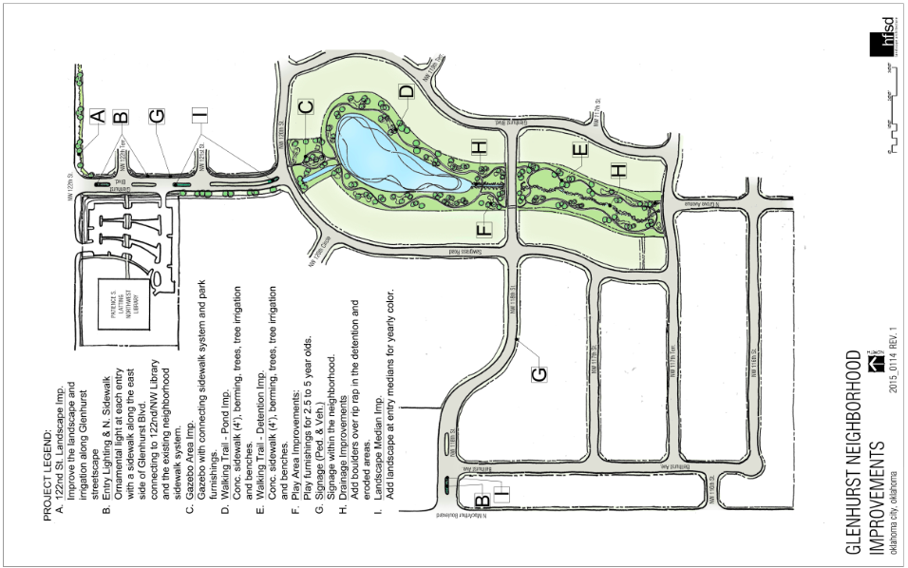
Capital Improvements

Slide 12
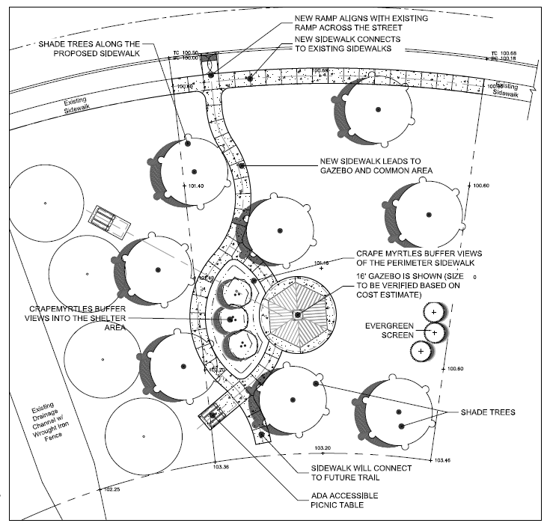
Capital Improvements

Slide 13
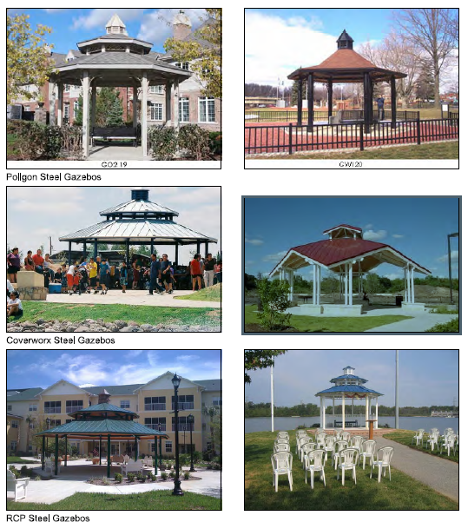
Capital Improvements

Slide 14
Committee Reports
Covenants
Directory
Landscape
Security Patrol
Social
Web Page
Welcoming

Slide 15
Covenants
Members: Judy Johnson, Chair; Jerry Duncan; Lonnie Eggleston
Sent 77 letters during 2015 pertaining to 54 violations
Overall, 36 of the violations (67%) were corrected. The letters are effective.
Habitual offenders = 7 (yard maintenance (1), trash cans (3), satellite dish (1), BB goals (2)). Satellite dish and BB goal violations were forwarded to the HOA Board for action.

Slide 16
Covenants (Continued)
Breakdown of covenant violations
Landscaping/trees 6
Yard maintenance 19
Trash cans 20
Satellite dishes 2
Property repairs 1
Trailers 2
BB goals 4

Slide 17
Directory
Inputs received from HOA Management Company
Plan is to release a new Glenhurst Directory in 2016
Opt Out is available
Directory Contains
Name
Address
Phone Number
382 Active Members in the Directory

Slide 18
Landscape
LANDSCAPE EXPENSE: (Common Ground Maintenance /Weed Control & Fertilization)
Maintenance duties divided: Landscape Partners (2 year / mowing, edging, trimming) Don’s Pest & Weed Control (weed control and fertilization)
New for 2016: Maintenance for all 3 entrance beds and median beds on Glenhurst Blvd and 118th street separated from common ground maintenance.
Nature’s Way Landscaping contracted in 2016 for all bed maintenance to include: trimming, fertilization, weeding, addition of soil/amendments, and spring and fall bedding plants/color.
Summer of 2015 sod was added on the northwest side of the pond to try to cover bare areas. A permanent solution will take some major dirt work to cover all the rock ledges on that portion of the pond.

Slide 19
Landscape (Continued)
IRRIGATION / SPRINKLER EXPENSE:
Routine maintenance as necessary for broken lines, valves, etc.
Drip water system added on west side of Glenhurst Blvd., south of the Library sidewalk to maintance new landscaping.
2016 proposed additional improvements: Re-work the 118th entrance system to improve performance and increase water pressure in system. Inventory existing sprinkler heads and adjust, add, and replace heads as necessary to improve efficiency of system.
Pond Pump had to be replaced in August of2015

Slide 20
Landscape (Continued)
ENTRY SHRUBS / FLOWER EXPENSE:
The committee requested that the entrance bed and median bed maintenance be separated from the general common ground maintenance for a better outcome to include spring and fall bedding plants.
Gift certificates of $50 each for “Yard of the Month” will continue in the summer months of June, July, and August.
New, additional LED lights were purchased to be hung by a contractor during the Christmas holiday season.

Slide 21
Landscape (Continued)
GOING FORWARD
The Landscape Committee will work in conjunction with the Capital Improvement Committee for improvements to the common areas in Glenhurst HOA.
Respectfully submitted: Landscape Committee
Malinda Eggleston, Jim Davis, Mary Acree, Sue Sullivan,

Slide 22
Security Patrol
Crime
There were reports of crime in 2015
Stolen Auto (1 incident)
Assault (1 incident)
Fraud (1 Incident)
Burglary (3 incidents)
Garage Doors
If the garage door is left open
Welcome to criminals (or would-be criminals)
Please inform Glenhurst Security of criminal or suspicious activity – we want to notify everyone to be alert

Slide 23
Security Patrol (Continued)
Seeking new members for patrol
Two hours of training at Hefner Police Station
Two person team
Two hour shift each month patrolling the community
Non-confrontational – report and contact police if necessary
Please see Steve Smith after the meeting or contact via e-mail

Slide 24
Social
2016 Social Calendar
Dinner Groups
Groups go to dinner on the 2nd Thursday January through November.
Groups are randomly selected for 4 months. In the fifth month, you will be a part of another group for 4 months, etc. This is a great way to have fun, eat at different restaurants, and get to know your neighbors.
If you are interested in becoming a part of the dinner groups contact Judy Smith at judithsmith@cox.net

Slide 25
Social (Continued)
Ladies Lunch Group
Ladies of the Glenhurst neighborhood go to a different restaurant on the 2nd and 4th Wednesdays of each month January through October.. We meet at the restaurant at 12:30.
In November we only go on the 2nd Wednesday and in December we have a party on the 2nd Wednesday.
If you are not currently included in the email list, contact Diana Forrest at mtfdlf@cox.net
Men’s Coffee Meeting
The men of the neighborhood meet Monday through Friday at 8:00 a.m. at McDonalds on MacArthur and Memorial.

Slide 26
Social (Continued)
Garage Sale
We have a neighborhood garage sale on the 1st Friday and Saturday of May. Each home has their own sale and is responsible for their own permit. We do put bright yellow signs at two entrances advertising the garage sale.
*****Social Committee Chairperson needed****
Spring Picnic, Fall Picnic, and Annual Christmas Party will not be held without a Chairperson.

Slide 27
Web Page
Our Yearly web visits is 27,750
Hits from ALL over the world
Bulletin Board – 2954 year
Logging In – 1250 year
Covenants – 588 Year
Glenhurst also has a Facebook Page
Glenhurst is part of Nextdoor – Blog for Neighborhoods

Slide 28
Newsletter
Glenhurst is no longer publishing a newsletter.
Information can be sent to Judy Smith to be posted to the Glenhurst HOA Website

Slide 29
Welcoming
Glenhurst
116th St 10
117th St 2
117th Terr 7
118th Cir 1
120th St 2
121st St 2
122nd Terr 2
Belhurst Blvd 2
Glenhurst Blvd 2
Sawgrass Rd 3
Wileman Way 2
Total 35
Villas
119th Cir 1
120th Cir 4
121st Cir 2
Dornick Cir 3
Total 10

Slide 30
Elections
David Paine
Melinda Paine
Marvin Grosche
Open
Open
Note: There MUST be at least three members on the board
Note: Board members decide on positions during the next HOA meeting

Slide 31
Q&A
Rules of Engagement
Please wait to be acknowledged
Introduce yourself
Please speak loud enough for everyone to hear
Please be courteous to others

Slide 32
Closing Remarks
The HOA does not exist without community participation
Initial Goals for 2015
Improve awareness of HOA Covenants
Review and initiate Capital Improvement Plan
Increase participation in Glenhurst activities
Add members to the Glenhurst Security Patrol
Continue to visit the Glenhurst Web Page and Facebook for up-to-date information

