Slide 1



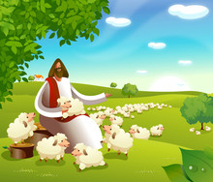

March Newsletter
Dear Families,
Thank you for supporting the
Scholastic Book Fair. We raised over
three hundred dollars worth of
books for the school.
We will be celebrating “Read
Across America Day” on Tuesday,
March 2nd. It is a day to
celebrate our favorite activity-READING!
The day occurs each year on the
birthday of our beloved children’s
book author Dr. Seuss.
Miss Cindy & Miss Caryn
March Theme:
“Jesus shows how to care for others. I will be a good friend.”
“Like a shepherd, He will tend to his flock.” –Isaiah 40:11
Kids of Grace Summer Camp
Kids of Grace summer camps are a great opportunity for your child
to continue learning and growing with their friends. Look for registration information to be distributed with the next couple of weeks.

Slide 2

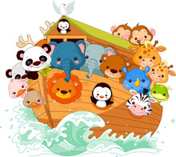




March Newsletter
2021
Upcoming Events
March 2- READ ACROSS
AMERICA DAY
March 5- NO School
KOG Staff Workday
April 2- Good Friday
April 4- Easter
April 5-9- Spring Break
Music and Chapel
In Chapel: In Chapel, Miss Cindy and Pastor Clint will include stories about Noah, the Last Supper and Easter
.
In Music: In music, Miss Phaedra will teach the children songs about Noah and Easter.
Let’s celebrate Dr. Seuss!
We will celebrate “Read Across America”
By doing fun things each day at Kids of Grace- Here is the schedule:
Monday- Wear Red and Blue
Tuesday- “Read Across America Day”
Wear red and white/crazy hair
day
Wednesday- Wacky Wednesday
Thursday- Hat Day
Friday- Staff Day/ No School
Harris Teeter
Together in Education
Please link TODAY!
KOG receives a percentage of your shopping total from Harris Teeter, so we can purchase art supplies and equipment for our Preschool and Kindergarten.
Kids of Grace VIC code is 4150.
If you have previously linked your
VIC card, you will have to
“re-link”for 2020-2021!
  If you don’t have a VIC card, please
  Consider signing up….you’ll also earn
Points towards discounts on fuel purchases.
KOG appreciates your support!

