Slide 1
Child & Adolescent Psyhiatry
Tomislav Franić M.D, Ph.D
Assitant Professor of Psychiatry
Child and Adolescent Psychiatrist
tomislav.franic@mefst.hr

Slide 2
Childhood – the period of protection, peace and happines?

Slide 3
Or something else?
FTT

Slide 4
Up to 18% children shows some kind of psychological/psychiatric problems.
10% need some kind of help
SD County 11 800

Slide 5
Social changes
Global
Local
The disintegration of traditional social structures (two-generation families, single-parent families)
The new scales of values
Faster, better, easier more beautiful, more measured in $, €, £
A huge amount of information of questionable value

Slide 6
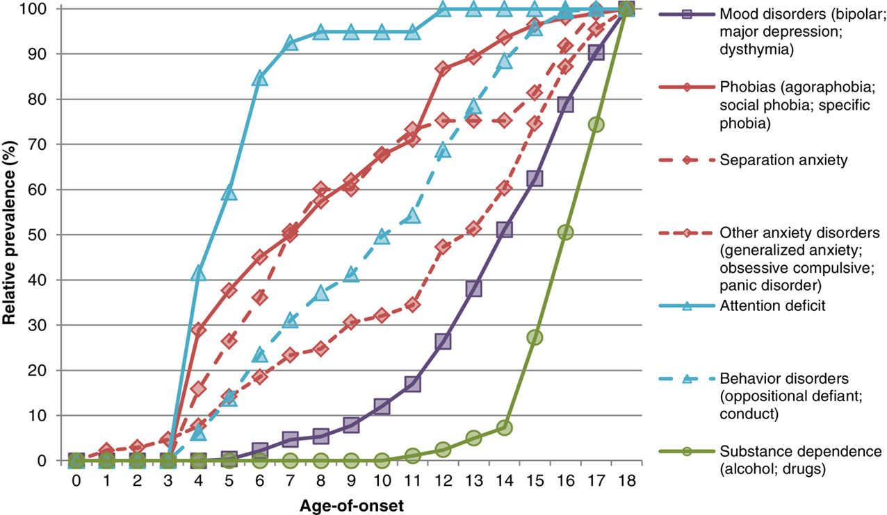

Slide 7
Developmental psychopatology

Slide 8
Children are in the process of development and is needed to distinct the mental problems from maturational proceses.
Disturbances do not have the same intensity as in adults
Children in some situations are more vulnerable and yet in some situations more easily recover

Slide 9
Normal vs. abnormal?

Slide 10
"Normality" depends on the family, social, religious and cultural environment
but also

Slide 11
is changing and evolving through growing civilization and individual

Slide 12
Adaptive vs. maladaptive behavior
The symptom is not always dysfunctional. It depends on the stage of biological, cognitive, emotional and social development

Slide 13
Symptom | Normal | Pathological
Enuresis | 3 years | 8 years
Separation anxiety | 8-24 months | 5 years
Negativism | 2 years | 7 years
Inability to perform the task | 3 years | 10 years

Slide 14
Diagnosing
ICD 10 WHO 1992.
DSM IV 1994.

Slide 15
Chapter V Mental and behavioural disorders (F00-F99)
This chapter contains the following blocks:
F00-F09Organic, including symptomatic, mental disorders
F10-F19Mental and behavioural disorders due to psychoactive substance use
F20-F29Schizophrenia, schizotypal and delusional disorders
F30-F39Mood [affective] disorders
F40-F48Neurotic, stress-related and somatoform disorders
F50-F59Behavioural syndromes associated with physiological disturbances and physical factors
F60-F69Disorders of adult personality and behaviour
F70-F79Mental retardation
F80-F89Disorders of psychological development
F90-F98Behavioural and emotional disorders with onset usually occurring in childhood and adolescence
F99-F99Unspecified mental disorder

Slide 16
Narrow repertoire of expression

Slide 17
Externalizing or disruptive disorders
Internalizing disorders
Social and developmental deficits

Slide 18
Externalising disorders
The most common cause of reporting to health service
aggression
opposing
impulsiveness
hyperactivity
antisocial behavior, lying, theft
boys> girls
Reports of parents and teachers more accurate, self report underestimate symptoms

Slide 19
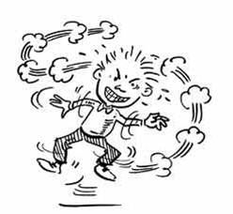
F 90 ADHD

Slide 20
A. Either (1) or (2):
Inattention (1)
Hyperactivity/ Impulsivity (2)

Slide 21
(1) inattention: six (or more) of the following symptoms of inattention have persisted for at least 6 months to a degree that is maladaptive and inconsistent with developmental level:
(a) often fails to give close attention to details or makes careless mistakes in schoolwork, work, or other activities
(b) often has difficulty sustaining attention in tasks or play activities
(c) often does not seem to listen when spoken to directly
(d) often does not follow through on instructions and fails to finish school work, chores, or duties in the workplace (not due to oppositional behavior or failure to understand instructions)
(e) often has difficulty organizing tasks and activities
(f) often avoids, dislikes, or is reluctant to engage in tasks that require sustained mental effort ( schoolwork or homework)
(g) often loses things necessary for tasks or activities (e.g., toys, school assignments, pencils, books, or tools)
(h) is often easily distracted by extraneous stimuli
(i) is often forgetful in daily activities

Slide 22
(2) hyperactivity-impulsivity: six (or more) of the following symptoms of hyperactivity-impulsivity have persisted for at least 6 months to a degree that is maladaptive and inconsistent with developmental level:
Hyperactivity
(a) often fidgets with hands or feet or squirms in seat
(b) often leaves seat in classroom or in other situations in which remaining seated is expected
(c) often runs about or climbs excessively in situations in which it is inappropriate (in adolescents or adults, may be limited to subjective feelings of restlessness)
(d) often has difficulty playing or engaging in leisure activities quietly
(e) is often "on the go" or often acts as if "driven by a motor"
(f) often talks excessively

Slide 23
Impulsivity
(g) often blurts out answers before questions have been completed
(h) often has difficulty awaiting turn
(i) often interrupts or intrudes on others (e.g., butts into conversations or games)

Slide 24
B. Some hyperactive-impulsive or inattentive symptoms that caused impairment were present before age 7 years
C. Some impairment from the symptoms is present in two or more settings (e.g., at school [or work] and at home).
D. There must be clear evidence of clinically significant impairment in social, academic, or occupational functioning.
E. The symptoms do not occur exclusively during the course of a Pervasive Developmental Disorder, Schizophrenia, or other Psychotic Disorder and are not better accounted for by another mental disorder (e.g., Mood Disorder, Anxiety Disorder, Dissociative Disorders, or a Personality Disorder).

Slide 25
The incidence of 3-5 %
m / f 3/1
50-80 % comorbidity : 60 % learning disorders , behavioral disorders and 40 % opposing disorder , addiction , depression , bipolar disorder

Slide 26
Outcome
20% antisocial personality disorder
15-20% the substance abuse
High rate of suicidality
low self-esteem
unemployment
20-30% percent of the full syndrome in adulthood

Slide 27
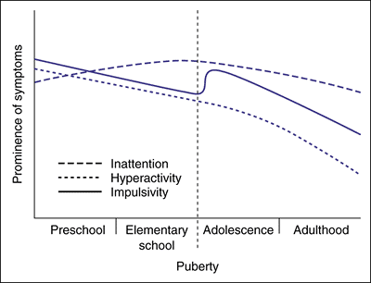

Slide 28
Treatment
CBT, especially behavioral methods
Social skills training
Working with parents
Working with teachers
Drugs

Slide 29
F 91 Conduct disorders
Disorders characterized by a repetitive and persistent pattern of dissocial, aggressive, or defiant conduct. Such behavior should amount to major violations of age-appropriate social expectations; it should therefore be more severe than ordinary childish mischief or adolescent rebelliousness and should imply an enduring pattern of behavior (six months or longer). Features of conduct disorder can also be symptomatic of other psychiatric conditions, in which case the underlying diagnosis should be preferred.

Slide 30
F91.1 Unsocialized conduct disorder
Disorder characterized by the combination of persistent dissocial or aggressive behaviour (meeting the overall criteria for F91.- and not merely comprising oppositional, defiant, disruptive behaviour) with significant pervasive abnormalities in the individual's relationships with other children.

Slide 31
Internalising disorders
The next most frequent cause of referal
anxiety
social withdrawal
depression
somatization
phobias
Boys equal girls , girls more in adolescence
Self-reports more accurate, teachers and parents underestimate symptoms

Slide 32
Anxiety
Fear = sense of threat in the presence of the actual dangerous situation, person or object
Anxiety = sense of threat and anticipation of undesirable events the nature of which is unknown

Slide 33
Anxiety - Anxiety disorders
Fear of distinct objects - Phobias

Slide 34
Psychical component

Slide 35
Somatic component
Tremor
Dry mouth , paleness around the mouth
Chest pain , palpitations , tachycardia
Muscle tension , numbness or muscle weakness
Tingling, numbness of limbs
Fidgeting , hyperactivity , hypoactivity
Frequent urination
Nausea , vomiting , abdominal pain , diarrhea
Tachypnea , shortness of breath , feeling of choking
Difficult swallowing
Redness
Sweating
Dizziness, vertigo , headaches

Slide 36
Anxiety and phobic disorders? 8% (but often unrecognized)
Generalized Anxiety Disorder
Specific phobias
Social phobias
Separation anxiety
School anxiety
Panic disorder
OCD
PTSD
Agoraphobia

Slide 37
Depression
FTT
Psychotic depresion
BD
Suicidality
Irritability

Slide 38
Social and developmental deficites

Slide 39
Mental retardation
quantitative disorder

Slide 40
F70 Light mental retardation 50 / 55-70
F71 Mild mental retardation 35 / 40-50 / 55
F72 Severe mental retardation 20 / 25-35 / 40
F73 Deep mental retardation <20/25

Slide 41
Disorders of psychological development (F80-F89)

Slide 42
F 80 Specific developmental disorders of speech and language
F80. 0 Specific disorder of articulation of speech
F80. 1 Disruption of linguistic perception
F80. 2 Disruption linguistic expression
F80. 3 Acquired aphasia with epilepsy (Landau - Kleffner syndrome)
F80. 8 Other developmental disorders of speech and language
F80. 9 Developmental disorder of speech and language, unspecified

Slide 43
F81 Specific developmental disorders of school skills F81. 0 Specific disorders of reading F81. 1 Specific disorders spelling F81. 2 Specific disorder of arithmetical skills F81. 3 Mixed disorder of school skills

Slide 44
Qualitative disorders

Slide 48
F 84 Pervasive developmental disorders
Group of disorders characterized by persistent, serious disorder of reciprocal social interaction, communication, and the presence of stereotyped interests, behavior and activity.

Slide 49
F 84 Pervasive developmental disorders
F84. 0 Autism in children
F84. 1 Atypical Autism
F84. 2 Rett syndrome
F84. 3 Other disintegrative disorder of childhood
F84. 4 Hyperactive disorder associated with mental retardation and stereotyped movements
F85. 5 Asperger's Syndrome

Slide 50
tomislav.franic@mefst.hr
CV at https://www.mediafire.com/?l2rbaqowua3b3cb
http://www.milestone-transitionstudy.eu
www.icmhsg.org

