Slide 1
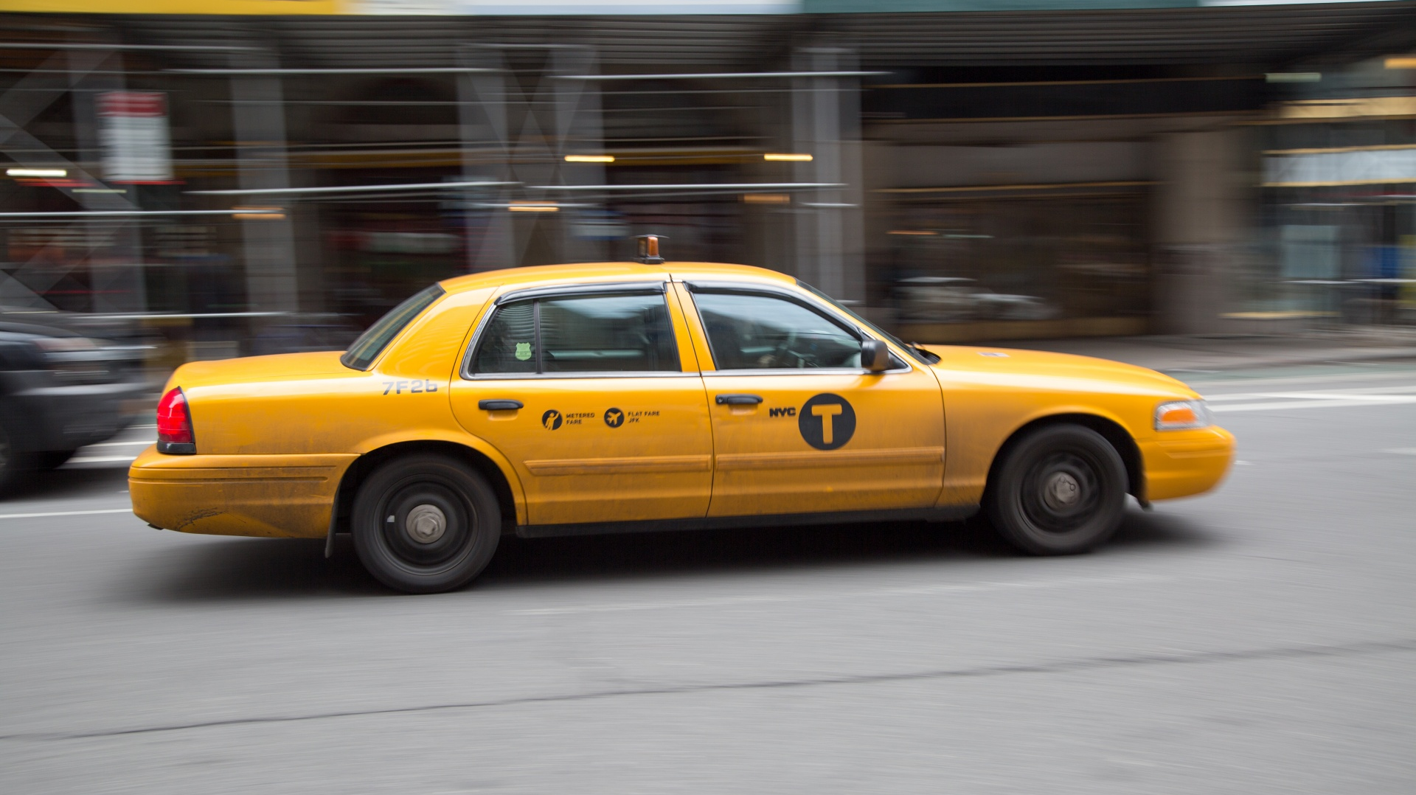
TaxiMETERS
Jonathan Brillo
MWMA President
Quincy

Slide 2
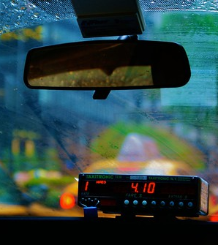
TOPICS
What is a taximeter
Brief History and Evolution
Inspection
Questions

Slide 3
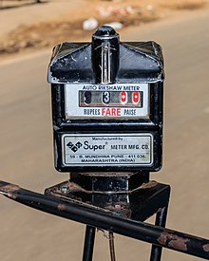
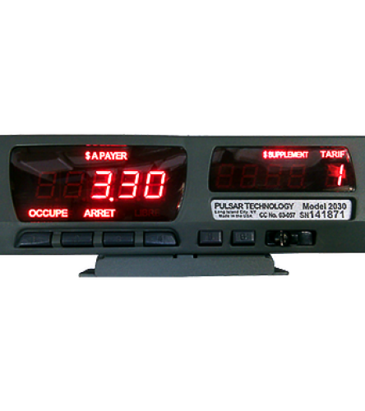
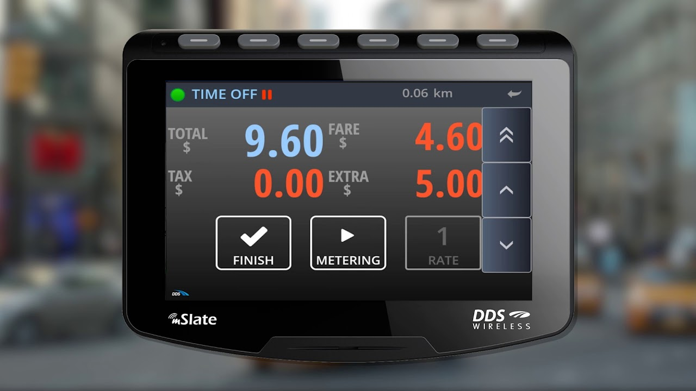
What is a taximeter
A taximeter is a mechanical or electronic device installed in taxicabs and auto rickshaws that calculates passenger fares based on a combination of distance travelled and waiting time.
HB 44 “…devices that automatically calculate at a predetermined rate or rates and indicate the charge for hire of a vehicle.”

Slide 4
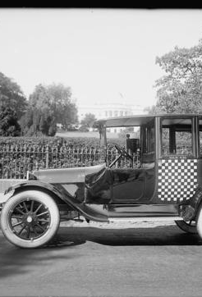
Brief History and evolution
Visual History of New York taxicabs

Slide 5


The Future

Slide 6
INSPECTION
What you need
-Training
-Certified Course
-Stopwatch
-Safety Equipment
-HB 44 Section 5.54

Slide 7
INSPECTION Types
-Visual
-Distance Test
*course, fifth-wheel, or simulated
-Time Test
-Interference Test

Slide 8
Visual Inspection
-Walk around the taxi and be sure it is safe to ride in
*take note of the medallion and registration plates
-Look for flat tires, check air pressure
-Fare indicated on/in car?
-Meter
*legal for trade?
*proper markings
*sealed (damage or tampered with?)
*functions are operating correctly
*display is functioning and not obscured

Slide 9
Distance Test
Road Test
-What are your intervals
-Tolerances (HB 44 Section 5.54, page 5-36)

Slide 10
Content
Subtitle
Subtitle
Add text, images, art, and videos.
Add transitions, animations, and motion.
Save to OneDrive, to get to your presentations from your computer, tablet, or phone.
Open the Design Ideas pane for instant slide makeovers.
When we have design ideas, we’ll show them to you right there.

Slide 11
Additional content
Subtitle
Subtitle
Subtitle
Add text, images, art, and videos.
Add transitions, animations, and motion.
Save to OneDrive, to get to your presentations from your computer, tablet, or phone.
Open the Design Ideas pane for instant slide makeovers.
When we have design ideas, we’ll show them to you right there.
This PowerPoint theme uses its own unique set of colors, fonts, and effects to create the overall look and feel of these slides.
PowerPoint has tons of themes to give your presentation just the right personality.

Slide 12


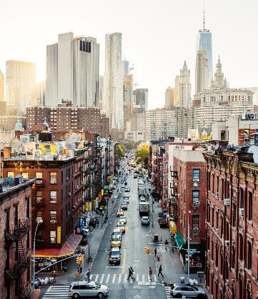
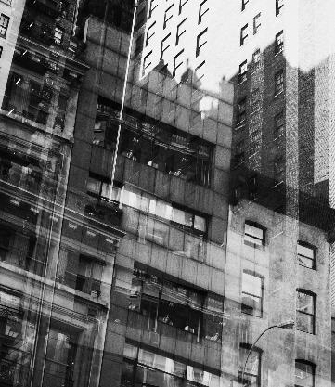
SUMMARY
With PowerPoint, you can create presentations and share your work with others, wherever they are. Type the text you want here to get started. You can also add images, art, and videos on this template. Save to OneDrive and access your presentations from your computer, tablet, or phone.

Slide 13

THANK YOU
Presenter name
Email address
Website

