Slide 1
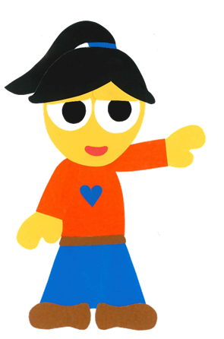
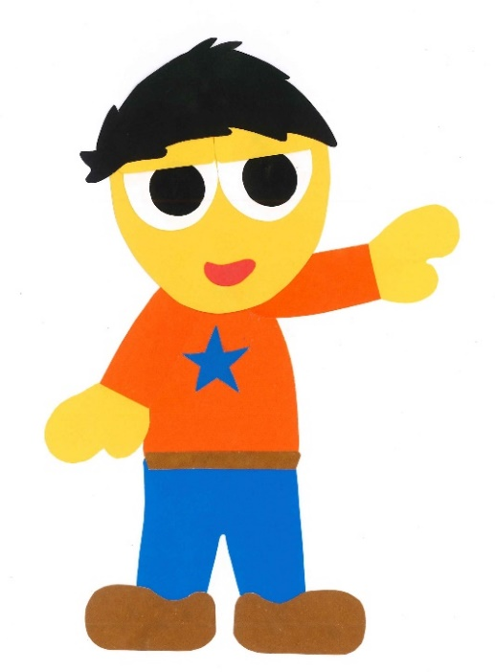
WE
CAN
READ
Teacher Donald

Slide 2
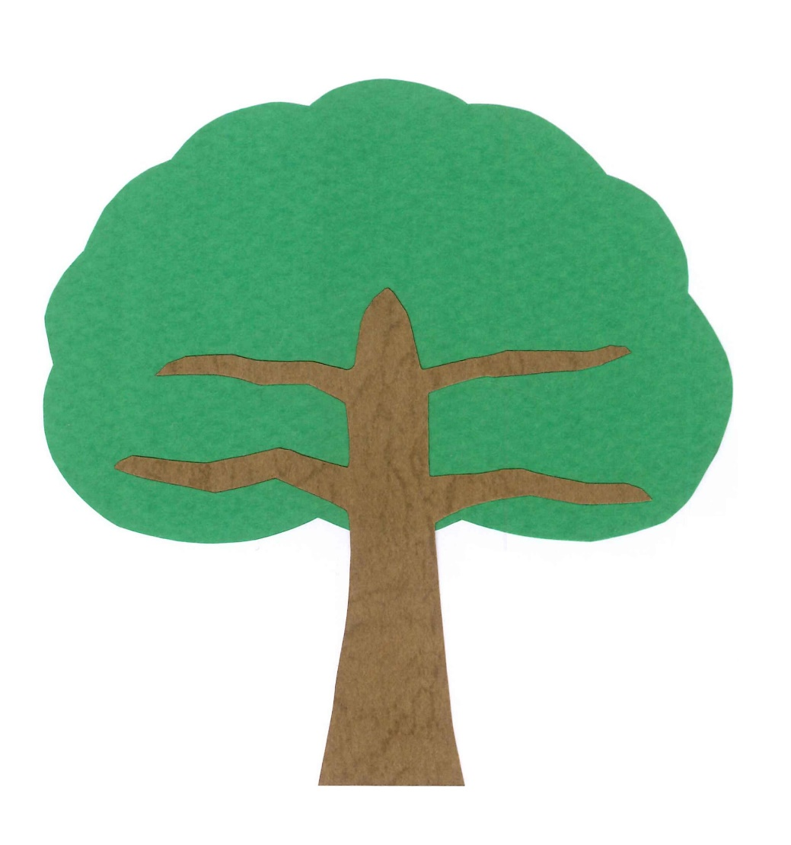
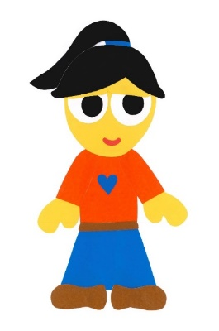
How Many Birds Are In The Tree?
By:
Donald Joyce
WE CAN READ

Slide 3
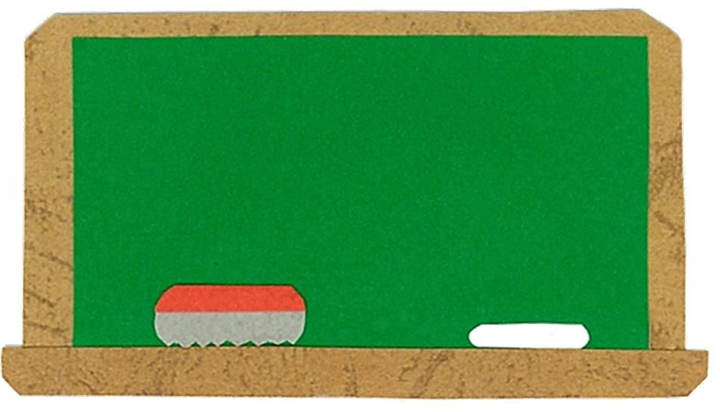
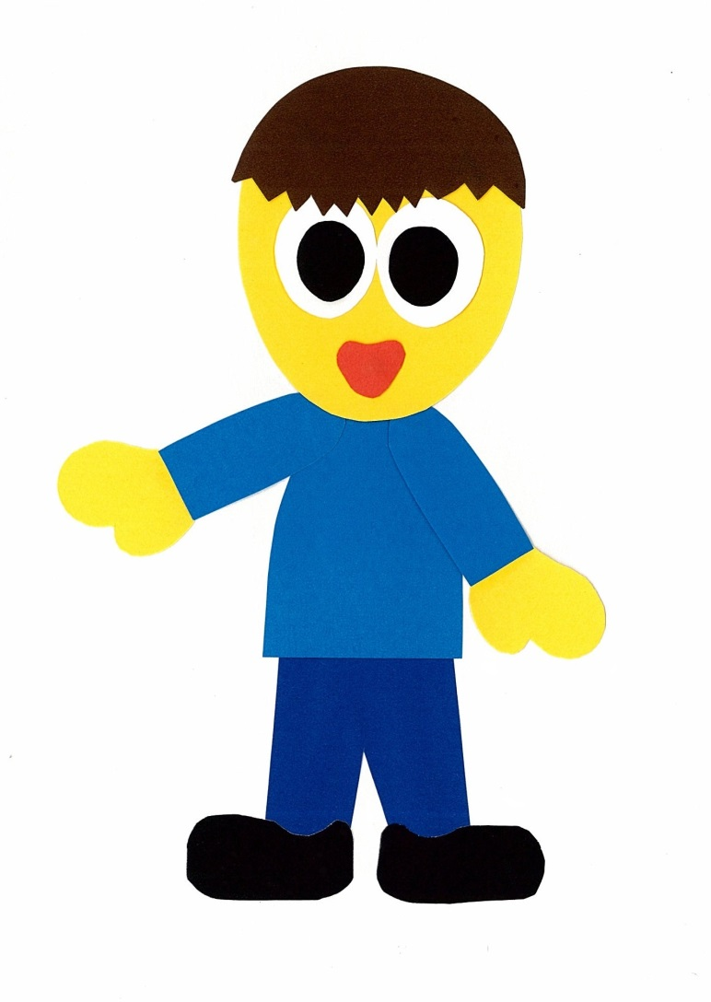
Let’s
Talk!

Slide 4
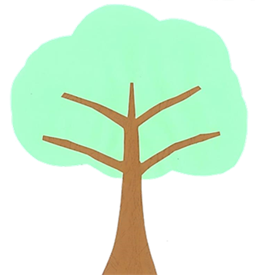
What can you see in
a tree?
I can see ___.

Slide 5
Let’s
Learn!

Slide 6
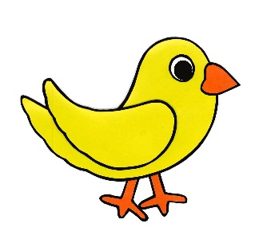
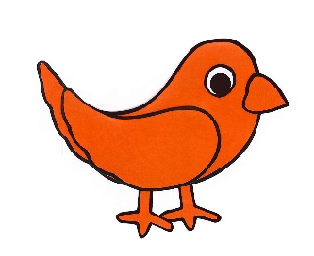
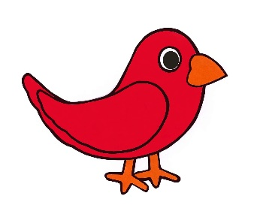
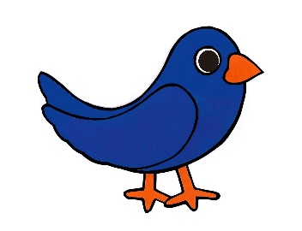
one
two
three
four
five

Slide 7
six
seven
eight
nine
ten

Slide 8
Let’s
Read!

Slide 9
How Many Birds Are In The Tree?
By:
Donald Joyce
WE CAN READ

Slide 10
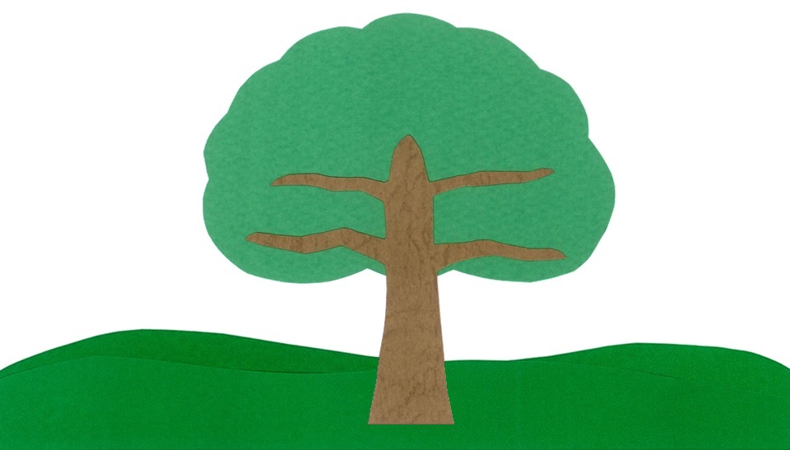
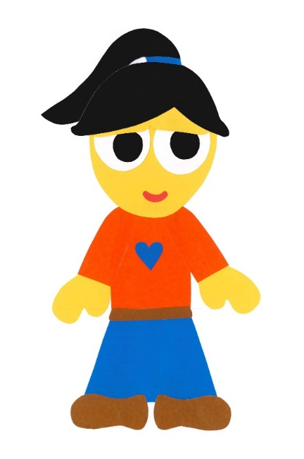
Look!
An orange bird.

Slide 11
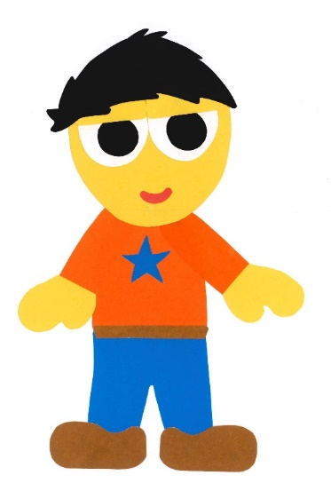
There is one bird
in the tree.

Slide 12
Look!
Two yellow birds.

Slide 13
There are three birds in the tree.

Slide 14
Look!
Three blue birds.

Slide 15
There are six birds in the tree.

Slide 16
Look!
Four red birds.

Slide 17
There are ten birds in the tree.

Slide 18
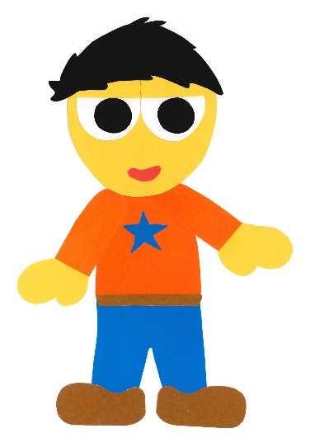
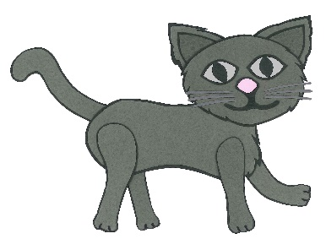
Look!
A grey cat.

Slide 19
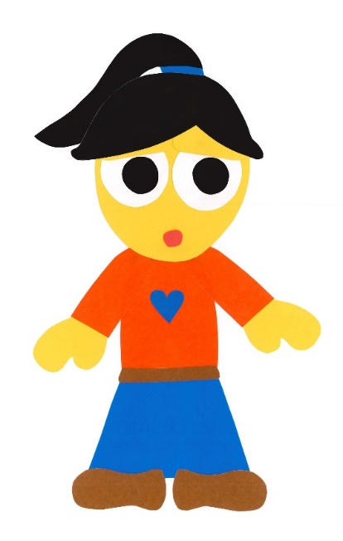
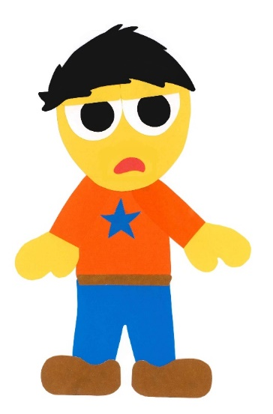
There are no birds in the tree.

Slide 20
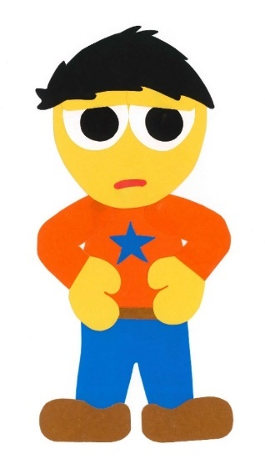
There is one cat
in the tree.

Slide 21
How Many Birds Are In The Tree?
By:
Donald Joyce
WE CAN READ

Slide 22
Let’s
Review!

Slide 23
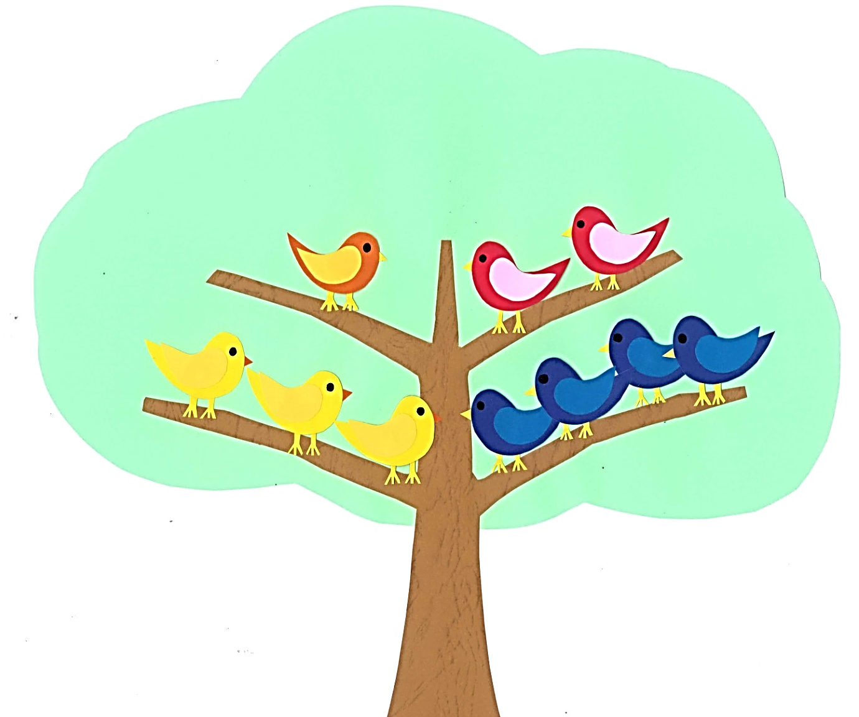
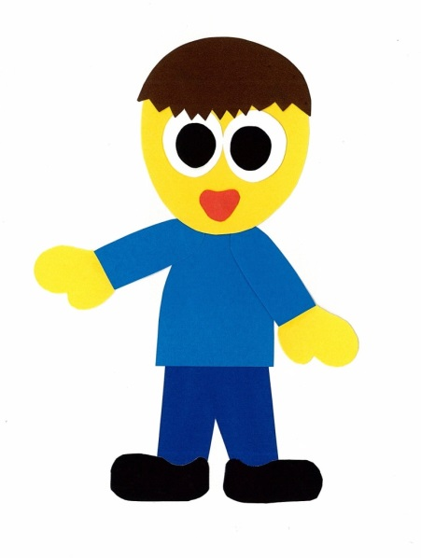
How many orange birds are in the tree?
?
?
?
?
?
?
?
?
?
?

Slide 24
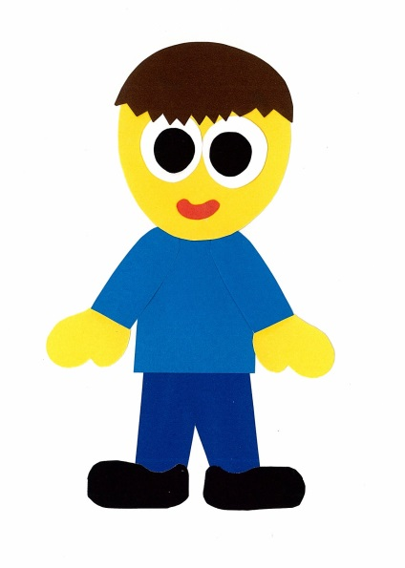
There is one
orange bird.
?
?
?
?
?
?
?
?
?

Slide 25
How many red birds are in the tree?
?
?
?
?
?
?
?
?
?

Slide 26
There are two
red birds.
?
?
?
?
?
?
?

Slide 27
How many yellow birds are in the tree?
?
?
?
?
?
?
?

Slide 28
There are three
yellow birds.
?
?
?
?

Slide 29
How many blue birds are in the tree?
?
?
?
?

Slide 30
There are four
blue birds.

Slide 31
Let’s
Connect!

Slide 32
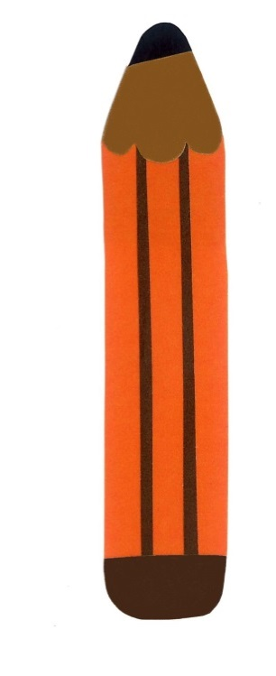
Get a pencil and paper!

Slide 33
Draw a tree. How many birds are in the tree?
There are __ birds in the tree.

Slide 34
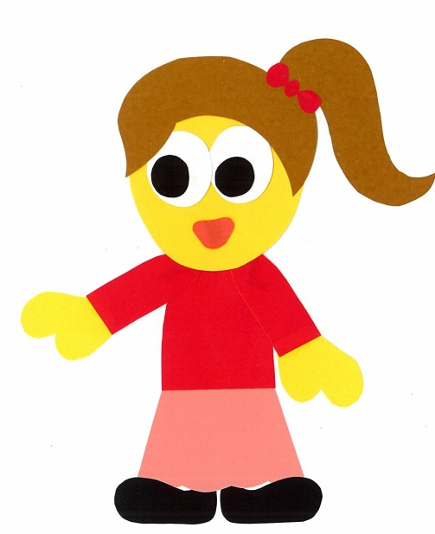
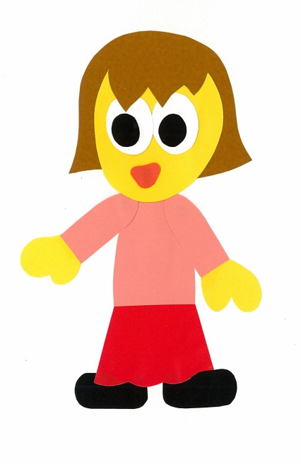
Find a friend. Play a guessing game…
Are there 3 birds in the tree?
No, there aren’t.

Slide 35
1
Is there __ bird
in the tree?
Yes, there is.
No, there isn’t.
2+
Are there __ birds in the tree?
Yes, there are.
No, there aren’t.

Slide 36
WE
CAN
READ
Donald Joyce
www.teacherdonald.com

