Slide 1
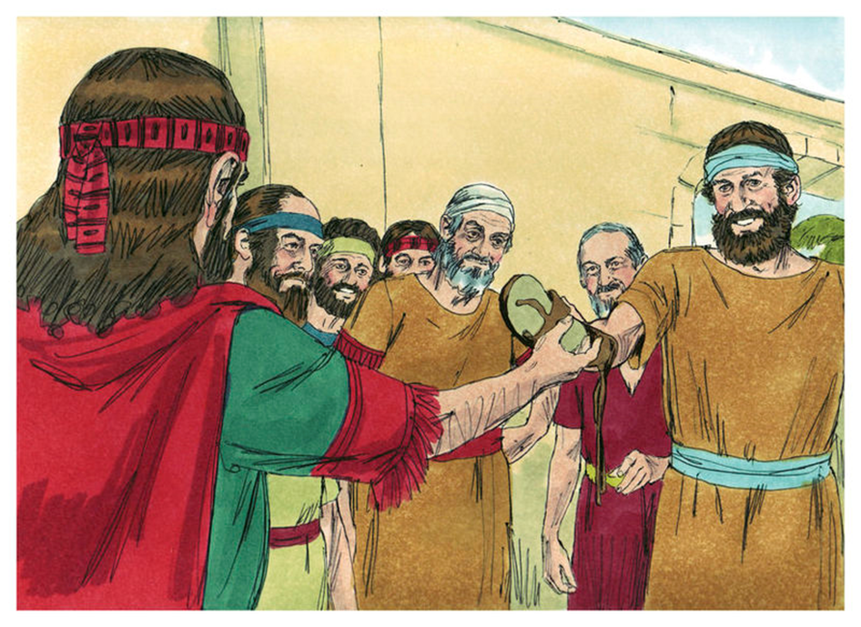
Trinity Evangelical Lutheran Church September 4, 2022
WELCOME!
Ruth, Chapter 4
Notes:
Image: Five Loaves by Caroline Coolidge Brown. Copyright © Caroline Coolidge Brown. All rights reserved. Used by permission of the artist.

Slide 2
= Please stand if able
= Please be seated
Prelude – Darrell Fryman
Office of the Acolyte
Ringing of the Bell
Welcome
“In a world where you can be anything, We can be kind!”
Notes:
Image: Five Loaves by Caroline Coolidge Brown. Copyright © Caroline Coolidge Brown. All rights reserved. Used by permission of the artist.

Slide 3
CONFESSION AND FORGIVENESS
All may make the sign of the cross, the sign marked at baptism…
L: We confess our sins before God and one another.
Pause for silence and reflection.
L: Faithful God…
Notes:
Image: Five Loaves by Caroline Coolidge Brown. Copyright © Caroline Coolidge Brown. All rights reserved. Used by permission of the artist.

Slide 4
CONFESSION AND FORGIVENESS
C: We are not always quick to claim you as our God. We do not show care for one another. We fail to see all people as your people, and hurt one another with our actions or lack of action. Forgive us our sins, and give us the same fierce love for our neighbors that Ruth had for Naomi.
Notes:
Image: Five Loaves by Caroline Coolidge Brown. Copyright © Caroline Coolidge Brown. All rights reserved. Used by permission of the artist.

Slide 5
CONFESSION AND FORGIVENESS
L: God, who calls and sustains, forgives you all your sins. Go forth in the confidence of God’s loving care, in Jesus Christ, our savior.
C: Amen.
Notes:
Image: Five Loaves by Caroline Coolidge Brown. Copyright © Caroline Coolidge Brown. All rights reserved. Used by permission of the artist.

Slide 6
Hymn of Praise
“Praise to the Lord, the Almighty” LBW 543
Notes:
Image: Five Loaves by Caroline Coolidge Brown. Copyright © Caroline Coolidge Brown. All rights reserved. Used by permission of the artist.

Slide 7
“Praise to the Lord, the Almighty” LBW 543
1 Praise to the Lord, the Almighty, the King of creation!
O my soul, praise him, for he is your health and salvation!
Let all who hear now to his temple draw near,
joining in glad adoration!
Notes:
Image: Preparing yeast dough. Copyright © tomasworks/iStock/Thinkstock. Used by permission.

Slide 8
“Praise to the Lord, the Almighty” LBW 543
2 Praise to the Lord, who o'er all things is wondrously reigning
and, as on wings of an eagle, uplifting, sustaining.
Have you not seen all that is needful has been
sent by his gracious ordaining?
Notes:
Image: Preparing yeast dough. Copyright © tomasworks/iStock/Thinkstock. Used by permission.

Slide 9
“Praise to the Lord, the Almighty” LBW 543
3 Praise to the Lord, who will prosper your work and defend you;
surely his goodness and mercy shall daily attend you.
Ponder anew what the Almighty can do
if with his love he befriend you.
Notes:
Image: Preparing yeast dough. Copyright © tomasworks/iStock/Thinkstock. Used by permission.

Slide 10
“Praise to the Lord, the Almighty” LBW 543
4 Praise to the Lord! Oh, let all that is in me adore him!
All that has life and breath, come now with praises before him!
Let the amen sound from his people again.
Gladly forever adore him!
Notes:
Image: Preparing yeast dough. Copyright © tomasworks/iStock/Thinkstock. Used by permission.

Slide 11
APOSTOLIC GREETING
P: The grace of our Lord Jesus Christ, the love of God, and the communion of the Holy Spirit be with you all.
C: And also with you.
Notes:
Image: Five Loaves by Caroline Coolidge Brown. Copyright © Caroline Coolidge Brown. All rights reserved. Used by permission of the artist.

Slide 12
KYRIE
A: In peace let us pray to the Lord.
C: Lord have mercy.
A: For the peace from above, and for our salvation, let us pray to the Lord.
C: Lord have mercy.
A: For the peace of the whole world, for the well being of the Church of God, and for the unity of all, let us pray to the Lord.
C: Lord have mercy.
Notes:
Image: Five Loaves by Caroline Coolidge Brown. Copyright © Caroline Coolidge Brown. All rights reserved. Used by permission of the artist.

Slide 13
KYRIE
A: For this Holy House, and for all who offer here their worship and praise, let us pray to the Lord.
C: Lord have mercy.
A: Help, save, and defend us, gracious Lord.
C: Amen.
Notes:
Image: Five Loaves by Caroline Coolidge Brown. Copyright © Caroline Coolidge Brown. All rights reserved. Used by permission of the artist.

Slide 14
PRAYER OF THE DAY
P: Let us pray… God of lovingkindness, You blessed your servants Ruth, Boaz, and Naomi with the birth of a son, who would be an ancestor of Jesus. Bless us now as inheritors of Jesus’ reign, for the sake of your son, our Lord, Jesus Christ.
C: Amen.
Notes:
Image: Five Loaves by Caroline Coolidge Brown. Copyright © Caroline Coolidge Brown. All rights reserved. Used by permission of the artist.

Slide 15
Notes:
Image: Preparing yeast dough. Copyright © tomasworks/iStock/Thinkstock. Used by permission.

Slide 16
Scripture Reading
R: The Scripture reading is from the Book of Ruth, Chapter 4.
C: Glory to you O’ Lord! (Spoken)
Notes:
Image: Five Loaves by Caroline Coolidge Brown. Copyright © Caroline Coolidge Brown. All rights reserved. Used by permission of the artist.

Slide 17
Ruth 4
No sooner had Boaz gone up to the gate and sat down there than the next-of-kin, of whom Boaz had spoken, came passing by. So Boaz said, “Come over, friend; sit down here.” And he went over and sat down. ²Then Boaz took ten men of the elders of the city, and said, “Sit down here”; so they sat down. ³He then said to the next-of-kin, “Naomi, who has come back from the
Notes:
Image: Five Loaves by Caroline Coolidge Brown. Copyright © Caroline Coolidge Brown. All rights reserved. Used by permission of the artist.

Slide 18
Ruth 4
country of Moab, is selling the parcel of land that belonged to our kinsman Elimelech. ⁴So I thought I would tell you of it, and say: Buy it in the presence of those sitting here, and in the presence of the elders of my people. If you will redeem it, redeem it; but if you will not, tell me, so that I may know; for there is no one prior to you to redeem it, and I come after you.” So he said, “I will
Notes:
Image: Five Loaves by Caroline Coolidge Brown. Copyright © Caroline Coolidge Brown. All rights reserved. Used by permission of the artist.

Slide 19
Ruth 4
redeem it.” ⁵Then Boaz said, “The day you acquire the field from the hand of Naomi, you are also acquiring Ruth the Moabite, the widow of the dead man, to maintain the dead man’s name on his inheritance.” ⁶At this, the next-of-kin said, “I cannot redeem it for myself without damaging my own inheritance. Take my right of redemption yourself, for I cannot redeem it.” ⁷Now this was
Notes:
Image: Five Loaves by Caroline Coolidge Brown. Copyright © Caroline Coolidge Brown. All rights reserved. Used by permission of the artist.

Slide 20
Ruth 4
the custom in former times in Israel concerning redeeming and exchanging: to confirm a transaction, the one took off a sandal and gave it to the other; this was the manner of attesting in Israel. ⁸So when the next-of-kin said to Boaz, “Acquire it for yourself,” he took off his sandal.
⁹Then Boaz said to the elders and all the people, “Today you are witnesses
Notes:
Image: Five Loaves by Caroline Coolidge Brown. Copyright © Caroline Coolidge Brown. All rights reserved. Used by permission of the artist.

Slide 21
Ruth 4
that I have acquired from the hand of Naomi all that belonged to Elimelech and all that belonged to Chilion and Mahlon. ¹⁰I have also acquired Ruth the Moabite, the wife of Mahlon, to be my wife, to maintain the dead man’s name on his inheritance, in order that the name of the dead may not be cut off from his kindred and from the gate of his native place; today you are
Notes:
Image: Five Loaves by Caroline Coolidge Brown. Copyright © Caroline Coolidge Brown. All rights reserved. Used by permission of the artist.

Slide 22
Ruth 4
witnesses.” ¹¹Then all the people who were at the gate, along with the elders, said, “We are witnesses. May the Lord make the woman who is coming into your house like Rachel and Leah, who together built up the house of Israel. May you produce children in Ephrathah and bestow a name in Bethlehem; ¹²and, through the children that the Lord will give you by this young woman,
Notes:
Image: Five Loaves by Caroline Coolidge Brown. Copyright © Caroline Coolidge Brown. All rights reserved. Used by permission of the artist.

Slide 23
Ruth 4
may your house be like the house of Perez, whom Tamar bore to Judah.”
¹³So Boaz took Ruth and she became his wife. When they came together, the Lord made her conceive, and she bore a son. ¹⁴Then the women said to Naomi, “Blessed be the Lord, who has not left you this day without next-of-kin; and may his name be renowned in Israel! ¹⁵He shall be to you a restorer of life
Notes:
Image: Five Loaves by Caroline Coolidge Brown. Copyright © Caroline Coolidge Brown. All rights reserved. Used by permission of the artist.

Slide 24
Ruth 4
and a nourisher of your old age; for your daughter-in-law who loves you, who is more to you than seven sons, has borne him.” ¹⁶Then Naomi took the child and laid him in her bosom, and became his nurse. ¹⁷The women of the neighborhood gave him a name, saying, “A son has been born to Naomi.” They named him Obed; he became the father of Jesse, the father of David.
Notes:
Image: Five Loaves by Caroline Coolidge Brown. Copyright © Caroline Coolidge Brown. All rights reserved. Used by permission of the artist.

Slide 25
Ruth 4
¹⁸Now these are the descendants of Perez: Perez became the father of Hezron, ¹⁹Hezron of Ram, Ram of Amminadab, ²⁰Amminadab of Nahshon, Nahshon of Salmon, ²¹Salmon of Boaz, Boaz of Obed, ²²Obed of Jesse, and Jesse of David.
Notes:
Image: Five Loaves by Caroline Coolidge Brown. Copyright © Caroline Coolidge Brown. All rights reserved. Used by permission of the artist.

Slide 26
Ruth 4
P: This is the Word of the Lord.
C: Praise to You, O Christ (Spoken)
Notes:
Image: Five Loaves by Caroline Coolidge Brown. Copyright © Caroline Coolidge Brown. All rights reserved. Used by permission of the artist.

Slide 27
Sermon
Notes:
Image: Five Loaves by Caroline Coolidge Brown. Copyright © Caroline Coolidge Brown. All rights reserved. Used by permission of the artist.

Slide 28
APOSTLE’S CREED
C: I believe in God, the Father almighty, creator of heaven and earth.

Slide 29
APOSTLE’S CREED
C: I believe in Jesus Christ, his only Son, our Lord. He was conceived by the power of the Holy Spirit and born of the virgin Mary. He suffered under Pontius Pilate, was crucified, died, and was buried.

Slide 30
APOSTLE’S CREED
C: He descended into hell. On the third day he rose again. He ascended into heaven, and is seated at the right hand of the Father. He will come again to judge the living and the dead.

Slide 31
APOSTLE’S CREED
C: I believe in the Holy Spirit, the holy catholic Church, the communion of saints, the forgiveness of sins, the resurrection of the body, and the life everlasting. Amen.

Slide 32
NICENE CREED
C: We believe in one God, the Father, the Almighty, maker of heaven and earth, of all that is, seen and unseen.

Slide 33
NICENE CREED
C: We believe in one Lord, Jesus Christ, the only Son of God, eternally begotten of the Father, God from God, Light from Light, true God from true God, begotten, not made, of one Being with the Father.

Slide 34
NICENE CREED
C: Through him all things were made. For us and for our salvation he came down from heaven; by the power of the Holy Spirit he became incarnate from the virgin Mary, and was made man. For our sake he was crucified under Pontius Pilate;

Slide 35
NICENE CREED
C: he suffered death and was buried. On the third day he rose again in accordance with the Scriptures; he ascended into heaven and is seated at the right hand of the Father. He will come again in glory to judge the living and the dead, and his kingdom will have no end.

Slide 36
NICENE CREED
C: We believe in the Holy Spirit, the Lord, the giver of life, who proceeds from the Father and the Son. With the Father and the Son he is worshiped and glorified. He has spoken through the prophets. We believe in one holy catholic and apostolic Church.

Slide 37
NICENE CREED
C: We acknowledge one Baptism for the forgiveness of sins. We look for the resurrection of the dead, and the life of the world to come. Amen.

Slide 38
PRAYERS OF INTERCESSION
Each petition will end with the words,
A: God, in your mercy,
The congregation will respond with:
C: You hear our prayer.

Slide 39
PRAYERS OF INTERCESSION
The prayer concludes…
P: With gratitude for your faithfulness, we pray these things in the name of Jesus Christ, our savior.
C: Amen.

Slide 40
Offering Prayer
Notes:
Image: Five Loaves by Caroline Coolidge Brown. Copyright © Caroline Coolidge Brown. All rights reserved. Used by permission of the artist.

Slide 41
THE GREAT THANKSGIVING
Communion by pre-packaged Communion Cups. All the Baptized are welcome to celebrate this Holy Meal.

Slide 42
DIALOGUE
P: The Lord be with you.
C: And also with you.
P: Lift up your hearts.
C: We lift them to the Lord.
P: Let us give thanks to the Lord our God.
C: It is right to give him thanks and praise.

Slide 43
Preface
P: It is indeed right…
…join their unending hymn

Slide 44
Sanctus
C: Holy, holy, holy Lord, God of power and might: Heaven and earth are full of your glory. Hosanna. Hosanna. Hosanna in the highest. Blessed is he who comes in the name of the Lord. Hosanna in the highest.

Slide 45
Eucharistic Prayer
P: Holy God, our Maker, Redeemer, and Healer…
…in your holy Church, both now and forever.
C: Amen

Slide 46
THE LORD’S PRAYER
C: Our Father, who art in heaven, hallowed be thy name, thy kingdom come, thy will be done, on earth as it is in heaven. Give us this day our daily bread; and forgive us our trespasses, as we forgive those who trespass against us; and lead us not into temptation, but deliver us from evil.

Slide 47
THE LORD’S PRAYER
C: For thine is the kingdom, and the power, and the glory, forever and ever. Amen.

Slide 48
INVITATION TO COMMUNION
P: As Ruth, Naomi, and Boaz celebrated the birth of their son, let us celebrate together the gift of God’s son, Jesus Christ our savior. Come to the feast of life.

Slide 49
POST COMMUNION BLESSING
P: May this Body and Blood of our Lord and Savior, Jesus Christ, strengthen, keep, and unite us, now and forever.
C: Amen.

Slide 50
POST COMMUNION PRAYER
P: Let us pray… Life-giving God, through this meal you have bandaged our wounds and fed us with your mercy. Now send us forth to live for others, both friend and stranger, that all may come to know your love. This we pray in the name of Jesus.
C: Amen

Slide 51
Announcements
Notes:
Image: Five Loaves by Caroline Coolidge Brown. Copyright © Caroline Coolidge Brown. All rights reserved. Used by permission of the artist.

Slide 52
SENDING BLESSING
P: God, who gives life to all things and frees us from despair, bless you with truth and peace. And may the holy Trinity, ☩ one God, guide you always in faith, hope, and love.
C: Amen.

Slide 53
Sending Song
“Let All Things Now Living” ELW 881
Notes:
Image: Five Loaves by Caroline Coolidge Brown. Copyright © Caroline Coolidge Brown. All rights reserved. Used by permission of the artist.

Slide 54
“Let All Things Now Living” ELW 881
1 Let all things now living
a song of thanksgiving
to God the creator triumphantly raise,
who fashioned and made us,
protected and stayed us,
who still guides us on to the end of our days.
Notes:
Image: Five Loaves by Caroline Coolidge Brown. Copyright © Caroline Coolidge Brown. All rights reserved. Used by permission of the artist.

Slide 55
“Let All Things Now Living” ELW 881
1 God's banners are o'er us,
God's light goes before us,
a pillar of fire shining forth in the night,
till shadows have vanished
and darkness is banished,
as forward we travel from light into light.
Notes:
Image: Five Loaves by Caroline Coolidge Brown. Copyright © Caroline Coolidge Brown. All rights reserved. Used by permission of the artist.

Slide 56
“Let All Things Now Living” ELW 881
2 God rules all the forces:
the stars in their courses
and sun in its orbit obediently shine;
the hills and the mountains,
the rivers and fountains,
the deeps of the ocean proclaim God divine.
Notes:
Image: Five Loaves by Caroline Coolidge Brown. Copyright © Caroline Coolidge Brown. All rights reserved. Used by permission of the artist.

Slide 57
“Let All Things Now Living” ELW 881
2 We too should be voicing
our love and rejoicing;
with glad adoration a song let us raise
till all things now living
unite in thanksgiving:
"To God in the highest, hosanna and praise!"
Notes:
Image: Five Loaves by Caroline Coolidge Brown. Copyright © Caroline Coolidge Brown. All rights reserved. Used by permission of the artist.

Slide 58
DISMISSAL
P: … depart in Christ’s Love.
C: Seeking, welcoming, and serving all. Amen!
POSTLUDE
By
Darrell Fryman
From sundaysandseasons.com. Copyright © 2022 Augsburg Fortress. All rights reserved. Reprinted by permission under Augsburg Fortress Liturgies Annual License #SAS023830. New Revised Standard Version Bible, Copyright © 1989, Division of Christian Education of the National Council of the Churches of Christ in the United States of America. Used by permission. All rights reserved. Revised Common Lectionary, Copyright © 1992 Consultation on Common Texts, admin Augsburg Fortress. Used by permission.

