Slide 1
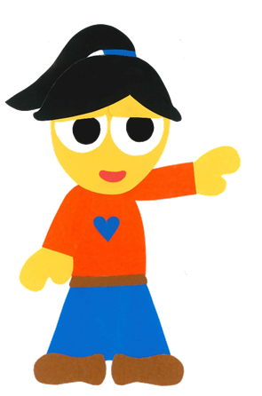
WE
CAN
READ
Donald Joyce

Slide 2
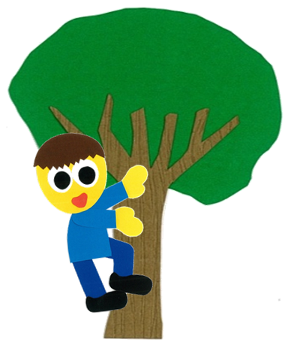
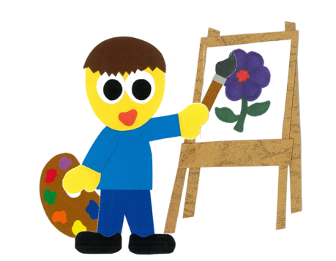
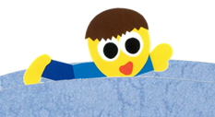
What
Can You Do?
By:
Donald Joyce
WE CAN READ

Slide 3
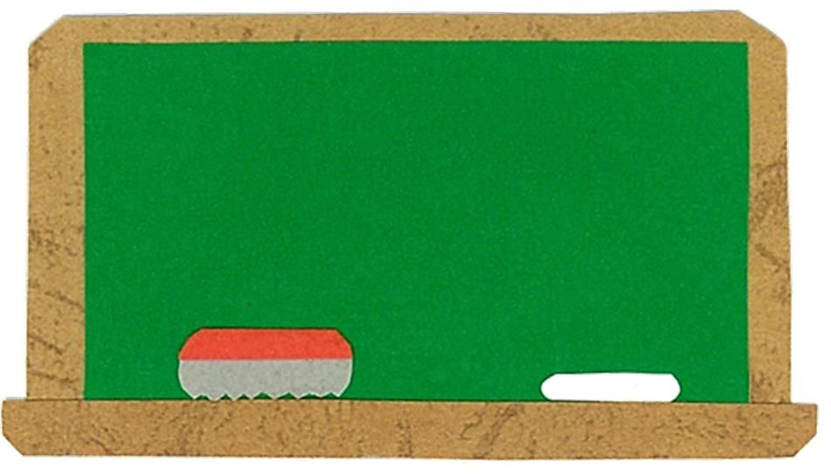
Let’s
Talk!

Slide 4
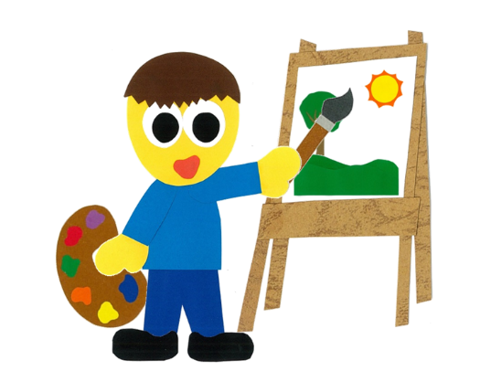
What can you do?
I can ___.
Me too!

Slide 5
Let’s
Learn!

Slide 6
run
jump
climb
swim
read
paint

Slide 7
Let’s
Read!

Slide 8
What
Can You Do?
By:
Donald Joyce
WE CAN READ

Slide 9
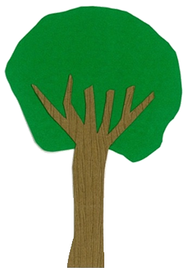
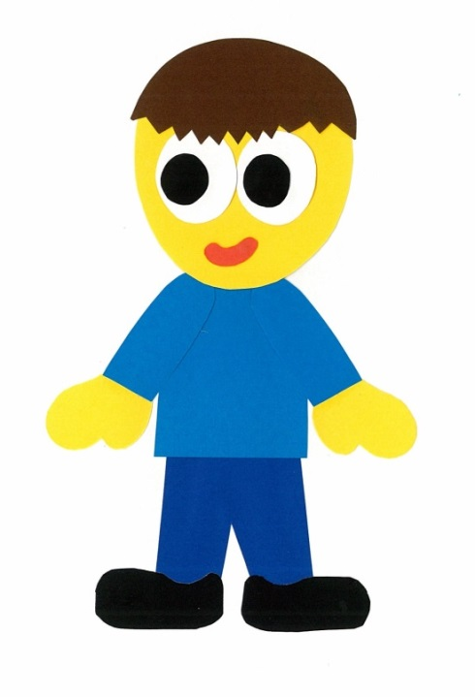
What can you do?

Slide 10
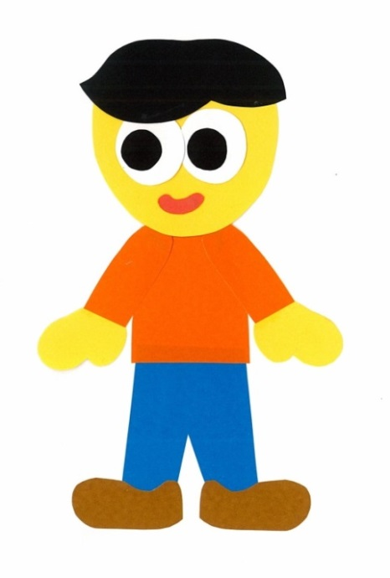
I can run.

Slide 11
I can run, too!

Slide 12
What can you do?

Slide 13
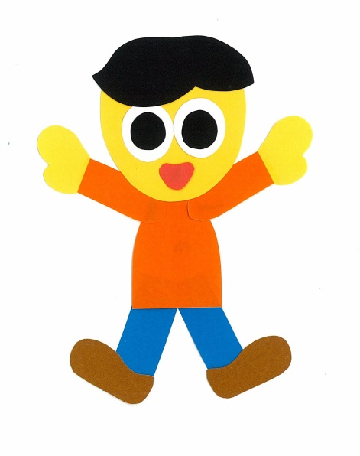
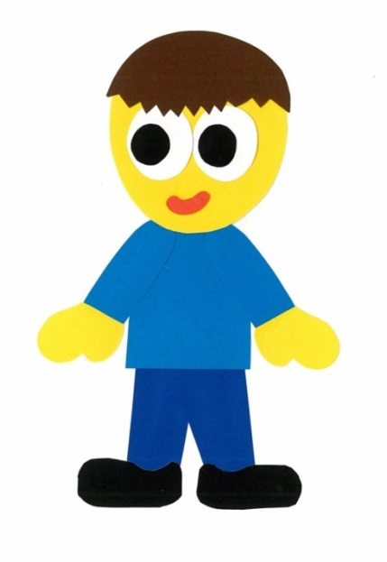
I can jump.

Slide 14
I can jump, too!

Slide 15
What can you do?

Slide 16
I can climb.

Slide 17
I can climb, too!

Slide 18
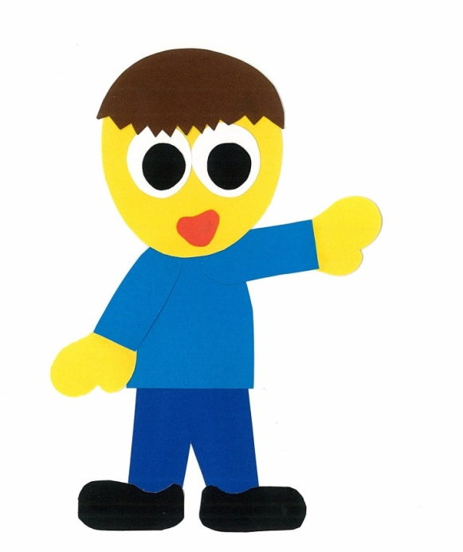
What can you do?

Slide 19
I can swim.

Slide 20
I can swim, too!

Slide 21
What can you do?

Slide 22
I can read.

Slide 23
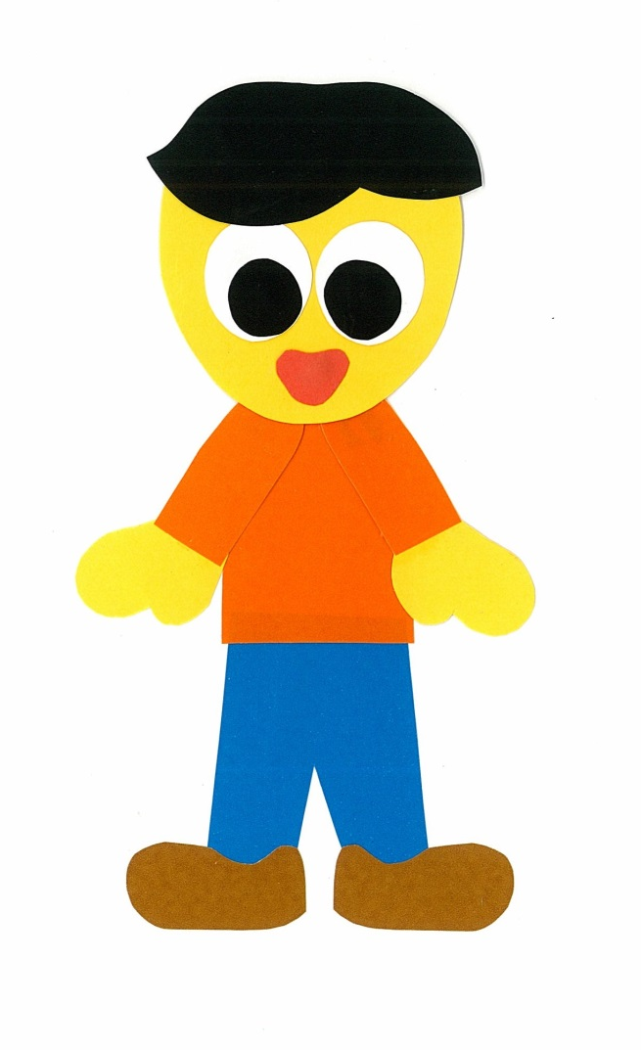
I can read, too!

Slide 24
What can you do?

Slide 25
I can paint.

Slide 26
I can paint, too!

Slide 27
What can you do?

Slide 28
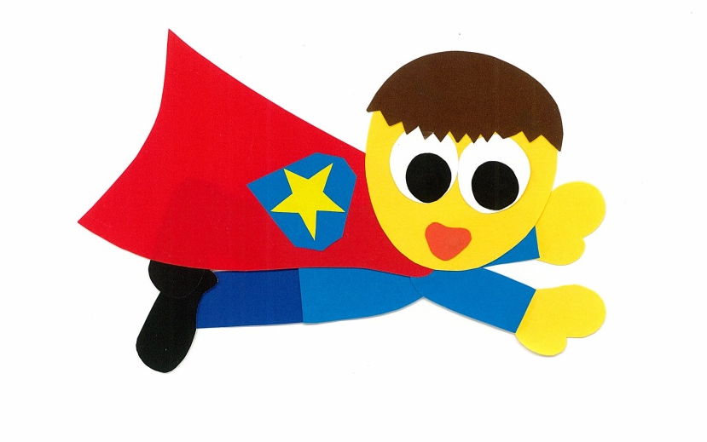
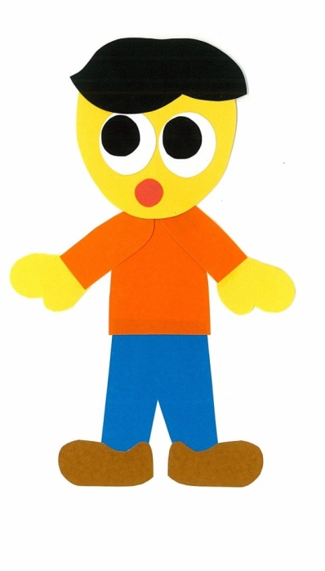
I can fly.

Slide 29
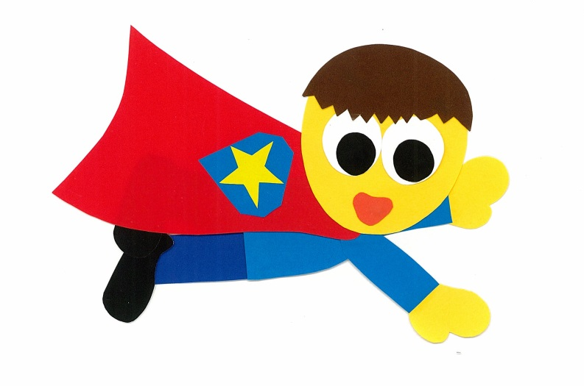
Can you fly too?

Slide 30
What
Can You Do?
By:
Donald Joyce
WE CAN READ

Slide 31
Let’s
Review!

Slide 32
He can run.

Slide 33
He can jump.

Slide 34
He can climb.

Slide 35
He can read.

Slide 36
He can swim.

Slide 37
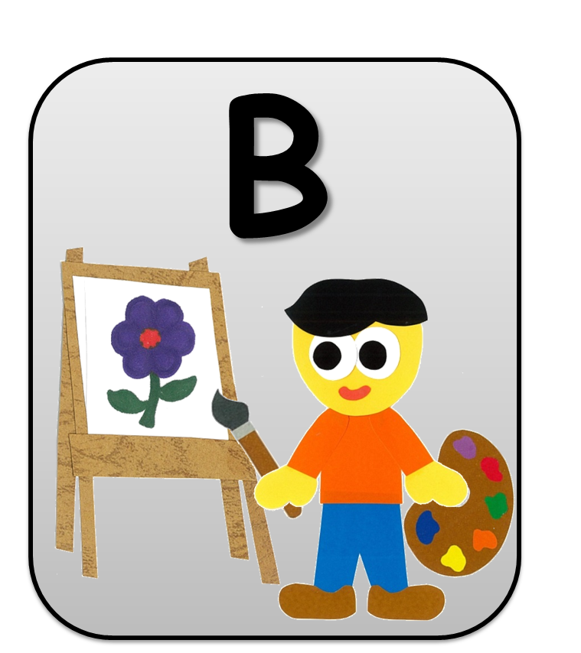
He can paint.

Slide 38
He can fly.

Slide 39
Let’s
Connect!

Slide 40
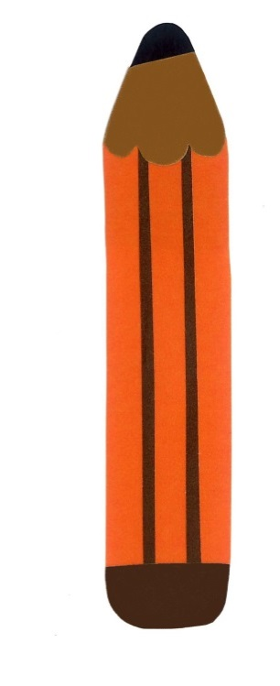
Get a pencil and paper!

Slide 41
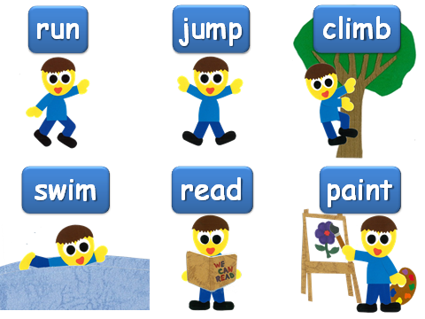
Write 3 things you can do.
I can ____.

Slide 42
Let’s guess…

Slide 43
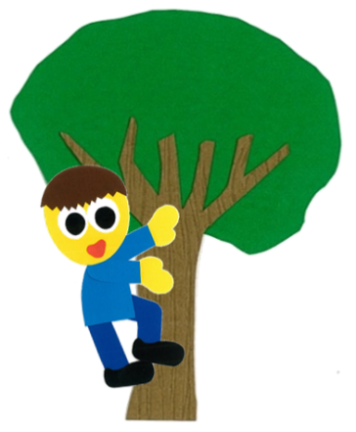
Can you ___?
run
climb
swim
jump
read
paint
Yes, I can.
No, I can’t.

Slide 44
WE
CAN
READ
Donald Joyce
www.teacherdonald.com

