Slide 1
“High” Middle Ages in Review
APEH Mr. Buttell
CBHS

Slide 2
The Black Death

Slide 3
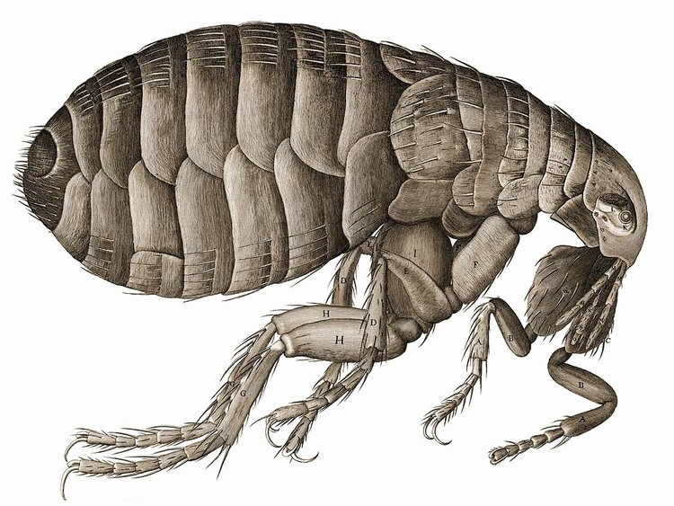
Pathology
Most historians identify the disease as the bubonic plague.
Disease that normally affects rats, fleas living on infected rats drink their blood and pass bacteria on to the next animal or human they bite.
Occurred several times in history and killed million in the sixth century.
The medieval plague was often transmitted from person to person through coughing and sneezing as well as through flea bites.

Slide 4
Symptoms
Classic symptom was agonizingly painful growth, the size of a nut in the armpit, in the groin, or on the neck.
If the “bubo” was not lanced and drained, next stage was appearance of black spots or blotches caused by bleeding under the skin.
Finally, victims spit blood and coughed violently, death followed within two or three days.
Coughing also released pathogens into the air infecting others.

Slide 5
Spread
In October 1347, Genoese ships brought the plague from Kaffa to Messina and it spread to Sicily.
Port of Pisa it spread south to Rome and east to Florence and all of Tuscany
Late spring in 1348 southern Germany was infected
Port of Marseilles, it enters France infecting southern France and Spain.
June 1348, two ships entered the Bristol Channel introducing it to England and then it travelled NE to Scandinavia.
Entered Poland through the Baltic ports and spread eastward.

Slide 6
Death Toll
Mortality rates are estimates because population figures did not exist for most countries and cities in pre-plague period
Widely accepted estimate that 1/3 of population of western Europe and the Mediterranean died in the first wave of infection.
Italian cities endured huge losses; Florence lost between ½ and 2/3 of its population in 1348.
Some areas, including Milan and Nuremburg, were largely spared because city authorities closed the city gates and stored enough food to sustain the population.
Waves of emigrants moved across Europe to escape the plague.
Improved standards of hygiene and quarantine measures also lessened the plague’s toll, but it continued to appear until 1721

Slide 7
The Hundred Years’ War (1337-1453)

Slide 8
Causes
Disagreements over the rights to land: France absorbed the duchy of Aquitaine into France. The duchy had become part of the holdings of the English crown when Eleanor or Aquitaine married King Henry II of England in 1152.
A dispute over the succession to the French throne after Charles IV of France died childless in 1328, ends Capetian Dynasty. (He was last surviving son of Philip the Fair)
Nobles passed the crown to Philip VI of Valois, a nephew of Philip the Fair, rather than to Philip’s sister Isabella or to her son Edward III, King of England.
Claiming Salic Law, 6th C. code of the Franks, prohibited women from ruling or passing down right to rule, banning female succession.

Slide 9
Causes
In 1329, Edward III formally recognized Philip VI’s lordship over Aquitaine.
In 1337, Philip exercised full French jurisdiction in Aquitaine, confiscated the duchy which Edward took as a cause for war.
War turned into a civil war in France, with some French nobles, notably the dukes of Burgundy, supporting English monarchy in order to thwart the centralizing goals of the French crown.
Govt.’s of both England and France manipulated public opinion to support the war.

Slide 10
Causes
English public was convinced the war was waged for one reason: to secure for King Edward the French crown he had been unjustly denied.
Edward III issued letters describing evil deeds of the French and listing royal needs, while Philip VI sent agents to warn communities about the dangers of invasion.
Both sides develop a deep hatred of the other as royal propaganda fostered a form of early nationalism.

Slide 11
Causes
Economic factors involving the wool trade and the control of Flemish towns were linked to these political issues.
Wealth of Flemish merchants and cloth mfg. depended on English wool.
Flemish burghers strongly supported the claims of Edward III even though Flanders belonged to the French crown.
War also presented opportunities for wealth and advancement: knights were promised regular wages, criminals were granted pardons and great nobles were rewarded with estates; royal exhortations before battles repeatedly stressed that, if victorious, the troops might keep whatever they seized.

Slide 12
English Successes
War began with a series of French raids on English coastal town in 1337, but the French fleet was destroyed and rest of the war was fought primarily in France and the Low Countries.
During early stages, England was highly successful.
At Crecy in northern France in 1346, English longbowmen scored a great victory over French knights and crossbowmen.
English use of the canon and longbow, which allowed for rapid reloading, unhorsed French horsemen and cause mass confusion and panic.
Edward was not able to take all of France, but the English held Aquitaine and other provinces and allied themselves with many of France’s nobles.

Slide 13
French Fight Back
After brief peace, French fought back and recovered some territory.
Treaty halted hostilities as both sides concentrated on conflicts over power at home.
War began again in 1415 when an army led by English soldier-king Henry V invaded France and defeated a much larger French force at Agincourt.
Henry then followed that up with a reconquest of Normandy.
By 1419, English forced were at the walls of Paris.
Henry married the daughter of the French King, a treaty made Henry and any sons the couple would have heir to the French throne.
Henry died unexpectedly, however, and although the English went on to besiege the city of Orleans, the France cause was not lost.

Slide 14
Joan of Arc (1412-1431)
Ultimate French success rests on actions of a peasant girl who came from a religious household and whose visions and leadership revived French fortunes and led to victory.
She heard voices as a child that told her the uncrowned King Charles VII had to be crowned and the English expelled from France.
She traveled to French court wearing male clothing, had an audience with Charles, and secured his support to travel with the French army to Orleans dressed as a knight.
There, she dictated a letter to the English, ordering them to surrender to “The Maid” sent by God.
She inspired and led French attacks, forcing the English to retreat from Orleans.

Slide 15
Joan of Arc (1412-1431)
The King made Joan co-commander of the entire army, and she led it to a string of military victories; other cities surrendered without a fight and returned their allegiance to France.
In July 1429, two months after the end of the siege of Orleans, Charles VII was crowned king at Reims.
In 1430 the Burgundians captured Joan; Charles refused to ransom her, and she was sold to the English, who charged her with heresy in a church court and burned her at the stake in Rouen.
Burgundians switched their allegiance to the French, who reconquered Normandy and finally, ejected the English from Aquitaine.

Slide 16
Joan of Arc (1412-1431)
As loss of life mounted and more money was spent, Parliamentary opposition in England mounted, fewer soldiers were sent, and more territory passed into French hands.
At the war’s end in 1453, only the town of Calais remained in English hands.
In 1456 Charles VII requested that the pope conduct a new trial of Joan; the pope cleared her of all charges and declared her a martyr.
Pious and popular legends aside, Joan, a teenage girl who saved the French monarchy, became a political symbol of France.

Slide 17
Aftermath of the War
In France, thousands of soldiers and civilians had been slaughtered and hundreds of thousands of acres of rich farmland were ruined.
The economy was in shambles and the war disrupted trade and drastically reduced French participation in international commerce, and the heavy taxes that financed war aggravated peasant grievances.
The war wreaked havoc in England as well, suffering an enormous financial loss, spending more than 5 million pound on the war effort.

Slide 18
Aftermath of the War
The war stimulated technological experimentation especially with artillery, and canon revolutionized warfare, making the stone castle no longer impregnable.
Edward III’s constant need for money stimulated the development of the English Parliament. The Commons, realized they held the purse strings.
Statute of 1341 required all new taxes have parliamentary approval.
When he signed the law he acknowledged Parliament’s power.
Charles VI found this idea distasteful, and regional and provincial assemblies did not want a national assembly.
In both countries, the war did promote the growth of nationalism.

Slide 19
Challenges to the Church

Slide 20
Babylonian Captivity and Great Schism
Death of Pope Boniface VIII and in effort to control the Church and its policies, King Philip the Fair of France pressured the new pope, Clement V, to settle permanently in Avignon.
The popes lived in Avignon from 1309 to 1376, often called the Babylonian Captivity
It cut off church leadership from its historic roots and the source of its ancient authority, Rome, which badly damaged papal prestige.

Slide 21
Babylonian Captivity and Great Schism
In 1377, Pope Gregory XI brought the papal court back to Rome, but he died shortly after the return.
The next pope, Urban VI was a distinguished administrator and had excellent intentions for church reform, but he went about it in a tactless and bullheaded manner.
Attacking clerical luxuries, denouncing by name and threatening excommunication individual cardinals and bishops, who then slipped away from Rome and met at Anagni.
The cardinals declared Urban’s election invalid because it had come about under threats from the Roman mob, and they excommunicated him and named a new pope, Cardinal Robert of Geneva (Cousin of King Charles V of France) who took the name of Clement VII.

Slide 22
Babylonian Captivity and Great Schism
The two popes—Urban at Rome and Clement VII at Avignon—began the Great Schism that divided Western Christendom until 1417.
Power of Europe aligned themselves with Urban or Clement along strictly political lines: France, Aragon, Castile, Portugal, Scotland, and, later on, the Italian city-states supported the French pope, Clement; England and the German emperor, long-time enemies of France, recognized Urban.
The schism weakened the religious faith of many Christians and brought church leadership into serious disrepute.

