Slide 1
Successful Life Long Recovery
The Family Solution Finder Learning Seminars

Slide 2
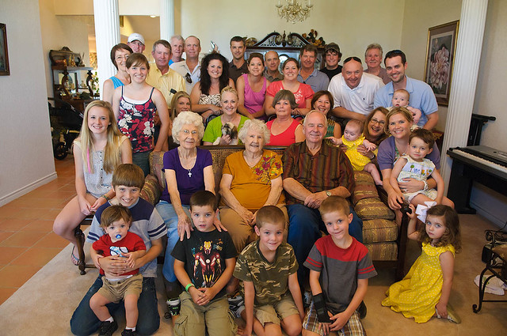
Successful Life-long recovery
The family needs to understand they are not experts, few families are prepared for this and therefore most will seek assistance from services within their community. The Relapse is a part of most journey’s and to understand its parts helps family members to put the event of a relapse in it proper perspective.
The question is where to gain knowledge about creating a support network. We suggest your drug counselor and family therapist. Then on line video’s can be a secondary source.
Taking care of yourself is an important part of being empowered and ready for what might come next. It will not just happen, this is something you have to build into your lifestyle, on purpose.
Notes:
The family Solution Finder has 32 1.5hr seminars coving all the issues a family will likely face in their journey. The family can view these in the monthly meeting or at home. Each issues require a family plan of action

Slide 4
Seminar Overview
Relapse Prevention Plan (Triggers)
Create your Support Network
First Take care of yourself
Practical Exercise
Supportive Family environment

Slide 5
Create your support system

Slide 6
Decisions, and more decisions,
There are decision in every phase of the journey:
Use the F.T.R. Model to determine your solution
Use the Value Based Family Decision Making Model to make a decision on your course of action and set up a plan.
Create a flexible plan on how you will find and remove triggers that may lead to a relapse. Each member of the family would benefit by creating their own individual support system plan and develop a set of habits that will create a self care daily routine.

Slide 8
Conclusion
Relapse Prevention Plan (Triggers)
Create your support network
First take care of yourself
Complete a “Responding to A Family Issue”

Slide 9
CONTACT US:
Roy Poillon Executive Director/Founder
Office: 440.385.7605 Mobile: 814.722.8946
Familiesimpactedbyopioids@gmail.com
www.Familiesimpactedbyopioids.com
LinkedIn Roy Poillon
Facebook: Familiesimpactedbyopioids public group
Instagram: Families Impacted by Opioids
ALWAYS SEEK THE ADVICE OF A PROFESSIONAL THERAPIEST BEFORE ACTING ON ANY PART OF THE INFORAMTION PROVIDED IN THESE PROGRAMS.

