Slide 1
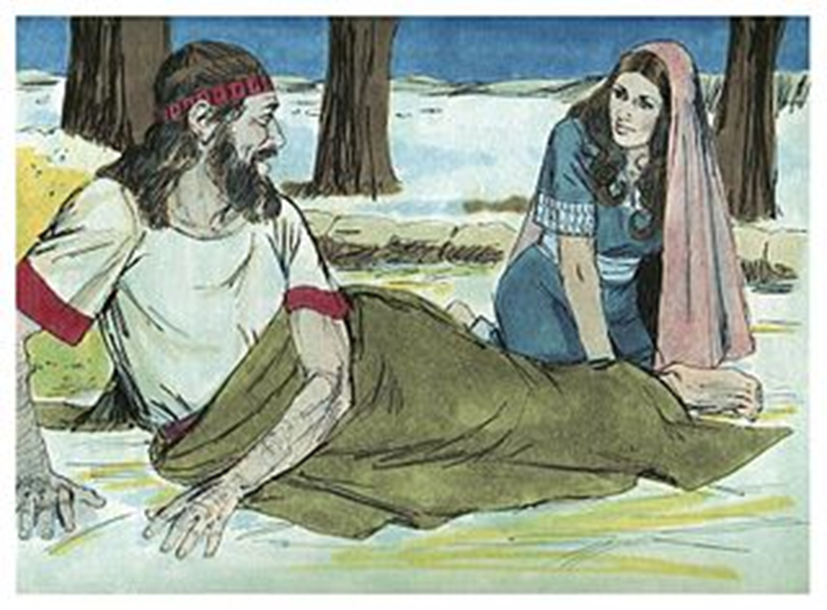
Welcome in the Name of
The Triune God
August 28, 2022
Ruth and Boaz
Prelude by Darrell Fryman
Office of the Acolyte
Ringing of the Bell
Scripture Focus: Ruth, Chapter 3
Notes:
Image: Preparing yeast dough. Copyright © tomasworks/iStock/Thinkstock. Used by permission.

Slide 2
CONFESSION AND FORGIVENESS
All may make the sign of the cross, the sign marked at baptism…
P: We confess our sins before God and one another.
Pause for silence and reflection.
P: Saving God,
Notes:
Image: Five Loaves by Caroline Coolidge Brown. Copyright © Caroline Coolidge Brown. All rights reserved. Used by permission of the artist.

Slide 3
CONFESSION AND FORGIVENESS
C: Too often we have turned away from you and toward ourselves. We have not had unity of spirit, sympathy, love for one another, a tender heart, or a humble mind. We have repaid evil for evil. We have failed to serve. Draw us back into the joy of your beloved community, and give us eager hearts to love our neighbors.
Notes:
Image: Five Loaves by Caroline Coolidge Brown. Copyright © Caroline Coolidge Brown. All rights reserved. Used by permission of the artist.

Slide 4
CONFESSION AND FORGIVENESS
L: God who redeems all flesh gives you new life in Christ and forgives you all your sins. Rejoice in the grace and mercy of God, through Jesus Christ, our savior.
C: Amen.
☩
Notes:
Image: Five Loaves by Caroline Coolidge Brown. Copyright © Caroline Coolidge Brown. All rights reserved. Used by permission of the artist.

Slide 5
Hymn of Praise
“Praise Him”
Notes:
Image: Five Loaves by Caroline Coolidge Brown. Copyright © Caroline Coolidge Brown. All rights reserved. Used by permission of the artist.

Slide 6
Praise Him
Praise Him, Praise Him
All Ye little children
God is Love, God is love
Praise Him, praise him
All ye little children
God is Love, God is Love
Notes:
Image: Five Loaves by Caroline Coolidge Brown. Copyright © Caroline Coolidge Brown. All rights reserved. Used by permission of the artist.

Slide 7
Praise Him
Love Him, Love Him
All Ye little children
God is Love, God is love
Love Him, Love him
All ye little children
God is Love, God is Love
Notes:
Image: Five Loaves by Caroline Coolidge Brown. Copyright © Caroline Coolidge Brown. All rights reserved. Used by permission of the artist.

Slide 8
Praise Him
Thank Him, Thank Him
All Ye little children
God is Love, God is love
Thank Him, Thank him
All ye little children
God is Love, God is Love
Notes:
Image: Five Loaves by Caroline Coolidge Brown. Copyright © Caroline Coolidge Brown. All rights reserved. Used by permission of the artist.

Slide 9
Praise Him
Serve Him, Serve Him
All Ye little children
God is Love, God is love
Serve Him, Serve him
All ye little children
God is Love, God is Love
Notes:
Image: Five Loaves by Caroline Coolidge Brown. Copyright © Caroline Coolidge Brown. All rights reserved. Used by permission of the artist.

Slide 10
APOSTOLIC GREETING
P: The grace of our Lord Jesus Christ, the love of God, and the communion of the Holy Spirit be with you all.
C: And also with you.
Notes:
Image: Five Loaves by Caroline Coolidge Brown. Copyright © Caroline Coolidge Brown. All rights reserved. Used by permission of the artist.

Slide 11
PRAYER OF THE DAY
P: Let us pray… God of lovingkindness, You call us into relationship with one another, blessing families and communities for the good of all. Give us the power to uphold and protect the bonds that make us one in you, for the sake of your son, Jesus Christ.
C: Amen.
Notes:
Image: Five Loaves by Caroline Coolidge Brown. Copyright © Caroline Coolidge Brown. All rights reserved. Used by permission of the artist.

Slide 12
Marge Warner
Kindness Buttons & Bars
Notes:
Image: Preparing yeast dough. Copyright © tomasworks/iStock/Thinkstock. Used by permission.

Slide 13
Scripture Reading
R: The Scripture reading is from the book of Ruth, Chapter 3.
C: Glory to you O’ Lord! (Spoken)
Notes:
Image: Five Loaves by Caroline Coolidge Brown. Copyright © Caroline Coolidge Brown. All rights reserved. Used by permission of the artist.

Slide 14
Ruth 3:10-13; 15-17
¹⁰He said, “May you be blessed by the Lord, my daughter; this last instance of your loyalty is better than the first; you have not gone after young men, whether poor or rich. ¹¹And now, my daughter, do not be afraid, I will do for you all that you ask, for all the assembly of my people know that you are a worthy woman. ¹²But now, though it is true that I am a near
Notes:
Image: Five Loaves by Caroline Coolidge Brown. Copyright © Caroline Coolidge Brown. All rights reserved. Used by permission of the artist.

Slide 15
Ruth 3:10-13; 15-17
kinsman, there is another kinsman more closely related than I. ¹³Remain this night, and in the morning, if he will act as next-of-kin for you, good; let him do it. If he is not willing to act as next-of-kin for you, then, as the Lord lives, I will act as next-of-kin for you.
¹⁵Then he said, “Bring the cloak you are wearing and hold it out.” So she held it, and he measured out six
Notes:
Image: Five Loaves by Caroline Coolidge Brown. Copyright © Caroline Coolidge Brown. All rights reserved. Used by permission of the artist.

Slide 16
Ruth 3:10-13; 15-17
measures of barley, and put it on her back; then he went into the city. ¹⁶She came to her mother-in-law, who said, “How did things go with you, my daughter?” Then she told her all that the man had done for her, ¹⁷saying, “He gave me these six measures of barley, for he said, ‘Do not go back to your mother-in-law empty-handed.’”
Notes:
Image: Five Loaves by Caroline Coolidge Brown. Copyright © Caroline Coolidge Brown. All rights reserved. Used by permission of the artist.

Slide 17
Ruth 3:10-13; 15-17
P: This is the Word of the Lord.
C: Praise to You, O Christ (Spoken)
Notes:
Image: Five Loaves by Caroline Coolidge Brown. Copyright © Caroline Coolidge Brown. All rights reserved. Used by permission of the artist.

Slide 18
• KINDNESS BIBLE VERSES
Notes:
Image: Five Loaves by Caroline Coolidge Brown. Copyright © Caroline Coolidge Brown. All rights reserved. Used by permission of the artist.

Slide 19
SERMON
Notes:
Image: Five Loaves by Caroline Coolidge Brown. Copyright © Caroline Coolidge Brown. All rights reserved. Used by permission of the artist.

Slide 20
Special Music
Katherine Jump
Notes:
Image: Five Loaves by Caroline Coolidge Brown. Copyright © Caroline Coolidge Brown. All rights reserved. Used by permission of the artist.

Slide 21
APOSTLE’S CREED
C: I believe in God, the Father almighty, creator of heaven and earth.

Slide 22
APOSTLE’S CREED
C: I believe in Jesus Christ, his only Son, our Lord. He was conceived by the power of the Holy Spirit and born of the virgin Mary. He suffered under Pontius Pilate, was crucified, died, and was buried.

Slide 23
APOSTLE’S CREED
C: He descended into hell. On the third day he rose again. He ascended into heaven, and is seated at the right hand of the Father. He will come again to judge the living and the dead.

Slide 24
APOSTLE’S CREED
C: I believe in the Holy Spirit, the holy catholic Church, the communion of saints, the forgiveness of sins, the resurrection of the body, and the life everlasting. Amen.

Slide 25
NICENE CREED
C: We believe in one God, the Father, the Almighty, maker of heaven and earth, of all that is, seen and unseen.

Slide 26
NICENE CREED
C: We believe in one Lord, Jesus Christ, the only Son of God, eternally begotten of the Father, God from God, Light from Light, true God from true God, begotten, not made, of one Being with the Father.

Slide 27
NICENE CREED
C: Through him all things were made. For us and for our salvation he came down from heaven; by the power of the Holy Spirit he became incarnate from the virgin Mary, and was made man. For our sake he was crucified under Pontius Pilate;

Slide 28
NICENE CREED
C: he suffered death and was buried. On the third day he rose again in accordance with the Scriptures; he ascended into heaven and is seated at the right hand of the Father. He will come again in glory to judge the living and the dead, and his kingdom will have no end.

Slide 29
NICENE CREED
C: We believe in the Holy Spirit, the Lord, the giver of life, who proceeds from the Father and the Son. With the Father and the Son he is worshiped and glorified. He has spoken through the prophets. We believe in one holy catholic and apostolic Church.

Slide 30
NICENE CREED
C: We acknowledge one Baptism for the forgiveness of sins. We look for the resurrection of the dead, and the life of the world to come. Amen.

Slide 31
BLESSING FOR THE NEW SCHOOL YEAR
BLESSING OF BACKPACKS
Notes:
Image: Five Loaves by Caroline Coolidge Brown. Copyright © Caroline Coolidge Brown. All rights reserved. Used by permission of the artist.

Slide 32
PRAYERS OF INTERCESSION
Each petition will end with the words,
A: God in your mercy,
The congregation will respond with:
C: You hear our prayer.

Slide 33
PRAYERS OF INTERCESSION
The prayer concludes…
P: With gratitude for your faithfulness, we pray these things in the name of Jesus Christ, our savior.
C: Amen.

Slide 34
SHARING OF THE Peace
The Sharing of the Peace that began when the congregation arrived is now shared with the Pastor at this time...
P: The peace of the Lord be with you always.
C: And also with you.

Slide 35
OFFERING PRAYER
Notes:
Image: Five Loaves by Caroline Coolidge Brown. Copyright © Caroline Coolidge Brown. All rights reserved. Used by permission of the artist.

Slide 36
THE LORD’S PRAYER
P: Jesus is the “tie that Binds us together”, let us pray as Jesus taught…
C: Our Father, who art in heaven, hallowed be thy name, thy kingdom come, thy will be done, on earth as it is in heaven. Give us this day our daily bread; and forgive us our trespasses,

Slide 37
THE LORD’S PRAYER
C: as we forgive those who trespass against us; and lead us not into temptation, but deliver us from evil. For thine is the kingdom, and the power, and the glory, forever and ever. Amen.

Slide 38
ANNOUNCEMENTS
Notes:
Image: Five Loaves by Caroline Coolidge Brown. Copyright © Caroline Coolidge Brown. All rights reserved. Used by permission of the artist.

Slide 39
SENDING BLESSING
P: The God of peace, Father, ☩ Son, and Holy Spirit, bless you, comfort you, and show you the path of life this day and always.
C: Amen.
☩
☩

Slide 40
Sending Song
“Kids Under Construction”
Notes:
Image: Five Loaves by Caroline Coolidge Brown. Copyright © Caroline Coolidge Brown. All rights reserved. Used by permission of the artist.

Slide 41
Kids Under Construction
Refrain
Kids under construction -
Maybe the paint is still wet.
Kids under construction -
The Lord may not be finished yet.
Notes:
Image: Five Loaves by Caroline Coolidge Brown. Copyright © Caroline Coolidge Brown. All rights reserved. Used by permission of the artist.

Slide 42
Kids Under Construction
1. We're more than just accidents without the cause;
We're more than just bodies and brains.
God made us on purpose; we're part of a plan.
He cares and He knows us by name.
Notes:
Image: Five Loaves by Caroline Coolidge Brown. Copyright © Caroline Coolidge Brown. All rights reserved. Used by permission of the artist.

Slide 43
Kids Under Construction
Refrain
Kids under construction -
Maybe the paint is still wet.
Kids under construction -
The Lord may not be finished yet.
Notes:
Image: Five Loaves by Caroline Coolidge Brown. Copyright © Caroline Coolidge Brown. All rights reserved. Used by permission of the artist.

Slide 44
Kids Under Construction
2. Now, mister, I know that I get in your way;
I'm noisy and just bug you so.
But there's lots of questions I just have to ask
If I'm ever going to know.
Notes:
Image: Five Loaves by Caroline Coolidge Brown. Copyright © Caroline Coolidge Brown. All rights reserved. Used by permission of the artist.

Slide 45
Kids Under Construction
Refrain
Kids under construction -
Maybe the paint is still wet.
Kids under construction -
The Lord may not be finished yet.
Notes:
Image: Five Loaves by Caroline Coolidge Brown. Copyright © Caroline Coolidge Brown. All rights reserved. Used by permission of the artist.

Slide 46
Kids Under Construction
3. I try to remember the manners I've learned
My "yes maam's and thank you's and please"
But I guess you think that more often than not
I argue and bother and tease.
Notes:
Image: Five Loaves by Caroline Coolidge Brown. Copyright © Caroline Coolidge Brown. All rights reserved. Used by permission of the artist.

Slide 47
Kids Under Construction
Refrain
Kids under construction -
Maybe the paint is still wet.
Kids under construction -
The Lord may not be finished yet.
Notes:
Image: Five Loaves by Caroline Coolidge Brown. Copyright © Caroline Coolidge Brown. All rights reserved. Used by permission of the artist.

Slide 48
Kids Under Construction
4. Dear Jesus, please make me more patient and kind,
And help us to be more like You.
And make room for all other children of Yours,
For they are still growing up, too.
Notes:
Image: Five Loaves by Caroline Coolidge Brown. Copyright © Caroline Coolidge Brown. All rights reserved. Used by permission of the artist.

Slide 49
Kids Under Construction
Refrain
Kids under construction -
Maybe the paint is still wet.
Kids under construction -
The Lord may not be finished yet.
Notes:
Image: Five Loaves by Caroline Coolidge Brown. Copyright © Caroline Coolidge Brown. All rights reserved. Used by permission of the artist.

Slide 50
DISMISSAL
P: Until we gather again as God’s people to offer our worship and praise, depart in Christ’s Love,
C: Seeking, welcoming, and serving all. Amen!
Postlude by Roxanne Groff
Copyright © 2022 Augsburg Fortress. All rights reserved. Reprinted by permission under Augsburg Fortress Liturgies Annual License #SAS023830. New Revised Standard Version Bible, Copyright © 1989, Division of Christian Education of the National Council of the Churches of Christ in the United States of America. Used by permission. All rights reserved. Revised Common Lectionary, Copyright © 1992 Consultation on Common Texts, admin Augsburg Fortress. Used by permission.

