Slide 1
Trinity Evangelical Lutheran Church August 7, 2022
WELCOME!
Notes:
Image: Five Loaves by Caroline Coolidge Brown. Copyright © Caroline Coolidge Brown. All rights reserved. Used by permission of the artist.

Slide 2
Trinity Evangelical Lutheran Church August 7, 2022
WELCOME!
First Peter, Chapter 5
Notes:
Image: Five Loaves by Caroline Coolidge Brown. Copyright © Caroline Coolidge Brown. All rights reserved. Used by permission of the artist.

Slide 3
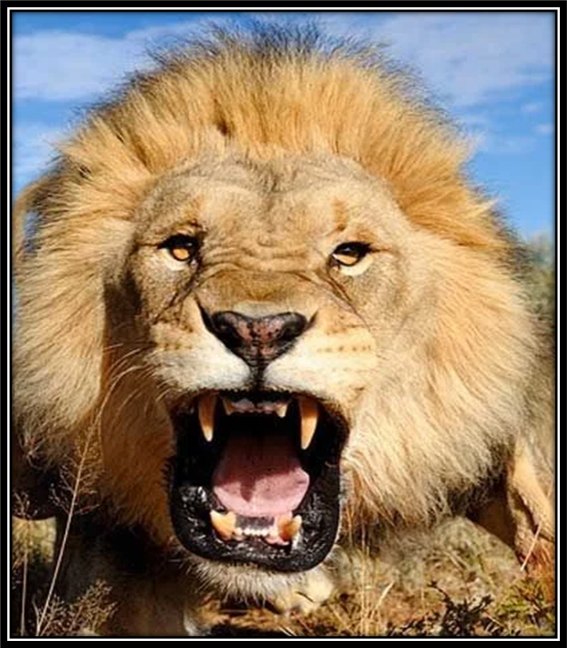
= Please stand if able
= Please be seated
Prelude - Roxanne Groff
Office of the Acolyte
Ringing of the Bell
Welcome
Notes:
Image: Five Loaves by Caroline Coolidge Brown. Copyright © Caroline Coolidge Brown. All rights reserved. Used by permission of the artist.

Slide 4
CONFESSION AND FORGIVENESS
All may make the sign of the cross, the sign marked at baptism…
L: We confess our sins before God and one another.
Pause for silence and reflection.
L: Saving God…
Notes:
Image: Five Loaves by Caroline Coolidge Brown. Copyright © Caroline Coolidge Brown. All rights reserved. Used by permission of the artist.

Slide 5
CONFESSION AND FORGIVENESS
C: Too often we have turned away from you and toward ourselves. We have not had unity of spirit, sympathy, love for one another, a tender heart, or a humble mind. We have repaid evil for evil. We have failed to serve. Draw us back into the joy of your beloved community, and give us eager hearts to love our neighbors.
Notes:
Image: Five Loaves by Caroline Coolidge Brown. Copyright © Caroline Coolidge Brown. All rights reserved. Used by permission of the artist.

Slide 6
CONFESSION AND FORGIVENESS
L: God who redeems all flesh gives you new life in Christ and forgives you all your sins. Rejoice in the grace and mercy of God, through Jesus Christ, our savior.
C: Amen.
Notes:
Image: Five Loaves by Caroline Coolidge Brown. Copyright © Caroline Coolidge Brown. All rights reserved. Used by permission of the artist.

Slide 7
Hymn of Praise
“Now Thank We All Our God”
LBW 533
Notes:
Image: Five Loaves by Caroline Coolidge Brown. Copyright © Caroline Coolidge Brown. All rights reserved. Used by permission of the artist.

Slide 8
Now Thank We All Our God LBW 533
1 Now thank we all our God
with hearts and hands and voices,
who wondrous things has done,
in whom his world rejoices;
who, from our mothers’ arms,
has blest us on our way
with countless gifts of love,
and still is ours today.
Notes:
Image: Preparing yeast dough. Copyright © tomasworks/iStock/Thinkstock. Used by permission.

Slide 9
Now Thank We All Our God LBW 533
2 Oh, may this bounteous God
through all our life be near us,
with ever joyful hearts
and blessed peace to cheer us,
and keep us in his grace,
and guide us when perplexed,
and free us from all harm
in this world and the next.
Notes:
Image: Preparing yeast dough. Copyright © tomasworks/iStock/Thinkstock. Used by permission.

Slide 10
Now Thank We All Our God LBW 533
3 All praise and thanks to God
the Father now be given,
the Son, and him who reigns
with them in highest heaven,
the one eternal God,
whom earth and heav’n adore;
for thus it was, is now,
and shall be evermore.
Notes:
Image: Preparing yeast dough. Copyright © tomasworks/iStock/Thinkstock. Used by permission.

Slide 11
APOSTOLIC GREETING
P: The grace of our Lord Jesus Christ, the love of God, and the communion of the Holy Spirit be with you all.
C: And also with you.
Notes:
Image: Five Loaves by Caroline Coolidge Brown. Copyright © Caroline Coolidge Brown. All rights reserved. Used by permission of the artist.

Slide 12
KYRIE
A: In peace let us pray to the Lord.
C: Lord have mercy.
A: For the peace from above, and for our salvation, let us pray to the Lord.
C: Lord have mercy.
A: For the peace of the whole world, for the well being of the Church of God, and for the unity of all, let us pray to the Lord.
C: Lord have mercy.
Notes:
Image: Five Loaves by Caroline Coolidge Brown. Copyright © Caroline Coolidge Brown. All rights reserved. Used by permission of the artist.

Slide 13
KYRIE
A: For this Holy House, and for all who offer here their worship and praise, let us pray to the Lord.
C: Lord have mercy.
A: Help, save, and defend us, gracious Lord.
C: Amen.
Notes:
Image: Five Loaves by Caroline Coolidge Brown. Copyright © Caroline Coolidge Brown. All rights reserved. Used by permission of the artist.

Slide 14
PRAYER OF THE DAY
P: Let us pray… God of all grace, you call us to your eternal glory in Christ. Restore us, support us, and strengthen us, so that we might bear witness to your salvation, for the sake of your son, Jesus Christ.
C: Amen.
Notes:
Image: Five Loaves by Caroline Coolidge Brown. Copyright © Caroline Coolidge Brown. All rights reserved. Used by permission of the artist.

Slide 15
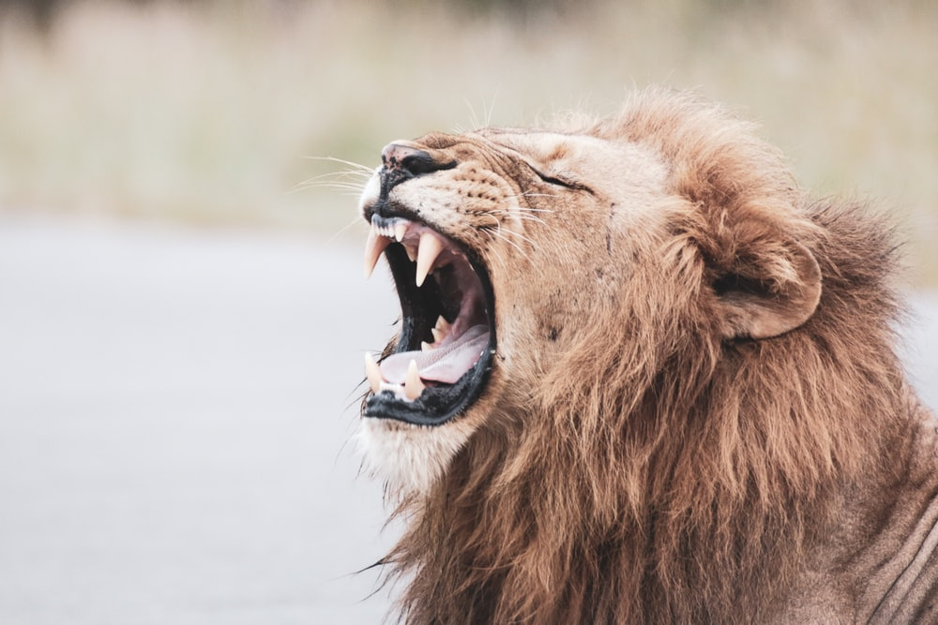
Notes:
Image: Preparing yeast dough. Copyright © tomasworks/iStock/Thinkstock. Used by permission.

Slide 16
Scripture Reading
R: The Scripture reading is from the Book of First Peter, Chapter 5.
C: Glory to you O’ Lord! (Spoken)
Notes:
Image: Five Loaves by Caroline Coolidge Brown. Copyright © Caroline Coolidge Brown. All rights reserved. Used by permission of the artist.

Slide 17
1 Peter 5
Now as an elder myself and a witness of the sufferings of Christ, as well as one who shares in the glory to be revealed, I exhort the elders among you ²to tend the flock of God that is in your charge, exercising the oversight, not under compulsion but willingly, as God would have you do it—not for sordid gain but eagerly. ³Do not lord it over those in your charge, but be examples
Notes:
Image: Five Loaves by Caroline Coolidge Brown. Copyright © Caroline Coolidge Brown. All rights reserved. Used by permission of the artist.

Slide 18
1 Peter 5
to the flock. ⁴And when the chief shepherd appears, you will win the crown of glory that never fades away.
⁵In the same way, you who are younger must accept the authority of the elders. And all of you must clothe yourselves with humility in your dealings with one another, for “God opposes the proud, but gives grace to the humble.” ⁶Humble yourselves therefore under
Notes:
Image: Five Loaves by Caroline Coolidge Brown. Copyright © Caroline Coolidge Brown. All rights reserved. Used by permission of the artist.

Slide 19
1 Peter 5
the mighty hand of God, so that he may exalt you in due time. ⁷Cast all your anxiety on him, because he cares for you.
⁸Discipline yourselves, keep alert. Like a roaring lion your adversary the devil prowls around, looking for someone to devour. ⁹Resist him, steadfast in your faith, for you know that your brothers and sisters in all the world are
Notes:
Image: Five Loaves by Caroline Coolidge Brown. Copyright © Caroline Coolidge Brown. All rights reserved. Used by permission of the artist.

Slide 20
1 Peter 5
undergoing the same kinds of suffering.
¹⁰And after you have suffered for a little while, the God of all grace, who has called you to his eternal glory in Christ, will himself restore, support, strengthen, and establish you. ¹¹To him be the power forever and ever. Amen.
Notes:
Image: Five Loaves by Caroline Coolidge Brown. Copyright © Caroline Coolidge Brown. All rights reserved. Used by permission of the artist.

Slide 21
1 Peter 5
¹²Through Silvanus, whom I consider a faithful brother, I have written this short letter to encourage you and to testify that this is the true grace of God. Stand fast in it. ¹³Your sister church in Babylon, chosen together with you, sends you greetings; and so does my son Mark. ¹⁴Greet one another with a kiss of love. Peace to all of you who are in Christ.
Notes:
Image: Five Loaves by Caroline Coolidge Brown. Copyright © Caroline Coolidge Brown. All rights reserved. Used by permission of the artist.

Slide 22
1 Peter 5
P: This is the Word of the Lord.
C: Praise to You, O Christ (Spoken)
Notes:
Image: Five Loaves by Caroline Coolidge Brown. Copyright © Caroline Coolidge Brown. All rights reserved. Used by permission of the artist.

Slide 23
Sermon
Notes:
Image: Five Loaves by Caroline Coolidge Brown. Copyright © Caroline Coolidge Brown. All rights reserved. Used by permission of the artist.

Slide 24
Sermon
Notes:
Image: Five Loaves by Caroline Coolidge Brown. Copyright © Caroline Coolidge Brown. All rights reserved. Used by permission of the artist.

Slide 25
Peter’s Advice
On
How To Not Become
Lion Dessert
Humble Yourselves
Exercise Self-Control
God’s Grace
Notes:
Image: Five Loaves by Caroline Coolidge Brown. Copyright © Caroline Coolidge Brown. All rights reserved. Used by permission of the artist.

Slide 26
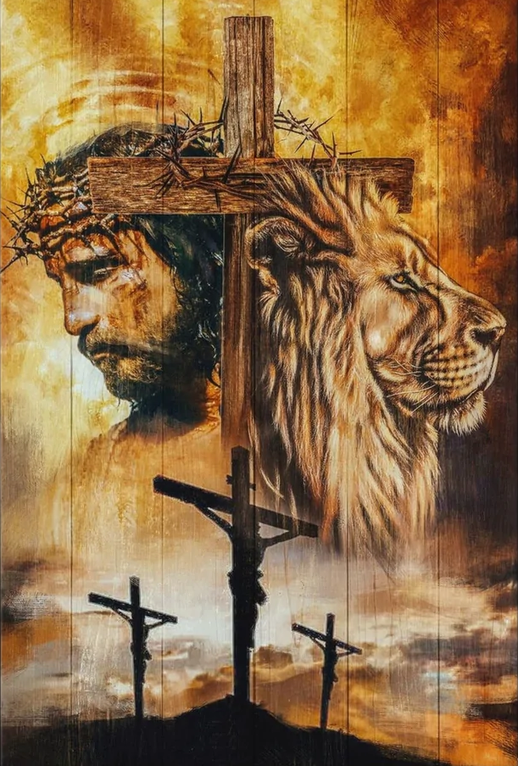
Sermon
Notes:
Image: Five Loaves by Caroline Coolidge Brown. Copyright © Caroline Coolidge Brown. All rights reserved. Used by permission of the artist.

Slide 27
APOSTLE’S CREED
C: I believe in God, the Father almighty, creator of heaven and earth.

Slide 28
APOSTLE’S CREED
C: I believe in Jesus Christ, his only Son, our Lord. He was conceived by the power of the Holy Spirit and born of the virgin Mary. He suffered under Pontius Pilate, was crucified, died, and was buried.

Slide 29
APOSTLE’S CREED
C: He descended into hell. On the third day he rose again. He ascended into heaven, and is seated at the right hand of the Father. He will come again to judge the living and the dead.

Slide 30
APOSTLE’S CREED
C: I believe in the Holy Spirit, the holy catholic Church, the communion of saints, the forgiveness of sins, the resurrection of the body, and the life everlasting. Amen.

Slide 31
NICENE CREED
C: We believe in one God, the Father, the Almighty, maker of heaven and earth, of all that is, seen and unseen.

Slide 32
NICENE CREED
C: We believe in one Lord, Jesus Christ, the only Son of God, eternally begotten of the Father, God from God, Light from Light, true God from true God, begotten, not made, of one Being with the Father.

Slide 33
NICENE CREED
C: Through him all things were made. For us and for our salvation he came down from heaven; by the power of the Holy Spirit he became incarnate from the virgin Mary, and was made man. For our sake he was crucified under Pontius Pilate;

Slide 34
NICENE CREED
C: he suffered death and was buried. On the third day he rose again in accordance with the Scriptures; he ascended into heaven and is seated at the right hand of the Father. He will come again in glory to judge the living and the dead, and his kingdom will have no end.

Slide 35
NICENE CREED
C: We believe in the Holy Spirit, the Lord, the giver of life, who proceeds from the Father and the Son. With the Father and the Son he is worshiped and glorified. He has spoken through the prophets. We believe in one holy catholic and apostolic Church.

Slide 36
NICENE CREED
C: We acknowledge one Baptism for the forgiveness of sins. We look for the resurrection of the dead, and the life of the world to come. Amen.

Slide 37
PRAYERS OF INTERCESSION
Each petition will end with the words,
A: Faithful God,
The congregation will respond with:
C: You hear our prayer.

Slide 38
PRAYERS OF INTERCESSION
The prayer concludes…
P: Holy God we place all for whom we pray into your loving care, trusting in the promise of your salvation.
C: Amen.

Slide 39
Offering Prayer
Notes:
Image: Five Loaves by Caroline Coolidge Brown. Copyright © Caroline Coolidge Brown. All rights reserved. Used by permission of the artist.

Slide 40
THE GREAT THANKSGIVING
Communion by pre-packaged Communion Cups. All the Baptized are welcome to celebrate this Holy Meal.

Slide 41
DIALOGUE
P: The Lord be with you.
C: And also with you.
P: Lift up your hearts.
C: We lift them to the Lord.
P: Let us give thanks to the Lord our God.
C: It is right to give him thanks and praise.

Slide 42
Preface
P: It is indeed right…
…join their unending hymn

Slide 43
Sanctus
C: Holy, holy, holy Lord, God of power and might: Heaven and earth are full of your glory. Hosanna. Hosanna. Hosanna in the highest. Blessed is he who comes in the name of the Lord. Hosanna in the highest.

Slide 44
Eucharistic Prayer
P: Holy God, our Maker, Redeemer, and Healer…
…in your holy Church, both now and forever.
C: Amen

Slide 45
THE LORD’S PRAYER
C: Our Father, who art in heaven, hallowed be thy name, thy kingdom come, thy will be done, on earth as it is in heaven. Give us this day our daily bread; and forgive us our trespasses, as we forgive those who trespass against us; and lead us not into temptation, but deliver us from evil.

Slide 46
THE LORD’S PRAYER
C: For thine is the kingdom, and the power, and the glory, forever and ever. Amen.

Slide 47
INVITATION TO COMMUNION
P: Young or old, we are all yet little children, fed and nurtured by our heavenly Mother/Father. Come to this holy table, set for you, and eat together in love.

Slide 48
POST COMMUNION BLESSING
P: May this Body and Blood of our Lord and Savior, Jesus Christ, strengthen, keep, and unite us, now and forever.
C: Amen.

Slide 49
POST COMMUNION PRAYER
P: Let us pray… Life-giving God, through this meal you have bandaged our wounds and fed us with your mercy. Now send us forth to live for others, both friend and stranger, that all may come to know your love. This we pray in the name of Jesus.
C: Amen

Slide 50
Announcements
Notes:
Image: Five Loaves by Caroline Coolidge Brown. Copyright © Caroline Coolidge Brown. All rights reserved. Used by permission of the artist.

Slide 51
SENDING BLESSING
P: The God of peace, Father, ☩ Son, and Holy Spirit, bless you, comfort you, and show you the path of life this day and always.
C: Amen.

Slide 52
Sending Song
“Oh, For A Thousand Tongues to Sing”
LBW 559
Notes:
Image: Five Loaves by Caroline Coolidge Brown. Copyright © Caroline Coolidge Brown. All rights reserved. Used by permission of the artist.

Slide 53
O For A Thousand Tongues To Sing–LBW 559
1 Oh, for a thousand tongues to sing
my great Redeemer’s praise,
the glories of my God and King,
the triumphs of his grace!
2 My gracious Master and my God,
assist me to proclaim,
to spread through all the earth abroad
the honors of your name.
Notes:
Image: Five Loaves by Caroline Coolidge Brown. Copyright © Caroline Coolidge Brown. All rights reserved. Used by permission of the artist.

Slide 54
O For A Thousand Tongues To Sing–LBW 559
3 The name of Jesus charms our fears
and bids our sorrows cease,
sings music in the sinner’s ears,
brings life and health and peace.
4 He breaks the pow’r of canceled sin;
he sets the pris’ner free.
His blood can make the foulest clean;
his blood avails for me.
Notes:
Image: Five Loaves by Caroline Coolidge Brown. Copyright © Caroline Coolidge Brown. All rights reserved. Used by permission of the artist.

Slide 55
O For A Thousand Tongues To Sing–LBW 559
5 To God all glory, praise, and love
be now and ever giv’n
by saints below and saints above,
the church in earth and heav’n.
Notes:
Image: Five Loaves by Caroline Coolidge Brown. Copyright © Caroline Coolidge Brown. All rights reserved. Used by permission of the artist.

Slide 56
DISMISSAL
P: … depart in Christ’s Love.
C: Seeking, welcoming, and serving all. Amen!
POSTLUDE
By
Roxanne Groff
From sundaysandseasons.com. Copyright © 2022 Augsburg Fortress. All rights reserved. Reprinted by permission under Augsburg Fortress Liturgies Annual License #SAS023830. New Revised Standard Version Bible, Copyright © 1989, Division of Christian Education of the National Council of the Churches of Christ in the United States of America. Used by permission. All rights reserved. Revised Common Lectionary, Copyright © 1992 Consultation on Common Texts, admin Augsburg Fortress. Used by permission.

