Slide 1
L32 Conversion of amino acids to specialized products. Porphyrins and bile pigments

Slide 2
Amino acids are precursors for biosynthesis of
many physiologically active compounds
Synthesis of HEME
Synthesis of physiologically active AMINES
The key reaction is decarboxylation: release of CO₂
Enzyme: decarboxylase
cofactor: pyridoxal phosphate (PLP)

Slide 3
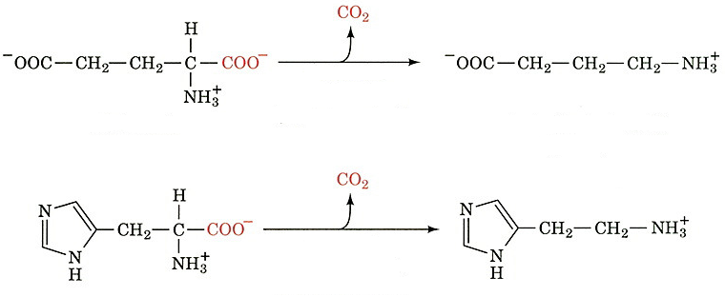
GABA is one of the main brain inhibitory neurotransmitters
CO₂
glutamate decarboxylase
(PLP dependent)
GABA
glutamate
CO₂
histidine decarboxylase
(PLP dependent)
histidine
histamine
HISTAMINE participates in allergic reactions and controls a gastric acid secretion

Slide 4
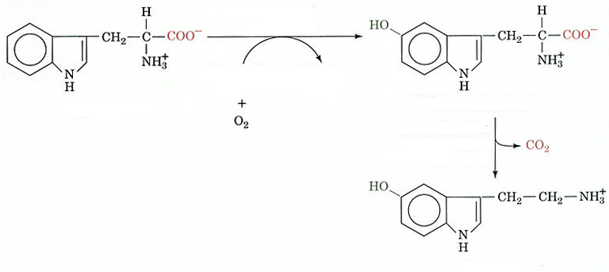
SEROTONIN causes a contraction
of smooth muscles
tryptophan hydroxylase
tetrahydrobiopterin
dihydrobiopterin
5-hydroxytryptophan
tryptophan
CO₂
decarboxylase
(PLP dependent)
serotonin

Slide 5
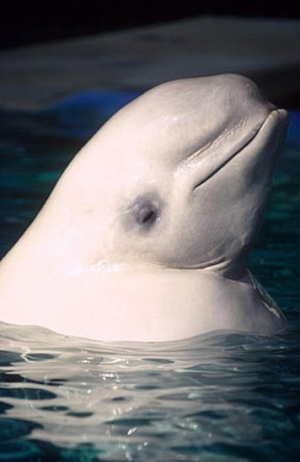
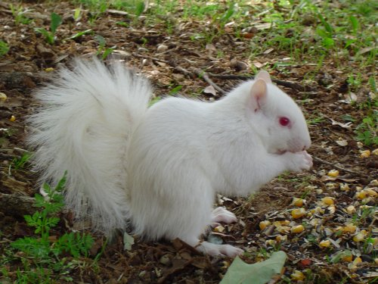
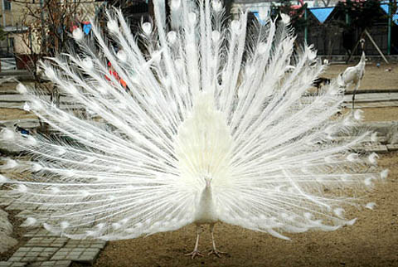
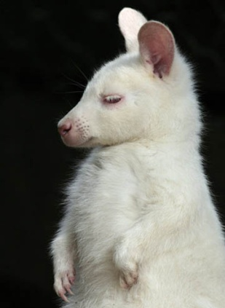
Albinism is a result of TYROSINE
metabolism disorder
O₂ H₂O
tyrosinase
tyrosine
DOPA
tyrosinase
O₂
H₂O
melanin
dopaquinone

Slide 6
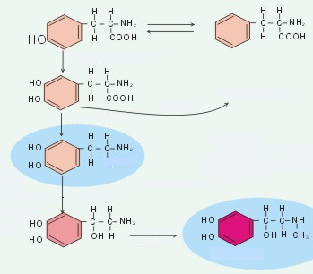
Tyrosine is a precursor for the synthesis of
catecholamine dopamine,
noradrenaline and adrenaline
tyrosine
phenylalanine
tyrosine hydroxylase
catechol
L-DOPA
melanin
CO₂
Parkinson’s disease:
lack of dopamine
H
dopamine
noradrenaline
adrenaline
Hormone:
stimulates a glycogen breakdown

Slide 7
HEME
circular tetrapyrrole
four pyrrole rings interconnected via methine bridges (=CH-).
Planar system of conjugated double bonds absorbs a visible light and is responsible for a dark red heme color

Slide 8
HEME
M
V
Substituents are
methyl (M)
vinyl (V)
propionic acid (P)
M
M
V
P
M
P

Slide 9
HEME
The most common porphyrin in human organism
In the complex with the proteins produces hemoglobin, myoglobin and cytochrome, including cytochrome P450

Slide 10
In mitochondria:
α
ALA-synthase
ALA-synthase
succinyl-CoA
(“active succinate”)
pyridoxal-phosphate
glycine
α-amino-β-ketoadipate
δ-aminolevulinate (ALA)

Slide 11
In CYTOSOL:
two molecules of ALA are condensed
with ALA dehydratase (contains Zn, inhibited by Pb)
forming porphobilinogen (PBG)
ALA-dehydratase
two molecules of
δ-aminolevulinate
porphobilinogen
(first precursor of porphyrin)

Slide 12
four molecules of porphobilinogen
uroporphyrinogen-I-synthase
(PBG-deaminase or HMB-synthase)
(PBG-deaminaza ili HMB-sintaza)
hydroxymethylbilane or HMB
(linear tetrapyrrole)
ili HMB

Slide 13
HMB spontaneously cyclizes forming
uroporphyrinogen I
or is converted to uroporphyrinogen III
with the uroporphyrinogen III synthase
Under normal conditions a resulting uroporphyrinogen is almost exclusively the isomer type III but, in some of porphyria, more of porphyrinogen type I isomer is formed.
hydroxymethylbilane or HMB
(linear tetrapyrrole)
spontaneous cyclization
uroporphyrinogen-III-synthase
type I uropophyrinogen
type III uropophyrinogen

Slide 14
uroporphyrinogen pyrrole rings are connected with methylene bridges (-CH₂-), which do not form a conjugated ring system
therefore, these compounds are colorless
porphyrinogens rapidly auto-oxidize to the colored porphyrins
catalysis by light and by produced porphyrins
type III uropophyrinogen

Slide 15
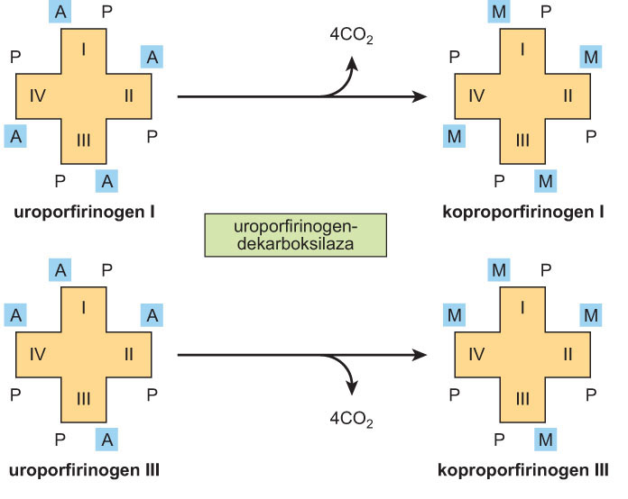
The reaction is catalyzed by uroporphyrinogen-decarboxylase, which can translate uroporphyrinogen I to coproporphyrinogen I as well
Uroporphyrinogen III is converted to coproporphyrinogen III by decarboxylation of all acetate (A) groups to form methyl (M) substituents.
uropophyrinogen I
uroporphyrinogen-decarboxylase
coproporphyrinogen I
uropophyrinogen III
coproporphyrinogen III

Slide 16
porphobilinogen
uroporphyrinogen-I-synthase
hydroxymethylbilane
spontaneously
uropophyrinogen I
uropophyrin I
light
uroporphyrinogen-decarboxylase
coproporphyrinogen I
coproporphyrin I
light

Slide 17
coproporphyrinogen III
5. uroporphyrinogen-decarboxylase
uroporphyrinogen III
4. uroporphyrinogen-III-synthase
hydroxymethylbilane
in cytosol
3. uroporphyrinogen-I-synthase
porphobilinogen
2. ALA-
dehydratase
1. ALA-
synthase
mitochondria
succinyl-CoA + glycine

Slide 18
in mitochondria
coproporphyrinogen-oxydase
protporphyrinogen III
protoporphyrinogen-oxydase
or light in vitro
protporphyrin III
ferrochelatase
HEME

Slide 19
The biosynthesis of heme occurs in most mammalian cells
with the exception of mature erythrocytes which do not contain mitochondria
However, approximately 85% of heme synthesis takes place in the erythroid precursor cells of bone marrow
and most of the remaining synthesis in the hepatocytes

Slide 20
ALA-synthase is a key regulatory enzyme in the biosynthesis of heme in the liver
ALA-synthase
ALA-synthase
succinyl-CoA
(“active succinate”)
pyridoxal-phosphate
glycine
α-amino-β-ketoadipate
δ-aminolevulinate (ALA)
Heme, probably acting through some apopressor molecules, negatively regulates the synthesis of mRNAs for ALA-synthase
Heme also affects
translation of the enzyme
transfer from the cytosol to the mitochondria

Slide 21
Many drugs can cause increased activity of ALA synthase
Most drugs are metabolized in the liver system using hemoprotein, cytochrome P450
During the drugs metabolism of drugs the consumption of heme is increased by cytochrome P450

Slide 22
Porphyrins are precursors of bile colors (bilirubin, etc.)
Cholesterol is a precursor of bile salts

Slide 23
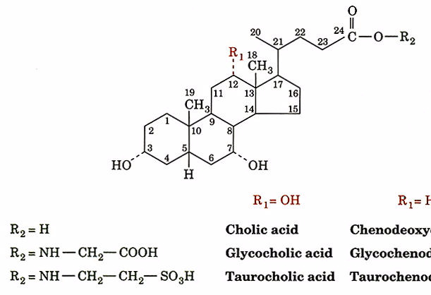
Bile acids (salts)
COO⁻
R₁ = OH
Bile salts
help solubilize lipids from the food
help the hydrolysis of lipids in the gastrointestinal tract
facilitate the resorption of the products of lipolysis
cholic acid
glycocholic acid
taurocholic acid
The main bile acid is glycocholic
23

Slide 24
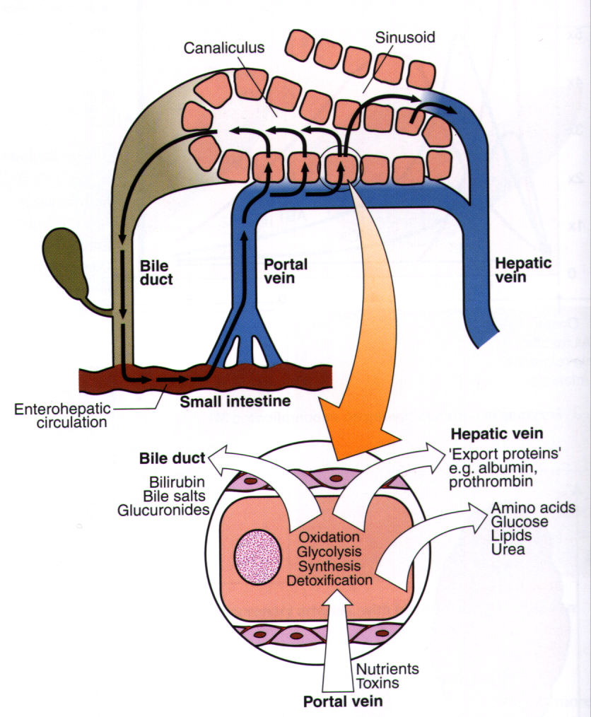
Liver functions

Slide 25
Heme catabolism produces BILIRUBIN
an adult weighing 70 kg processes about 6 g of hemoglobin / day
Hemoglobin is degraded:
globin is disintegrated to its constituent amino acids, which will be reused,
heme iron enters the pool of iron, also for reuse
Proportion of heme porphyrin containing no iron is also broken down, mainly in the RE cells of the liver, spleen and bone marrow

Slide 26
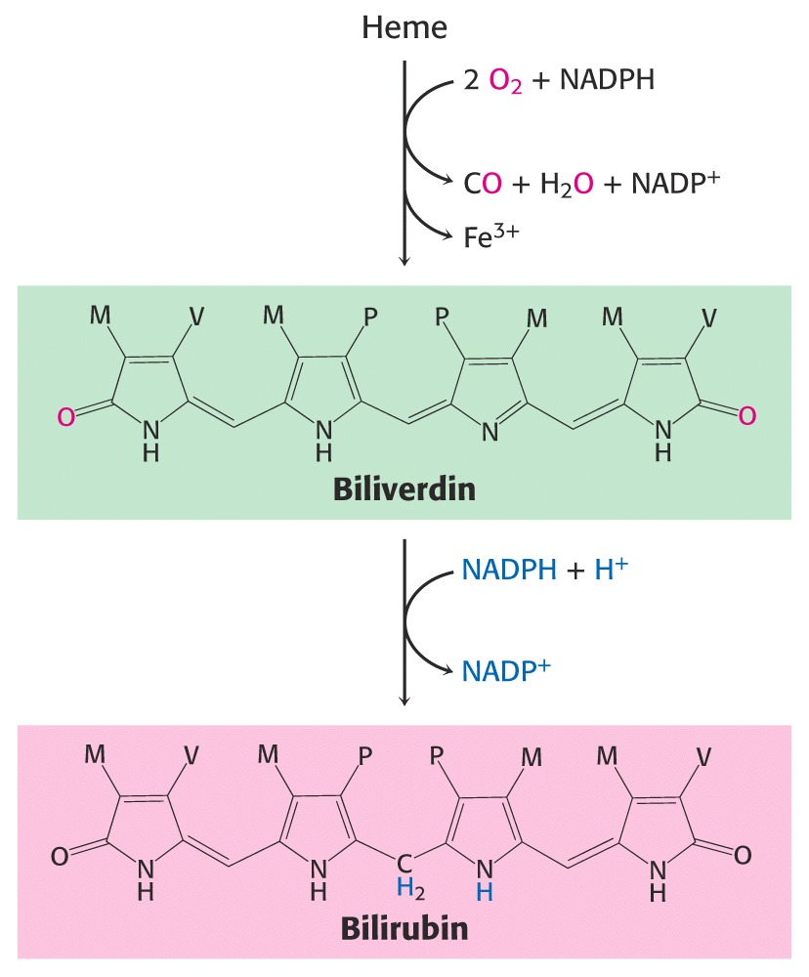
Heme catabolism
HEME OXYGENASE
Linearni
tetrapirol
BILIVERDIN REDUCTASE
weakly soluble in water
Unconjugated

Slide 27
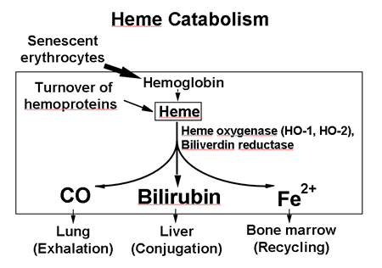

Slide 28
BILIRUBIN creating
Normal (decomposition of old erythrocytes)
Pathological degradation (intra-or extra-vascular hemolysis)
Portion of myoglobin and cytochrome P450 (20%)

Slide 29
BILIRUBIN
In the liver, bilirubin reacts with UDP glucuronate, creates monoglucuronide, and diglucuronide (more soluble in water)
In the intestines, bacteria deconjugate bilirubin diglucuronide and convert it into urobilinogen.
Part of urobilinogen is reabsorbed into the blood and excreted in the urine.
Most of the urobilinogen is oxidized to urobilin and stercobilinogen in stercobilin and excreted in the feces (color!)

Slide 30
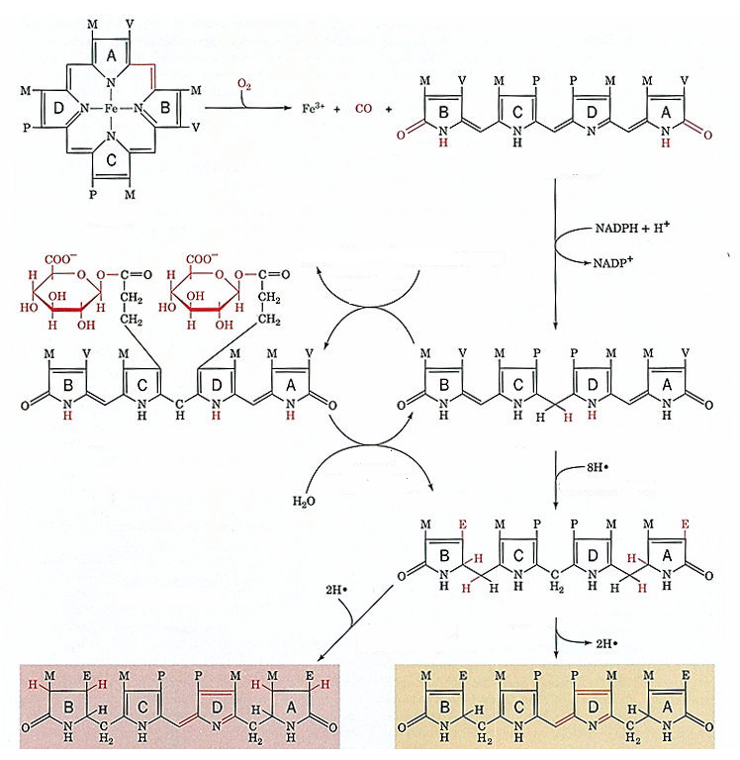
HEME OXYGENASE
BILIVERDIN
HEME
CONJUGATED BILIRUBIN- DIGLUCURONIDE
UNCONJUGATED BILIRUBIN

Slide 31
urobilinogen
stercobilinogen
urobilin

Slide 32
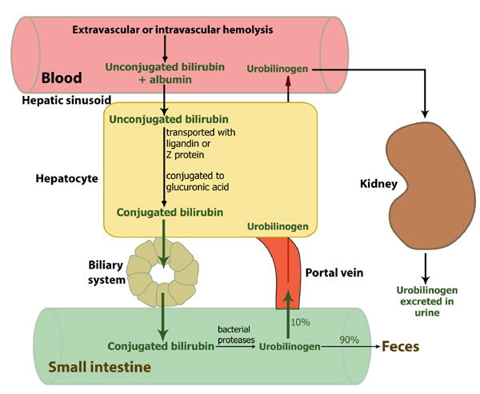

Slide 33
