Slide 1
Viral hepatitis
Nenad Pandak

Slide 2
Viral hepatitis
Common disease
Hepatocyte lesion and/or necrosis
Acute hepatitis syndrome
Chronic hepatitis syndrome

Slide 3
Viral hepatitis
Most common viral causes
Hepatitis A virus – HAV
Hepatitis B virus – HBV
Hepatitis C virus – HCV
Hepatitis D virus – HDV
Hepatitis E virus – HEV

Slide 4
Viral hepatitis
Less common viral causes
Hepatitis G virus – HGV
Transfusion transmitted virus – TTV
EBV, CMV, HSV, VZV, Parotitis virus, Adenovirus, Enterovirus, Rubella virus…

Slide 5
Acute hepatitis
Preicteric stage
Malaise
Sense of “not feeling well”
Fatigue and generalized weakness
Anorexia, nausea, vomiting
Dull upper right quadrant pain
Flu-like illness
Myalgia, headache, chills, fever

Slide 6
Acute hepatitis
Less common symptoms
Serum sickness syndrome
Immune complex deposition
Fever, rash, arthralgia and/or arthritis
Preicteric stage
Lasting 3-10 days
Resolves with the onset of jaundice

Slide 7
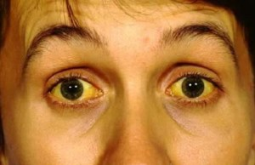
Acute hepatitis
Icteric stage
20-50% patients
Jaundice
Dark urine
Scleral icterus
Pale-colored stools
Immune complex deposition (B, C)
Vasculitis, glomerulonephritis

Slide 8
Acute hepatitis
Convalescent stage
Slow recovery
Depending on
Severity of the disease
Viral etiology

Slide 9
Acute hepatitis
Icterus
Hepatic enlargement
Tenderness
Splenomegaly

Slide 10
Acute hepatitis
Laboratory findings
Aspartat aminotrasnferase AST
Alanin amintransferase ALT
AST/ALT ratio <1
AP, LDH mildly elevated
Bilirubin
Prothrombin time PT
Siginificant elevation – bad prognostic sign

Slide 11
Acute hepatitis
Fulminant hepatitis
Acute liver necrosis
Encephalopathy
Coagulopathy
Mortality >70%

Slide 12
Chronic hepatitis
Inflammation and hepatocyte necrosis lasting >6 months
No general infection signs and symptoms
Discovered by accident
Chronic persistent hepatitis
Mild form
Chronic active hepatitis
Agressive form

Slide 13
Chronic persistent hepatitis
Mild, nonprogressive, slowly progressive
Limited liver damage
Rarely fatigue, nausea, inappetence
Moderately elevated AST, ALT
Possible progression to chronic active hepatitis

Slide 14
Chronic active hepatitis
Significant liver injury
Occasional or permanent fatigue
Periodic marked AST, ALT elevation
Possible icterus
Progression to cirrhosis

Slide 15
Viral hepatitis
 | A | B | C | D | E
Source of virus | Stool | Blood / blood products Body fluids | Blood / blood products Body fluids | Blood / blood products Body fluids | Stool Zoonotic
Transmission | Fecal – oral route | Percutaneous Permucosal | Percutaneous Permucosal | Percutaneous Permucosal | Fecal – oral route
Chronic infection | NO | YES | YES | YES | NO/yes

Slide 16
Hepatitis A

Slide 17
HAV
Picornavirus
RNA virus
Highly resistant to drying or heating
Present in liver, bile, feces and blood
Inactivated by chlorine

Slide 18
Epidemiology
Fecal – oral transmission
Direct contact
Hydric epidemics
Lower synitary standards

Slide 20
Pathogenesis
Enters gastrointestinal tract
Replication in oropharingeal and intestinal epithelial cells
Viremia
Hepatocyte infection and replication
Viremia
Excretion of virus into the bile
Stool shedding

Slide 21
Clinical presentation
Incubation period 4 weeks (15-45 days)
Preicteric stage
Abrupt onset
Fever, malaise, fatigue, nausea, vomiting, inappetence
Respiratory symptoms occasionally
Children diarrhea

Slide 22
Clinical presentation
Icteric stage
25% adults anicteric
90% children anicteric
Less vigorous immune reaction
Gradual improvement
Duration of illness 4-8 weeks

Slide 23
Complications
Relapsing course 10%
Prolonged (benign) cholestasis
Fulminant hepatitis

Slide 24
Diagnosis
Serology
Detection of virus in stools
PCR
EM

Slide 25
Diagnosis

Slide 26
Therapy
Moderate physical activity
“healthy” food
Avoid alcohol
Fulminant hepatitis
ICU admission
Liver transplantation

Slide 27
Hepatitis B

Slide 28
HBV
Hepadnavirus
DNA virus
Outer surface protein: HBsAg
Core protein: HBcAg
Secreted core antigen: HBeAg

Slide 29
Diagnostics
HBsAg - anti-HBs
HBcAg - anti-HBc: IgM i IgG
HBeAg - anti-HBe
PCR HBV DNA

Slide 30
HBV
Very resistant
Survives in serum at 4°C – months
Frozen (– 20°C) – years
2 min at 98°C kills the virus
Detergents
HBV DNA may integrate into host cell DNA during CHB
Increased incidence of hepatocellular carcinoma

Slide 31
HBV infections
Acute B hepatitis
Chronic B hepatitis
90% neonates
20-50% children
<5% adults
Cirrhosis
Hepatocellular carcinoma

Slide 32
Epidemiology
350.000.000 people infected worldwide
1.000.000 deaths annually worldwide
Fulminant hepatitis, cirrhosis, carcinoma
75% hepatocellular carcinoma – HBV
5-10% liver transplantations due to HBV infection

Slide 33
Epidemiology
Blood, urine, bile, saliva, semen, breast milk, vaginal secretions
Transmission
Sexual contact
Parenteral
Blood and contaminated objects
IDU, healthcare workers
Perinatal
During the labor
Horizontally

Slide 35
Clinical presentation
Incubation period 30-180 days
Not always self-limiting disease
Symptoms resolve over 1-3 months
Amonotransferase values return to normal over 1-4 months

Slide 36
Clinical presentation
Virus remains in the liver for decades
AST, ALT elevation >6 months
Indication of progression to chronic disease

Slide 37
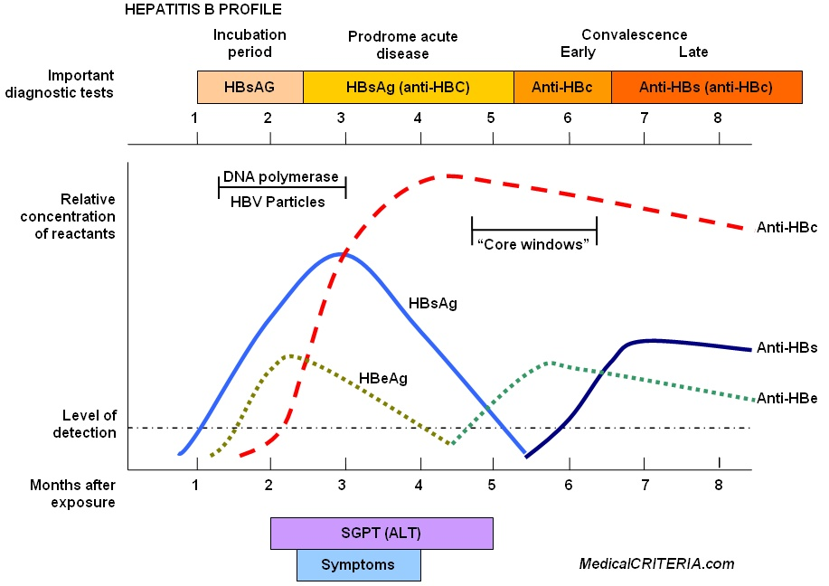
Diagnosis

Slide 38
Diagnosis of CHB

Slide 39
Diagnosis

Slide 40
Complications
Fulminant hepatitis
1/1.000 icteris cases
High mortality
Chronic hepatitis
Cirrhosis
Hepatocellular carcinoma

Slide 41
Treatment
Acute hepatitis
Supportive care
Severe cases
Lamivudin
Prevention
Vaccination
High-titer hepatitis B immunoglobulin

Slide 42
Treatment
Aim
Reducing the viral load
Improving liver tests
Lamivudin
Adefovir
Entecavir
Telbivudine
Tenofovir

Slide 43
Hepatitis D

Slide 44
HDV – delta agent
Single-stranded RNA virus
Lipoprotein envelope provided by HBV
Only in human host coinfected with HBV
Supresses HBV replication

Slide 45
Transmission
Parenteral
IDUs
Sexual contact

Slide 47
Clinical presentation
Coinfection
Indistinguishable from hepatitis B
Higher incidence of hepatic failure in IDUs
Superinfection
Higher risk of severe chronic hepatitis
Symptoms as if acute hepatitis

Slide 48
Prevention
Vaccination HBV
Avoiding unsafe activities

Slide 49
Hepatitis C

Slide 50
HCV
Flaviviridae family
RNA virus
6 genotypes (1-3)
3 subtypes (a-c)
India, SE Asia: 3, 6
Africa: 1, 2, 4
Europe, USA: 1, 2, 3a

Slide 51
Transmission
Parenteral
IDUs
Blood transfusion
Haemodialysis
Nosocomial
Sexual contact
Vertical mother – child

Slide 52
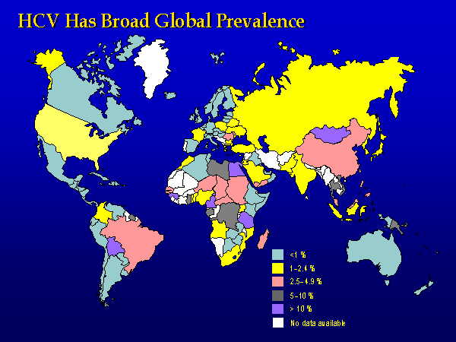

Slide 53
Clinical presentation
Incubation period 2-26 weeks
Average 6-10 weeks
Acute hepatitis 20-30% infected
Mild disease
Anicteric
Mostly unrecognised
Chronic infection 70-80%

Slide 54
CHC diagnosis

Slide 55
Treatment CHC
Seldom clears spontaneously
20-25% progress to cirrhosis (over 20-30 years)
Increased incidence of hepatocellular carcinoma

Slide 56
Treatment CHC
Initial therapy
Pegilated interferon α-2a + ribavirin
Duration
Genotype, viral load
Relapse, nonrespond, partial respond
Pegilated interferon α-2a + ribavirin + protease inhibitors

Slide 57
Treatment CHC
New protease inhibitors
Polymerase inhibitors
Interferon free therapy

Slide 58
Hepatitis E

Slide 59
HEV
Caliciviridae family
RNA virus
4 genotypes (1-4)
Genotype 1, 2
Epidemics
Low income countries
Genotype 3, 4
Sporadic cases
Developed countries

Slide 60
Epidemiology
Transmission
Fecal – oral
Hydric epidemics
Genotype 1 & 2
Possible zoonosis
Genotype 3

Slide 61
Clinical presentation
Incubation period 40 days (15-60)
Acute hepatitis
Mortality 1-3%
Pregnant women 3rd trimester
15-25%
Only genotype 1 & 2

Slide 62
Clinical presentation
Genotype 3 & 4
Acute hepatitis
Sporadic cases
Unrecognised
Immunocompromised persons
Chronic hepatitis

Slide 63
Diagnosis
Serology
HEV IgM
HEV IgG
Westernblot
PCR HEV RNA

Slide 64
Diagnosis

Slide 65
Treatment
Acute hepatitis
Supportive care
Chronic hepatitis
Reducing immunosupression
Ribavirin

