Slide 1
Young Authors
2020-2021
LET YOUR LIGHT SHINE

Slide 2
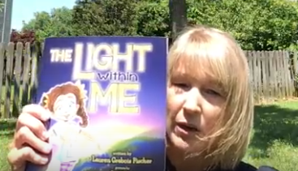
LET YOUR LIGHT SHINE
YA Read Aloud

Slide 4
Inspirational Interactive Activity
https://www.youtube.com/watch?v=8YuWAZmD0aU
Be A Light
Listen to the song Be a Light by Thomas Rhett. What does this song make you think of? What connections can you make?
Take 2 minutes to jot down words that come to your mind WHILE listening that could jumpstart your own writing submission for YA! Be ready to share!

Slide 5
Writing Perspectives and Springboards
Being yourself/self pride
Finding the positive during challenging times
Sharing your talents with others

Slide 6
Writing Perspectives and Springboards
Being a positive influence and inspiring others
Showing kindness, generosity and spreading joy
Creating change to better our world YA Writing Ideas

Slide 7
Writing Deadlines & Requirements
Your teacher will give you a deadline to submit your story, poem, or artwork. It has to be ontime so it can be submitted for judging. Every entry must have a hard copy and a digital copy turned in to your teacher.

