Slide 1
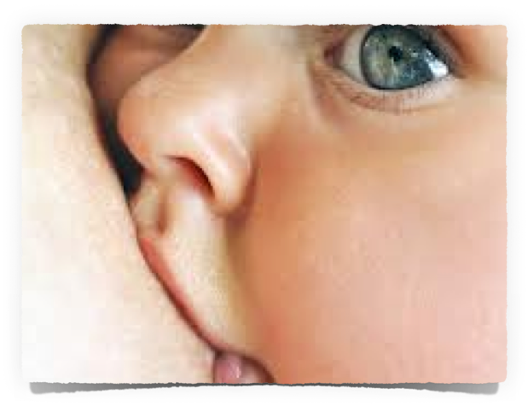
Bumps2babies
The School of Antenatal Educators

Slide 2
Communication
V
Verbal and Non-verbal

Slide 3
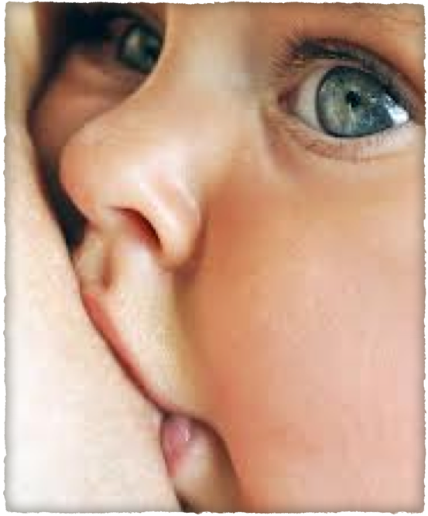

Slide 4
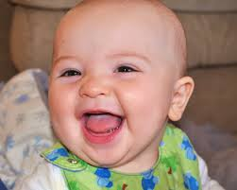
Communication
…. is a process of exchanging information, ideas, thoughts, feelings and emotions through speech, signals, writing, or behaviour
Notes:
How many of you use your hands when speaking? How many cry when relating an upsetting experience?

Slide 5
Understanding
In order to deliver the right message, you must put yourself on the other side of the table and think from your receiver’s point of view.
Would he understand the message?
How it would sound on the other side of the table?
...
Notes:
Put yourself in the other persons shoes – you can see a completely different perspective

Slide 6
Verbal Communication
is further divided into:
a) Oral Communication
b) Written Communication

Slide 7
Oral communication;
Spoken words are used. It includes face-to-face conversations, speech, telephone conversation, video, radio, television, email.
It is influenced by pitch, volume, speed and clarity of speaking.

Slide 8
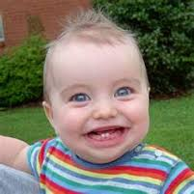
Advantages of Oral communication are:
It brings quick feedback. In a face-to-face conversation, by reading facial expression and body language one can guess whether he/she should trust what’s being said or not.
Notes:
You can instantly see a response from the person – and change your direction appropriately

Slide 9
Disadvantage of oral communication
In face-to-face discussion, user is unable to deeply think about what he is delivering.
Notes:
Many people struggle to take in verbal information when its new they need more to help it settle into the long term memory.

Slide 10
Written Communication is most common form of communication being used
Advantages of written communication :
Messages can be edited and revised many time before information is given – giving accuracy of information. Written communication provides a record and can be saved for later study. A written message enables receiver to fully understand
Notes:
Written and verbal communication emphasise the information helping the information to go from the short term memory to the long

Slide 11
Nonverbal communication is the sending or receiving of wordless messages. We can say that communication other than oral and written, such as
Gesture
body language
Posture
tone of voice
facial expressions
Notes:
Babys and children read into nonverbal messaging far more than most adults – special needs are different!

Slide 12
Nonverbal communication is all about the body language of speaker.

Slide 13
Scenarios
You are waiting for your ladies to arrive are you ..
* Sat at your desk writing
* Stood tall smiling as they arrive
Out of the room – I will enter when they are all there?
What does this tell your mums and dads?

Slide 14
You read your mums and dads profiles before they attend the antenatal class that morning one reads….
Midwife! How do you feel?
* Worried I may not have the knowledge to give them
* Wonder why they are coming to your class
Just get on with it –
What reasons could a midwife want with attending an antenatal class? ( discuss)

Slide 15
Your class has started and there is…
One lady starts giggling when you use the word vagina
Others in the group are looking embarrassed
How would you handle this?
Notes:
Do you think they are embarrassed because they feel the same or embarrassed for her? Or that she has emphasised the word And made it uncomfortable for them Too?

Slide 16
Conclusion
Our body language, verbal and non-verbal can give away so much information, not only about ourselves but also about how we feel.

Slide 17
Postnatal Depression
Question: A women attends our classes and seems very down.
Who’s responsibility to look out for
postnatal depression?
Notes:
What are the signs of Postnatal depression?

