Slide 1
Georgia Association of Veteran Certifying Officials (GAVCO) Annual Conference March 8 - 10, 2017 EDUCATION SERVICE UPDATE Jerome I. Marshall Chief, Education Liaison Officer (CELO) Education Service | South Region | Atlanta, GA
MyVA Veterans Experience Office Staff Training

Slide 2
Overview
Education Processing Jurisdictional Realignment
FY 2012-FY 2016 Trainees/Dollars Paid
Claims Processing Highlights
New Legislation
Contact Us

Slide 3
Jurisdictional Realignment
VA Secretary’s transformational myVA Iniative to enhance the Veterans experience
Reassigned 106 employees from Atlanta RPO (Education processing) to:
Veteran Service Center (disability Compensation & Pension benefits processing) {75}
VACO Education Service {25}
Including new Compliance & Liaison Training team
South Region Compliance & Liaison {6}
Transition made possible due to successes achieved through Education processing automation (LTS)

Slide 4
Jurisdictional Realignment
Atlanta RPO represented approximately 7% of national workload.
Education claims and enrollment certifications from former Atlanta RPO states redirected to Buffalo & Muskogee RPOs:
Buffalo – North Carolina & US Virgin Islands
Muskogee – Georgia & Puerto Rico

Slide 5
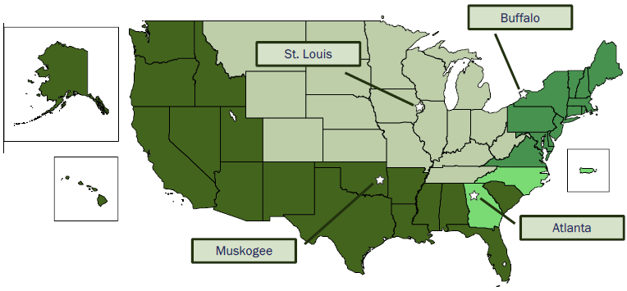
Jurisdictional Realignment
Before:

Slide 6
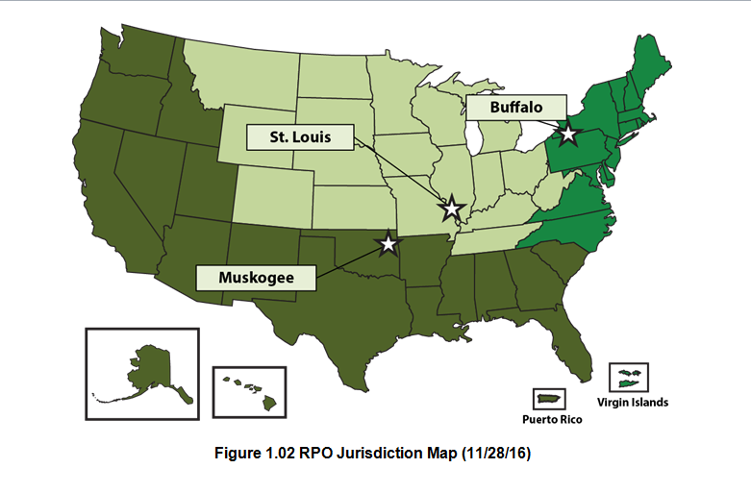
Jurisdictional Realignment
After:

Slide 7
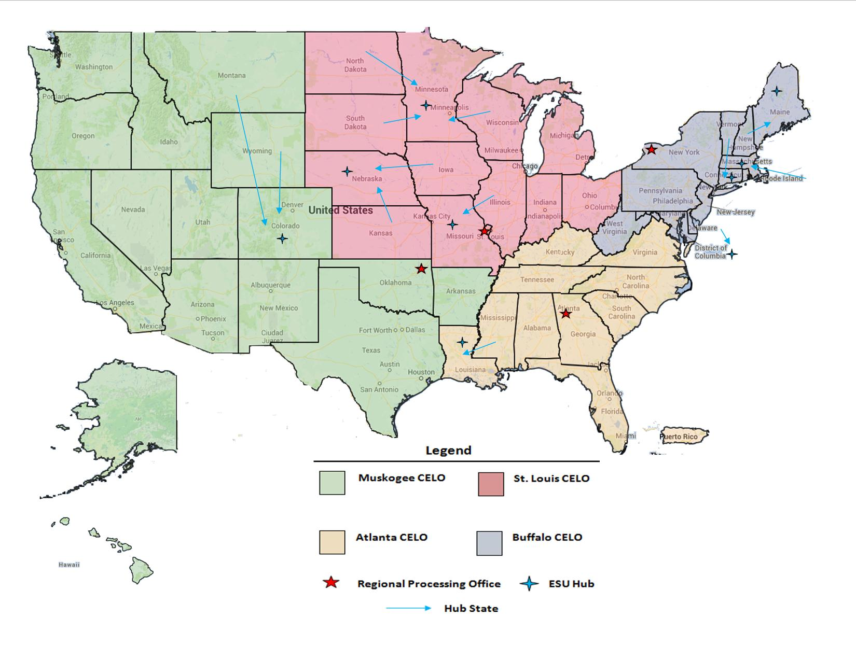
Compliance & Liaison Jurisdiction

Slide 8
FY 2012 – FY 2016 Trainees/Dollars Paid
Benefit | Education Programs | FY 12 Trainees/Dollars Paid | FY 13 Trainees/Dollars Paid | FY 14 Trainees/Dollars Paid | FY 15 Trainees/Dollars Paid | FY 16 Trainees/Dollars Paid
Chapter 30 | Montgomery GI Bill (MGIB)-AD | 118,549 / $932M | 99,755 / $775M | 77,389 / $512M | 61,403 / $442.2M | 47,307 / 365.1M
Chapter 32 | Veterans Educational Assistance Program (VEAP) | 76 / $682K | 29 / $496K | 8 / $359K | 4 / $35K | N/A
*Chapter 33 | Post-9/11 GI Bill | 646,302 / $8.5B | 754,229 / $10.2B | 790,408 / $10.8B | 790,507 / $11.2B | 790,090 / $11.6B
Chapter 35 | Survivors’ and Dependents’ Educational Assistance Program (DEA) | 87,707 / $455M | 89,160 / $483M | 90,789 / $514M | 91,755 / $493.2M | 96,762 / $520.5M
Chapter 1606 | Montgomery GI Bill Selected Reserve (MGIB-SR) | 60,393 / $157M | 62,656 / $156M | 63,745/ $150M | 63,030 / $141.1M | 61,388 / $139.3
Chapter 1607 | Reserve Educational Assistance Program (REAP) | 19,774 / $77M | 17, 297 / $70M | 13,784/ $56M | 9,965 / $40.5M | 4,538 / $20.7M
 | Veterans Retraining Assistance Program (VRAP) | 12,251 / $6.1M | 67,918 / $428M | 52,288 / $413M | N/A | N/A
Total |  | 945,052 / $10.1B | 1,091,044 / $12.1B | 1,088,411 / $12.4B | 1,016,664 / $12.3B | 1,000,085 / 12.9B
As of February 8, 2017, VA issued $72 billion in Post-9/11 GI Bill benefit payments to 1,725,063 individuals since program inception (August 2009).

Slide 9
Claims Processing Highlights
Claims Inventory | FY14 | FY15 | FY16 | FYTD 2017 thru 1ST Quarter
Claims Processed | 4.3M | 4.2M | 4.1M | 894K
Original Claims Timeliness (Average Days to Complete) | 16.7 | 18.4 | 16.7 | 18.1
Supplemental Claims Timeliness (Average Days to Complete) | 5.9 | 7.0 | 6.7 | 7.8
Payment Accuracy | 98.7% | 99.4% | 98.8% | 97.8% (4th Q FY16)
Claims Processed
 | Original | Supplemental
December 2016 | 22,132 | 294,091

Slide 10
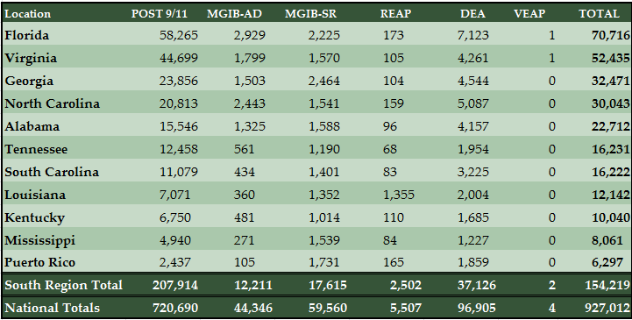
Beneficiaries who received education benefits during fiscal year 2016 by state (South Region)

Slide 11
New Legislation
PL 114-315
Veterans Health Care and Benefits Improvement Act of 2016
TITLE IV – EDUCATIONAL ASSISTANCE AND VOCATIONAL REHABILITATION

Slide 12
PL 114-315
Section 401 – Clarification of eligibility for Marine Gunnery Sergeant John David Fry Scholarship.
------------------------------------------------------
Amends section 701(d) of the Veterans Access, Choice, and Accountability Act of 2014 (Public Law 113-146) to treat deaths of servicemembers that occurred between September 11, 2001, and December 31, 2005, as if they had occurred on January 1, 2006.
Effectively extends for five years a surviving spouse’s eligibility for the Fry Scholarship if his or her spouse died between September 11, 2001 and December 31, 2005.
Applies to terms of study beginning on or after January 1, 2015.

Slide 13
PL 114-315
Section 404 – Reports on progress of students receiving Post-9/11 Educational Assistance.
------------------------------------------------------
Requires educational institutions to submit an annual report to VA not later than one year after enactment on the academic progress of students for whom it receives payments under the Post-9/11 GI Bill.
The Secretary of Veterans Affairs is required to include this information in the annual report to Congress on the Post-9/11 GI Bill.

Slide 14
PL 114-315
Section 405 – Improvement of election process for Post-9/11 Educational Assistance Program.
------------------------------------------------------
In the case of an individual who on or after January 1, 2017, submits to VA an election of which education program to use that VA determines is clearly against the interests of the individual or who fails to make an election, VA may make an alternative election on behalf of the individual that VA determines is in the best interests of the individual.
Requires VA to promptly notify the veteran of such alternate election and allow the veteran thirty days to modify the election.

Slide 15
PL 114-315
Section 406 – Work-study allowance.
------------------------------------------------------
Provides an additional period of five years, from June 30, 2017, to June 30, 2022, during which a student may receive a work-study allowance for performing outreach services for:
a state approving agency (SAA),
providing hospital and domiciliary care and medical treatment to veterans in a State home, or
performing an activity relating to the administration of a national cemetery or a State veterans’ cemetery.
These activities were previously ‘Sunset’ effective June 30, 2013.

Slide 16
PL 114-315
Section 407 – Centralized reporting of veteran enrollment by certain groups, districts, and consortiums of educational institutions.
------------------------------------------------------
Modifies section 3684 of title 38 so that an “educational institution” for purposes of reporting to VA enrollments in education programs would include a group, district, or consortium of separately accredited educational institutions located in the same state that are organized in a manner that facilitates the centralized reporting of enrollments in the group, district, or consortium of institutions.
‘Guest Student’ sans the guest student letter requirement
Implementation guidelines pending.

Slide 17
PL 114-315
Section 408 – Role of State approving agencies (Deemed Approved).
------------------------------------------------------
Amends section 3672 of title 38 so that an education program would be deemed approved for purposes of VA education benefits only if a state approving agency determines that the program meets the deemed-approved criteria.
Modifies section 3675 of title 38 so that a program that is not subject to approval under section 3672 of title 38 may be approved by a state approving agency or VA acting in the role of a state approving agency when the criteria for approval of accredited programs at for-profit institutions are met.

Slide 18
PL 114-315
Section 410 – Criteria used to approve courses (Reasonable Additional Criteria).
------------------------------------------------------
Under current law (38 U.S.C. 3676), a non-accredited course may be approved only if the institution submits to the state approving agency a written application and the state approving agency finds upon investigation that a list of specified criteria have been satisfied, including any additional criteria deemed necessary by the state approving agency.
This Section amends Section 3676 stipulating that additional criteria may be required only if the Secretary of Veterans Affairs, in consultation with the state approving agency and pursuant to regulations prescribed to carry out this requirement, determines
that the additional criteria are necessary and
treat public, private, and proprietary for-profit educational institutions equitably.
Ditto for accredited courses approved under 38 U.S.C. 3675.

Slide 19
PL 114-315
Section 411 – Compliance surveys.
------------------------------------------------------
Amends 38 U.S.C. 3693 to provide that VA generally must conduct an annual compliance survey of educational institutions and training establishments offering approved courses if at least 20 veterans or other VA beneficiaries are enrolled in its courses
VA must survey each institution or establishment not less than once during every 2-year period
Previously required annual compliance surveys at
Institutions of higher learning (IHLs) with 300 or more VA beneficiaries and
All courses not leading to a standard college degree (NCDs, including job training establishments).

Slide 20
PL 114-315
Section 412 – Modification of reductions in reporting fee multipliers for payments by Secretary of Veterans Affairs to educational institutions.
------------------------------------------------------
Changes the rates of the reporting fees that are paid to educational institutions for each educational assistance beneficiary for that calendar year.
The rates change from $9 (non-advance pay) and $13 (advance pay) per student to:
$6 and $12 per student from December 16, 2016 until September 25, 2017, and
$7 and $12 per student from September 26, 2017, to September 25, 2026.

Slide 21
PL 114-315
Section 414 – Survey of individuals using their entitlement to educational assistance under the educational assistance programs administered by the Secretary of Veterans Affairs.
------------------------------------------------------
Requires VA to contract with a non-government entity to conduct a survey of individuals who are using or have used VA educational benefits.
Must be contracted within nine months of enactment and completed within six months.
Must include:
demographic information,
opinion on effectiveness of transition assistance, and
resources used to decide on a program of education and which education benefit to use.

Slide 22
PL 114-315
Section 415 – Department of Veterans Affairs provision of information on articulation agreements between institutions of higher learning.
------------------------------------------------------
Requires VA counselors providing educational or vocational counseling services pursuant to section 3697A of title 38 to provide information about articulation agreements related to educational institutions in which the counseled individual is interested in attending.
Also requires VA to include information on such counseling services and the availability of information on articulation agreements in any certification of eligibility (COE) for educational assistance that it provides to an eligible individual.

Slide 23
PL 114-315
Section 417 – Technical amendment relating to in-state tuition rate for individuals to whom entitlement is transferred under all-volunteer force educational assistance program and post-9/11 educational assistance (Expansion of Section 702).
------------------------------------------------------
Amends section 3679(c)(2)(B) of title 38 to specify that a covered individual includes someone using education benefits transferred to them under section 3319 of title 38 when the person who transferred benefits is a veteran within three years of separation from active duty or a member of the uniformed services described in section 3319(b).
Under this section, VA would be required to disapprove courses in which these covered individuals are charged more than the in-state tuition rate charged to residents of the State for the same program.
This change will apply to courses and terms beginning after July 1, 2017.

Slide 24
Contact Us
WEBSITE: www.benefits.va.gov/gibill
FACEBOOK: www.facebook.com/gibillEducation
TELEPHONE: 1-888-GIBILL-1 (1-888-442-4551)

