Slide 1
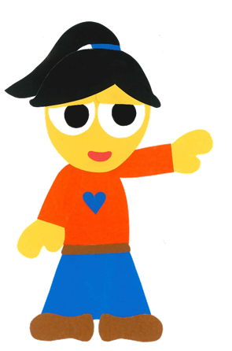
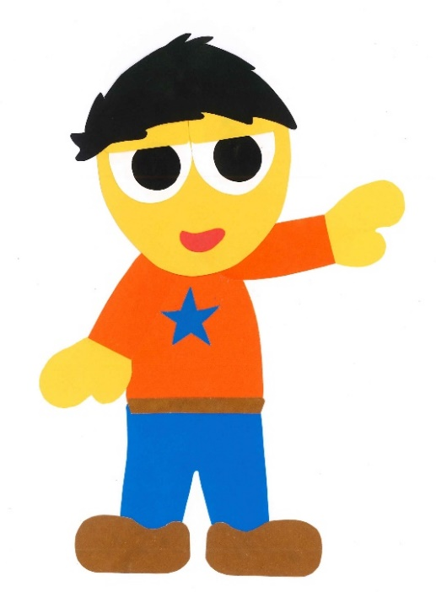
WE
CAN
READ
Donald Joyce
www.teacherdonald.com

Slide 2
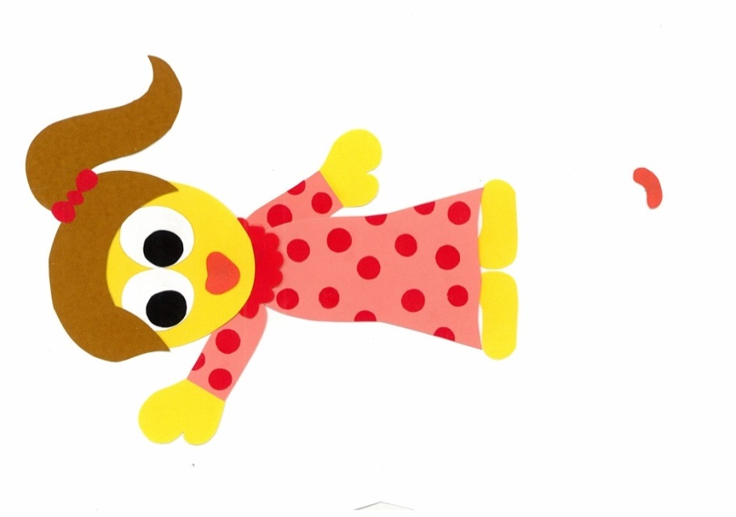
What Should I Wear?
By:
Donald Joyce
WE CAN READ

Slide 3
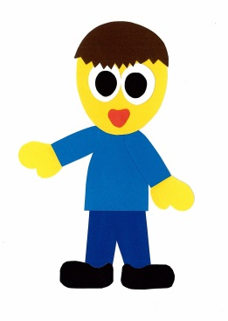
What are you wearing?
I am wearing ___.
Me too!

Slide 4
What do you like
to wear?
I like to wear ___.
Me too!

Slide 5
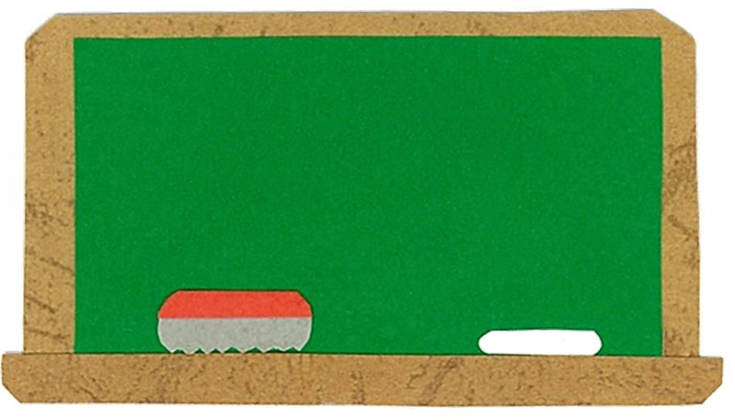
Let’s
Learn!

Slide 6
T-shirt
uniform
shorts
dress
sweater
jeans
pajamas

Slide 7
Let’s
Read!

Slide 8
What Should I Wear?
By:
Donald Joyce
WE CAN READ

Slide 9
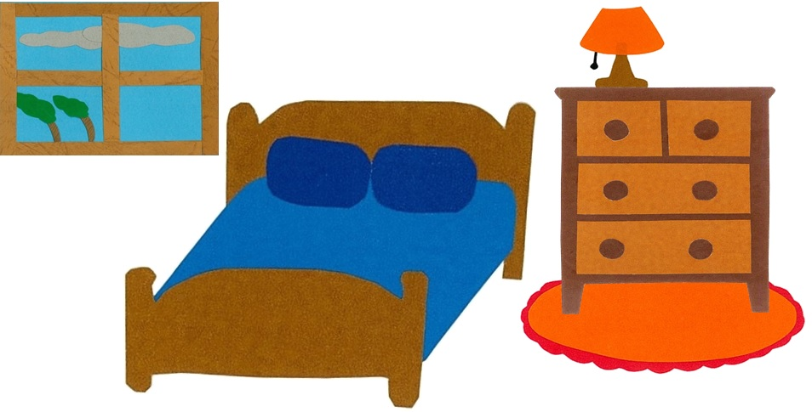
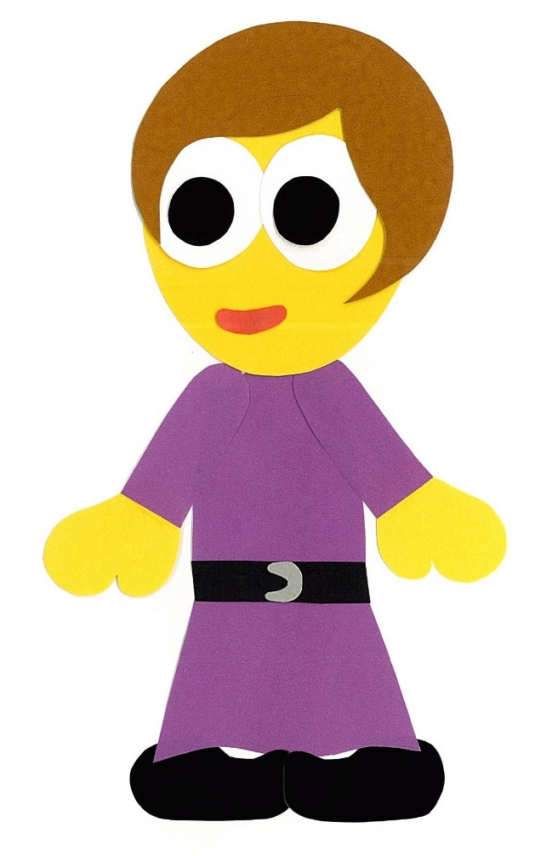
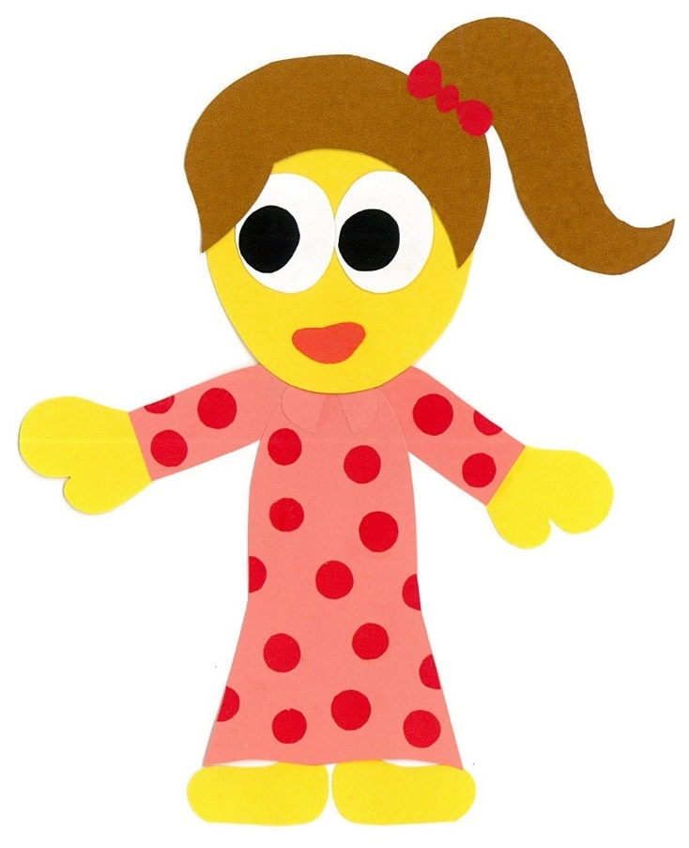
What should I wear to school?

Slide 10
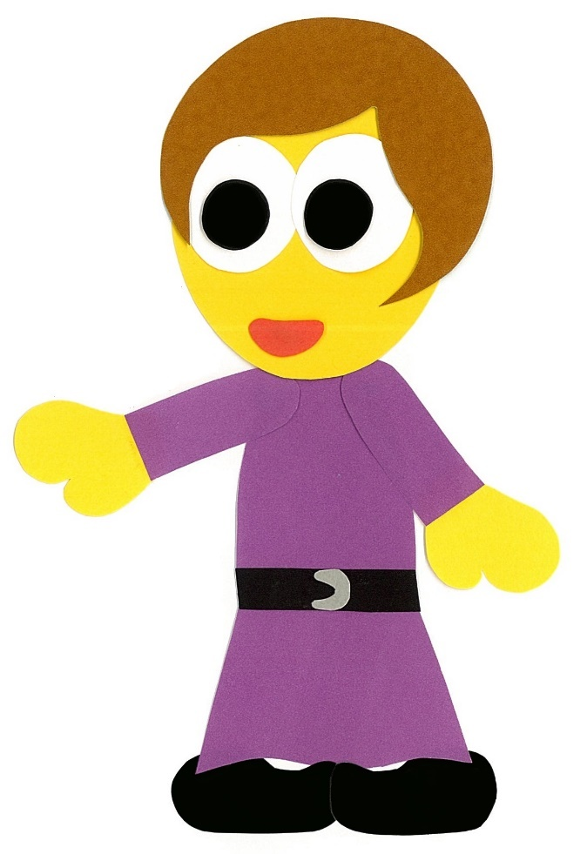
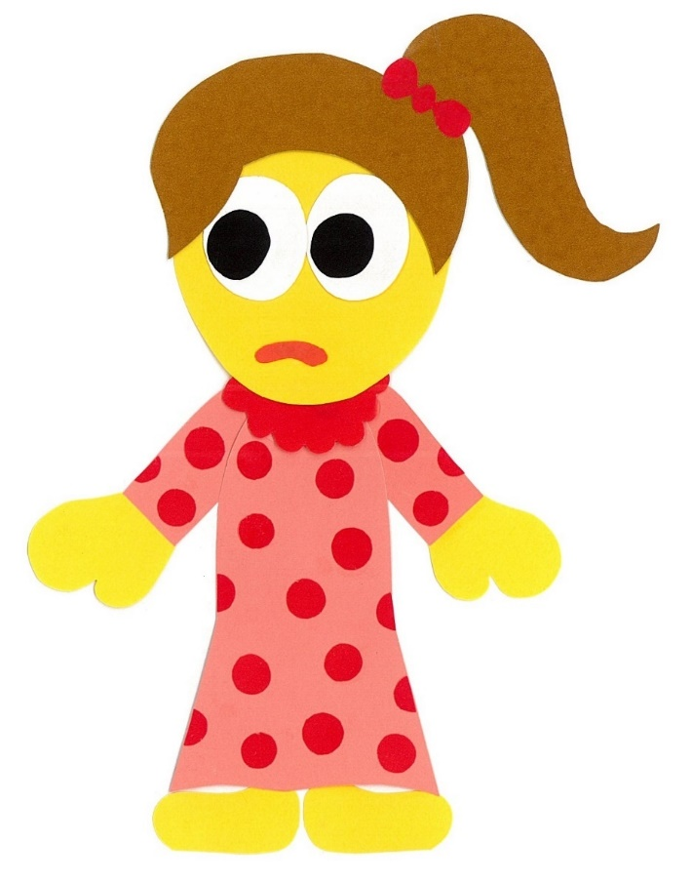
You should wear
your uniform.

Slide 11
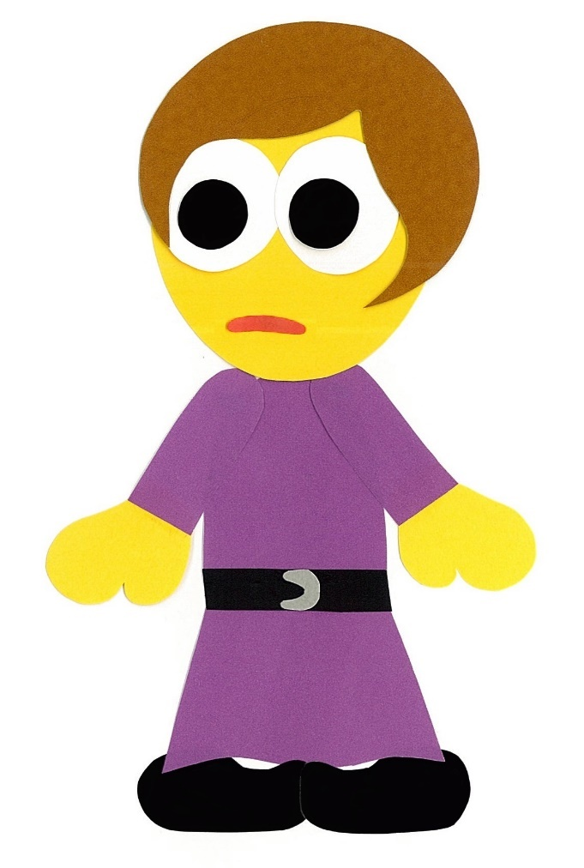
I do not want to wear my uniform.

Slide 12
I want to wear shorts and a T-shirt.

Slide 13
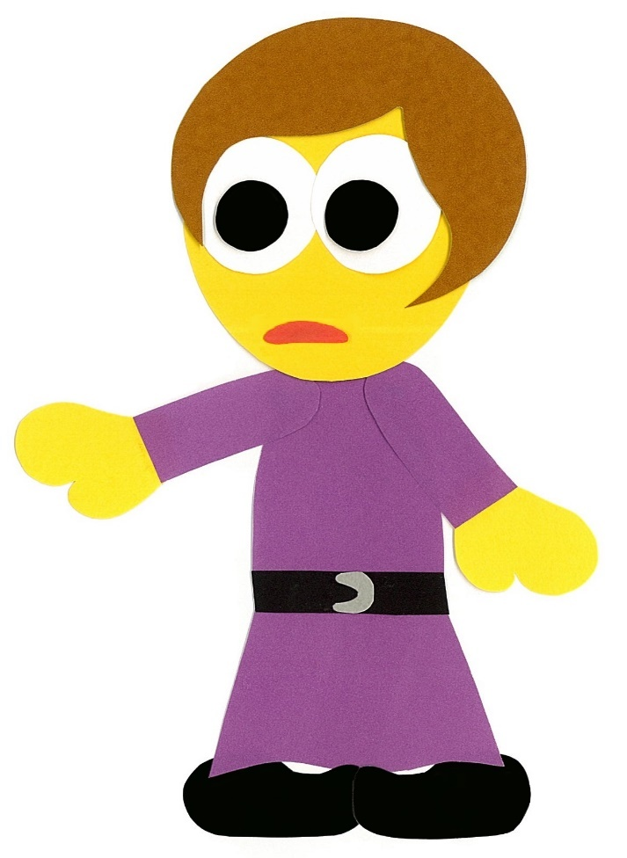
You cannot wear shorts and a T-shirt.

Slide 14
You should wear
a sweater and jeans.

Slide 15
I do not want to wear a sweater and jeans.

Slide 16
I want to wear
a dress.

Slide 17
You cannot wear
a dress.

Slide 18
You should wear your pajamas to school.

Slide 19
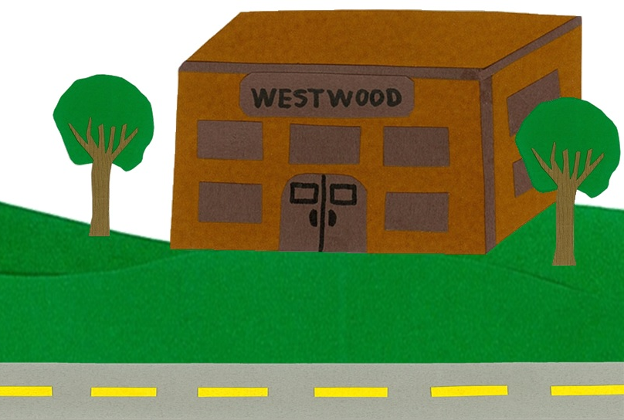
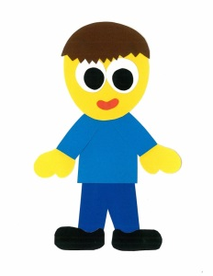
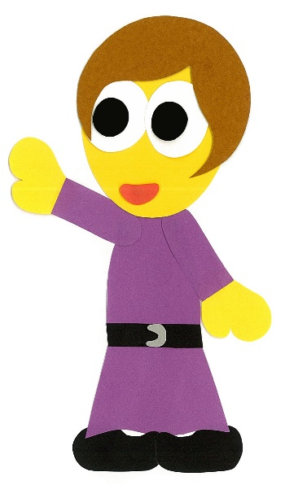
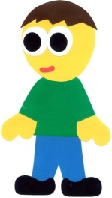
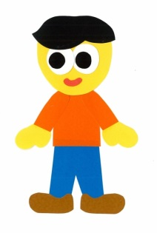
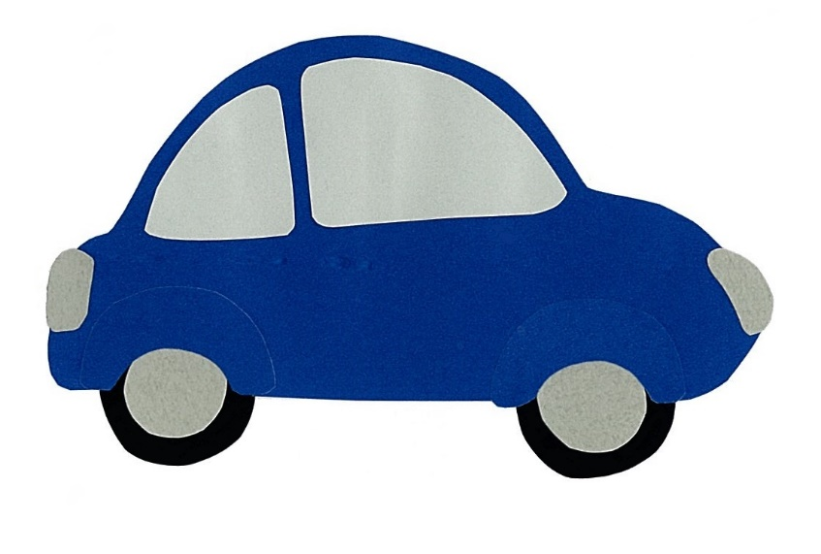
Bye, Mom!
See you later!

Slide 20
What Should I Wear?
By:
Donald Joyce
WE CAN READ

Slide 21
Let’s
Review!

Slide 22
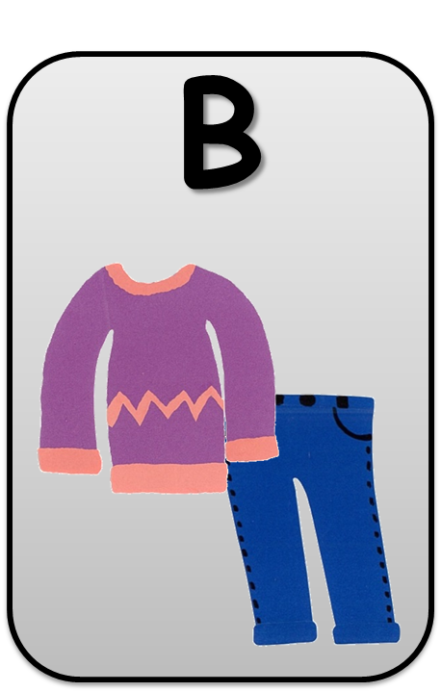
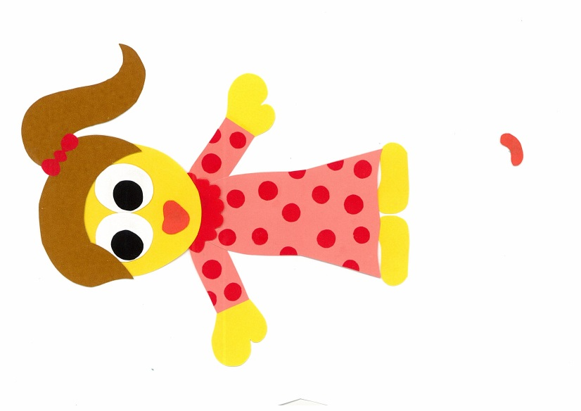
She wants to wear
a dress.
A

Slide 23
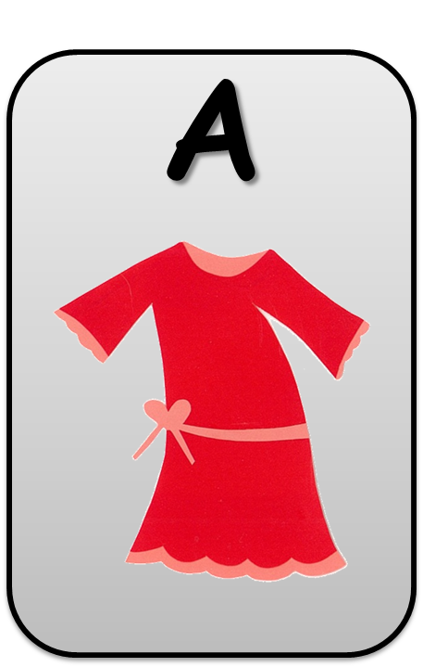
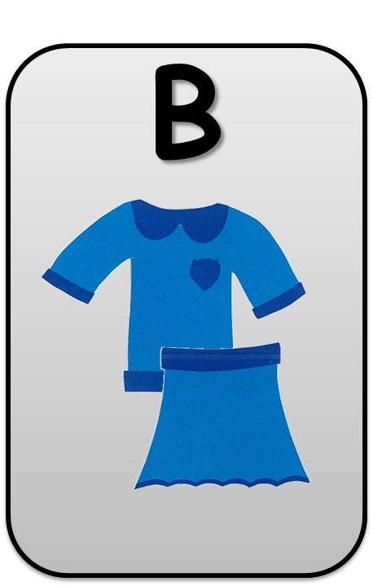
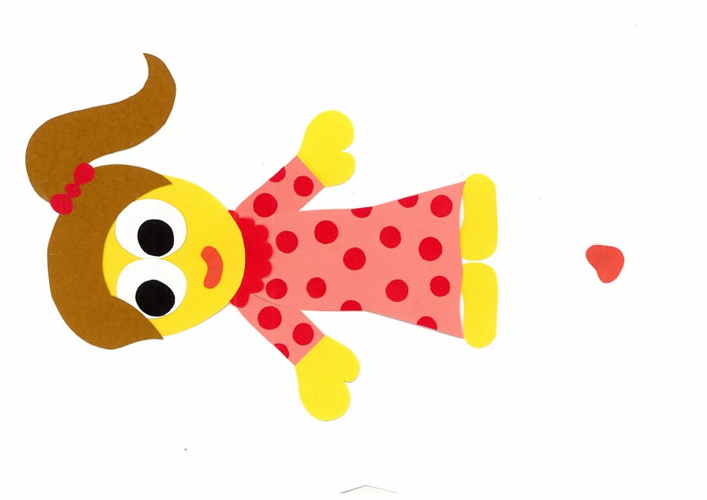
She doesn’t want to wear a uniform.

Slide 24
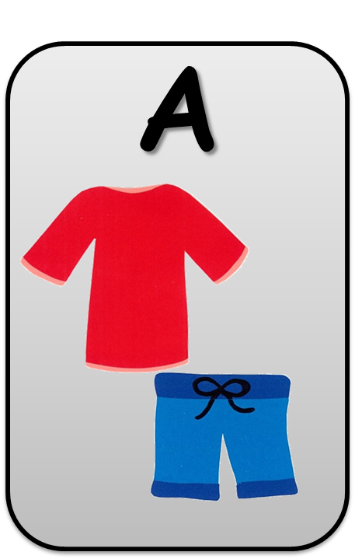
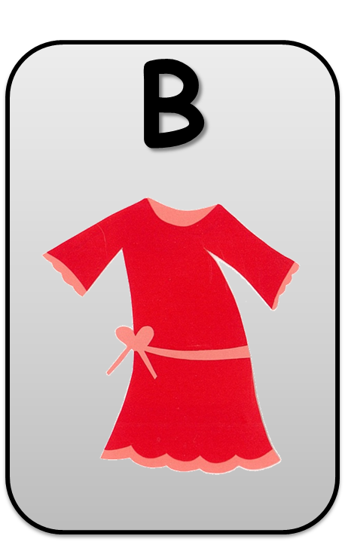
She wants to wear
a T-shirt and shorts.

Slide 25
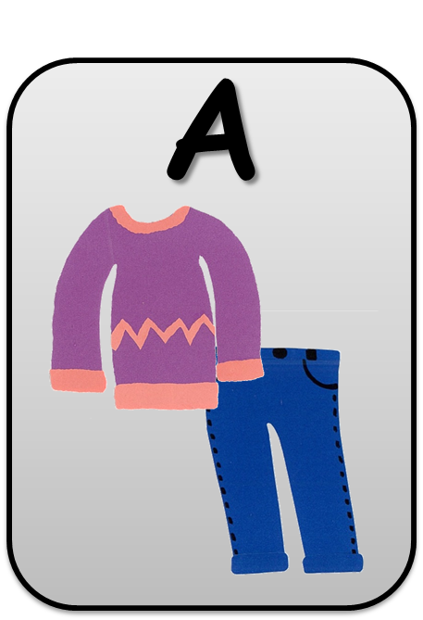
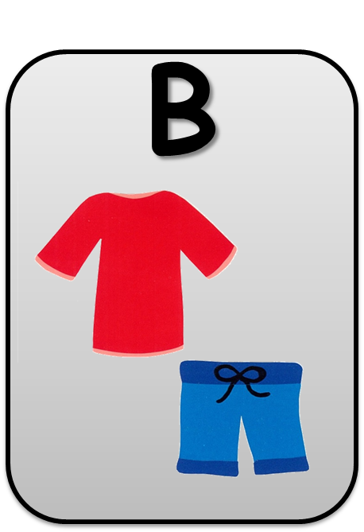
She doesn’t want to wear a sweater
and jeans.

Slide 26
Let’s
Connect!

Slide 27
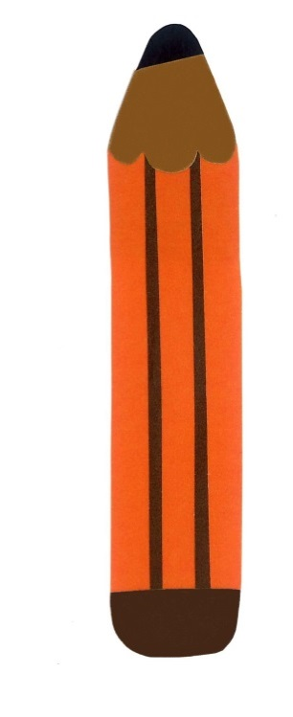
Get a pencil and paper!

Slide 28
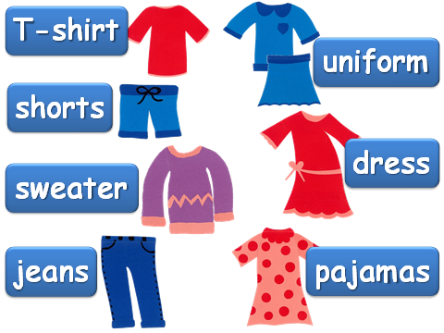
It’s a warm and sunny day…
What should you wear?
I should wear (a) ___.
I should wear (a) __ and (a) __.

Slide 29
It’s a cold and
windy day…
What should you wear?
I should wear a ___.
I should wear a __ and __.

Slide 30
Get a pencil and paper!

Slide 31
What do you want to wear?
Draw a picture.

Slide 32
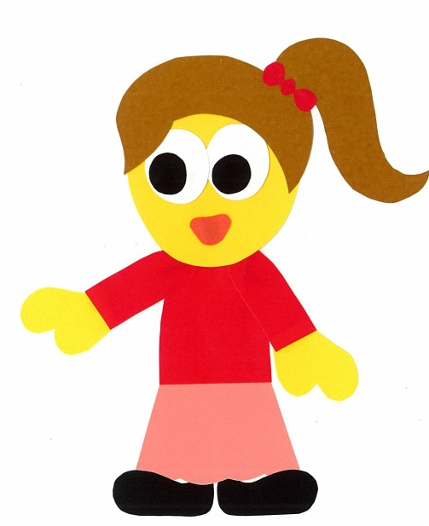
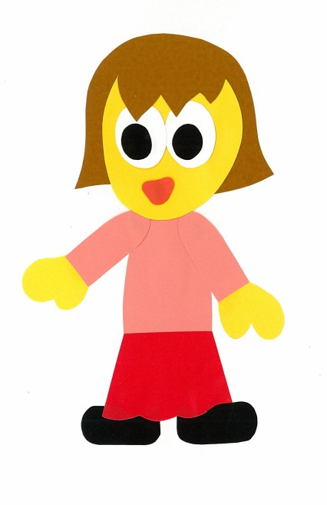
Find a friend. Play a guessing game.
Are you wearing a uniform?
No, I am not.

Slide 33
Are you wearing
(a) ___?
Yes, I am.
No, I am not.

Slide 34
WE
CAN
READ
Donald Joyce
www.teacherdonald.com

