Slide 1
KACD Spring Area Meeting Update
March 2022

Slide 2
NACD Insurance
Information has been sent to all districts

Slide 3
Success Stories

Slide 4
KACD 75/25 Technical Assistance Program
Boone
Campbell
Kenton
Gallatin
Pendleton
Bracken
Trimble
Carroll
Grant
Owen
Robert
son
Mason
Lewis
Greenup
Oldham
Henry
Harrison
Fleming
Franklin
Scott
Nicholas
Carter
Boyd
Jefferson
Shelby
Bourbon
Rowan
Spencer
Bath
Elliott
Lawrence
Woodford
Fayette
Montgomery
Meade
Bullitt
Anderson
Jessa-
mine
Clark
Menifee
Morgan
Henderson
Hancock
Breckinridge
Nelson
Washington
Mercer
Powell
Johnson
Martin
Union
Daviess
Hardin
Madison
Estill
Wolfe
Magoffin
McLean
Marion
Boyle
Garrard
Lee
Floyd
Webster
Ohio
Grayson
Larue
Lincoln
Breathitt
Pike
Crittenden
Taylor
Casey
Rockcastle
Jackson
Owsley
Knott
Hopkins
Muhlenberg
Butler
Hart
Green
Perry
Livingston
Caldwell
Edmonson
Clay
Ballard
McCracken
Adair
Pulaski
Laurel
Leslie
Letcher
Lyon
Warren
Barren
Metcalfe
Russell
Carlisle
Marshall
Christian
Logan
Wayne
Knox
Harlan
Hickman
Graves
Trigg
Todd
Allen
Cumberland
Whitley
Bell
Simpson
Monroe
Clinton
McCreary
Fulton
Calloway
Contracted Counties
Contract Partners

Slide 5
Legislative Update

Slide 6
District Awards
Deadline: May 1 to KACD

Slide 7
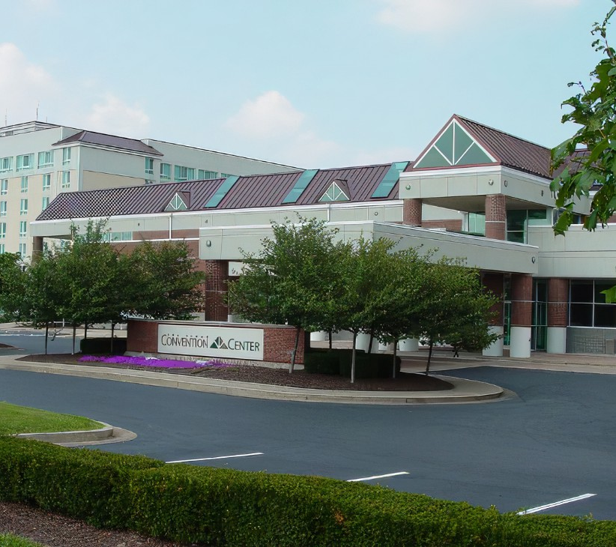
KACD Annual Meeting
Holiday Inn / Sloan Convention Center
Bowling Green, Kentucky
July 10-12, 2022

Slide 8
Resolutions
Deadline: June 1 To be Printed for Meeting
Can also bring Resolutions to the Annual Meeting

Slide 9
Monthly District Zoom Share Sessions
Last Wednesday of each month
10:00 am eastern time

Slide 10
Contact Information:
Crystal Renfro, KACD Executive Director
PO Box 4027
Frankfort, KY 40604-4027
Phone: 502-682-1770
Email: Crystal.Renfro.KACD@outlook.com

Slide 11
Questions ???

