Slide 1
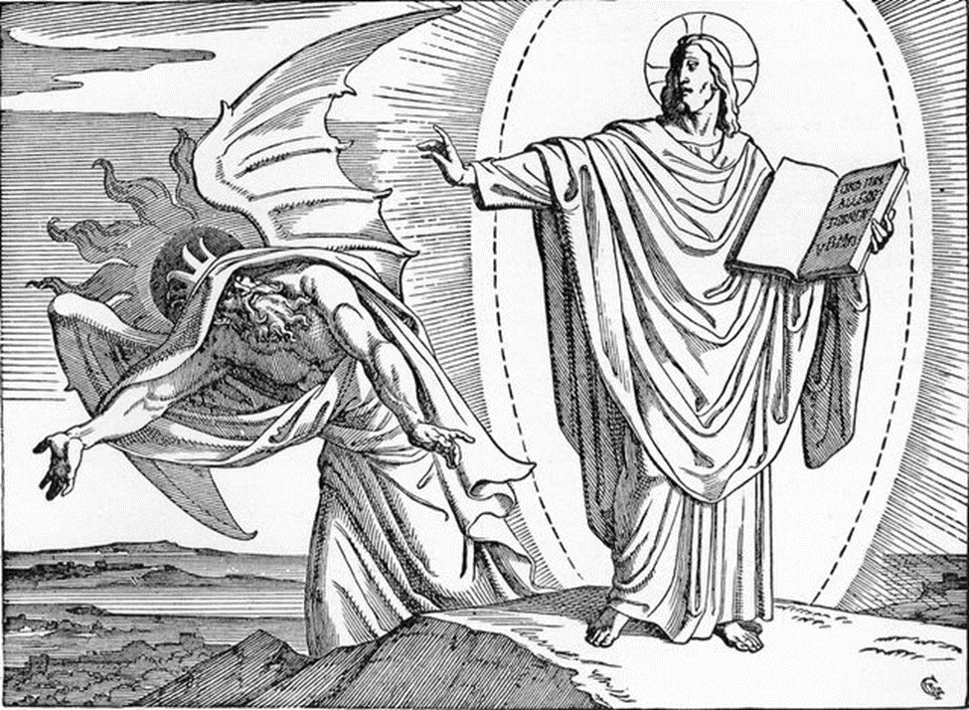
Trinity Evangelical Lutheran Church January 15, 2023
WELCOME!
Scripture Reading: Matthew 4:1-17
The Temptation of Jesus
Notes:
Image: Five Loaves by Caroline Coolidge Brown. Copyright © Caroline Coolidge Brown. All rights reserved. Used by permission of the artist.

Slide 2
= Please stand if able
= Please be seated
Prelude – Roxanne Groff
Office of the Acolyte
Ringing of the Bell
Welcome
Notes:
Image: Five Loaves by Caroline Coolidge Brown. Copyright © Caroline Coolidge Brown. All rights reserved. Used by permission of the artist.

Slide 3
CONFESSION AND FORGIVENESS
All may make the sign of the cross, the sign marked at baptism…
L: We confess our sins before God and one another.
Pause for silence and reflection.
L: Merciful God…
Notes:
Image: Five Loaves by Caroline Coolidge Brown. Copyright © Caroline Coolidge Brown. All rights reserved. Used by permission of the artist.

Slide 4
CONFESSION AND FORGIVENESS
C: Christ came into the world and showed us how to live, but we have failed to live by what he taught. We have not loved you with all our heart, soul, mind and strength, we have not done to others as we would have done to ourselves. Shine a light on our hearts, that we might turn from the shadows of our sin and walk in your ways.
Notes:
Image: Five Loaves by Caroline Coolidge Brown. Copyright © Caroline Coolidge Brown. All rights reserved. Used by permission of the artist.

Slide 5
CONFESSION AND FORGIVENESS
L: Jesus came not to condemn the world, but that the world might be saved through him. By his abundant love, all your sins are forgiven, that you might walk in the light of Christ.
C: Amen.
Notes:
Image: Five Loaves by Caroline Coolidge Brown. Copyright © Caroline Coolidge Brown. All rights reserved. Used by permission of the artist.

Slide 6
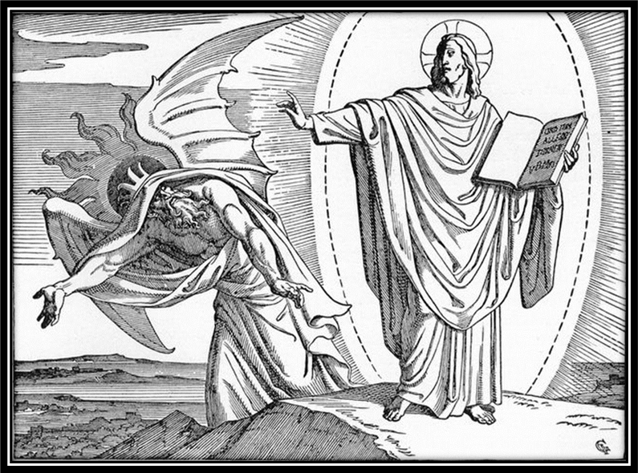
Hymn of Praise
“Seek Ye First the Kingdom of God”
WOV 783
Notes:
Image: Five Loaves by Caroline Coolidge Brown. Copyright © Caroline Coolidge Brown. All rights reserved. Used by permission of the artist.

Slide 7
Seek Ye First the Kingdom of God-WOV 783
1 Seek ye first the kingdom of God And His righteousness And all these things Shall be added unto you Allelu alleluia
Notes:
Image: Preparing yeast dough. Copyright © tomasworks/iStock/Thinkstock. Used by permission.

Slide 8
Seek Ye First the Kingdom of God-WOV 783
2 Ask and it shall be given unto you Seek and ye shall find Knock and the door Shall be opened unto you Allelu alleluia
Notes:
Image: Preparing yeast dough. Copyright © tomasworks/iStock/Thinkstock. Used by permission.

Slide 9
Seek Ye First the Kingdom of God-WOV 783
3 Man shall not live by bread alone But by ev'ry word That proceeds From the mouth of God Allelu alleluia
Notes:
Image: Preparing yeast dough. Copyright © tomasworks/iStock/Thinkstock. Used by permission.

Slide 10
APOSTOLIC GREETING
P: The grace of our Lord Jesus Christ, the love of God, and the communion of the Holy Spirit be with you all.
C: And also with you.
Notes:
Image: Five Loaves by Caroline Coolidge Brown. Copyright © Caroline Coolidge Brown. All rights reserved. Used by permission of the artist.

Slide 11
KYRIE
Notes:
Image: Five Loaves by Caroline Coolidge Brown. Copyright © Caroline Coolidge Brown. All rights reserved. Used by permission of the artist.

Slide 12
KYRIE
P: In peace let us pray to the Lord.
C: Lord have mercy.
P: For the peace from above, and for our salvation, let us pray to the Lord.
C: Lord have mercy.
P: For the peace of the whole world, for the well being of the Church of God, and for the unity of all, let us pray to the Lord.
C: Lord have mercy.
Notes:
Image: Five Loaves by Caroline Coolidge Brown. Copyright © Caroline Coolidge Brown. All rights reserved. Used by permission of the artist.

Slide 13
KYRIE
P: For this Holy House, and for all who offer here their worship and praise, let us pray to the Lord.
C: Lord have mercy.
P: Help, save, and defend us, gracious Lord.
C: Amen.
Notes:
Image: Five Loaves by Caroline Coolidge Brown. Copyright © Caroline Coolidge Brown. All rights reserved. Used by permission of the artist.

Slide 14
PRAYER OF THE DAY
P: Let us pray… Sustaining God, with the words of your holy scriptures, Jesus resisted all the temptations of the devil. Write your word on our hearts that we might also turn away from evil, in Jesus name.
C: Amen.
Notes:
Image: Five Loaves by Caroline Coolidge Brown. Copyright © Caroline Coolidge Brown. All rights reserved. Used by permission of the artist.

Slide 15
Notes:
Image: Preparing yeast dough. Copyright © tomasworks/iStock/Thinkstock. Used by permission.

Slide 16
Scripture Reading
R: The Holy Gospel according to Saint Matthew, the fourth chapter.
C: Glory to you O’ Lord! (Spoken)
Notes:
Image: Five Loaves by Caroline Coolidge Brown. Copyright © Caroline Coolidge Brown. All rights reserved. Used by permission of the artist.

Slide 17
Matthew 4:1-17
Then Jesus was led up by the Spirit into the wilderness to be tempted by the devil. ²He fasted forty days and forty nights, and afterwards he was famished. ³The tempter came and said to him, “If you are the Son of God, command these stones to become loaves of bread.” ⁴But he answered, “It is written, ‘One does not live by bread alone, but by every word that comes
Notes:
Image: Five Loaves by Caroline Coolidge Brown. Copyright © Caroline Coolidge Brown. All rights reserved. Used by permission of the artist.

Slide 18
Matthew 4:1-17
from the mouth of God.’” ⁵Then the devil took him to the holy city and placed him on the pinnacle of the temple, ⁶saying to him, “If you are the Son of God, throw yourself down; for it is written, ‘He will command his angels concerning you,’ and ‘On their hands they will bear you up, so that you will not dash your foot against a stone.’” ⁷Jesus said to him, “Again it is written,
Notes:
Image: Five Loaves by Caroline Coolidge Brown. Copyright © Caroline Coolidge Brown. All rights reserved. Used by permission of the artist.

Slide 19
Matthew 4:1-17
‘Do not put the Lord your God to the test.’” ⁸Again, the devil took him to a very high mountain and showed him all the kingdoms of the world and their splendor; ⁹and he said to him, “All these I will give you, if you will fall down and worship me.” ¹⁰Jesus said to him, “Away with you, Satan! for it is written, ‘Worship the Lord your God, and serve only him.’” ¹¹Then the devil
Notes:
Image: Five Loaves by Caroline Coolidge Brown. Copyright © Caroline Coolidge Brown. All rights reserved. Used by permission of the artist.

Slide 20
Matthew 4:1-17
left him, and suddenly angels came and waited on him.
¹²Now when Jesus heard that John had been arrested, he withdrew to Galilee. ¹³He left Nazareth and made his home in Capernaum by the sea, in the territory of Zebulun and Naphtali, ¹⁴so that what had been spoken through the prophet Isaiah might be fulfilled: ¹⁵“Land of Zebulun, land of Naphtali,
Notes:
Image: Five Loaves by Caroline Coolidge Brown. Copyright © Caroline Coolidge Brown. All rights reserved. Used by permission of the artist.

Slide 21
Matthew 4:1-17
on the road by the sea, across the Jordan, Galilee of the Gentiles— ¹⁶the people who sat in darkness have seen a great light, and for those who sat in the region and shadow of death light has dawned.” ¹⁷From that time Jesus began to proclaim, “Repent, for the kingdom of heaven has come near.”
Notes:
Image: Five Loaves by Caroline Coolidge Brown. Copyright © Caroline Coolidge Brown. All rights reserved. Used by permission of the artist.

Slide 22
Matthew 4:1-17
R: This is the Word of the Lord.
C: Praise to You, O Christ (Spoken)
Notes:
Image: Five Loaves by Caroline Coolidge Brown. Copyright © Caroline Coolidge Brown. All rights reserved. Used by permission of the artist.

Slide 23
Sermon
Notes:
Image: Five Loaves by Caroline Coolidge Brown. Copyright © Caroline Coolidge Brown. All rights reserved. Used by permission of the artist.

Slide 24
APOSTLE’S CREED
C: I believe in God, the Father almighty, creator of heaven and earth.

Slide 25
APOSTLE’S CREED
C: I believe in Jesus Christ, his only Son, our Lord. He was conceived by the power of the Holy Spirit and born of the virgin Mary. He suffered under Pontius Pilate, was crucified, died, and was buried.

Slide 26
APOSTLE’S CREED
C: He descended into hell. On the third day he rose again. He ascended into heaven, and is seated at the right hand of the Father. He will come again to judge the living and the dead.

Slide 27
APOSTLE’S CREED
C: I believe in the Holy Spirit, the holy catholic Church, the communion of saints, the forgiveness of sins, the resurrection of the body, and the life everlasting. Amen.

Slide 28
NICENE CREED
C: We believe in one God, the Father, the Almighty, maker of heaven and earth, of all that is, seen and unseen.

Slide 29
NICENE CREED
C: We believe in one Lord, Jesus Christ, the only Son of God, eternally begotten of the Father, God from God, Light from Light, true God from true God, begotten, not made, of one Being with the Father.

Slide 30
NICENE CREED
C: Through him all things were made. For us and for our salvation he came down from heaven; by the power of the Holy Spirit he became incarnate from the virgin Mary, and was made man. For our sake he was crucified under Pontius Pilate;

Slide 31
NICENE CREED
C: he suffered death and was buried. On the third day he rose again in accordance with the Scriptures; he ascended into heaven and is seated at the right hand of the Father. He will come again in glory to judge the living and the dead, and his kingdom will have no end.

Slide 32
NICENE CREED
C: We believe in the Holy Spirit, the Lord, the giver of life, who proceeds from the Father and the Son. With the Father and the Son he is worshiped and glorified. He has spoken through the prophets. We believe in one holy catholic and apostolic Church.

Slide 33
NICENE CREED
C: We acknowledge one Baptism for the forgiveness of sins. We look for the resurrection of the dead, and the life of the world to come. Amen.

Slide 34
PRAYERS OF INTERCESSION
Each petition will end with the words,
A: Merciful God,
The congregation will respond with:
C: You hear our prayer.

Slide 35
PRAYERS OF INTERCESSION
The prayer concludes…
P: Receive our prayers and hold all for whom we pray in your loving arms, in the name of your son, Jesus Christ.
C: Amen.

Slide 36
OFFERING
OFFERTORY PRAYER
Notes:
Image: Five Loaves by Caroline Coolidge Brown. Copyright © Caroline Coolidge Brown. All rights reserved. Used by permission of the artist.

Slide 37
DIALOGUE
P: The Lord be with you.
C: And also with you.
P: Lift up your hearts.
C: We lift them to the Lord.
P: Let us give thanks to the Lord our God.
C: It is right to give him thanks and praise.

Slide 38
THE PREFACE
P: It is indeed right and salutary …
…we praise your name and join their unending hymn:

Slide 39
THE SANCTUS
C: Holy, holy, holy Lord, God of power and might: Heaven and earth are full of your glory. Hosanna. Hosanna. Hosanna in the highest. Blessed is he who comes in the name of the Lord. Hosanna in the highest.

Slide 40
EUCHARISTIC PRAYER
P: Blessed are you, O holy God……
…in your holy Church, both now and forever.
C: Amen!

Slide 41
THE LORD’S PRAYER
P: United into one body, let us pray as Jesus taught…
C: Our Father, who art in heaven, hallowed be thy name, thy kingdom come, thy will be done, on earth as it is in heaven.

Slide 42
THE LORD’S PRAYER
C: Give us this day our daily bread; and forgive us our trespasses, as we forgive those who trespass against us; and lead us not into temptation, but deliver us from evil. For thine is the kingdom, and the power, and the glory, forever and ever. Amen.

Slide 43
INVITATION TO COMMUNION
P: Jesus did not turn stones into bread, but instead gave of his own body in this sacred host we share together. Come and receive the food that truly satisfies, in remembrance of him. The table is set and all are welcome.

Slide 44
POST COMMUNION BLESSING
P: May this Body and Blood of our Lord and Savior, Jesus Christ, ☩ strengthen, keep, and unite us, now and forever.
C: Amen.

Slide 45
POST COMMUNION PRAYER
P: Let us pray… Holy One, we thank you for the healing that springs forth abundantly from this table. Renew our strength to do justice, love kindness, and journey humbly with you.
C: Amen

Slide 46
ANNOUNCEMENYS
Notes:
Image: Five Loaves by Caroline Coolidge Brown. Copyright © Caroline Coolidge Brown. All rights reserved. Used by permission of the artist.

Slide 47
SENDING BLESSING
P: The God who faithfully brings forth justice and breaks the oppressor’s rod bless, strengthen, and uphold you, today and always.
C: Amen.
☩

Slide 48
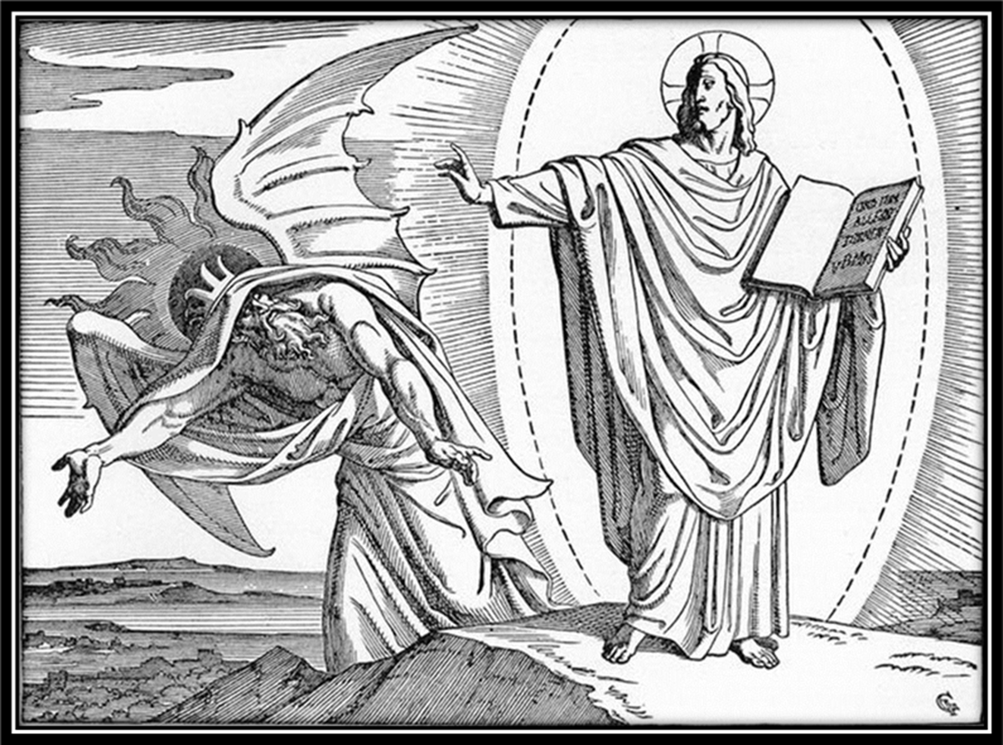
SENDING SONG
“Brightest and Best”
LBW 84
Notes:
Image: Five Loaves by Caroline Coolidge Brown. Copyright © Caroline Coolidge Brown. All rights reserved. Used by permission of the artist.

Slide 49
Brightest and Best LBW 84
1 Brightest and best of the stars of the morning,
dawn on our darkness and lend us your aid.
Star of the East, the horizon adorning,
guide where our infant redeemer is laid.
Notes:
Image: Preparing yeast dough. Copyright © tomasworks/iStock/Thinkstock. Used by permission.

Slide 50
Brightest and Best LBW 84
2 Cold on his cradle the dewdrops are shining;
low lies his head with the beasts of the stall;
angels adore him in slumber reclining,
maker and monarch and savior of all.
Notes:
Image: Preparing yeast dough. Copyright © tomasworks/iStock/Thinkstock. Used by permission.

Slide 51
Brightest and Best LBW 84
3 Shall we not yield him, in costly devotion,
fragrance of Edom and off’rings divine,
gems of the mountain and pearls of the ocean,
myrrh from the forest or gold from the mine?
Notes:
Image: Preparing yeast dough. Copyright © tomasworks/iStock/Thinkstock. Used by permission.

Slide 52
Brightest and Best LBW 84
4 Vainly we offer each ample oblation,
vainly with gifts would his favor secure;
richer by far is the heart’s adoration,
dearer to God are the prayers of the poor.
Notes:
Image: Preparing yeast dough. Copyright © tomasworks/iStock/Thinkstock. Used by permission.

Slide 53
Brightest and Best LBW 84
5 Brightest and best of the stars of the morning,
dawn on our darkness and lend us your aid.
Star of the east, the horizon adorning,
guide where our infant redeemer is laid.
Notes:
Image: Preparing yeast dough. Copyright © tomasworks/iStock/Thinkstock. Used by permission.

Slide 54
DISMISSAL
P: … depart in Christ’s Love.
C: Seeking, welcoming, and serving all. Amen!
POSTLUDE
By
Roxanne Groff
From sundaysandseasons.com. Copyright © 2023 Augsburg Fortress. All rights reserved. Reprinted by permission under Augsburg Fortress Liturgies Annual License #SAS023830. New Revised Standard Version Bible, Copyright © 1989, Division of Christian Education of the National Council of the Churches of Christ in the United States of America. Used by permission. All rights reserved. Revised Common Lectionary, Copyright © 1992 Consultation on Common Texts, admin Augsburg Fortress. Used by permission.

