Slide 1
Training
taken from
September Office Hours
September 2021

Slide 2
New GA ELR
Personal:
Married to my Queen for 7 yrs.
Four kids ages 2, 7, 16, 16 (2 Girls and 2 Boys)
Veteran
Work Experience:
6 yrs. in the NAVY as Corpsmen
1 yr. with DOD
9 yrs. with the VA:VBA
Fun Fact:
Didn’t realize the thief in Home Alone was the cop until age 33.
Contact Info:
Ofc: (404) 929-6050
GeorgiaELR.VBAATG@va.gov
SCO Hotline: 855-225-1159
Students: 888-442-4551
https://gibill.custhelp.va.gov/ ask a question

Slide 3
Debt Management Center (DMC) – School Debts

Slide 4
Background
All collection action on VA debts under the jurisdiction of the U.S. Department of the Treasury was suspended until September 30, 2021
Institutions (schools) continued to receive the normal series of debt letters
Referrals to the Treasury Offset Program were not paused for schools

Slide 5
How To Contact TOP
Schools may contact TOP by calling the TOP Call Center at
1-800-304-3107
Treasury will verify that a caller is in a need-to-know position with the institution/school
Treasury will need to know at least one of the following:
date of the payment
amount of the original payment
amount of the offset
Make sure to obtain the Debt Account ID related to the offset from Treasury (typically ends in 0075 for school tuition) before contacting DMC about an offset

Slide 6
Options for School Debt Resolution
Payment Options
Pay in Full
Dispute
Payment Plan
Compromise
If an institution/school is experience difficulties with repayment, please email dmcedu.vbaspl@va.gov

Slide 7
DMC School Official Debt Line
Contact Information
833-720-2574 (international 612-843-6508)
Use for questions on Post 9/11 GI Bill® Tuition and Fees debts such as:
Term dates for a debt
Confirm a payment was received
Confirm an outstanding balance
Assistance with an online payment
Disputes regarding the existence or amount of the debt should be sent via
email to dmcedu.vbaspl@va.gov

Slide 8
SCO Annual Training Requirements

Slide 9
FY22 SCO Annual Training Reminders
New Training Cycle!
The new training cycle runs from October 1 thru August 31 of the following year
Existing SCOs have 11 months to meet their annual training requirement
September 1-30:
Training Window Closes for Existing SCOs
New SCO training is continuous throughout the year
Training Compliance
Compliance will be determined by the number of modules completed
Centralized Certifications
Only designated SCOs are required to complete the annual training (22-8794 (va.gov))
SCOs listed as points of contact are not required to complete the training because they are not authorized to submit enrollment certifications to VA
9

Slide 10
FY22 SCO Annual Training Reminders
Training modality to complete annual training requirement:
Asynchronous Online training located on the SCO training portal
Mandatory training topics specific to facility type
PowerPoint Presentations from virtual training events
Synchronous SCO Approved training events (virtual or in-person instructor led) presented by or co-presented with a VA employee at:
Online Training Events
National or Regional Conferences
Local Workshops
One-On-One Training with the ELR of jurisdiction
10

Slide 11
FY22 SCO Annual Training Requirements
New SCOs
Must complete the training prior to being authorized to certify enrollments to VA
Upon training completion, must submit training certificates with VA Form 22-8794 to the ELR of jurisdiction
Facility Type | Number of Training Modules Required
Institutions of Higher Learning (IHLs) | 10
Non-College Degree (NCD) Programs | 10
High Schools and Residency Programs | 1
OJT/Apprenticeship Programs | 1
Vocational Flight | 1
11

Slide 12
FY22 SCO Annual Training Requirements
Existing SCOs
Must complete one (1) mandatory self-paced online training module specific to their facility type
Must complete three (3) elective modules using the training modality of their choice
Note: The three (3) electives are not required if only one (1) training module is needed to meet compliance
Facility Type | Number of Training Modules Required
Institutions of Higher Learning (IHLs) | 4
Institutions of Higher Learning (IHLs) with Flight Courses | 4
Institutions of Higher Learning (IHLs) with NCDs | 4
Non-College Degree (NCD) Programs | 4
Vocational Flight | 4
*High Schools and Residency Programs | 1
*OJT/Apprenticeship Programs | 1
12

Slide 13
FY22 SCO Annual Training Requirements
Here are important training dates for School Certifying Officials (SCOs)
Annual Training Window Opened. Updated training requirements for all new SCOs and continuing
60-Day Training Alert! Notifications
15-Day Training Alert!
and reminders of the approaching
Notifications and reminders of the approaching August 31st continuing education deadline will be posted on the GI Bill® website and sent to SCOs via Gov Delivery notice
Existing SCOs - No training in progress New SCOs – Training is continuous throughout the year
August 31st continuing education
deadline will be posted on the GI
education requirements for
Bill® website and sent to SCOs via
existing SCOs are effective
Gov Delivery notice
October 1,
2021
July 1, 2022
August 15,
2022
Sept 1-30,
2022
June 1, 2022
August 1, 2022
August 31, 2022
90-Day Training Alert! 90-Day Notifications and reminders of the
30-Day Training Alert! Notifications
Annual Training Window Closes!
approaching August 31st continuing
and reminders of the approaching
Continuing education requirements for
education deadline will be posted on
August 31st continuing education
existing SCOs completed
the GI Bill® website and sent to
SCOs via Gov Delivery notice
deadline will be posted on the GI
Bill® website and sent to SCOs via
Gov Delivery notice
Please remember, if you don’t complete your annual training requirements, VA has the authority to remove your access from VA-ONCE and the SAA has the authority to disapprove your school’s programs
13

Slide 14
FY22 SCO Annual Training Reminders
Non-Compliance
When covered institutions fail to complete the required training by the end of the training cycle, a notification via Gov.Delivery will be sent of the delinquency informing the institution of the impending loss of their ability to certify enrollments to VA
If covered institution remains non-compliant after the end of the training cycle, the ELR will remove their ability to certify to VA and refer the institution to the SAA for review and determination on suspension or withdrawal actions in accordance with Colmery Act section 305
It will be a function of the National Training Team – Schools to generate training compliance reports at the 90, 60, and 30-day milestones, and at the end of the training cycle to determine compliant and non-compliant institutions
14

Slide 15
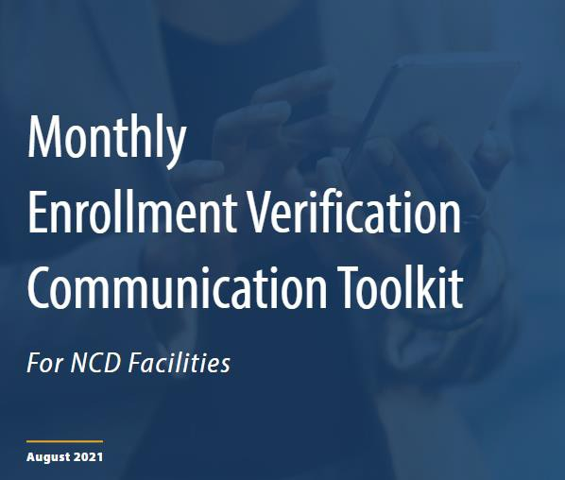
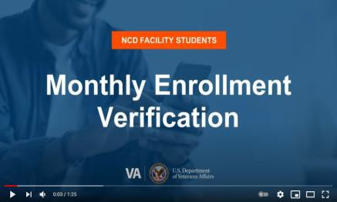
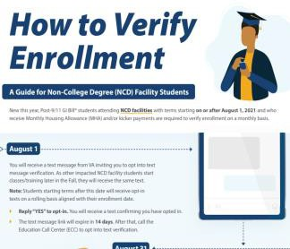
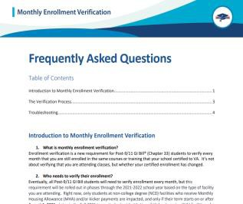
Communication Resources
NCD SCO Enrollment Verification Toolkit Available Now!
@VAVetBenefits
@GIBillEducation
VeteransBenefits@
Messages.VA.gov
Enrollment Verification Webpage
How to Opt Into Text
Message Verification Video
How to Verify Your Monthly Enrollment Via Text Video
How to Verify Enrollment Infographic
Frequently Asked
Questions
Enrollment Verification
VAntage Point Blog
73

Slide 16
Resources
SCO Education and Training Page-
SCO Training Portal
School Certifying Officials Handbook
ELR of Jurisdiction
74

Slide 17
How To Self Certify
Click on the URL Below or Copy and Paste it in your web browser https://vba-tpss.vbatraining.org/assess/trkSignIn?refid=XSCO
Enter your email address and eight (8) digit facility code and click Next
Note: If you do not have a User Profile, click New User Account and follow the steps to set up your profile
Scroll down and click the Conference/Workshop/Virtual Training tab
Select the applicable training session from the list of topics that appears on the right side of the screen by clicking Begin
To enter Conference/Workshop/Virtual Training Title, click the dropdown arrow, select SCO Virtual Training Session and click Submit
Enter the start date and the end date
Enter your Facility Name, City and State (Main Campus) and click Submit
Certify your attendance by clicking Agree and then submit
Print your training certificate and keep for your records
17

Slide 18
Email Inquiries & Contact Information
Reminder: Do NOT send any emails to the Education Service Operations Integrity Mailbox!
If you have questions or concerns regarding any of the following:
Issues involving SCO Approved Credit & tracking your progress
SCO Portal Access and its Use
Inquiries on the Adobe Connect Registration & Access Process
You must Only submit them to the Education Service Training Mailbox edutraining.vbaco@va.gov
Spread The Word: All Webinars and Training Events are announced via GovDelivery You must register there and keep your information updated
Education Service Does Not maintain any Email Distribution Lists to inform Stakeholders of these important events!
18

Slide 19
Ask VA

Slide 20
Ask VA
Account Creation
The “Ask a Question” system on the GI Bill® website will be upgraded to a new system called “Ask VA” on October 18, 2021. You will then be able to submit questions and documents through the new system
You will need a VA.gov account. If you need to create a new account, you must verify your identity. You can do so by using your account for certain secure VA systems, like MyHealtheVet, or by creating an ID.me account.
Note: Creating an ID.me account may require personal identity documents.

Slide 21
Ask VA
Account Creation…
We advise you create your VA.gov account in advance, because it can take some time to verify your identity. Call the MyVA411 main information line at 800-698-2411 if you have issues setting up an account. Alternatively, you can use VA-ONCE to submit monthly certifications of an on-the-job training, apprenticeship, or work-study participant’s hours, which is the preferred submission portal.

Slide 22
Ask VA
International SCOs
Note: International SCOs should note that some non-U.S. documents are accepted.
If you have questions about the account verification process, these resources may help:
Privacy & security on VA.gov
ID.me Help

Slide 23
Ask VA
Conversation History
If you have an open issue in Ask a Question, it will be addressed and closed as part of the system transition.
Any documents or evidence you’ve previously submitted will be preserved in your file, but any conversation history will be lost
Make a record of any conversation history you want to preserve. To do this, open your “Ask A Question” account, open any inquiries you want to save, and copy the text of those inquiries into a stand-alone document.

Slide 24
Ask VA
GI Bill® Frequently Asked Questions – NEW!
As of October 18, 2021, any link to “Ask A Question” will automatically redirect to “Ask VA,” but we recommend that you update links and bookmarks to the new system
All of the GI Bill® Frequently Asked Questions on the GI Bill® website will be moved to a new location. You will still be able to find them on the website, but if you’ve saved a link to a particular question, it will no longer work.

Slide 25
85/15 Rule & 35% Exemption

Slide 26
85/15 Rule
What Is The 85/15 Rule?
The 85/15 Rule prohibits paying Department of Veterans Affairs (VA) benefits to students enrolling in a program when more than 85% of the students enrolled in that program are having any portion of their tuition, fees, or other charges paid for them by the Education and Training Institution (ETI) or VA under Title 38 or Title 10
If the ratio of supported students to non-supported students exceeds 85% only students maintaining continuous enrollment may receive benefits for that program
Note: Students receiving Veteran Readiness and Employment (Chapter 31), or Survivors’ and Dependents’ Educational Assistance (Chapter 35), benefits must be counted when calculating 85/15 Rule compliance, but they can continue to be certified and enrolled if the ETI is found to be in violation of the 85/15 Rule.

Slide 27
85/15 Rule
Why Does The 85/15 Rule Exist?
To ensure that a minimum number of students, who are not receiving VA funds, are willing to pay for the full cost of the program
To ensure the price of the program responds to the general demands of the open market and that the minimal number of non-VA beneficiaries find the program to be worthwhile

Slide 28
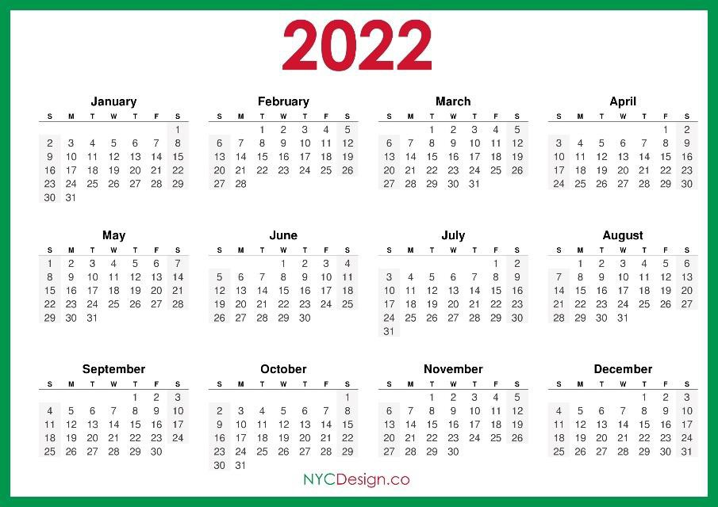
Reporting Requirements
When Do Routine 85/15 Calculations Need to Be Provided?
If the ETI is structured on a Term, Quarter, or Semester Basis:
85/15 calculations must be submitted to the Education Liaison Representative (ELR) of jurisdiction no later than 30 days after the start of each regular term (excluding summer terms)
EXAMPLE:
Spring Term start date: January 3, 2022
85/15 Report due: February 1, 2022
Fall Term start date: 85/15 Report due:
September 6, 2022
October 5, 2022

Slide 29
Reporting Requirements
When Do Routine 85/15 Calculations Need to Be Provided?
If the ETI is not structured on a Term Basis, then –
85/15 calculations must be submitted to the ELR of jurisdiction no later than 30 days after the beginning of each calendar quarter
Calendar quarters align with the quarters of VA’s fiscal year which starts in October
and ends in September.
Calculations must be submitted for all enrollment periods in the previous calendar quarter
Due dates for routine reporting of 85/15 calculations will be as follows:

Slide 30
35% Exemption

Slide 31
35% Exemption
What is the 35% Exemption?
An ETI with a 35% Exemption is not required by regulation to routinely report 85/15 calculations to VA
85/15 calculations must still be provided at the request of VA or State Approving Agency staff
35% Exemption Criteria
The total number of VA beneficiaries enrolled in the educational institution must be less than or equal to 35% of the total student enrollment.
NOTE 1: Any program(s) that exceed 85% supported student enrollment are not exempt and the ETI must continue to monitor and routinely report enrollment data on any programs not included in the 35% Exemption
NOTE 2: Total student population is NOT based on Full Time Equivalency (FTE)

Slide 32
35% Exemption
35% Exemption Calculations vs 85/15 Calculations
35% Exemption Calculations are based on actual student enrollment and are calculated based on VA students vs. Non-VA students. (38 CFR 21.4201 [c] [4])
85/15 Calculations are based on full time equivalency and are calculated based on supported vs. non-supported students. (38 CFR 21.4201 [e] [2])

Slide 33
35% Exemption
35% Exemption Reset
There will be a national reset to rescind all 35% Exemptions
This reset is effective October 1, 2021
VA is resetting the 35% Exemption because recent reviews of 85/15 conducted by VA revealed that a number of ETI were not correctly computing the ratio of supported to non-supported students, especially those ETI with the 35% Exemption
NOTE: If a facility does not currently hold a 35% Exemption, the ETI is still required to provide routine reports as previously outlined

Slide 34
35% Exemption
35% Exemption – Next Report Due – Non-Term Based ETI
Since the reset for ETI is effective October 1, 2021, all non-term based ETI must submit 85/15 calculations no later than October 30, 2021. Those calculations, which will cover all enrollment periods for each individual cohort or module, beginning between the dates of July 1 and September 30, 2021
When non-term based ETI enrollment ratios meet the necessary exemption criteria then the ETI may reapply for the 35% Exemption
NOTE: Per 38 Code of Federal Regulations (CFR) 21.4201 if there is reason to believe that the enrollment of Veterans and eligible persons in the course may exceed 85 percent of the total student enrollment in the course, a 35% Exemption can be revoked at that time

Slide 35
35% Exemption
35% Exemption – Reapplication - Non-Term Based ETI
If 85/15 Enrollment Ratios meet the necessary exemption criteria for periods beginning on or after October 1, 2021, then the non-term based ETI may apply for the 35% Exemption
Completed Statement of Assurance of Compliance with 85 Percent Enrollment Ratios for each of the enrollment periods occurring within the corresponding reporting period must accompany any application for the 35% Exemption
A response to the submission will be provided to the ETI within 90 days
NOTE: Per 38 Code of Federal Regulations (CFR) 21.4201 if there is reason to believe that the enrollment of Veterans and eligible persons in the course may exceed 85 percent of the total student enrollment in the course, a 35% Exemption can be revoked at that time

Slide 36
35% Exemption
35% Exemption – Next Report Due – Term Based ETI
When the ETI is term based, the reset will be effective October 1, 2021. All term based ETI must submit 85/15 calculations no later than 30 days after the start of the Spring 2022 term, as it is published in the academic calendar
When IHL ETI enrollment ratios meet the necessary exemption criteria then the ETI
may reapply for the 35% Exemption
NOTE: Per 38 Code of Federal Regulations (CFR) 21.4201 if there is reason to believe that the enrollment of Veterans and eligible persons in the course may exceed 85 percent of the total student enrollment in the course, a 35% Exemption can be revoked at that time

Slide 37
35% Exemption
35% Exemption – Reapplication – Term Based ETI
If a term based ETI’s 85/15 Enrollment Ratios meet the necessary exemption criteria for terms beginning on or after October 1, 2021, then the ETI may apply for the 35% Exemption
The earliest date a term based ETI can apply for the 35% Exemption is when the Spring 2022 reporting for 85/15 calculations is submitted. A completed Statement of Assurance of Compliance with 85 Percent Enrollment Ratios for the corresponding reporting period must accompany any application for the 35% Exemption
A response to the submission will be provided to the ETI within 90 days
NOTE: Per 38 Code of Federal Regulations (CFR) 21.4201 if there is reason to believe that the enrollment of Veterans and eligible persons in the course may exceed 85 percent of the total student enrollment in the course, a 35% Exemption can be revoked at that time

Slide 38
35% Exemption
35% Exemption – Routine Lifecycle Maintenance
When granted, 35% Exemptions will routinely expire for all ETIs every 24 months:
NOTE: Per 38 Code of Federal Regulations (CFR) 21.4201 if there is reason to believe that the enrollment of Veterans and eligible persons in the course may exceed 85 percent of the total student enrollment in the course, a 35% Exemption can be revoked at that time

Slide 40
Branch and Extension Campuses
Branch Campuses
Approved campuses that have both administrative capability and a Facility Code must complete 85/15 calculations separate of the main campus of the Educational & Training Institution (ETI)
Students will be individually counted (based on full-time equivalency at the site)
This is true for both supported and non-supported students
NOTE: Though issued a facility code, approved teaching sites, commonly referred to as “extension campuses,” typically do not maintain administrative capability and are not approved separate of a parent campus. If you’re unsure whether your campus is approved independently of the main campus, contact your SAA.

Slide 41
Branch and Extension Campuses
Extension Campuses
Approved training sites without administrative capabilities (those sites approved and possessing an extension campus facility code) do not require separate 85/15 calculations. The student will be counted under the campus which maintains administrative capability over that training site (i.e., the “parent” campus of the training site) be that the main campus or an approved branch campus. Example:
Any enrollments in classes held at Extension Campus A (1-1-X789-56) are included in calculations for
programs approved under its parent campus of IHL Main Campus (1-1-1234-56)
Any enrollments in classes held at Extension Campus A (1-1-X789-56) are included in calculations for programs approved under its parent campus of IHL Main Campus (1-1-1234-56)

Slide 43
Concentrations and Specializations
Dual Majors and Dual Degrees
Students enrolled in multiple majors must be counted for each major in which they are enrolled
Students enrolled in multiple degrees, in the case that the multiple degrees are not approved by the State Approving Agency of jurisdiction as a single program, must be counted in each separately approved degree
This is true for both supported and non-supported students. Each is counted as a full-time or part- time students under each major based on the total number of credits the student is pursuing during the enrollment period.

Slide 44
Concentrations and Specializations, cont.
Concentrations and Specializations
Students must be counted for each concentration and track in which they are enrolled. Per 38 Code of Federal Regulations (CFR) 21.4201(e)(1), a course or curriculum that varies in any way from a similar course, although it may have the same designation, requires a separate 85/15 percent computation
Consequently, separate 85/15 computations are required when there is any difference in the educational/vocational objective, length, cost, or equipment of a program based on the concentration or track
This is true for both supported and non-supported students. Each is counted as a full- time or part-time students under each concentration based on the total number of credits the student is pursuing during the enrollment period.

Slide 45
Concentrations and Specializations, cont.
Differing Modalities
If a program with the same name is offered through different modalities (e.g., in- residence, online, blended, etc.) and the requirements vary (such as differences in attendance requirements, unit subjects, required completion length, required charges, etc.), then the differing modalities must be separately listed and calculated for 85/15 Rule purposes
This is true for both supported and non-supported students. Each is counted as a full- time or part-time students under each modality based on the total number of credits the student is pursuing during the enrollment period.

Slide 46
Concentrations and Specializations, cont.
Concentrations and Modalities Interaction
Separate 85/15 calculations are required whenever there is a difference in the length, cost, or equipment of a program. It is possible if there are differing modalities, in concentrations, that these would require their own individual 85/15 calculations
This is true for both supported and non-supported students - and are counted as a full-time or part- time students under each modality/concentration based on the total number of credits the student is pursuing during the enrollment period.

Slide 47
Supported Students and Non-Supported Students
Supported Students
Any student receiving any amount of VA Education benefits under Title 38 or Title 10
Any student where the full amount of tuition, fees, and other mandatory charges has not been paid to the ETI prior to the reporting date (i.e., no later than 30 days from the start of a term or 30 days after the end of quarter), unless the student is using an institutionally funded payment plan to pay the full amount of tuition, fees, and other mandatory charges and all of the following apply:
The availability and requirements of the payment plan policy is published both on the ETI’s website and in the ETI’s approved catalog
The payment plan is available to any enrolled student interested in participating in such plans
The payment plan explicitly requires the student to pay the outstanding balance by the end of the
85/15 reporting period (academic term or calendar quarter)
The payment plan policy prevents the student from training beyond the reporting period unless the outstanding balance is paid in full
Any student who is granted any waiver or forgiveness of tuition, fees, or other charges
Any student who receives an institutionally funded scholarship or grant, if the institutional policy for determining the recipient of such aid is not equal with respect to Veterans and nonveterans alike, excluding graduate students (i.e., restricted aid)

Slide 48
Supported Students and Non-Supported Students
Non-Supported Students
Any student who pays the full amount of tuition, fees, and other mandatory charges to the ETI prior to the end of the current reporting period (i.e., no later than 30 days from the start of a term or end of quarter)
Any student using an institutionally funded payment plan to pay the full amount of tuition, fees, and other mandatory charges when all the following apply:
The availability and requirements of the payment plan policy is published both on the ETI’s website and in the ETI’s approved catalog
The payment plan is available to any enrolled student interested in participating in such plans
The payment plan explicitly requires the student to pay the outstanding balance by the end of the 85/15 reporting period (academic term or calendar quarter)
The payment plan policy prevents the student from training beyond the reporting period unless the outstanding balance is paid in full
Any student receiving Title IV Department of Education aid
Any student receiving Tuition Assistance through the Department of Defense
Any student receiving non-institutional aid (scholarships, grants, or other types of aid offered by a third-party entity
not affiliated with the ETI)
Any student receiving an institutionally funded loan, scholarship, or grant, if the policy for determining the recipient of such aid is equal with respect to Veterans and nonveterans alike (i.e., unrestricted aid)
Graduate students in receipt of institutional aid
NOTE: If the student is receiving multiple types of aid and any of it is supported, the student must be counted as a supported student

Slide 49
Supported Students and Non-Supported Students
Third Party Aid
Student’s receiving third party aid from a source not affiliated with the ETI can be counted as a non-supported student, unless they possess another criteria which requires the student to be counted as a supported student
This would include, but is not limited to, third party scholarships, grants, employer education reimbursement, etc

Slide 50
Supported and Non-Supported Students
Third Party Aid Examples
Students receiving Department of Education (Title IV, FAFSA) loans or grants will be counted as non-supported students
Students receiving Department of Defense (Tuition Assistance, MyCAA) funds will be counted as non-supported students
NOTE: If the student is receiving multiple types of aid and any of it is supported, the student must be counted as a supported student

Slide 51
Supported Students and Non-Supported Students
Institutional Scholarships
Undergraduate students who receive an institutionally funded scholarship or grant must be counted as a supported student if the policy for determining the recipient of such aid is designed or applied in an unequal way with respect to Veterans and nonveterans alike (i.e., restricted aid)
Students in graduate-level programs may receive restricted aid and can still be counted
as non-supported students

Slide 52
Supported Students and Non-Supported Students
Institutional Scholarships
Example 1
Example of restricted aid - Children of faculty members at ABC University receive a scholarship for full tuition reimbursement. If the child is eligible for aid from any other source (such as by being a GI Bill® beneficiary), the student is only allowed to utilize one source of aid
All students receiving the restricted aid must be counted as supported students
Example of unrestricted aid – Children of faculty members at ABC University receive a scholarship for full tuition reimbursement. This applies to all children of faculty members, including children using VA benefits
Students receiving the unrestricted aid, and do not possess another criteria which requires the student to be counted as a supported student, must be counted as non-supported students

Slide 53
Supported Students and Non-Supported Students
Institutional Scholarships
Example 2
Example of restricted aid - The ETI obligates that a student decline all institutional aid (such as merit or athletic scholarships) in order to be certified for Yellow Ribbon benefits
Any student receiving institutional aid which a student receiving Yellow Ribbon could
not receive, must be counted as a supported student

Slide 54
Supported Students and Non-Supported Students
Discounts, Waivers, And Tuition Forgiveness
If the ETI is granting a reduced tuition and fees (essentially a discount) to all students in a program then this would not be restricted aid, and students receiving this discount (and no other type of supported aid) would continue to count as non-supported students
If the ETI is granting a waiver or tuition/fees forgiveness selectively (all students in a program were charged X amount, and only some students are being granted the lesser charges), then students receiving the waiver or forgiveness would need to be counted as supported students for that term

Slide 55
Supported Students and Non-Supported Students
Discounts, Waivers, And Tuition Forgiveness
Example 1
All firefighters are given a discounted tuition of $500.00
Students who are firefighters and are using GI Bill® benefits are given the discounted tuition of $500.00
Students receiving this discount, and do not possess another criteria which requires the student to be counted as a supported student, must be counted as non- supported students

Slide 56
Supported and Non-Supported Student
Discounts, Waivers, And Tuition Forgiveness
Example 2
As a result of COVID-19 all students who were attending in-residence are converted from an in-residence to an online modality and are provided a discounted tuition of
$500.00
Students who were attending in-residence and are using GI Bill® benefits are given the discounted tuition of $500.00
Students receiving this discount, and do not possess another criteria which requires the student to be counted as a supported student, must be counted as non- supported students
**NOTE: There is now a change in cost due to modality – so if the online modality wasn’t specifically broken out previously, it must be now

Slide 58
Overlapping Modular/Cohort Reporting
Overlapping Modules/Cohorts
Routinely speaking Non-College Degree (NCD) programs are structured on a modular or cohort basis where terms may overlap each other. There are also some Institutions of Higher Learning (IHL) that are structured to offer all programs this way.
Note: This does not refer to programs offered on a term basis, such as those offered in “mini-mesters”
at an otherwise traditionally term-structured institution
This means that when calculating 85/15 for these types of programs, the school administrators will review and report on all students enrolled in a program at the start of each module or cohort
It helps to visualize this as a cascading effect with one pool of students graduating from one module into another larger pool of students and so on……

Slide 59
Overlapping Modular/Cohort Reporting
Overlapping Modules/Cohorts (1 of 3)
NCD ETI has one approved program (Example program) which has the following cohort dates:
Cohort One - 01/01/2021 – 07/01/2021 Cohort Two - 02/01/2021 – 08/01/2021 Cohort Three - 03/01/2021 – 09/01/2021
The ETI must review 85/15 compliance as it begins enrolling students in Cohort One (01/01/2021 – 07/01/2021) to ensure that it’s supported student population remains in compliance with the requirements of the 85/15 Rule
The ETI enrolls 5 students using GI Bill® benefits (supported students) and 1 student completely self-paying who pays the full tuition and fees before the first day of class (non- supported student)
The current 85/15 calculation for Example program is 83.33%

Slide 60
Overlapping Modular/Cohort Reporting
Overlapping Modules/Cohorts (2 of 3)
When enrolling students for Cohort Two (02/01/21 – 08/01/21) the ETI must review 85/15 compliance by including all students who are still attending, so all new students and all still enrolled students in Cohort One (01/01/21 – 07/01/21), which must be factored into the calculation. So, because a new supported student would put the ETI out of compliance with 85/15 (it would be 6 supported students and 1 non-supported student which would make the 85/15 percentage 85.71%), the site would be unable to certify a new supported student until a new non- supported student enrolled
For Cohort Two (02/01/2021 – 08/01/2021) ETI enrolls 2 students who are completely self- paying (non-supported students) and 4 students using GI Bill® benefits (supported students)
Because the cohorts overlap, all students are calculated together for a total of 9 supported students and 3 non-supported students
The current 85/15 calculation for Example Program is 75%

Slide 61
Overlapping Modular/Cohort Reporting
Overlapping Modules/Cohorts (3 of 3)
When enrolling students for Cohort Three (03/01/2021 – 09/01/2021) the ETI must review 85/15 compliance by including all students who are still attending; so, all of the students enrolled in the current cohort and students still enrolled form the earlier cohorts, Cohort One (01/01/2021 – 07/01/2021), and Cohort Two (02/01/2021 – 08/01/2021) must be factored into the calculation
For Cohort Three (03/01/2021 – 09/01/2021) the ETI enrolls 0 students who are completely self-paying (non-supported student) and 2 students using GI Bill® benefits (supported students)
Because the cohorts overlap, all students are calculated together for a total of 11 supported students and 3 non-supported students
The current 85/15 calculation for Example Program is 78.57%

Slide 62
Changes in Enrollment
Changes In Enrollment
Changes in enrollment which happen on or after the first day of term do not require 85/15 calculations to be amended and resubmitted. This may have a ripple effect for the following term.
Changes in enrollment where students preregistered but never attended do require 85/15 calculations to be amended and resubmitted

Slide 63
Changes in Enrollment
Changes In Enrollment Example
VA-ONCE IHL ETI has one approved program (Example program) which has the following
term dates:
During the Fall Term the ETI enrolls 5 students using GI Bill® benefits (supported students) and 2 student completely self-paying who pay the full tuition and fees before the first day of class (non-supported students)
The current 85/15 calculation for Example program is 71.43%

Slide 64
Changes in Enrollment
Changes In Enrollment Example – No Amendment Required
VA-ONCE IHL ETI has one approved program (Example program) which has the following term dates:
On 10/01/2021 one of the non-supported student drops from the program for personal reasons. On 11/01/2021 the other non-supported student drops from the program for personal reasons
The ETI does not have to amend and resubmit new 85/15 calculations for the Fall term

Slide 65
Changes in Enrollment
Changes In Enrollment Example – No New Certifications
VA-ONCE IHL ETI has one approved program (Example program) which has the following term dates:
Prior to the Spring Term a new student wishes to enroll in the program and be certified for GI Bill® benefits (supported student). Because the program is already at over 85% supported students, this new student could not be certified for GI Bill® benefits

Slide 66
Changes in Enrollment
Changes In Enrollment Example – Program at 100%
VA-ONCE IHL ETI has one approved program (Example program) which has the following term dates:
During the Spring 2022 Term no new students enroll in the program. The current 85/15 calculation for Example program is 100%
All students continuously enrolled in the program may continue to be certified
85/15 calculations must be provided to the ELR of jurisdiction because a program is in excess of 85% supported students
The ELR will suspend the program with an 85/15 payment suspension, which serves as a
safeguard to prevent new students from being paid for the program

Slide 67
Changes in Enrollment
Changes In Enrollment Example – Natural Progression
School Certifying Officials must ensure that they do not certify new students for terms which would cause the program to be in excess of 85% supported students (with the exception of Chapter 31 or Chapter 35 students)
If a change in enrollment (or normal progression – such as graduation, academic dismal, etc.) causes a program to exceed 85% supported students, VA will take payment suspension actions, but this would not be considered an error in certifying
If a pattern of 85/15 violation is noted VA will take additional compliance actions and may
escalate the pattern to other federal agencies for their review

Slide 69
Special Situations
Special Situation – No Students In A Program
When submitting 85/15 calculations, programs (and any applicable tracks calculations for those programs
the ETI must list all approved and concentrations) and provide
All programs must be included, even if there are no supported students or
no students enrolled in the program at all
This includes all approved undergraduate, graduate, and NCD programs

Slide 70
Special Situations
Special Situation – One Student In A Program
When submitting 85/15 calculations, the ETI must list all approved programs (and
any applicable tracks and concentrations) and provide calculations for that program.
If a program has a total student population of one supported student, the ETI is not in violation of the 85/15 Rule. The ETI is not officially in violation of the 85/15 Rule until a second supported student enters the program.

Slide 71
85/15 Rule Inquiries
Questions regarding specific 85/15 situations should be sent to your Education Liaison Representative of jurisdiction. Contact information for Education Liaison Representatives can be found on the GI Bill® website.

Slide 72
Lesson References
38 U.S. Code § 3680A
38 CFR § 21.4201

