Slide 1
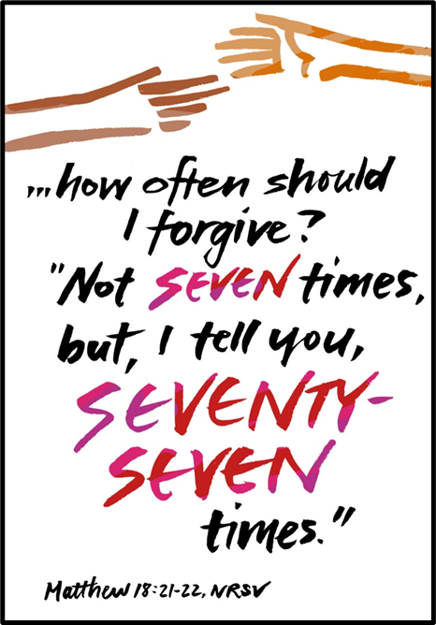
Trinity Evangelical Lutheran Church February 26, 2023
WELCOME!
1. Gather
2. Word
3. Meal
4. Sending
Notes:
Image: Five Loaves by Caroline Coolidge Brown. Copyright © Caroline Coolidge Brown. All rights reserved. Used by permission of the artist.

Slide 2
= Please stand if able
= Please be seated
1. Gather
Prelude – Pam Sherman
Office of the Acolyte
Ringing of the Bell
Welcome
Notes:
Image: Five Loaves by Caroline Coolidge Brown. Copyright © Caroline Coolidge Brown. All rights reserved. Used by permission of the artist.

Slide 3
1. Gather
THANKSGIVING FOR BAPTISM
All may make the sign of the cross, the sign marked at baptism, as the presiding minister begins.
P: Blessed be the holy Trinity, ☩ one God, the fountain of living water, the rock who gave us birth, our light and our salvation.
C: Amen.
Notes:
Image: Five Loaves by Caroline Coolidge Brown. Copyright © Caroline Coolidge Brown. All rights reserved. Used by permission of the artist.

Slide 4
1. Gather
THANKSGIVING FOR BAPTISM
The presiding minister addresses the assembly.
P: Joined to Christ in the waters of baptism, we are clothed with God’s mercy and forgiveness. Let us give thanks for the gift of baptism.
Notes:
Image: Five Loaves by Caroline Coolidge Brown. Copyright © Caroline Coolidge Brown. All rights reserved. Used by permission of the artist.

Slide 5
1. Gather
THANKSGIVING FOR BAPTISM
Water may be poured into the font as the presiding minister gives thanks.
P: We give you thanks, O God, for in the beginning your Spirit moved over the waters and by your Word you created the world, calling forth life in which you took delight. Through the waters of the flood you delivered Noah and his family
Notes:
Image: Five Loaves by Caroline Coolidge Brown. Copyright © Caroline Coolidge Brown. All rights reserved. Used by permission of the artist.

Slide 6
1. Gather
THANKSGIVING FOR BAPTISM
P: Through the sea you led your people Israel from slavery into freedom. At the river your Son was baptized by John and anointed with the Holy Spirit. By water and your Word you claim us as daughters and sons, making us heirs of your promise and servants of all. We praise you for the gift of water that sustains life, and above all we praise you for the gift of new life in Jesus Christ
Notes:
Image: Five Loaves by Caroline Coolidge Brown. Copyright © Caroline Coolidge Brown. All rights reserved. Used by permission of the artist.

Slide 7
1. Gather
THANKSGIVING FOR BAPTISM
P: Shower us with your Spirit, and renew our lives with your forgiveness, grace, and love. To you be given honor and praise through Jesus Christ our Lord in the unity of the Holy Spirit, now and forever.
C: Amen.
The service continues with gathering song.
Notes:
Image: Five Loaves by Caroline Coolidge Brown. Copyright © Caroline Coolidge Brown. All rights reserved. Used by permission of the artist.

Slide 8
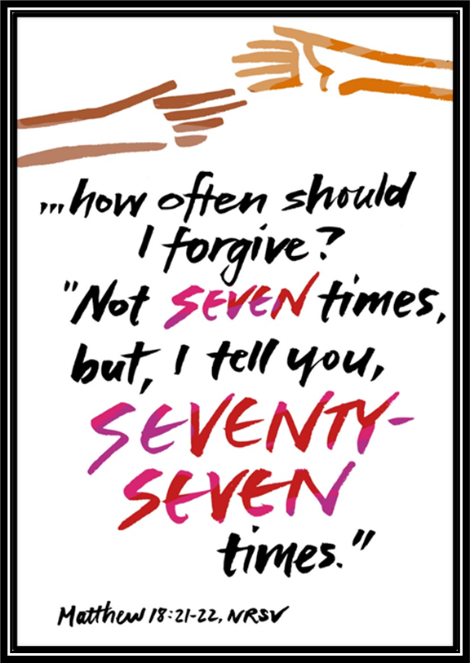
GATHERING SONG
1. Gather
“Blest Be the Tie that Binds”
LBW 370
Notes:
Image: Five Loaves by Caroline Coolidge Brown. Copyright © Caroline Coolidge Brown. All rights reserved. Used by permission of the artist.

Slide 9
1. Gather
“Blest Be the Tie that Binds” LBW 370
1 Blest be the tie that binds
our hearts in Christian love;
the unity of heart and mind
is like to that above.
Notes:
Image: Preparing yeast dough. Copyright © tomasworks/iStock/Thinkstock. Used by permission.

Slide 10
1. Gather
“Blest Be the Tie that Binds” LBW 370
2 Before our Father’s throne
we pour our ardent prayers;
our fears, our hopes, our aims are one,
our comforts and our cares.
Notes:
Image: Preparing yeast dough. Copyright © tomasworks/iStock/Thinkstock. Used by permission.

Slide 11
1. Gather
“Blest Be the Tie that Binds” LBW 370
3 We share our mutual woes,
our mutual burdens bear,
and often for each other flows
the sympathizing tear.
4 From sorrow, toil, and pain,
and sin we shall be free;
and perfect love and friendship
Notes:
Image: Preparing yeast dough. Copyright © tomasworks/iStock/Thinkstock. Used by permission.

Slide 12
1. Gather
APOSTOLIC GREETING
P: The grace of our Lord Jesus Christ, the love of God, and the communion of the Holy Spirit be with you all.
C: And also with you.
Notes:
Image: Five Loaves by Caroline Coolidge Brown. Copyright © Caroline Coolidge Brown. All rights reserved. Used by permission of the artist.

Slide 13
1. Gather
PRAYER OF THE DAY
P: Let us pray… God of grace and mercy, you have forgiven us far more and more often than we deserve. Make us equally forgiving to all those in our lives, that we may live together in harmony, in Jesus name.
C: Amen.
Notes:
Image: Five Loaves by Caroline Coolidge Brown. Copyright © Caroline Coolidge Brown. All rights reserved. Used by permission of the artist.

Slide 14
Word
Gather
Sending
Meal
Notes:
Image: Preparing yeast dough. Copyright © tomasworks/iStock/Thinkstock. Used by permission.

Slide 15
Word
Notes:
Image: Preparing yeast dough. Copyright © tomasworks/iStock/Thinkstock. Used by permission.

Slide 16
Scripture Reading
Word
R: Our scripture reading for this day is from the Gospel according to Matthew, the 18th chapter..
C: Glory to you O’ Lord! (Spoken)
Notes:
Image: Five Loaves by Caroline Coolidge Brown. Copyright © Caroline Coolidge Brown. All rights reserved. Used by permission of the artist.

Slide 17
Word
Matthew 18:15-35
¹⁵“If another member of the church sins against you, go and point out the fault when the two of you are alone. If the member listens to you, you have regained that one. ¹⁶But if you are not listened to, take one or two others along with you, so that every word may be confirmed by the evidence of two or three witnesses. ¹⁷If the member refuses to listen to them, tell it to the
Notes:
Image: Five Loaves by Caroline Coolidge Brown. Copyright © Caroline Coolidge Brown. All rights reserved. Used by permission of the artist.

Slide 18
Word
Matthew 18:15-35
church; and if the offender refuses to listen even to the church, let such a one be to you as a Gentile and a tax collector. ¹⁸Truly I tell you, whatever you bind on earth will be bound in heaven, and whatever you loose on earth will be loosed in heaven. ¹⁹Again, truly I tell you, if two of you agree on earth about anything you ask, it will be done for you by my Father in heaven.
Notes:
Image: Five Loaves by Caroline Coolidge Brown. Copyright © Caroline Coolidge Brown. All rights reserved. Used by permission of the artist.

Slide 19
Word
Matthew 18:15-35
²⁰For where two or three are gathered in my name, I am there among them.”
²¹Then Peter came and said to him, “Lord, if another member of the church sins against me, how often should I forgive? As many as seven times?” ²²Jesus said to him, “Not seven times, but, I tell you, seventy-seven times. ²³“For this reason the kingdom of heaven may be compared to a king who
Notes:
Image: Five Loaves by Caroline Coolidge Brown. Copyright © Caroline Coolidge Brown. All rights reserved. Used by permission of the artist.

Slide 20
Word
Matthew 18:15-35
wished to settle accounts with his slaves. ²⁴When he began the reckoning, one who owed him ten thousand talents was brought to him; ²⁵and, as he could not pay, his lord ordered him to be sold, together with his wife and children and all his possessions, and payment to be made. ²⁶So the slave fell on his knees before him, saying, ‘Have patience with me, and I will pay you everything.’ ²⁷And
Notes:
Image: Five Loaves by Caroline Coolidge Brown. Copyright © Caroline Coolidge Brown. All rights reserved. Used by permission of the artist.

Slide 21
Word
Matthew 18:15-35
out of pity for him, the lord of that slave released him and forgave him the debt. ²⁸But that same slave, as he went out, came upon one of his fellow slaves who owed him a hundred denarii; and seizing him by the throat, he said, ‘Pay what you owe.’ ²⁹Then his fellow slave fell down and pleaded with him, ‘Have patience with me, and I will pay you.’ ³⁰But he refused; then he went and
Notes:
Image: Five Loaves by Caroline Coolidge Brown. Copyright © Caroline Coolidge Brown. All rights reserved. Used by permission of the artist.

Slide 22
Word
Matthew 18:15-35
threw him into prison until he would pay the debt. ³¹When his fellow slaves saw what had happened, they were greatly distressed, and they went and reported to their lord all that had taken place. ³²Then his lord summoned him and said to him, ‘You wicked slave! I forgave you all that debt because you pleaded with me.
Notes:
Image: Five Loaves by Caroline Coolidge Brown. Copyright © Caroline Coolidge Brown. All rights reserved. Used by permission of the artist.

Slide 23
Word
Matthew 18:15-35
³³Should you not have had mercy on your fellow slave, as I had mercy on you?’ ³⁴And in anger his lord handed him over to be tortured until he would pay his entire debt. ³⁵So my heavenly Father will also do to every one of you, if you do not forgive your brother or sister from your heart.”
Notes:
Image: Five Loaves by Caroline Coolidge Brown. Copyright © Caroline Coolidge Brown. All rights reserved. Used by permission of the artist.

Slide 24
Word
Matthew 18:15-35
R: This is the Word of the Lord.
C: Praise to You, O Christ (Spoken)
Notes:
Image: Five Loaves by Caroline Coolidge Brown. Copyright © Caroline Coolidge Brown. All rights reserved. Used by permission of the artist.

Slide 25
Sermon
Word
Notes:
Image: Five Loaves by Caroline Coolidge Brown. Copyright © Caroline Coolidge Brown. All rights reserved. Used by permission of the artist.

Slide 26
Word
APOSTLE’S CREED
C: I believe in God, the Father almighty, creator of heaven and earth.

Slide 27
APOSTLE’S CREED
Word
C: I believe in Jesus Christ, his only Son, our Lord. He was conceived by the power of the Holy Spirit and born of the virgin Mary. He suffered under Pontius Pilate, was crucified, died, and was buried.

Slide 28
APOSTLE’S CREED
Word
C: He descended into hell. On the third day he rose again. He ascended into heaven, and is seated at the right hand of the Father. He will come again to judge the living and the dead.

Slide 29
APOSTLE’S CREED
Word
C: I believe in the Holy Spirit, the holy catholic Church, the communion of saints, the forgiveness of sins, the resurrection of the body, and the life everlasting. Amen.

Slide 30
NICENE CREED
Word
C: We believe in one God, the Father, the Almighty, maker of heaven and earth, of all that is, seen and unseen.

Slide 31
NICENE CREED
Word
C: We believe in one Lord, Jesus Christ, the only Son of God, eternally begotten of the Father, God from God, Light from Light, true God from true God, begotten, not made, of one Being with the Father.

Slide 32
NICENE CREED
Word
C: Through him all things were made. For us and for our salvation he came down from heaven; by the power of the Holy Spirit he became incarnate from the virgin Mary, and was made man. For our sake he was crucified under Pontius Pilate;

Slide 33
NICENE CREED
Word
C: he suffered death and was buried. On the third day he rose again in accordance with the Scriptures; he ascended into heaven and is seated at the right hand of the Father. He will come again in glory to judge the living and the dead, and his kingdom will have no end.

Slide 34
NICENE CREED
Word
C: We believe in the Holy Spirit, the Lord, the giver of life, who proceeds from the Father and the Son. With the Father and the Son he is worshiped and glorified. He has spoken through the prophets. We believe in one holy catholic and apostolic Church.

Slide 35
NICENE CREED
Word
C: We acknowledge one Baptism for the forgiveness of sins. We look for the resurrection of the dead, and the life of the world to come. Amen.

Slide 36
PRAYERS OF INTERCESSION
Word
Each petition will end with the words,
A: Merciful God,
The congregation will respond with:
C: You hear our prayer.

Slide 37
PRAYERS OF INTERCESSION
Word
The prayer concludes…
P: We lift these prayers to you, Gracious God, in the name of your son, Jesus Christ, our savior.
C: Amen.

Slide 38
SHARING OF THE PEACE
Word
(The Sharing of the Peace that began when the congregation arrived is now shared with the Pastor at this time...)
P: The peace of the Lord be with you always.
C: And also with you.

Slide 39
OFFERING
Gather
Word
Sending
Meal
Notes:
Image: Five Loaves by Caroline Coolidge Brown. Copyright © Caroline Coolidge Brown. All rights reserved. Used by permission of the artist.

Slide 40
OFFERTORY PRAYER
Gather
Word
Sending
Meal
Notes:
Image: Five Loaves by Caroline Coolidge Brown. Copyright © Caroline Coolidge Brown. All rights reserved. Used by permission of the artist.

Slide 41
THE LORD’S PRAYER
C: Our Father, who art in heaven, hallowed be thy name, thy kingdom come, thy will be done, on earth as it is in heaven.
Meal

Slide 42
THE LORD’S PRAYER
C: Give us this day our daily bread; and forgive us our trespasses, as we forgive those who trespass against us; and lead us not into temptation, but deliver us from evil.
Meal

Slide 43
THE LORD’S PRAYER
C: For thine is the kingdom, and the power, and the glory, forever and ever. Amen.
Meal

Slide 44
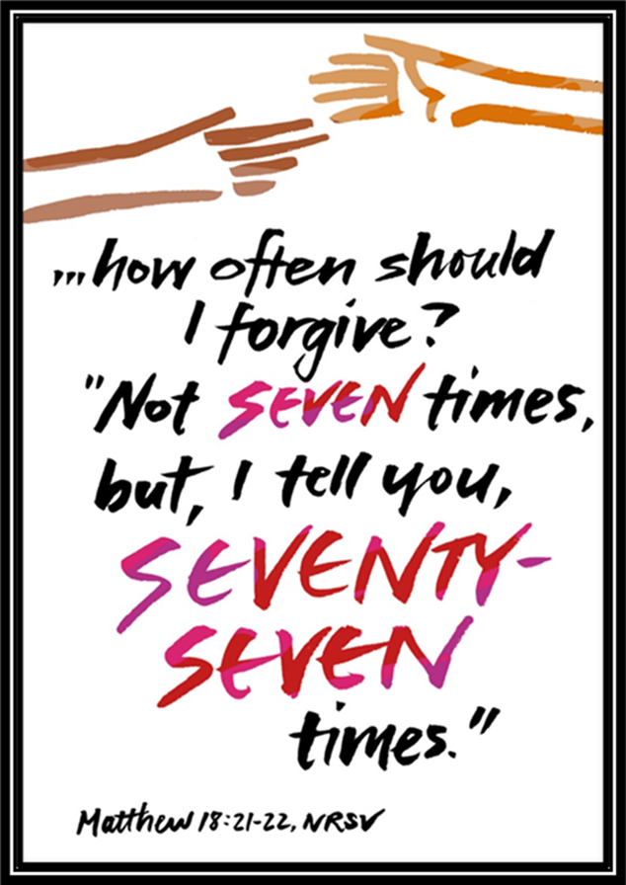
ANNOUNCEMENTS
Gather
Word
Meal
Sending
Notes:
Image: Five Loaves by Caroline Coolidge Brown. Copyright © Caroline Coolidge Brown. All rights reserved. Used by permission of the artist.

Slide 45
SENDING BLESSING
P: God, the giver of love, Christ, the resurrection and the life, and the Holy Spirit of rebirth bless you in this Lenten journey.
C: Amen.
☩
Sending

Slide 46
SENDING SONG
“O Zion, Haste”
LBW 397
Sending
Notes:
Image: Five Loaves by Caroline Coolidge Brown. Copyright © Caroline Coolidge Brown. All rights reserved. Used by permission of the artist.

Slide 47
O Zion Haste LBW 397
1 O Zion, haste, your mission high fulfilling,
to tell to all the world that God is light;
that he who made all nations is not willing
one soul should perish, lost in shades of night.
Sending
Notes:
Image: Preparing yeast dough. Copyright © tomasworks/iStock/Thinkstock. Used by permission.

Slide 48
O Zion Haste LBW 397
Refrain
Publish glad tidings, tidings of peace,
tidings of Jesus, redemption, and release.
Sending
Notes:
Image: Preparing yeast dough. Copyright © tomasworks/iStock/Thinkstock. Used by permission.

Slide 49
O Zion Haste LBW 397
2 Publish to ev’ry people, tongue, and nation
that God, in whom they live and move, is love;
tell how he stooped to save his lost creation
and died on earth that we might live above.
Sending
Notes:
Image: Preparing yeast dough. Copyright © tomasworks/iStock/Thinkstock. Used by permission.

Slide 50
O Zion Haste LBW 397
Refrain
Publish glad tidings, tidings of peace,
tidings of Jesus, redemption, and release.
Sending
Notes:
Image: Preparing yeast dough. Copyright © tomasworks/iStock/Thinkstock. Used by permission.

Slide 51
O Zion Haste LBW 397
3 Give of your own to bear the message glorious,
give of your wealth to speed them on their way,
pour out your soul for them in prayer victorious,
and haste the coming of the glorious day.
Sending
Notes:
Image: Preparing yeast dough. Copyright © tomasworks/iStock/Thinkstock. Used by permission.

Slide 52
O Zion Haste LBW 397
Refrain
Publish glad tidings, tidings of peace,
tidings of Jesus, redemption, and release.
Sending
Notes:
Image: Preparing yeast dough. Copyright © tomasworks/iStock/Thinkstock. Used by permission.

Slide 53
O Zion Haste LBW 397
4 He comes again! O Zion, ere you meet him,
make known to ev’ry heart his saving grace;
let none whom he has ransomed fail to greet him,
through your neglect, unfit to see his face.
Sending
Notes:
Image: Preparing yeast dough. Copyright © tomasworks/iStock/Thinkstock. Used by permission.

Slide 54
O Zion Haste LBW 397
Refrain
Publish glad tidings, tidings of peace,
tidings of Jesus, redemption, and release.
Sending
Notes:
Image: Preparing yeast dough. Copyright © tomasworks/iStock/Thinkstock. Used by permission.

Slide 55
DISMISSAL
P: … depart in Christ’s Love.
C: Seeking, welcoming, and serving all. Amen!
POSTLUDE
By
Pam Sherman
From sundaysandseasons.com. Copyright © 2023 Augsburg Fortress. All rights reserved. Reprinted by permission under Augsburg Fortress Liturgies Annual License #SAS023830. New Revised Standard Version Bible, Copyright © 1989, Division of Christian Education of the National Council of the Churches of Christ in the United States of America. Used by permission. All rights reserved. Revised Common Lectionary, Copyright © 1992 Consultation on Common Texts, admin Augsburg Fortress. Used by permission.
Sending

