Slide 1
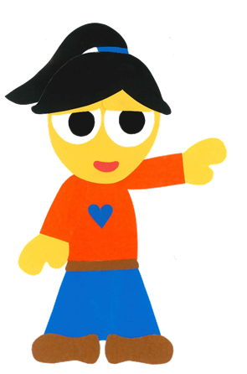
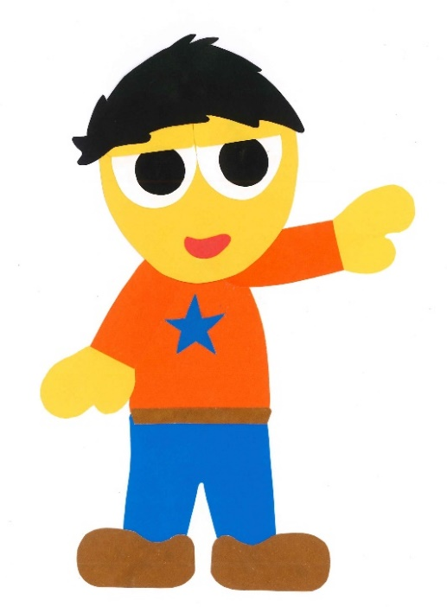
WE
CAN
READ
Donald Joyce
www.teacherdonald.com

Slide 2
What Do You Want To Be?
By:
Donald Joyce
WE CAN READ

Slide 3
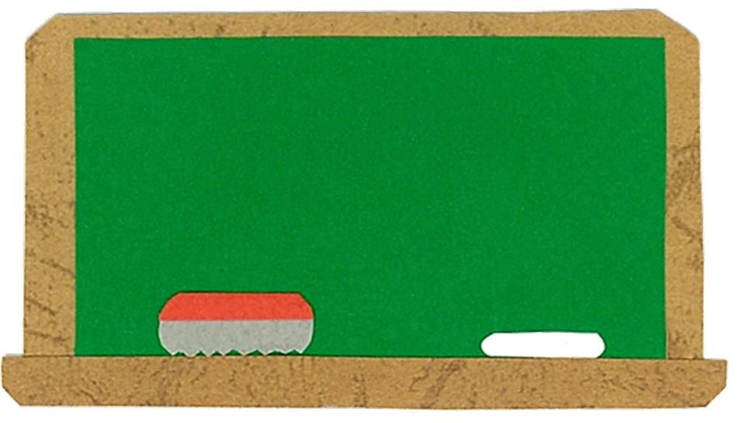
Let’s
Talk!

Slide 4
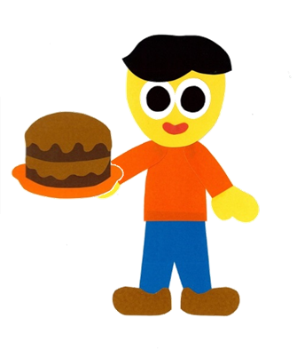
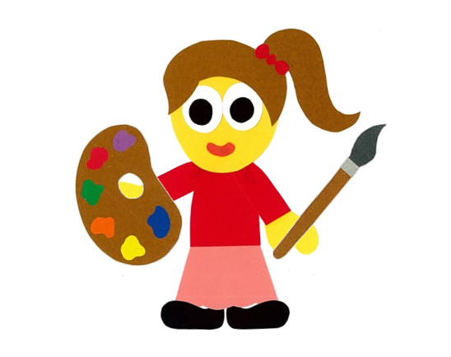
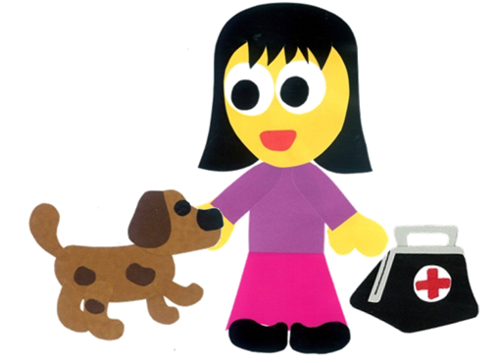
What do you want to be
when you are older?
I want to be (a/an) ___.

Slide 5
Let’s
Learn!

Slide 6
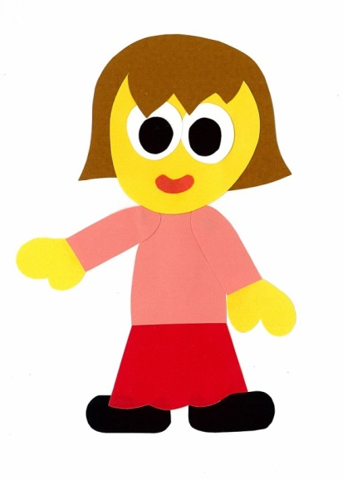
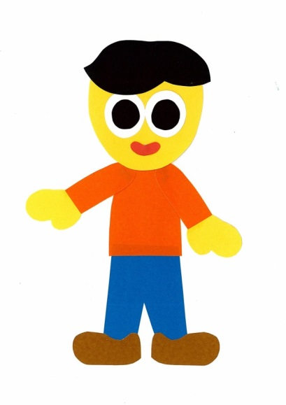
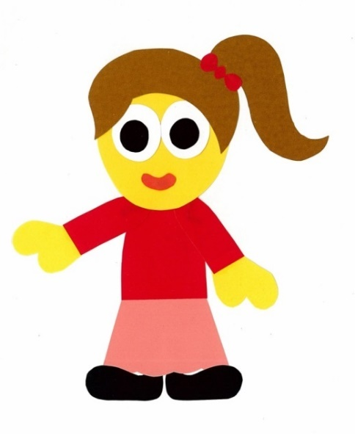
a doctor
a dentist
a baker
a painter
a vet
a magician

Slide 7
Let’s
Read!

Slide 8
What Do You Want To Be?
By:
Donald Joyce
WE CAN READ

Slide 9
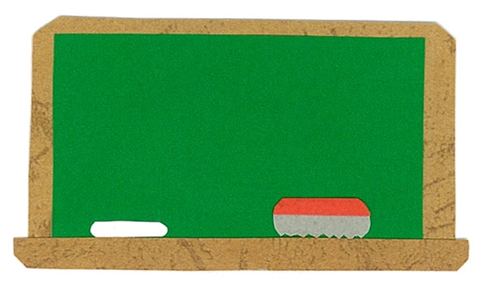
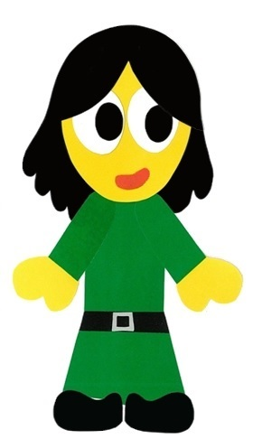
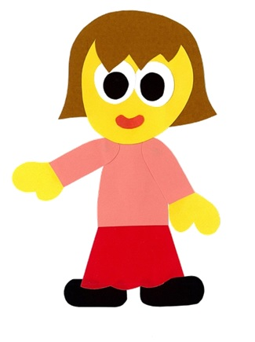
What do you want
to be?

Slide 10
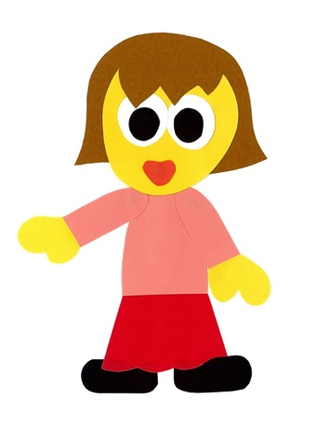
I want to be
a doctor.

Slide 11
I like to
help people.

Slide 12
What do you want
to be?

Slide 13
I want to be
a dentist.

Slide 14
I like to
brush my teeth.

Slide 15
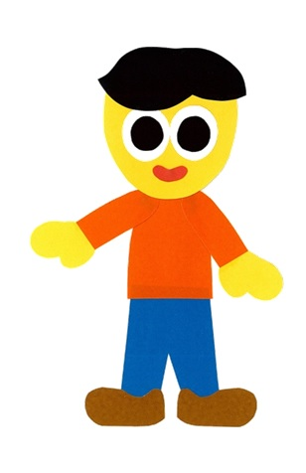
What do you want
to be?

Slide 16
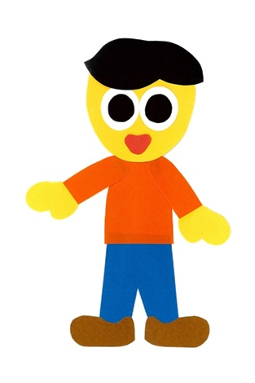
I want to be
a baker.

Slide 17
I like to
bake cakes.

Slide 18
What do you want
to be?

Slide 19
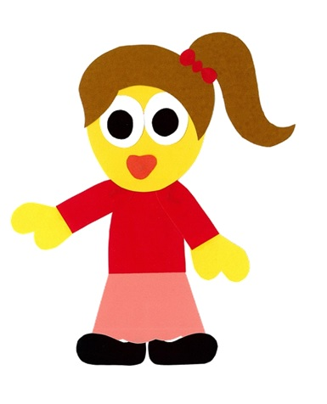
I want to be
a painter.

Slide 20
I like to
paint pictures.

Slide 21
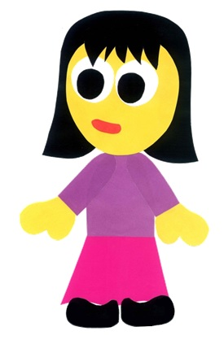
What do you want
to be?

Slide 22
I want to be
a vet.

Slide 23
I like to
help animals.

Slide 24
What do you want
to be?

Slide 25
I want to be
a magician.

Slide 26
I like to
do magic tricks.

Slide 27
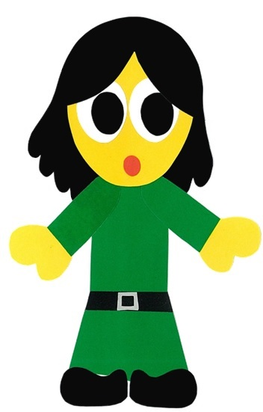

Slide 29
What Do You Want To Be?
By:
Donald Joyce
WE CAN READ

Slide 30
Let’s
Review!

Slide 31
She wants to be a vet.

Slide 32
He wants to be a magician.

Slide 33
She wants to be a doctor.

Slide 34
He wants to be a dentist.

Slide 35
She wants to be a painter.

Slide 36
He wants to be a baker.

Slide 37
Let’s
Connect!

Slide 38
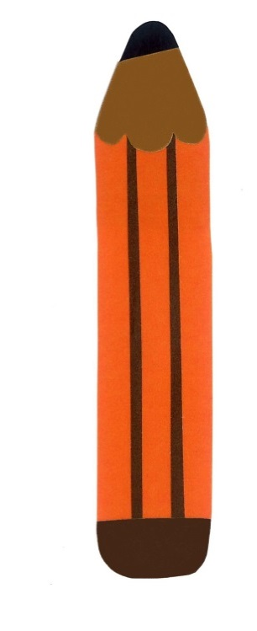
Get a pencil and paper!

Slide 39
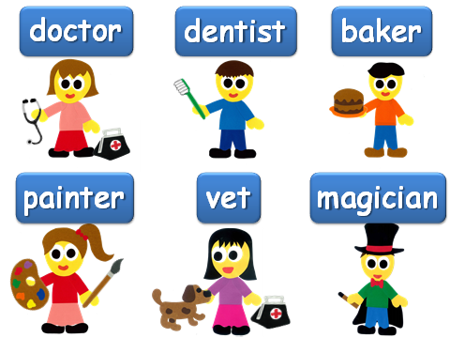
What do you want to be?
I want to be a ___.

Slide 40
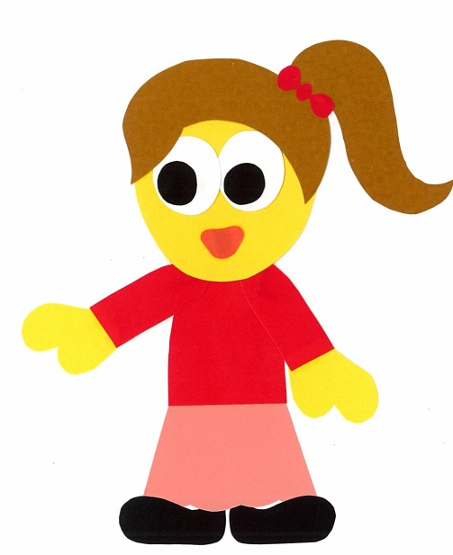
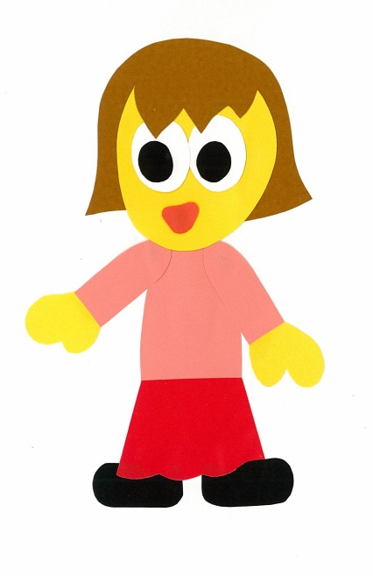
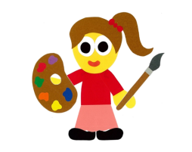
Find a friend. Play a guessing game.
Do you want to be a doctor?
No, I
don’t.

Slide 41
Do you want to
be a _____?
Yes, I do.
No, I do not.

Slide 42
WE
CAN
READ
Donald Joyce
www.teacherdonald.com

