Slide 1
Seminar 6 Diuretics
University of Split
School of Medicine
Department of Pharmacology

Slide 2
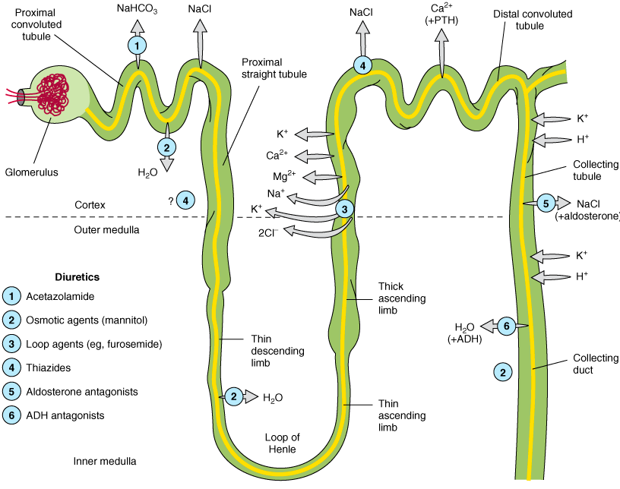
Notes:
Diuretics-agents that increase urine volume; natriuretic causes increase in renal sodium excretion
-opisat malo građu

Slide 3
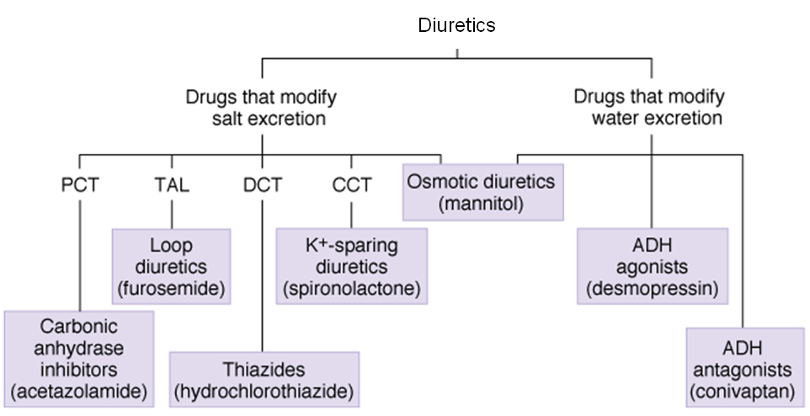

Slide 4
Classification of diuretics
Carbonic anhydrase inhibitors (acetazolamide)
Agents that alter water excretion (osmotic diuretics – mannitol)
Loop agents (furosemide, torasemide)
Thiazides (hydrochlorothiazid, indapamide, chlorthalidone)
K⁺-sparing agents (spironolactone, amiloride, triamterene)
Combination of diuretics (hydrochlorothiazid + K⁺-sparing agents )

Slide 5
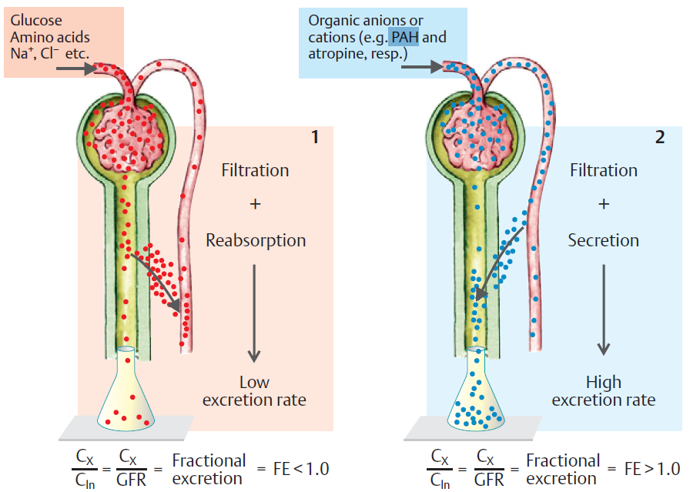

Slide 6
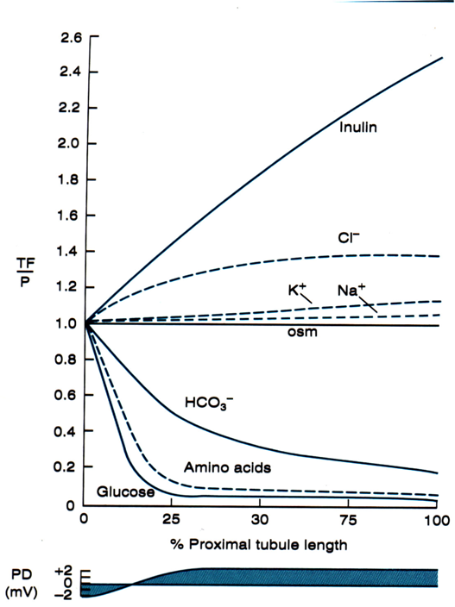
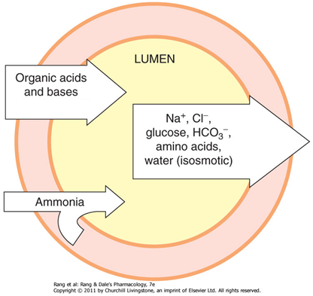
Notes:
Glukoza i ak – kotransport s Na na luminalnoj strani, a na bazolateralnoj olakšana difuzija

Slide 7
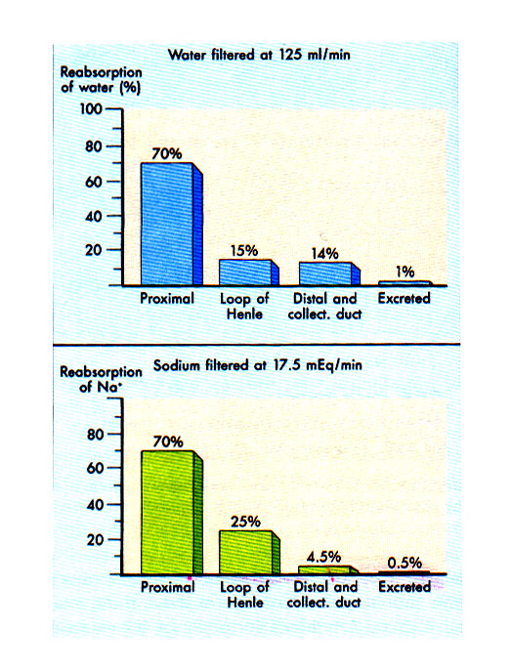

Slide 8
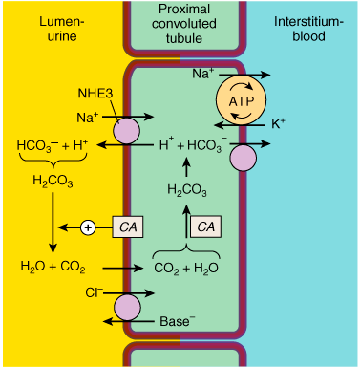
Carbonic anhydrase
inhibitors
(Proximal tubule)
Apical membrane Na⁺/H⁺ exchange (via NHE3) and bicarbonate reabsorption in the proximal convoluted tubule cell. Na⁺/K⁺ ATPase is present in the basolateral membrane to maintain intracellular sodium and potassium levels within the normal range. Because of rapid equilibration, concentrations of the solutes are approximately equal in the interstitial fluid and the blood. Carbonic anhydrase (CA) is found in other locations in addition to the brush border of the luminal membrane.

Slide 9
Carbonic anhydrase inhibitors
Place of action
Proximal tubule
Mechanism of action (pharmacodynamics)
inhibition of enzyme carbonic anhydrase, blocking reabsorption of Na⁺ and HCO₃– in the PCT (proximal tubule)
Representative drugs
acetazolamide , dorzolamide
Clinical Indications
glaucoma (usually topical medications), metabolic alkalosis, urinary alkalinization,
acute mountain sickness
Toxicity
hyperchloremic metabolic acidosis, renal stones
Contraindications
cirrhosis of the liver (alkalinization of the urine decreases urinary excretion of NH₄⁺ and may contribute to the development hyperammonemia and hepatic encephalopathy)

Slide 10
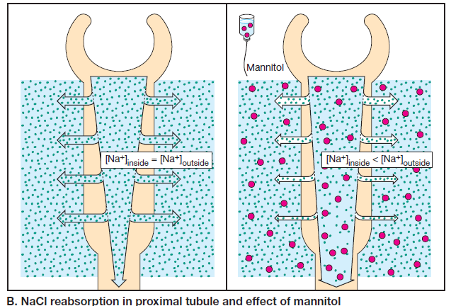
Osmotic diuretics
Notes:
-Što je to osmoza? Osmoza je difuzija vode koja se očituje pri odjeljivanju dviju otopina selektivno polupropusnom membranom (membrana propusna na vodu, ali ne i na otopljenu tvar). Voda se, zbog razlika u koncentracijama otopljenih tvari (iona i manjih molekula), preko membrane kreće s mjesta više na mjesto niže slobodne energije.
-Objasniti što se događa s manitolom
-U GIT može uzrokovat dijareju, zbog toga se koristi i.v.
-Filtrira se 100% u glomerulu, a ne reapsorbira se

Slide 11
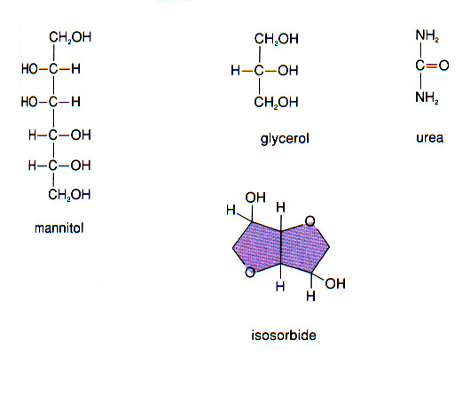
Notes:
http://rfumshistogroup13.pbworks.com/w/page/4300337/FrontPage#Groupmembers
Neki spominju i glukozu kao jedan od osmotskih diuretika, ali samo ako je u velikoj koncentraciji pa je nemoguća potpuna apsorpcija u proksimalnom tubulu
Izosorbid i glicerol mogu se uzeti i oralno

Slide 12
Agents that alter water excretion– osmotic diuretics
Place of action:
Proximal tubule i descending limb of Henle's loop
Mechanism of action (pharmacodynamics)
filtration in glomerulus, but inability of reabsorption of osmotically active agent (promotes water diuresis)
Representative drugs
mannitol
Clinical indications :
increase of urine volume, reduction of intracranial and intraocular pressure
Toxicity
↑ extracellular volume expansion; followed by dehydration, hyperkalemia, and hypernatremia – excessive use of mannitol
Contraindications
oliguria
Notes:
Excessive use of mannitol without adequate water replacement can ultimately lead to severe dehydration, free water losses, and hypernatremia. As water is extracted from cells, intracellular K⁺ concentration rises, leading to cellular losses and hyperkalemia. These complications can be avoided by careful attention to serum ion composition and fluid balance.

Slide 13
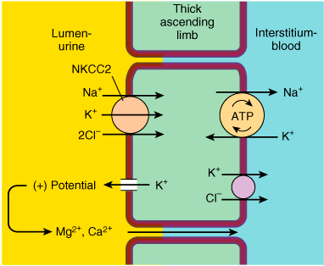
Loop diuretics
Place of action
The thick ascending limb (TAL) of the loop of Henle
Mechanism of action
(pharmacodynamics)
selective blockade of Na⁺/K⁺/2Cl–
cotransporter, causes an increase in
urinary excretion of NaCl
Representative drugs
furosemide, torsemide
Clinical Indications
heart failure, hypertension, acute
pulmonary edema, other edematous
conditions (liver cirrhosis ), acute hypercalcemia, hyperkalemia, acute renal failure
Toxicity
hypokalemic metabolic alkalosis, ototoxicity
hyperuricemia (attacks of gout!), hypomagnesemia (↓ Mg²⁺ ), allergic reactions
Ion transport pathways across the luminal and
basolateral membranes of the thick ascending limb
cell. The lumen positive electrical potential created
by K⁺ back diffusion drives divalent (and monovalent) cation reabsorption via the paracellular pathway.
NKCC2 is the primary transporter in the luminal membrane.
Notes:
? Piše u knjizi da su rezervirani za zatajenje srca i bubrega, a da se za hipertenziju koriste tiazidi najčešće
Iako je suprijenosnik elektroneutralan, dolazi do nakupljanja K u st i povratne difuzije u lumen - + potencijal u lumenu – olakšava reapsorpciju Ca i Mg
Ototoksičnost- reverzibilna najčešće, češće u bubrežnih bolesnika i onih koji su na terapiji nekim drugim ototoksičnim lijekom npr. aminoglikozidnim antibioticima
Hiperuricemija-povećana reapsorpcija mokraćne kiseline u proks. tubulu udružena s hipovolemijom – giht
Na/k atp-aza jer izvor manjka Na unutra i onda ovaj moze niz konc gradijent

Slide 14
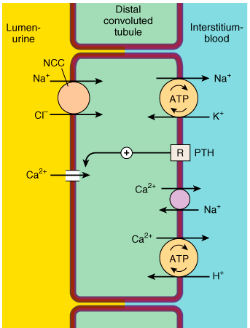
Thiazides
Distal covulted tubule
(DCT)
Ion transport pathways across the luminal and basolateral membranes of the distal convoluted tubule cell. As in all tubular cells, Na⁺/K⁺ ATPase is present in the basolateral membrane. NCC is the primary sodium and chloride transporter in the luminal membrane. (R, parathyroid hormone [PTH] receptor.)
Notes:
Relativno nepropusan za vodu-razrijeđuje se tubularna tekućina
NCC-osjetljiv na tiazide
Nema + potencijala u lumenu jer K+ ne cirkulira-nema električne sile za Ca i Mg nego se Ca aktivno reapsorbira u tubul, a dalje putem Na7Ca izmjenjivača dalje u intersticij,tj krv (regulirano PTH)

Slide 15
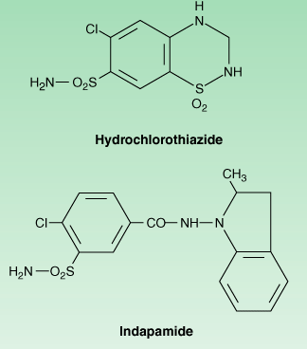
Thiazides
Place of action:
distal convulted tubule (DCT)
Mechanism of action (pharmacodynamics)
inhibition of cotransporter Na⁺/Cl⁻ in distal convulted tubule system
Representative drugs
hydrochlorothiazide, indapamide, chlortalidon
Clinical indications :
Hypertension, heart failure, nephrolithiasis (hypercalciuria), nephrogenic diabetes insipidus
Toxicity
hypokalemic metabolic alkalosis, impaired carbohydrate tolerance (hyperglycemia!!!) hyperuricemia, hyperlipidemia, ↓ Na⁺ , allergic reactions
Notes:
Alergije – preosjetljivost,sulfonamidna grupa,
Ciroza kada da,kada ne koji??? Pročitati i znati objasniti

Slide 16
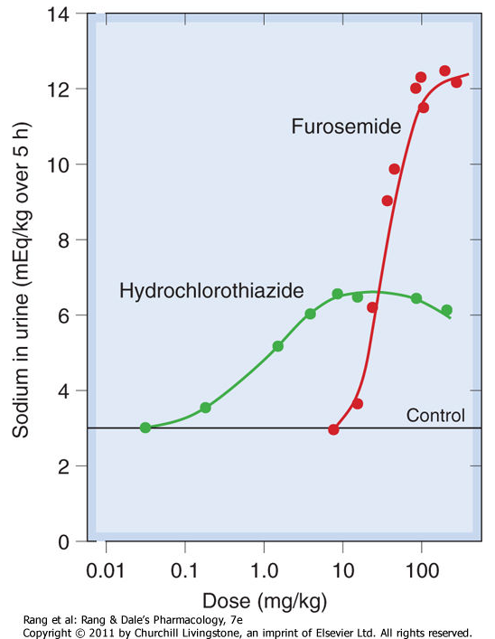

Slide 17
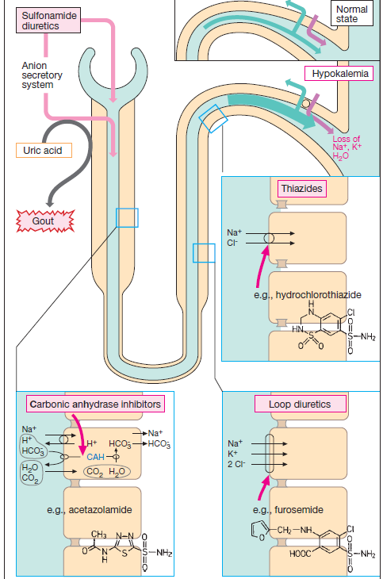
Sulfonamide
group of
diuretics

Slide 18
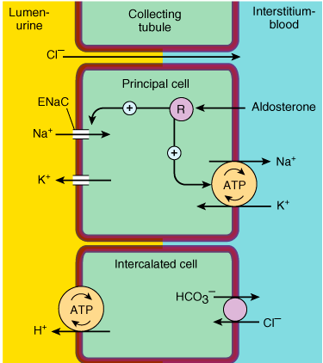
Potassium-Sparing
Diuretics
Distal convulted tubule and collecting cortical tubule
Ion transport pathways across the luminal and basolateral membranes of collecting tubule an collecting duct cells. Inward diffusion of Na⁺ via the epithelial sodium channel (ENaC) leaves a lumen-negative potential, which drives reabsorption of Cl– and efflux of K⁺. (R, aldosterone receptor.)
Notes:
Samo 2-5% NaCl se tu reapsorbira,ali je značajan-završno mjesto- regulacija konc Na u urinu i volumena urina
Sekrecija K+ - glavno mjesto za to
Nema + potencijala u lumenu jer K+ ne cirkulira-nema električne sile za Ca i Mg nego se Ca aktivno reapsorbira u tubul, a dalje putem Na7Ca izmjenjivača dalje u intersticij,tj krv (regulirano PTH)
Osjetljiv na mineralokortikoide (aldosteron – potiče transkripciju gena i aktivnost kanala u apikalnoj i Na/K-ATP aze u bazolat. Memb.)
Glavne st- transport vode, Na+,K+ (ionski kanali, ali više Na uđe nego K izađe pa – potencijal u lumenu – tjera Cl- paracelularno u intersticij, a K vuče van iz st.)
Gubitak K+ diureticima – Na dođe s nekim drugim ionom (HCO3) i on se ne može reapsorbirat, K+ zbog jako – potenc. Ide van u lumen i gubi se
Umetnute – sekrecija H+
ENaC- epitelni natrijski kanal

Slide 19
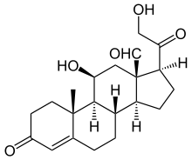
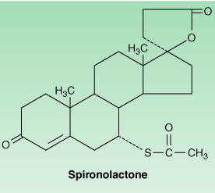
Potassium-Sparing Diuretics
Place of action
Distal convulted tubule and collecting cortical tubule
Mechanism of action
antagonists of aldosterone (directly –binding, to mineralocorticoid receptors; non-directly - inhibition of Na⁺ influx through ion channels in the luminal membrane )
Representative drugs
spironolactone– direct antagonist
amiloride, triamterene – indirect antagonist
Clinical indications
primary hyperaldosteronism (directly hypersecretion), secondary hyperaldosteronism (heart failure, hepatic cirrhosis)
Toxicity
Hyperkalemia, gynecomastia
Contraindications:
Oral K⁺ administration
aldosterone
Notes:
Hyperchloremic Metabolic Acidosis
By inhibiting H⁺ secretion in parallel with K⁺ secretion, the K⁺-sparing diuretics can cause acidosis similar to that seen with type IV renal tubular acidosis.
Gynecomastia
Synthetic steroids may cause endocrine abnormalities by actions on other steroid receptors. Gynecomastia, impotence, and benign prostatic hyperplasia all have been reported with spironolactone. Such effects have not been reported with eplerenone because it is much more selective than spironolactone for the mineralocorticoid receptor, being virtually inactive on androgen or progesterone receptors.
2 ◦ hiperaldoteronizam (zatajenje srca, ciroza jetre) – smanjenje efektivnog intravaskularnog volumena
Hiperkalijemija – povećana mogućnost ako je bubrežni bolesnik, ili zbog upotrebe dr lijekova koji smanjuju ili inhibiraju djelovanje renina npr. B-blokatora, NSAIDa jetre ili angitenzina II

Slide 20
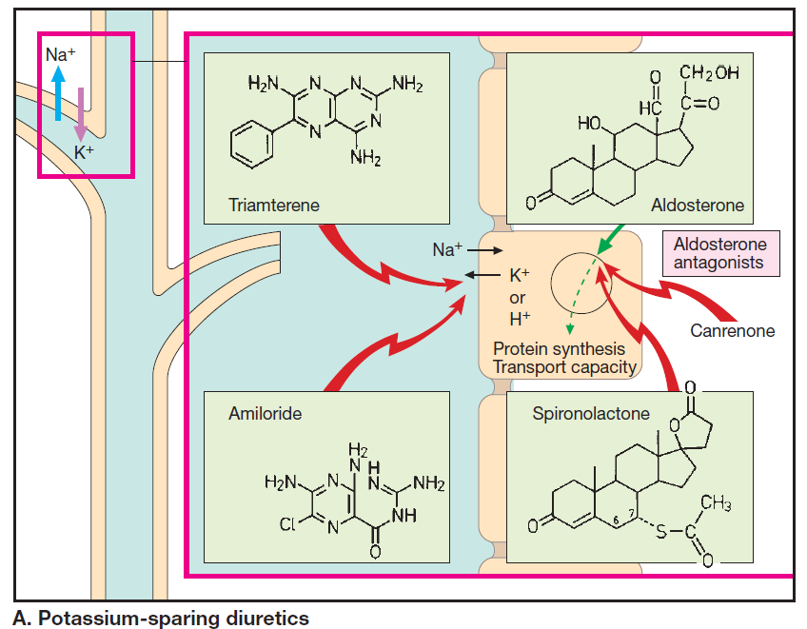

Slide 21
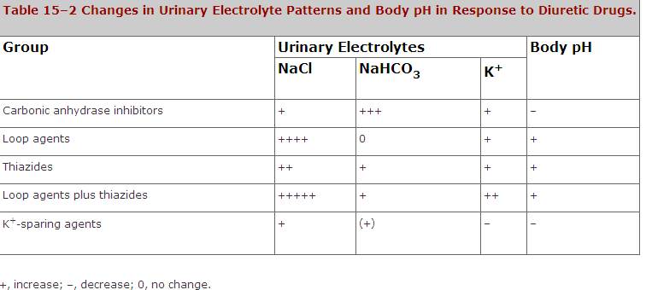

Slide 22
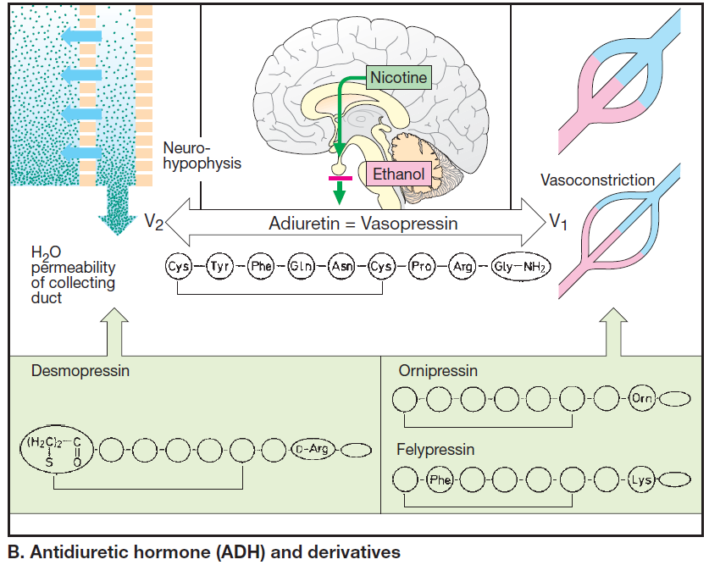
Notes:
Objasnit ulogu ADH, V1 ( u konc. većim nego za antidiurezu – djeluje na glatku muskulaturu krv. žila – vazopresin = vazokonstrikcija, porast krv. tlaka i koronarna vazoronstrikcija mogu dovesti do angine pectoris) i V2 receptore
Etanol i nikotin – smanjuju djelovanje ADH
Desmopresin – terapija centralnog diabetes insipidusa

Slide 23
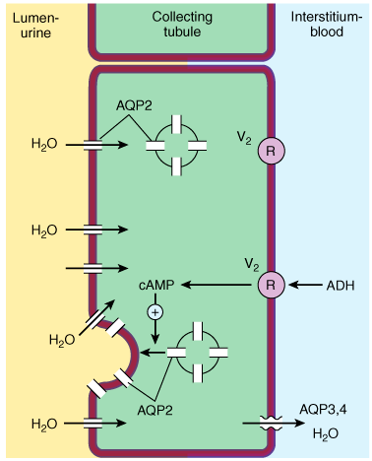
Water transport across the luminal and basolateral membranes of collecting duct cells. Above, low water permeability exists in the absence of antidiuretic hormone (ADH). Below, in the presence of ADH, aquaporins are inserted into the apical membrane, greatly increasing water permeability. (AQP2, apical aquaporin water channels; AQP3,4, basolateral aquaporin water channels; V₂, vasopressin V₂ receptor.)

Slide 24
Clinical pharmacology of diuretics
Edematous states
Heart failure (loop diuretics)
Kidney disease and renal failure (loop diuretics)
Hepatic cirrhosis (spironolactone)
Nonedematous states
Hypertension (thiazides, loop diuretics)
Nephrolithiasis (thiazides)
Hypercalcemia (loop diuretics + saline)
Notes:
Diuretici henleove petlje-najdjelotvorniji danas (furosemid,torasemid,etakrinska kis)-povećavaju izlučivanje Mg i Ca
Tiazidi – inhibiraju transport NaCl u distalnom tubulu (hidroklorotiazid), pospješuju reapsorpciju Ca
*fiziološka – sprečavanje hipovolemije
Pitanja u lippincotu, human pharmacology

Slide 25
